Slide 2
Welcome to MongoDB
Matt Bates
SA | CE
matt@mongodb.com
Norberto Leite
SA | Engineer
norberto@mongodb.com

Slide 3
Agenda
About MongoDB
Data Model
Query Model
Scalability & Availability

Slide 4
About MongoDB

Slide 5

Global Community
8,000,000+
MongoDB Downloads
200,000+
Online Education Registrants
35,000+
MongoDB Management Service (MMS) Users
30,000+
MongoDB User Group Members
20,000+
MongoDB Days Attendees

Slide 6
Data Model

Slide 7
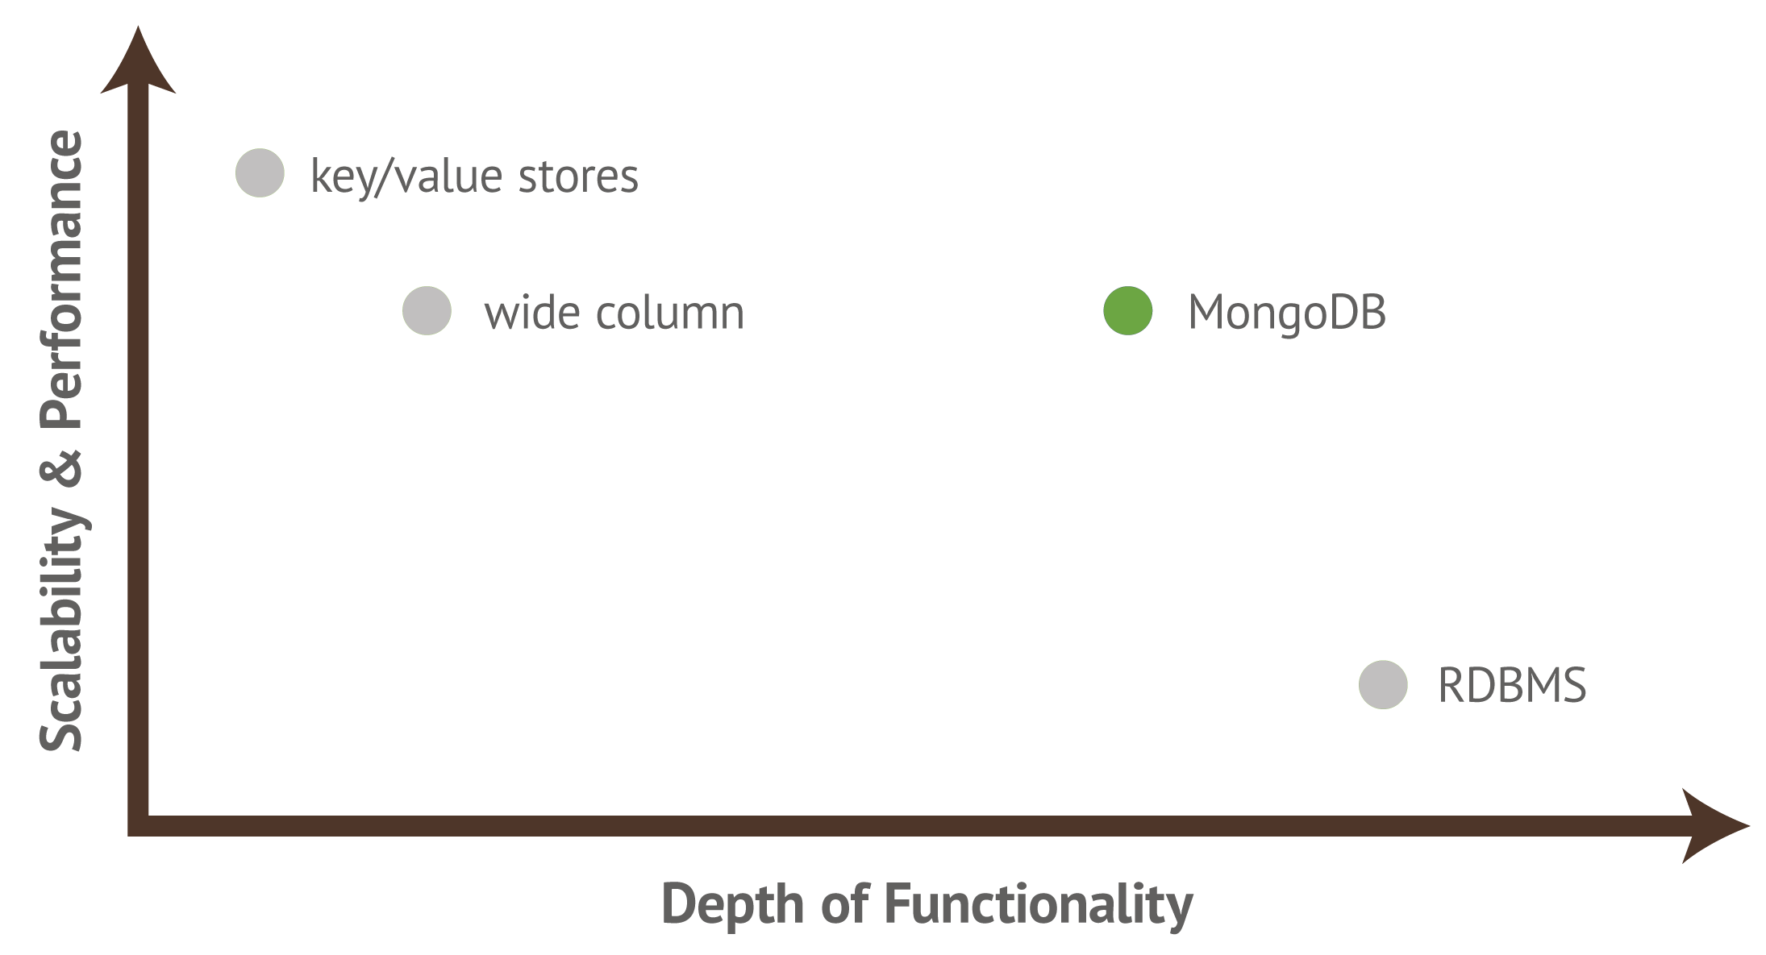
Operational Database Landscape
Notes:
MongoDB aims to blend the scalability and performance of K/V stores with the rich query functionality of the RDBMS
With a document model, MongoDB can provide the flexible schema demanded by modern applications, supporting structured, semi structured, unstructured and polymorphic data. Through embedding data using sub-documents and arrays, they eliminate the need for expensive JOINs, enabling simple scaling across multiple nodes.
At the same time, support for powerful query operators, the aggregation framework and rich secondary indexes, users do not trade away the ability to run complex queries against data. MongoDB can do this in real time, across multi-structured data sets

Slide 8
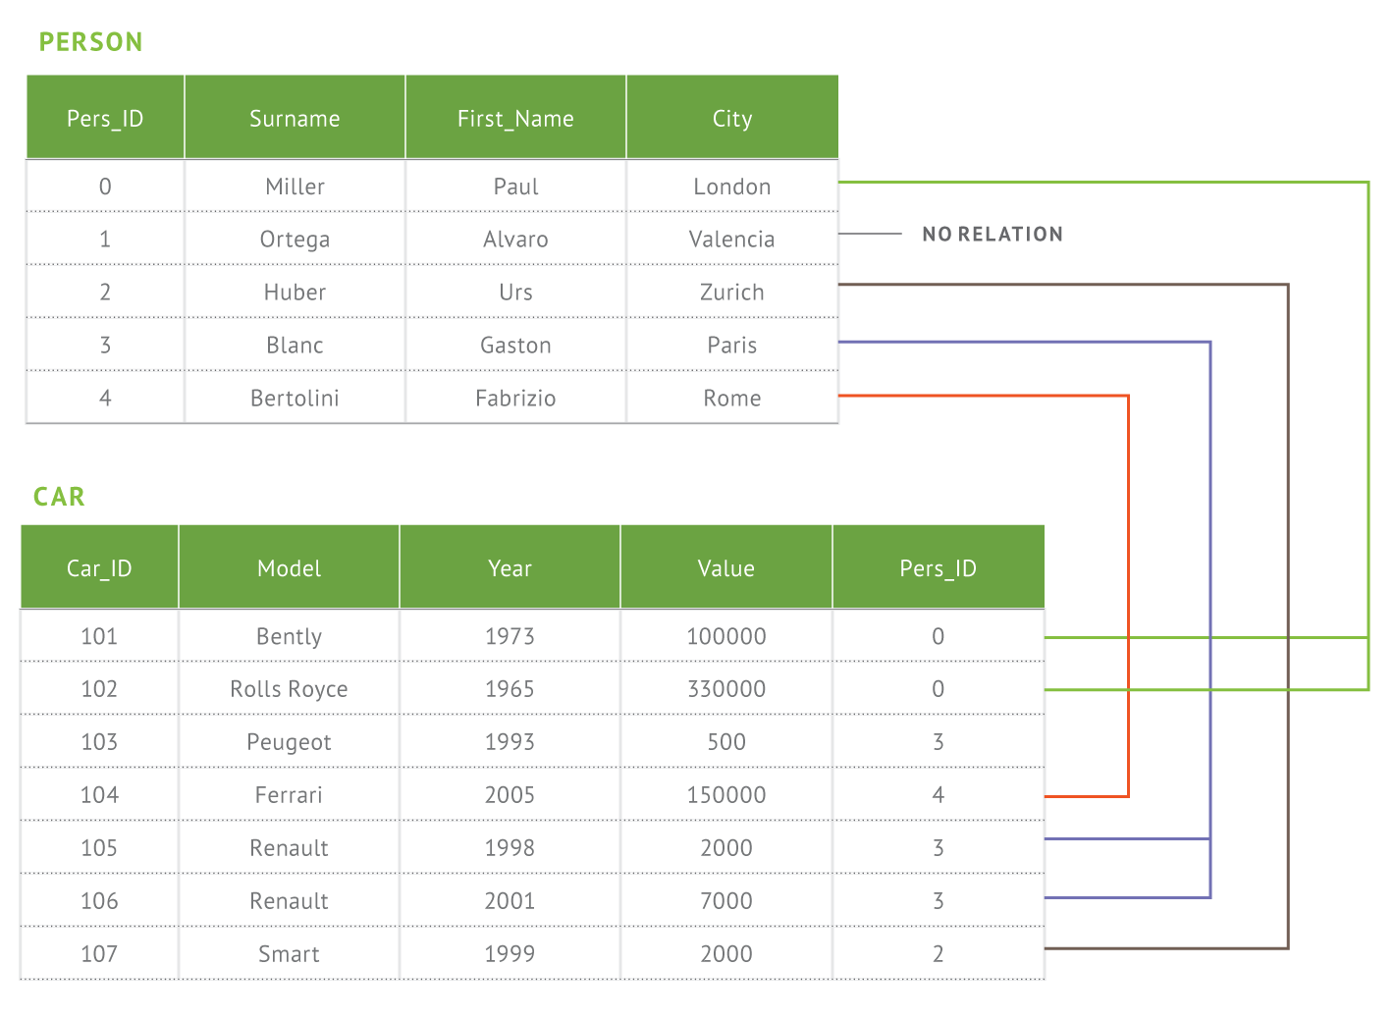
Document Data Model
Relational
MongoDB
{
first_name: ‘Paul’,
surname: ‘Miller’,
city: ‘London’,
location: [45.123,47.232],
cars: [
{ model: ‘Bentley’,
year: 1973,
value: 100000, … },
{ model: ‘Rolls Royce’,
year: 1965,
value: 330000, … }
}
}
Notes:
Here we have greatly reduced the relational data model for this application to two tables. In reality no database has two tables. It is much more common to have hundreds or thousands of tables. And as a developer where do you begin when you have a complex data model?? If you’re building an app you’re really thinking about just a hand full of common things, like products, and these can be represented in a document much more easily that a complex relational model where the data is broken up in a way that doesn’t really reflect the way you think about the data or write an application.

Slide 9
Documents are Rich Data Structures
{
first_name: ‘Paul’,
surname: ‘Miller’,
cell: ‘+447557505611’
city: ‘London’,
location: [45.123,47.232],
Profession: [banking, finance, trader],
cars: [
{ model: ‘Bentley’,
year: 1973,
value: 100000, … },
{ model: ‘Rolls Royce’,
year: 1965,
value: 330000, … }
}
}
String
Typed field values
Number
Geo-Coordinates
Fields
Fields can contain arrays
Fields can contain an array of sub-documents

Slide 10
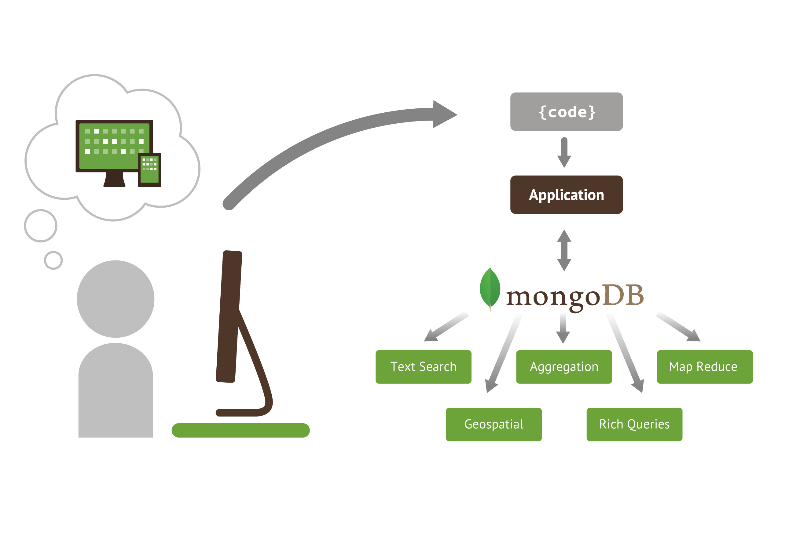
MongoDB is Fully Featured
Notes:
Rich queries, text search, geospatial, aggregation, mapreduce are types of things you can build based on the richness of the query model.

Slide 11
Do More With Your Data
Rich Queries
MongoDB
Find Paul’s cars
Find everybody in London with a car built between 1970 and 1980
{
first_name: ‘Paul’,
surname: ‘Miller’,
city: ‘London’,
location: [45.123,47.232],
cars: [
{ model: ‘Bentley’,
year: 1973,
value: 100000, … },
{ model: ‘Rolls Royce’,
year: 1965,
value: 330000, … }
}
}
Geospatial
Find all of the car owners within 5km of Trafalgar Sq.
Text Search
Find all the cars described as having leather seats
Aggregation
Calculate the average value of Paul’s car collection
Map Reduce
What is the ownership pattern of colors by geography over time? (is purple trending up in China?)

Slide 12
Replica Sets – High Availability
Replica Set – two or more copies
Self-healing shard
Addresses availability considerations:
High Availability
Disaster Recovery
Maintenance
Deployment Flexibility
Data locality to users
Workload isolation: operational & analytics
Notes:
High Availability – Ensure application availability during many types of failures
Disaster Recovery – Address the RTO and RPO goals for business continuity
Maintenance – Perform upgrades and other maintenance operations with no application downtime
Secondaries can be used for a variety of applications – failover, hot backup, rolling upgrades, data locality and privacy and workload isolation

Slide 13
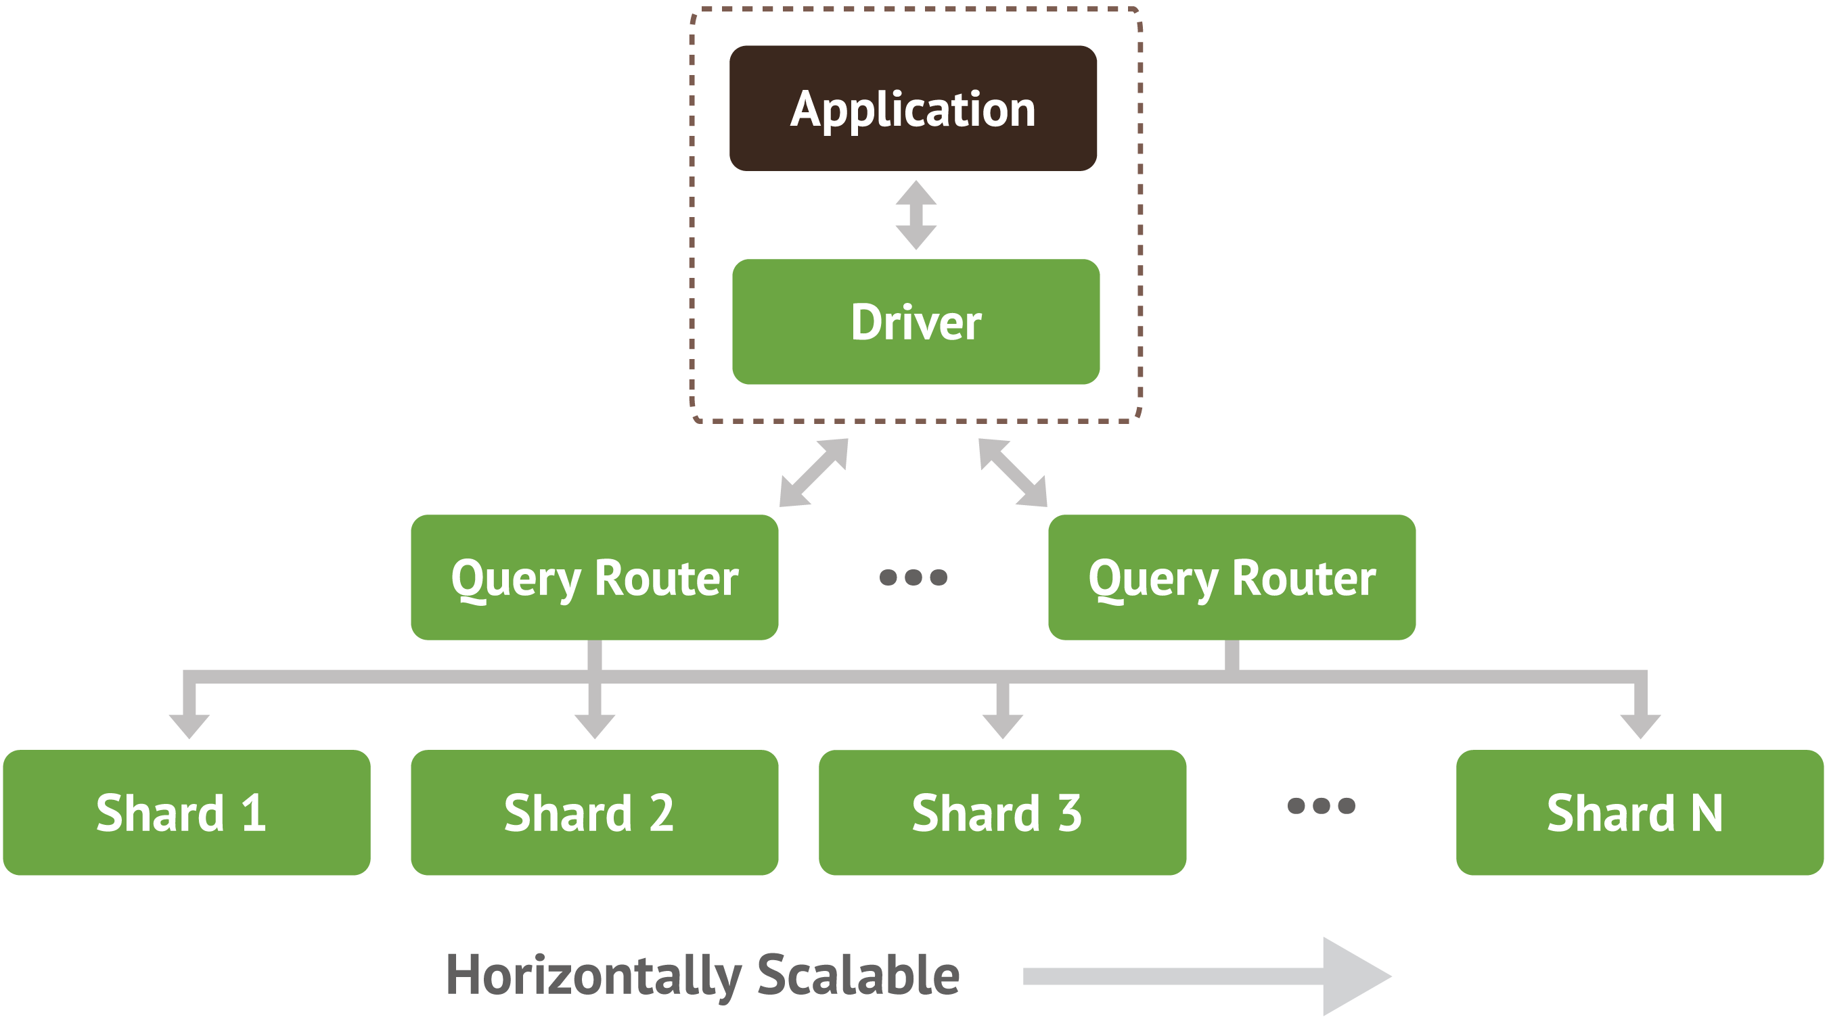
Sharding – Horizontal Scalability
Notes:
Sharding is transparent to applications; whether there is one or one hundred shards, the application code for querying MongoDB is the same. Applications issue queries to a query router that dispatches the query to the appropriate shards.
For key-value queries that are based on the shard key, the query router will dispatch the query to the shard that manages the document with the requested key. When using range-based sharding, queries that specify ranges on the shard key are only dispatched to shards that contain documents with values within the range. For queries that don’t use the shard key, the query router will dispatch the query to all shards and aggregate and sort the results as appropriate. Multiple query routers can be used with a MongoDB system, and the appropriate number is determined based on performance and availability requirements of the application.

Slide 14




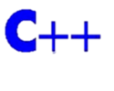








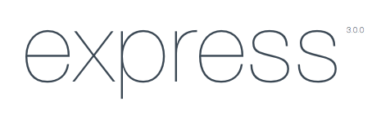

Drivers & Ecosystem
Support for the most popular languages and frameworks
Java
Ruby
Perl
Python
MEAN Stack
Morphia

Slide 15

Mentioning Marks presentation …

