Slide 1
Introduction to programming in python
Part I

Slide 2
Interpreters and Compilers
Computers understand only binary instructions. Humans (normal ones, anyway) do not.
Humans write source code in a programming language.
The source code must be converted to computer language.
Compiler: produces a standalone binary (executable) from a program.
Interpreter: the source code (often called a script) causes the interpreter to carry out the instructions.
Compiled code typically executes faster than interpreted code

Slide 3
Python howto

Slide 4
Anaconda
From the Navigator start Spyder.
If you have not launched it previously, the button will ask you to install it. Go ahead and do so.
You should see a workspace similar to what is on one of the next slides.

Slide 5
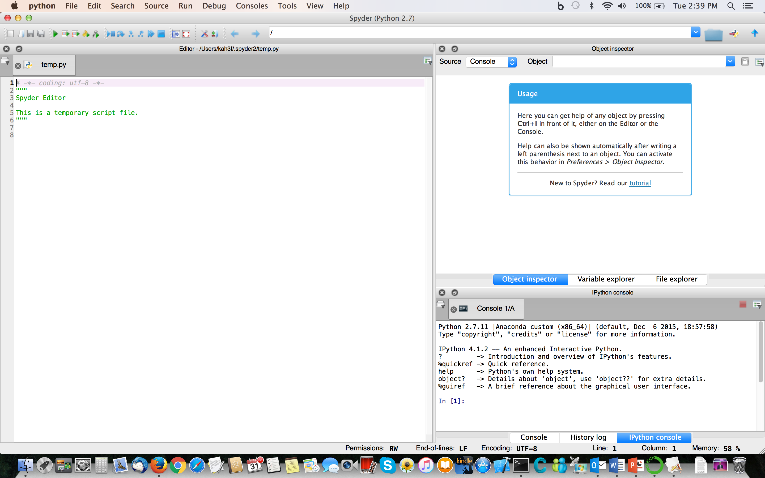

Slide 6
Spyder
The left panel is the editor panel. Type your code in there.
On the top right are explorer panels. In this introduction we will use Variable and File explorers.
On the bottom right is the iPython console. You can switch to a plain Python interpreter by clicking on Console. The interpreter prompt is
>>>
The notes will use this for typing at the interpreter even if you may be using iPython.

Slide 7
Using Spyder
If you type
print "Hello World"
In the Editor pane, you must run it for the print to be carried out.
You can also type commands directly into the iPython console. If you type an expression its value will be printed:
In [1]: x=5
In [2]: y=7
In [3]:x+y
Out [3]: 12
This is not the case for expressions typed alone on a line in the Editor pane.
x=5
y-7
x+y
Nothing will happen if we run the above lines of code. You must use print in a script to see any output.
In the iPython console we can also use up-down arrow keys to scroll in our commands, and the right-left arrow keys to edit them.

Slide 8
Running Scripts in Spyder
Run scripts either with the green arrow icons or through the Run menu. Run/green arrow runs the entire script. Run selection or current line will run a highlighted portion of our script. We can create cells by enclosing chunks of code with lines consisting of
#%%
Run cell/green arrow with a box runs the cell. Run cell/green arrow, box, and red "line feed" arrow runs the cell and advances.
A yellow triangle beside a line indicates a syntax error or potential problem. Spyder offers tab completion for names familiar to it. It can show a list of members of a package for your selection, and when you have chosen a function it can show you a list of its arguments.
One of the handiest features of Spyder is the ability to indent and unindent blocks of code from the Edit menu. Click to highlight the text you wish to indent or unindent, then choose the appropriate option under Edit. We will later see why this is very useful. Another helpful option allows you to highlight several lines of code, then select "Add block comment." This will save you a lot of typing once you begin to write and debug your own programs. To remove the block comment, select it and choose "Remove block comment" from the Edit menu.

Slide 9
Exercise
We can see some of these these features in action by creating a simple plot Type
import matplotlib.pylab as plt
First we see a yellow triangle, indicating plt is imported but not used. We ignore it since we know we will be using it. As we type
x=plt.
We see the editor show us our choices from the pylab package. we can select one or we can keep typing. We type
x=plt.linsp
to further narrow it down. That leads us to
x=plt.linspace
The editor then pops up a box with the arguments required by linspace. Finally we type inside the parentheses
-1.*plt.pi,plt.pi, 100
for a final result of
x=plt.linspace(-1.*plt.pi,plt.pi.,100)
Finally we type
y=plt.sin(x)
plt.plot(x,y)
You must save a file before you can run it. Go to the File menu, Save As, and name it sine.py
When we run this code, we see the plot appear embedded in the iPython console. We can right-click on the image to bring up a menu that allows us to save the plot.

Slide 10
The Variable Explorer
The Variable Explorer allows us to show the values of variables in our programs. It is particularly helpful for looking at a group of values (an array). We can change the number of decimal places printed by clicking "Format" and typing in an expression of the form %.3f for three decimal places. The Variable Explorer also includes icons for saving, refreshing, or importing data to our workspace.
To clear all values in the workspace, type
%reset
at the iPython console.
Now re-run your sine-plotting code and observe how the variables acquire values.

Slide 11
Using iPython/Jupyter
Spyder is best for code development. If you merely want to use the interpreter in an interactive manner, iPython is another option. In Anaconda I recommend the QtConsole version.
Jupyter is a Web-based notebook environment. It can work with Python (via iPython), R, Julia, and many others.
Jupyter QtConsole 4.2.0Python 2.7.11 |Anaconda custom (x86_64)| (default, Dec 6 2015, 18:57:58)
Type "copyright", "credits" or "license" for more information.
IPython 4.1.2 -- An enhanced Interactive Python.
? -> Introduction and overview of IPython's features.
%quickref -> Quick reference.
help -> Python's own help system.
object? -> Details about 'object', use 'object??' for extra details.
In [1]:

Slide 12
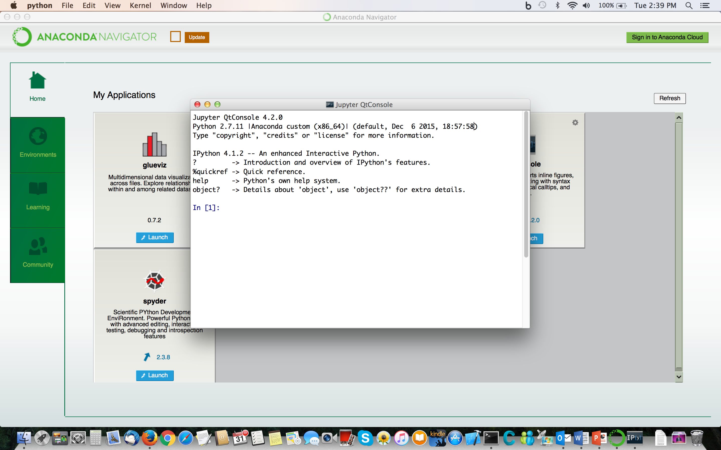

Slide 13
Variables, Expressions, and Statements

Slide 14
Variables
Variables in computer programming are not quite like mathematical variables.
Variables are placeholders for locations in memory.
Variables always have a type even if you don’t have to declare it
The primitive types correspond (more or less) to the types defined in hardware, specifically integers, floating-point (single and double), and characters.
Many languages define more basic types including Booleans, strings, complex numbers, and so forth.

Slide 15
Variables
Oversimplified illustration:
x=x+1 is mathematically nonsensical but in programming it means to add 1 to the value referenced by x and store it back to the same location in memory.
0
64
128
192
A
B
C
D

Slide 16
Variable Names
Most are chosen by the programmer
Python is case sensitive.
myVariable is not the same as Myvariable which is not the same as MyVariable
Generally you should avoid assigning names that differ only by case.
Watch out for typos
In dynamically typed languages the interpreter will assume that a misspelled old variable name is a new one.
Python will throw an error if the typo has not been initialized, which gives you some protection.

Slide 17
Literals
Literals are also called constants
Warning: in some languages like C, constant means “cannot be changed” not “a specific value.”
Literals are specific values, as distinct from variables.
But variables are often assigned initially using literals.
Examples
3 (Integer)
3.2 (Floating point)
1.234e-25 (Floating point, exponential notation)
100000000000000000L (Python long integer)
"This is a string" (Python string)
True (Python Boolean)
1.0+2J (Python complex)

Slide 18
Expressions
Expressions are combinations of variables, literals, operators on those variables, invocations of functions, and so on.
Given values for all variables, it must be possible to evaluate the expression to yield an unambiguous result.
The interpreter has a strict set of rules to evaluate an expression. It does not care what you actually intended so you must adapt to it. If it cannot arrive at an unambiguous result it will reject your code.

Slide 19
Statements
A statement is one complete “sentence” in the language. It contains one complete instruction. Examples:
assign A to B
In nearly all languages this is written
B=A
compute something and assign to a variable
C=0.25*math.pi*d**2

Slide 20
Statements in Python
Python statements do not require a semicolon at the end and it is considered bad form to add one.
Multiple statements may be placed on a line if they are separated by semicolons.
Backslash \ is the line-continuation character.
Lists and other data structures that are comma-separated may be continued on subsequent lines with the comma at the end of the lines.
The do-nothing (no-op) statement: pass

Slide 21
Examples
x=x+1
A equivalent notation is
x+=1
(x,y,z)=myfunc(a)
f=open("myfile.txt","w")
x=0; y=1; z=2
A=[1, 2, 3,
4, 5, 6]

Slide 22
Code Blocks
Statements can be grouped into blocks that function logically as a single statement.
In Python blocks are indicated by indentation level.
You can indent each block by however many spaces you wish, but each block level must be indented by exactly the same number. You should be consistent from one section of code to another.
Do not use tabs.
Some editors (e.g. Spyder) will automatically indent the next statement to the same level as the one before it. You escape to a more outer level with backspace or some other key.

Slide 23
Comments
Comments are statements or partial statements inserted for the benefit of human readers of the program.
Comments are ignored by the interpreter (or compiler).
Python:
Ordinary comments begin with a hash mark #
All symbols from the hash mark rightward to the end of the line is ignored by the interpreter

Slide 24
TYPES

Slide 25
Numbers in the Computer
Digital computers operate on Binary digITs or bits. A bit can be on or off so it can represent a 0 or a 1. Thus computers use binary (base 2) fundamentally. Bits are usually grouped into units of 8 called a byte.
Memory is organized into words. In modern systems Word size is what determines the “32 bit OS” or “64 bit OS.” Essentially all newer systems use a 64-bit OS.
Computers cannot use base 10. This has important consequences. For most purposes numbers must be converted from base 10 to base 2 and back again.

Slide 26
Internal Representations
In the computer, everything is just a sequence of 0 and 1 values. There must be rules to interpret that as a number, a character, a sound, a picture, whatever.
Consider for your amusement: an infinite and purely random binary sequence could contain every book that could be written, all music that could be played, all possible images--and so forth.
We won’t discuss the internal representation of anything but numbers (and a little bit about characters).

Slide 27
Types
A type is a categorization of a variable. The type tells the interpreter how to convert the bits in memory to a representation.
The "primitive" types are those defined by the hardware or that map directly to hardware.
Types are very important even in interpreted languages.
Each type has a set of operators defined on it. Often these are represented by the mathematical operators
+ - * /

Slide 28
Typing
Dynamic typing (Python, R, etc.)
In most interpreted languages the types are dynamic. A variable's type can change.
Type by Inference
Interpreted languages generally figure out the type based on context.
var=1 #integer
var=1. #floating point
If the program defines the type this is called a declaration.
Some declarations are possible or necessary
In Python NumPy allows or sometimes requires type declarations.

Slide 29
Integers
No decimal point, just a whole number
Depending on programming language an integer may be 16/32/64 bits, or 32 bits only. This has nothing to do with the word size--it is defined by the language.
Python uses signed integers. One bit is used for the sign and the rest of the bits are available for the magnitude.
Hence integers have a finite range that can be represented For 32 bits the range is -2,147,483,648 to 2,147,483,647. In Python the integer is at least 32 bits and in newer systems is more usually 64 bits.
Integers are exact as long as they fit within their defined range.

Slide 30
Longs
Unique to Python
Has (in principle) infinite precision
Computed in software and can be SLOW
Not the same as a “long” in C/C++/Java
Indicated by L at the end in literals
Interpreter will automatically switch if the standard integer overflows

Slide 31
Floating Point Single Precision
Floating point single precision
Computers use a variant of scientific notation to represent numbers with fractional parts
Sign, exponent, mantissa
Numbers are represented in the form
<+->.fraction x 2e
32 bits in nearly all languages
Approximately 6-7 decimal digits of precision, approximate exponent range is 10⁻¹²⁶ to 10¹²⁷
Used only occasionally in Python

Slide 32
Floating Point Double Precision
Double precision floating point
Sign, exponent, mantissa as for single
64 bits used for representation
Number of bits NOT a function of the OS type!
Approximately 15-16 decimal digits of precision, approximate exponential range 10⁻³⁰⁸ to 10³⁰⁸
Overflow results in Inf or -Inf
In Python you can assume that all floating-point numbers are doubles unless there was an explicit declaration somewhere.

Slide 33
Properties of Floating-Point Numbers
Floating-point numbers are what we use to represent the mathematical real numbers but they are not like the reals in many ways.
The mathematical real numbers are an infinite set. There is a finite number of floating-point numbers.
Only integer or terminating rational numbers can be exactly represented at all. All other numbers are approximated. Some numbers that are terminating in base 10 are not terminating in base 2 and vice versa.

Slide 34
More About Floats
Floating-point numbers are not equally distributed. There are far more of them near 0 than for large numbers.
There is a smallest nonzero number (in magnitude, on both sides) and a largest positive and negative. Thus Inf and -Inf are not all that “infinite.”
Imaginary numbers are not automatically included. So e.g. sqrt(-1.0)is something called a NaN (Not a Number).

Slide 35
Mathematical Operations on Floats
Floating-point operations (+, -, *, /) are commutative but in general are neither associative nor distributive. That is,
a+b=b+a
but in general
(a+b)+c ≠ a+(b+c)
a*(b+c) ≠ a*b+a*c

Slide 36
Summary: Integers and Floats
 | Integer | Float
Numbers | Whole numbers, no decimal point | Integers and rational numbers
Internal representation | Can use sign bit (Python does) → one bit used for sign, remaining bits used for magnitude | Scientific-like notation with exponent and significand (mantissa) using base 2, sign bit
Bits | 16, 32, or 64 (language dependent) | 32 (single precision), or 64 (double precision)
Range | -2^{bits-1} to +2^{bits-1}-1 (finite), 32 bit: -2,147,483,648 to 2,147,483,647 | ~10⁻³⁰⁸ to ~10⁺³⁰⁸ (finite), not equally distributed
Precision | exact | 15-16 decimal places, non-terminating rational or real numbers are approximated
Other features | Addition of two large number may result in overflow | Imaginary numbers not automatically included

Slide 37
Complex
Python supports complex types.
A complex number consists of 2 doubles:
R+I*1J
R+I*1j
It accepts either J or j (so is not case sensitive in this context) but the numerical value of the imaginary part must immediately precede it. If the imaginary part is a variable as in these examples, the 1 must be present.

Slide 38
Arithmetic Operators
Operators are defined on integers, doubles (floats), and complex
+ - add subtract
* / multiply divide
** exponentiation (can also use pow(a,b))
Operator precedence is:
** (* /) (+ -)
All languages evaluate left to right by precedence unless told otherwise with parentheses
+= add and assign: c+=1 is equivalent to c=c+1
Similarly -=, *=, /=

Slide 39
Special Integer Operators
Python:
Integer division //
Remainder (mod) %
2//3 = 0
7%2=1
Python Gotcha: versions below 3:
2/3=0
Versions 3 and above:
2/3=0.666666666666666
-Why not 7 at the end?
To avoid this, start each file in 2.7 with
from __future__ import division

Slide 40
Exercise
Start Spyder (or iPython) on your operating system. Find the interpreter pane. Type at the prompt (>>> or In [1]:):
>>>x=17.
>>>Xs=11.
>>>num_1=10
>>>num_2=14
To print to the console, use the print command.
>>>print x
>>>print Xs/x
>>>print Xs//x
>>>print Xs/x + x
>>>print Xs/(x+x)
>>>print x/num_1
>>>print num_1/num_2
>>>print num_2/num_1

Slide 41
More Interpreter Fun
>>>print 4+2*3
>>>print (4+2)*3
>>>print 20/4*5
>>>print 20/(4*5)
>>>print .1+.2 #why is it not .3 exactly?
>>>print 5//2
>>>print -5//2
>>>print 5//-2
>>>print 11//3
>>>print 11.4//3.5
>>>print 11%3
>>>print 11.4%3.5 #!?
>>>print 11.4-(11.4//3.5)*3.5

Slide 42
Boolean
Boolean variables indicate truth value.
Booleans have only two possible values, True and False (note capitalization)
Internally Booleans are integers, but this is (usually) not important to the programmer.
Use Booleans as Booleans, not as integers. It makes code much clearer.

Slide 43
Type Conversions
If a variable is of one type but it needs to be of a different type, it is necessary to do a type conversion aka a cast.
An expression with more than one numeric type is said to be mixed.
N=20*3.5/11.0
Most interpreters will automatically cast numeric variables to make mixed expressions consistent. The variables are promoted according to their rank. Lowest to highest the types are integer, float, double, complex.
Almost no languages can or will automatically cast non-numeric types to numerics.

Slide 44
Explicit Casting
Explicit casting among numeric types:
R=float(I)
I=int(R)
Z=complex(r1,r2)
Explicit casting of numeric to non-numeric:
Example: string to integer and vice versa
i_age=39
age=str(i_age)
employee_age="51"
i_age=int(employee_age)

Slide 45
Mutable and Immutable Types
In Python a very important distinction is whether a type is mutable or immutable.
Mutable:
Generally applies to “compound” types
Elements can be changed
Immutable:
Cannot be changed.
Can be overwritten with an entirely new value or values

Slide 46
Immutable Types
Immutable types cannot be changed in place, but they can be overwritten.
X=1.
X=2.
Strings are a "compound" type yet they are immutable:
S1="Hello world"
S1[0:5]="Goodbye" #illegal
S1="Goodbye cruel world" #legal

Slide 47
Mutable Types
Most of the more "advanced" data structures are mutable:
Lists
Dictionaries
NumPy arrays

Slide 48
Strings

Slide 49
Strings
A string is a sequence of characters
Characters occupy one (ASCII) or two (Unicode) bytes
Strings using unicode are a type unicode
String length can be dynamically determined but once set, it is fixed.
Strings are immutable and cannot be changed. They can only be overwritten.
Line_1=“The first line of a file\n”
\n is the end of line character.
The length of this string is 25. Spaces and end-of-line markers count.

Slide 50
String Operators
There are many string operations (some of which require function calls).
Concatenation +
S1+S2
Substring extraction
SubString=S[0:3]
WARNING: The first character is counted as 0, and the last one in the substring is UB-1. This substring consists of characters 0, 1, and 2 of the string S.
Strings are immutable so we cannot assign values to a substring. That is, they cannot appear on the left-hand side of an assignment.
S[0:3]="New" #error

Slide 51
More String Operations
Number of characters, including whitespace and special characters such as end of line:
len(string)
Remove characters from the beginning and end (empty parentheses removes spaces and tabs). The angle brackets indicate something optional and are not typed.
string.strip(<chars>)
String formatting operator %
Use with format characters to construct dynamic strings. (More on this when we get to input/output.)
result="I computed %f compared to %f" % \
(my_pi, math.pi)

Slide 52
Exercise
>>>title="This is a string"
>>>subtitle="Another string"
>>>print len(title)
>>>print title+":"+subtitle
>>>newtitle=title+" : "+subtitle
>>>print len(newtitle)
>>>print newtitle[2:4]
>>>newtitle[2:4]="at" Error-Why?
>>>print "The value of x is %f" % x

Slide 53
Docstrings
Documentation strings or “docstrings” use a special form of comment.
The lines are enclosed in triple double quotes
""" """
Everything within triple double quotes is treated as a literal string and a comment, including line breaks.
Docstrings are placed at the top of program units, just under the declaration of the unit name (if present).
If they are correctly placed, certain automated tools are available to display the documentation.

Slide 54
Exercise
Define variables x=21.0, n=30, s="My new string"
Convert n into a float and store the result into a new variable y.
Use the string s to create another string that contains the literal “Your new string” – do not just create a variable with that string, use part of s along with a new literal.
Set a variable the_answer containing the literal string "42." (be sure to include the period).
Type
>>>z=int(the_answer)
What happened? Try
>>>z=float(the_answer)

Slide 55
LISTS

Slide 56
Lists in Python
Lists are one of the most important data types in Python. They are flexible and easy to use.
Lists are ordered collections of objects. Each element of the list can be of any type, including another list. Elements can be referenced by an index.
Lists are dynamically sized.
Lists must be declared before they can be used.
Empty list:
L=[]
Return a new list from a built-in function:
L=range(12)
This function returns a list of integers 0,1,…,11
We count from 0 by default, and the upper bound is the limit we do not reach.

Slide 57
List Elements
We can access a particular element by its index – this is why we refer to lists as an ordered data type.
Indices are enclosed in square brackets.
L[2]
The first element is always numbered 0, so a list with N elements has indices 0,1,…,N-1
Lists are mutable so you can change elements
myL=[1,2,3]
myL[1]=4
print myL

Slide 58
Sublists (Slices)
subL=L[1:3]
The colon indicates the range. It is sometimes called the range operator in this context.
Always remember that in Python the upper bound is the first value that is not reached, so this slice is elements 1 and 2.
Since we count from zero they are the second and third elements.
subL=L[2:]
Elements from the third to the end of the list
subL=L[:3]
Elements from the beginning to the third element (index number 2).
subL=L[1:7:2]
Elements 1, 3, 5

Slide 59
Enlarging Lists
Initialize an empty list
L1=[]
Initialize a list of known size, all elements to same value
L1=[0]*N
Append
L1.append("Graham")
Extend
L1.extend(["Graham","Michael"])
append versus extend:
append adds the argument as the new last element. That argument can itself be a list. extend must take a list as its argument. It concatenates that list onto the original list.

Slide 60
More Ways to Enlarge
Concatenate
L=[1,2,3]+[4,5,6]
Insert
L.insert(i,item)
This inserts item before element i
To add an item at the beginning of a list, use
L.insert(0,item)

Slide 61
Shortening lists
Delete an element by its index
del L[i]
Delete the first occurrence of a particular element
L.remove(item)
The item must match exactly or an error occurs.
Remove and return an element
item=L.pop(<i>)
The angle brackets indicate an optional argument. If it is absent the last element is returned. If it is present that element is returned.
Lastval=L.pop()
A_val=L.pop(2)

Slide 62
More List Methods
The length of a list is given by len
LenOfL=len(L)
Maximum or minimum value of the items:
max(L), min(L)
Membership test
item in list
Index of first time item occurs
myIndex=L.index(item)
Number of times item occurs
NumItem=L.count(item)

Slide 63
Exercises
At the Python interpreter prompt type
>>>NumList=range(10)
Print the length of the list
Change the fourth element to 11
Extend the list with L=[20,30,40]
Print the index of the item 9
Remove that item from the list
Print the current length of the list
Sort the list and then reverse the sorted version

Slide 64
Rearranging Lists
Sort a list in place (overwrites the original)
L.sort()
Return a sorted list to a new list
Lsorted=sorted(L)
Reverse the list in place (overwrites)
L.reverse()
Reverse the list and return to another list
Lreversed=L[::-1]

Slide 65
Copying Lists
A=[1,2,3,4]
B=A
B[2]=9
print A
>>>[1,2,9,4]
B is just an alias (nickname) for A. If B changes so does A. THIS IS TRUE FOR ALL MUTABLE TYPES.
Slicing notation creates a view that for lists is a copy if it's the entire list:
C=A[:]
C[1]=11
print A

Slide 66
More Copying
Another way to create a true copy is to use the list function, which converts any sequence into a list (its argument can already be a list):
B=list(A)
We can also use the copy module (much more about modules soon to come)
import copy
C=copy.deepcopy(A)

Slide 67
Conditionals

Slide 68
Making Choices
Computer programs really can’t do that many things. They can
Assign values to variables (memory locations).
Make decisions based on comparisons.
Repeat a sequence of instructions over and over.
Call subprograms.
Decisions (conditionals) are one of the fundamental programming constructs.

Slide 69
Branching (Pseudocode)
IF ( comparison operation evaluating to Boolean) do something ELSE do some other thing
IF ( comparison ) do something ELSE IF (comparison) do some other thing ELSE default behavior
WARNING: In nearly all languages the comparison may short circuit, i.e. once it determines T or F of the comparison it does not do any more evaluations. Don’t rely on a compound comparison operation to set a value.

Slide 70
Python Syntax
elif and else are optional
Must use colons and indent the code blocks!
Each block must have at least one statement so use pass if there is no action (avoid this if you can)
if <comparison operation>:
code
elif <comparison operation>:
more code
else:
yet more code

Slide 71
More Conditionals
Single-line statements:
if x==0: z=0
There is no case/switch statement; use elif:
if cond1:
block1
elif cond2:
block2
elif cond3:
block3
else:
final choice

Slide 72
Boolean Operators
Negation
not
not flag
AND
is_present and has_value
True when both are True, otherwise False
OR
is_zero or is_negative
WARNING In all programming languages (that I know) or is non-exclusive!! That is, the clause is True if BOTH are True as well as if EITHER is True. In human languages or tends to be exclusive.
English: You can have ice cream or cake (but not both)
#Python
if ice_cream_OK or cake_OK:
#True if both are True

Slide 73
Precedence of Booleans
not has highest rank, followed by and, then or
Exercise
>>>first=True
>>>second=False
>>>third=False
>>>print first or second
>>>print first and second or third
>>>print (first and second) or third
>>>print not first and second
>>>print not (first and second)

Slide 74
Comparison Operators
Comparison operators return Boolean results.
Comparison operators are often called conditional operators or relational operators.
Comparison operators represent relationships. They can be defined on any type. Most commonly we use numerical comparison operators.
These compare two numerical values for equality, non-equality, greater than, less than, greater than or equal to, less than or equal to.

Slide 75
Comparison operators
Generally they resemble their mathematical counterparts:
Equal, not equal
== !=
Less than, greater than, less than or equal, greater than or equal
< > <= >=
All comparison operators have the same rank relative to one another. All comparison operators outrank Boolean operators.
Chaining: In Python we can write e.g.
0<a<=1
just as in the similar mathematical expression. An and operator is always assumed. The above is equivalent to
0<a and a<=1

Slide 76
Exercise
>>>a=11.; b=9.; c=45.; n=3
>>>print a>b
>>>print a<b and c==n
>>>print a<b or c==n
>>>print a>b or c==n and a<b
>>>print (a>b or c==n) and a<b
>>>is_greater=a>b
>>>print is_greater,type(is_greater)

Slide 77
The in operator
The in operator determines whether an item is a member of a sequence. It returns a Boolean value.
>>>A=[1.,2,3.,4.,5,6]
>>>1 in A
>>>1. in A
>>>9 in A
Negation: not in
>>>9 not in A

Slide 78
The is operator
The is operator compares two objects and determines whether they are exactly the same. It returns a Boolean.
Example: check whether a list is a true copy or not.
>>>A=[2, 3.5, 8, 10.]
>>>B=A[:]
>>>C=A
>>>B==A
>>>B is A
>>>C is A
Negation: is not
>>>B is not A

Slide 79
Operator Precedence Summary Table
Operator | Meaning
() | Grouping
f(x..) | function
x[a:b} | slice
x[i] | subscript
x.attribute | attribute reference
** | exponentiation
~x | bitwise not
+x, -x | positive, negative
* / % | multiplication, division, remainder
+ - | addition subtraction
<< >> | bitwise shifts
& | bitwise and
^ | bitwise xor (exclusive or)
| | bitwise or
in, not in, is, is not, <, <=, >, >=, <>, !=, == | comparison operators
not x | negation
and | and
or | or
lambda | lambda expression

Slide 80
Loops

Slide 81
Around and Around
One of the most fundamental processes in a computer program is to repeat statements many, many (perhaps many, many, many) times.
Computers never run out of patience
but loops are sometimes very slow compared to equivalent constructs, though this is mainly true in interpreted languages.

Slide 82
Examples of Applications
Read all the lines of a file
Apply a process to all elements of an array
Compute some value by adding up terms
Mathematically this could be expressed as

Slide 83
Types of Loops
Most languages have two major types of loops, for (or do) and while.
FOR
for loops are executed a fixed number of iterations. It is possible to exit early but this must be added to the code.
WHILE
while loops do not have a predetermined number of iterations. They terminate when some condition becomes False.

Slide 84
FOR loops in Python
Python’s for loop steps through a sequence (called an iterator) of items.
for <item> in <iterator>:
block1
else: # optional
block2
The else clause is executed when the loop completes the iterator.
Colons are required as indicated. The blocks must be indented.

Slide 85
Range
The iterator is most often a list.
To loop over a sequence of numbers, use the range function.
Arguments must be integers!
range(10) : 0,1,2,3,4,5,6,7,8,9
range(1,10): 1,2,3,4,5,6,7,8,9
range(0,10,2): 0,2,4,6,8
range(10,0,-2): 10,8,6,4,2 [ NO ZERO!]
If the stride is present the lower-bound argument must be present. Otherwise the lower bound may be omitted, in which case it is zero. If the stride is omitted it is 1.

Slide 86
enumerate
Often we need both the item and its index. We can do this by keeping track of the index with a variable of a type called a counter, or we can use enumerate.
velocity=[-11.,-3.,-1.,1.,2.,3.,4.]
for i,v in enumerate(velocity):
print i,v

Slide 87
Exercise
Loop over the first 10 integers (not counting zero) and print each one.
Use a loop similar to the one you just coded to sum the first 10 integers. Hint: you will need an accumulator variable.
Modify your summation loop to sum the first N integers, where you set N before the loop starts.

Slide 88
WHILE Loops
while loops use a conditional to determine when to exit
Make sure your expression evaluation changes!!!
while <Boolean expression>:
block
else: # optional
block
The else clause is executed iff the conditional becomes False (normal termination).

Slide 89
Example
x=-20
y=-10
while (x<0 and y<0):
x=10-y
y=y+1
z=0

Slide 90
Example: Loop+If
The hat function is
0 if x< x0
F(x)= f0 if x>x0 and x<=x1
0 if x≥x1
How do we code this up?

Slide 91
Solution
First we must decide on a range for x. We also need to choose values for x0, x1, and f0.
Let's set x0=-1 and x1=1
Let's have x run from -3 to +3.
We also need to decide how many values of x!
Note that everything is discrete in computers.
Let us use 101 values. We have to count the zeroth (-3).
First set up x
n_xvals=101
xmax=3.
xmin=-3.
x_vals=[0.]*n_xvals #replication
Compute the spacing between x values.
dx=(xmax-xmin)/(n_xvals-1)

Slide 92
Solution (continued)
Set initial value for x_vals list
x_vals[0]=xmin
Compute x_vals
for i in range(1,n_xvals):
x_vals[i]=xvals[i-1]+dx
Set x0 and x1:
x0=-1.
x1=1.
Set up f0
f0=1.
Now set up the function
f_vals=[]
for x in x_vals:
if x<x0 or x>=x1:
f_vals.append(0.)
else:
f_vals.append(f0)

Slide 93
Plot it
import matplotlib.pyplot as plt
plt.plot(x_vals,f_vals)
plt.show()
Another option:
if x0<x<=x1:
f_vals.append(f0)
else:
f_vals.append(0.)

Slide 94
Leaving Early
break: leave loop – any else clause will not be executed
break can exit only from the loop level in which it occurs. (In Python this corresponds to its indentation level.)
continue: skip rest of loop and go to next iteration
similar to break, it skips only the rest of the statements at its own loop level.

Slide 95
Python Example
x=1.
L=[x]
while x>0:
x=x+1. #or x+=1
L.append(x)
if x>=10000.0: break
if x<100.0 : continue
x=x+20.0 #or x+=20

Slide 96
Else clause
The else clause of a loop is nearly always used in conjunction with break.
If our loop terminates normally then we do something additional.
iter=0
while iter<=max_iter:
x_new=optimize(f,x_old)
iter+=1
if abs(x_new-x_old)<tol:
break
x_old=x_new
else:
print “Warning: max_iter exceeded”

Slide 97
Repeat/Until
A while loop is equivalent to
while True:
if not <Boolean expression>:
break
statement
statement
while always tests at the top of the loop. The while… if/break form can test anywhere, e.g. at the bottom to implement the repeat-until of some other languages.

Slide 98
Repeat/Until in Python
If we wish to test at the bottom of the loop (i.e. after the statements in the loop body have been executed) we use a while with a break.
while True:
statement
statement
statement
if <Boolean expression>: break

Slide 99
Nested Loops
We can have loops within loops. The outer loop variable stays fixed while the inner one goes through its iterator; then the outer one takes the next value.
for i in range(5):
for j in range(5):
print i,j

Slide 100
Reinitializing
In nested loops, if we recompute something due to a change we must reinitialize something else.
Example:
import matplotlib.pyplot as plt
import math
Nx=101
Nsines=4
x_vals=range(Nx)
for i,x in enumerate(x_vals):
x_vals[i]=0.01*x
for n in range(1,Nsines+1):
y_vals=[]
for x in x_vals:
y_vals.append(math.sin(n*math.pi*x))
plt.plot(x_vals,y_vals)
plt.show()

Slide 101
Example (for Lab)
The task:
Write a program that calculates the square root of a non-negative real number. The algorithm is called the "Babylonian method" and is at least two millennia old. It is as follows:
Start with an initial guess, typically the number itself.
The next estimate will be the arithmetic average of the last estimate with the number divided by the last estimate. Continue until we reach the desired accuracy.
We will work through this now.
How should we test this program?
What do we do if we want to print a table of square roots?

