Slide 1
Python: Basemap

Slide 2
Basemap
Basemap is a library within matplotlib and has tools for plotting data on Earth map projections.
Basemap uses the maps of 25 different projections as a baseline for the graphics.
Matplotlib is used to superimpose attributes, such as rivers and political lines.

Slide 3
Using Basemap
The basic steps for using Basemap are
Import the package/module
Create a basemap object with a projection type
Draw any desired features (e.g., coastlines, countries, parallels, meridans, etc.)
Add any measured attributes as points or contours
Display the plot
More details for Basemap can be found at http://matplotlib.org/basemap/

Slide 4
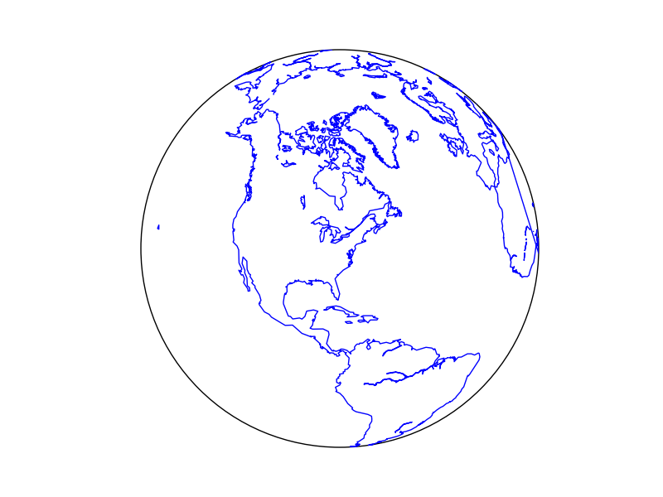
Basemap Example 1
# Import packages/modules
from mpl_toolkits.basemap import Basemap
import matplotlib.pyplot as plt
# Create the Basemap object with a specified projection
m = Basemap(projection=‘ortho’, lat_0=40, lon_0=-80)
# Draw coastlines.
m.drawcoastlines(color=‘blue’)
# Display the result
plt.show()
Depending on the type of projection, various keywords/arguments will be needed. Here, lat_0 and lon_0 provide the “center point” of the map.

Slide 5
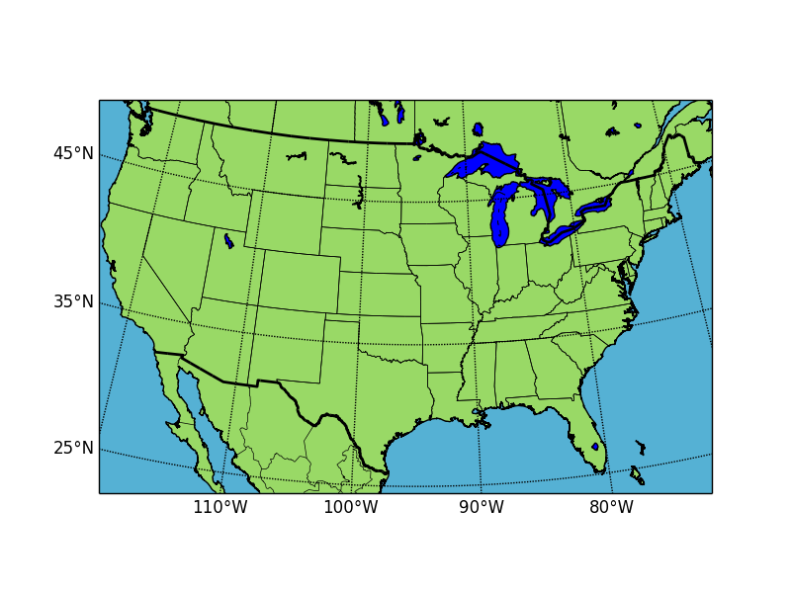
Basemap Example 2
from mpl_toolkits.basemap import Basemap
import matplotlib.pyplot as plt
import numpy as np
# Initialize a basemap object
m = Basemap(projection ='lcc’, llcrnrlon=-119,llcrnrlat = 22, urcrnrlon = -64, urcrnrlat = 49, \
lat_0=33, lon_0=-95, resolution ='h', area_thresh = 1000)
# Draw coast lines, country lines, and state lines
m.drawcoastlines()
m.drawcountries(linewidth=2)
m.drawstates()
# Fill in colors
m.drawmapboundary(fill_color=‘#55B1D4')
m.fillcontinents(color='#99D966', lake_color='blue')
# Draw parallels & meridians
# labels indicate location for ticks: [left, right, top, bottom]
m.drawparallels(np.arange(25, 65, 10), labels=[1, 0, 0, 0])
m.drawmeridians(np.arange(-120, -40, 10), labels=[0, 0, 0, 1])
plt.show()
lcc = Lambert Conformal map of lower 48 states
llcrnrlon = longitude of lower-left corner of map
llcrnrlat = latitude of lower-left corner of the map
urcrnrlon = longitude of upper-right corner of map
urcrnrlat = latitude of upper-left corner of the map
resolution = resolution of features: h=high, (crude, low, and intermediate available)
area_thresh = minimum size for a feature to be plotted (e.g., 1000 => 1000 square kms.)

Slide 6
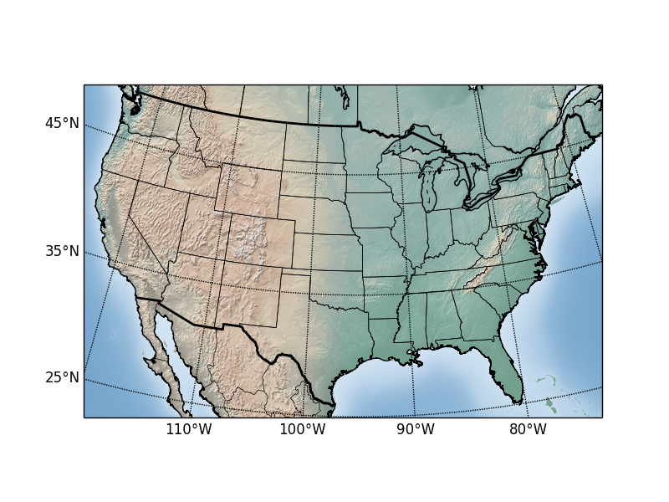
Basemap Example 3
from mpl_toolkits.basemap import Basemap
import matplotlib.pyplot as plt
import numpy as np
m = Basemap(llcrnrlon=-119,llcrnrlat = 22, urcrnrlon = -64, urcrnrlat = 49, projection ='lcc', lat_1=33, lat_2=45, lon_0=-95, resolution ='h', area_thresh = 10000)
#Superimpose relief image on map
m.shadedrelief()
#Draw coast lines, country lines, and state lines
m.drawcoastlines()
m.drawcountries(linewidth=2)
m.drawstates()
#draw parallels & meridians
# labels indicate locations: [left, right, top, bottom]
m.drawparallels(np.arange(25, 65, 10), labels=[1, 0, 0, 0])
m.drawmeridians(np.arange(-120, -40, 10), labels=[0, 0, 0, 1])
plt.show()
See what happens if you replace
m.shadedrelief()
with
m.bluemarble()

Slide 7
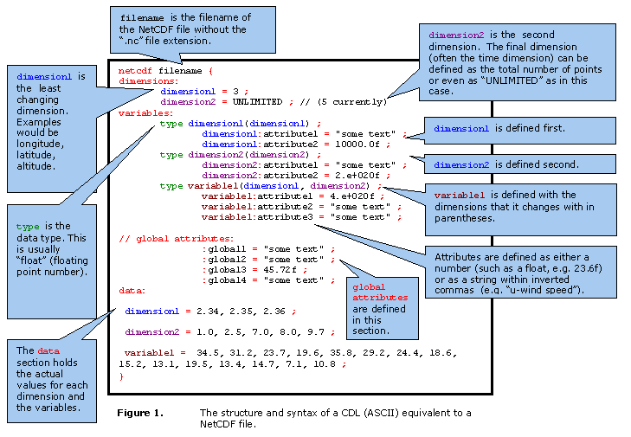
netCDF
Figure borrowed from https://badc.nerc.ac.uk/help/formats/netcdf/index_cf.html

Slide 8
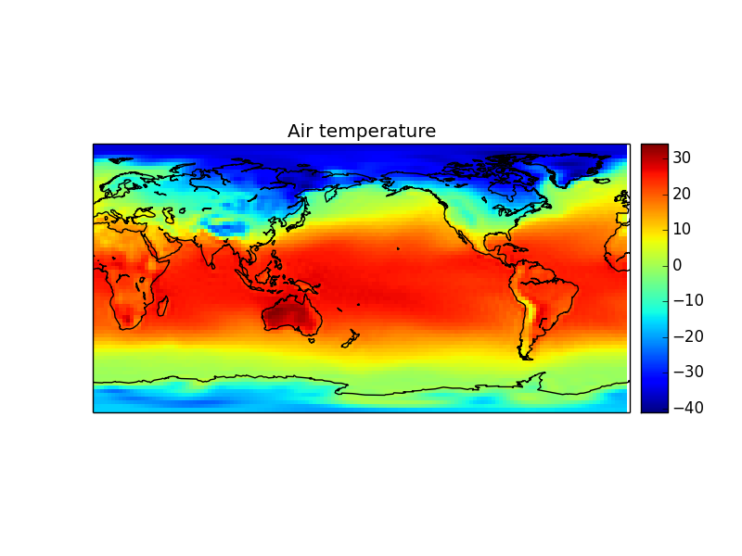
Basemap Example 4
import netCDF4
from mpl_toolkits.basemap import Basemap
import matplotlib.pyplot as plt
import numpy as np
#Open file and get the data of interest
f = netCDF4.Dataset('../air.mon.mean.nc', 'r')
air = f.variables['air'][0,:,:]
lat = f.variables['lat'][:]
lon = f.variables['lon'][:]
lon_units = f.variables['lon'].units
lat_units = f.variables['lat'].units
# Initialize a basemap object
b = Basemap(projection='cyl', lon_0=180)
b.pcolormesh(lon, lat, air, shading = 'flat', cmap=plt.cm.jet)
b.colorbar()
# Draw coast lines & add title
b.drawcoastlines()
plt.title("Air temperature")
plt.show()
To include contour lines, insert the following:
plt.contour(lon, lat, air, 10, colors)

