Slide 1
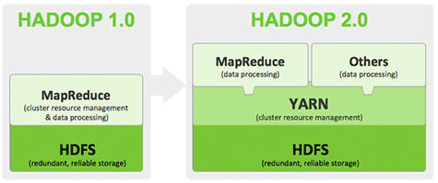
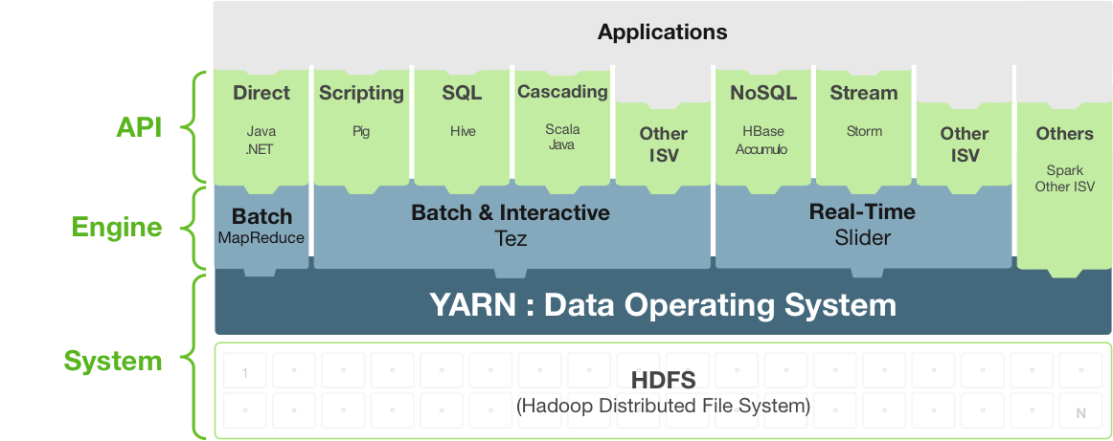

Slide 2

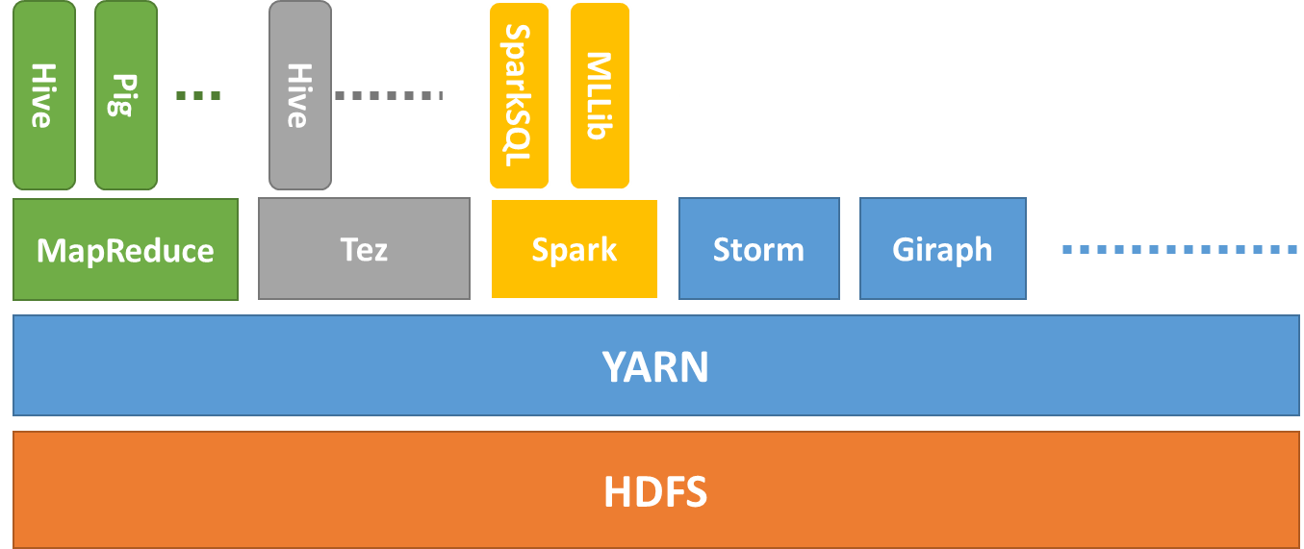




Sherlock Demo
Operations
Visualization
…
…
MRDocker
SprDocker
NFS
Map
Hansken
Hadoop 2.0
cloud

Slide 3
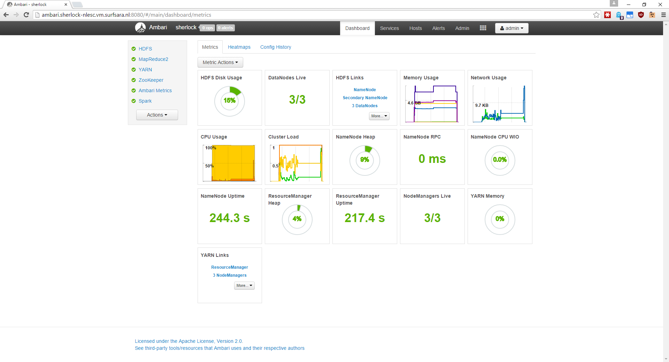

Slide 4
Sherlock Demo
Operations
Visualization
…
…
MRDocker
SprDocker
NFS
Map
Hansken
Hadoop 2.0
cloud

Slide 5
Sherlock Demo
Operations
Visualization
…
…
MRDocker
SprDocker
NFS
Map
Hansken
Hadoop 2.0
cloud

Slide 6





Batch Processing
Docker Images
Hadoop Frameworks
or
Standalone solutions
(e.g., using libHDFS)
Interactive Processing
MRDocker
SprDocker
External Processing
.txt
.jpg
DBMS
.xls
.shp
.img
Sequence
Avro
Parquet
ORCFiles
Data Import
Data Export
NFS
Hadoop 2.0

Slide 7


Batch Processing
Docker Images
Hadoop Frameworks
or
Standalone solutions
(e.g., using libHDFS)
Interactive Processing
MRDocker
SprDocker
Externalization
.txt
.jpg
.xls
.shp
.img
Sequence
Avro
Parquet
ORCFiles
Data Import
DBMS
Hadoop 2.0

