Slide 1
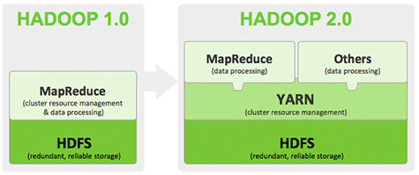
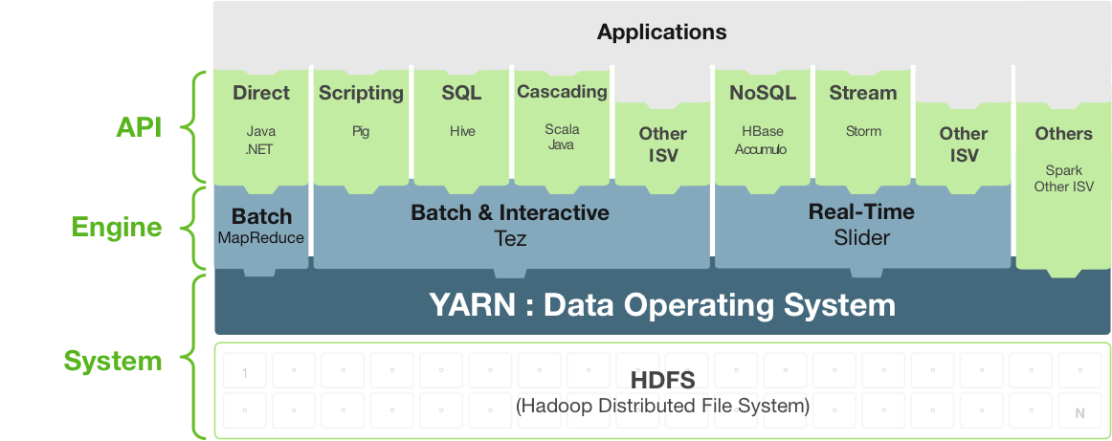

Slide 2
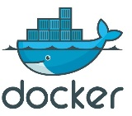
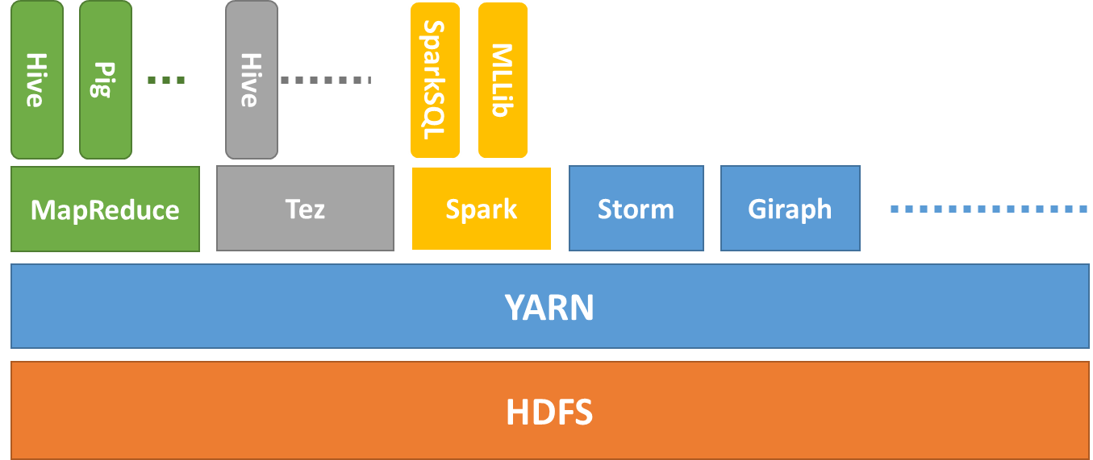




Sherlock Demo
Operations
Visualization
…
…
MRDocker
SprDocker
NFS
Map
Hansken
Hadoop 2.0
cloud

Slide 3
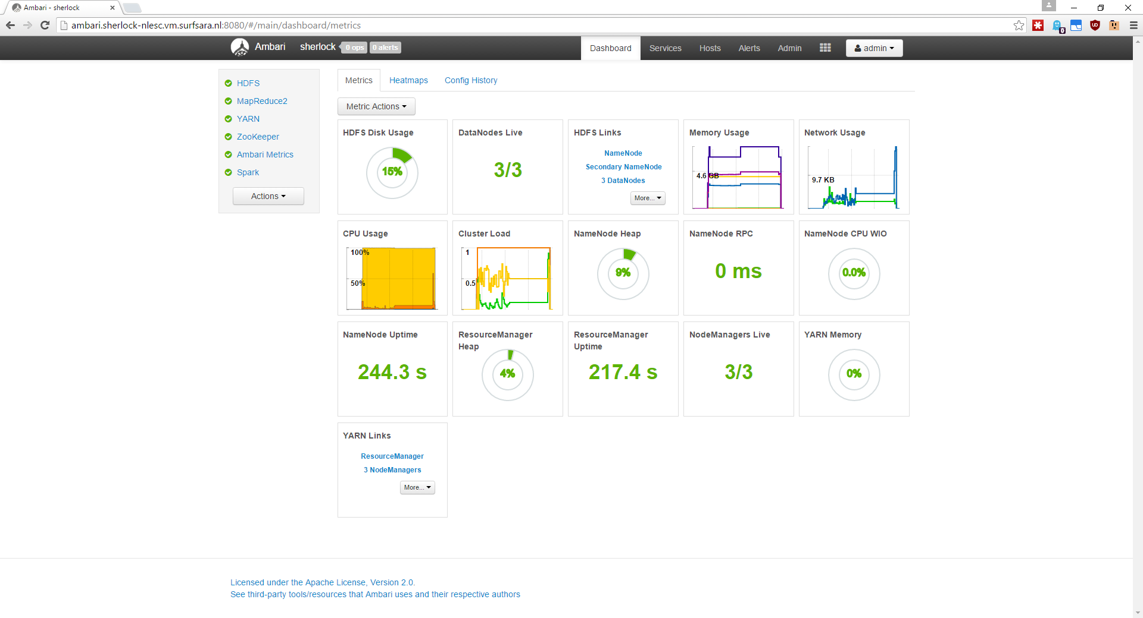

Slide 4
Sherlock Demo
Operations
Visualization
…
…
MRDocker
SprDocker
NFS
Map
Hansken
Hadoop 2.0
cloud

Slide 5
Sherlock Demo
Operations
Visualization
…
…
MRDocker
SprDocker
NFS
Map
Hansken
Hadoop 2.0
cloud

Slide 6





Batch Processing
Docker Images
Hadoop Frameworks
or
Standalone solutions
(e.g., using libHDFS)
Interactive Processing
MRDocker
SprDocker
External Processing
.txt
.jpg
DBMS
.xls
.shp
.img
Sequence
Avro
Parquet
ORCFiles
Data Import
Data Export
NFS
Hadoop 2.0

Slide 7


Batch Processing
Docker Images
Hadoop Frameworks
or
Standalone solutions
(e.g., using libHDFS)
Interactive Processing
MRDocker
SprDocker
Externalization
.txt
.jpg
.xls
.shp
.img
Sequence
Avro
Parquet
ORCFiles
Data Import
DBMS
Hadoop 2.0

Slide 8





Batch Processing
Standalone solutions or Hadoop Frameworks
Docker Images
Interactive Processing
MRDocker
SprDocker
Externalization
Docker Swarm
Hadoop 2.0
.txt
.jpg
.shp
.xls
.img
Flask
Data Import
Sequence Avro ORC
PySpark
DBMS
HDFS

Slide 9


Externalization
Batch Processing
Interactive
Processing
Docker Images
DBMS
MRDocker
SprDocker
Docker Swarm
Hadoop 2.0
.txt
.jpg
.shp
.xls
.img
Flask
Data Import
Sequence Avro ORC
PySpark
HDFS

Slide 10
TDI - Infrastructure
By exploiting state-of-the-art standards
Transparent data ingestion
Stepwise data exploration
Easy to plug visualization tools
Sherlock use cases
Ongoing NLeSC technology developments:
DataVaults on Spark, workflow management, etc.
Batch Processing
Interactive
Processing
Docker Images
MRDocker
SprDocker
Docker Swarm
Hadoop 2.0
.txt
.jpg
.shp
.xls
.img
Flask
Data Import
Sequence Avro ORC
PySpark
HDFS

Slide 11
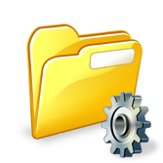
TDI - eScience Infrastructure
By selecting state-of-the-art products we designed
Effective integrated infrastructure
Transparent data ingestion
Stepwise data exploration
Easy to plug visualization tools
Validated by the Sherlock use cases
Ongoing NLeSC technology developments:
In-situ data access for eData, workflow management, etc.
Batch Processing
NoteBooks
Docker Images
File Browser
MRDocker
SprDocker
Docker Swarm
Hadoop 2.0
.txt
.jpg
.shp
.xls
.img
Flask
Data Import
Sequence Avro ORC
PySpark
HDFS

Slide 12
For more info at : https://github.com/nlesc-sherlock/
data_tools_integration
shelly : Create hadoop/spark cluster using Ambari and Docker swarm with Ansible
uplift : Web Application to upload/ingest files into hdfs
hdfs-dfs-client-docker : Docker-based tool capable of interacting with a remote hdfs filesystem
hadoop-streaming-docker : Hadoop streaming python inside docker
yarn-docker : Yarn applications running docker containers
spark-docker : Running docker containers inside Spark.
spark-flask : Webservice which runs sparksql queries in a docker container.

