Slide 1
TDI – eScience Infrastructure
Romulo, Jisk, Niels and Stefan
NLeSC

Slide 2

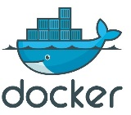



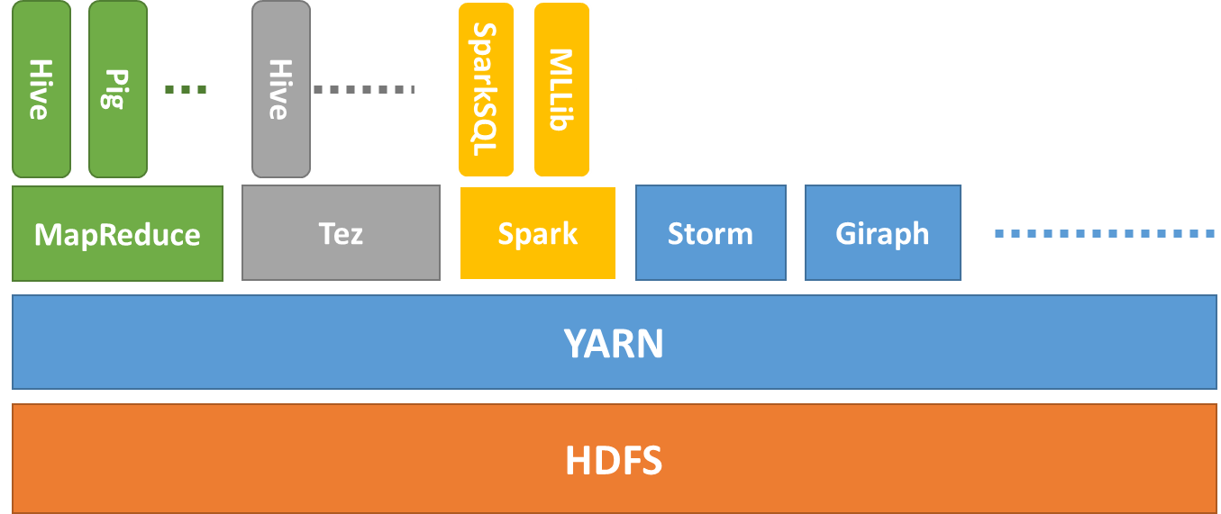


TDI - eScience Infrastructure
By selecting state-of-the-art products we designed
Effective integrated infrastructure
Transparent data ingestion
Stepwise data exploration
Easy to plug visualization tools
Validated by the Sherlock use cases
Ongoing NLeSC technology developments:
In-situ data access for eData, workflow management, etc.
Batch Processing
NoteBooks
Docker Images
File Browser
MRDocker
SprDocker
Docker Swarm
Hadoop 2.0
.txt
.jpg
.shp
.xls
.img
Flask
Data Import
Sequence Avro ORC
PySpark
HDFS

Slide 3
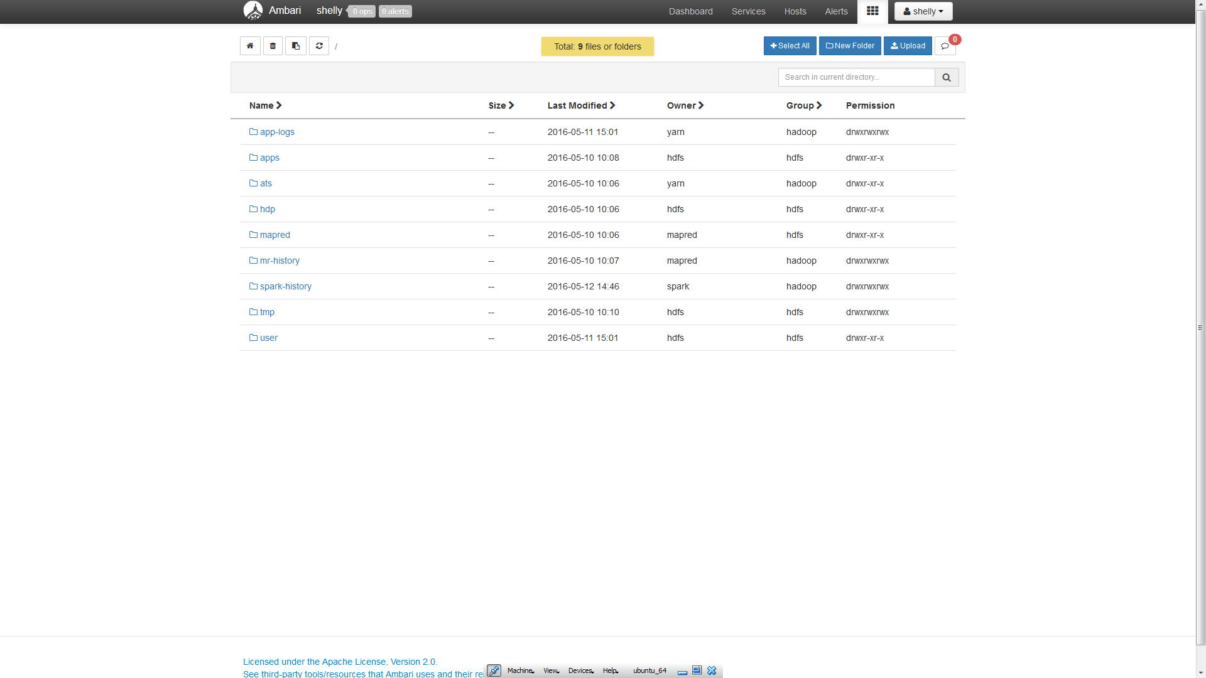
File Browser…

Slide 4
Demo???
Data
Panama papers
Perform analysis (Does Maarten has an offshore?)
https://github.com/nlesc-sherlock/spark-flask/blob/master/app.py
Visualize result
User interface:
http://emma2.sherlock-nlesc.vm.surfsara.nl:8081/table
Spark:
http://emma2.sherlock-nlesc.vm.surfsara.nl:4040

Slide 5
For more info at : https://github.com/nlesc-sherlock/
data_tools_integration
shelly : Create hadoop/spark cluster using Ambari and Docker swarm with Ansible
uplift : Web Application to upload/ingest files into hdfs
hdfs-dfs-client-docker : Docker-based tool capable of interacting with a remote hdfs filesystem
hadoop-streaming-docker : Hadoop streaming python inside docker
yarn-docker : Yarn applications running docker containers
spark-docker : Running docker containers inside Spark.
spark-flask : Webservice which runs sparksql queries in a docker container.

Slide 6
Future work
TODO:
Deploy Sherlock’s use cases to our infrastructure
Ingestion Gui
GPU in Docker swarm
“Why” documentation for eStep
To investigate:
Docker on Yarn
Spark inside Docker to run on Docker swarm
Workflow dockers
Elastic Search / MongoDB / PostgreSQL
In-situ data access

Slide 7
