Slide 1
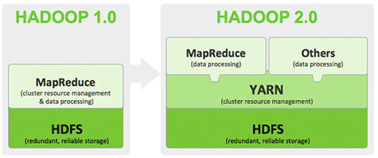
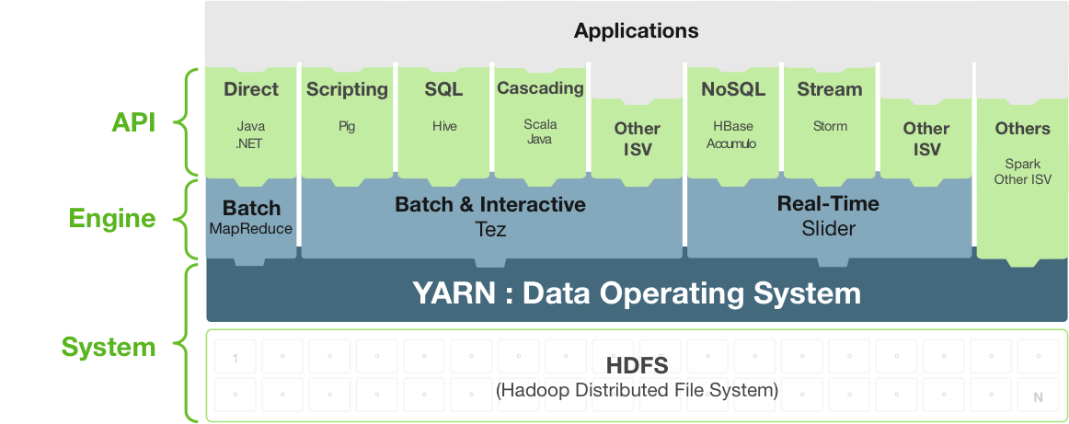

Slide 2

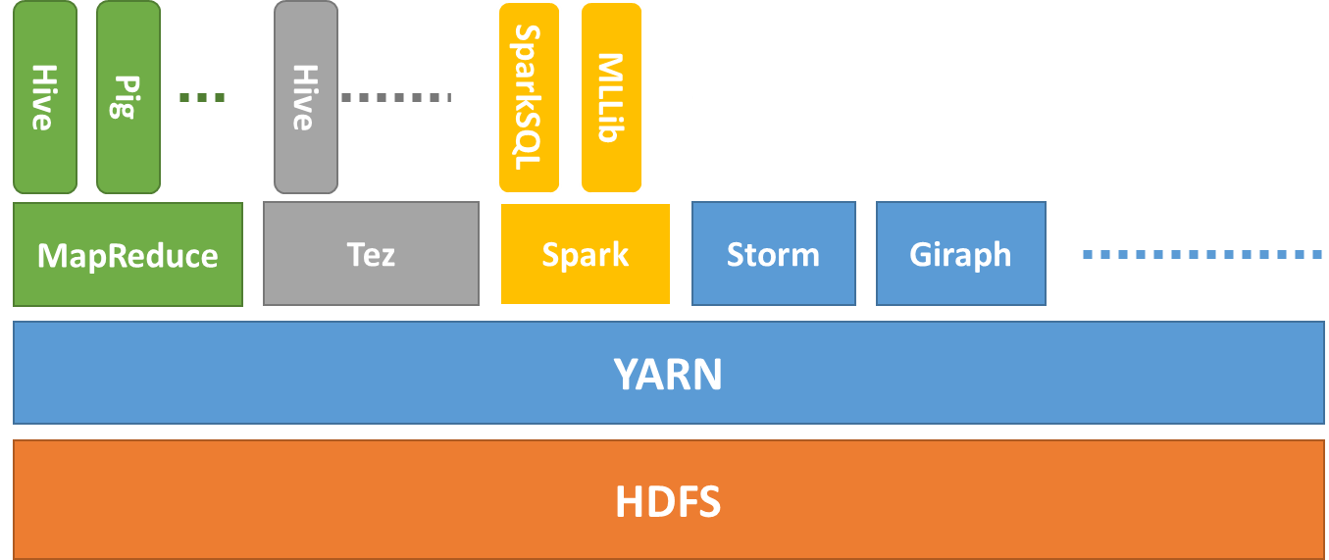




Sherlock Demo
Operations
Visualization
…
…
MRDocker
SprDocker
NFS
Map
Hansken
Hadoop 2.0
cloud

Slide 3
Sherlock Demo
Operations
Visualization
…
…
MRDocker
SprDocker
NFS
Map
Hansken
Hadoop 2.0
cloud

