Slide 1
TDI – eScience Infrastructure
Romulo, Jisk, Niels and Stefan
…Jason…

Slide 2

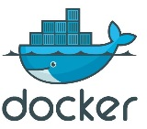

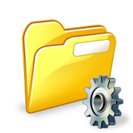

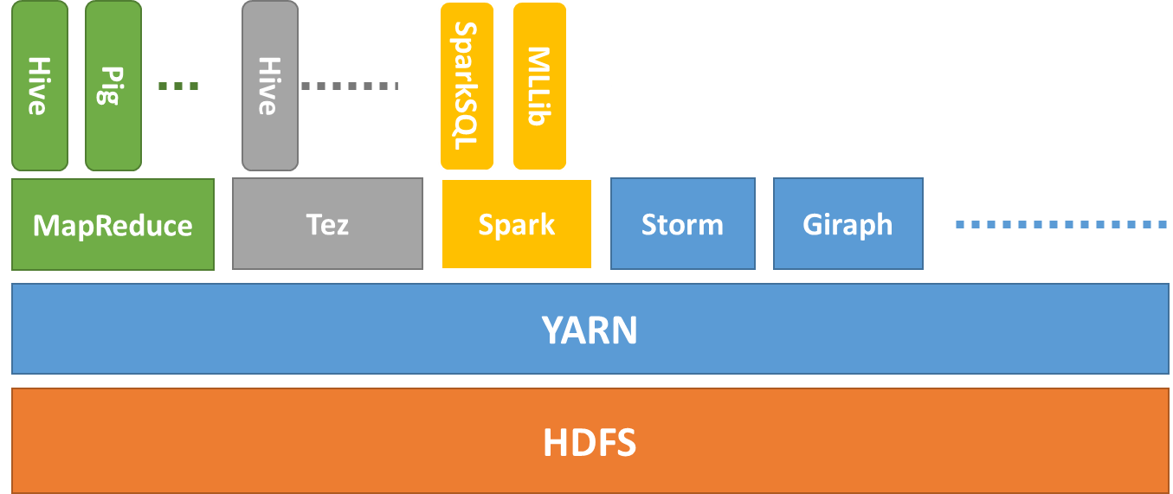


TDI - eScience Infrastructure
By selecting state-of-the-art products we designed
Effective integrated infrastructure
Transparent data ingestion
Stepwise data exploration
Easy to plug visualization tools
Validated by the Sherlock use cases
Ongoing NLeSC technology developments:
In-situ data access for eData, workflow management, etc.
Batch Processing
NoteBooks
Docker Images
File Browser
MRDocker
SprDocker
Docker Swarm
Hadoop 2.0
.txt
.jpg
.shp
.xls
.img
Flask
Data Import
Sequence Avro ORC
PySpark
HDFS

Slide 3
For more info at : https://github.com/nlesc-sherlock/
data_tools_integration
shelly : Create hadoop/spark cluster using Ambari and Docker swarm with Ansible
uplift : Web Application to upload/ingest files into hdfs
hdfs-dfs-client-docker : Docker-based tool capable of interacting with a remote hdfs filesystem
hadoop-streaming-docker : Hadoop streaming python inside docker
yarn-docker : Yarn applications running docker containers
spark-docker : Running docker containers inside Spark.
spark-flask : Webservice which runs sparksql queries in a docker container.

Slide 4
