Slide 1
Scaling SwiftMHC Training: A 100× Speedup Through Systematic Pipeline Optimisation
Cunliang Geng
AI SIG | 2026-05-07

Slide 2
Finding the Bottleneck in PyTorch Training No guesswork: measure first, optimise second
Cunliang Geng
AI SIG | 2026-05-07

Slide 3
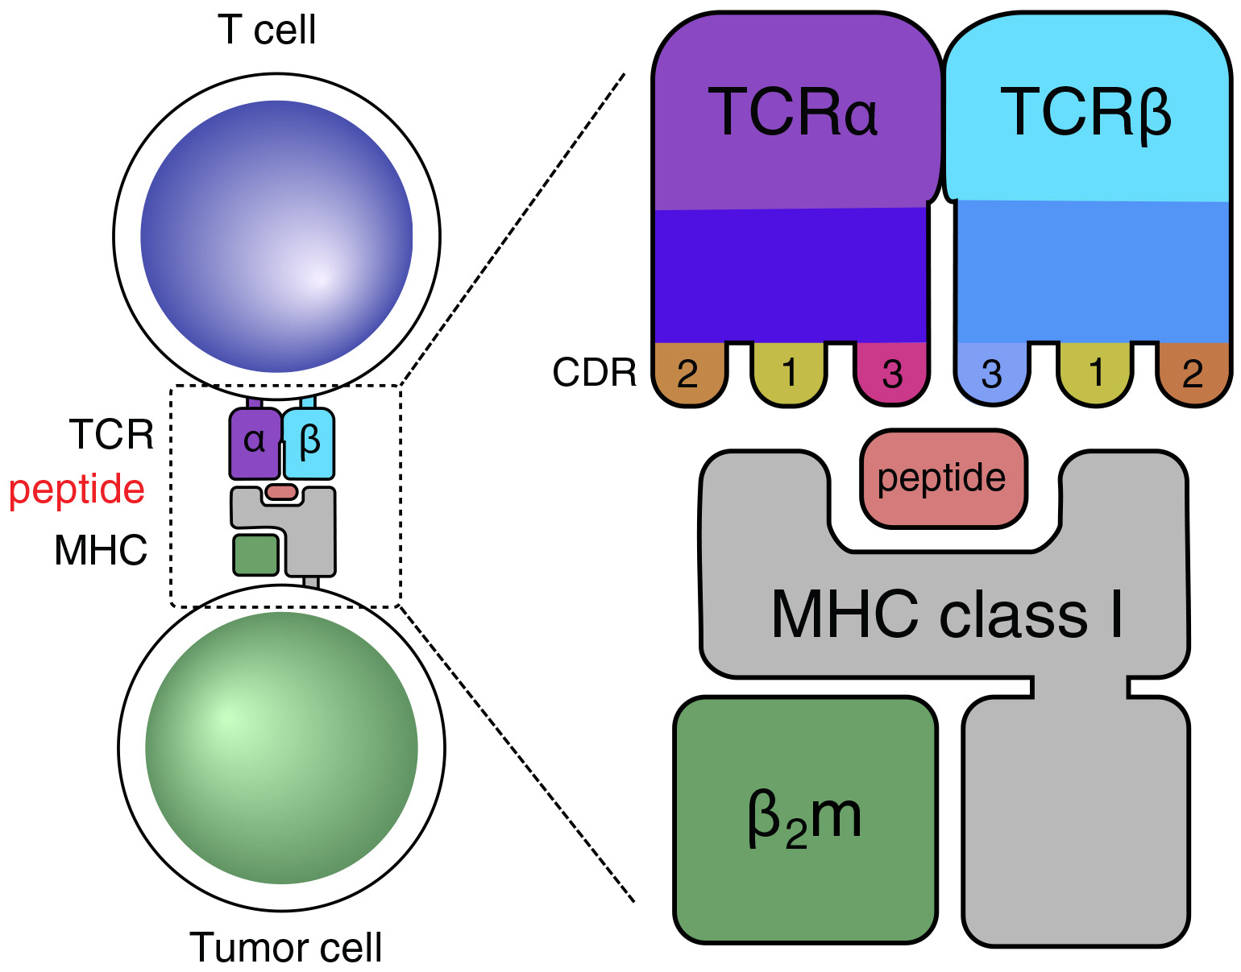
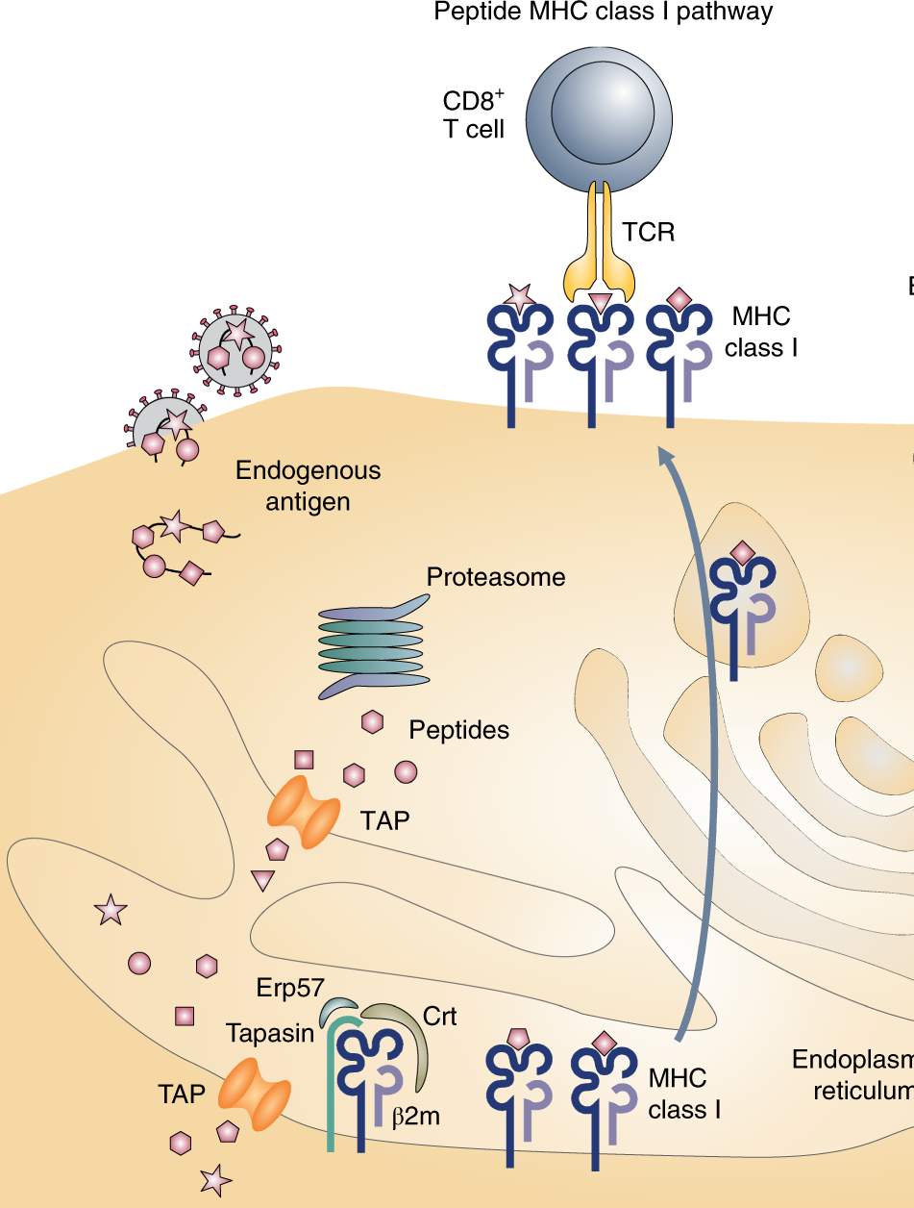
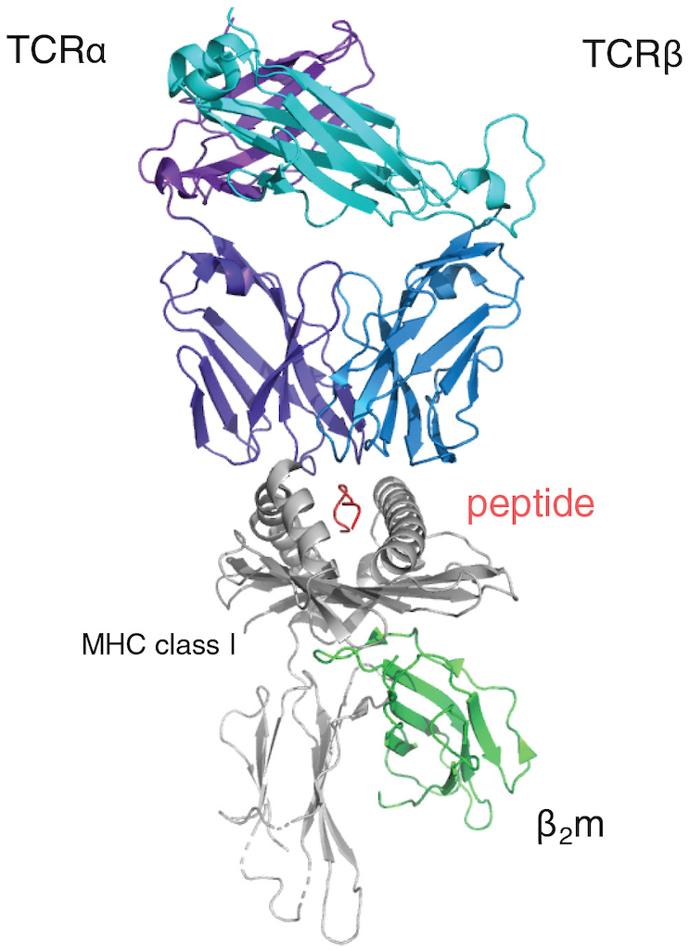
TCR-peptide-MHC complex critical to immune system
Source: www.imgt.org
Major Histocompatibility Complex
Notes:
MHC-peptide complexes are surface structures formed by Major Histocompatibility Complex (MHC) molecules binding short peptide fragments derived from self or foreign proteins.
These complexes are displayed on cell surfaces to be recognized by T-cell receptors (TCRs), serving as the primary mechanism for immune surveillance to identify and initiate responses against pathogens, tumor cells, and foreign tissue.

Slide 4
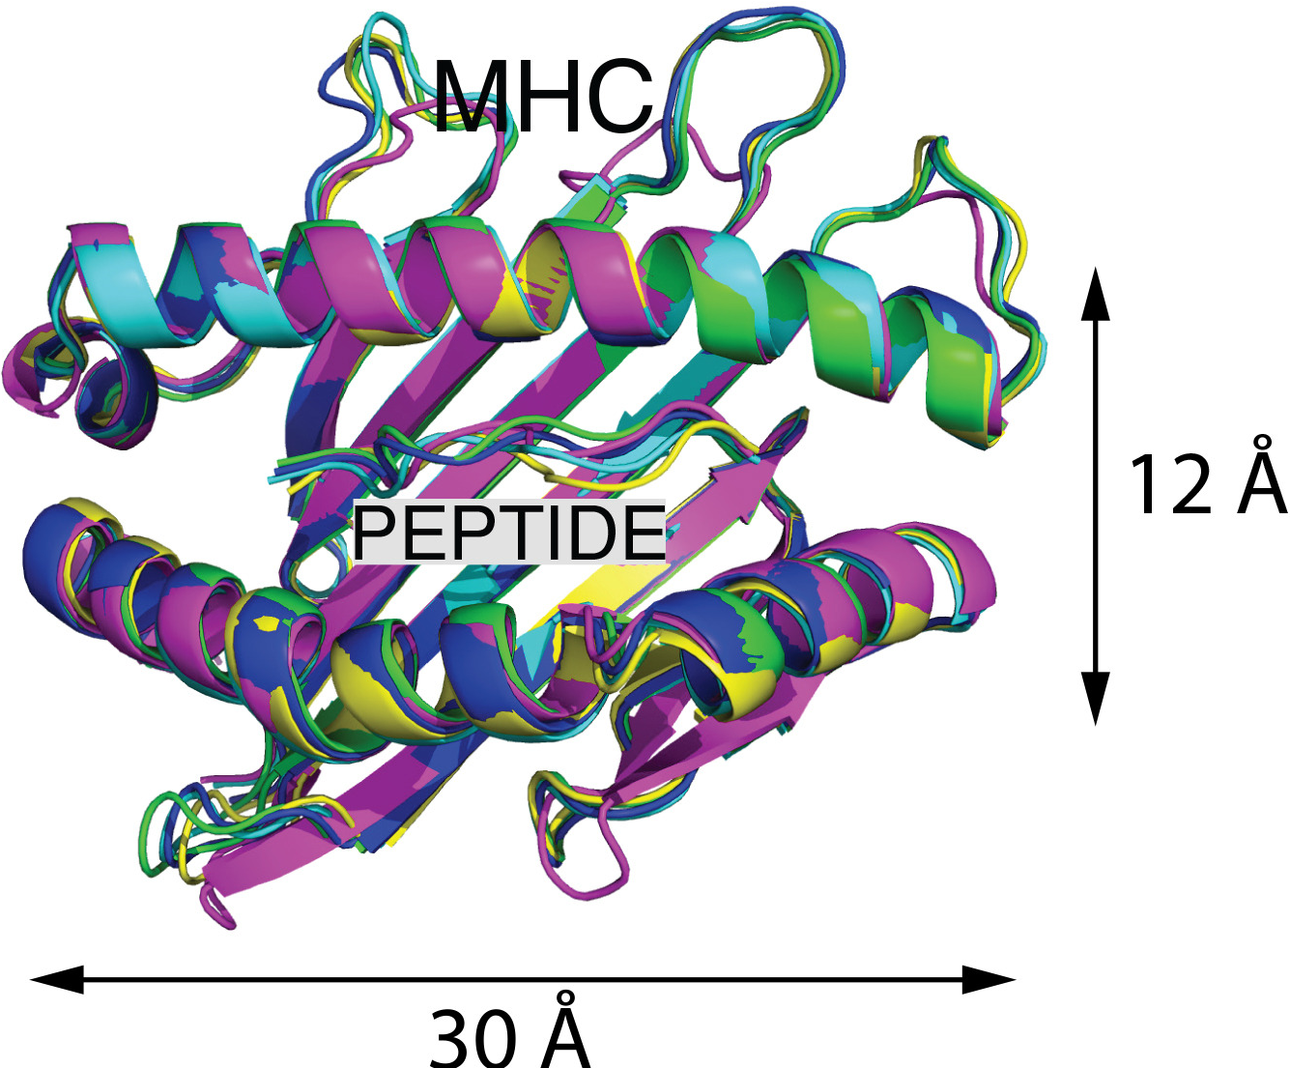
Predicting peptide strongly binding to MHC critical to vaccine design
Notes:
Here we focus on the MHC-peptide interaction, this step determines whether a peptide is presented to TCR or not.

Slide 5

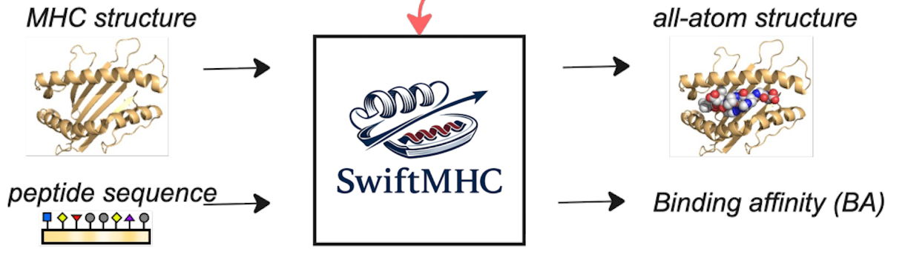

SwiftMHC
Colab is available for quick start
X-lab-3D/swiftmhc-inference
https://colab.research.google.com/github/X-lab-3D/swiftmhc-inference/blob/main/colab/SwiftMHC_colab.ipynb
DOI: 10.1016/j.crmeth.2026.101364
Notes:
SwiftMHC predicts the peptide structure and its affinity binding to the MHC.
It use a transformer-based deep learning architecture.
Codebase: https://github.com/X-lab-3D/swiftmhc-inference
Paper: https://www.cell.com/cell-reports-methods/fulltext/S2667-2375(26)00064-0
Colab: https://colab.research.google.com/github/X-lab-3D/swiftmhc-inference/blob/main/colab/SwiftMHC_colab.ipynb

Slide 6
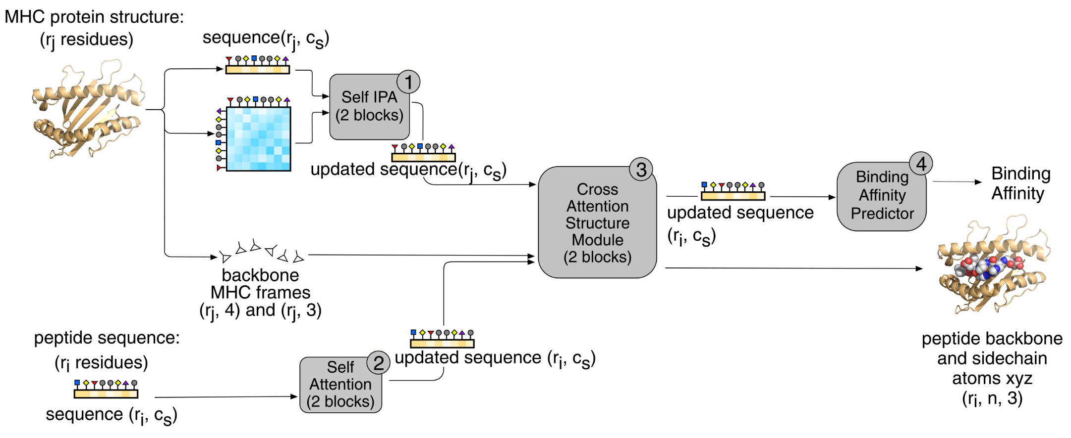
SwiftMHC architecture
Transformer-based architecture
X-lab-3D/swiftmhc-inference
DOI: 10.1016/j.crmeth.2026.101364
Notes:
SwiftMHC predicts the peptide structure and its affinity binding to the MHC.
It use a transformer-based deep learning architecture.
Codebase: https://github.com/X-lab-3D/swiftmhc-inference
Paper: https://www.cell.com/cell-reports-methods/fulltext/S2667-2375(26)00064-0
Colab: https://colab.research.google.com/github/X-lab-3D/swiftmhc-inference/blob/main/colab/SwiftMHC_colab.ipynb

Slide 7
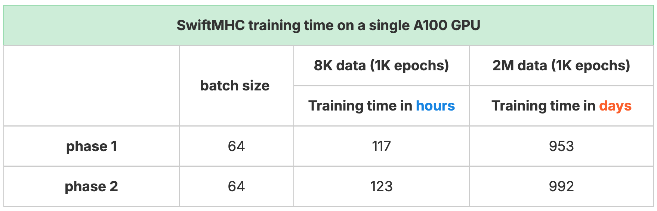
Challenge faced when scaling training set from 8K to 2M
* SwiftMHC training has two phases due to the use of different loss functions.
Training is slow, why?
Notes:
A ML project lifecycle has 3 major stages: data stage, training stage, and deployment stage. Here we focus on the training stage.
IF the size of the training data set is incrased from 8K samples to 2M samples, the training time used is about 2000 days on a single A100 GPU, roughly 5.5 years.
Training is slow, why?
The first misconception: training is just running model on GPUs. Training is slow, so model is slow. Is that correct?

Slide 8
Training pipeline
Data
loading
Data
preprocessing
Data
transfer
Forward
pass
Loss
computation
Backward
pass
Optimizer
step
Logging &
checkpointing
Training is a pipeline, not just “a model runs on GPU”.
If training is slow, any stage in the pipeline could be responsible
Notes:
To understand why training is slow, first we need to understand what happens during a training process.
Training a model is not just ”run the model on GPU”, it’s a pipeline, having multiple stages or steps.
[describe the training process in detail]
The starting point is the training dataset, first one batch of data is sampled from it, then the data batch is loaded from the disk to memory (the data might be stored as a text file or in a HDF5 file on your disk),
After loading, the data might be preprocessed, e.g. calculating some features required for the training, or transforming data to target format, etc
Then, the training-ready data will be transferred to GPU devices, the training of the model will happen on the GPU devices
The yellow blocks are the actual training of the model, one batch of data forward pass the model, then compute the loss, then do the backward pass to compute the gradients, in the end, the optimizer updates the model parameters.
After the model is updated with one batch of data, you may checkpoint the current model and/or record some experiment logs, such as metrics performance, GPU usage, speed performance, etc
This is a whole training process, and next batch of data will go through the same process.
So it is clear to see that if training is slow, any stage in this pipeline could be responsible.

Slide 9
Training pipeline
Data
loading
Data
preprocessing
Data
transfer
Forward
pass
Loss
computation
Backward
pass
Optimizer
step
Logging &
checkpointing
Disk
CPU, Memory
CPU, GPU
GPU, GPU memory, CPU, network
CPU, Disk
I/O: Disk
Memory: host memory, GPU memory
Compute: CPU, GPU
Communication: network
Training is a pipeline across multiple hardware components.
If training is slow, any hardware component could be responsible
Notes:
It is a pipeline across multiple hardware components.
A bottleneck can appear at any stage, and on any component.
Since the bottleneck can be in different stages and different hardware components, guessing is unreliable. That is why we profile.

Slide 10
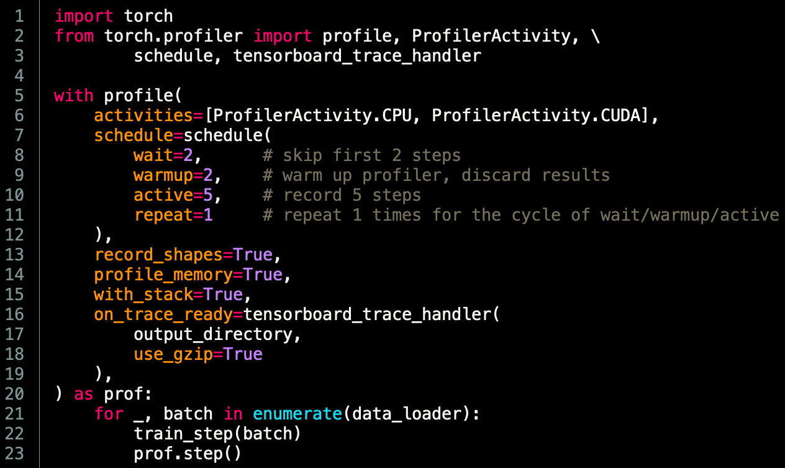
To profile is to measure
PyTorch profiler tells where time is spent and where memory is used
Notes:
Save profiler results as a compressed json file.

Slide 11
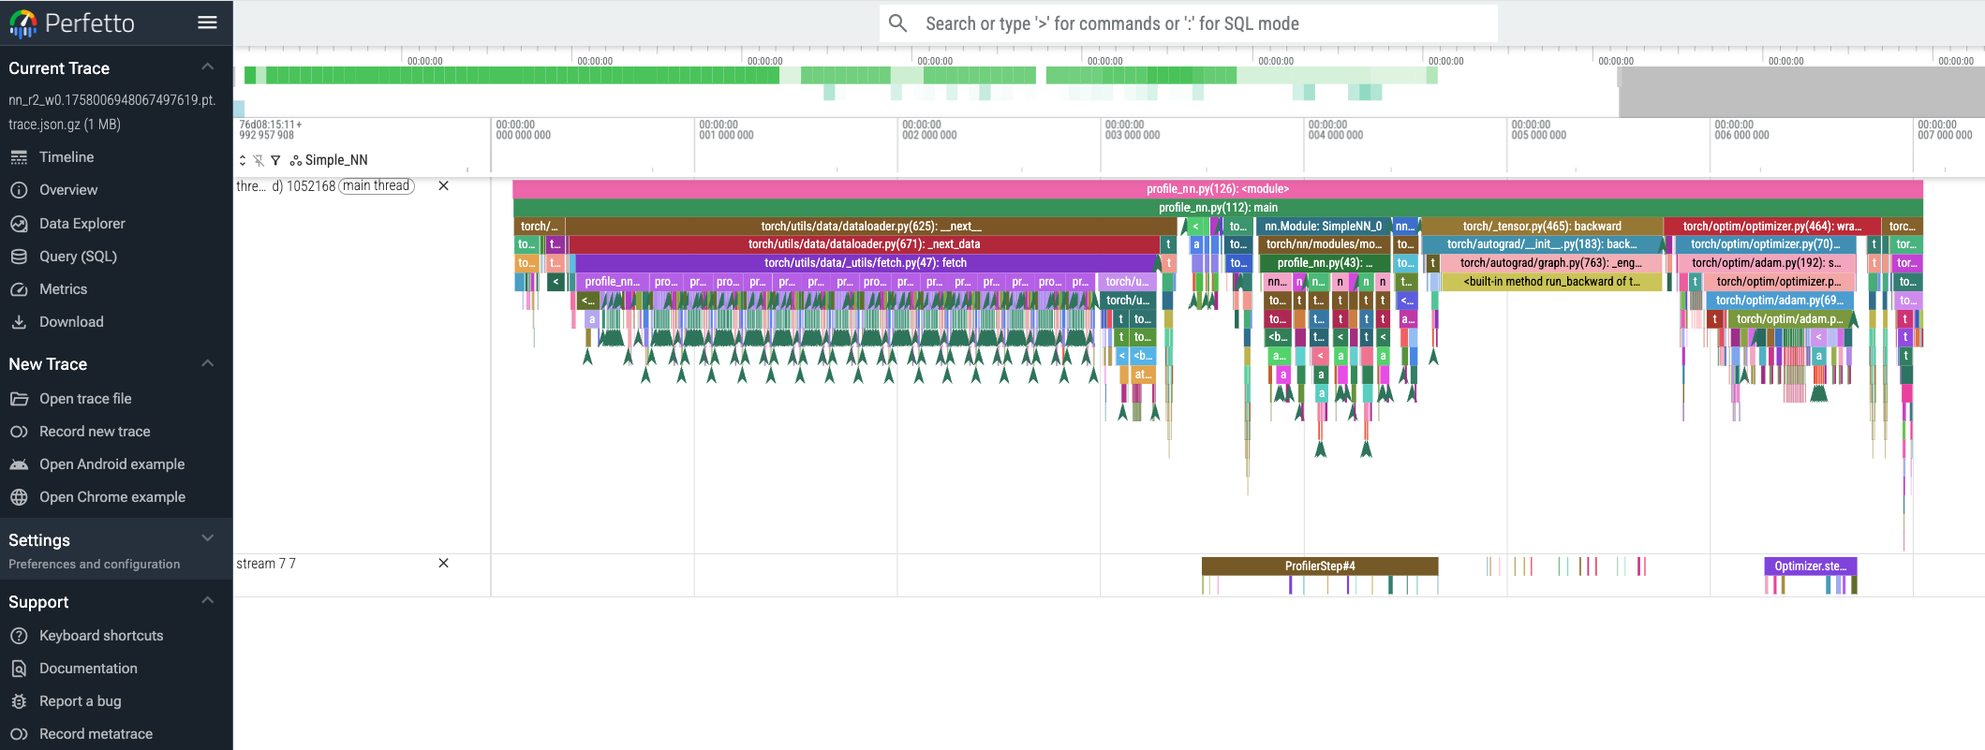
Visualise profile traces
CPU
GPU
Perfetto is a powerful tool to visualise profiler results
https://ui.perfetto.dev/
Notes:
Here is a example for a simple NN.
Demo:
matmul_recordall.1757929075794531861.pt.trace.json.gz
nn_r3_w0.1758007151387493600.pt.trace.json.gz

Slide 12
Holistic Trace Analysis (HTA)
GPU time breakdown:
Idle time
Compute time (e.g. matrix multiplications)
Non-compute time (communication or memory events)
CUDA kernel launch statistics:
Distributions of GPU kernels with
very small duration,
large duration,
and excessive launch time
GPU idle time breakdown:
Host wait
Kernel wait
Other wait
Trace diff:
Compare the frequency and total duration of CPU operators
and GPU kernels from two sets of traces
HTA is a powerful tool to analyse profiler results
https://hta.readthedocs.io/
Notes:
https://hta.readthedocs.io/en/latest/

Slide 13
Comments on profiling tools
PyTorch Profiler is usually the right first tool for diagnosing PyTorch training/inference performance at the Python/application level.
Use Nsight Systems when PyTorch Profiler points to CPU/GPU overlap, data transfer, GPU under-utilization, or distributed/system-level issues.
Use Nsight Compute when you need to diagnose at CUDA-kernel-level or are developing/customizing kernels.
Do not use the deprecated PyTorch Profiler TensorBoard integration; use Perfetto for profiler traces.
Note TensorBoard itself is not deprecated and can still be used for training metrics and experiment visualization.
Notes:
https://hta.readthedocs.io/en/latest/

Slide 14
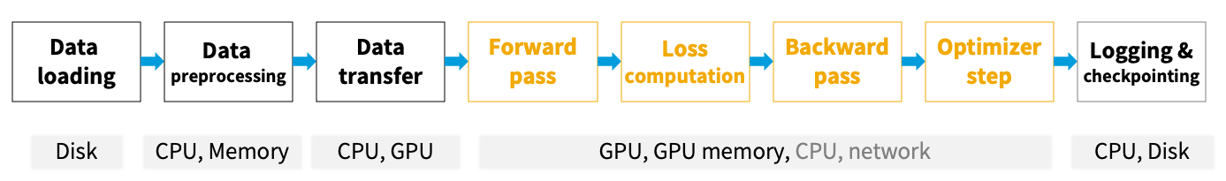
Example pattern 1: slow data preparing
Possible symptoms:
CPU is busy, and DataLoader takes a long time
GPU is idle, and there are gaps between each batch
Possible causes:
Slow data loading
Slow data preprocessing
Slow data transfer
Optimisation:
Store data on disk with faster I/O, or on temp RAM if training data is small
Use multiple CPUs and enable persistent workers
Load data to CPU memory with pinned memory. DO NOT directly load data to GPU memory.
Use non-blocking transfer
Optimise preprocessing computations
SwiftMHC:
53 ms/sample → 16 ms/sample

Slide 15
Pattern 2: out of memory (OOM)
Possible symptoms:
Batch size is small
GPU OOM if increasing batch size
Memory usage is low most of time, and peak memory is high
Possible causes:
GPU memory constraint
Some stages or operations have much higher memory usage than others
Optimisation:
Optimise the stages or operations with high memory usage
Use mixed precision (BF16)
Use gradient checkpointing
SwiftMHC:
peak memory 23GB (batch size 64) → 13GB (bs 2048)

Slide 16
Pattern 3: tiny operations
Possible symptoms:
GPU usage is low
Many gaps on GPU profile trace
Possible causes:
Tiny operations in forward pass and/or loss computation
Optimisation:
Vectorize operations
Merge operations
Try `torch.compile` on forward pass and loss functions
SwiftMHC:
53 ms/sample → 6 ms/sample

Slide 17
Pattern 4: overhead
Possible symptoms:
Logging and checkpointing takes a long time
Metrics computation takes longer time when batch size goes up
GPU is idle during logging and checkpointing
Possible causes:
Slow logging, checkpointing or metrics computation
Optimisation:
Optimise the metrics computation, e.g. vectorize and merge operations, reduce repeated compuations and retrieval
Reduce the frequency of logging and checkpointing
Simplify the content for logging and checkpointing
SwiftMHC:
RMSD compuation overhead (bs 2048)
27ms → 0.7ms

Slide 18
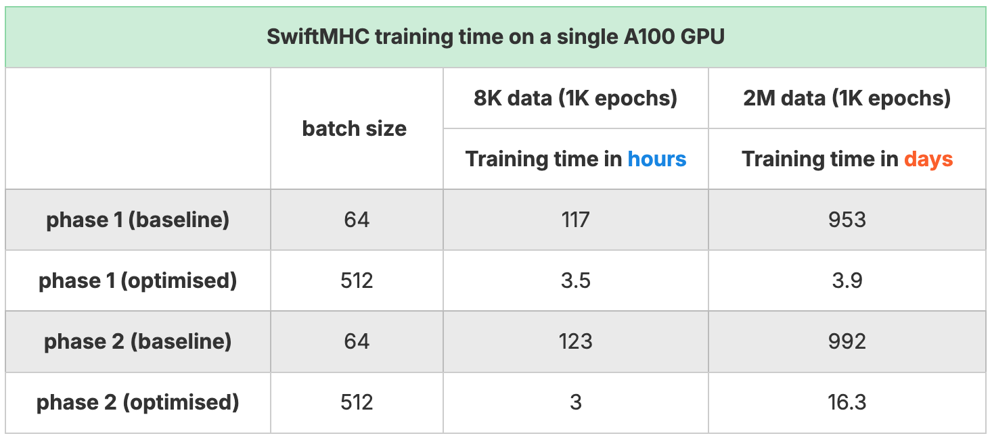
SwiftMHC results after optimisation
Training on 2M dataset:
2000 days → 20 days

Slide 19
Take home message
Training is a pipeline: multiple stages, different hardware
Training bottleneck: profile first, optimise second, no guesswork
Everything counts at scale

Slide 20




Acknowledgements
Coos Baakman
Li Xue
Daniel Rademaker
David Frühbuß
Yannick J.M. Aarts
Giulia Crocioni
Bart Schilperoort

Slide 21

Thank you!
Cunliang Geng
c.geng@esciencecenter.nl

