Slide 1
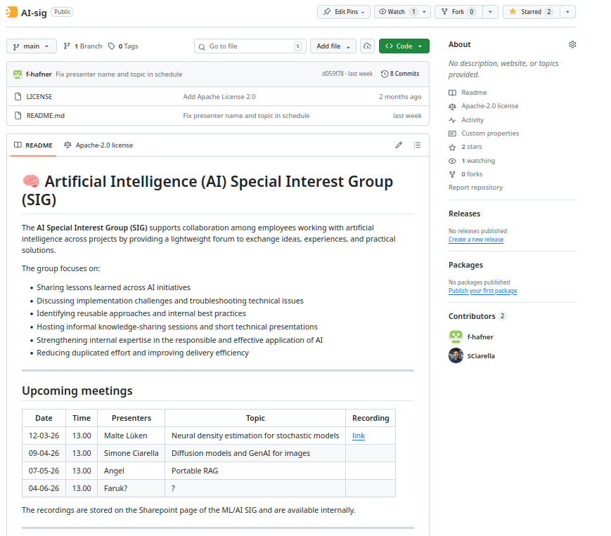

Slide 2
Diffusion models for synthetic data generation
Based on the XAI4SFM project (Simone Ciarella, Elena Ranguelova)
Simone Ciarella

Slide 3
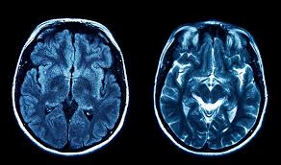
The Problem that starts everything
Example from XAI4SFM
Healthy or not?
Can we train a classifier?

Slide 4
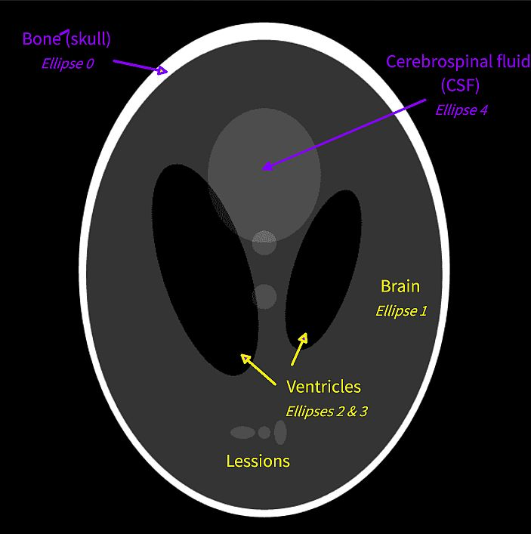
The Problem that starts everything
Shepp-Logan phantom (deterministic)
Healthy or not?
Can we train a classifier?

Slide 5
The Problem that starts everything
Shepp-Logan phantom (deterministic)
Healthy or not?
Can we train a classifier?
Use AI to generate training data

Slide 6
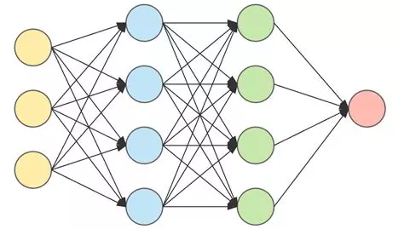
How to generate an image
Typical neural network
Some input
(prompt, data, ?)
image

Slide 7
How to generate an image
Some input
(prompt, data, ?)
image
How do you train this?
No labeled data or well defined loss

Slide 8
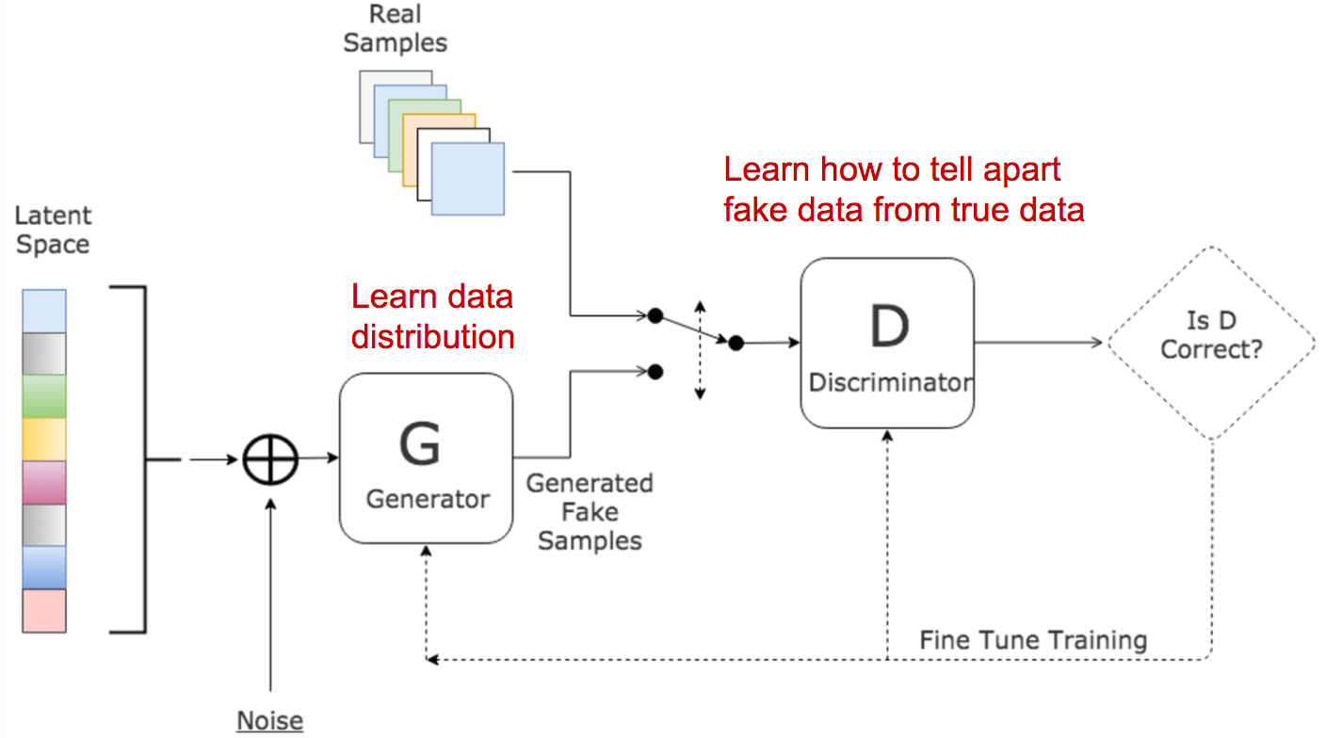
Generative Adversarial Networks GANs
https://lilianweng.github.io/posts/2017-08-20-gan/

Slide 9
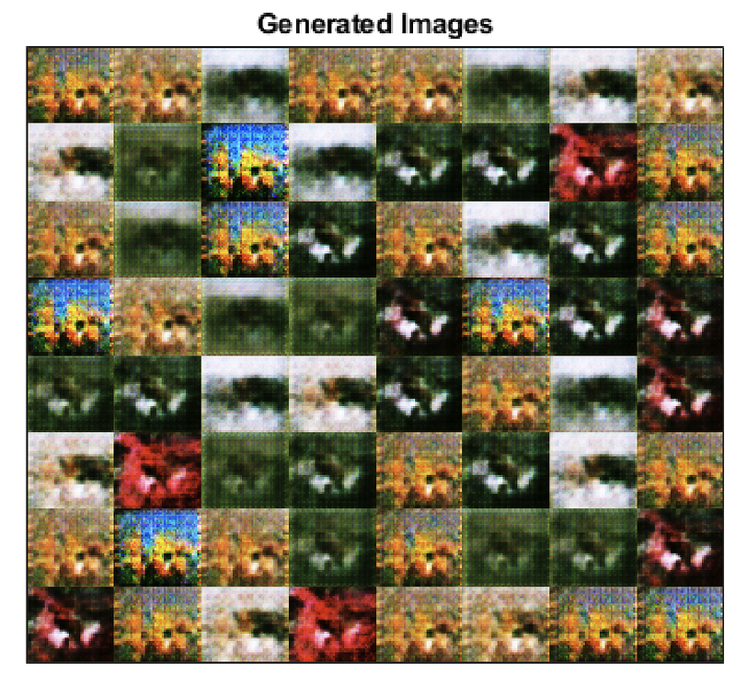
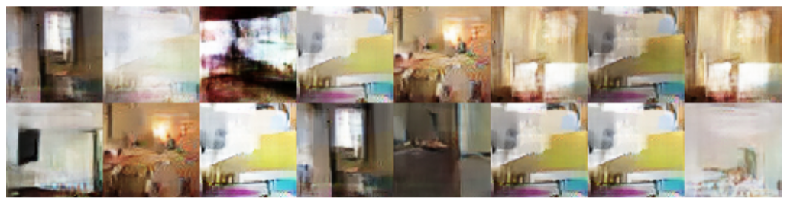
Why GANs fail
Discriminator too strong ----> no gradient because it is always correct (vanishing gradient)
Vanishing gradient: Arjovsky, Martin, and Léon Bottou. "Towards principled methods for training generative adversarial networks." arXiv preprint arXiv:1701.04862 (2017).
Generator finds a strong solution ----> it tends to repeat that too much (mode collapse)
Mode collapse: Arjovsky, Martin, Soumith Chintala, and Léon Bottou. "Wasserstein generative adversarial networks." International conference on machine learning. Pmlr, 2017.
https://lilianweng.github.io/posts/2017-08-20-gan/

Slide 10
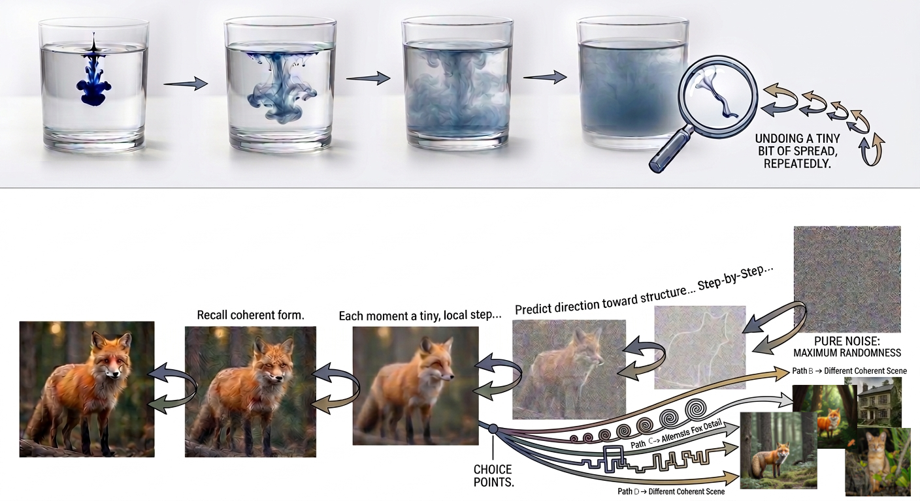
Diffusion models

Slide 11
Diffusion models
Step by step undo diffusion

Slide 12
Diffusion models
Step by step undo diffusion

Slide 13
Diffusion models
Step by step undo diffusion

Slide 14
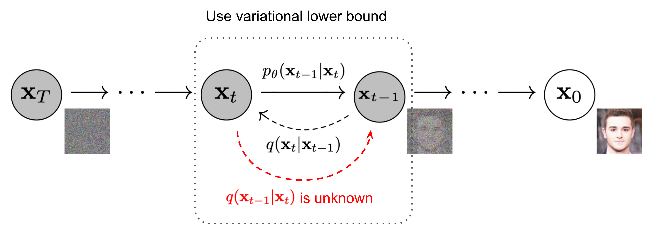
Diffusion models
DDPM: Ho, Jonathan, Ajay Jain, and Pieter Abbeel. "Denoising diffusion probabilistic models." Advances in neural information processing systems 33 (2020): 6840-6851.

Slide 15
Diffusion models
Forward process q(t|t-1) is gaussian (gaussian can be combined easily)
DDPM: Ho, Jonathan, Ajay Jain, and Pieter Abbeel. "Denoising diffusion probabilistic models." Advances in neural information processing systems 33 (2020): 6840-6851.

Slide 16
Diffusion models
Forward process q(t|t-1) is gaussian (gaussian can be combined easily)
We try to learn the reverse p_theta
DDPM: Ho, Jonathan, Ajay Jain, and Pieter Abbeel. "Denoising diffusion probabilistic models." Advances in neural information processing systems 33 (2020): 6840-6851.

Slide 17
Diffusion models
Forward process q(t|t-1) is gaussian (gaussian can be combined easily)
We try to learn the reverse p_theta, but how to train if reverse process is unknown?
DDPM: Ho, Jonathan, Ajay Jain, and Pieter Abbeel. "Denoising diffusion probabilistic models." Advances in neural information processing systems 33 (2020): 6840-6851.

Slide 18
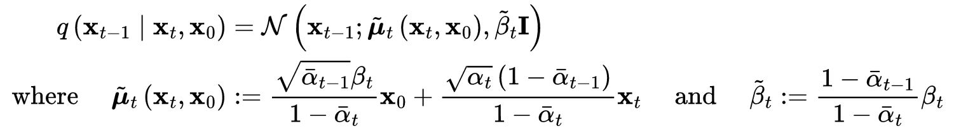
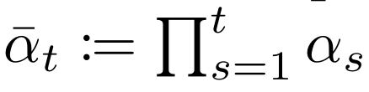

Diffusion models
Turns out that the rev process is this (tractable only if conditioned on x0 too)
DDPM: Ho, Jonathan, Ajay Jain, and Pieter Abbeel. "Denoising diffusion probabilistic models." Advances in neural information processing systems 33 (2020): 6840-6851.

Slide 19
Diffusion models
Turns out that the rev process is this (tractable only if conditioned on x0 too)
So we make this choice of model
DDPM: Ho, Jonathan, Ajay Jain, and Pieter Abbeel. "Denoising diffusion probabilistic models." Advances in neural information processing systems 33 (2020): 6840-6851.

Slide 20
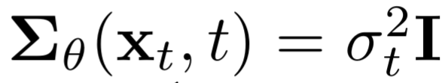
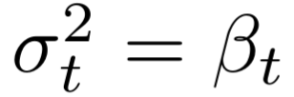
Diffusion models
Turns out that the rev process is this (tractable only if conditioned on x0 too)
So we make this choice of model
No training!
DDPM: Ho, Jonathan, Ajay Jain, and Pieter Abbeel. "Denoising diffusion probabilistic models." Advances in neural information processing systems 33 (2020): 6840-6851.

Slide 21
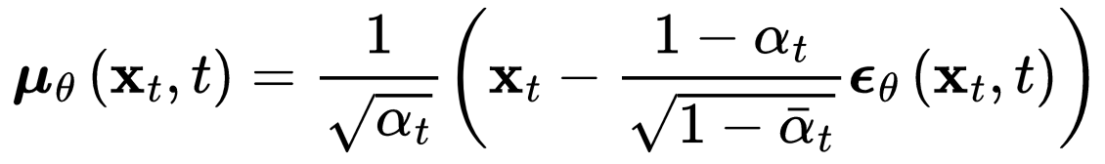
Diffusion models
Turns out that the rev process is this (tractable only if conditioned on x0 too)
So we make this choice of model
No training!
DDPM: Ho, Jonathan, Ajay Jain, and Pieter Abbeel. "Denoising diffusion probabilistic models." Advances in neural information processing systems 33 (2020): 6840-6851.

Slide 22
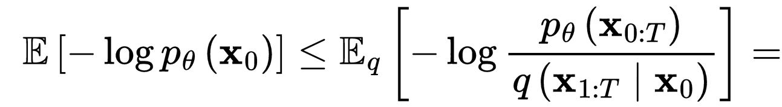
Training Diffusion models
Minimize variational lower bound (KL divergence) =
maximizing the likelihood that we reconstruct data (x0) from denoising procedure
DDPM: Ho, Jonathan, Ajay Jain, and Pieter Abbeel. "Denoising diffusion probabilistic models." Advances in neural information processing systems 33 (2020): 6840-6851.

Slide 23
Training Diffusion models
Minimize variational lower bound (KL divergence) =
maximizing the likelihood that we reconstruct data (x0) from denoising procedure
DDPM: Ho, Jonathan, Ajay Jain, and Pieter Abbeel. "Denoising diffusion probabilistic models." Advances in neural information processing systems 33 (2020): 6840-6851.

Slide 24
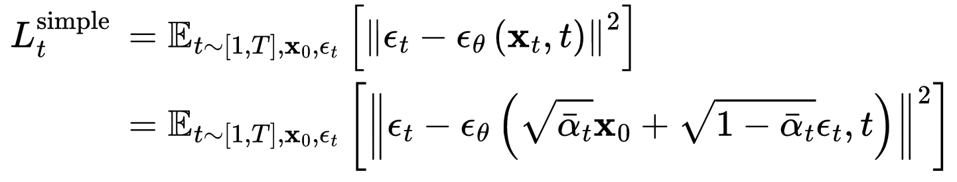
Training Diffusion models
Trick from
DDPM: Ho, Jonathan, Ajay Jain, and Pieter Abbeel. "Denoising diffusion probabilistic models." Advances in neural information processing systems 33 (2020): 6840-6851.
It Is just a MSE!

Slide 25
Training Diffusion models
Trick from
DDPM: Ho, Jonathan, Ajay Jain, and Pieter Abbeel. "Denoising diffusion probabilistic models." Advances in neural information processing systems 33 (2020): 6840-6851.
It Is just a MSE!
Since xt is gaussian we only need x0!
(no need to store xt)

Slide 26
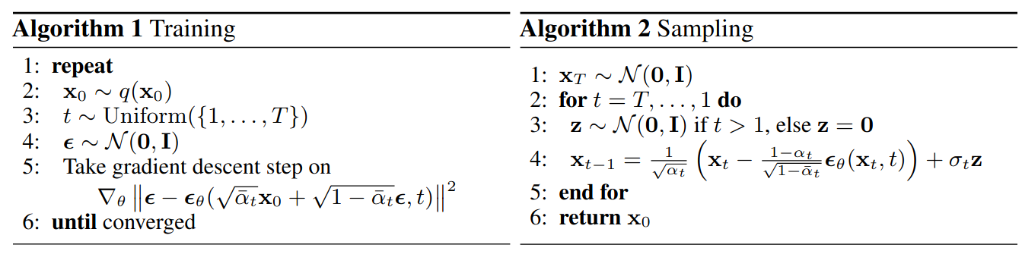
Diffusion models (recap)
DDPM: Ho, Jonathan, Ajay Jain, and Pieter Abbeel. "Denoising diffusion probabilistic models." Advances in neural information processing systems 33 (2020): 6840-6851.

Slide 27
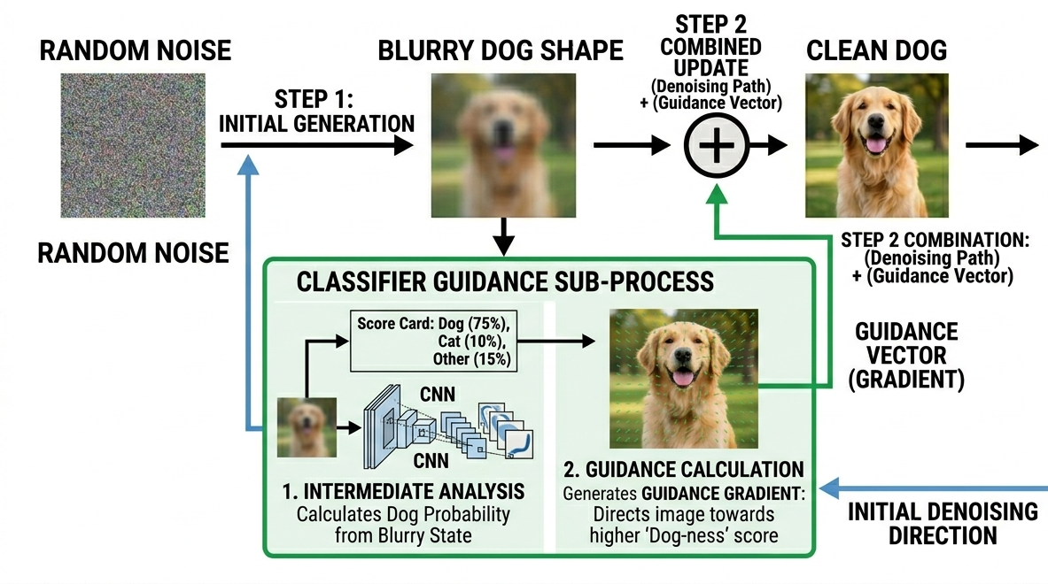
How to drive the generation
But you need a classifier that knows about your data!

Slide 28

How to drive the generation
“A Dog”
Ho, Jonathan, and Tim Salimans. "Classifier-free diffusion guidance." arXiv preprint arXiv:2207.12598 (2022).

Slide 29
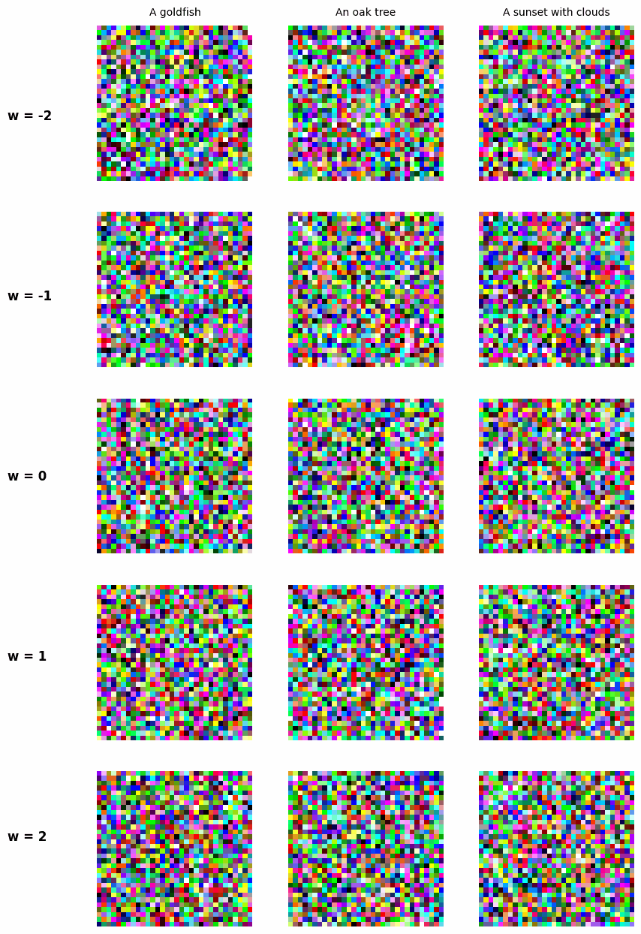
DIY results
Check my DIY implementation:
github.com/NLeSC-Knowledge-Development/xNoise
No way this can generate realistic data

Slide 30
The Hugging Face route
Follow here: github.com/NLeSC-Knowledge-Development/fine-data-generation

Slide 31
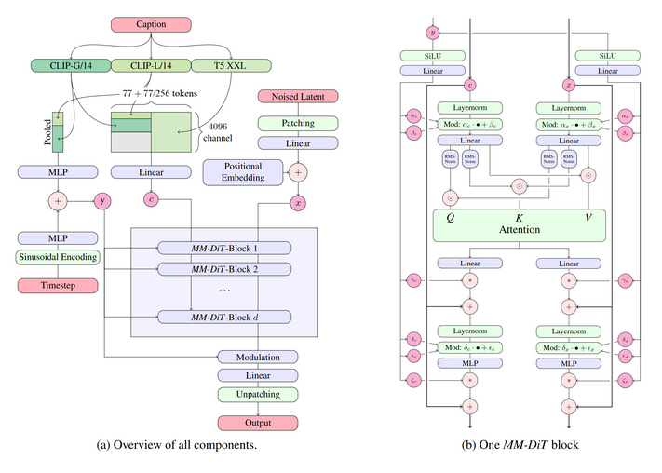
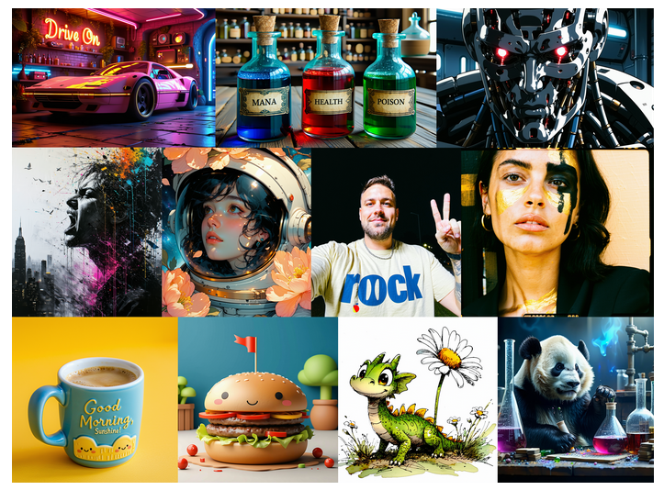
The Hugging Face route
Follow here: github.com/NLeSC-Knowledge-Development/fine-data-generation
- Pick a pretrained diffusion model on Hugging Face (Stable Diffusion 3.5)

Slide 32


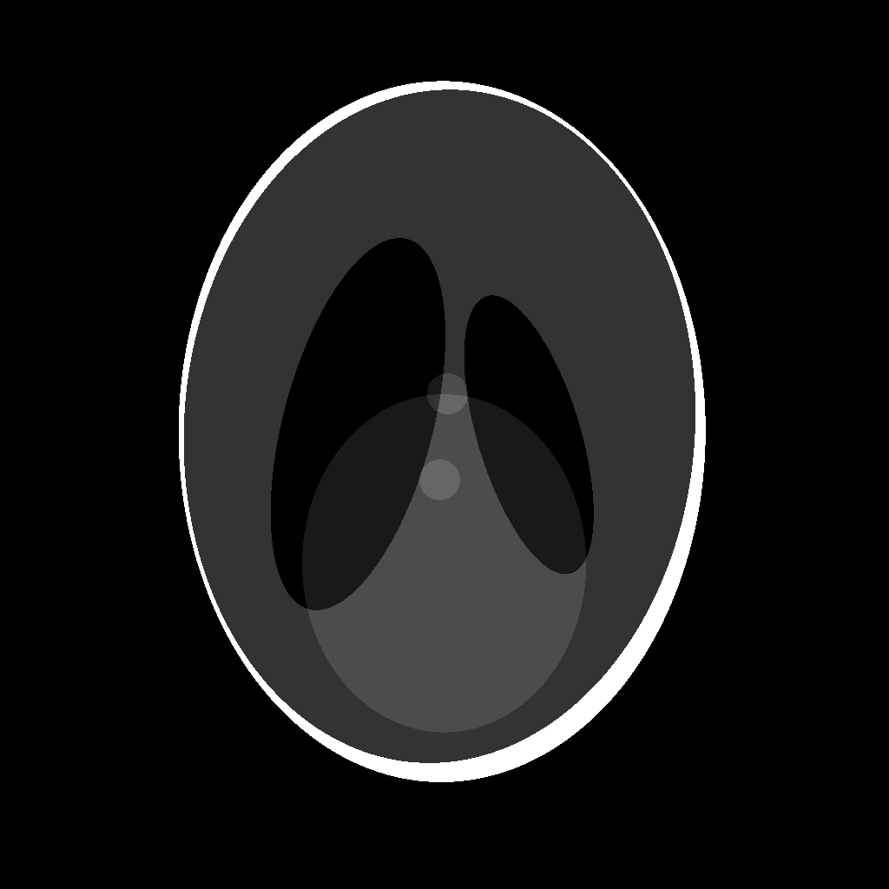
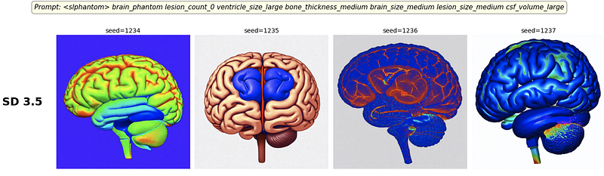
The Hugging Face route
Follow here: github.com/NLeSC-Knowledge-Development/fine-data-generation
- Pick a pretrained diffusion model on Hugging Face (Stable Diffusion)
- Prepare your own dataset for fine tuning (you can go down to ~10 samples!)
Each one needs its own annotation

Slide 33
The Hugging Face route
Follow here: github.com/NLeSC-Knowledge-Development/fine-data-generation
- Pick a pretrained diffusion model on Hugging Face (Stable Diffusion)
- Prepare your own dataset for fine tuning
- Set up the training environment (Diffusers, Transformers, Accelerate)

Slide 34
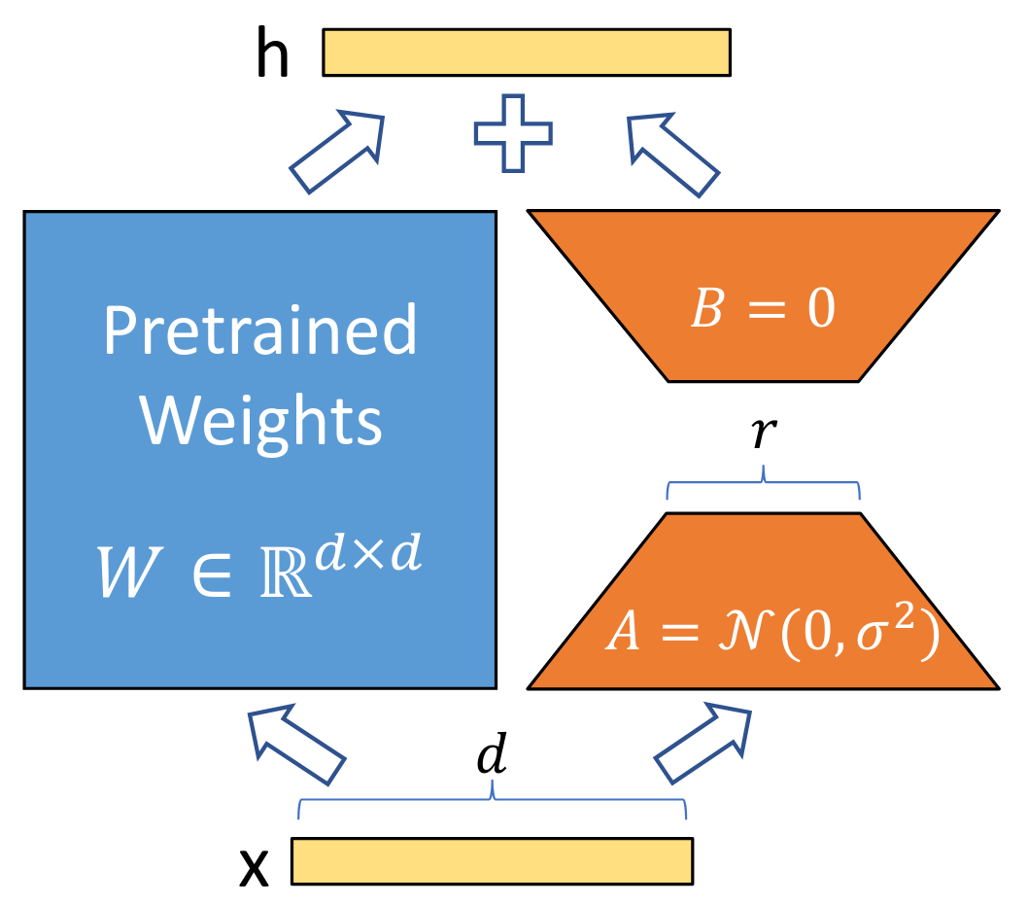
The Hugging Face route
Follow here: github.com/NLeSC-Knowledge-Development/fine-data-generation
- Pick a pretrained diffusion model on Hugging Face (Stable Diffusion)
- Prepare your own dataset for fine tuning
- Set up the training environment (Diffusers, Transformers, Accelerate)
- Launch a LoRA fine-tuning job by choosing a few key settings such as learning rate, image resolution, batch size, and number of training steps
Only train A and B ( r<<d )
Hu, Edward J., et al. "Lora: Low-rank adaptation of large language models." Iclr 1.2 (2022): 3.

Slide 35
The Hugging Face route
Follow here: github.com/NLeSC-Knowledge-Development/fine-data-generation
- Pick a pretrained diffusion model on Hugging Face (Stable Diffusion)
- Prepare your own dataset for fine tuning
- Set up the training environment (Diffusers, Transformers, Accelerate)
- Launch a LoRA fine-tuning job by choosing a few key settings such as learning rate, image resolution, batch size, and number of training steps
- Load the trained LoRA weights back into the base model
Base model (SD3.5): too generic

Slide 36
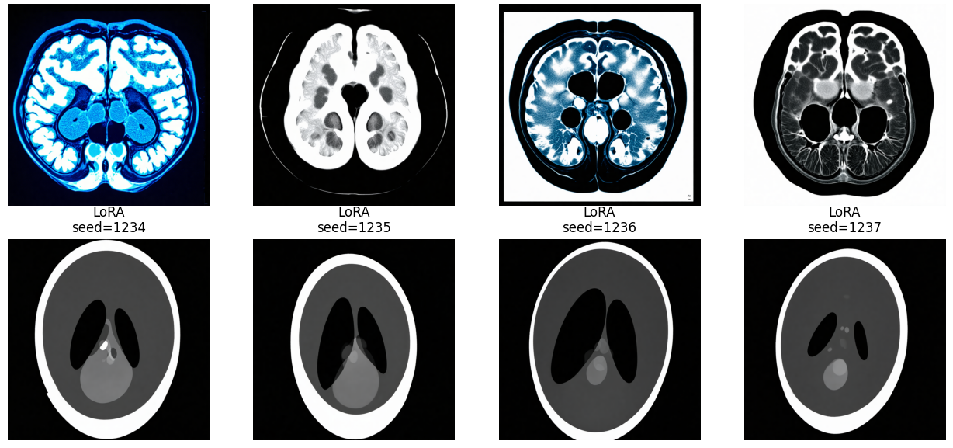
The Hugging Face route
Follow here: github.com/NLeSC-Knowledge-Development/fine-data-generation
- Pick a pretrained diffusion model on Hugging Face (Stable Diffusion)
- Prepare your own dataset for fine tuning
- Set up the training environment (Diffusers, Transformers, Accelerate)
- Launch a LoRA fine-tuning job by choosing a few key settings such as learning rate, image resolution, batch size, and number of training steps
- Load the trained LoRA weights back into the base model
Base model (SD3.5): too generic
Base model + LoRA

Slide 37
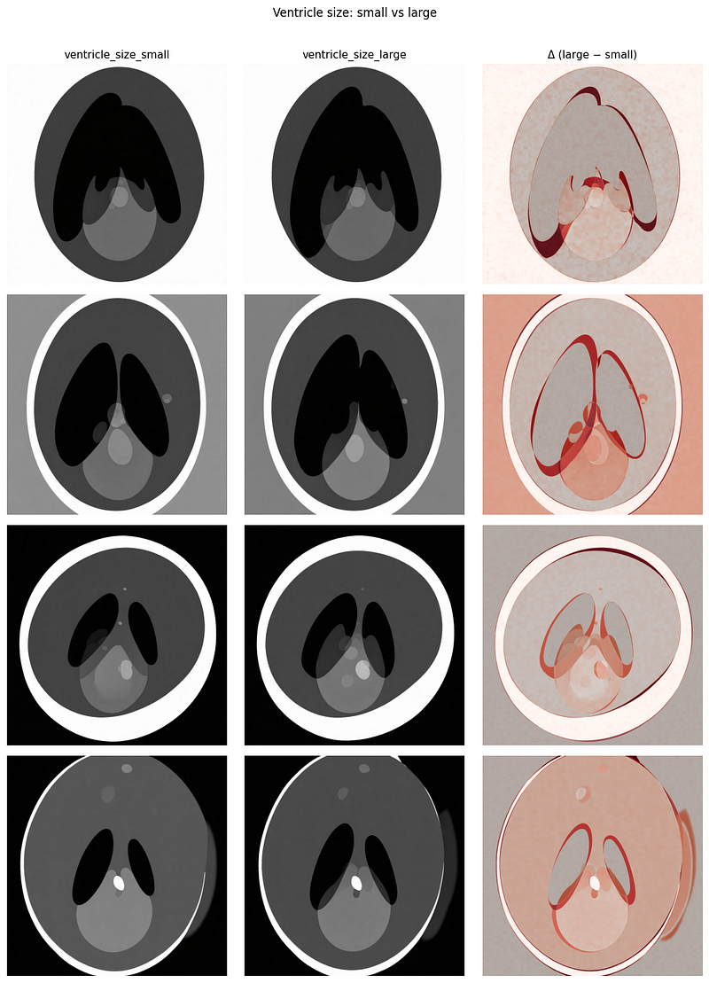
(bonus) “Explainability”
Small Ventricles
Large Ventricles
Diff
Manipulate the prompt to manipulate the generated sample

Slide 38
Conclusion
Why are we using diffusion models and how they work
You can code them yourself
But you can also rely on tools like Hugging Face
Workflow to generate your own synthetic data
github.com/NLeSC-Knowledge-Development/xNoise
github.com/NLeSC-Knowledge-Development/fine-data-generation

