Slide 1
Overview on Quantum Gates – Part II
Quantum Computing SIG - May 11th 2023
Carlos

Slide 2
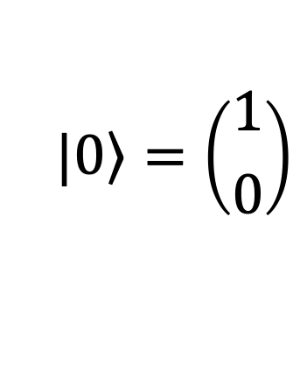
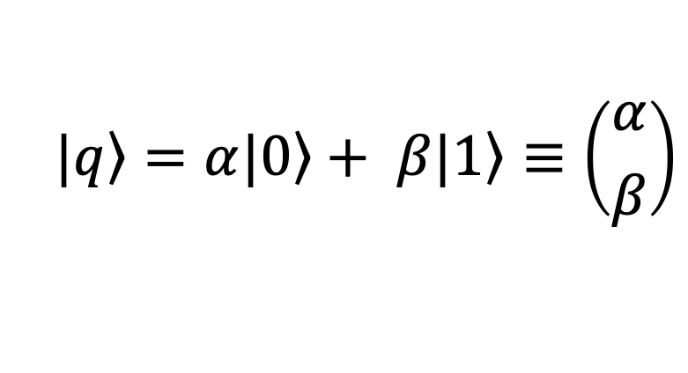
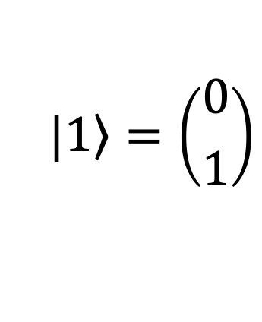
Qubits as vectors; Gates as matrices
Basis vectors
$$\left.|0\right\rangle =\left({1 \atop 0}\right)$$
$$\left.|1\right\rangle =\left({0 \atop 1}\right)$$
Pauli X, Y, Z
Hadamard
Superposition
$$\left.|q\right\rangle =α\left.|0\right\rangle + β\left.|1\right\rangle ≡\left({α \atop β}\right)$$
Rotation

Slide 3
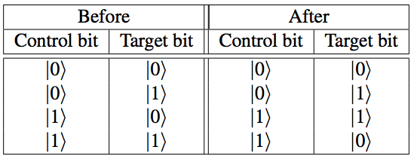
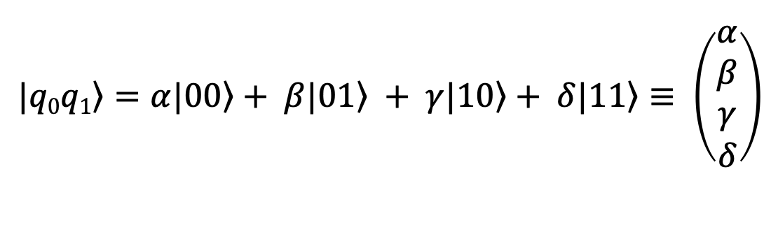
Two-qubit gates
Superposition
$$\left.|q0q1\right\rangle =α\left.|00\right\rangle + β\left.|01\right\rangle + γ\left.|10\right\rangle + δ\left.|11\right\rangle ≡ \left(\begin{matrix}α \\ β \\ γ \\ δ\end{matrix}\right)$$
Controlled NOT
Example:
Truth table of CX

Slide 4
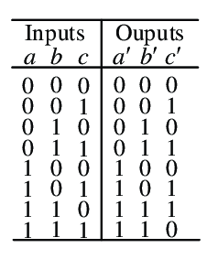
Other multi-qubit gates
Truth table of Toffoli or CCNOT

Slide 5
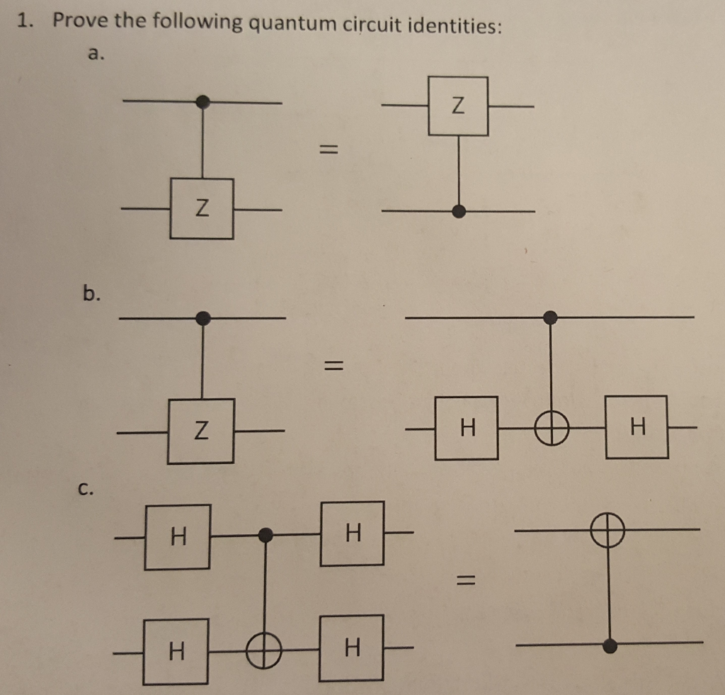
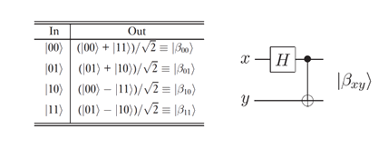
Useful definitions
HXH = Z
HYH = -Y
HZH = X
Curcuit Identitites:
Bell states

Slide 6
LAB
Let’s play with a few quantum gates using IBM quantum composer
(https://quantum-computing.ibm.com/composer)

Slide 7
Applications

Slide 8
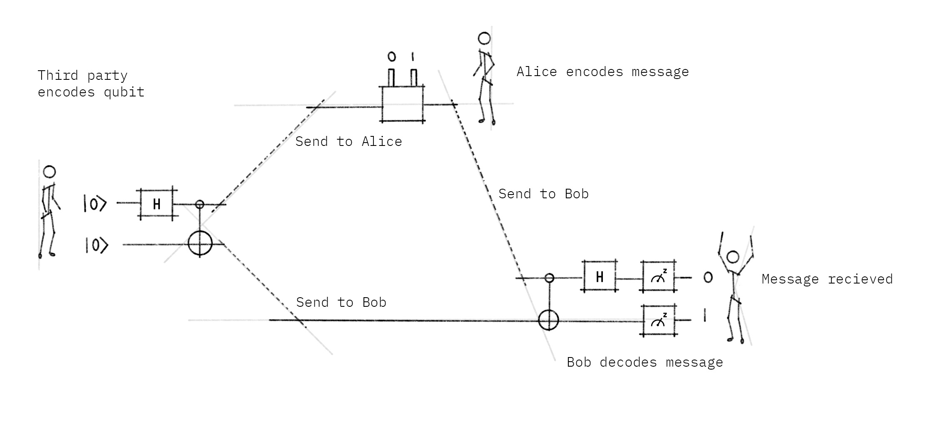
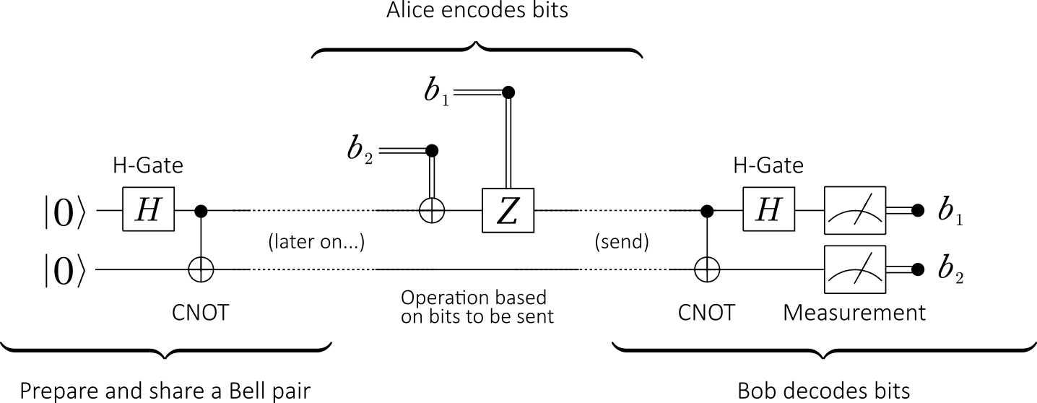
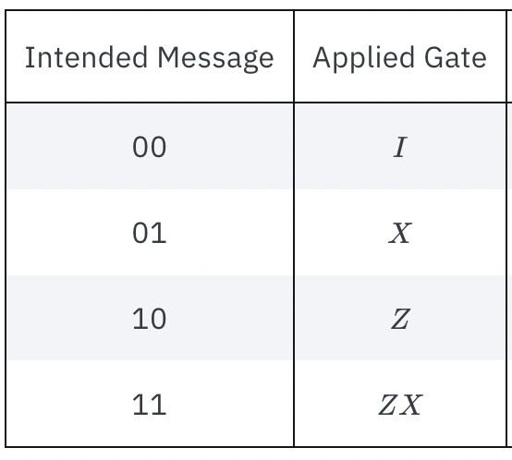
Superdense coding
transmit two classical bits using one qubit
Alice operation
(b₁b₂)

Slide 9
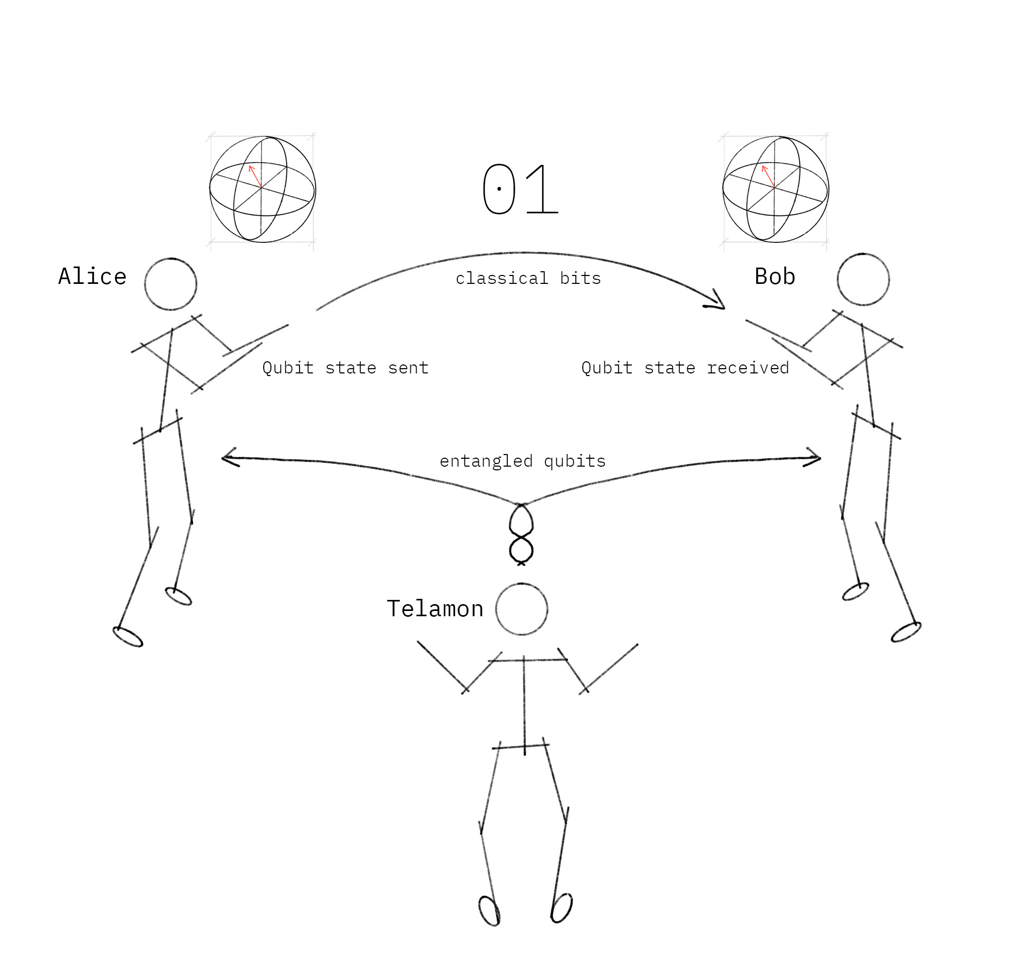
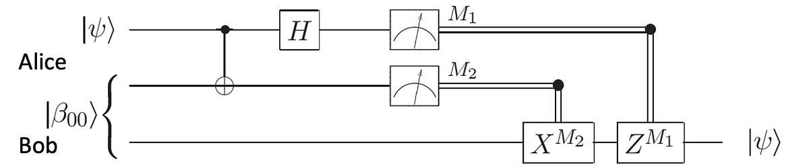
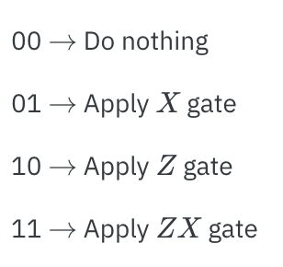
Quantum teleportation
transmit one qubit using two classical bits
Bob operation

Slide 10
See you next SIG
www.eScienceCenter.nl
info@esciencecenter.nl
+31 (0)20 460 4770

