Slide 1
Overview on Quantum Gates
Quantum Computing SIG - April 13th 2023
Carlos

Slide 2
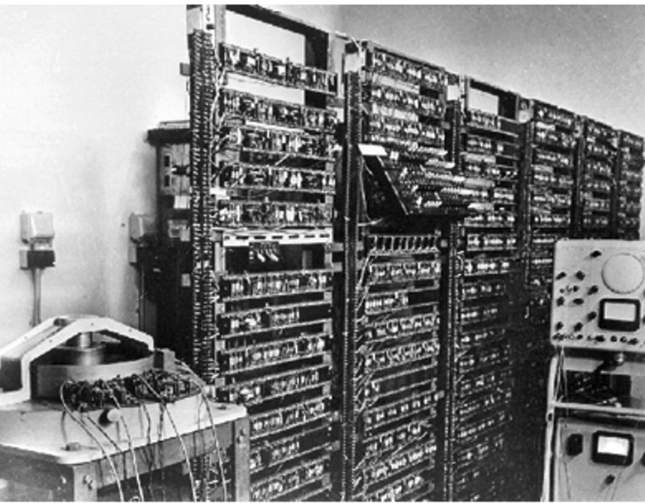
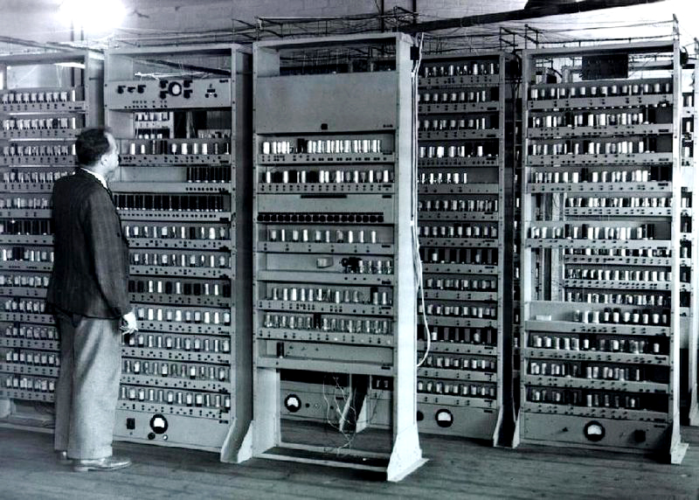
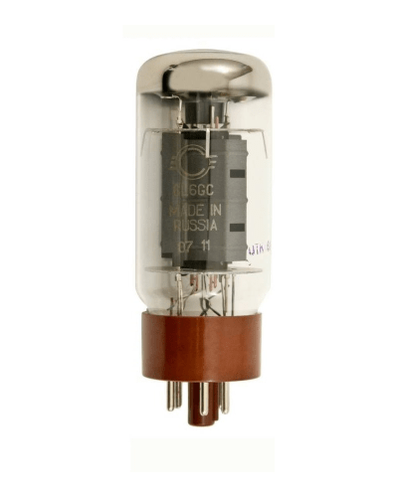
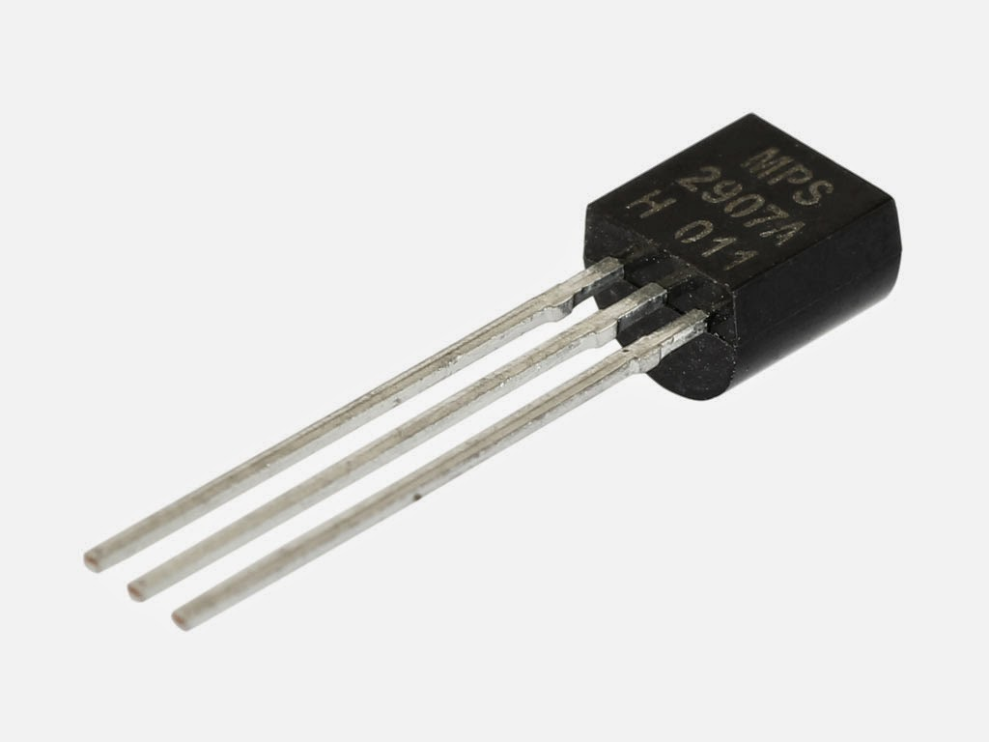
Classical computers
Vaccum-tube computers
(1940-1956)
University of Manchester’s first
Transistor Computer (1953)

Slide 3
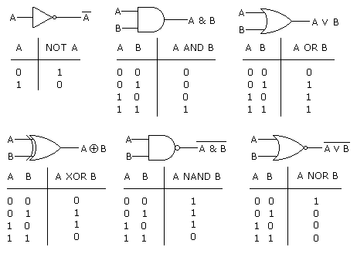
Classical logic gates & truth tables

Slide 4
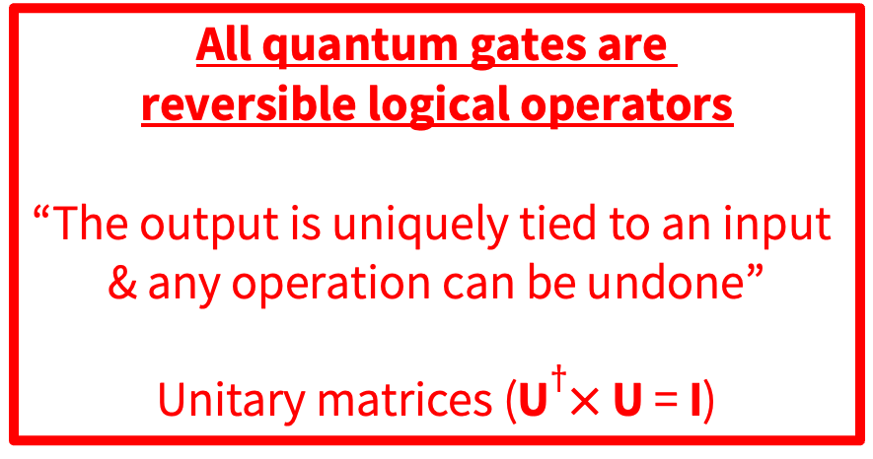
Classical gates & logical irreversibility
Definition of logical irreversibility
“The output of a device does not
uniquely define the input”
All quantum gates are
reversible logical operators
“The output is uniquely tied to an input
& any operation can be undone”
Unitary matrices (U$†×$ U = I)

Slide 5

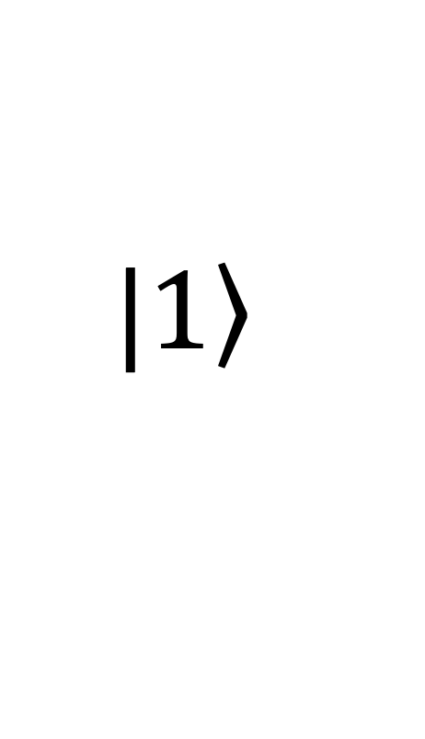
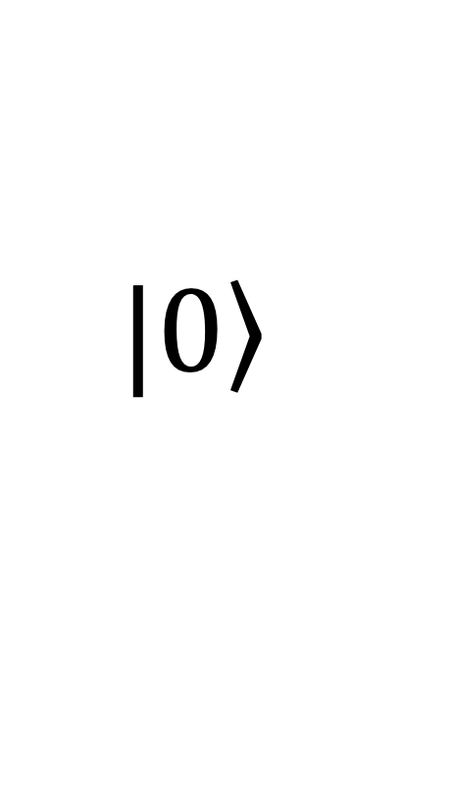
What is a qubit ?
$$\left.|0\right\rangle$$
$$\left.|1\right\rangle$$

Slide 6
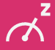

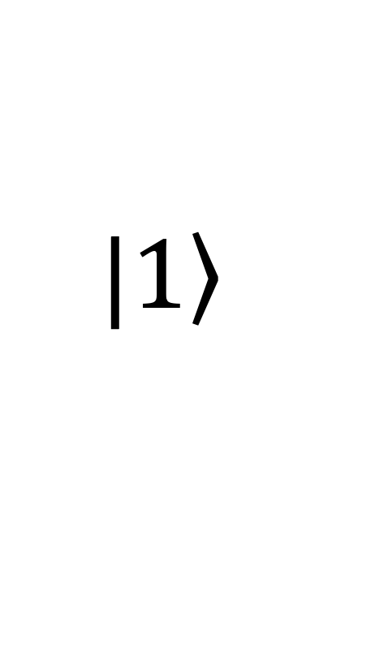
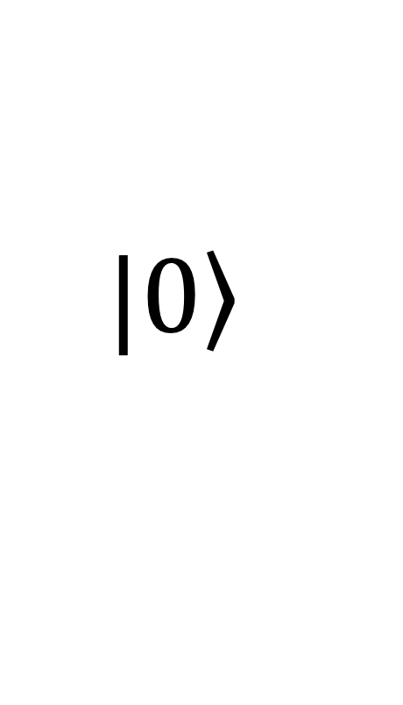
What is a Quantum Gate?
X
“I’m in the
1st floor!”
$$\left.|0\right\rangle$$
$$\left.|1\right\rangle$$

Slide 7
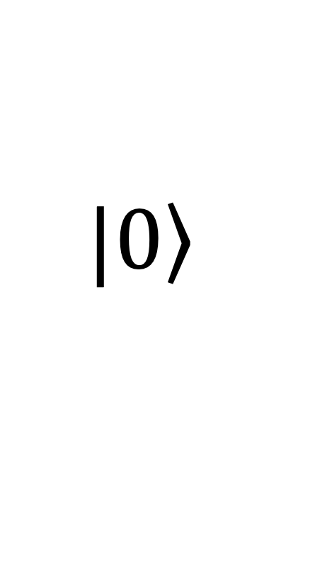

What is a Quantum Gate?
I/Z
“I’m in the
ground floor!”
$$\left.|0\right\rangle$$
$$\left.|0\right\rangle$$

Slide 8


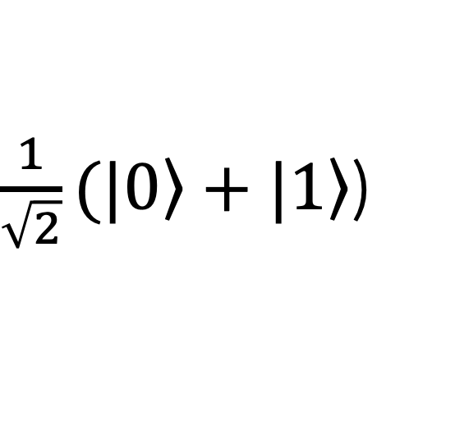
What is a Quantum Gate?
H
50% “ground floor”
50% “1st floor”
$$\left.|0\right\rangle$$
$\frac{1}{\sqrt{2}}(|\left.0\right\rangle +\left.|1\right\rangle$)

Slide 9
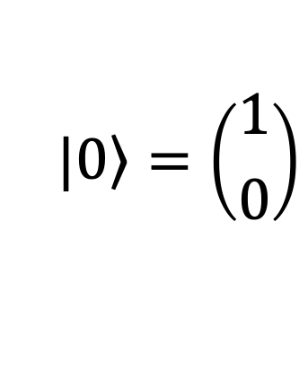
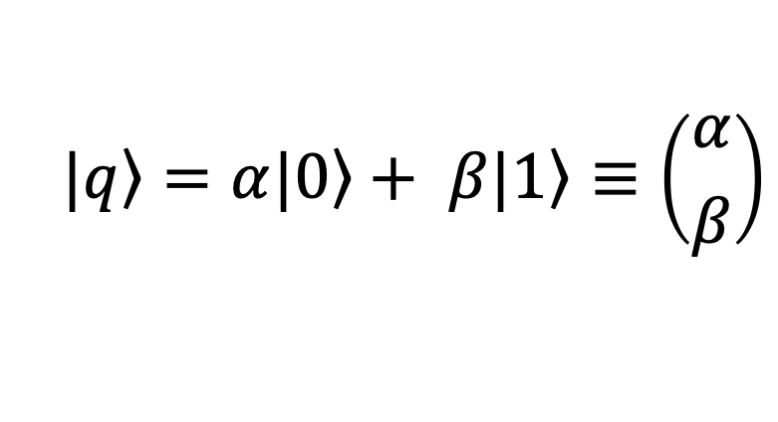
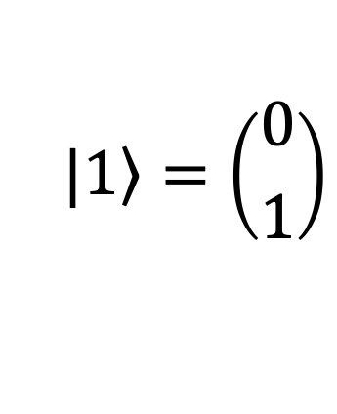
Qubits as vectors; Gates as matrices
Basis vectors
$$\left.|0\right\rangle =\left({1 \atop 0}\right)$$
$$\left.|1\right\rangle =\left({0 \atop 1}\right)$$
Pauli X, Y, Z
Hadamard
Superposition
$$\left.|q\right\rangle =α\left.|0\right\rangle + β\left.|1\right\rangle ≡\left({α \atop β}\right)$$
Rotation

Slide 10

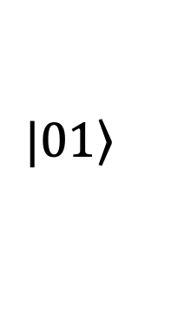

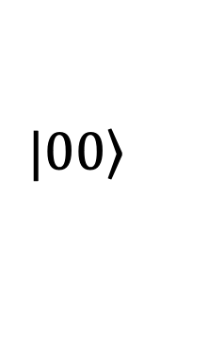
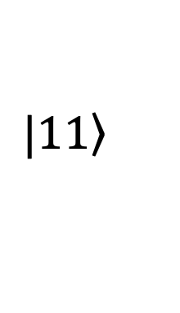
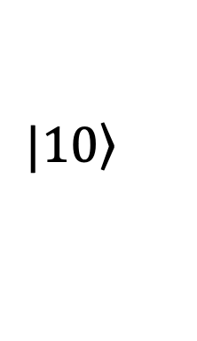
Two-qubit system & gates
$$\left.|00\right\rangle$$
$$\left.|10\right\rangle$$
$$\left.|01\right\rangle$$
$$\left.|11\right\rangle$$

Slide 11
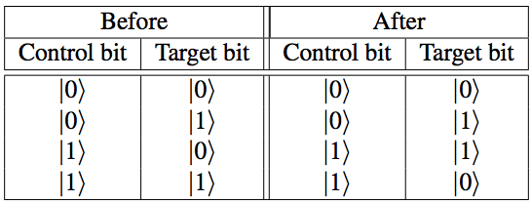
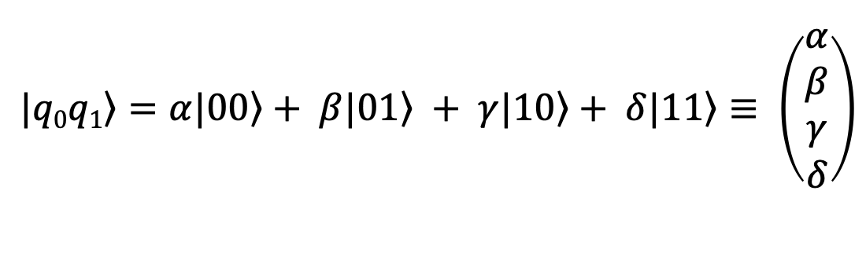
Two-qubit gates
Superposition
$$\left.|q0q1\right\rangle =α\left.|00\right\rangle + β\left.|01\right\rangle + γ\left.|10\right\rangle + δ\left.|11\right\rangle ≡ \left(\begin{matrix}α \\ β \\ γ \\ δ\end{matrix}\right)$$
Controlled NOT
Example:
Truth table of CX

Slide 12
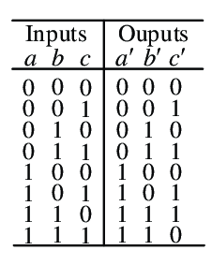
Other multi-qubit gates
Truth table of Toffoli or CCNOT

Slide 13
LAB
Let’s play with a few quantum gates using IBM quantum composer
(https://quantum-computing.ibm.com/composer)

Slide 14
See you next SIG
www.eScienceCenter.nl
info@esciencecenter.nl
+31 (0)20 460 4770

