Slide 1
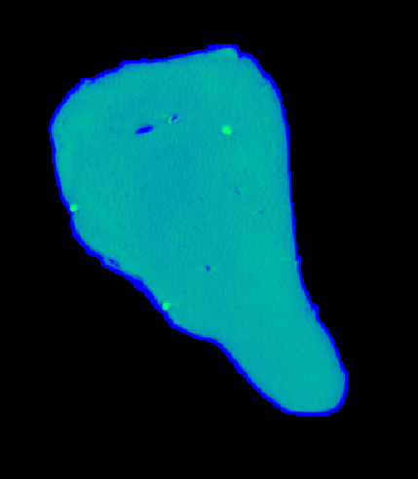
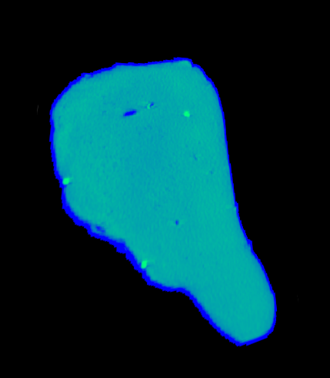
Tracked Points
B
B
A
A
C
C

Slide 2

Warp Fields

Slide 3
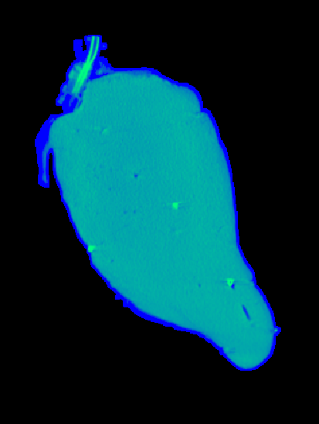

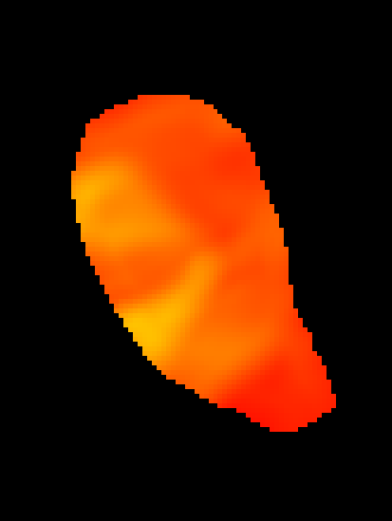
Local Rigidity Metric

Slide 4
Problems
Selection Bias in Deformation Analysis
Insufficient Variability in Deformations
CT Resolution Limitations

