Slide 1

Predicting Brain Connectivity Mapping Using Radiomics Features in Anatomical MRI
Master in Artificial Intelligence
Levente Zsolt Nagy
Thesis supervisor: Alfredo Vellido Alcacena
Thesis co-supervisor: Estela Camara Mancha

Slide 2
Background
Magnetic Resonance Imaging
Diffusion Tensor Imaging

Slide 3
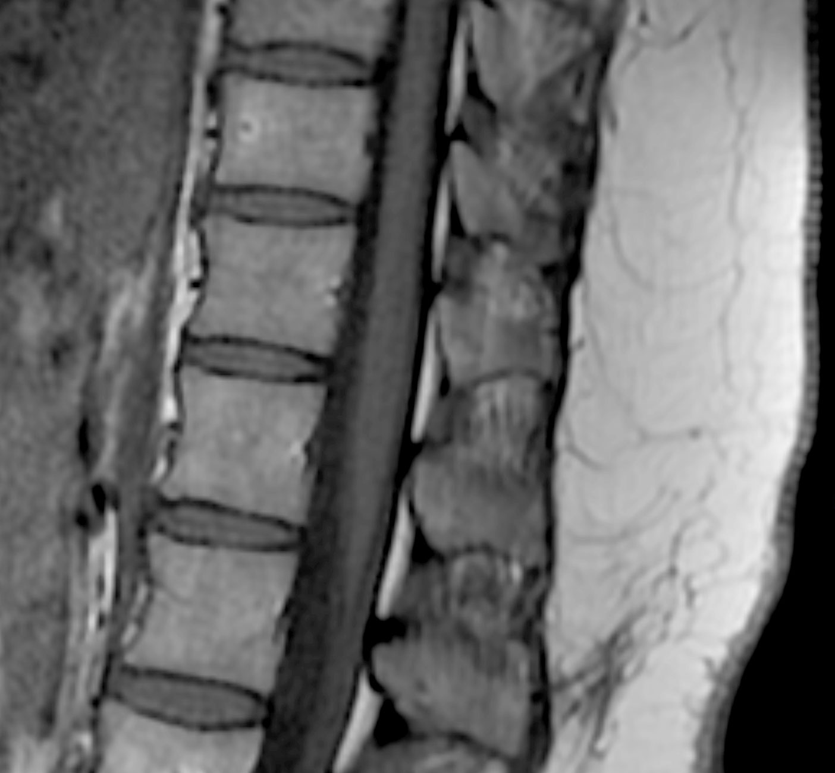
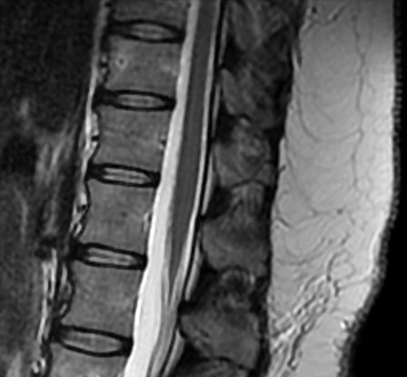
Magnetic Resonance Imaging
volumetric imaging technique
can highlight distinct tissue properties
T1 and T2
Notes:
Introduce T1 and T2 what is visible on which
T1 longitudinal relaxation time, refers to the time it takes for the protons to realign with the magnetic field after the radiofrequency pulse is turned off
Highlights high fat content
T2 transverse relaxation time, measures how long it takes for protons to lose phase coherence among the spins perpendicular to the magnetic field
Highlights high water content

Slide 4
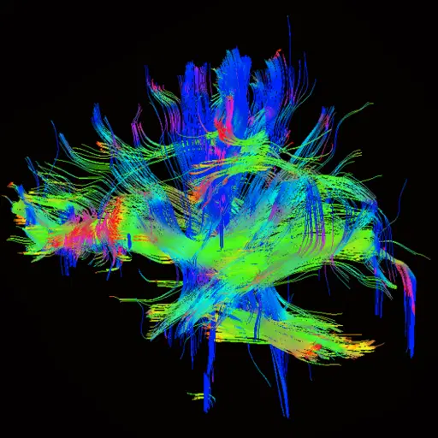
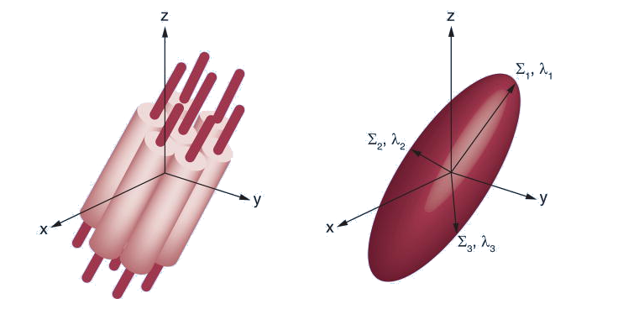
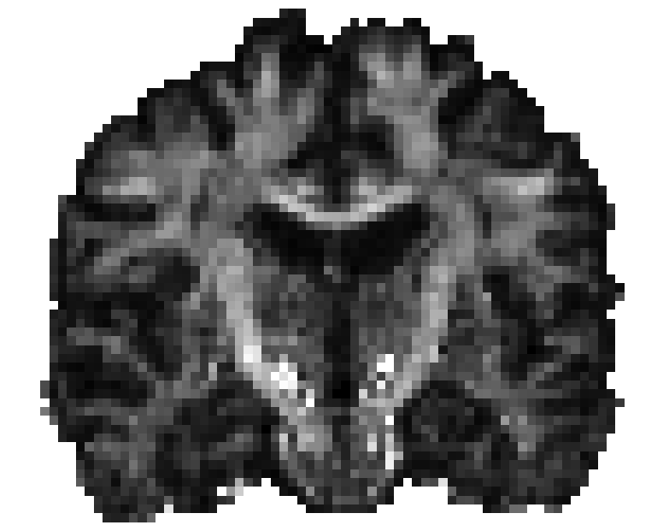
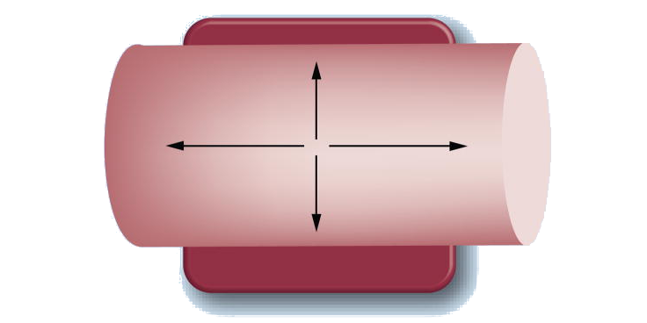
Diffusion Tensor Imaging
cells impose anisotropy on water diffusion
FA, MD and Relative Connectivity
Notes:
Introduce diffusion weighted image
Introduce FA, MD
Introduce Tractography, Relative Connectivity

Slide 5
State of the Art
T1/T2 and Myelin
Radiomics
Neural Networks
Notes:
Summarize the 3 key points that provide foundation for this thesis.

Slide 6
T1/T2 and Myelin
T1/T2 => cortical myelin maps (more robust than R1)
mapping cortical areas
direct correlation to MWF

Slide 7
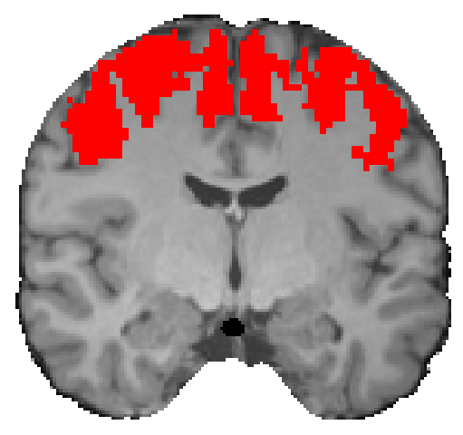
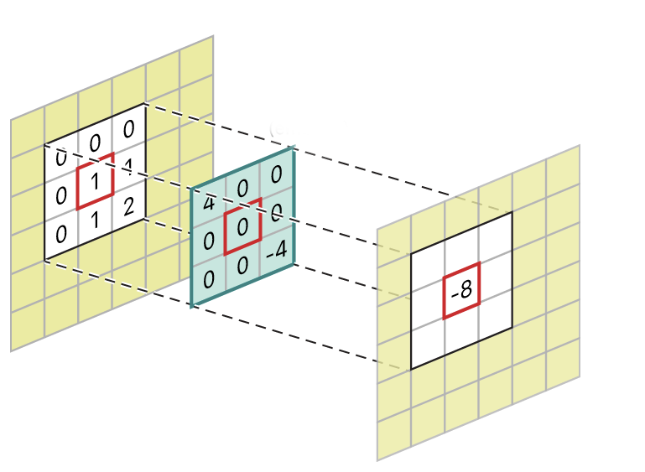
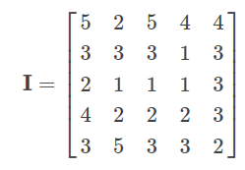
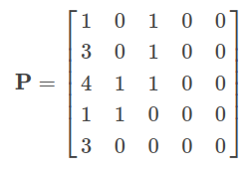
Radiomics
quantitative information from diagnostic images
voxel and non-voxel based
GLRLM at θ = 0
Notes:
Introduce Radiomics
Non-Voxel based, arbitrary kernel (e.g. Motor Cortex)
Voxel base, kernel-based similar to CNN backbone
Example feature class is GLRLM at phi 0 (horizontal run lengths) Intensity Matrix & GLRLM
Example features in class are Short Run Emphasis and Run Length Non-Uniformity

Slide 8
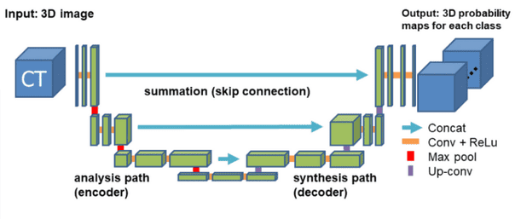
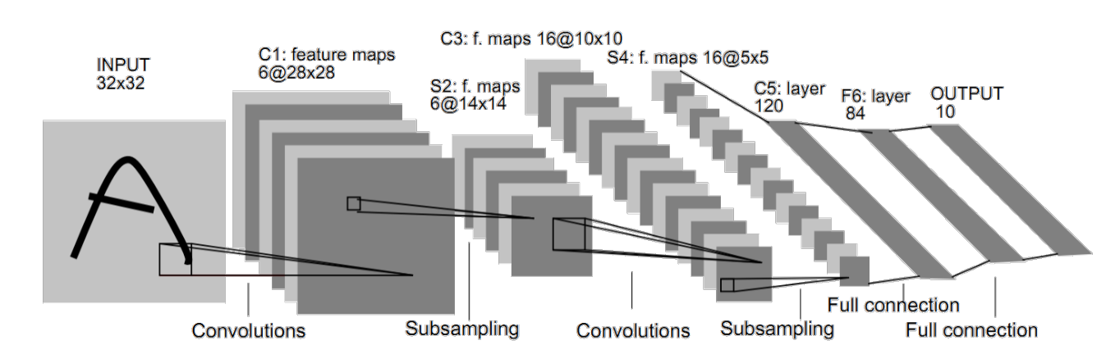
Neural Networks
FNNs have great performance on large, high-dimensional datasets
FCNNs & CNNs for handling spatial data
Notes:
Clarify why use NNs over other methods
Introduce spatial solutions as FCNNs and CNNs
Mention CNN backbone followed by classification or regression head of the fully connected layers after flattening is a FNN

Slide 9
Motivation & Objectives
Can structural connectivity images be synthesized directly from anatomical images using machine learning?
use radiomics for feature extraction
replace 3D convolutional backbone
use FNN classification/regression head
increase performance with T1/T2

Slide 10
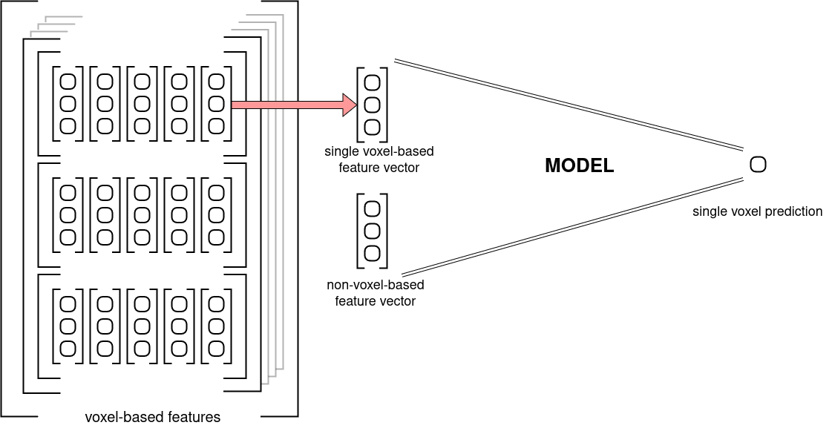
Proposed Solution

Slide 11
Limitations and Robustness
Basal Ganglia => ROI
Huntington’s Disease
32 control + 38 patient records

Slide 12
Data Workflow
Native or Normalized Space
T1 or T1/T2 Input Image
Non-Voxel Based Features
Kernel Size and Bin Size
Coordinate Map
Scaling and Normalization
Balance Ratios

Slide 13




Native or Normalized Space
brains are unique
non-linear registration
lowers variance

Slide 14
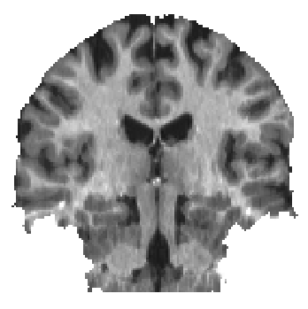
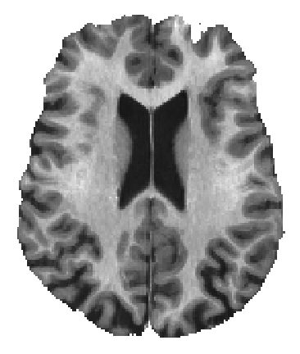
T1 or T1/T2 Input Image
myelin proxy
additional noise!!!
T2 is anisotropic

Slide 15
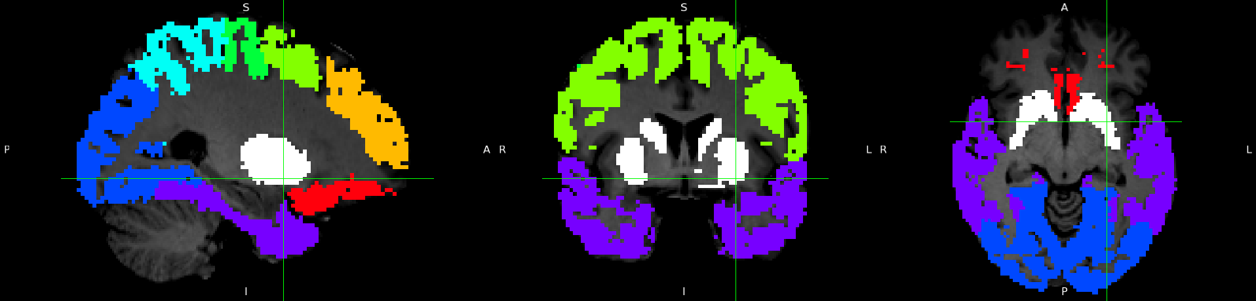
Non-Voxel Based Features
Cortical Targets
Basal Ganglia
Entire Brain

Slide 16
Kernel Size and Bin Size
kernel size => same as in a CNN
absolute binning
relative binning

Slide 17
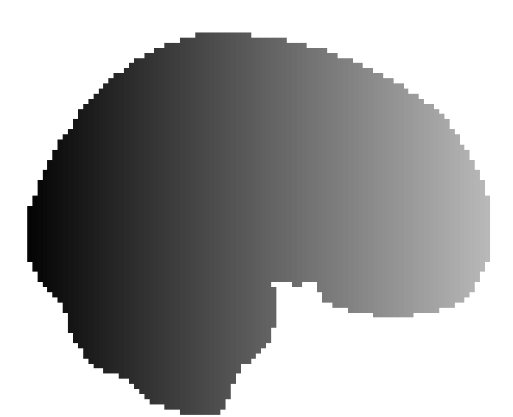



Coordinate Map
global context
normalized space
de-normalization => native space

Slide 18
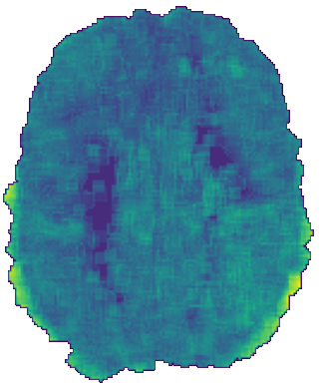
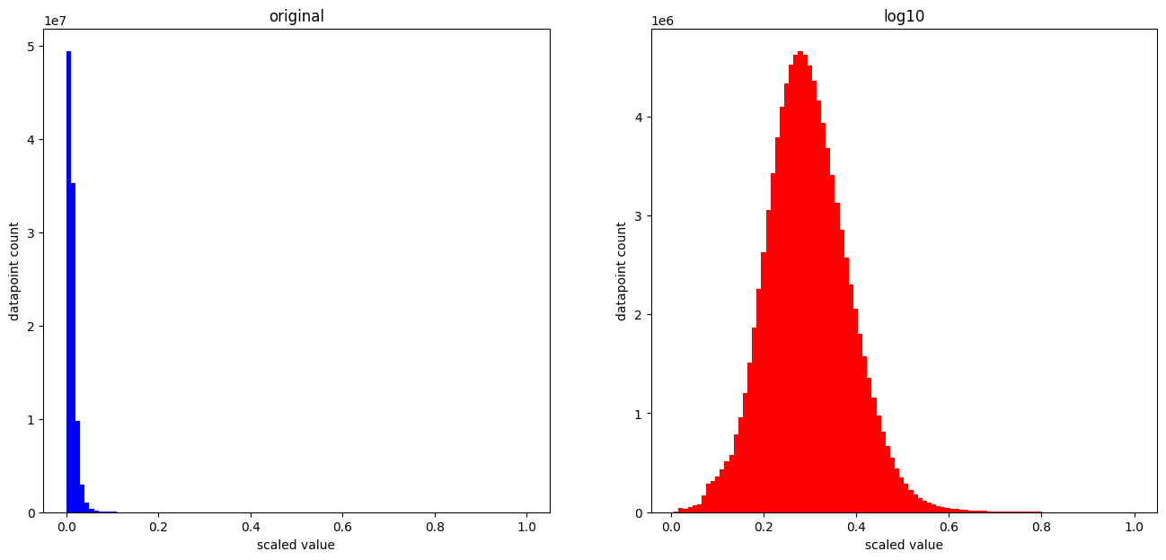
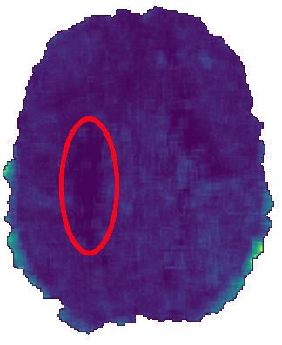
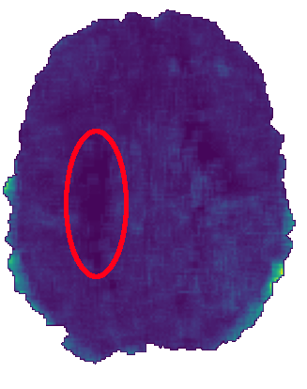
Scaling and Normalization
min-max scaling
left skewed features => log

Slide 19
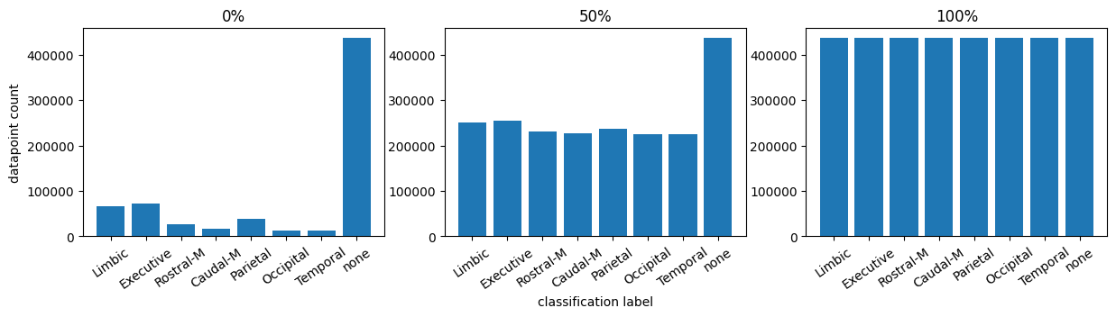
Balance Ratios
Partially balanced data
0 => unbalanced; 1 => balanced

Slide 20
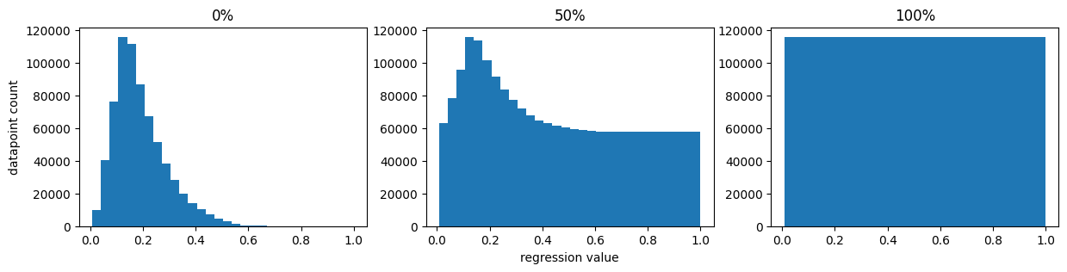
Balance Ratios

Slide 21
Additional Aspects
Single/Many Different Kernel Sizes
Single/Many Different Bin Sizes
Control/Patient/Both Records
Left/Right/Both Hemisphere Datapoints
Additional Clinical Features for Patient Records
Data Augmentation in Native Space

Slide 22
Exhaustive Sequential Backwards Feature Selection
target metric => validation accuracy
stopping criteria => target metric 2% decrease
stopped after 41 features (92 total)
Maximum accuracy increase of 2% (peaked at iteration 35)

Slide 23
Results
Subcortical Segmentation
Fractional Anisotropy
Mean Diffusivity
Relative Connectivity

Slide 24
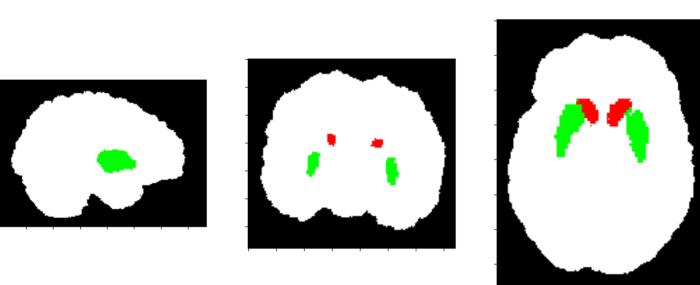
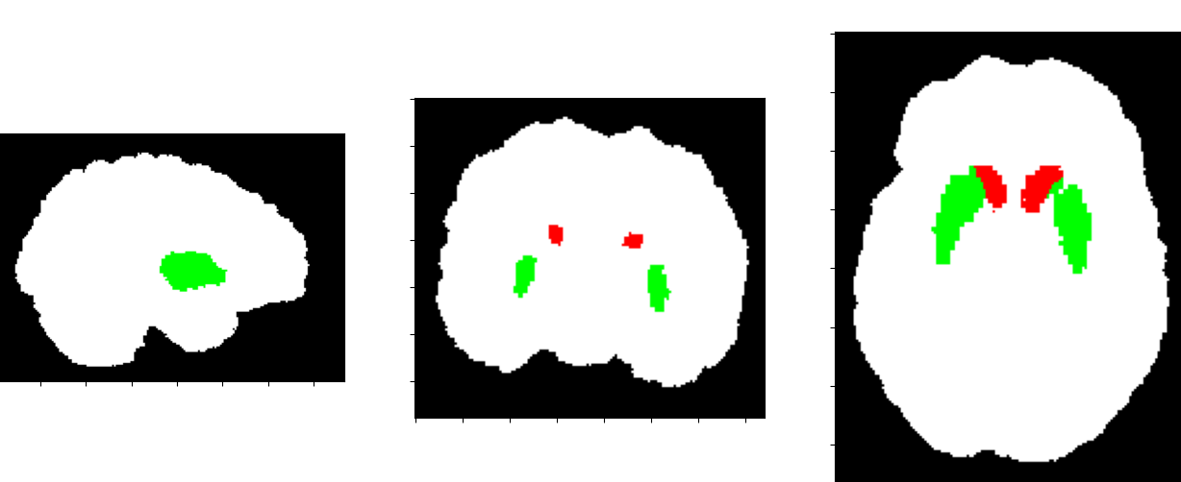
Subcortical Segmentation
Minimal tuning required
96% accuracy
true
predicted

Slide 25
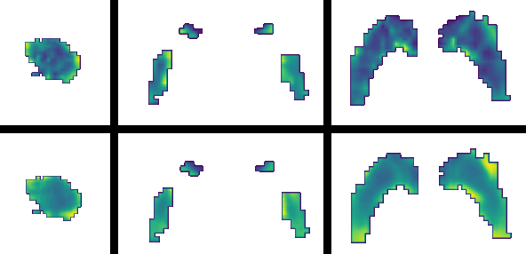
Fractional Anisotropy
T1-Normalized space
Patients records 0.1 correlation decrease
Mixed records only 0.03 decrease
0.85 Pearson
true
predicted

Slide 26
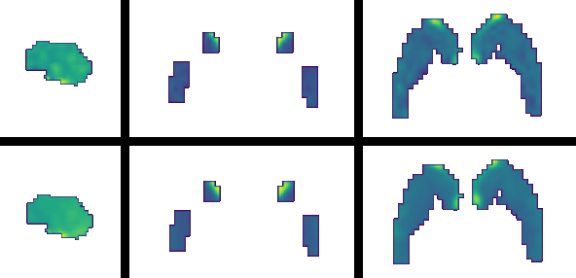
Mean Diffusivity
Very similar results between modalities
Patients records 0.04 correlation decrease
Mixed records only 0.02 decrease
0.95 Pearson
true
predicted

Slide 27
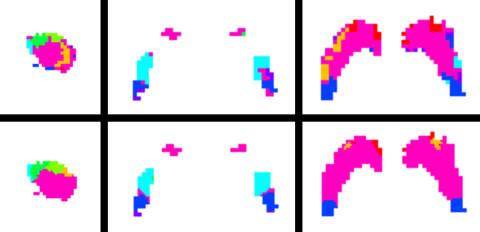
Relative Connectivity
T1-Normalized space
Patients records 4% accuracy decrease
Mixed records only 2% decrease
73% accuracy
true
predicted

Slide 28
Conclusions
normalized space is preferred over native space
T1 generally better than T1/T2
T1/T2 better performance with less input data
possible explanation => T2 is anisotropic
substantial performance drop with patients only
marginal decrease with mixed records
clinical features did compensate for patients records

Slide 29
Conclusions
augmentation did not affect performance
log transforming the left skewed features did help
right hemisphere datapoints better performance
mixed hemisphere data no performance drop

Slide 30
Future Improvements
feature selection re-run
constant gender ratio
optimize binning, kernel size and feature class combinations

Slide 31
Project Future
expand FA and MD models for the whole brain
improve relative connectivity model

Slide 32
Thank You for Your Attention!
Any Questions?

