Slide 1
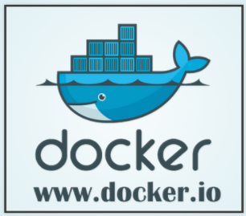
Devops

Slide 2
Introduction – What is docker?
Docker is an open platform for developing, shipping, and running applications. Docker enables you to separate your applications from your infrastructure so you can deliver software quickly.
With Docker, you can manage your infrastructure in the same ways you manage your applications
Docker provides the ability to package and run an application in a loosely isolated environment called a container
Each container is isolated and secure
Containers are lightweight as they don’t need extra load of os or virtualization

Slide 3
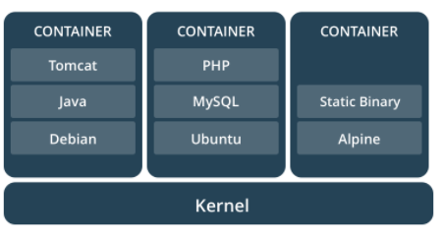
What is a container?
Containers are way to package software
The format of the package allows it to run isolated on a shared operating system
Containers only bundle libraries and settings required to make software work
Container image runs same irrespective of the operating system
Light weight
Standard
Secure

Slide 4
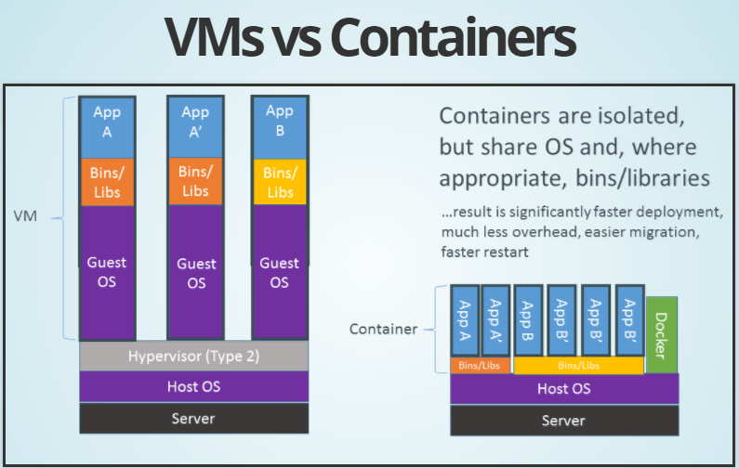

Slide 5
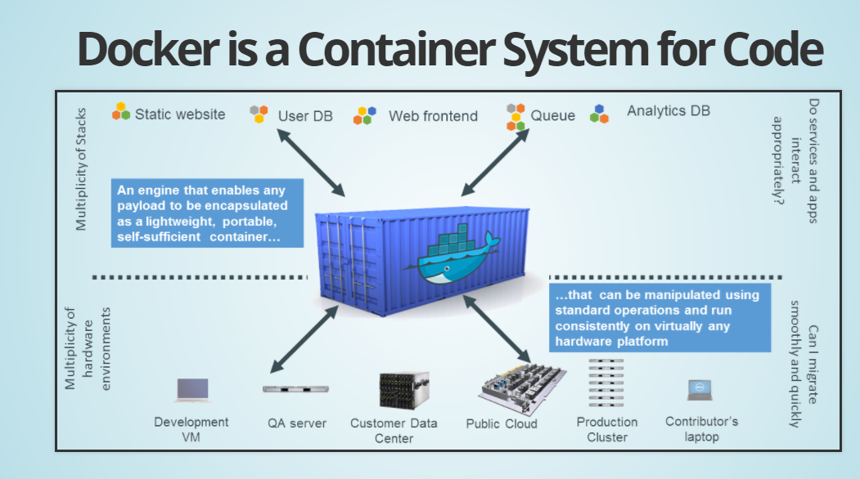
Docker is a container system

Slide 6
What does it do?
Docker automates the repetitive tasks of setting up and configuring environments so that developers can focus on what matters : building software
Example Tasks:
Download software needed for development
Configure dev environment
Create working directories
Configure options
Connect dependent software ie databases, Queues etc
Build software
Install on QA, PreProd, Prod environments
All of this is automated

Slide 7
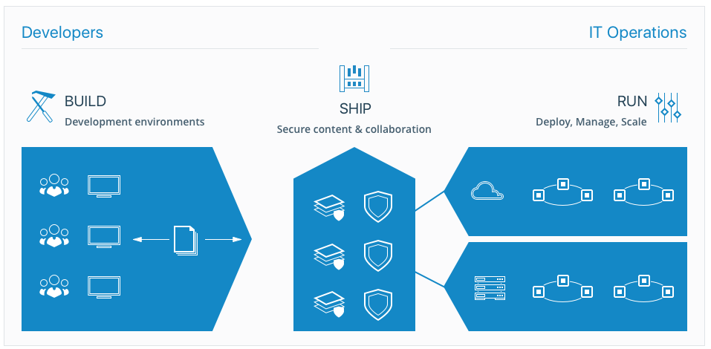
End to end flow

Slide 8
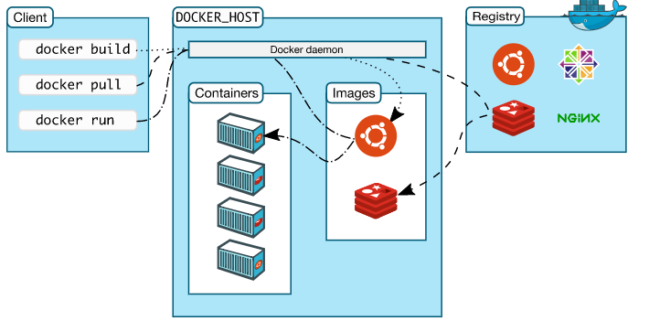
Docker Architecture
Docker daemon listens for docker commands and also manages containers, images and network
Docker client is a primary way of communicating with Docker
Docker Registry stores docker images, Docker Hub and Docker cloud are public registries

Slide 9
Setting up Docker with DockerMachine
Docker Host an be installed directly for Linux, Windows or Mac
Better way is to use Docker Machine
Two ways
Install Docker Toolbox for Windows
https://docs.docker.com/toolbox/toolbox_install_windows/
OR
Download Docker Machine from github
https://github.com/docker/machine/releases/tag/v0.14.0

Slide 10
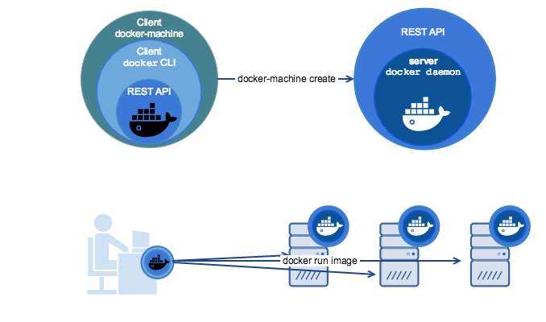
Docker Machine
Usage
Install Docker on Windows or Mac
Provision and manage multiple remote Docker hosts
Provision swarm clusters

Slide 11
Provision a Docker Host on local machine
Install VirtualBox if not already installed on your local machine
https://www.virtualbox.org/wiki/Downloads
Check if you have any running docker machines
$docker-machine ls
Create a new docker host
$docker-machine create default
OR
$docker-machine create –driver virtualbox default
Other Commands
To check the environment of provisioned machine
$docker-machine env default
Get the IP of deployed host
$docker-machine ip default
Connnect with host using ssh
$docker-machine ssh default

Slide 12
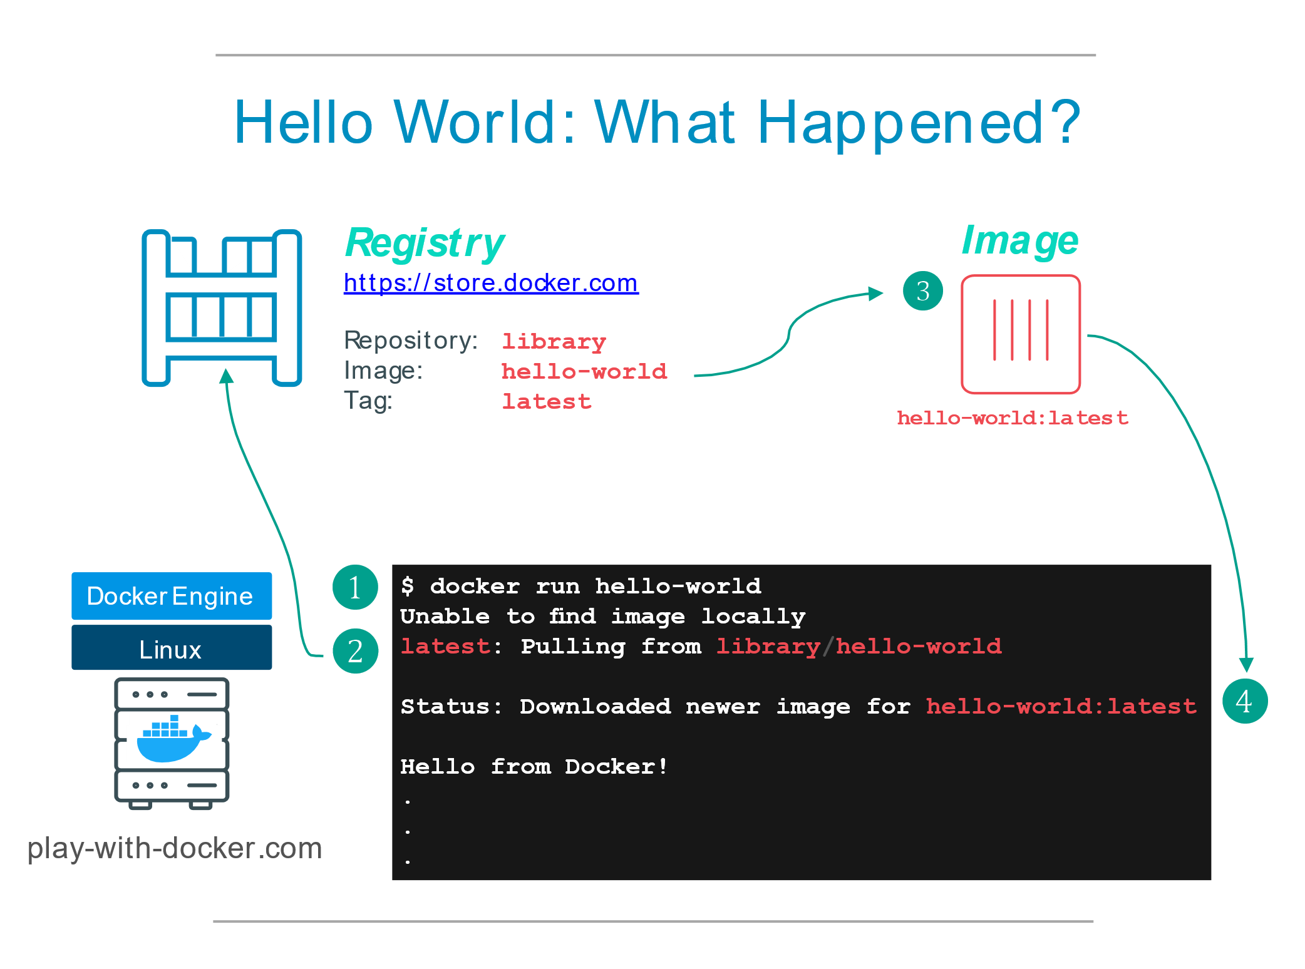
Let’s play with it
http://training.play-with-docker.com/helloworld/
Run the following commands
$docker --version
$docker container run hello-world
What happened?
Docker client contacted the daemon
Docker daemon pulled hello-world image from the Docker Hub
Docker daemon created new container using the image as a template
The container executes and produces the output
The Docker daemon streamed output to the Docker client

Slide 13
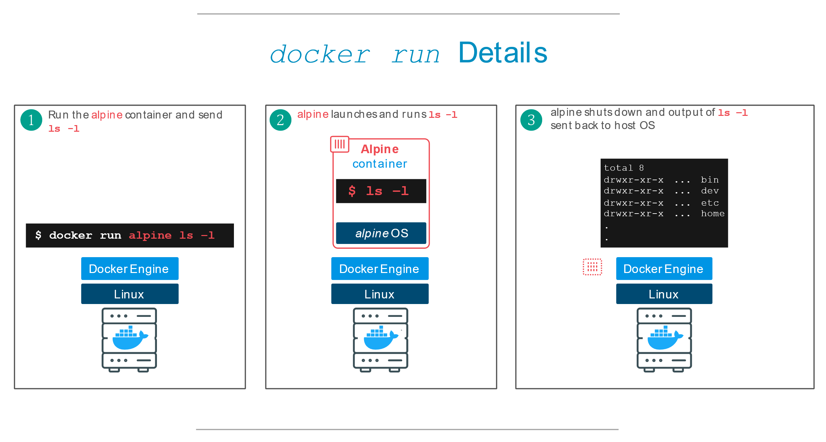
Base linux container
$docker image pull alpine
$docker image ls -a
$docker container run alpine ls -l
Run container in an interactive mode
$docker container run alpine –it /bin/sh

Slide 14
Basic Docker commands
docker container ls # List all running containers
docker container ls -a # List all containers, even those not running
docker container stop <hash> # Gracefully stop the specified container
docker container <hash> # Force shutdown of the specified container
docker container rm <hash> # Remove specified container from this machine
docker image ls -a # List all images on this machine
docker image rm <image id> # Remove specified image from this machine

Slide 15
Docker Objects
Image
An image is a lightweight, stand-alone, executable package that includes everything needed to run a piece of software, including the code, a runtime, libraries, environment variables, and config files.
Container
A container is a runtime instance of an image—what the image becomes in memory when actually executed. It runs completely isolated from the host environment by default, only accessing host files and ports if configured to do so.
Services
In a distributed application, different pieces of the app are called “services.” For example, if you imagine a ecommerce site, it probably includes a service for storing product data in a database, a service for product search, a service for the front-end, and so on.

Slide 16
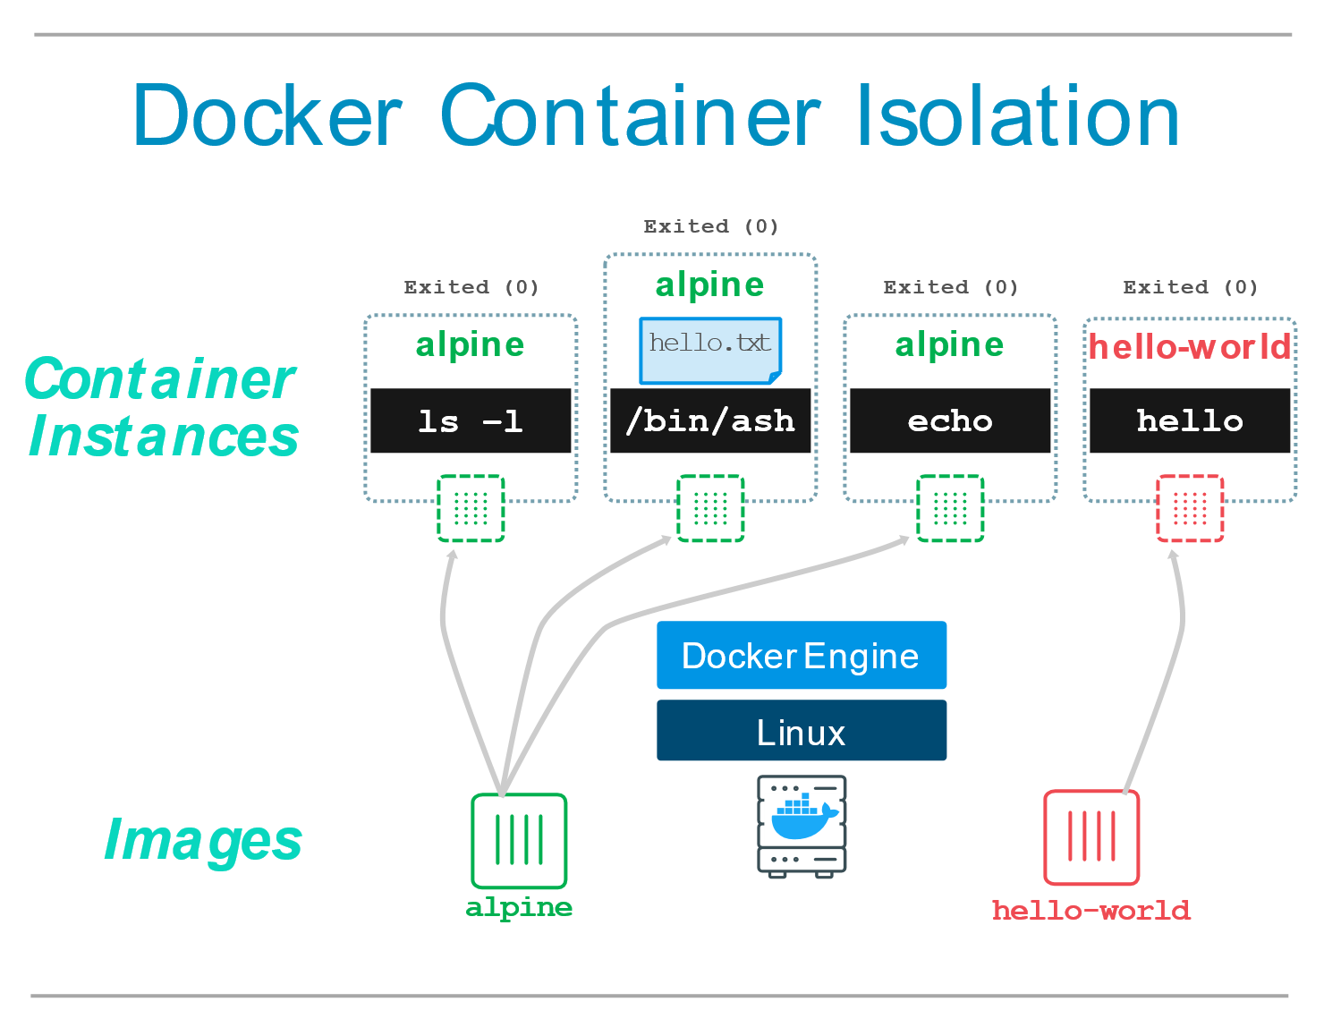
Container Isolation
Each $docker run command starts a new container
Let’s check
$docker container run alpine ls -a
$docker container run alpine –it /bin/sh
> echo ‘Hello World’ > hello.txt
> ls
$docker container run hello-world
Very important feature
Provides security across containers. No Container can access content of another container
Useful to recreate application environments
Useful to quickly create separate, isolated copies of an application and have them run side by side without interfering with each other

Slide 17
Why & what docker?
Why?
Run everywhere
Regardless of kernel version
Regardless of host distro
Physical or virtual, cloud or not
Container and host architecture must match...
Run anything
If it can run on the host, it can run in the container
If it can on a Linux kernel, it can run
Fast delivery
Responsive deployment and scaling
What?
High level: a lightweight VM
Own process space
Own network interface
Can run stuff as root
Can have its own /sbin/init (different from host)
<<machine container>>
Low level: chroot on steroids
Can also not have its own /sbin/init
Container = isolated processes
Share kernel with host
<="" li=""><<application container>>

Slide 18
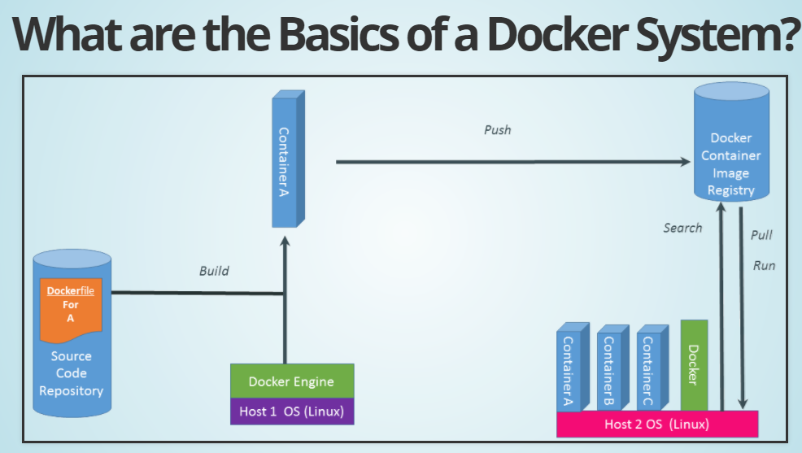

Slide 19
Basic steps to dockerization
Step 0: Create the image (environment and a Dockerfile)
Step 1: Create Container (Instantiating form an image)
Step 2: Connect Services (Compose file, manage dependencies at run-time)
Step 3: Scale using swarms (Scale-out option)
Step 4: Stack (Template – Which describes all containers and infrastructure)
Step 5: Deploy App (Deploy whole stack)

Slide 20
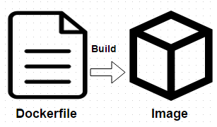
Create Container – Docker Files
Dockerfile is a basic building block for containerizing apps
Docker uses Dockerfile contents to build images
Docker file is a simple text file that contains instructions to be executed on the command line
$docker build command is used to build images using dockerfile

Slide 21
Creating Docker Images from Container
Create a container from which we want to create a new docker image
Modify the container using docker commit

Slide 22
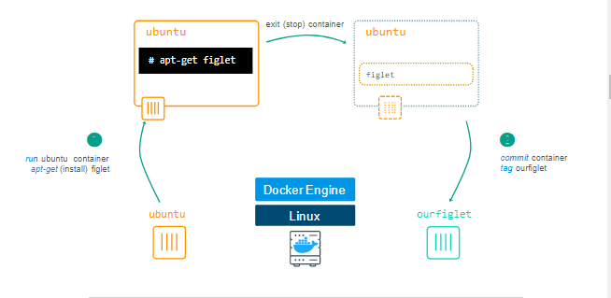
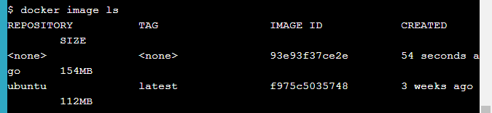
Lab: Image from existing container
Step 1: Get ubuntu container in the bash mode
$docker container run -ti ubuntu bash
Step 2: Install figlet in the container
apt-get update
apt-get install -y figlet
figlet "hello docker“
Exit
Step 3: Get list of containers
Docker container ls -a
Step 4: Check the differences using container diff command
Docker container diff <containerid>
Step 5: Create an image using commit
docker container commit CONTAINER_ID
Step 6: Check list of available images
Docker image ls
Step 7: Tag the image
docker image tag <IMAGE_ID> ourfiglet
docker image ls
Step 8: Create container from new image
Docker container run ourfiglet figlet hello world

Slide 23
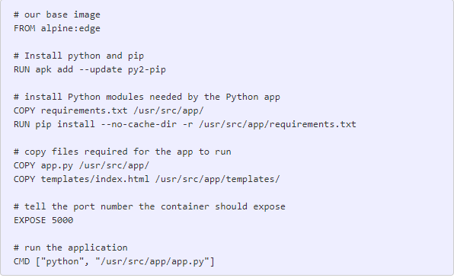
dockerfile commands
Common Dockerfile instructions start with RUN, ENV, FROM, MAINTAINER, ADD, and CMD, among others.
A Dockerfile must start with a FROM instruction. FROM is used to specify the base image that is used for container
ENV is used to create and export Environment variables
MAINTAINER is for storing information about the maintainer of the image/App
ADD is used to add files and folders to local file system of the container
CMD is used to execute local commands in the container
RUN is used to execute any commands in a new layer on top of the current image and commit the results
Dockerfile Example

Slide 24
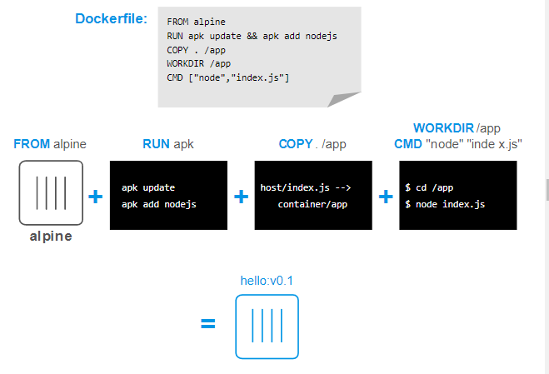

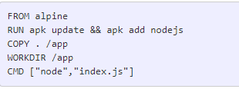
Lab: Create Image for Node.js
Step 1: Create index.js as follows
Step 2: Create Dockerfile in the same folder
Step 3: Run Docker build command
docker image build -t hello:v0.1 .
Step 4: Create container from the image
docker container run hello:v0.1

Slide 25
Lab – Create a dockerfile
Base Image
FROM java
MAINTAINER name
RUN apt-get update && apt-get install -y Maven
ADD . /usr/local/helloworld
RUN cd /usr/local/helloworld && mvn install
CMD ["java", "-cp", "/usr/local/helloworld/target/helloworld-1.0.jar", "HelloWorld"]
Install Maven
Add Files
Build application
Run application

Slide 26

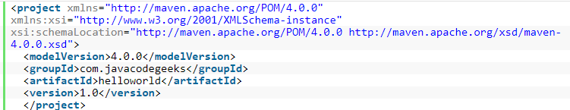
Lab – Create Application components
Class HelloWorld.java
Pom.xml

Slide 27

Lab – Build the docker image
If you do not have docker cloud username, register for docker cloud first and obtain username
Now use docker build command to build the image using cloud username
$ docker image build -t <YOUR_USERNAME>/myfirstapp
-t option is to supply optional Tag name
$ docker image build -t nlpappu/helloworld:1.0 .
Create the container and run image
$ docker container run -p 8888:5000 --name myfirstapp YOUR_USERNAME/myfirstapp

Slide 28
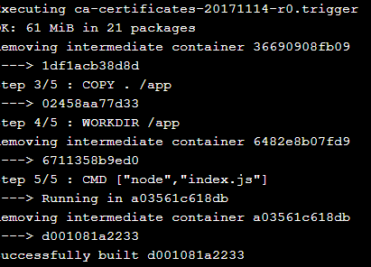
Image Layers
Docker images are build up from series of Layers
Layers is an important concept to understand
Layers are created as a result of changes in the image from Dockerfile commands (i.e. COPY)
To see list of intermediate container images, use history command
docker image history <image ID>

Slide 29
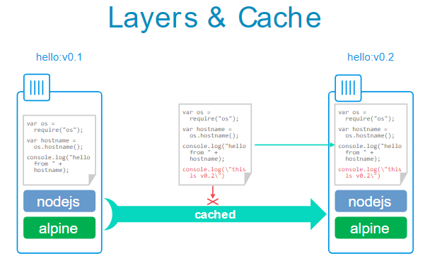
Lab: Image Layers
Modify the index.js by adding a line
echo "console.log(\"this is v0.2\");" >> index.js
Build the new version of the image
docker image build -t hello:v0.2
To inspect layers of the image we can isus docker inspect command
docker image inspect --format "{{ json .RootFS.Layers }}" <image ID>

Slide 30
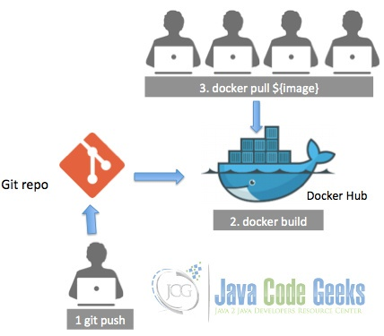
Automate Docker Build
Automate Docker build from Git

Slide 31
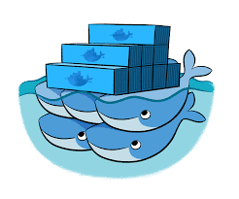
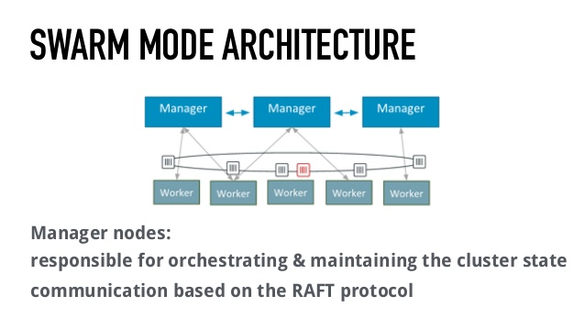
The swarm mode
Docker swarm mode is a native clustering engine that allows you to create and manage swarm clusters
We can deploy services to cluster for load balancing and fault tolerance
Swarm is a cluster of docker engines or nodes on which deploy services
A node is an instance of Docker engine participating in the swarm
To deploy an application on swarm cluster, we need to submit a service definition to manager node

Slide 32
Services
Service is a definition of tasks to execute on the manager or worker nodes
When we create service, we specify information about the image to use and which commands to execute inside running containers
Service definitions are captured in simple to read manifest or compose file written in yml format

Slide 33
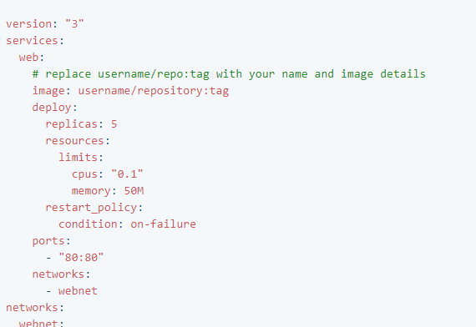
Service compose file
A kind of manifest file that defines service and its attributes
It is stored as yml file
Docker image to download
Number of instances
Resource on each node
Recovery mode
Ports and load balancing protocol

Slide 34
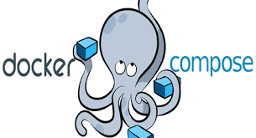
Docker compose
Docker compose is a tool for running multi-container Docker applications
It’s a way to define service and application composition
Composition may contain multiple containers along with their relationships
It’s like packaging app and external dependencies together
You can describe composition using YAML format

Slide 35
Docker compose – Use Cases
Running Application in isolated environments
Compose file provides a way to document and configure all of the application’s service dependencies (databases, queues, caches, web service APIs, etc). Using the Compose command line tool you can create and start one or more containers for each dependency with a single command
Automated testing environments
Compose provides a convenient way to create and destroy isolated testing environments for your test suite. By defining the full environment in a Compose file, you can create and destroy these environments in just a few commands. This is very helpful in CI/CD processes

Slide 36
Docker compose – Installation
Linux
Step 1:
Download docker-compose
Step 2:
Apply executable permissions to binary
curl -L https://github.com/docker/compose/releases/download/1.20.1/docker-compose-$(uname -s)-$(uname -m) -o /usr/local/bin/docker-compose
chmod +x /usr/local/bin/docker-compose
Step 3:
$ docker-compose --version docker-compose version 1.20.1, build 1719ceb

Slide 37
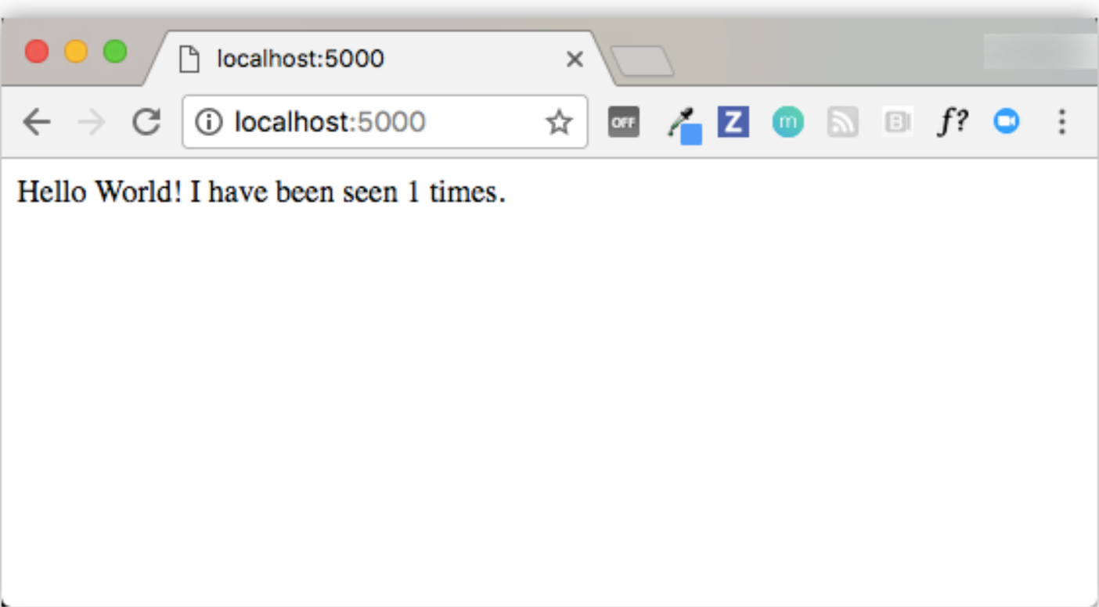
Lab: Python Web App with compose
app.py
import time
import redis from flask
import Flask app = Flask(__name__)
cache = redis.Redis(host='redis', port=6379)
def get_hit_count():
retries = 5
while True:
try: return cache.incr('hits’)
except redis.exceptions.ConnectionError as exc:
if retries == 0:
raise exc
retries -= 1
time.sleep(0.5)
@app.route('/’)
def hello():
count = get_hit_count()
return 'Hello World! I have been seen {} times.\n'.format(count)
if __name__ == "__main__":
app.run(host="0.0.0.0", debug=True)
Hit counter maintenance app
Python with Flask framework
App.py (Web Frontend)
Redis
(Cache for managing counter)
requirements.txt
flask
redis

Slide 38
Lab: Python Web App with compose
Dockerfile
FROM python:3.4-alpine
ADD . /code
WORKDIR /code
RUN pip install -r requirements.txt
CMD ["python", "app.py"]
Hit counter maintenance app
docker-compose.yml
version: '3’
services:
web:
build: .
ports:
- "5000:5000“
redis:
image: "redis:alpine"
Python with Flask framework
App.py (Web Frontend)
Redis
(Cache for managing counter)
tcp:5000
tcp:6379

Slide 39
Lab: Python Web App with compose
Build and run the app
$ docker-compose up
Creating network "composetest_default" with the default driver
Creating composetest_web_1 ...
Creating composetest_redis_1 ...
Creating composetest_web_1
Creating composetest_redis_1 ... done
Attaching to composetest_web_1, composetest_redis_1
web_1 | * Running on http://0.0.0.0:5000/ (Press CTRL+C to quit)
redis_1 | 1:C 17 Aug 22:11:10.480 # oO0OoO0OoO0Oo
Redis is starting oO0OoO0OoO0Oo
redis_1 | 1:C 17 Aug 22:11:10.480 # Redis version=4.0.1, bits=64, commit=00000000, modified=0, pid=1, just started
redis_1 | 1:C 17 Aug 22:11:10.480 # Warning: no config file specified, using the default config. In order to specify a config file use redis-server /path/to/redis.conf
web_1 | * Restarting with stat redis_1 | 1:M 17 Aug 22:11:10.483 * Running mode=standalone, port=6379.
redis_1 | 1:M 17 Aug 22:11:10.483 # WARNING: The TCP backlog setting of 511 cannot be enforced because /proc/sys/net/core/somaxconn is set to the lower value of 128.
web_1 | * Debugger is active! redis_1 | 1:M 17 Aug 22:11:10.483 # Server initialized
redis_1 | 1:M 17 Aug 22:11:10.483 # WARNING you have Transparent Huge Pages (THP) support enabled in your kernel. This will create latency and memory usage issues with Redis. To fix this issue run the command 'echo never > /sys/kernel/mm/transparent_hugepage/enabled' as root, and add it to your /etc/rc.local in order to retain the setting after a reboot. Redis must be restarted after THP is disabled.
web_1 | * Debugger PIN: 330-787-903 redis_1 | 1:M 17 Aug 22:11:10.483 * Ready to accept connections
Hit counter maintenance app
Python with Flask framework
App.py (Web Frontend)
Redis
(Cache for managing counter)
Test application
Point web browser to http://localhost:5000, Refresh page and see if counter increments
tcp:5000
tcp:6379

Slide 40
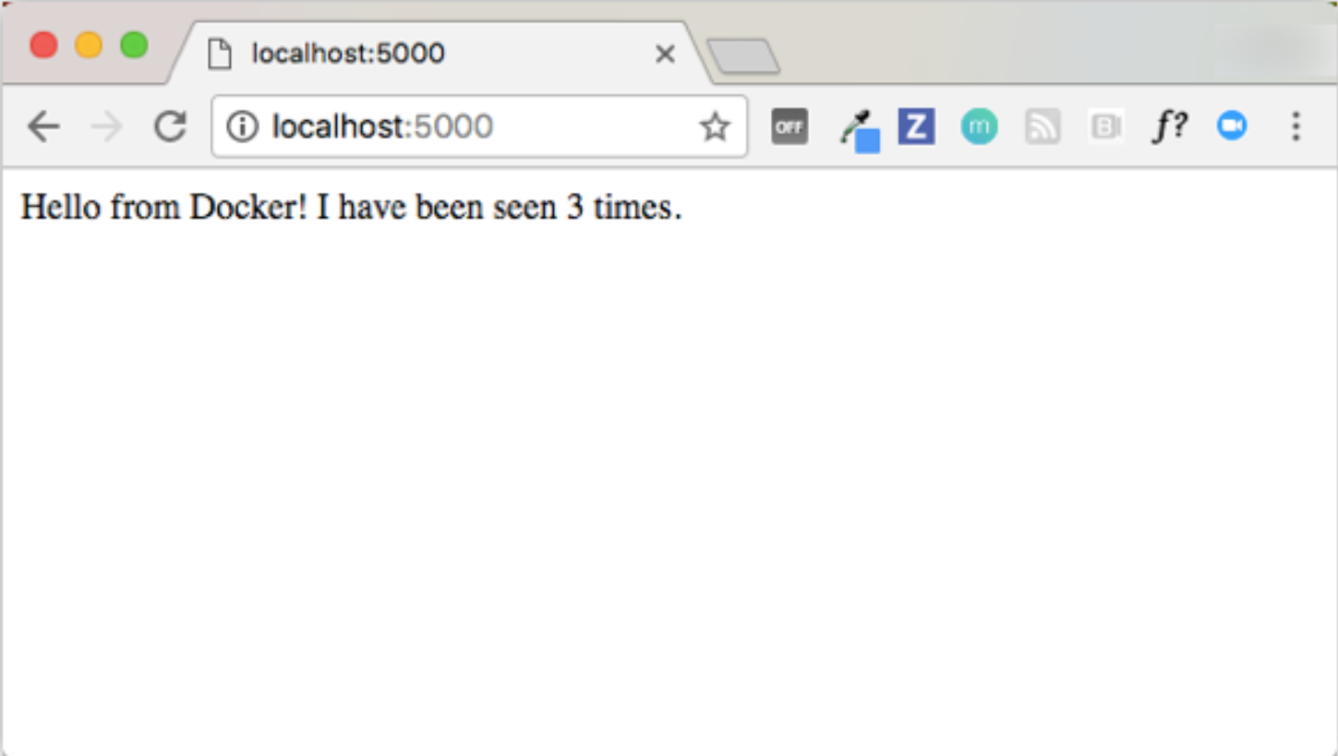
Lab: Python Web App with compose
Edit the compose file to add a bind mount
version: '3’
services:
web:
build: .
ports:
- "5000:5000"
volumes:
- .:/code
redis:
image: "redis:alpine"
Hit counter maintenance app
Re build and run the app
Python with Flask framework
App.py (Web Frontend)
Redis
(Cache for managing counter)
Change app.py
return 'Hello from Docker! I have been seen {} times.\n'.format(count)
Retest the app
tcp:5000
tcp:6379

Slide 41

Lab: docker-compose commands
Start Services in the background
$ docker-compose up -d
Check all the services
$ docker-compose ps
Run one-off commands for the services that is running
$ docker-compose run web env
$ docker-compose run redis env
Stop running services
$ docker-compose stop
Bring everything down, stop running containers, remove volumes
$ docker-compose down --volumes
Validate compose files
$ docker-compose config
Run arbitraty commands on running services
$ docker-compose exec web ls
Run logs
$ docker-compose logs [options] [SERVICE]
(Options) –f –t --tail

Slide 42
Lab: Django with compose
https://docs.docker.com/compose/django/

Slide 43
Lab: node.js with sqlserver
https://training.play-with-docker.com/node-sql-server-docker/

Slide 44
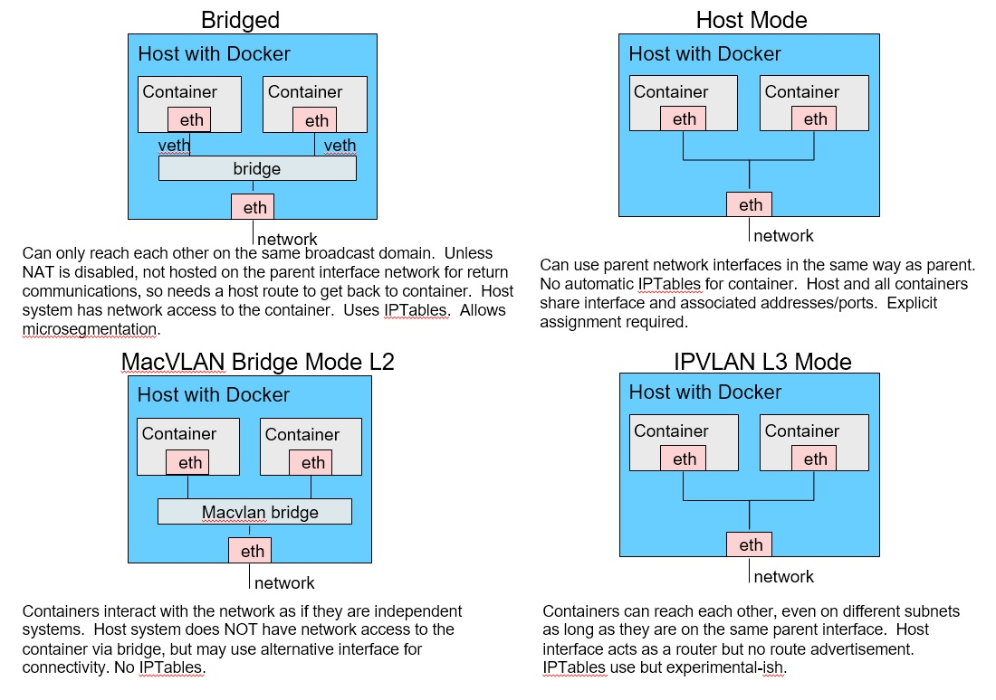
Docker - Networking
Docker containers can be connected to each other or non-docker workloads through networking
Docker’s networking system is pluggable using drivers
Core docker networking is provided by several drivers
Drivers supported : bridge (default), host, overlay, macvlan, none, Network plugins

Slide 45
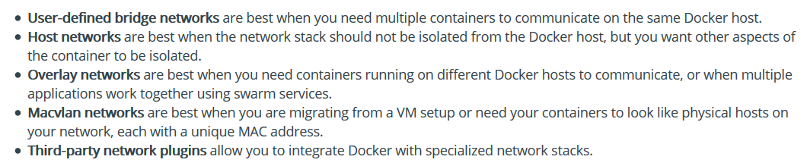
Use cases

Slide 46
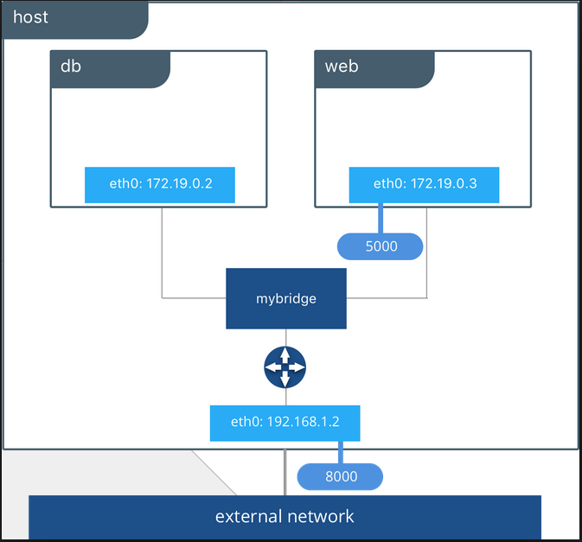
Bridge network
Bridge network allows containers running on same Docker host to communicate with each other
Docker Bridge network uses a software link layer device that provides communication between containers while isolating from outside world
A default bridge network is created when starting docker, additional bridge n/w can be created as user defined bridge networks

Slide 47
User defined bridge networks
Provides better isolation
Provides better interoperability
Automatic DNS resolution
Containers can be attached and detached on the fly
Creates a configurable bridge

Slide 48
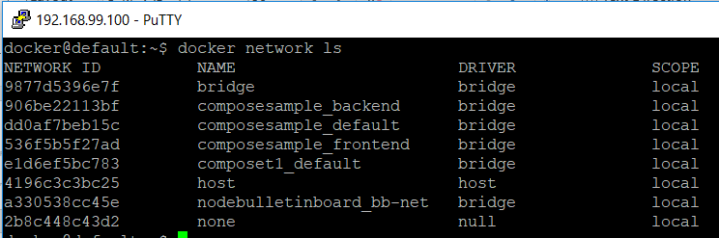
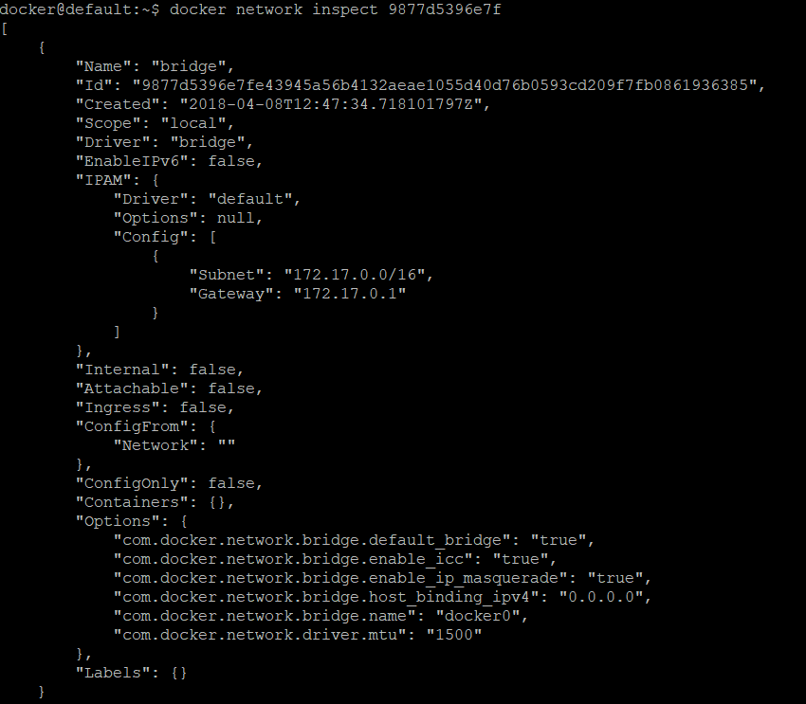
Exploring bridge network
Get information about networks
$docker network ls
Insect default (bridge) network
$docker network inspect 9877d5396e7f

Slide 49
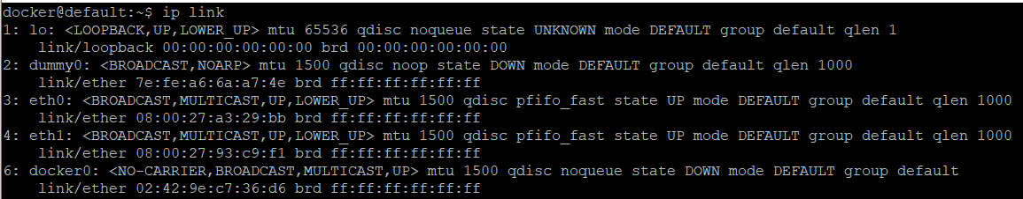
Exploring bridge network
Check the status of the network using ip link
$ip link
Create a new nginx container and check the ip link again
$ docker run --name my-nginx --publish 8080:80 nginx:latest

Slide 50
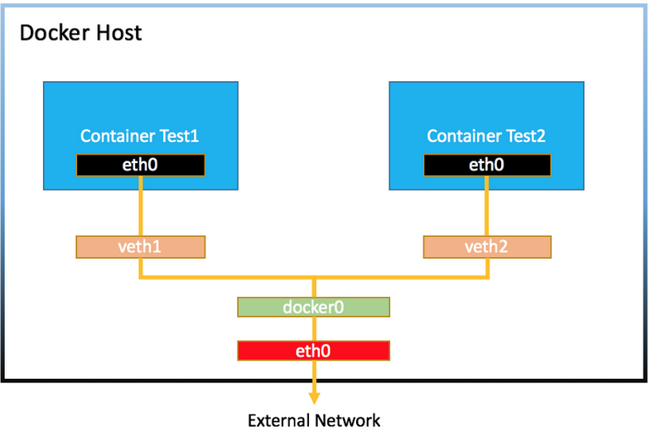

Exploring bridge network
$ docker network connect my-net my-nginx
Create a user defined bridge network
$docker network create my-net
Create a new nginx container and check the ip link again
$ docker run --name my-nginx --publish 8080:80 nginx:latest
Attach newly created network to container
$ docker network connect my-net my-nginx
Complete tutorial at
https://docs.docker.com/network/network-tutorial-standalone/

Slide 51
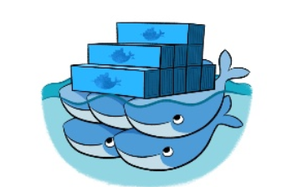
Swarm key concepts
Swarm allows cluster management and service orchestration for docker containers
These features are embedded in Docker engine using a swarmkit
A swarm consists of multiple Docker hosts which run in swarm mode and act as managers (to manage membership and delegation) and workers (which run swarm services).
When you create a service, you define its optimal state (number of replicas, network and storage resources available to it, ports the service exposes to the outside world, and more)
When Docker is running in swarm mode, you can still run standalone containers on any of the Docker hosts participating in the swarm, as well as swarm services.
Docker daemons can participate in a swarm as managers, workers, or both.

Slide 52
Swarm features
Simple to setup
Built-in integrated with Docker-engine
No external dependencies
Managed with standard docker CLI
Decentralized and resilient
Secure by default
Declarative service model
Scaling
Multi-host networking

Slide 53
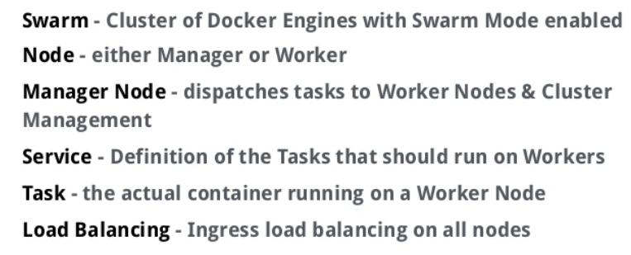
Swarm Concepts

Slide 54
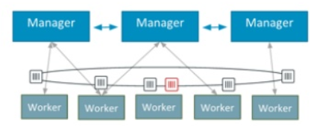
Swarm Architecture
Manager Nodes
Responsible for orchestrating and maintaining the cluster state communication based on the RAFT protocol
Worker Nodes
Receives tasks dispatched by manager nodes

Slide 55
Lab: Setup Swarm
https://docs.docker.com/engine/swarm/swarm-tutorial/

Slide 56
Overlay network
Overlay network creates a distributed network among multiple Docker daemon hosts.
This network sits on top of (overlays) the host-specific networks, allowing containers connected to it (including swarm service containers) to communicate securely.

Slide 57
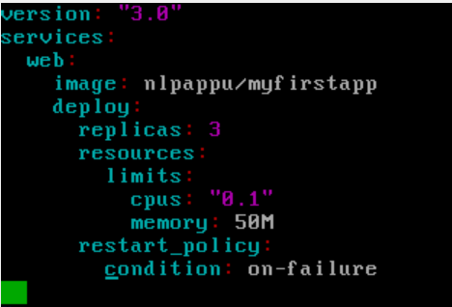
Lab – Creating a swarm
Create docker-compose.yml with following details
Remove the app
$docker stack rm swarmlab
Initialize the swarm
$docker swarm init
Deploy the service on the swarm
$docker stack deploy –c docker-compose.yml swarmlab
Now check the services
$docker service ls -a

Slide 58
Stack
A stack is a group of interrelated services that share dependencies, and can be orchestrated and scaled together
A single stack is capable of defining and coordinating the functionality of an entire application
You can define the stack together with shared service and deploy together

Slide 59
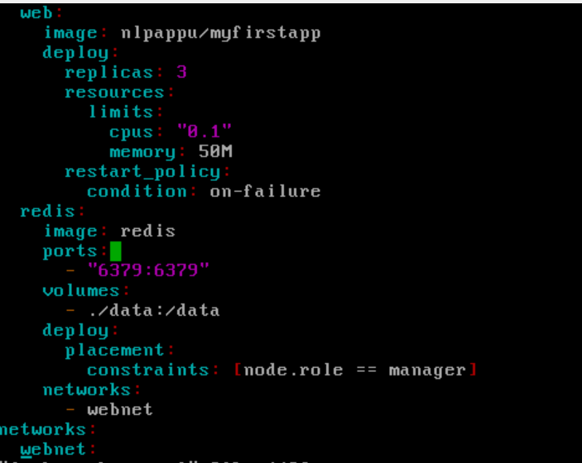
Lab-stack
Modify the compose file to add shared redis service
Deploy the service on the swarm
$docker stack deploy –c docker-compose.yml swarmlab
Now check the services
$docker service ls -a

Slide 60
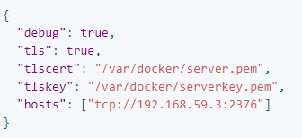
Docker administration
Starting docker manually
$dockerd - This is used to typically debug docker else start using system utils
Starting docker as a service
$sudo service start docker
Configuring docker
Two ways:
Either pass parameters as arguments / use /etc/docker/daemon.json (better approach)

Slide 61
Troubleshooting
Start with log messages
$journalctl –u docker.service
To enable debugging, update daemon.json file with
{
“debug” : true
}
To check the service status
$sudo service docker status

Slide 62
Containers Administration
Container Restart
Docker has restart policies for containers that controls whether containers start automatically
Restart policy can be specified when running the containers with --restart flag (options are no, on-failure, unless-stopped, always)
$docker run –dit –restart always redis
Limiting container’s resources
Provide memory usage parameters using –m or –memory flags
$docker run –memory=10m redis
Use –oom-kill-disable flag to prevent docker from killing the container processes
Limit the usage of CPUs by using –cpus flag while starting thecontainer
$docker run –it –cpus=“1.5” nlpappu/myfirstapp /bin/bash

Slide 63
Cleanup docker objects
To remove unused objects, use prune command option
$docker image prune – removes all unused images
$docker container prune – removes all unused (not running containers)
$docker volume prune – Removes all volumes not used by any container
$docker network prune – Removes all networks not used by any container
To prune everything at once, use
$docker system prune

Slide 64
Docker with puppet
Usage
Puppet can be used to prepare docker machines with images, containers and services
Steps
Install the docker module ($puppet module install garethr/docker)
In the site.pp, map module to node (include ‘docker’)
Install Docker images (docker::image{ ‘java’:}
Create and run containers
docker::run {‘helloworld’:
… parameters
}

