Slide 1
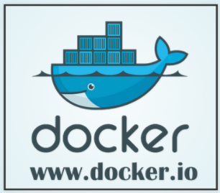
Devops

Slide 2
Introduction – What is docker?
Docker is an open platform for developing, shipping, and running applications. Docker enables you to separate your applications from your infrastructure so you can deliver software quickly.
With Docker, you can manage your infrastructure in the same ways you manage your applications
Docker provides the ability to package and run an application in a loosely isolated environment called a container
Each container is isolated and secure
Containers are lightweight as they don’t need extra load of os or virtualization

Slide 3
Why Docker?
Faster Development Process
Application Encapsulation
Uniform behavior
Easy monitoring
Easy to scale
Secure

Slide 4
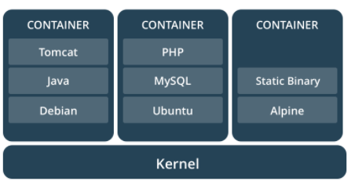
What is a container?
Containers are way to package software
The format of the package allows it to run isolated on a shared operating system
Containers only bundle libraries and settings required to make software work
Container image runs same irrespective of the operating system
Light weight
Standard
Secure

Slide 5
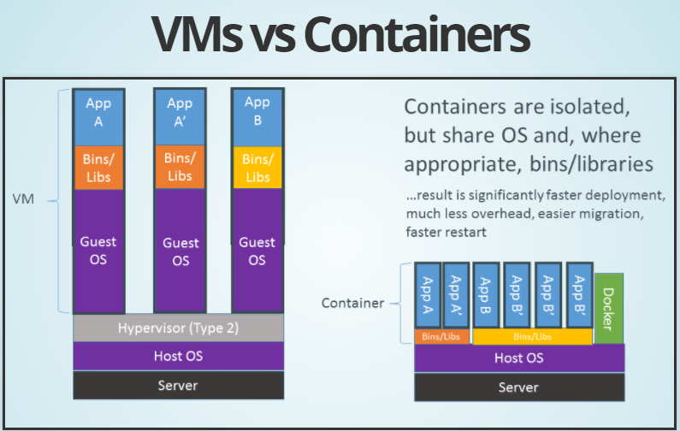

Slide 6
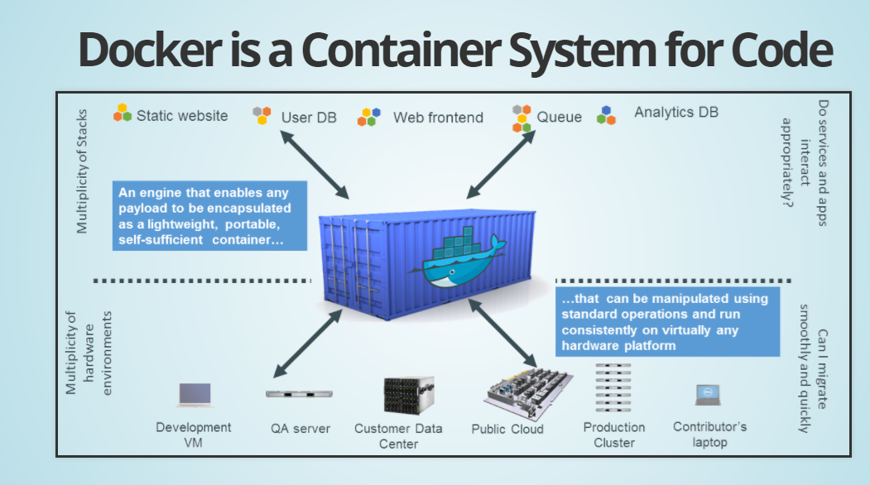
Docker is a container system

Slide 7
What does it do?
Docker automates the repetitive tasks of setting up and configuring environments so that developers can focus on what matters : building software
Example Tasks:
Download software needed for development
Configure dev environment
Create working directories
Configure options
Connect dependent software ie databases, Queues etc
Build software
Install on QA, PreProd, Prod environments
All of this is automated

Slide 8
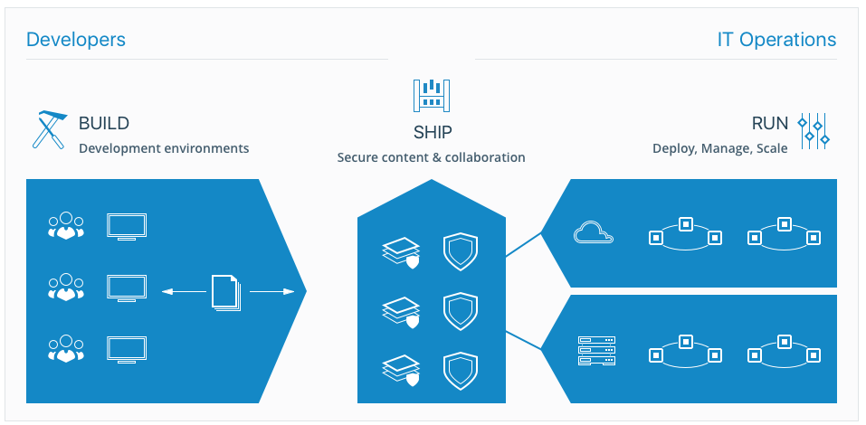
End to end flow

Slide 9
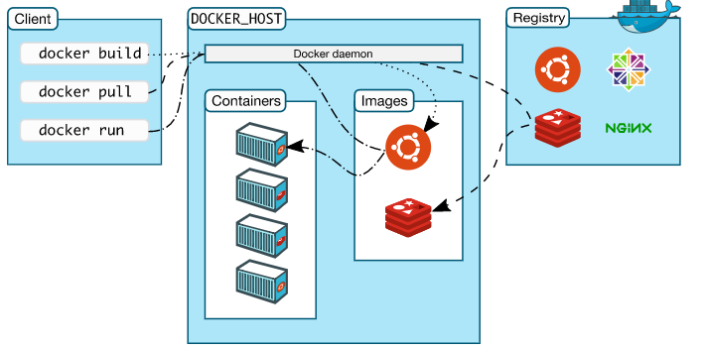
Docker Architecture
Docker daemon listens for docker commands and also manages containers, images and network
Docker client is a primary way of communicating with Docker
Docker Registry stores docker images, Docker Hub and Docker cloud are public registries

Slide 10
Setting up Docker with DockerMachine
Docker Host an be installed directly for Linux, Windows or Mac
Better way is to use Docker Machine
Two ways
Install Docker Toolbox for Windows
https://docs.docker.com/toolbox/toolbox_install_windows/
OR
Download Docker Machine from github
https://github.com/docker/machine/releases/tag/v0.14.0

Slide 11
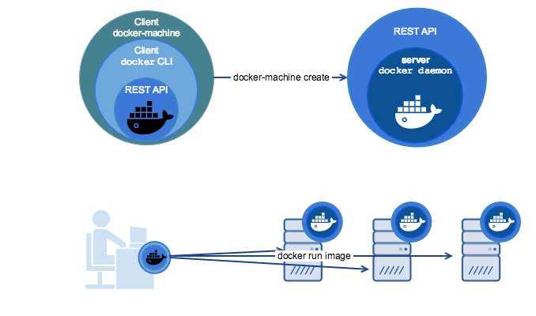
Docker Machine
Usage
Install Docker on Windows or Mac
Provision and manage multiple remote Docker hosts
Provision swarm clusters

Slide 12
Provision a Docker Host on local machine
Install VirtualBox if not already installed on your local machine
https://www.virtualbox.org/wiki/Downloads
Check if you have any running docker machines
$docker-machine ls
Create a new docker host
$docker-machine create default
OR
$docker-machine create –driver virtualbox default
Other Commands
To check the environment of provisioned machine
$docker-machine env default
Get the IP of deployed host
$docker-machine ip default
Connnect with host using ssh
$docker-machine ssh default

Slide 13
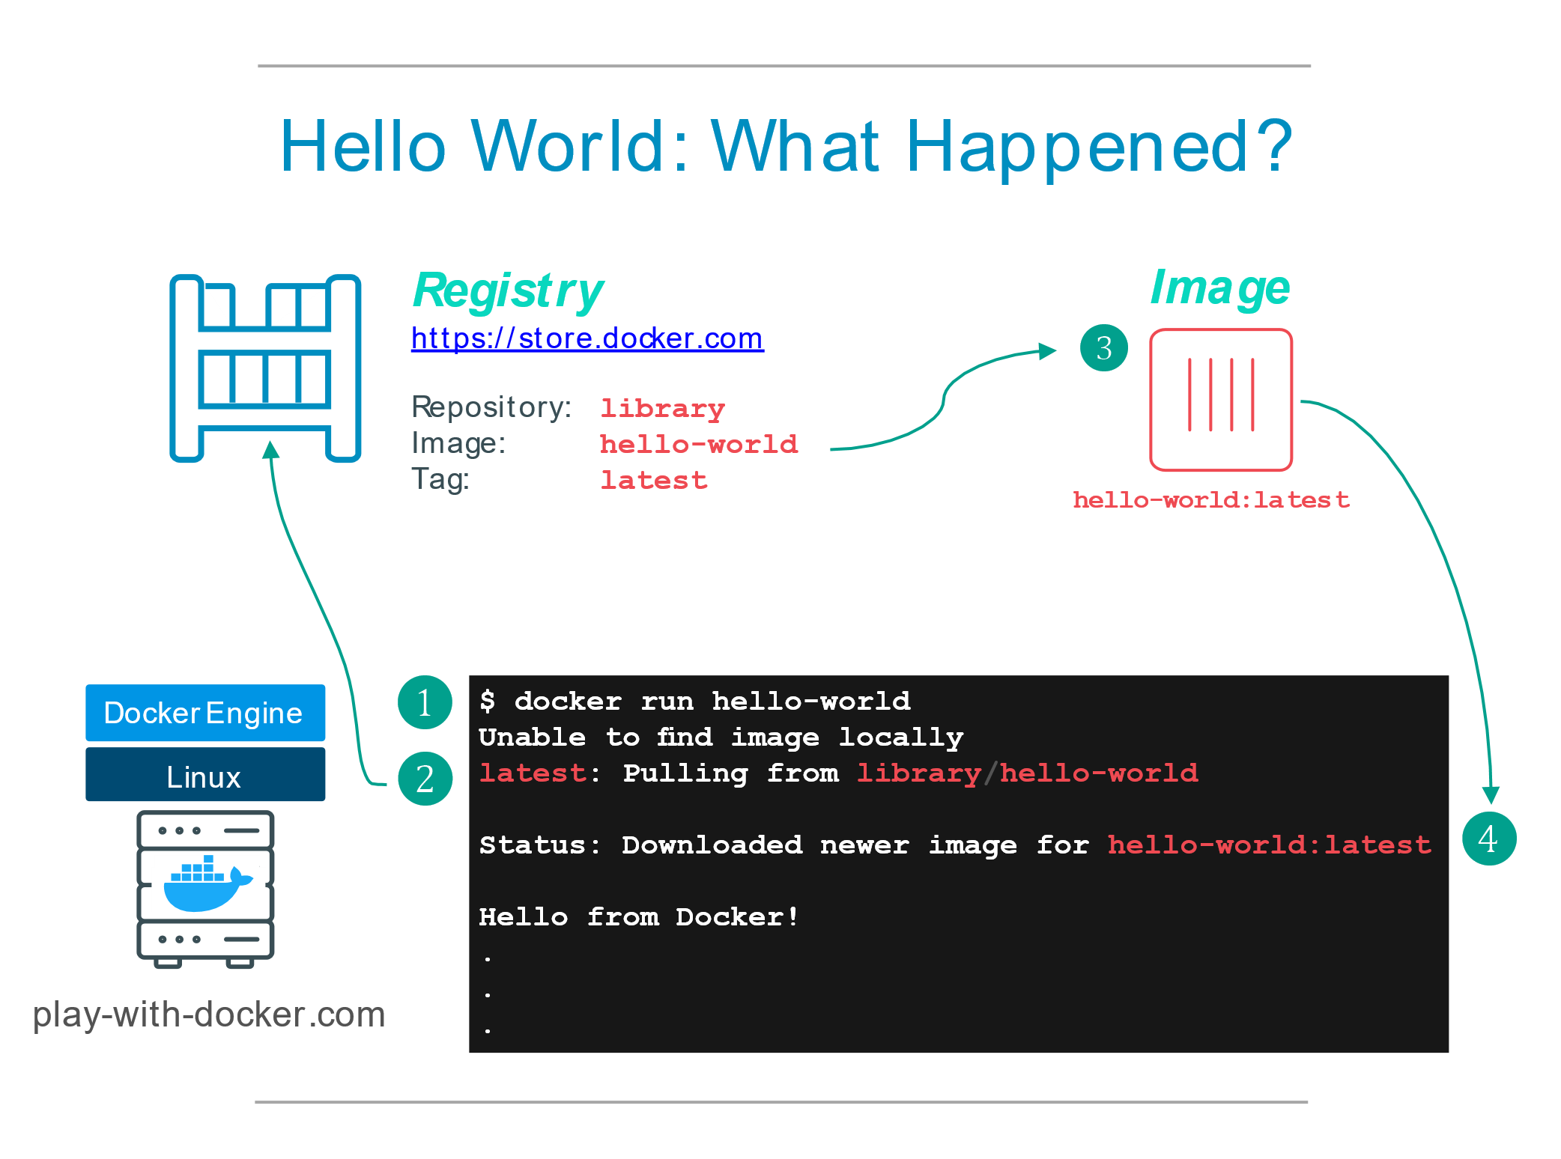
Let’s play with it
http://training.play-with-docker.com/helloworld/
Run the following commands
$docker --version
$docker container run hello-world
What happened?
Docker client contacted the daemon
Docker daemon pulled hello-world image from the Docker Hub
Docker daemon created new container using the image as a template
The container executes and produces the output
The Docker daemon streamed output to the Docker client

Slide 14
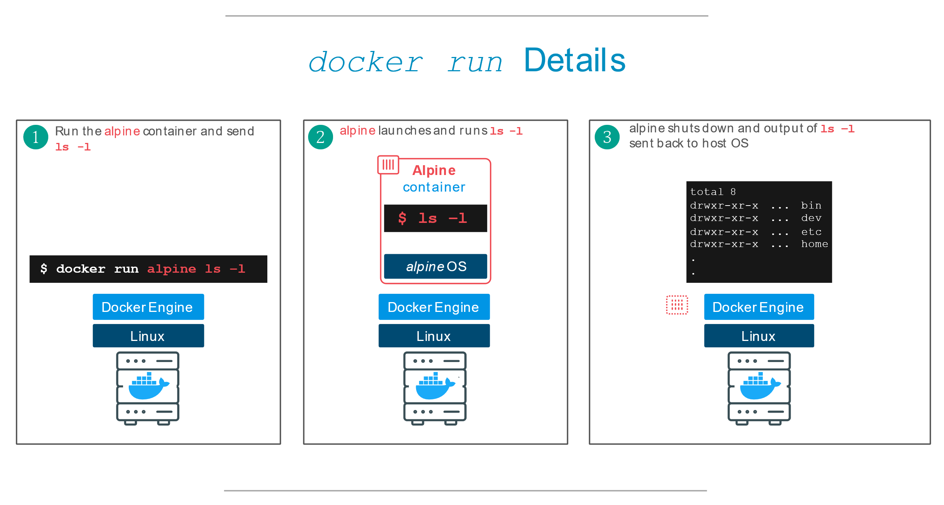
Base linux container
$docker image pull alpine
$docker image ls -a
$docker container run alpine ls -l
Run container in an interactive mode
$docker container run alpine –it /bin/sh

Slide 15
Basic Docker commands
docker container ls # List all running containers
docker container ls -a # List all containers, even those not running
docker container stop <hash> # Gracefully stop the specified container
docker container <hash> # Force shutdown of the specified container
docker container rm <hash> # Remove specified container from this machine
docker image ls -a # List all images on this machine
docker image rm <image id> # Remove specified image from this machine

Slide 16
Docker Objects
Image
An image is a lightweight, stand-alone, executable package that includes everything needed to run a piece of software, including the code, a runtime, libraries, environment variables, and config files.
Container
A container is a runtime instance of an image—what the image becomes in memory when actually executed. It runs completely isolated from the host environment by default, only accessing host files and ports if configured to do so.
Services
In a distributed application, different pieces of the app are called “services.” For example, if you imagine a ecommerce site, it probably includes a service for storing product data in a database, a service for product search, a service for the front-end, and so on.

Slide 17
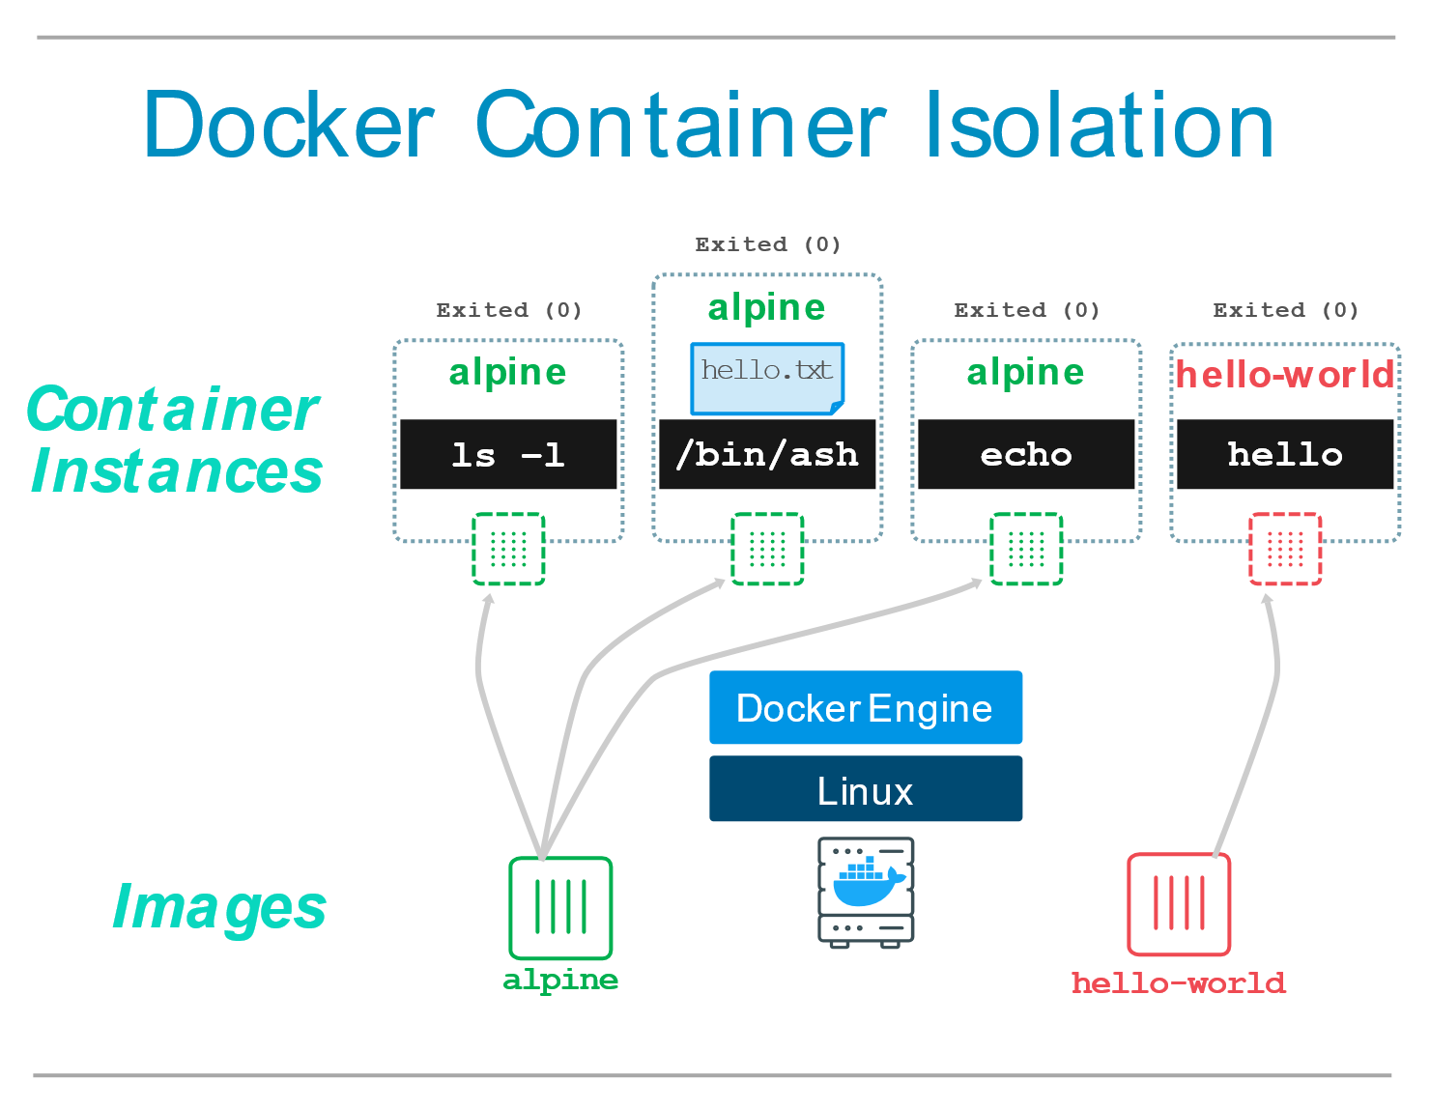
Container Isolation
Each $docker run command starts a new container
Let’s check
$docker container run alpine ls -a
$docker container run alpine –it /bin/sh
> echo ‘Hello World’ > hello.txt
> ls
$docker container run hello-world
Very important feature
Provides security across containers. No Container can access content of another container
Useful to recreate application environments
Useful to quickly create separate, isolated copies of an application and have them run side by side without interfering with each other

Slide 18
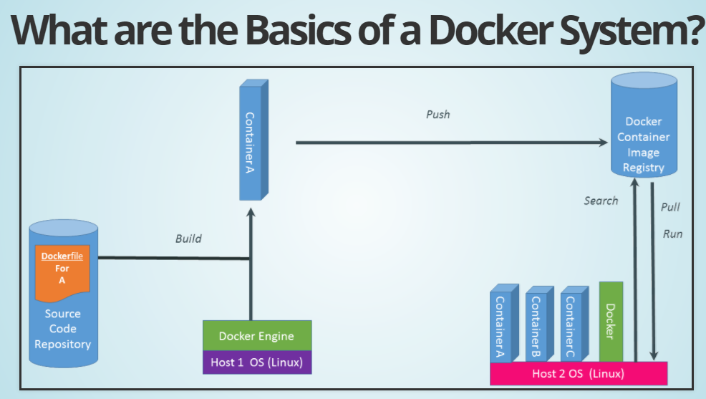

Slide 19
Basic steps to dockerization
Step 0: Create the image (environment and a Dockerfile)
Step 1: Create Container (Instantiating form an image)
Step 2: Connect Services (Compose file, manage dependencies at run-time)
Step 3: Scale using swarms (Scale-out option)
Step 4: Stack (Template – Which describes all containers and infrastructure)
Step 5: Deploy App (Deploy whole stack)

Slide 20
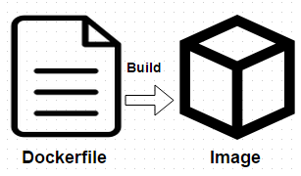
Create Container – Docker Files
Dockerfile is a basic building block for containerizing apps
Docker uses Dockerfile contents to build images
Docker file is a simple text file that contains instructions to be executed on the command line
$docker build command is used to build images using dockerfile

Slide 21
Creating Docker Images from Container
Create a container from which we want to create a new docker image
Modify the container using docker commit

Slide 22
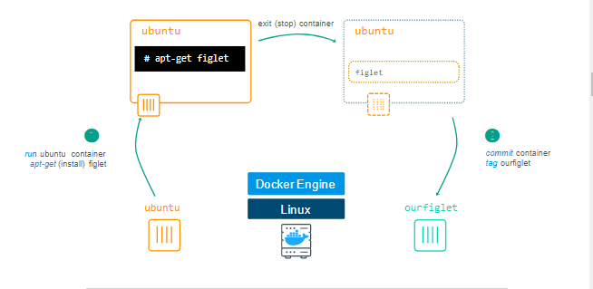
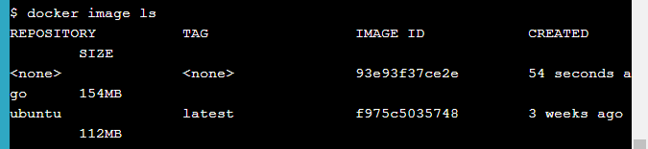
Lab: Image from existing container
Step 1: Get ubuntu container in the bash mode
$docker container run -ti ubuntu bash
Step 2: Install figlet in the container
apt-get update
apt-get install -y figlet
figlet "hello docker“
Exit
Step 3: Get list of containers
Docker container ls -a
Step 4: Check the differences using container diff command
Docker container diff <containerid>
Step 5: Create an image using commit
docker container commit CONTAINER_ID
Step 6: Check list of available images
Docker image ls
Step 7: Tag the image
docker image tag <IMAGE_ID> ourfiglet
docker image ls
Step 8: Create container from new image
Docker container run ourfiglet figlet hello world

Slide 23
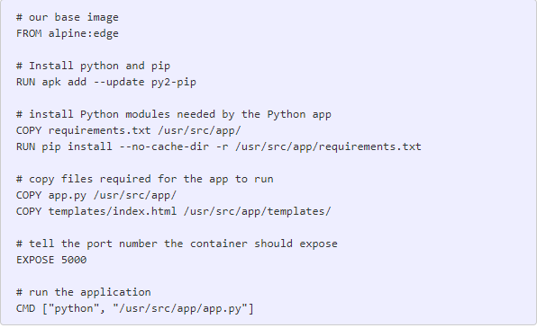
dockerfile commands
Common Dockerfile instructions start with RUN, ENV, FROM, MAINTAINER, ADD, and CMD, among others.
A Dockerfile must start with a FROM instruction. FROM is used to specify the base image that is used for container
ENV is used to create and export Environment variables
MAINTAINER is for storing information about the maintainer of the image/App
ADD is used to add files and folders to local file system of the container
CMD is used to execute local commands in the container
RUN is used to execute any commands in a new layer on top of the current image and commit the results
Dockerfile Example

Slide 24
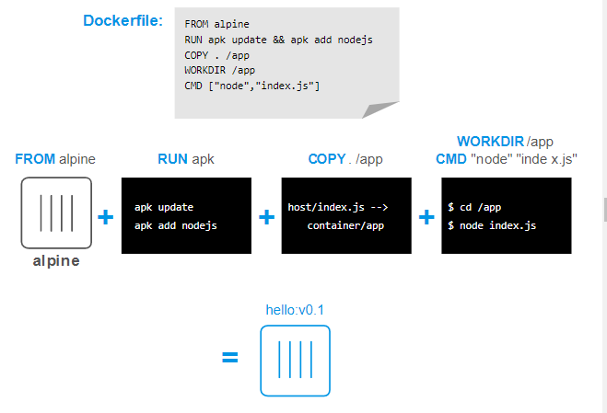

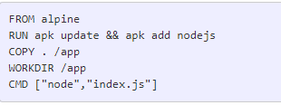
Lab: Create Image for Node.js
Step 1: Create index.js as follows
Step 2: Create Dockerfile in the same folder
Step 3: Run Docker build command
docker image build -t hello:v0.1 .
Step 4: Create container from the image
docker container run hello:v0.1

Slide 25
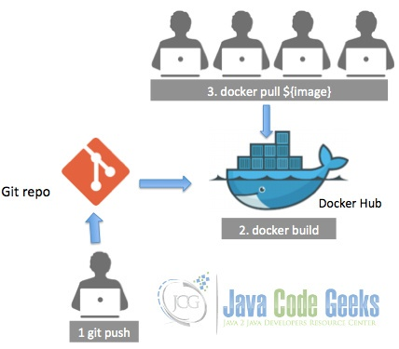
Automate Docker Build
Automate Docker build from Git

Slide 26
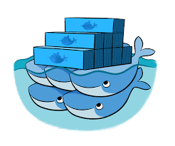
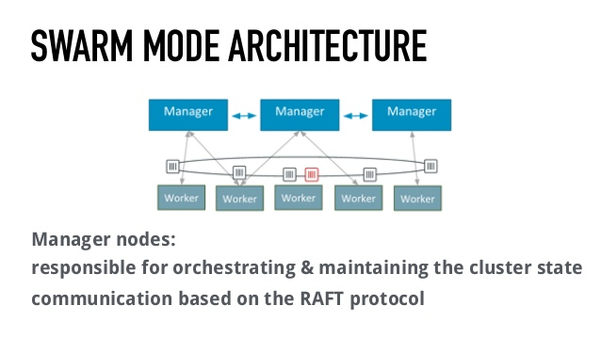
The swarm mode
Docker swarm mode is a native clustering engine that allows you to create and manage swarm clusters
We can deploy services to cluster for load balancing and fault tolerance
Swarm is a cluster of docker engines or nodes on which deploy services
A node is an instance of Docker engine participating in the swarm
To deploy an application on swarm cluster, we need to submit a service definition to manager node

Slide 27
Services
Service is a definition of tasks to execute on the manager or worker nodes
When we create service, we specify information about the image to use and which commands to execute inside running containers
Service definitions are captured in simple to read manifest or compose file written in yml format

Slide 28
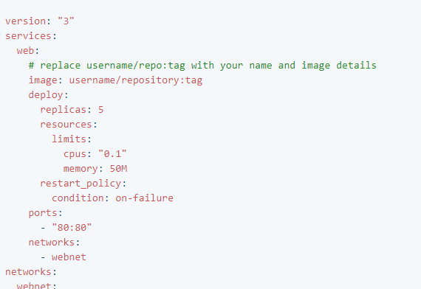
Service compose file
A kind of manifest file that defines service and its attributes
It is stored as yml file
Docker image to download
Number of instances
Resource on each node
Recovery mode
Ports and load balancing protocol

Slide 29
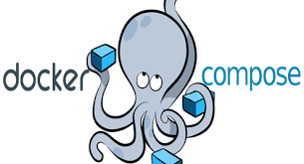
Docker compose
Docker compose is a tool for running multi-container Docker applications
It’s a way to define service and application composition
Composition may contain multiple containers along with their relationships
It’s like packaging app and external dependencies together
You can describe composition using YAML format

Slide 30
Docker compose – Use Cases
Running Application in isolated environments
Compose file provides a way to document and configure all of the application’s service dependencies (databases, queues, caches, web service APIs, etc). Using the Compose command line tool you can create and start one or more containers for each dependency with a single command
Automated testing environments
Compose provides a convenient way to create and destroy isolated testing environments for your test suite. By defining the full environment in a Compose file, you can create and destroy these environments in just a few commands. This is very helpful in CI/CD processes

Slide 31
Docker compose – Installation
Linux
Step 1:
Download docker-compose
Step 2:
Apply executable permissions to binary
curl -L https://github.com/docker/compose/releases/download/1.20.1/docker-compose-$(uname -s)-$(uname -m) -o /usr/local/bin/docker-compose
chmod +x /usr/local/bin/docker-compose
Step 3:
$ docker-compose --version docker-compose version 1.20.1, build 1719ceb

Slide 32
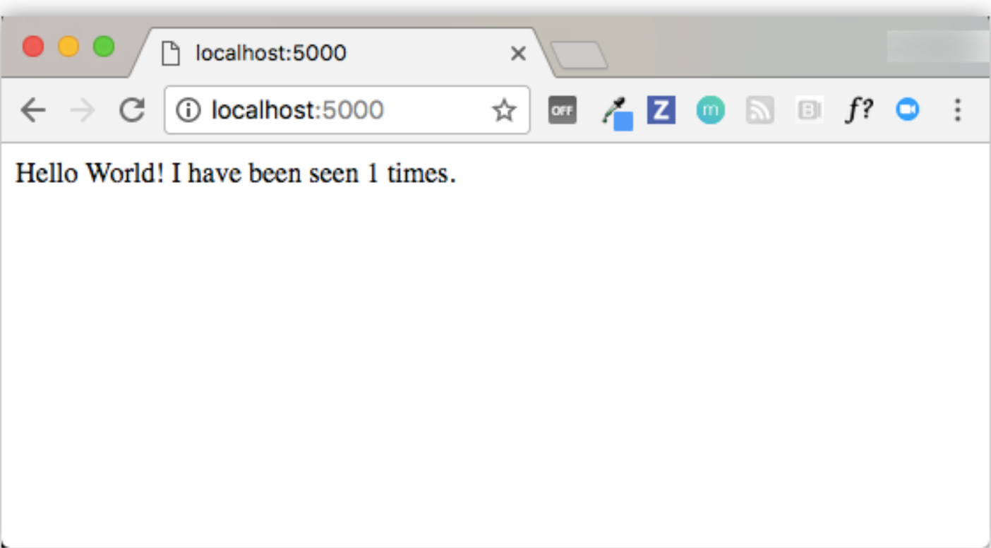
Lab: Python Web App with compose
app.py
import time
import redis from flask
import Flask app = Flask(__name__)
cache = redis.Redis(host='redis', port=6379)
def get_hit_count():
retries = 5
while True:
try: return cache.incr('hits’)
except redis.exceptions.ConnectionError as exc:
if retries == 0:
raise exc
retries -= 1
time.sleep(0.5)
@app.route('/’)
def hello():
count = get_hit_count()
return 'Hello World! I have been seen {} times.\n'.format(count)
if __name__ == "__main__":
app.run(host="0.0.0.0", debug=True)
Hit counter maintenance app
Python with Flask framework
App.py (Web Frontend)
Redis
(Cache for managing counter)
requirements.txt
flask
redis

Slide 33
Lab: Python Web App with compose
Dockerfile
FROM python:3.4-alpine
ADD . /code
WORKDIR /code
RUN pip install -r requirements.txt
CMD ["python", "app.py"]
Hit counter maintenance app
docker-compose.yml
version: '3’
services:
web:
build: .
ports:
- "5000:5000“
redis:
image: "redis:alpine"
Python with Flask framework
App.py (Web Frontend)
Redis
(Cache for managing counter)
tcp:5000
tcp:6379

Slide 34
Lab: Python Web App with compose
Build and run the app
$ docker-compose up
Creating network "composetest_default" with the default driver
Creating composetest_web_1 ...
Creating composetest_redis_1 ...
Creating composetest_web_1
Creating composetest_redis_1 ... done
Attaching to composetest_web_1, composetest_redis_1
web_1 | * Running on http://0.0.0.0:5000/ (Press CTRL+C to quit)
redis_1 | 1:C 17 Aug 22:11:10.480 # oO0OoO0OoO0Oo
Redis is starting oO0OoO0OoO0Oo
redis_1 | 1:C 17 Aug 22:11:10.480 # Redis version=4.0.1, bits=64, commit=00000000, modified=0, pid=1, just started
redis_1 | 1:C 17 Aug 22:11:10.480 # Warning: no config file specified, using the default config. In order to specify a config file use redis-server /path/to/redis.conf
web_1 | * Restarting with stat redis_1 | 1:M 17 Aug 22:11:10.483 * Running mode=standalone, port=6379.
redis_1 | 1:M 17 Aug 22:11:10.483 # WARNING: The TCP backlog setting of 511 cannot be enforced because /proc/sys/net/core/somaxconn is set to the lower value of 128.
web_1 | * Debugger is active! redis_1 | 1:M 17 Aug 22:11:10.483 # Server initialized
redis_1 | 1:M 17 Aug 22:11:10.483 # WARNING you have Transparent Huge Pages (THP) support enabled in your kernel. This will create latency and memory usage issues with Redis. To fix this issue run the command 'echo never > /sys/kernel/mm/transparent_hugepage/enabled' as root, and add it to your /etc/rc.local in order to retain the setting after a reboot. Redis must be restarted after THP is disabled.
web_1 | * Debugger PIN: 330-787-903 redis_1 | 1:M 17 Aug 22:11:10.483 * Ready to accept connections
Hit counter maintenance app
Python with Flask framework
App.py (Web Frontend)
Redis
(Cache for managing counter)
Test application
Point web browser to http://localhost:5000, Refresh page and see if counter increments
tcp:5000
tcp:6379

Slide 35
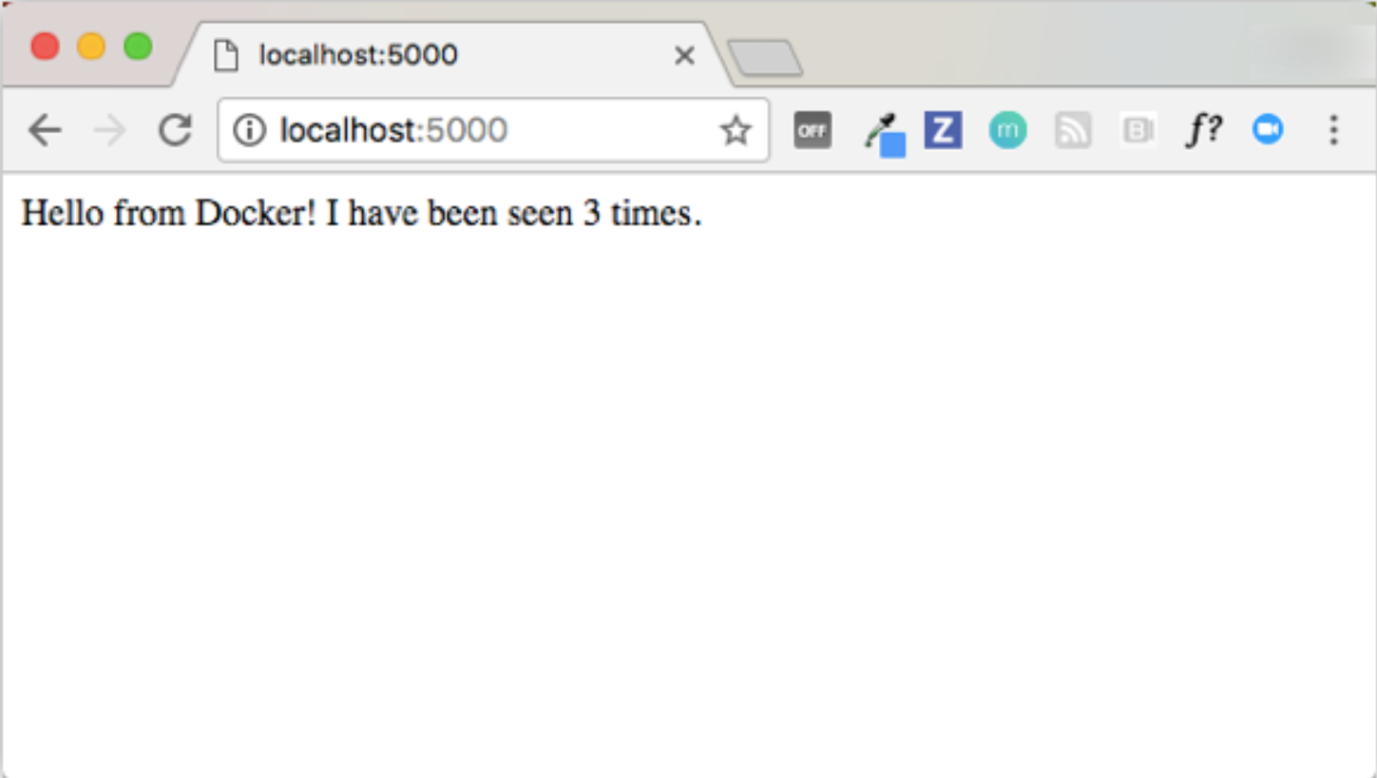
Lab: Python Web App with compose
Edit the compose file to add a bind mount
version: '3’
services:
web:
build: .
ports:
- "5000:5000"
volumes:
- .:/code
redis:
image: "redis:alpine"
Hit counter maintenance app
Re build and run the app
Python with Flask framework
App.py (Web Frontend)
Redis
(Cache for managing counter)
Change app.py
return 'Hello from Docker! I have been seen {} times.\n'.format(count)
Retest the app
tcp:5000
tcp:6379

Slide 36

Lab: docker-compose commands
Start Services in the background
$ docker-compose up -d
Check all the services
$ docker-compose ps
Run one-off commands for the services that is running
$ docker-compose run web env
$ docker-compose run redis env
Stop running services
$ docker-compose stop
Bring everything down, stop running containers, remove volumes
$ docker-compose down --volumes
Validate compose files
$ docker-compose config
Run arbitraty commands on running services
$ docker-compose exec web ls
Run logs
$ docker-compose logs [options] [SERVICE]
(Options) –f –t --tail

Slide 37
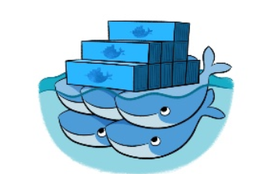
Swarm key concepts
Swarm allows cluster management and service orchestration for docker containers
These features are embedded in Docker engine using a swarmkit
A swarm consists of multiple Docker hosts which run in swarm mode and act as managers (to manage membership and delegation) and workers (which run swarm services).
When you create a service, you define its optimal state (number of replicas, network and storage resources available to it, ports the service exposes to the outside world, and more)
When Docker is running in swarm mode, you can still run standalone containers on any of the Docker hosts participating in the swarm, as well as swarm services.
Docker daemons can participate in a swarm as managers, workers, or both.

Slide 38
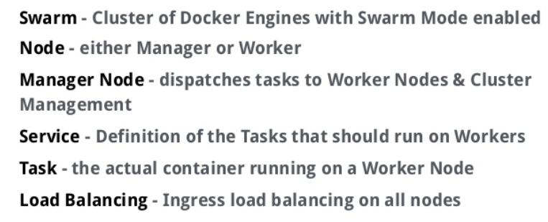
Swarm Concepts

Slide 39
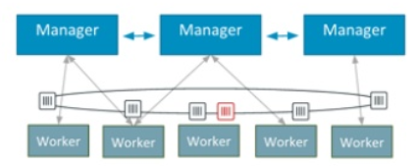
Swarm Architecture
Manager Nodes
Responsible for orchestrating and maintaining the cluster state communication based on the RAFT protocol
Worker Nodes
Receives tasks dispatched by manager nodes

Slide 40
Lab: Setup Swarm
Base Setup
Create 3 nodes
Initialize swarm on Manager node with
$ docker swarm init –advertise-addr <manager_ip>
On the other two nodes, join the swarm node using token generated by manager
Setup stack and deploy it on the swarm
On the manager node, deploy the stack with name
$ docker stack deploy –compose-file docker-compose.yml app1
$ docker stack services app1
Test the service with browser
Scale service instances
$ docker service scale app1_web=2
Check node statuses
Remove the stack
$ docker stack rm app1
https://docs.docker.com/engine/swarm/swarm-tutorial/

