Slide 1
Machine Learning
Basics of Regression and Classification

Slide 2
Motivation
Programming is hard…
But… wouldn’t it be great if we could just show the computer a few examples of the computation we’d like it to perform and it would take care of the rest of us?

Slide 3
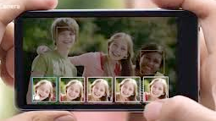
Example
Task: write a computer program to tell whether or not a person in a photograph is smiling
Notes:
This is a feature that is useful for the “best face” feature in a smartphone. The phone takes a bunch of photos in rapid succession and chooses the best image of each persons face (where best = is smiling)

Slide 4
Manual Approach to Programming a Smile Detector
Step 1: think really hard about what distinguishes a smiling from a non-smiling face
(for instance, perhaps it is that smiling faces tend to have more bright pixels around the mouth region, i.e. if their teeth are showing)
Step 2: write up a program to implement your rule for distinguishing smiles from non-smiles
Step 3: evaluate the quality (e.g. accuracy) of your program
Step 4: Iterate the whole process until system is “good enough”

Slide 5
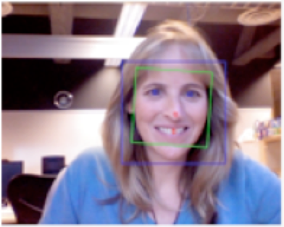

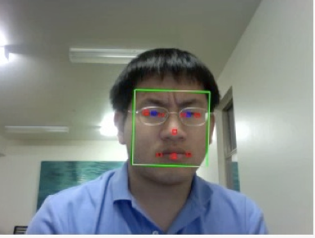
Automatic (Machine Learning) Approach to Programming a Smile Detector
Database of Smiling
Faces
Machine Learning Algorithm
…
Automated Smile Detection System!
Database of Non-Smiling
Faces
Large set of possible distinguishing characteristics
Notes:
Key point is to say that the filters in the middle encode a bunch of image characteristics that could possibly be related to the task of smile detection. You give the system a lot of potential choices and you let the algorithm sort it out. You are basically automating the manual process using math! The data acts as sort of a proxy for your prior knowledge / intuition about the problem.

Slide 6
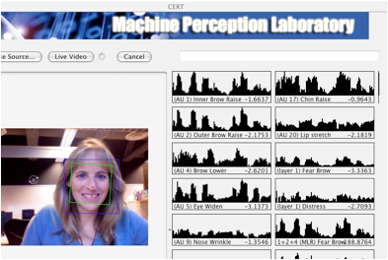
Result
Dianna, if you want to do a live demo of this I can send you the program (it runs on Macs) and is quite easy to use
Notes:
System can detect small changes in facial expression (Facial Action Coding System)

Slide 7
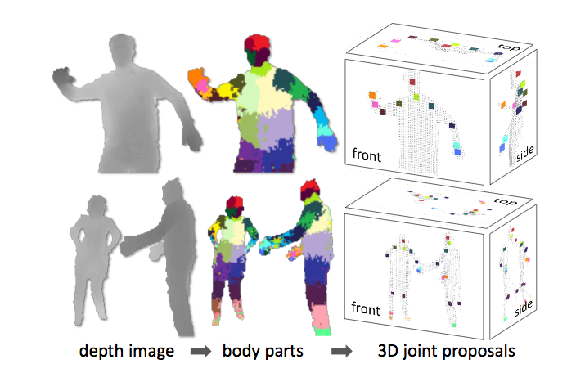
Other Machine Learning Successes: Real-Time Pose Recognition
http://research.microsoft.com/pubs/145347/BodyPartRecognition.pdf
Notes:
Kinect was trained based on a machine learning algorithm applied to a large database of human-labeled skeletal poses.

Slide 8
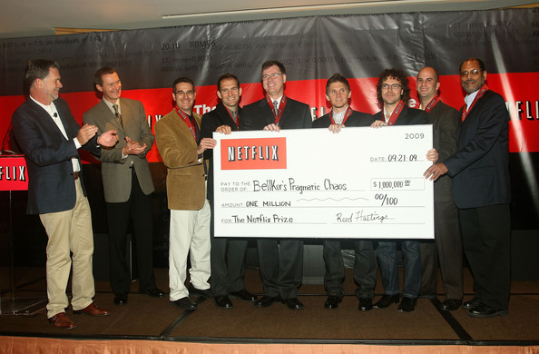
Other Machine Learning Successes: Netflix Prize
Notes:
Improved > 10% on ratings prediction = $1,000,000 prize. Winning entry was an amalgam of the entries of several of the teams (where the combination was learned using machine learning)

Slide 9
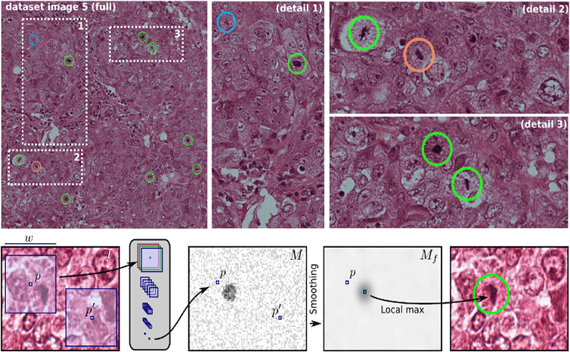
Other Machine Learning Successes: Interpreting Medical Images
Notes:
http://www.idsia.ch/~juergen/deeplearningwinsMICCAIgrandchallenge.html (detecting Mitosis)… important for cancer detection

Slide 10
Other Machine Learning Successes: Machine Learning in BioInformatics
http://intl-bib.oxfordjournals.org/content/7/1/86.full.pdf+html
Applications
Determine genetic markers of various cancers
Find the site in the genome where a protein is coded
Predict secondary (folding) structure of a protein

Slide 11
What is Driving the Trend Towards Machine Learning Approaches?
Driver 1: availability of large amounts of data
Driver 2: advances in computing power
Driver 3: better ML algorithms
Driver 4: emergence of a killer ($$$) application (online / mobile advertising optimization)

Slide 12
What’s the Bad News?
Successfully applying machine learning is not as easy as these successes make it seem
Key challenges
Choosing the right data
Choosing the right technique
Rigorously evaluate an approach
Debugging / refining your approach if it doesn’t work satisfactorily

Slide 13
Machine Learning (more formally)
Given:
where
Training set
Produce:
Output set
Such that “f” accurately predicts the output y given the input x for new data
Notes:
Make sure to say that \mathcal{Y} is an output space (commonly -1,+1 for classification (say in the case of smile detection), or \mathbb{R} in the case of regression (which I am assuming they have already seen). Also, make sure to say that the d-dimensional space of the x_i’s are some set of features / attributes you can measure about instance.
This slide could be much more technical and get into things like minimizing the risk (expected loss over some loss function), but I don’t think that will be very helpful.

Slide 14
How do we find “f”
Typical approach: choose “f” that balances accurately reproducing the outputs in your training set while not being overly “complicated”
Question for the class: what would be a choice (a bad one) that perfectly reproduces that data in the training set, but would not work well for new data?
Notes:
The answer to the question is the solution of just memorizing the training data and outputting a random output otherwise (or maybe always outputting the same if you don’t want to make it non-deterministic)

Slide 15
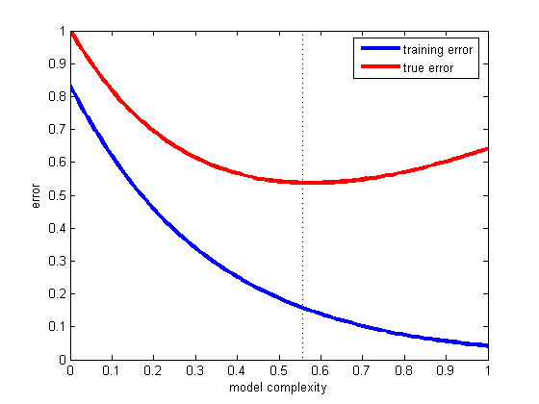
The Problem of Overfitting
Notes:
This is typically what will happen

Slide 16
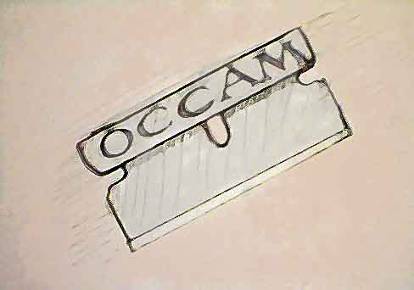
Occam’s Razor
Notes:
Explain what this is and

Slide 17
A Familiar Machine Learning Algorithm
Ordinary Least Squares (OLS) can be thought of as a machine learning algorithm
Why?
Notes:
You can say that this is trying to fit the training data as well as possible (in the least squares sense) but our prior knowledge will restrict us to only considering linear models (this is to some extent the idea of Occam’s razor being formalized)

Slide 18
Other Machine Learning Algorithms
http://scikit-learn.org/stable/supervised_learning.html#supervised-learning
Notes:
Key point is that while ordinary least squares is something shared by classical statistics and ML, there are many new algorithms that have sprung up from within the ML community. Tell them they will have a chance to play around with scikit-learn next class.

Slide 19
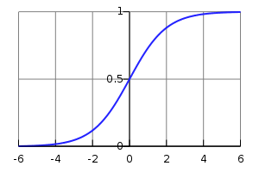
Algorithms for Classification: Logistic Regression
For classification:
For logistic regression we assign probability of the output being +1 as a linear function of the input x passed through the logistic function
Notes:
Say that we fit the particular weights of the linear combination using a fairly similar procedure as linear regression (the function we optimize is a bit different but the idea is pretty similar)

Slide 20
If you need more material: add Slides on Perceptron Algorithm
Pros: Easy to implement, has an easy to understand theorem regarding number of mistakes to learn a separating hyperplane

Slide 21
What if your Data is Non-Linear?
+
+
+
-
+
-
-
-
+
-
+
+
+
+

Slide 22
Two Solutions
Map Data into Higher Dimensional Space
E.g. add quadratic terms to separate out the positives outside the circle from negatives inside
Use a different algorithm (we will see this next time)

Slide 23
Evaluating Machine Learning Algorithms
Typical Approach: create a train / test split
Partition
into:
Learn Model on the training data and estimate performance using testing data (simulates having new data)

Slide 24
Potential Pitfalls
Don’t make the first half of your data a training set and the second half of your data the testing set! (any idea why?)
Tradeoff between too much versus too little test data (too much = suboptimal performance because it could be used for learning, too little = estimate of performance prone to noise).
Notes:
Answer to 1st question is that if the data is organized in a particular fashion the two sets may not be drawn from same distribution.
Also say that the second point can be ameliorated using techniques such as k-fold cross validation which we will see next time.

Slide 25
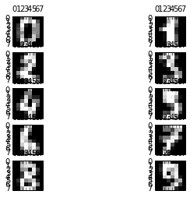
Quick Example: Digit Recognition
Notes:
This is from MNIST. Say a bit about the problem. 10-way classification based on 8x8 gray scale handdrawn images

Slide 26
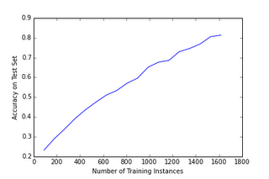
Illustration of Too Little Training Data: Digit Recognition
Notes:
Note: some noise in the graph. They will play around with this first hand in the lab. Make sure to highlight the left side of the graph as being particularly bad

Slide 27
Conclusion of ML Part 1
ML seeks to program computers using experience (data)
Fast growing field
Linear regression can be seen as a machine learning technique
Logistic regression is an ML technique used for classification
Chiefly interested in optimizing performance on unseen data (which we can estimate by splitting data into training and test sets)

Slide 29
More slides on ML applications if you want to kill time with shiny things ☺

Slide 30
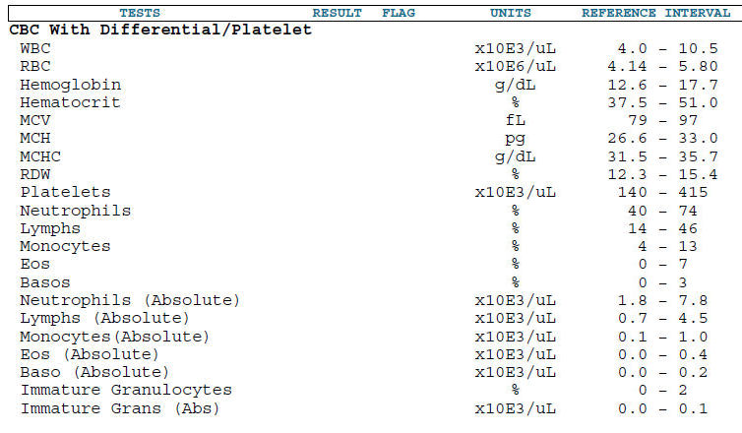
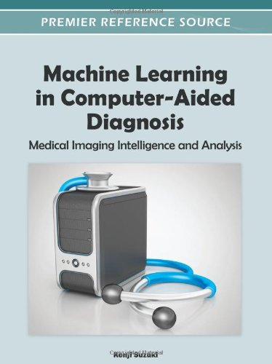
Medicine: Automated Medical Diagnosis

Slide 31
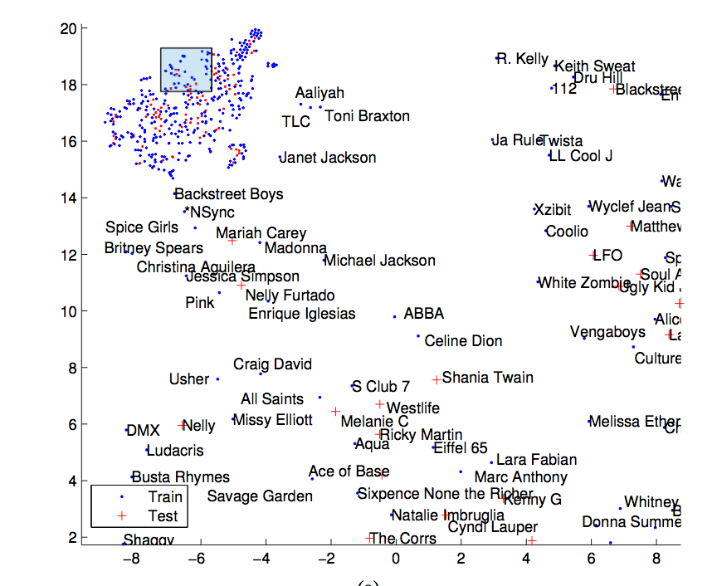
Machine Learning for Music Similarity Analysis

Slide 32
Reinforcement Learning in Robotics
http://www.youtube.com/watch?v=XiigTGKZfks (pendulum swingup… real system)
http://www.youtube.com/watch?v=oWKmgxZC5vk (unicycle in simulation)

Slide 33
Robotics: Programming by Demonstration
Programming industrial robot by demonstration: http://www.youtube.com/watch?v=Pnt2NY5J5Nk
Mario: http://www.youtube.com/watch?v=V00npNnWzSU
TuxCart: http://youtu.be/V00npNnWzSU

