Slide 1
Machine Learning
Tuning ML Algorithms

Slide 2
Review from Last Time
Motivation for Machine Learning:
Automate programming by “showing” the computer examples of the computation you want it to perform.
Notes:
Make sure to say, “where showing means providing the computer with sample input output pairs for the function you want it to compute”

Slide 3
Review: Machine Learning (more formally)
Given:
where
Training set
Produce:
Output set
Such that “f” accurately predicts the output y given the input x for new data
Notes:
Make sure to say that \mathcal{Y} is an output space (commonly -1,+1 for classification (say in the case of smile detection), or \mathbb{R} in the case of regression (which I am assuming they have already seen). Also, make sure to say that the d-dimensional space of the x_i’s are some set of features / attributes you can measure about instance.
This slide could be much more technical and get into things like minimizing the risk (expected loss over some loss function), but I don’t think that will be very helpful.

Slide 4
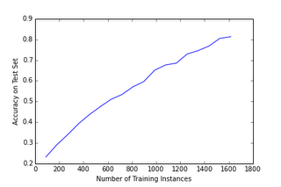
Review: Illustration of Too Little Training Data (digit recognition)
Notes:
Note: some noise in the graph. They will play around with this first hand in the lab. Make sure to highlight the left side of the graph as being particularly bad

Slide 5
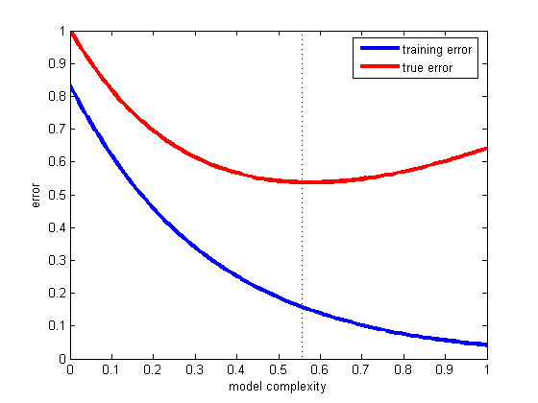
Tuning Your ML Algorithm
Motivating Question: is there any way we can “fix” the lefthand side of this curve?
Potential Fix lies here:
Notes:
If we can figure out how to control model complexity then we can minimize error and wind up in the sweet spot in the graph shown (note this is obviously a cartoon. Actual improvements will be even more dramatic as we will see).

Slide 6
Controlling Model Complexity: Ridge Regression
Objective function for logistic regression:
Penalty for not fitting the training data
Objective function for logistic regression with ridge term:
Penalty for not fitting the training data
Penalty for overly complex models
Notes:
Make sure to point out that the model complexity term is called the “ridge term”. Another name for this is Tikhonov Regularization (http://en.wikipedia.org/wiki/Tikhonov_regularization). Make sure to say C is some positive constant that the user has to specify. If someone asks how to pick C, say we will see this later.

Slide 7
Why is the Magnitude of the Weights a Good Metric of Model Complexity?
One answer: it clearly restricts our solution space of models (to those near the origin) which helps limit flexibility (i.e. complexity)
Another answer: a priori we expect that each feature in x should have a somewhat small impact on the output y.
Notes:
The first answer is pretty self explanatory. The second you can motivate by invoking the digit recognition example. For instance, suppose the weight for a particular pixel connected to a particular digit class (say 0) was 10. This would mean that the odds of an image being a 0 would increase dramatically if we changed the pixel brightness at that location a small amount. This seems unlikely a priori and ridge regression gives us a way to formalize this notion.

Slide 8
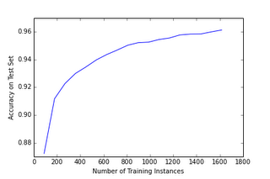
Results of Applying Ridge Regression to Digit Recognition
Note: the differing axes on the two figures!!

Slide 9
Tuning Your ML Algorithm
We have swept one crucial detail under the rug
Penalty for not fitting the training data
Penalty for overly complex models
How the heck do we get a good value of C?!?
Notes:
You could ask if anybody sees what it is before advancing the animation

Slide 10
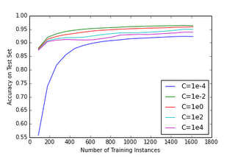
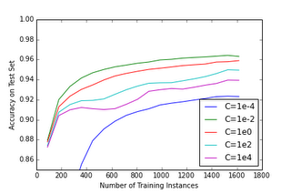
The Effect of C on Accuracy
Notes:
The one on the right is zoomed in on the lefthand side of the graph

Slide 11
Choosing C Continued
Simplest (and most common approach): choose the value that works the best!
Basically amounts to picking the max from previous graph

Slide 12
Choosing C and Validation Set
Choosing the maximum of the previous curves will give you a somewhat inflated estimate of model performance.
Better strategy: choose C based on a validation set, evaluate on a test set

Slide 13
Validation Sets
Training Set
Test Set
Training Set
Validation Set
Test Set
Notes:
Remember to say that validation set is used to choose C

Slide 14
Tuning ML Algorithms more Generally
Most ML Algorithms have some constants to set (like the value of “C” for ridge regression)
These are called “hyperparameters”
Validation sets are a good way to set these (but it is computationally inefficient)
You will experiment with this first hand in the lab.

Slide 15
Additional Topic: Relationship between Machine Learning and Data Mining
Dianna, you might want to add some slides about how ML algorithms could be used to understand data more thoroughly

Slide 16
Understanding Data Using ML: Example 1
Notes:
For more details see original source (http://mplab.ucsd.edu/~jake/pami_paper.pdf). This relates to a finding that people have a bias to look at the left side of people’s faces when discerning facial expressions. ML algorithm confirms same finding.

Slide 17
Understanding Data Using ML: Example 2
Notes:
The idea here was to explore using facial expression recognition software + Machine learning to predict driver fatigue from video of someone’s face. Graph shows a motivating fact about traffic accidents. Lower right is the experimental setup designed to harvest data.

Slide 18
Understanding Data Using ML: Example 2 (continued)
Notes:
This table shows which facial movements are most predictive of drowsiness (drowsiness was defined as about to crash in a simulated driving scenario). Blink / eye closure is obvious, however, outer brow raise is not. This result shows that people actually using their brow muscles to try to keep their eyelids open when they are very tired. This finding was unexpected, and highlights the ability for ML algorithms (in this case Logistic Regression) to pull out trends from data.

