Slide 1

IBM
Cisco
Red Hat
Hitachi
ServiceNow
Fordham University
University of Michigan
Purdue University
University of Delaware
University at Buffalo
Pennsylvania State University
Indiana University
University of Illinois Urbana-Champaign
SRI International
Natural Language Interaction Protocol:
A Universal Application-Level Protocol for the Age of Generative AI
(ECMA-TC56, AI Alliance Affiliated Project)
Ranjan Sinha
IBM Research

Slide 2
Collaborators
IBM
Dinesh Verma
Jonathan Lenchner
Abhay Ratnaparkhi
Ranjan Sinha
RedHat
Eric Erlandson
Sanjay Aiyagari
Cisco
Ashish Kundu
Hitachi
Yohei Kawaguchi
ServiceNow
Sean Hughes
SRI International
Yan-Ming Chiou
Independents
Raj Doodhiawala
Tom Sheffler
University at Buffalo
Jinjun Xiong
University of Delaware
Chien-Chung Shen
Mathews Mauriello
University of Michigan
Sugih Jamin
Purdue University
Elisa Bertino
Indiana University / University of Illinois Urbana-Champaign
Luyi Xing
Fordham University
Mahomed Rahouti
Pennsylvania State University
Winpeng Yin

Slide 3
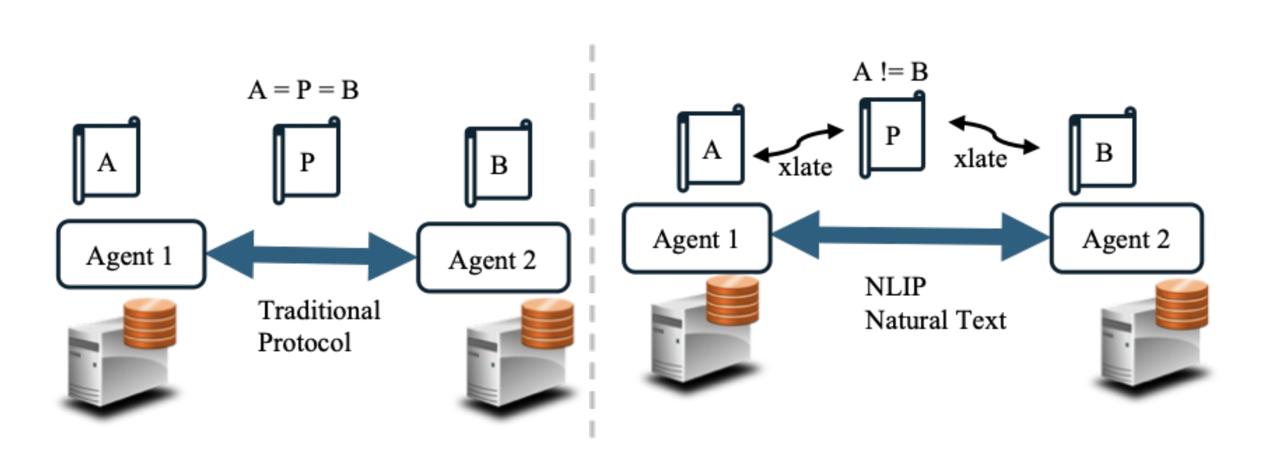
Motivation
Several application-level protocols and APIs with rigid schemas in use.
Challenges with integration, interoperability, and version management.
Could we apply generative AI to design smarter, more adaptable protocols?

Slide 4



Vision
NLIP provides a simple, open, standard, common protocol for apps, agents, and services to communicate with each other and to us.
Assumes GenAI capability on both end-points.
Follows request-response paradigm, to ensure that the meaning is refined and understood.
Requirements for Protocol
Should be secure
Should enable various safeguards such as data privacy, data usage policy, and DDoS prevention
Should be implementable over various underlying transports and API styles
Should support multimedia content exchange
Should permit communication efficiency
Should enable implementation in various languages
Should be standardized in an open forum
NLIP
NLIP

Slide 5
NLIP uses Generative AI for structure independent communications
Application-level protocols define the structure
Forces a rigid API
Version upgrade issues
Limits extensibility
Tight coupling between systems
NLIP allows structure independence
Information exchanged on the wire will be translated to a structure local to each communicating party
GenAI is good at parsing unstructured text to structured text
All three structures must be same
Traditional Protocol
{
“host”: “localhost”,
“port” : 8000
}
Structure Independence
NLIP
I am running on port 8000 locally
{
“host”: “localhost”,
“port” : 8000
}
{
“url”: “localhost:8000”,
}

Slide 6
NLIP Scope
In-Scope
Communication between two AI-Agents
Both across organizations and within organization
Communication between a human and an AI-Agent
Both across organizations and within organization
Out of Scope
Communication between legacy software
Both across organizations and within organization
Communication between a legacy software (not using AI) client and an AI-Agent
Both across organizations and within organization
NLIP is for AI-to-AI and human-to-AI conversations — not for old, pre-AI systems.

Slide 7




NLIP and other Protocols
Mode A
There are multiple single vendor protocols proposed for different aspects of AI agent tasks such as resource management, tool calls, and discovery
Anthropic MCP, IBM ACP, Google A2A, Cisco AGNTCY, …
NLIP can interoperate with them in two ways
Mode A:
NLIP provides Northbound API, vendor protocol provides Southbound API. Using a LLM to support translation.
Mode B:
NLIP provides interoperability across different domains of single vendor protocols. Each domain may have multiple agents using different frameworks.
Eventually, the industry should converge to an open standard protocol such as NLIP
NLIP
Translation Agent
Single Vendor Protocol
Mode B
Vendor C Domain
Vendor A Domain
NLIP
Vendor B Domain

Slide 8
History Repeats Itself
Observation
The IT landscape today is similar to 1990s
1990s:
Every business app had its own protocol, custom client, and bespoke integration.
Pre-HTTP protocols: FTP, Telnet, Gopher, NNTP, client-server protocols for CRM, ERP …
HTTP emerged as a simple, uniform, extensible protocol.
HTTP unified Internet experience under a single, general-purpose interface – the web browser.
Simplified application delivery, interoperability, unleashed Internet applications.
Today
Fragmented ecosystem of AI agents, tools, APIs, and proprietary integrations.
LLMs and AI agents don’t all talk the same language.
AI agents and chat are becoming a common interface for business solutions.
If we can define a single standard protocol – HTTP for intelligent systems.
Unleash scale and collaboration for Agentic AI applications.
NLIP will be for Agentic AI applications what HTTP was for the Internet.

Slide 9
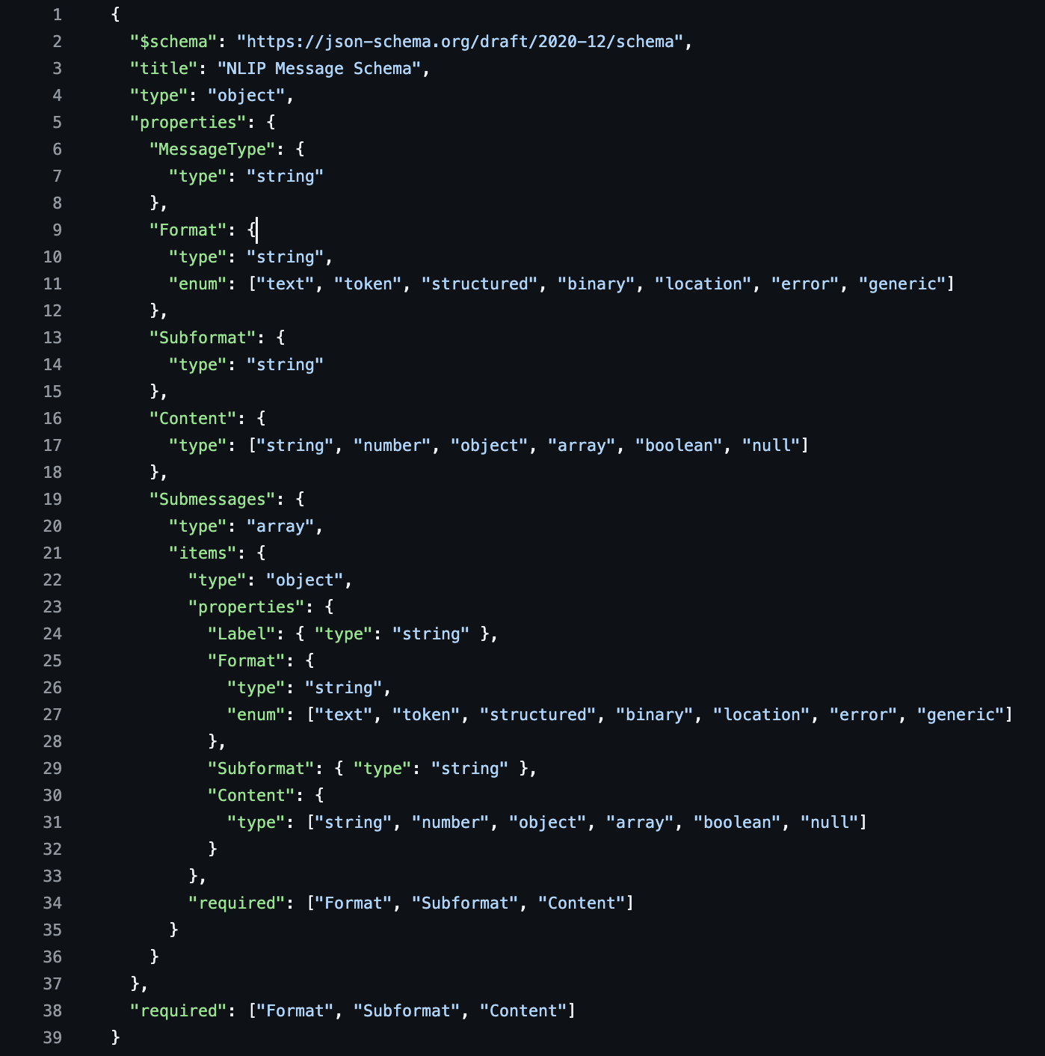
NLIP Schema – Simple and Concise
https://github.com/nlip-project/documents/blob/main/specification/nlip.json

Slide 10
NLIP Message Structure
Each NLIP message has a Type (control/data/general)
The basic structure of an NLIP Exchange is a Sub-Message
Format: what kind of content? (Text/JSON/Image/Video).
Subformat: More detail on the format. (Language for text, encoding for images).
Content: The actual message (“What is the weather in Berkeley tomorrow?”)
Label: simple name or tag (weather-info).
NLIP messages can consist of a sequence of sub-messages
MessageType
Format
Format
Subformat
Subformat
Content
Content
Label
Label
Submessages (opt)
Format
Subformat
Content
…
Label

Slide 11




NLIP Message Format is Community-Driven
Text
Media
Audio
Video
Images
Documents
Structured Information
NLIP
“Weather in Berkeley”
NLIP aims to solve the “Tower of Babel” problem in AI agent communication.
Agntcy: https://spec.acp.agntcy.org/#model/message
ACP: https://agentcommunicationprotocol.dev/core-concepts/message-structure
A2A: https://a2aproject.github.io/A2A/latest/specification/#64-message-object
Langchain: https://python.langchain.com/api_reference/core/messages/langchain_core.messages.ai.AIMessage.html
Autogen: https://github.com/microsoft/autogen/blob/main/python/packages/autogen-agentchat/src/autogen_agentchat/messages.py

Slide 12
NLIP Salient Features
Primary mode of interaction is natural language.
Could be typed text or spoken text with speech to text conversion.
Promotes an intuitive human-centric communication.
Vision, Audio and other modalities are supported.
Structured text supported but not intended as a primary interaction mode.
No custom configuration – All configuration and policy exchanges made using natural language.
The AI models used by different end-points (clients and servers) in a NLIP session can be different.

Slide 13



NLIP Reference Architecture
Mobile App
(Hopefully Universal)
NLIP
Library
NLIP
Base Xfer Protocol
HTTPS
Authentication
System
JWT/OAUTH
Secure
Connection
TLS
TLS Proxy
Authentication Server
Base Protocol Server
NLIP
Server
Business Application
Server
NLIP integrates seamlessly with existing system architectures.

Slide 14
Example: Version Management
Agent A
Registrar
NLIP can be used to interoperate among services that have different versions of internal representation.
Example:
Service R is a registration service:
Each registered agent has fields id, URI and Idempotency
Agent A does not support idempotency field
Initial registration does not contain information about it
{
“ID”:”A”, “URI”: “U”,
“idem”: “X”
}
I am A running on URI U
Are your operations Idempotent?
{
“ID”:”A”, “URI”: “U”,
“idem”: “False”
}
I can not interpret your message
You are A with URI U and do not support idempotency.
That is correct.

Slide 15
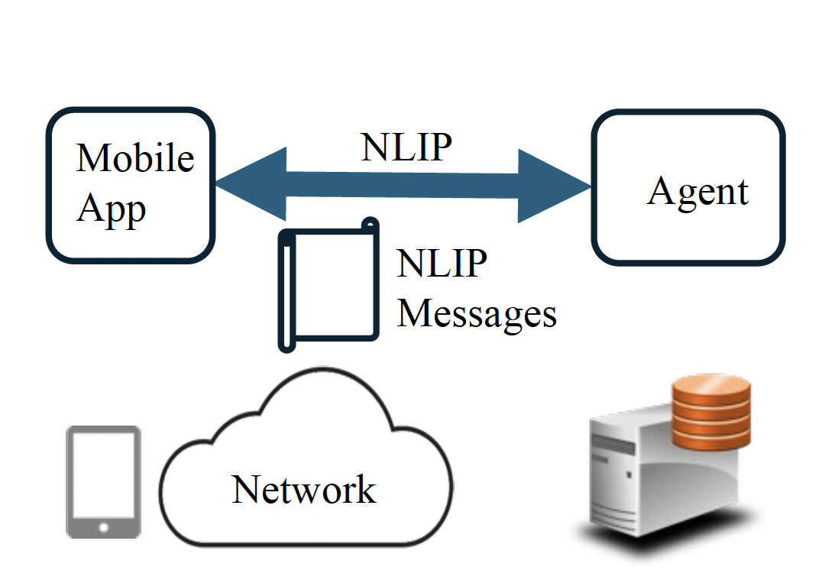
Use Case I: Chat Interaction
Chat client enquiring about the Ecma organization.
{ "format":"text", "subformat":"english", "content":"What is Ecma?” }
Response from the chat Server.
{ "format":"text", "subformat":"english", "content":"Ecma International (Ecma) is an independent, non-profit, global standards organization. It develops and publishes international standards for information technology, including specifications for programming languages, data formats, and software licensing.” }
https://github.com/nlip-project/ecma_draft/blob/main/tc56-2025-018.pdf

Slide 16
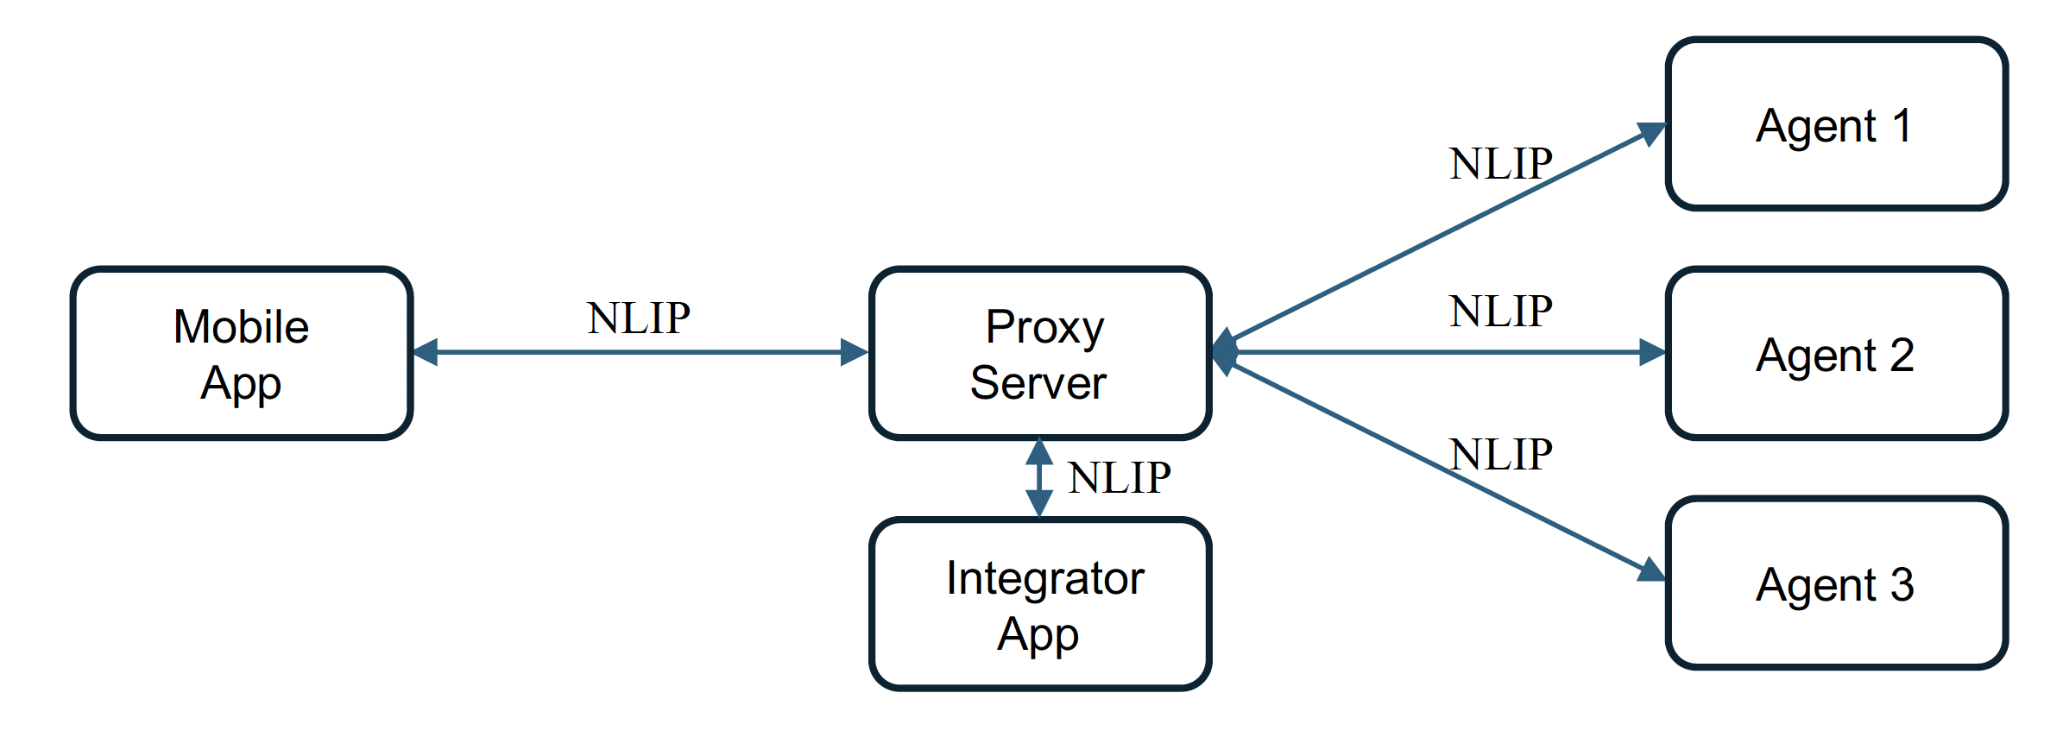
Use Case II: Federation among Various Agents
1. Client sends a NLIP message to the proxy server
{ "format":"text", "subformat":"english", "content":"What is Ecma?” }
2. Same message is sent out to three agents by the proxy server
3. Proxy server combines the responses from all the agents. It may send a request to an integrator agent using a NLIP messages with multiple submessages.
{ "format":"text", "subformat":"english", "content":"Ecma International (Ecma) is an independent, non-profit, global standards organization.” }
{
"messagetype":"Request",
"format":"text",
"subformat":"english",
"content":"Please combine the requests in the submessages”,
"submessages":[
{
"format":"text",
"subformat":"English",
"content”: “Ecma International (Ecma) is an independent, non-profit, global standards organization.
},
{
"format":"text",
"subformat":"English",
"content":"ECMA (European Computer Manufacturers Association) is a non-profit organization.”
},
{"format":"text",
"subformat":"English",
"content":"ECMA, or European Computer Manufacturers Association, is an organization.”
}
]}
Agent 1
{ "format":"text", "subformat":"english", "content":"ECMA (European Computer Manufacturers Association) International is a non-profit organization.” }
Agent 2
{ "format":"text", "subformat":"english", "content":"ECMA, or European Computer Manufacturers Association, is an organization.” }
Agent 3

Slide 17
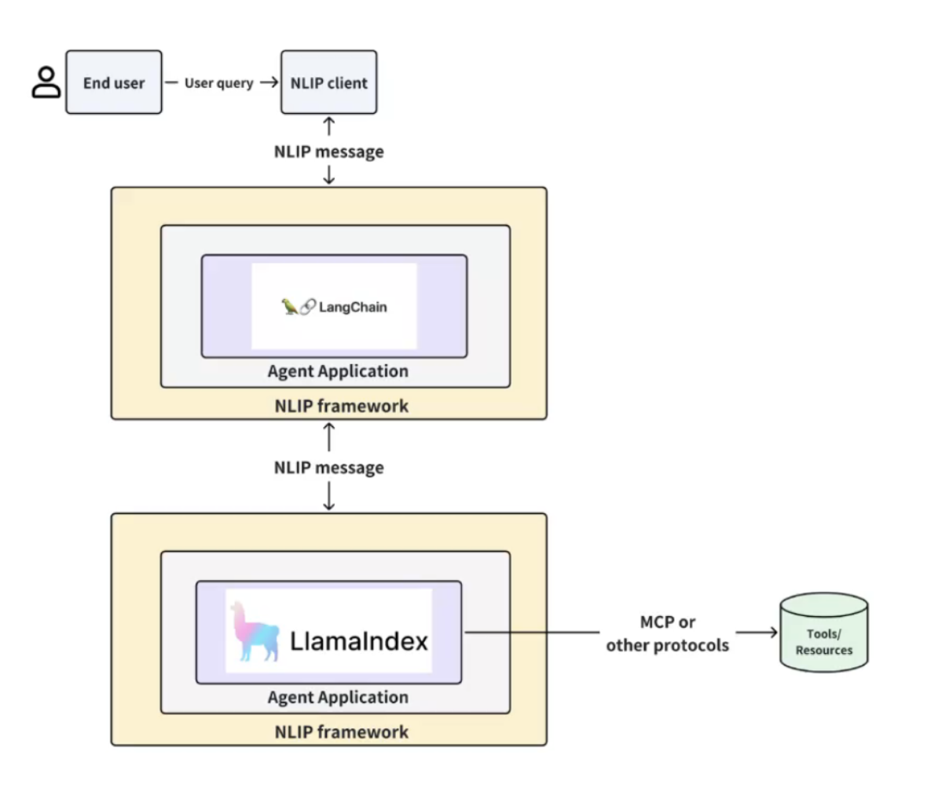
Use Case III: Integrating with Agent Development Frameworks
Works with popular Agentic AI frameworks like Langchain and LlamaIndex.
Supports tool calling through standard protocols.
Enables agent-to-agent communication.
Coordinator Agent
Weather chatbot
Coordinator agent receives a user query and delegates tasks to a worker agent, which accesses an external weather API.
The agents use NLIP messages for their interactions.
Coordinator aggregate responses from the worker and returns a synthesized answer to the user.
Weather API
Worker Agent

Slide 18
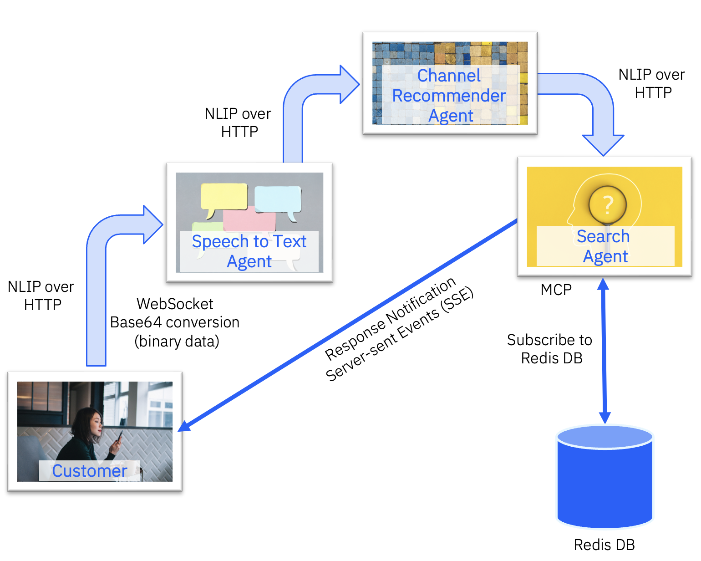
Use Case IV: Speech-to-Text for Customer Support
Customers get contextually relevant Reddit content just by speaking their question.
Voice Input: Audio is captured and sent via WebSocket as Base64-encoded data or as binary audio data using the NLIP message format.
Speech Processing: Speech-to-Text agent uses NVIDIA ASR model and forwards the text using NLIP protocol.
Smart Channel Selection: The Channel Recommender agent analyzes the query and identifies the most relevant Reddit channels to search.
Intelligent Search: Search Agent calls the Reddit APIs, pulls the most recent and relevant posts from each recommended channel, and caches results in Redis for real-time updates.
Seamless Integration: We use MCP (Model Context Protocol) to connect with Reddit's APIs, ensuring we get fresh, relevant content back to the user.
The entire flow uses NLIP messaging over HTTP, with Redis handling pub-sub for live updates.

Slide 19
NLIP Key Takeaways
Feature | Summary
Structure-Agnostic | NLIP is not tied to any predefined schema, allowing flexibility across diverse data formats.
Natural Language-Centric | Designed for expressing and interpreting intent in natural language, ideal for LLM-driven interactions.
Envelope Protocol | Acts as a wrapper that can carry other protocol-specific messages, enabling cross-protocol communication.
Built for Generative AI | Supports use of LLMs to translate or mediate between different agent message formats.
Design Principles | Simple, concise, open, and standardized — aiming to be a common protocol across agent ecosystems.

Slide 20

NLIP Status
NLIP is being defined and standardized under ECMA TC-56.
Draft specifications and initial implementations are available at: https://github.com/nlip-project.
Comments and feedback are being solicited for revisions at: https://nlip-project.org.
Formal standardization in the second half of 2025.
For more information or to get involved, please visit NLIP GitHub and contact us at contact@nlip-project.org.

Slide 22
NLIP Security Guidelines and Best Practices
Purpose: Provide a pragmatic, auditable checklist for securing NLIP-based multi-agent systems.
Scope: Identity, transport, runtime behaviour, data storage, observability, governance, and incident response. Expanded to include regulatory-compliance mappings (e.g., EU AI Act), ethical considerations, and supply-chain enhancements based on 2025 best practices.
Limitations: Excludes foundation-model internals, physical-datacentre safeguards, and national export controls.
https://github.com/nlip-project/security_guidelines

Slide 23
Support for Binary Data
Direct delivery - For things like live audio, send the raw data straight through without any extra packaging. It's fast and efficient.
Standard packaging - Wrap the file in a special format (Base64) with a shipping label that tells you what's inside - whether it's a video, image, or audio file.
Smart shipping - Automatically choose the fastest delivery method for big files like videos. If that doesn't work, we fall back to the standard packaging method.
https://github.com/nlip-project/ecma_draft/blob/main/tc56-2025-018.pdf

Slide 24
Current Set of NLIP Messages
Format | Subformat | Notes
text | Language of text (e.g. English, French etc.) | Provides a hint to the other side, can be used for model selection
token | An opaque string – determined by token creator | Content is an opaque string – used by end-point to share information such as correlators or authentication data
structured | JSON, URI, XML | Content is structured format. Allows backward compatibility for display of graphical GUI
binary | Encoding – image, video, sensor etc. | Subformat is content-type/encoding
location | Text or GPS | Coordinate if GPS, description if text
generic | Open | Provided for future extensions

