Slide 1
Condor
A modeling framework for disciplined engineers with a deadline
Benjamin W. L. Margolis, PhD
Kenneth R. Lyons, PhD
Joseph A. Garcia, PhD

Slide 2
Motivation
There are multiple programs/projects within the Agency that are interested in MDAO and 6DOF vehicle simulations.
  ARMD: 1) EPFD, 2) AATT, 3) IASP, 4) SFD
  HEOMD/NESC: Orion, HLS, etc
EPFD in particular has 3+ years of investment in a SOTA optimization framework without achieving the performance, robustness, or even flexibility of heritage tools; no delivery of promised solution to coupled optimization problem

Slide 3
If you could start from “scratch,” what would you do?
Leverage existing computational technology from the Machine Learning (ML) and Artificial Intelligent (AI) community
  Automatic Differentiation (AD)
  Code generation/Computational acceleration
Leveraging existing best practices for library design: Application development code should be ….
    Concise
      “Expressive” coding means less typing for the developer, focus is on actual modeling
      Let the computer handle the repetitive part of writing code leading to less opportunity for human error
    Well organized
      Separation of distinct code by purpose (e.g. a model vs. numerical algorithm/tuning)
      Easier to read, write, and debug code
      Easier maintenance, only change code in a single location = DRY (don’t repeat yourself) code
Key: don’t start from scratch!

Slide 4
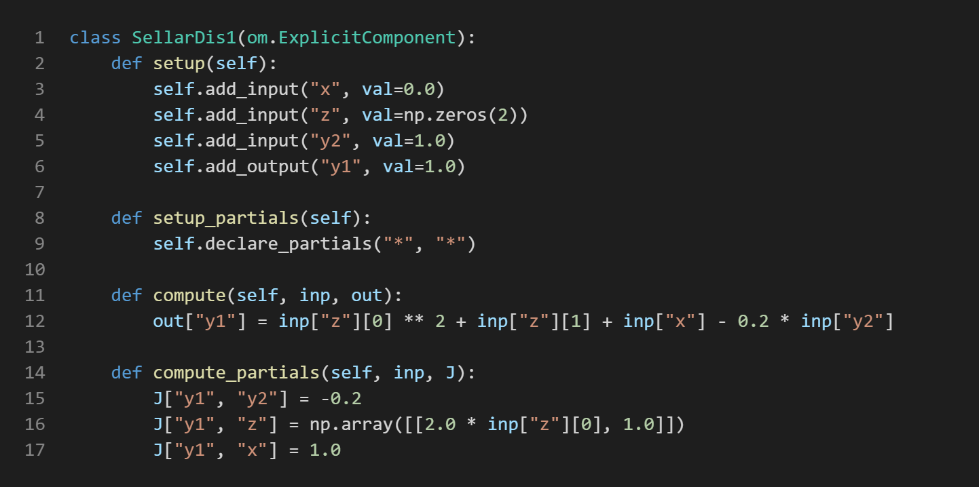
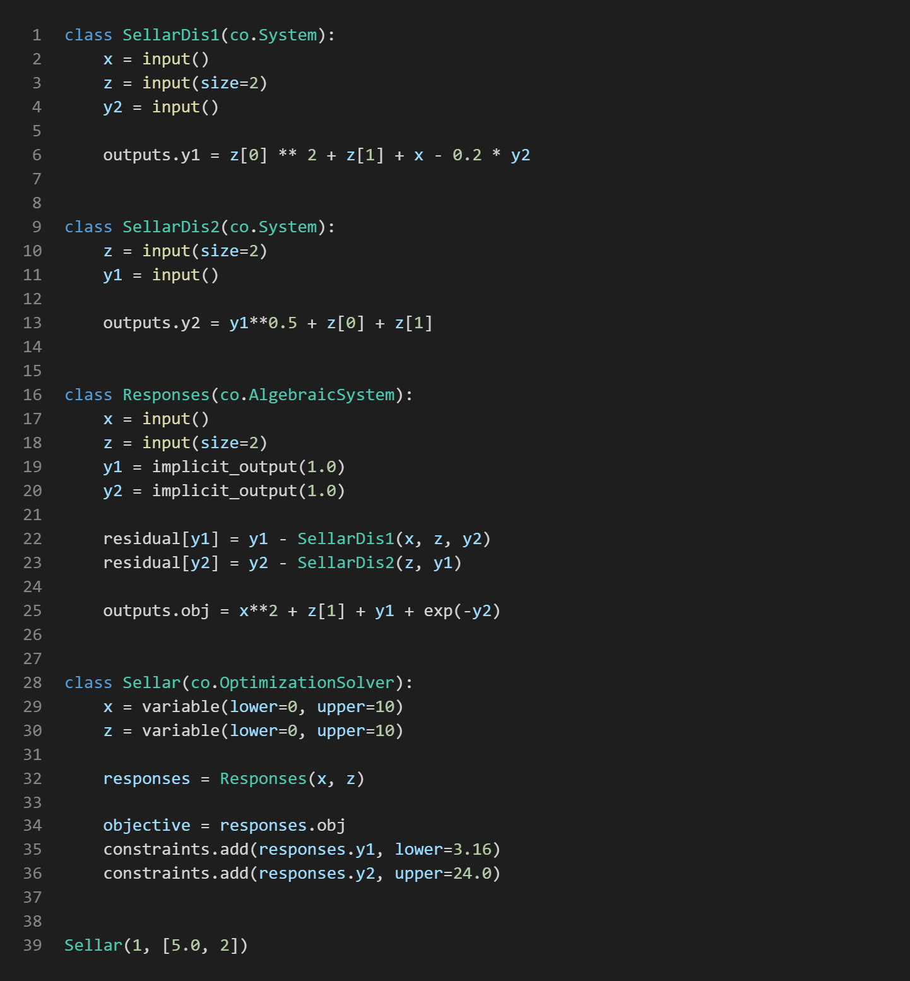
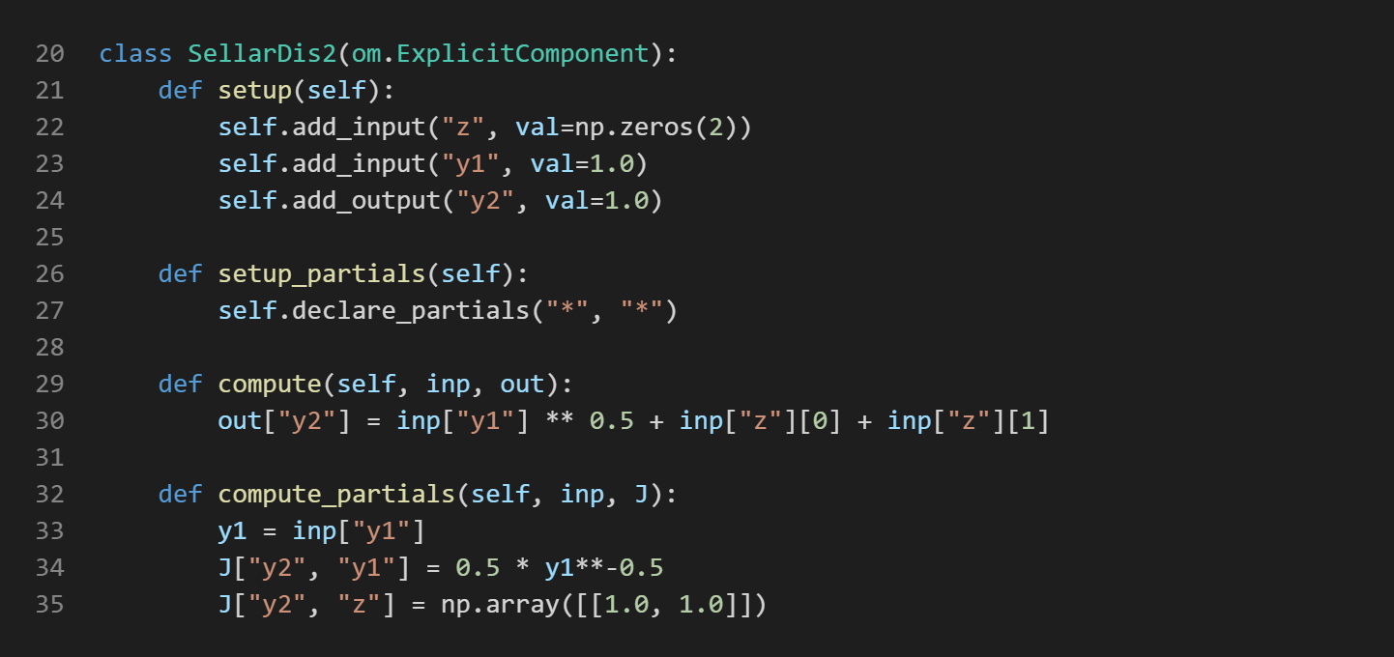
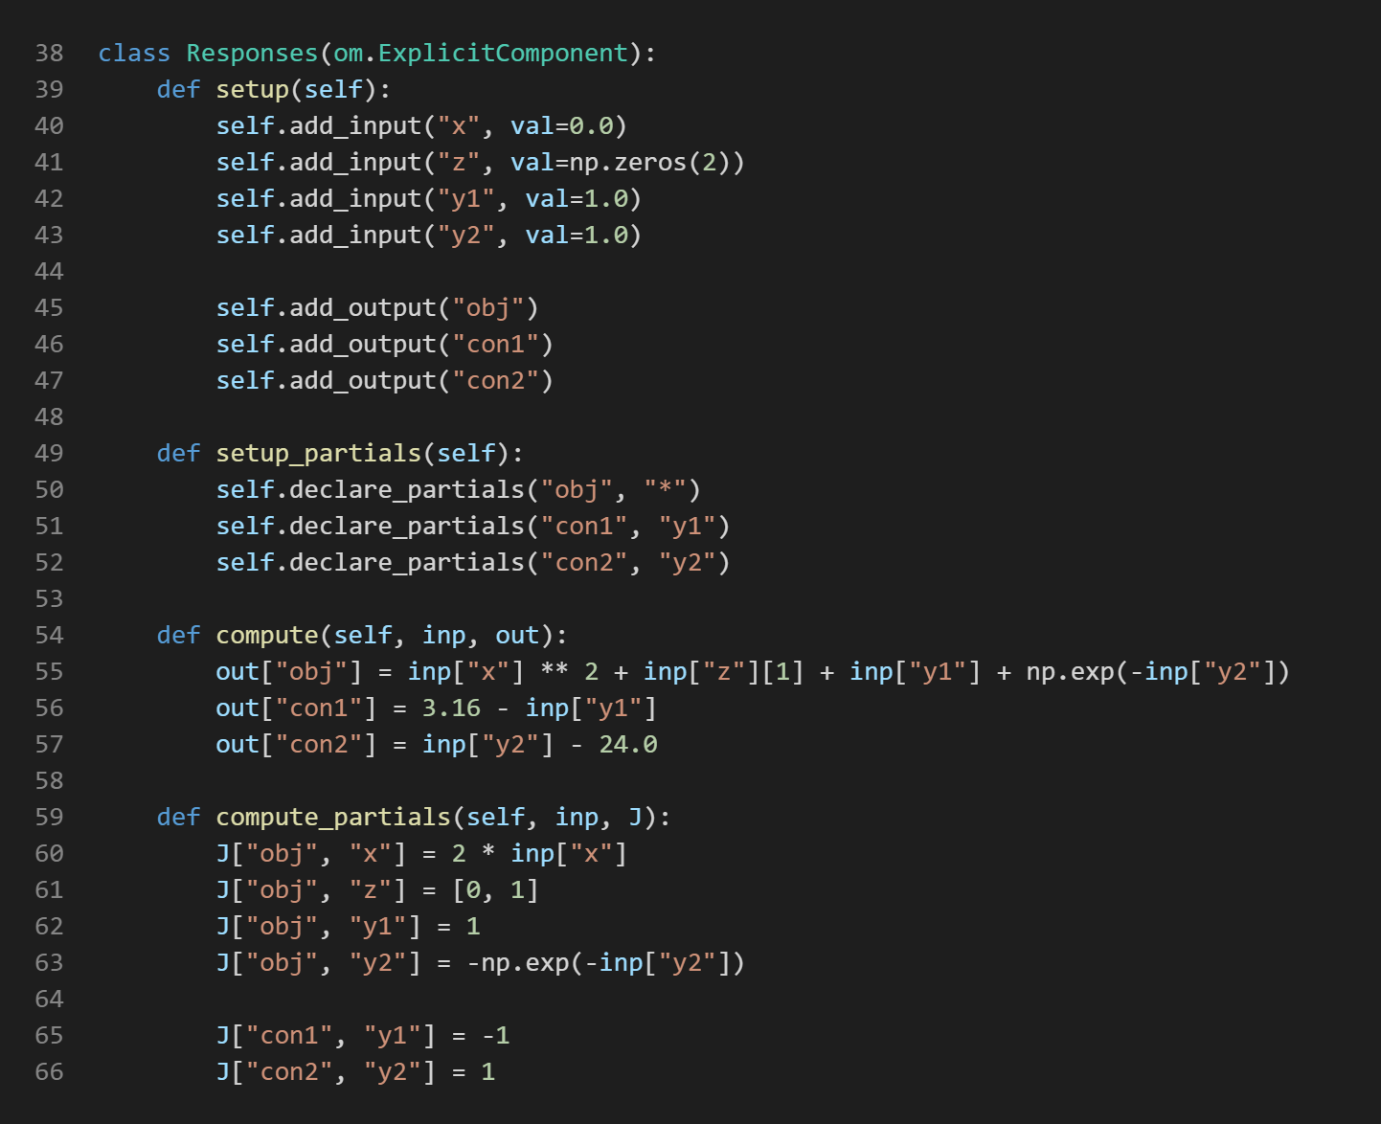
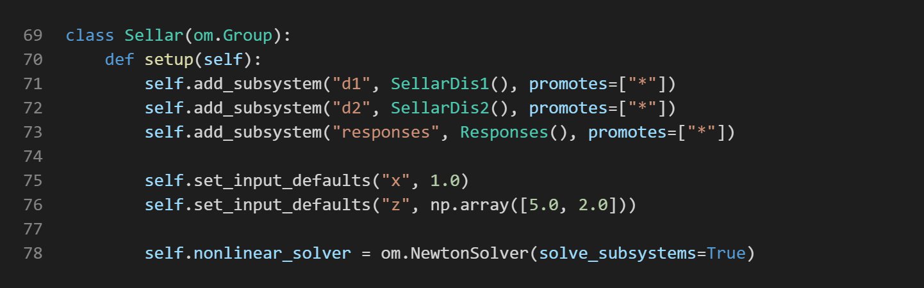
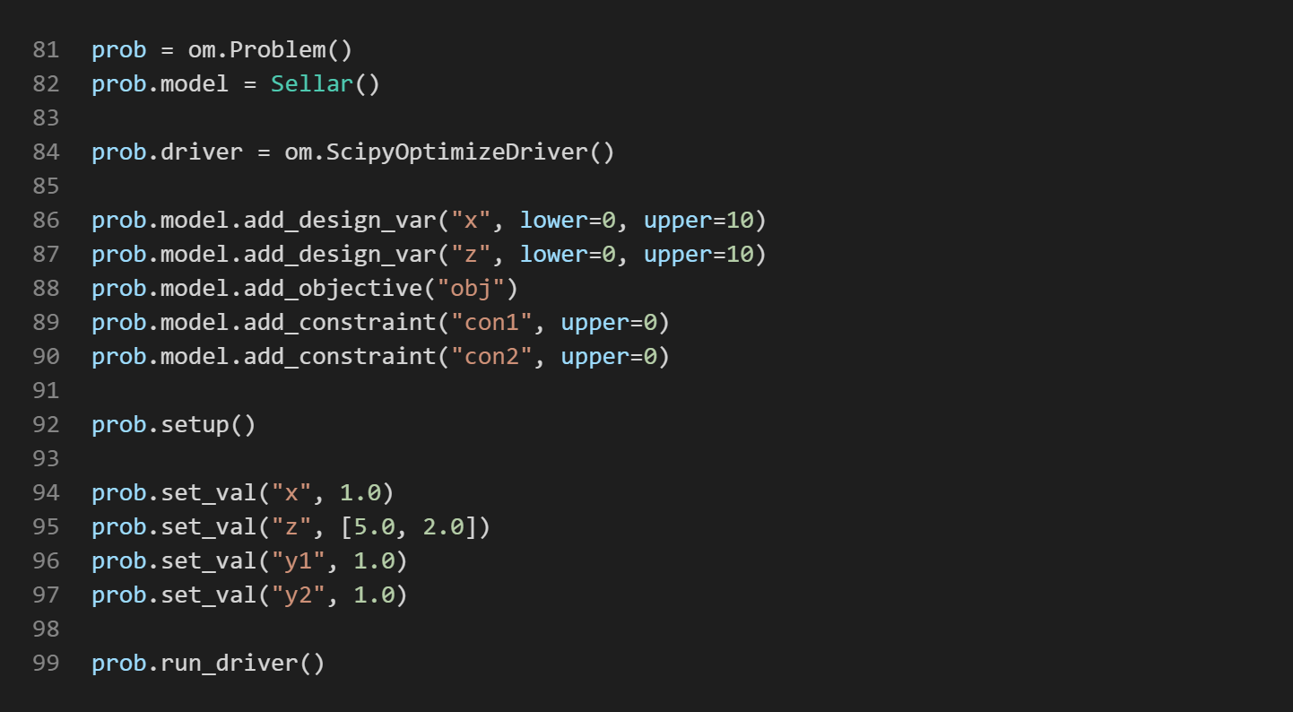
Documentation-driven design
OpenMDAO
Condor
99 Lines
2,188 Characters
39 Lines
612 Characters

Slide 5
Decide how user code should look then make it possible
OpenMDAO
Condor
99 Lines
2,188 Characters
39 Lines
612 Characters

Slide 6
First draft
Leverage existing technology: AI/ML communities know how to efficiently solve models for gradient-based optimization.
Rapid model development in Python
Computation acceleration:
Compiled C/Fortran
GPU and distributed HPC
Symbolic and Automatic Differentiation
Automatic interfacing to well-known solvers
Facilitate interface to existing codes

Slide 7
Goals
Use pythonic patterns, built-ins, and existing libraries as much as possible
Through Leveraging existing off-the-shelf (AI/ML) technology and best practices for code development
  Provide well vetted tools that can do Automatic Differentiation (AD)
  Reduce the time to code development both to upgrade existing code and to modify it to expand it capability
  Improve robustness of the tool chain due to the above benefits
  Speed up the CPU time to solutions due to Code generation/ Computational acceleration
Delivery of analysis! Not tool development

Slide 8
DRY organization
Condor model layer: what users write to describe model
Backend: casadi
Implementation layer: interface between condor model; generates everything needed to call numerical solver/perform numerical evaluation
represent elements from fields (i.e., inputs, outputs) and basic expressions (“symbols”)
Represent models as “advanced” expressions (e.g., casadi.callback, aesara.op) with partial derivative definitions
solver layer: (numerical) algorithm+code for most models, e.g., Newton’s method, IPOPT, SGM
propagate (symbolic) derivatives through expressions
Callable for numerical evaluation

Slide 9
Backend
Currently using casadi because it ships with all required functionality:
  Easily represent symbolic elements, condor Models, and expressions
  Propagate derivatives through symbolic expression tree
  Generate C code for numerical evaluation of expression tree
  Provides interfaces to IPOPT solvers at the C level
Other backends (e.g., SymPy, Aesara, etc) could be used, but some of the required functionality may need to be developed
To use a new backend, new implementation layer will be required to generate callables for model (and derivatives) to pass to solvers

Slide 10
Layer boundaries
Models use Fields generate elements (symbol atoms/leaves) for system input and build expressions for system output/internal solver computation using model-based, unary, and binary operations
Implementation for each model template provides two interfaces between the Model layer and symbolic backend:
  Generates a symbolic operator for the model so symbolic backend can propagate derivatives through model [“model-based operator”]
  Generates a numeric callable for the model so the model can be evaluated numerically; typically requires generating numerical callable for internal fields (and gradients) and passing that to the solver
  For casadi, the “callback” performs both and only requires numerical implementation and metadata – likely typical
    implementation should primarily be responsible for collecting/flattening fields
    custom callbacks should generate callables to pass to solver; casadi.callback.eval should just call solver with args – only ever sees numeric, casadi internals handle symbolic case
    solver should only interface with numeric callable
  --> Bind both symbolic and numeric results to model instance

Slide 11
The Model layer
 | Fields
Built-in template | input | internal | output
ExplicitSystem | input parameter |  | output
AlgebraicSystem | parameter | residual | implicit_output explicit_output variable output
OptimizationProblem | parameter | objective constraint | variable output
TrajectoryAnalysis | parameter constants? | state dot initial event.update | trajectory_output output
User Model classes inherit from a Model template
Model templates define the fields from which symbolic elements are drawn
Disciplined system encapsulation: build up more complex models by using sub-models, but only interact through input and output fields
Model class and ModelType metaclass implement “metaprogramming” (dynamic class generation) that enable the desired API
Solver options can be set using as Model inner-class namespace (or in separate code, executed before model calls) to provide clear separation between mathematical model and numerical details

Slide 12
Performance Considerations for Trajectory
Moved to scikits.odes CVODE, an implicit solver; implicit may generally be slower but more accurate than explicit? but faster per accuracy? see discussion://github.com/bmcage/odes/issues/127#issuecomment-923782240.
May be able to use state ordering so banded jacobian can be used. Other solver configuration options may improve performance as well.
Implicit means iterative solution at every time step → solvers (AlgebraicSystem or OptimizationProblem) for control will likely be worse! They probably need solution conditions lifted to DAE residual.
Maybe add explicit solver wrapper following new API. New API is well-organized & can likely wrap explicit+events and sundials CVODES/IDA relatively easily. SimuPy (explicit solver) version had problems for later orbital problems even though first orbital problem ~twice as fast (consistent with bmcage’s optimized example in discussion). Not sure if explicit issues for later orbital resolved by time-yielding
Modes definitely need if_else control branch instead of *float(bool) for explicit solver. Lifted DAE approach may be less important (although number of residuals may change…)
Use the built-in sensitivity method of IDAS/CVODES for the continuous portions, then SGM equations for discontinuities. May be able to minimize storage requirements/accuracy

Slide 13
Model definitions are symbolic
For most mathematical models, this is what you want
Conditionals: Use float-casting of boolean expressions to construct piecewise models instead of if-else flow control
higher-level interfaces: settings module
  a module can define settings that change the model definition
  Variables that user can set must be defined in a dict [SimpleNamespace?] and passed to condor.settings.get_settings.
  To access the dynamically defined model, use
  module_ref = condor.settings.get_module(<path.to.module>, **user_settings)
  instead of
  import <path.to.module>
If you need a lot of conditionals, loops, and interface logic maybe you need a new template, implementation, and/or solver

Slide 14
Gascon
GASP Advancement using Symbolics in CONdor
…Analysis and Supplemental modeling…
… Substitutable models? Solutions? Etc.
Demonstrate achievement of condor goals by giving two under-graduate summer interns 10 weeks to re-implement GASPy, which took a team of experienced engineers 2+ years to implement
Fastest path to solve EPFD’s coupled optimization problem

