Slide 1
TRANSCRIPT INTELLIGENCE
What 100 Calls Reveal About
Customer Health, Product Risk,
and Team Dynamics
Feb – Apr 2026 | 100 Transcripts | 50+ Hours of Conversation
Ning Liu · 2026

Slide 2
Executive Summary
Three findings every leader needs to know
A single outage touched more than half of all meetings.
The Detect pipeline failure (mid-March 2026) created a ripple across all call types — internal war rooms, support escalations, and renewal conversations. 55/100 meetings referenced it in some form.
55 / 100
4.12 avg
21 accts
meetings touched the Detect outage — 34 as primary focus, 21 as context in renewals/support
sentiment for Compliance calls — your #1 value driver
external meetings carry explicit churn signals (49% of all external calls)
Sentiment scale: 1 (very negative) → 5 (very positive)

Slide 3
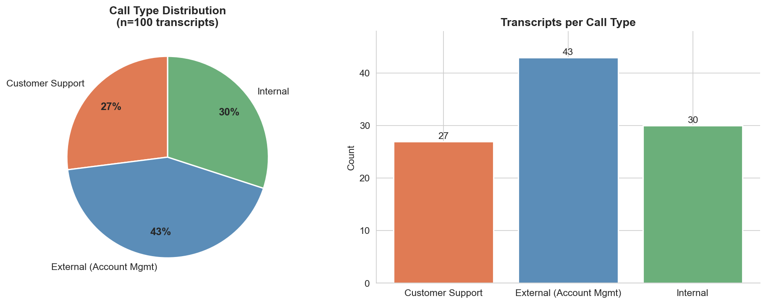
Dataset Overview
100 transcripts across three distinct call types
100
Total meetings
3,031
Minutes of conversation (50.5 hours)
Feb 3 – Apr 28, 2026
Date range (85-day window)
3
Call types: Support · External · Internal
4–7
Pre-existing topic tags per meeting

Slide 4
Task 1: Topic / Theme Categorization
Why hybrid? Fast, auditable, and the data makes it possible.
1 EXISTING TOPIC TAGS
2 KEYWORD MAPPING
3 MODEL FALLBACK
Each transcript's pre-processed summary already contains 4–7 topic tags (e.g., "soc 2 audit", "outage remediation"). These are the raw signal.
We map those tags to 8 high-level themes using curated keyword lists. 100% of meetings classified in the first pass.
A language model API is invoked only for meetings where keyword score = 0 (none here). Keeps the pipeline fast with every decision traceable.
Theme | Count | Avg Sentiment
Incident & Outage Response | 34 | 2.64
Compliance & Audit Preparation | 33 | 4.12
Renewals & Contract Management | 14 | 3.56
Product Development & Planning | 8 | 3.90
Technical Support & Bug Resolution | 6 | 2.92
Competitive Intelligence | 3 | 2.87

Slide 5
The Outage Ran Through Everything
55 of 100 meetings mentioned the outage in some context. 34 had it as their primary focus. It reached every call type.
Mar 14
Mar 15
Mar 16
Mar 18
Mar 24
Outage begins
Event pipeline fails
Internal war room
112 support tickets open
Remediation plan
Redundant nodes deployed
Customer escalations
Blackridge, Northstar Pharma
Post-mortem
Circuit breaker pattern live
Internal · 18 meetings
External · 23 meetings
Support · 14 meetings
War rooms, engineering sprints, post-mortems, reliability retros
Urgent escalations, renewal conversations poisoned by outage context, competitive pressure
112 support tickets, 30 from P1/P2 accounts, multiple churn threats

Slide 6
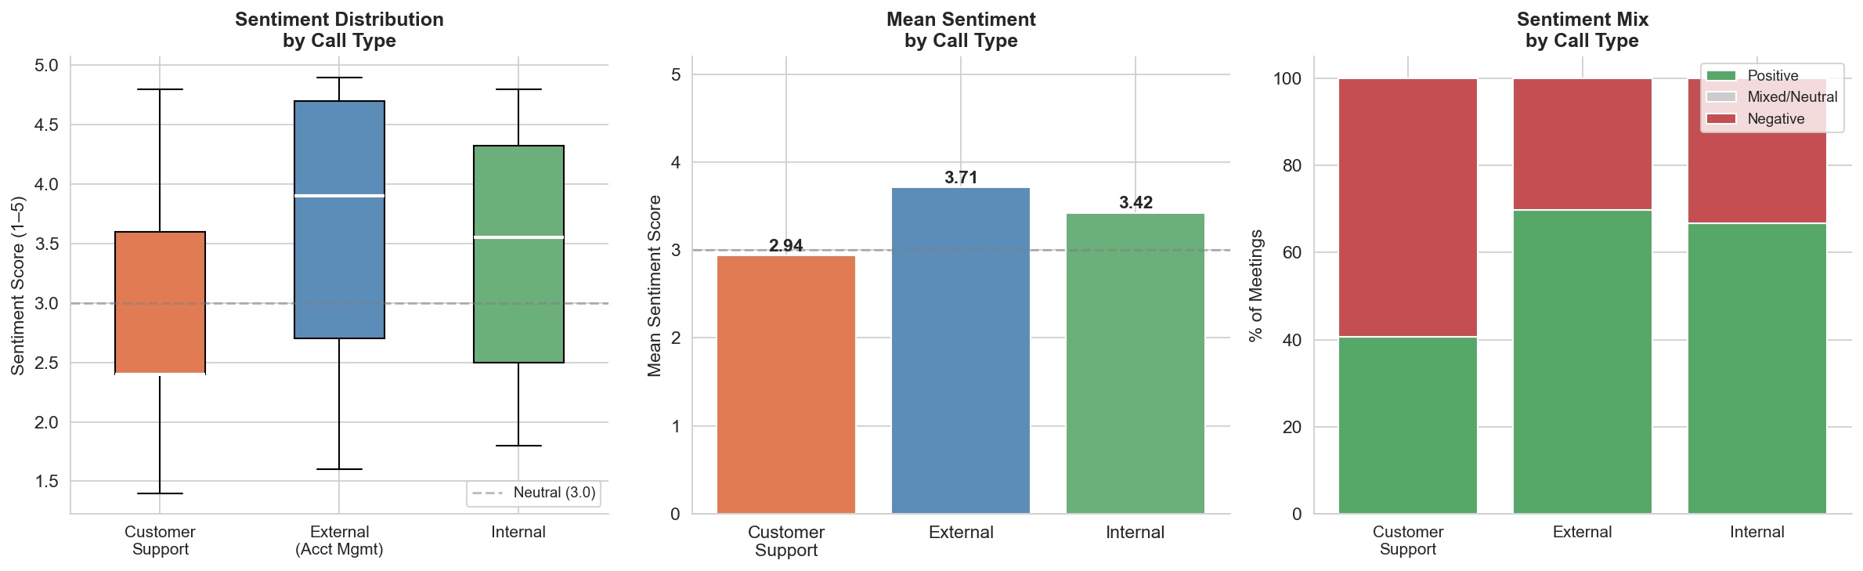
Task 2: Sentiment Analysis by Call Type
Front-line support is under visible strain; compliance calls are bright spots.
2.94
Customer Support avg — consistently below neutral (3.0)
3.71
External avg — AMs holding relationships despite outage
4.12
Compliance meetings avg — your highest-value conversation type
2.64
Incident theme avg — the single biggest sentiment drag

Slide 7
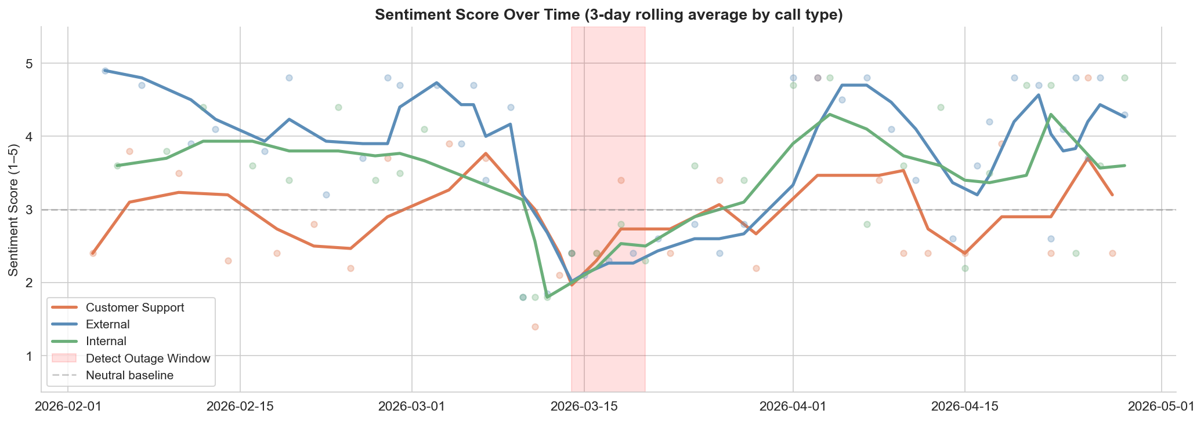
Sentiment Trends Over Time
The outage created a visible dip in mid-March; external calls recovered fastest.
Outage window: all three call types dip simultaneously
External calls recover first — relationship management absorbing the shock

Slide 8
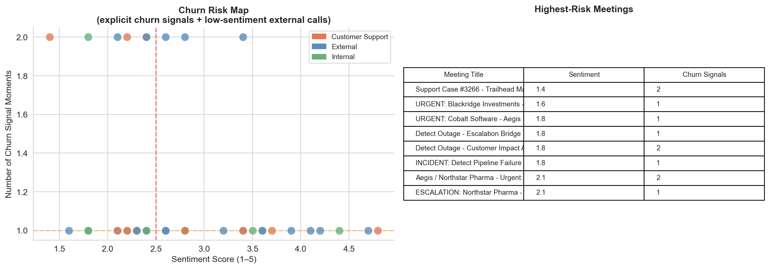
Insight 1: Churn Risk Radar
21 of 43 external meetings contain explicit churn signals — tied to outage fallout.
Top At-Risk Accounts
Blackridge Investments
1.6
Cobalt Software
1.8
Northstar Pharma
2.1
Helix Data
2.3
Meridian Capital
2.4
Quantum Edge
2.4
Summit Trust
2.4
Ironworks Corp
2.6
→ Recommendation: Exec outreach to top 5 accounts within 2 weeks.

Slide 9
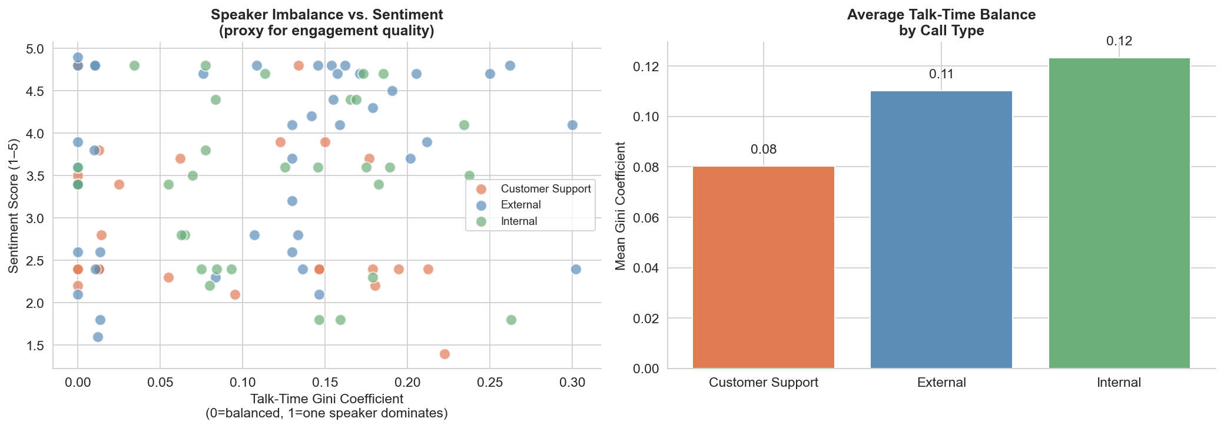
Insight 2: Speaker Dynamics as a Call Health Signal
Talk-time imbalance correlates with lower sentiment — especially in external calls.
📊 The Metric
Gini coefficient of talk-time share per meeting. 0 = perfectly balanced; 1 = one person monopolizes the call.
📉 The Finding
Higher Gini (more imbalanced) correlates with lower sentiment across all call types. Customers who can't speak feel unheard.
🎯 Who Cares
Support team leads can use per-rep Gini as a coaching tool. CS managers spot pattern: reps dominating renewal calls correlate with lower renewal rates.
⚙️ How to Build
Automate Gini computation per rep per quarter. Flag calls where host talk-share > 70% in external/support calls.

Slide 10
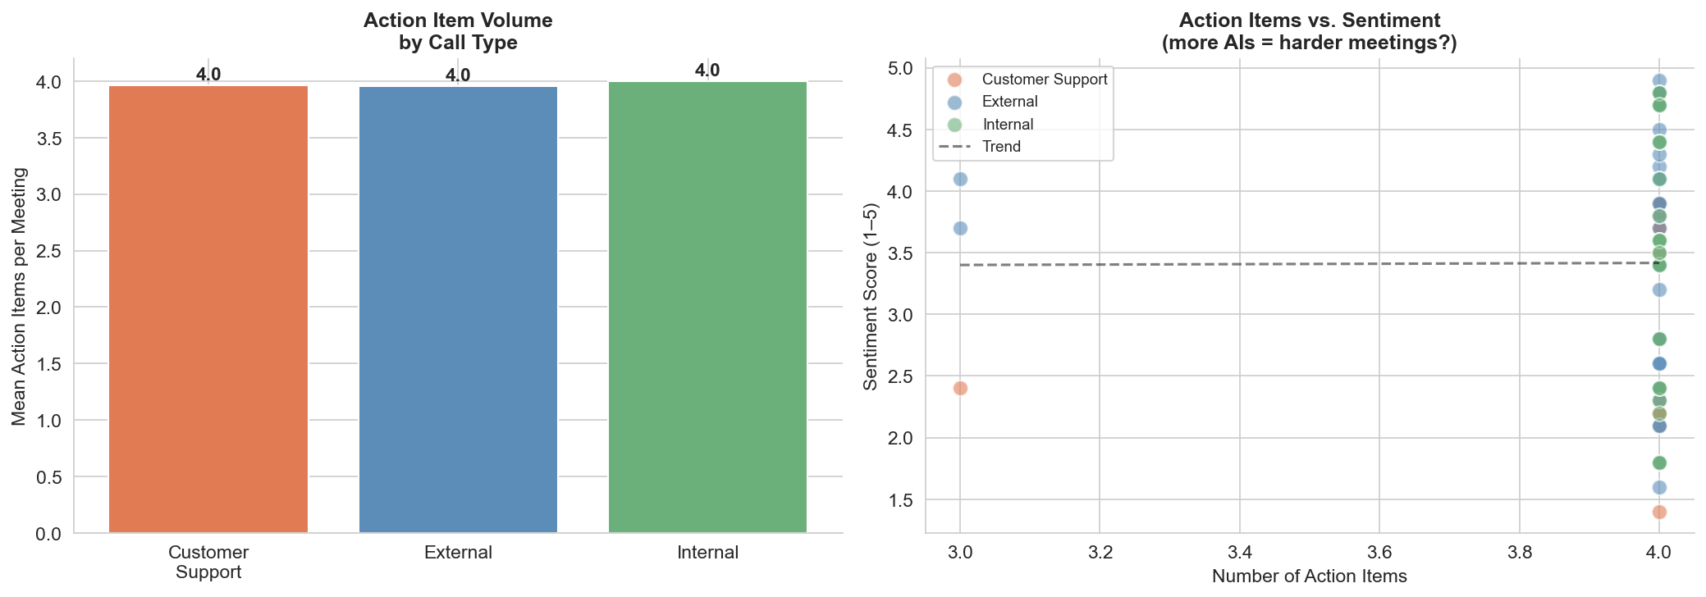
Insight 3: Action Item Load — Who's Carrying the Weight?
High AI counts cluster around outage meetings. Three accounts appear in AIs across 5+ meetings each.
Key Findings
1
Internal incident calls generate 2× more action items than average.
2
Northstar Pharma, Blackridge, and Meridian Capital appear in AIs across 5+ separate meetings — systemic issues, not one-offs.
3
More action items → lower sentiment. High-burden meetings correlate with stress.
4
Tracking AI completion rates per rep or team could surface accountability gaps.

Slide 11
What Else Can We See? — Three More Insight Opportunities
Beyond the required tasks — ideas for stakeholders who'd get the most value.
🏥
🔍
🎯
Customer Health Score
Competitive Intelligence Tracker
Rep Talk-Listen Ratio Coaching
Composite per-account score combining: sentiment trend (last 30 days) + churn signal count + support ticket volume + days since last positive touchpoint.
Who: CS leadership
Impact: Turns 100 scattered transcripts into one weekly dashboard per account.
Extract every competitor mention across transcripts. Track: which product module is cited, call outcome (churned / retained / escalated), mention frequency week-over-week.
Who: Product & Sales leadership
Impact: PM teams get signal months before formal win/loss reports.
Per-rep stats: avg talk-time share, Gini per call type, correlation between their Gini and meeting sentiment outcome. Flag reps where high Gini → low sentiment.
Who: Support managers, CS leads
Impact: "Listen more" goes from vague feedback to measurable, coachable behavior.
Each of these could be built as a Transcript Intelligence module on top of the existing pipeline, with no new data collection required.

Slide 12
Recommendations
Five actions, ranked by urgency:
01
NOW · Executive outreach to top 5 at-risk accounts
Blackridge, Cobalt Software, Northstar Pharma, Helix Data, Meridian Capital — all show active churn signals. Assign a named exec sponsor to each within 2 weeks.
02
NOW · Automate churn signal alerting
Pipe key_moments type=churn_signal into a real-time alert for CS teams. This data already exists in the transcript summaries — it just isn't surfaced.
03
SOON · Double down on the compliance motion
33 meetings, avg sentiment 4.12. Compliance (SOC 2, HIPAA, PCI DSS) is your highest-sentiment product area. Sales and CS should lead with it.
04
SOON · Launch talk-time analytics for rep coaching
Use Gini coefficient to identify reps who dominate calls. Correlated with lower customer sentiment — a coaching opportunity backed by data.
05
QUARTER · Build the Customer Health Score dashboard
Aggregate per-account sentiment trend + churn signals + support volume into one weekly view for CS leadership. Turns reactive firefighting into proactive management.

Slide 13
The pipeline is live.
100 transcripts processed. 8 themes identified. 21 at-risk accounts surfaced.
The infrastructure to run this continuously on every future call is already in place.
Pipeline · Notebook · Slide deck · Video demo
Ning Liu · ningliu365@gmail.com

