Slide 1
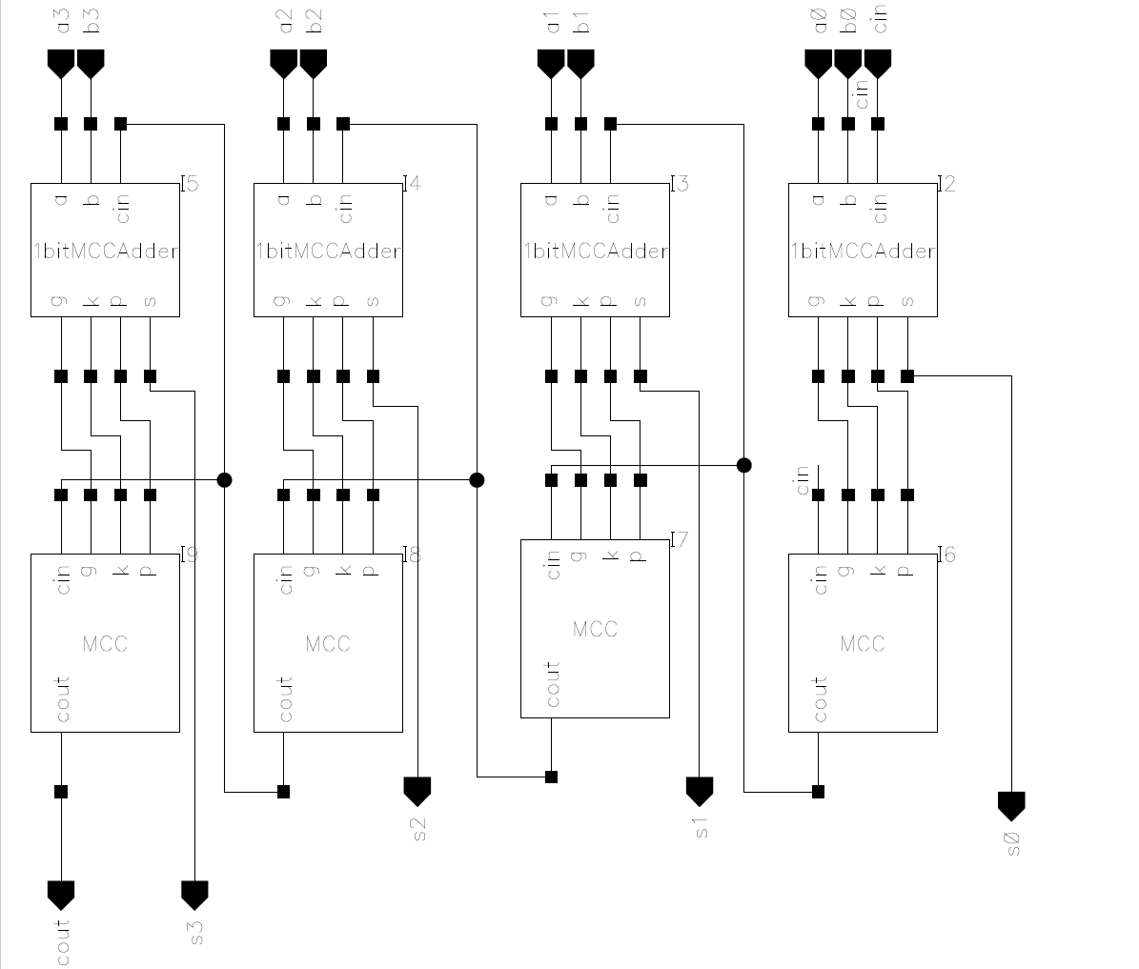
Group Number: 1
ECE 4130
Circuit/System Description
The most innovative portion of our system design is our adder.
The adder for our system is an 8-bit adder using 1-bit adders and Manchester Carry Circuits in order to perform the carry-look-ahead operations.
We designed two 4-bit Manchester Carry Adders, as seen on the right, which we then chained together to create an 8-bit adder.
Members: L. Tsai, N. Liu, A. Tran, C. Matz
‹#›

Slide 2
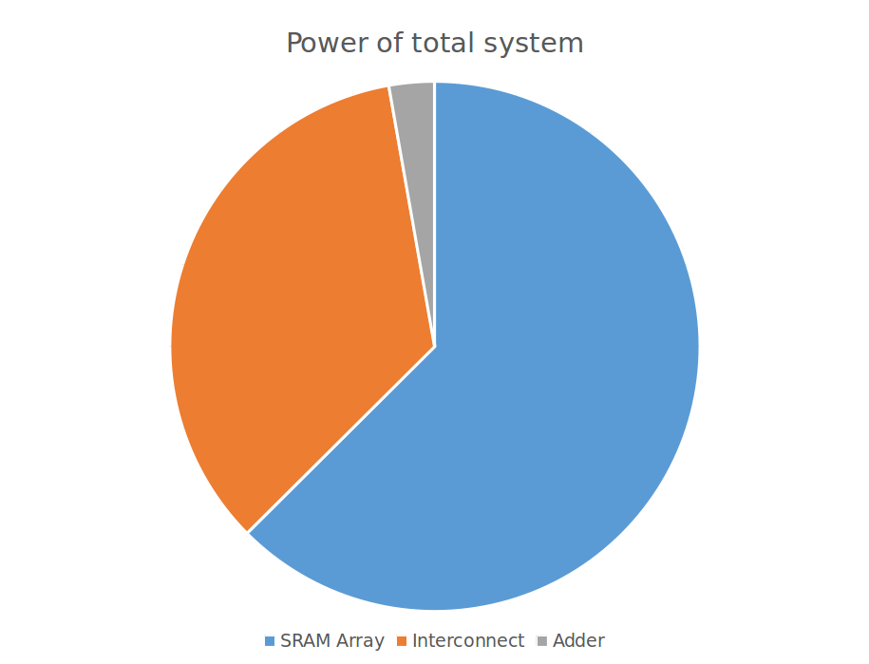

Group Number: 1
ECE 4130
SRAM Characteristics and Power
Key SRAM Metrics
VDD (mV) | Trip Voltage (mV) | Read Voltage (mV) | Write Margin (mV)
800 | 343.33 | 100.02 | 242.56
750 | 321.89 | 89.04 | 229.3
700 | 299.38 | 78.24 | 199.82
650 | 276 | 67.8 | 170
600 | 252.31 | 58 | 140
Members: L. Tsai, N. Liu, A. Tran, C. Matz
‹#›

Slide 3
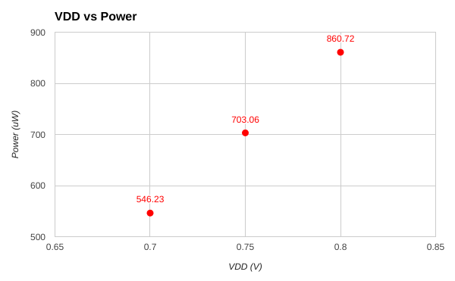
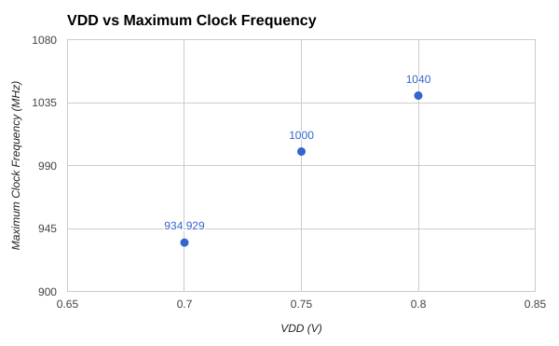
Group Number: 1
ECE 4130
Effect of Voltage Scaling
The power bottleneck for our system is the SRAM. This is due to the fact that the array is the largest part of the design and contains the most transistors.
The bottleneck for our systems clock frequency is the decoder. At lower VDD, the decoder takes more time to drive the word line. Eventually, the decoder will fail to drive the word line and the whole system will fail.
Members: L. Tsai, N. Liu, A. Tran, C. Matz
‹#›

Slide 4
Group Number: 1
ECE 4130
Design Limitations
Decoder Sizing: Problems with driving the word line at lower voltages and larger parasitics.
Precharge Sizing: Problems with charging bit lines to required voltage with large parasitics.
SRAM Efficiency: Each SRAM cell consumed a decent amount of power, therefore the entire array consumed more than 50% of the overall power.
Clock Frequency: Some parts in the design meet the borderline requirement for timing requirements. Therefore when trying to improve the speed of the design, a frequency of only 1040 MHz could be achieved.
Registers: Simple transistor sizing and operation made creating the registers simple to design and scale.
Read/Write Peripherals: Lots of interacting parts, tight timing constraints, and large loads made it difficult to design.
SRAM Array: Lots of testing for SRAM cell metrics and repetitive layout design makes the SRAM cell unforgettable. Ease of design also helps make it easy to remember.
Members: L. Tsai, N. Liu, A. Tran, C. Matz
‹#›

