Slide 1
Parameter Estimates
Parameter | Est. | SE | %RSE | Back-transformed(95%CI) | BSV(CV%) | Shrink(SD)%
Log Ka | 0.476 | 0.203 | 42.7 | 1.61 (1.08, 2.39) | 69.8 | 1.23%<
Log Cl | 1.02 | 0.0754 | 7.42 | 2.76 (2.38, 3.2) | 26.1 | 2.36%<
Log V | 3.46 | 0.0632 | 1.83 | 31.8 (28.1, 36) | 13.8 | 9.71%<
add.sd | 0.696 |  |  | 0.696

Slide 2
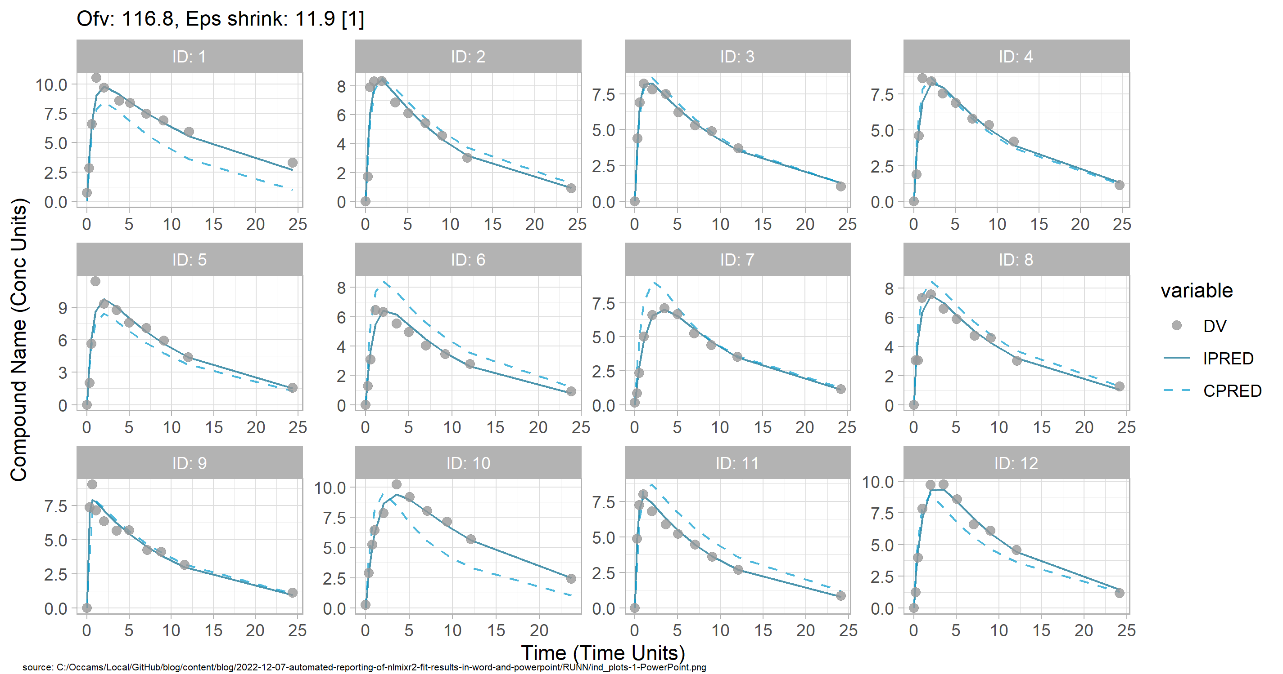
Individual and population prediction overlay

Slide 3
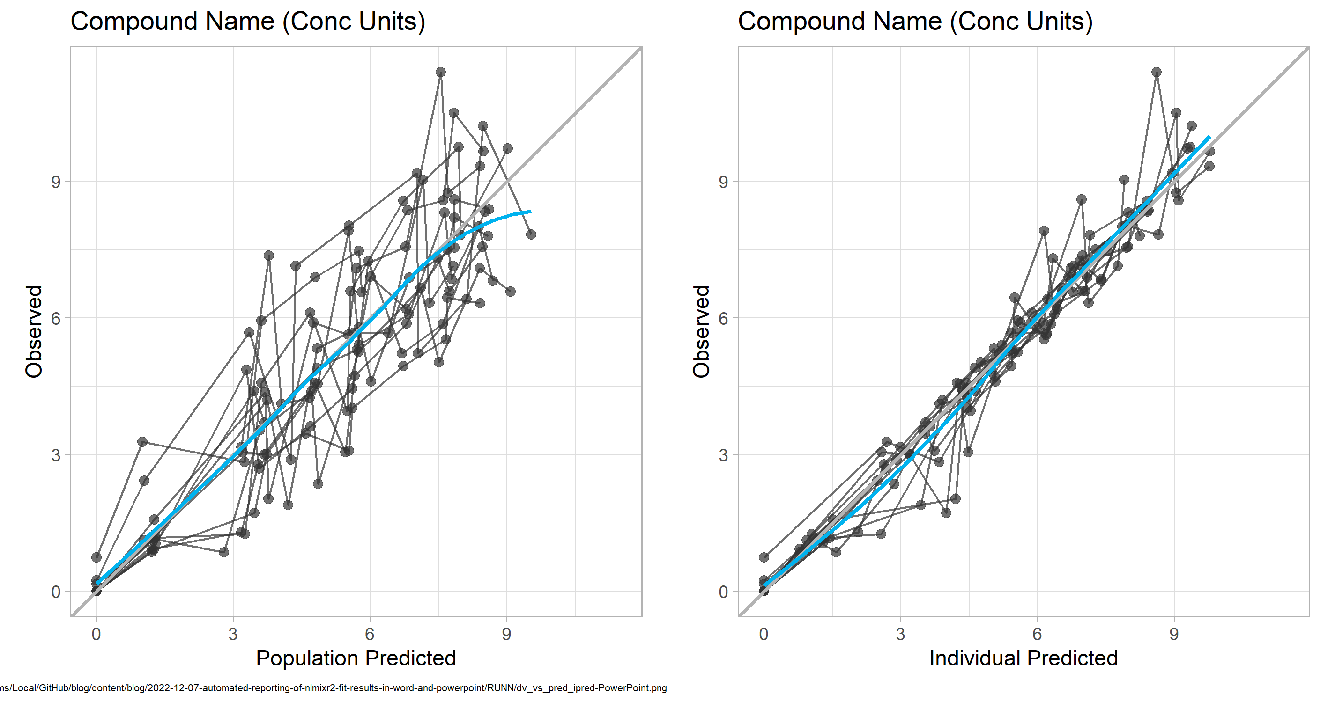
Observed vs Predicted

Slide 4
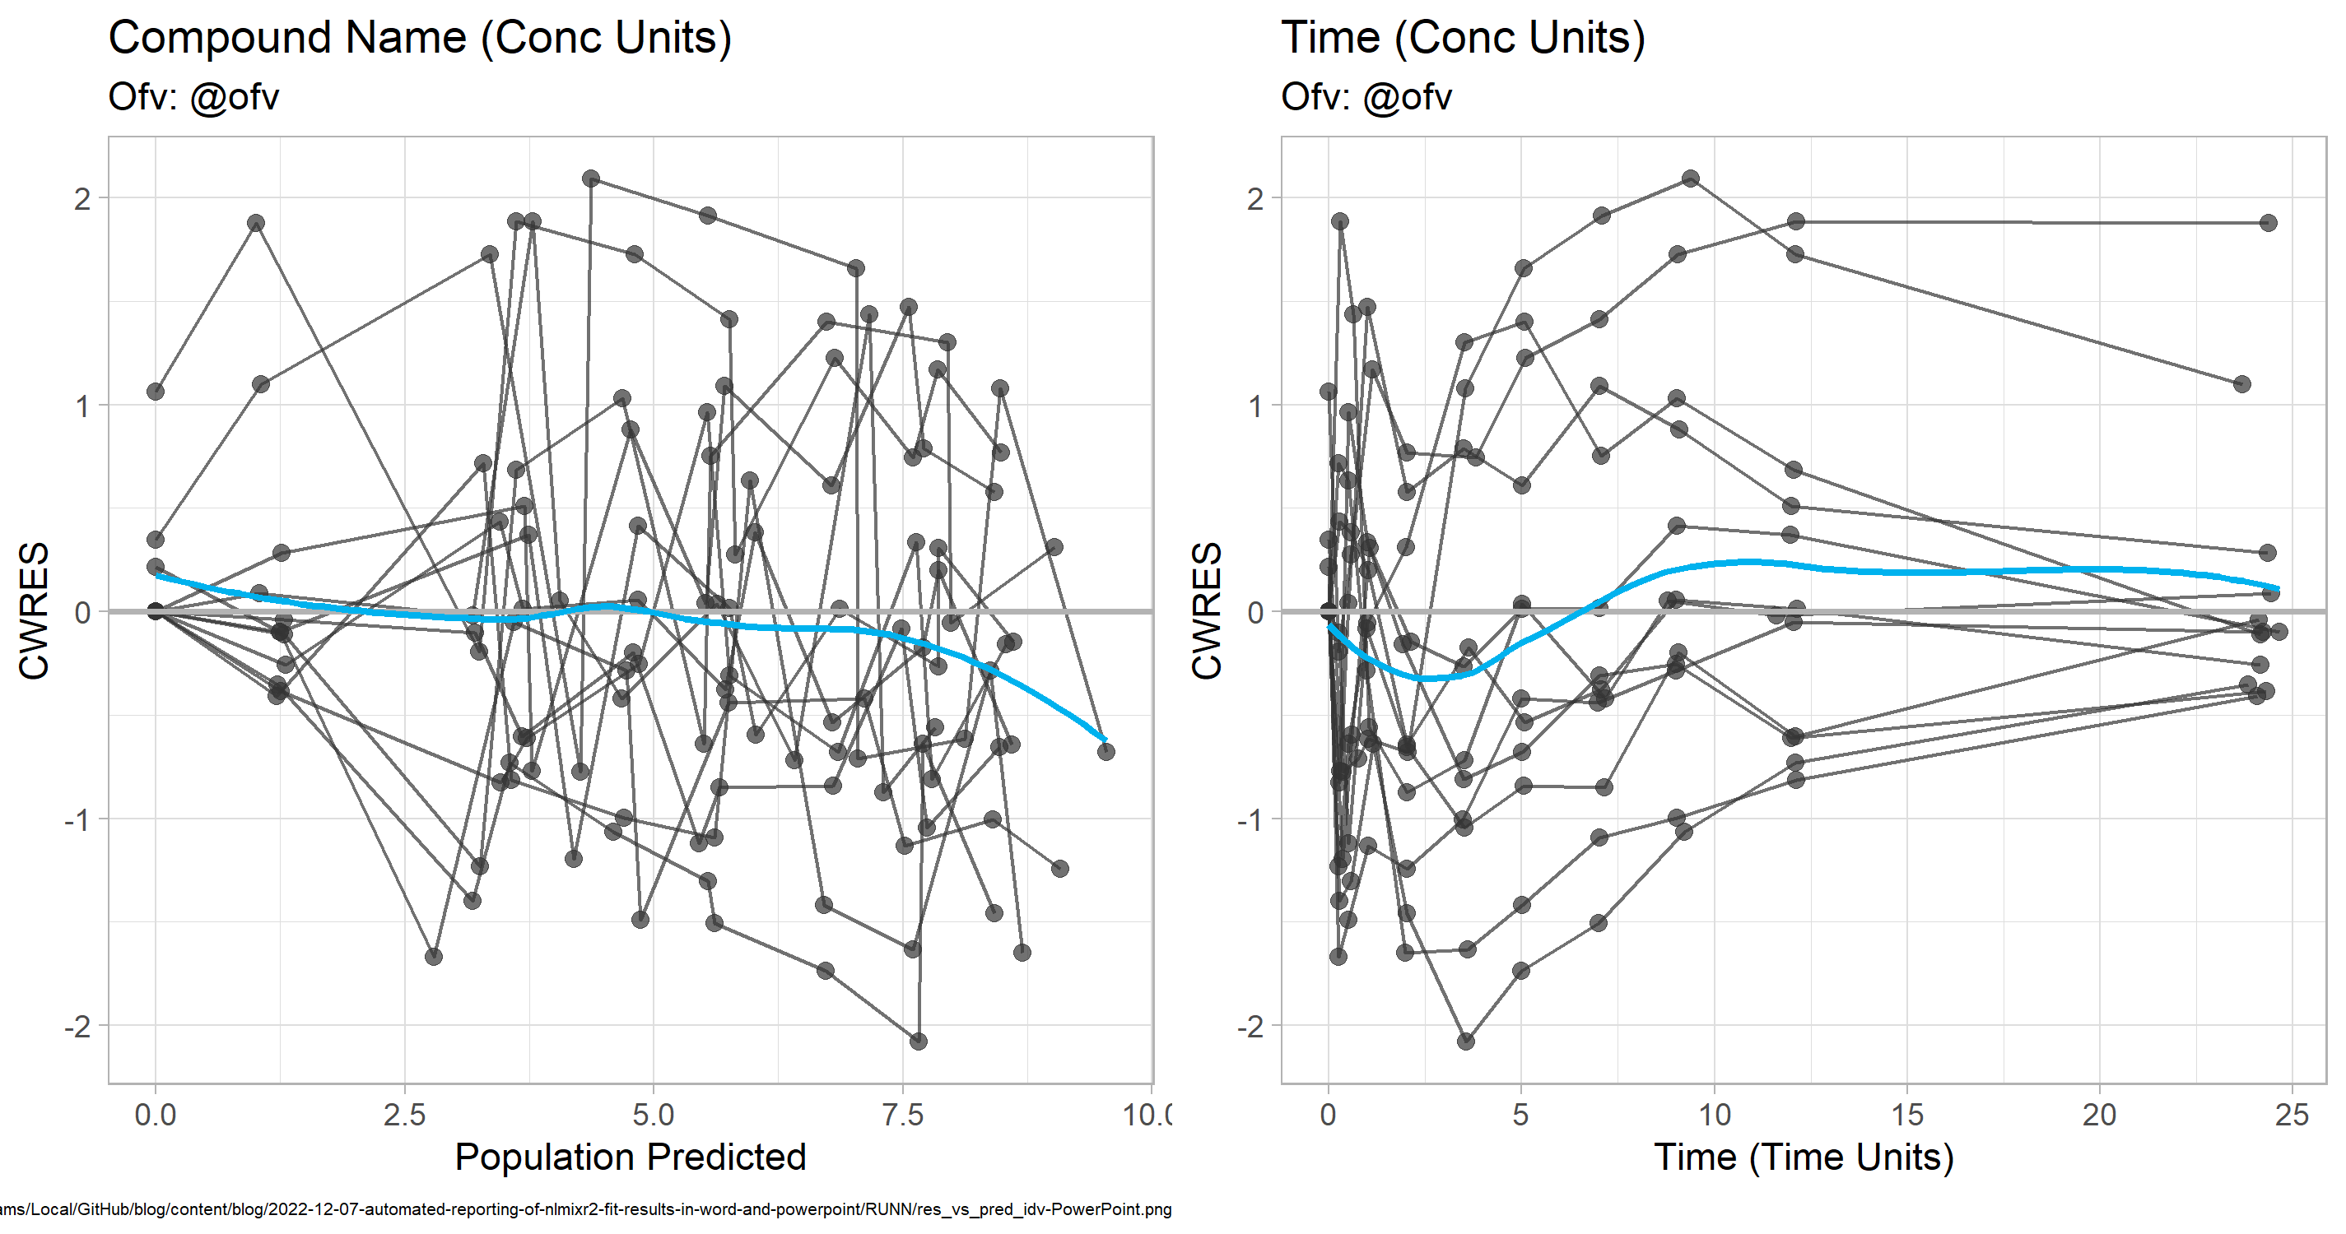
CWRES vs Pred and Time

Slide 5
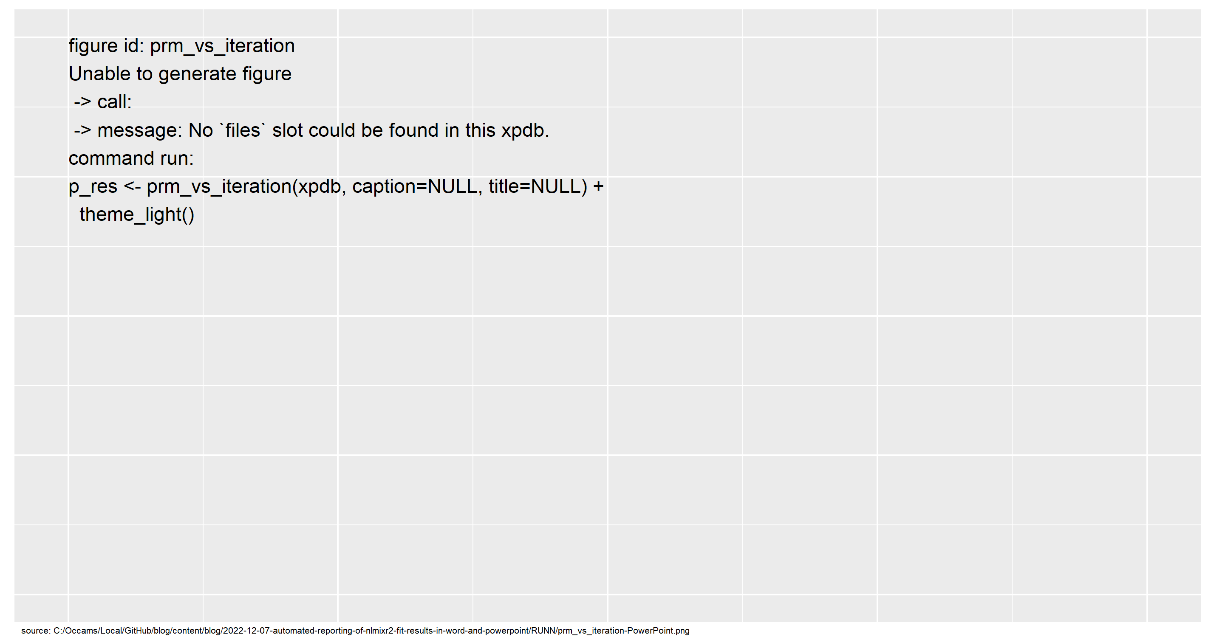
SAEM Stabilization

