Slide 1

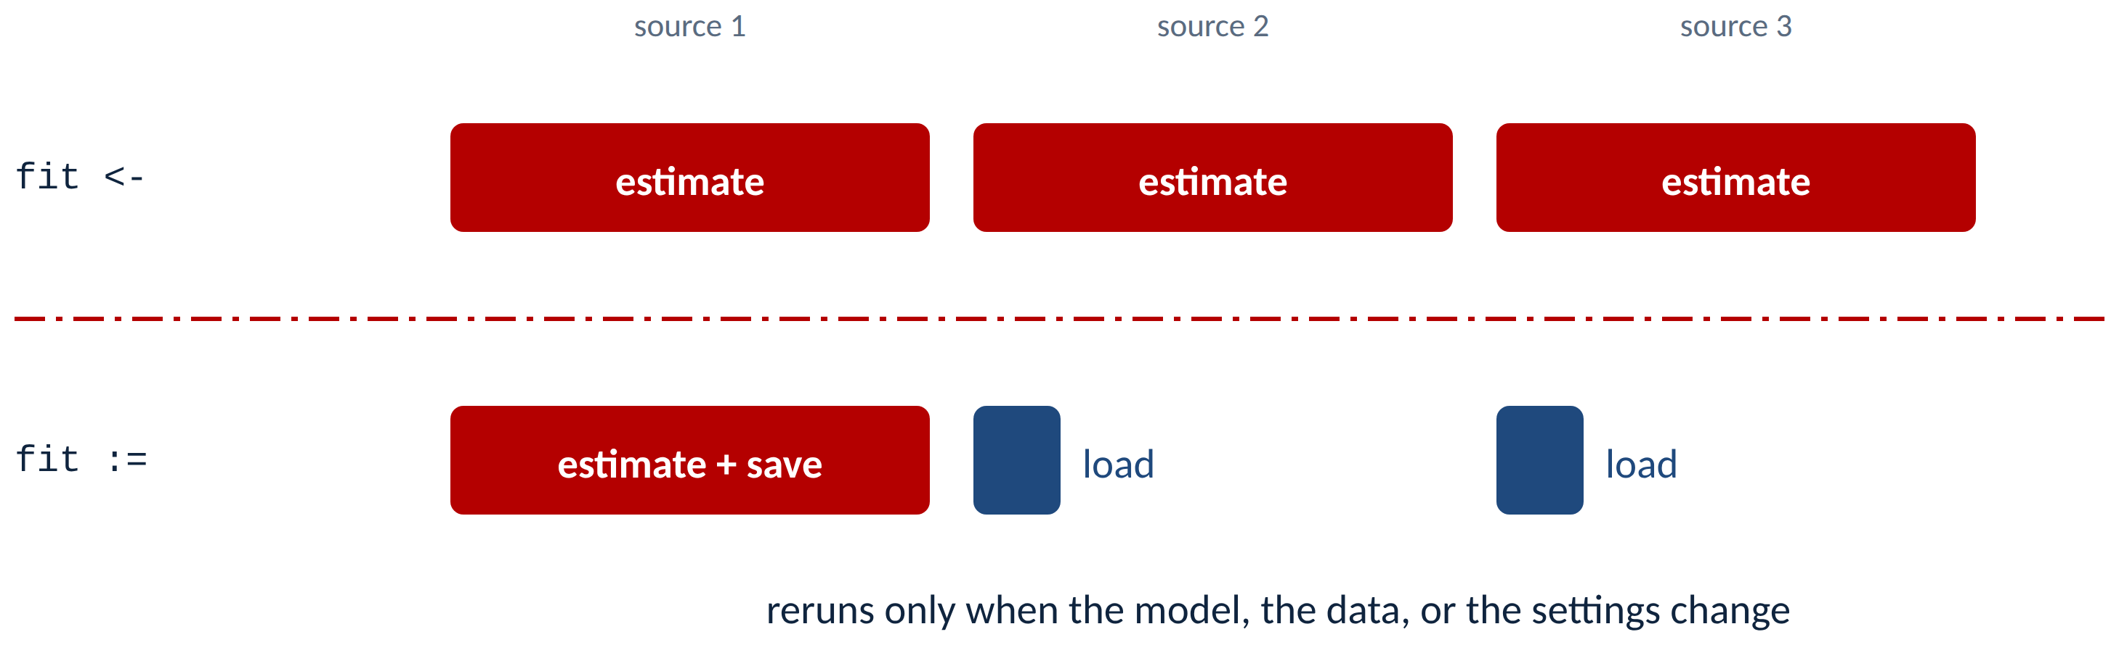
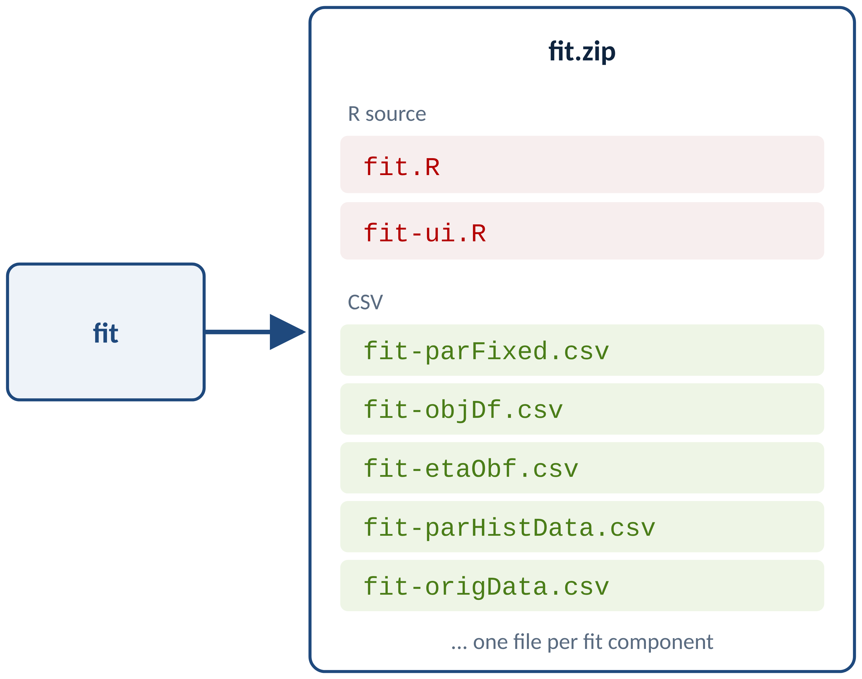
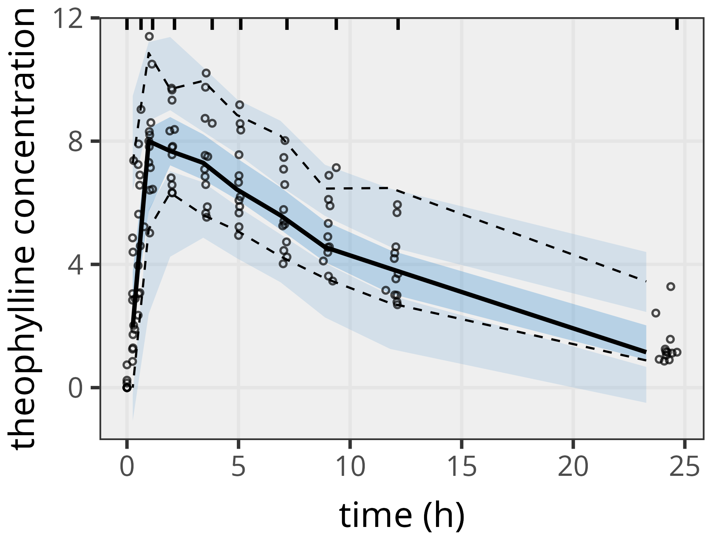
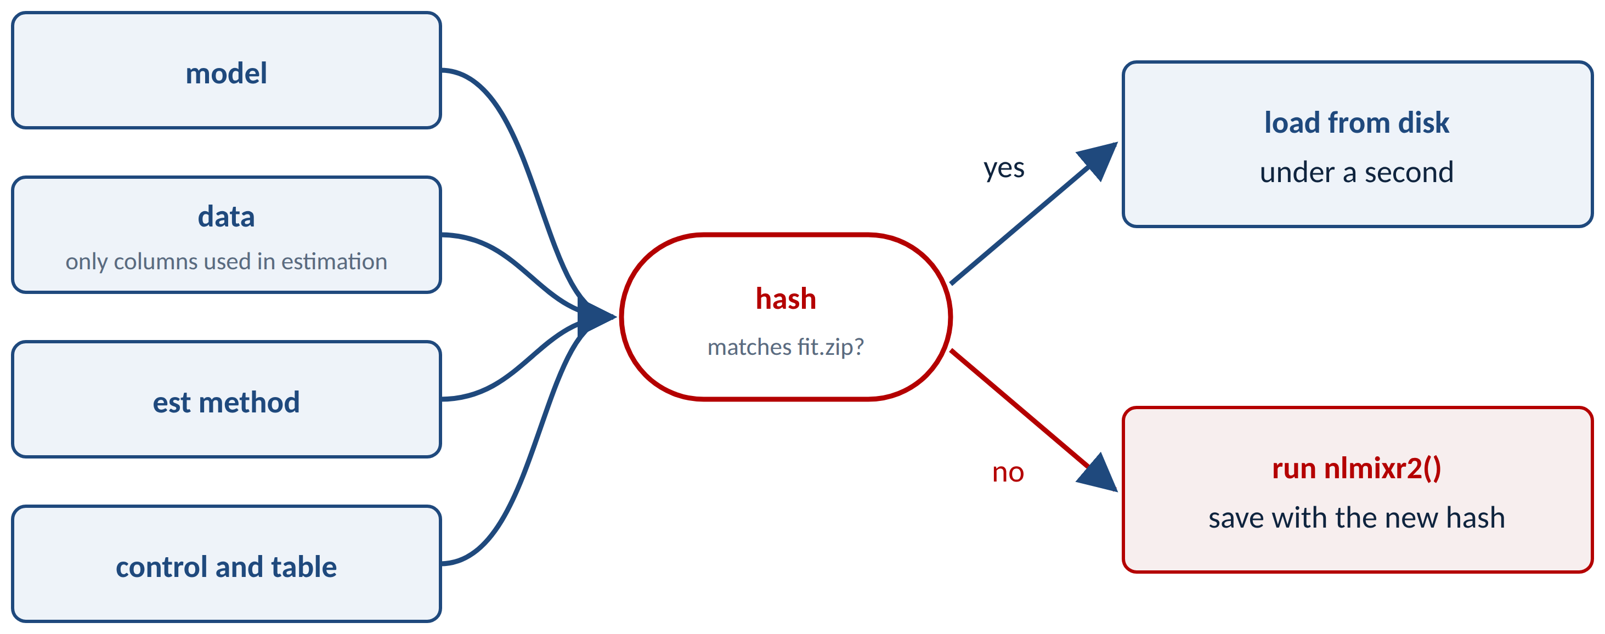
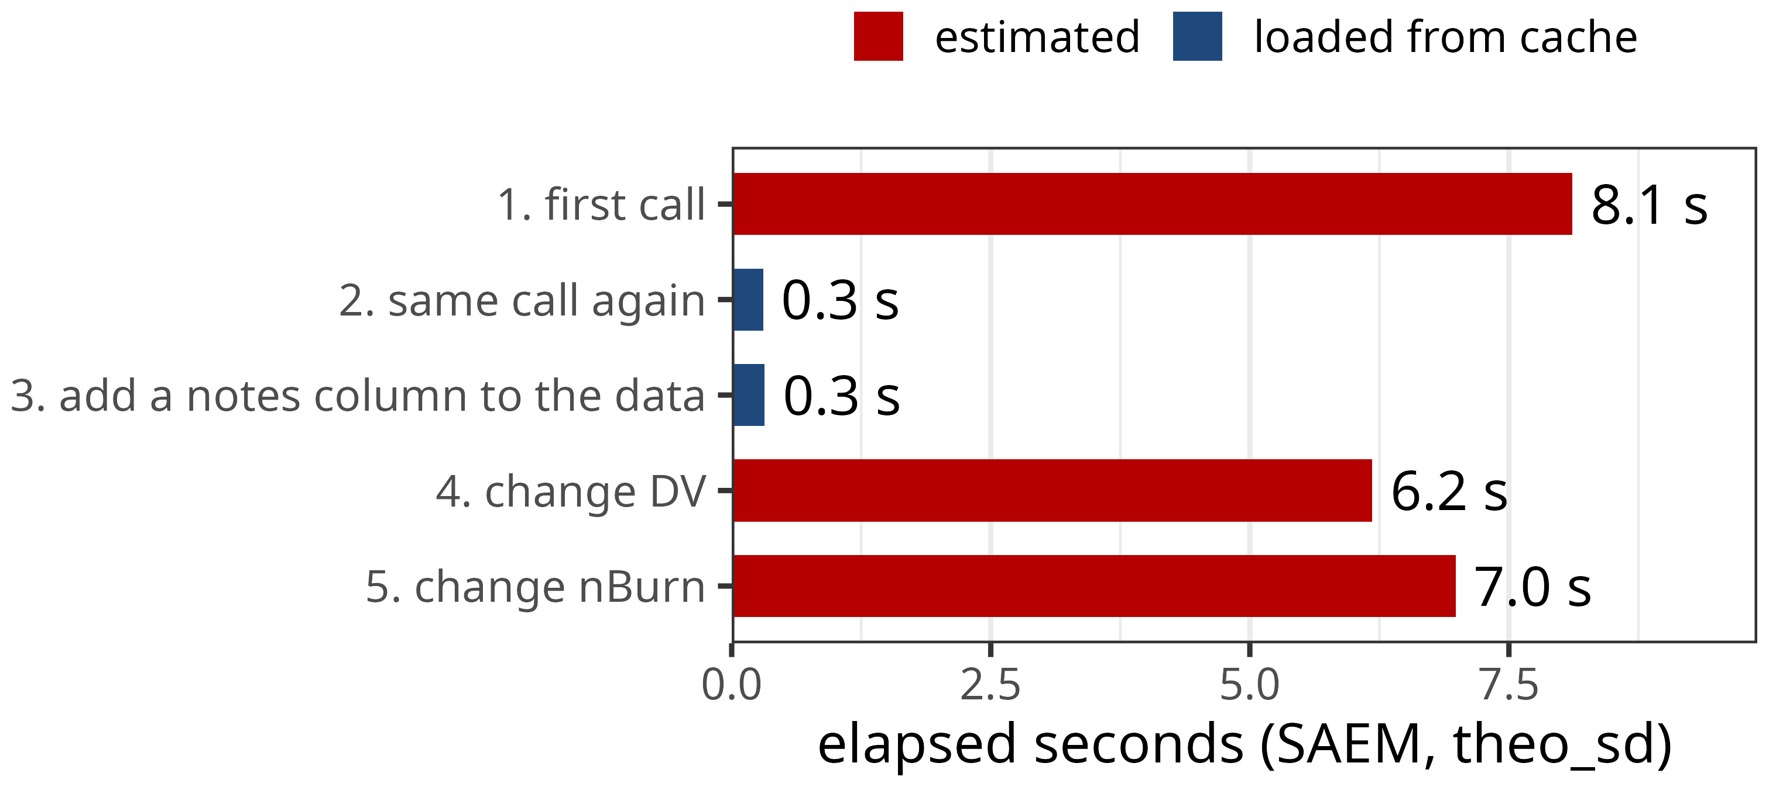
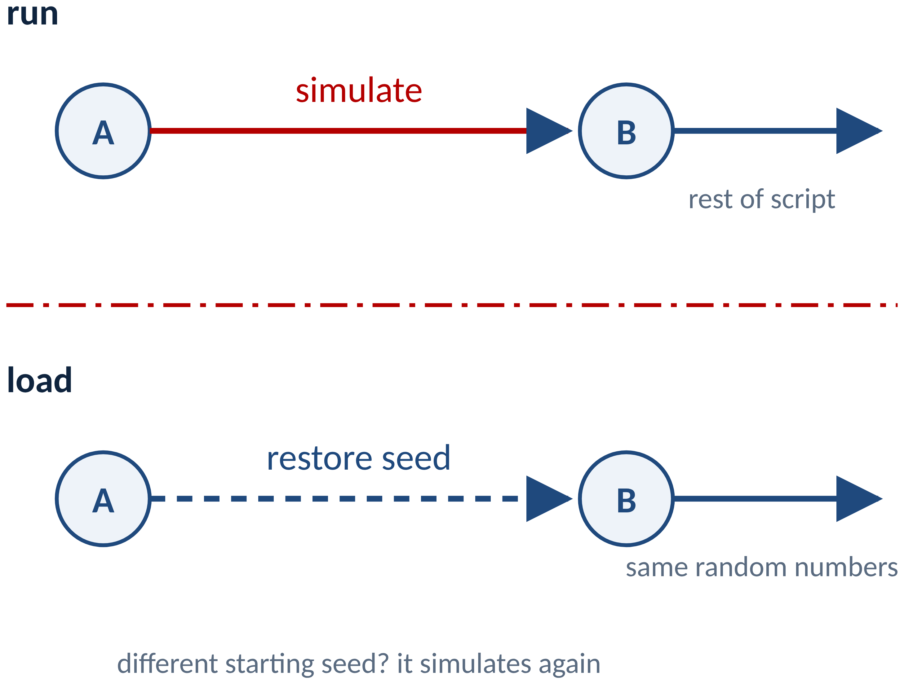


nlmixr2save
Fits you can read, runs you don’t repeat
Change one operator: fit := nlmixr2(model, data)
Saving and caching nlmixr2 fits: portable text files and the := operator
Objectives: Nonlinear mixed-effects (NLME) estimation and simulation take minutes to weeks. In reproducible workflows, re-running models unnecessarily wastes time, and language-specific binary serialization limits sharing results. nlmixr2[1] relied on serialization that was removed from the R ecosystem, making this urgent. We aimed to (1) save nlmixr2 fits as primarily CSV and R source files, and (2) add a caching operator, :=, that re-runs only when the model, data, or settings changed.
Methods: nlmixr2save was developed within the nlmixr2 ecosystem in R. Fits are decomposed into portable components – the final estimated model (as nlmixr2/rxode2[1–2] code), objective function values, tables, and metadata – written as R and CSV text and reconstructed without binary dependencies. The := operator is a drop-in replacement for <- when calling nlmixr2(), rxSolve(), or any long-running R function. It hashes the model, the estimation-relevant data columns, and all estimation or simulation options, plus the starting seed for random calls. A matching cache is loaded from disk and, for random calls, the final seed state restored; otherwise the call runs and the result is saved.
Results: Fits round-trip through a single zip file. Loaded fits keep full functionality: diagnostic plots, VPCs, and use as initial estimates for new runs. Switching fit <- nlmixr2(model, data, est="saem") to fit := nlmixr2(model, data, est="saem") is the only change needed for caching. Other functions are cached in rds format. Version 0.2.0 adds cache directory and prefix options, package-version checks, and nlmixr2saveShare() to share a fit without the original data.
Conclusions: nlmixr2save addresses two practical problems: long-term readable storage of nlmixr2 fits, and redundant runs during iterative development. The := operator gives intelligent result management with minimal effort, promoting efficient, reproducible, collaborative modeling – especially when scripts are re-sourced or rendered in dynamic documents.
References
[1] Fidler M, et al. CPT Pharmacometrics Syst Pharmacol. 2019;8(9):621–633.
[2] Wang W, Hallow KM, James DA. CPT Pharmacometrics Syst Pharmacol. 2016;5(1):3–10.
Install: install.packages("nlmixr2save")
Re-sourcing a script or re-rendering a report reruns nothing unless the model, data, or settings changed
saveFit() writes R source and CSV into one zip
A loaded fit still makes VPCs
The cache key hashes what the estimate depends on
Only changes that matter trigger a refit
Simulations restore the random seed
nlmixr2saveShare(): share a fit without the data
 | -noData | -noData-noFit
model, estimates, objective | kept | kept
etas, parameter history | kept | kept
predictions, residuals | kept | removed
original data | removed | removed
fit.zip is left unchanged; copies are written next to it
Authors
Matthew Fidler^{1,8}, Brendan Bender^{2,8}, William Denney^{3,8}, John Harrold⁸, Richard Hooijmaijers^{4,8}, Mutaz Jaber^{5,8}, Anne Keunecke^{4,8}, Rik Schoemaker^{6,8}, Max Taubert^{1,8}, Mirjam Trame^{7,8}, Justin Wilkins^{6,8}
¹Novartis, ²Genentech, ³Human Predictions, ⁴LAP&P, ⁵Gilead, ⁶Occams, ⁷Certara, ⁸The nlmixr2 team
Blog post + video
Documentation

