Slide 1
Simulation and parameter estimation with rxode2 and nlmixr2
rxode2/nlmixr2 Course PAGE 2026, Dubrovnik, Croatia Anne Keunecke, PhD Justin Wilkins, PhD
On behalf of the nlmixr development team:
Matt Fidler, Bill Denney, John Harrold, Richard Hooijmaijers, Mutaz Jaber, Anne Keunecke, Theo Papathanasiou, Rik Schoemaker, Max Taubert, Mirjam Trame, Justin Wilkins, Brendan Bender

Slide 2
Course outline: Part 1
A bit of history
Introduction to rxode2 simulation
Introduction to nlmixr2 and parameter estimation
Hands on with the warfarin PK models (part 1)
Advanced capabilities nlmixr2
Hands on with the warfarin PK and PKPD models (part 2)

Slide 3
Setting the stage: some background, and rxode2
rxode2/nlmixr2 Course PAGE 2026, Dubrovnik, Croatia Anne Keunecke, PhD
On behalf of the nlmixr development team:
Matt Fidler, Bill Denney, John Harrold, Richard Hooijmaijers, Mutaz Jaber, Anne Keunecke, Theo Papathanasiou, Rik Schoemaker, Max Taubert, Mirjam Trame, Justin Wilkins, Brendan Bender

Slide 4

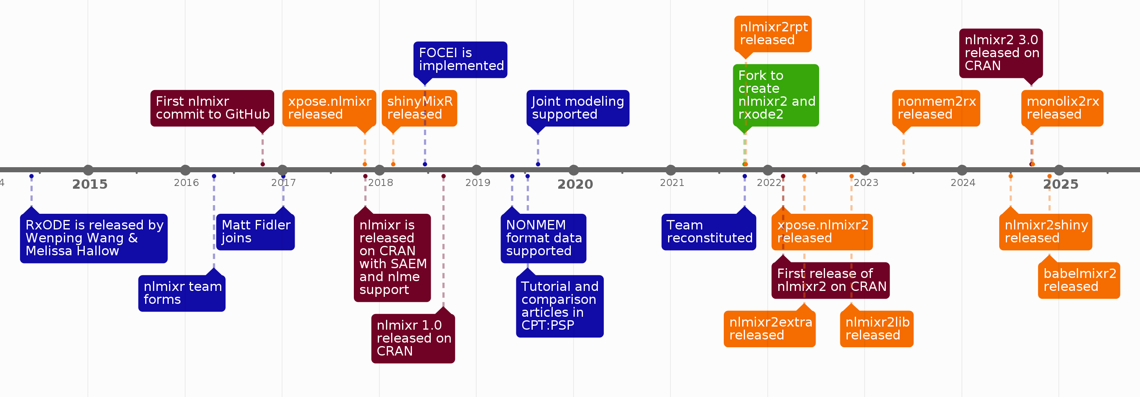

evolution
nlmixr2 evolved over 20 years, from code first written by Wenping Wang in 2005 to RxODE, which became the foundation for nlmixr in 2016. Renamed nlmixr2 in 2021, it now has a broad package ecosystem and a strong user base in academia and industry.
2
Wenping Wang
Richard Hooijmaaijers
Teun Post
Rik Schoemaker
Yuan Xiong
Justin Wilkins
Matt Fidler
Bill Denney
John Harrold
Richard Hooijmaaijers
Theo Papathanasiou
Rik Schoemaker
Max Taubert
Mirjam Trame
Justin Wilkins

Slide 5
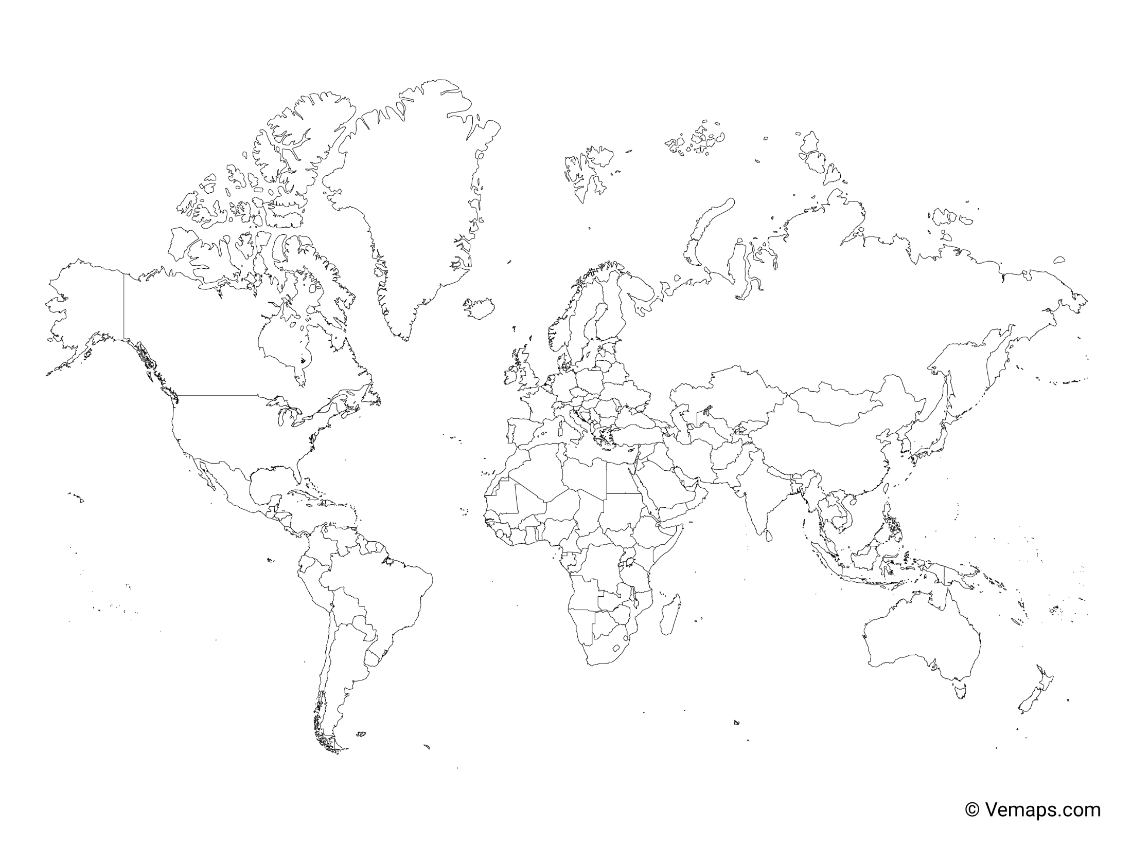








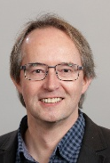

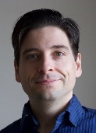
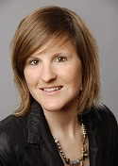


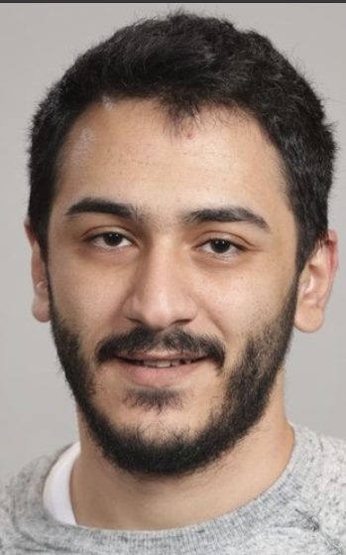

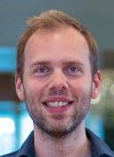
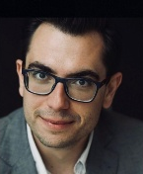


The team
The nlmixr2 R Consortium Working Group is an international group from nine large pharmaceutical companies and CROs. Team members’ time is donated by their organizations.
Rik Schoemaker
Anne Keunecke
Richard Hooijmaaijers
Brendan Bender
Bill Denney
Justin Wilkins
John Harrold
Mirjam Trame
Mutaz Jaber
Max Taubert
Matt Fidler
Theo
Papathanasiou
The nlmixr2 ecosystem is growing with contributions in and out of the working group

Slide 6
Governance and the advisory board
Development is led by Matt Fidler at Novartis, who provides the bulk of the coding
Other team members provide development support on the main or satellite packages, training, testing and documentation
An advisory group was established in 2024 to guide development priorities and to provide input on sustainability and theoretical matters; meets bi-annually or as needed
Paolo Denti (University of Cape Town, South Africa)
Jeffry Florian (FDA, USA)
Marc Gastonguay (Metrum, USA)
Kai Grosch (Novartis, USA)
Manuel Ibarra (Universidad de la República, Uruguay)
Mats Karlsson (Uppsala University, Sweden)
Joe Standing (University College London, UK)

Slide 7
rxode2 simulation software in R
rxode2 is pharmacometric simulation software using ordinary differential equations (ODEs) as an open-source R package
Rewritten by Matt Fidler after Wenping Wang’s original RxODE package, available on CRANª and GitHub^{b}, and described in a tutorial in CPT:PSP^{c} and with online documentation^{d}
Simulation of ODEs was already possible in R (using deSolve), but was slow and virtually impossible to code with flexible dosing history
rxode2 has rapid execution due to compilation in C
rxode2 allows fully flexible dosing history
Stable and mature software for Windows, OS X (in docker), Linux
Requires external compilers (provided by Rtools on Windows)
[a] CRAN: https://cran.r-project.org/web/packages/rxode2
[b] GitHub: https://github.com/nlmixr2/rxode2
[c] Wang W et al. CPT:PSP (2016) 5, 3–10.
[d] RxODE packagedown: https://nlmixr2.github.io/rxode2

Slide 8
Basic example: load the library and define the model
library(rxode2)
## set up the system of differential equations (ODEs) odeKA1 <- " d/dt(depot) = -ka*depot; # This is compartment number 1 (depot) d/dt(central) = ka*depot-(cl/v)*central; # This is compartment number 2 (central) C1=central/v; # Calculates concentration from amount "

Slide 9
Compile the model and set the parameter values
library(rxode2)
## set up the system of differential equations (ODEs) odeKA1 <- " d/dt(depot) = -ka*depot; # This is compartment number 1 (depot) d/dt(central) = ka*depot-(cl/v)*central; # This is compartment number 2 (central) C1=central/v; # Calculates concentration from amount " ## compile the model modKA1 <- rxode2(model = odeKA1) ## provide the parameter values to be simulated: Params <- c(ka = log(2)/0.5, # 1/h (absorption half-life of 30 minutes) cl = 0.135, # L/h v = 8) # L

Slide 10
Create an event table that defines the doses and the sampling times
library(rxode2)
## set up the system of differential equations (ODEs) odeKA1 <- " d/dt(depot) = -ka*depot; # This is compartment number 1 (depot) d/dt(central) = ka*depot-(cl/v)*central; # This is compartment number 2 (central) C1=central/v; # Calculates concentration from amount " ## compile the model modKA1 <- rxode2(model = odeKA1) ## provide the parameter values to be simulated: Params <- c(ka = log(2)/0.5, # 1/h (absorption half-life of 30 minutes) cl = 0.135, # L/h v = 8) # L ## create an empty event table that stores both dosing and sampling information : ev <- eventTable()
## add a dose to the event table: ev$add.dosing(dose = 500) # mg
## add time points to the event table where concentrations will be simulated
## these actions are cumulative ev$add.sampling(seq(0, 120, 0.1))

Slide 11
Then solve the equations and plot the results!
library(rxode2)
## set up the system of differential equations (ODEs) odeKA1 <- " d/dt(depot) = -ka*depot; # This is compartment number 1 (depot) d/dt(central) = ka*depot-(cl/v)*central; # This is compartment number 2 (central) C1=central/v; # Calculates concentration from amount " ## compile the model modKA1 <- rxode2(model = odeKA1) ## provide the parameter values to be simulated: Params <- c(ka = log(2)/0.5, # 1/h (absorption half-life of 30 minutes) cl = 0.135, # L/h v = 8) # L ## create an empty event table that stores both dosing and sampling information : ev <- eventTable() ## add a dose to the event table: ev$add.dosing(dose = 500) # mg ## add time points to the event table where concentrations will be simulated
## these actions are cumulative ev$add.sampling(seq(0, 120, 0.1)) ## Then solve the system ## The output from rxSolve is a solved RxODE object, ## By making it a data.frame only the simulated values are retained: Res <- data.frame(rxSolve(modKA1, Params, ev))

Slide 12
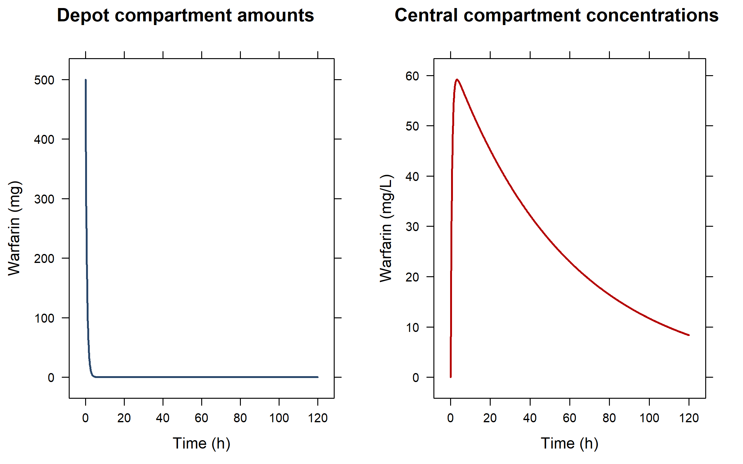
Single bolus dose in the first (depot) compartment

Slide 13
Adding extra doses (expand the existing eventTable): three additional infusions in the central compartment
## Extend the eventTable by adding three infusions to the central compartment ## Remember: updates to the eventTable are cumulative ev$add.dosing( dose = 250, # mg nbr.doses = 3, # add three doses dosing.to = 2, # add them to the second ODE in the model (=central) dosing.interval = 12, # h; set the doses 12 hours apart rate = 125, # mg/h; infuse at a rate of 125 mg/h, resulting in 2-hour infusions start.time = 36 # h; have the three doses start at 36h ) Res <- data.frame(rxSolve(modKA1, Params, ev))

Slide 14
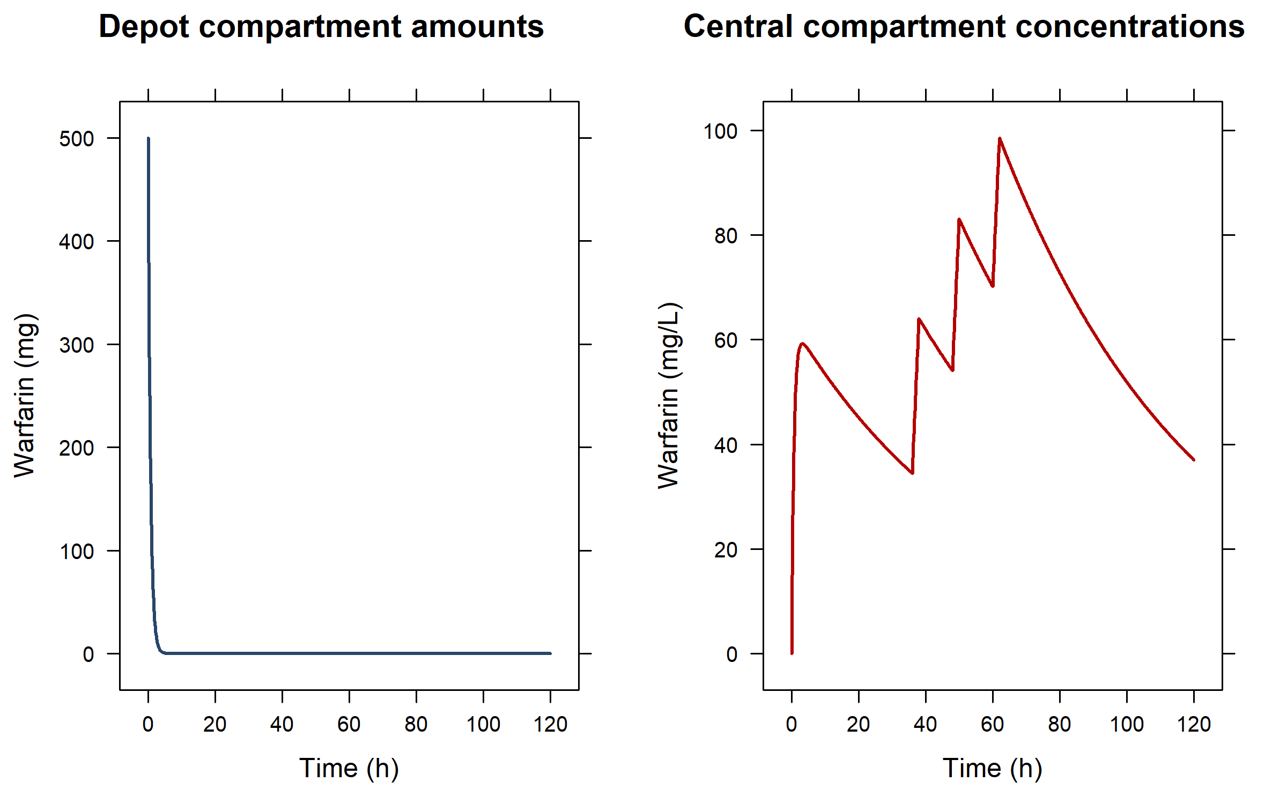
Multiple doses in different compartments: only the first dose goes into the depot (first) compartment

Slide 15
Extend the model: add a transit compartment…
odeKA1trans <- " d/dt(depot) = -ka*depot; d/dt(central) = ktr*trans-(cl/v)*central; # update to central: input from trans d/dt(trans) = ka*depot-ktr*trans; # transit compartment between depot and central C1=central/v; " ## compile the model modKA1trans <- rxode2(model = odeKA1trans) ## provide the extra ktr parameter: Params2 <- c( ka = log(2)/0.5, # 1/h (absorption half-life of 30 minutes) cl = 0.135, # L/h v = 8, # L ktr = log(2)/5) # 1/h (transit half-life of 5 hours) ## the event table does not have to change Res <- data.frame(rxSolve(modKA1trans, Params2, ev))
## if the trans compartment had been put as second compartment above,
## the eventTable would need an update to infuse in compartment 3 instead

Slide 16
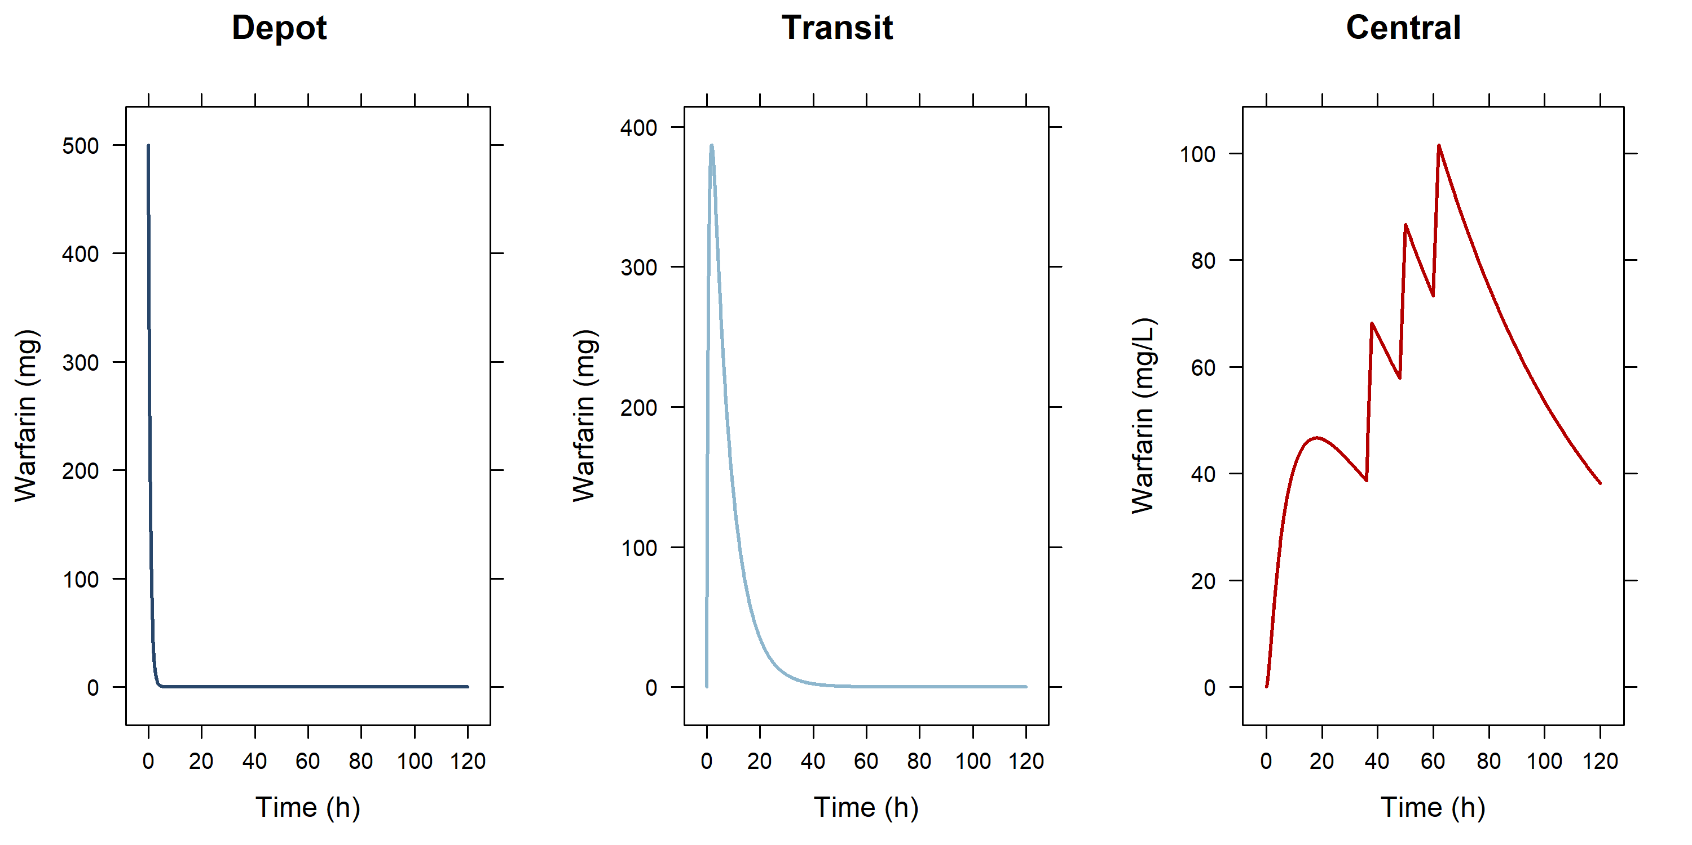
...adding a transit compartment between depot and central

Slide 17
Or with five transit compartments and only bolus doses in the depot…
odeKA5trans <- " d/dt(depot) = -ktr*depot; d/dt(central) = ktr*trans5-(cl/v)*central; # update to central: input from trans5 d/dt(trans1) = ktr*depot-ktr*trans1; # use same constant for every compartment d/dt(trans2) = ktr*trans1-ktr*trans2; d/dt(trans3) = ktr*trans2-ktr*trans3; d/dt(trans4) = ktr*trans3-ktr*trans4; d/dt(trans5) = ktr*trans4-ktr*trans5; C1=central/v; " ev3 <- eventTable() ev3$add.dosing(dose = 500) # mg; 1st bolus ev3$add.dosing( dose = 250, # mg nbr.doses = 3, # 3 additional doses (bolusses because rate is absent so rate=0)
dosing.interval = 12, # h; at 12 hour intervals dosing.to = 1, # dosed into depot (compartment 1) start.time = 36 # h; starting at 36 hours ) ev3$add.sampling(seq(0, 120, 0.1)) Params3 <- c(ktr = log(2)/1, # use same constant for every compartment cl = 0.135, v = 8) modKA5trans <- rxode2(model = odeKA5trans) Res <- data.frame(rxSolve(modKA5trans, Params3, ev3))
Savic-type transit absorption models can also be coded in terms of mean transit time and number of transit compartments using the transit() function!

Slide 18
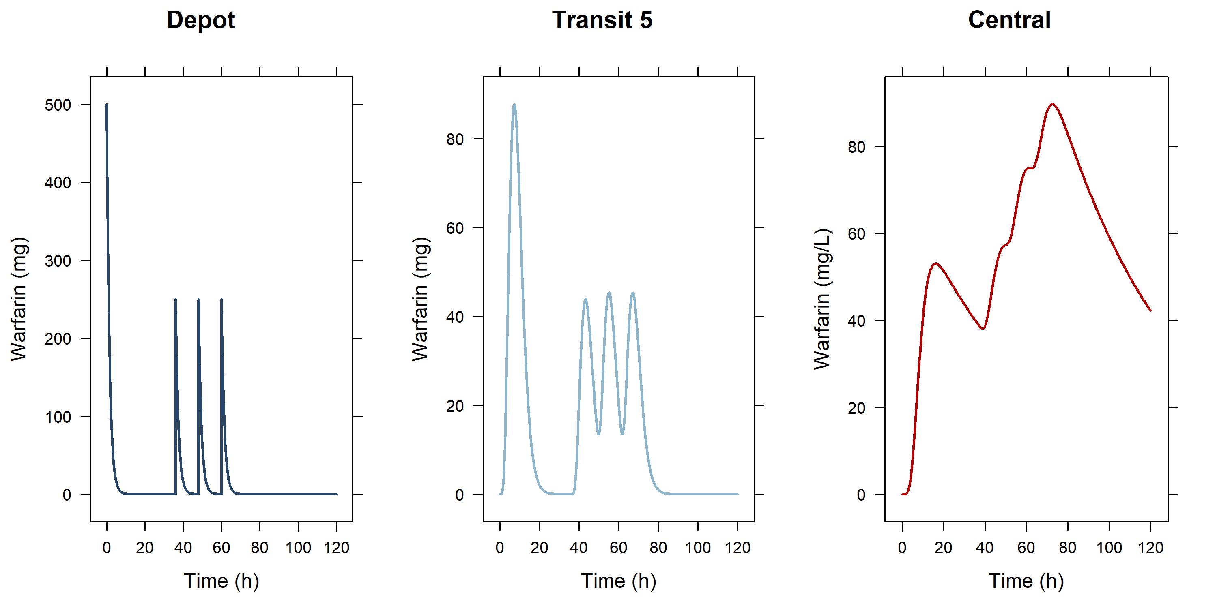
...adding 5 transit compartments between depot and central and giving 4 bolus doses in the 1st (depot) compartment

Slide 19
Alternatively: use NONMEM-style dataset as input
Instead of event tables, you can also use a NONMEM dataset structure for simulations

Slide 20
Hands-on session I: rxode2 simulations
Examine the code in HandsOn_1.R to run pre-programmed simulations and try out your own variations…

Slide 21
Assess the data before you start analysis
Classic data sets used by Nick Holford in his courses:
O'Reilly RA, Aggeler PM. Studies on coumarin anticoagulant drugs initiation of warfarin therapy without a loading dose. Circulation 1968;38:169-177
O'Reilly RA, Aggeler PM, Leong LS. Studies of the coumarin anticoagulant drugs: The pharmacodynamics of warfarin in man. Journal of Clinical Investigation 1963;42(10):1542-1551
Some simple plots to get a feel of the data
Additional xgxr functionality to improve and summarize the profiles

Slide 22
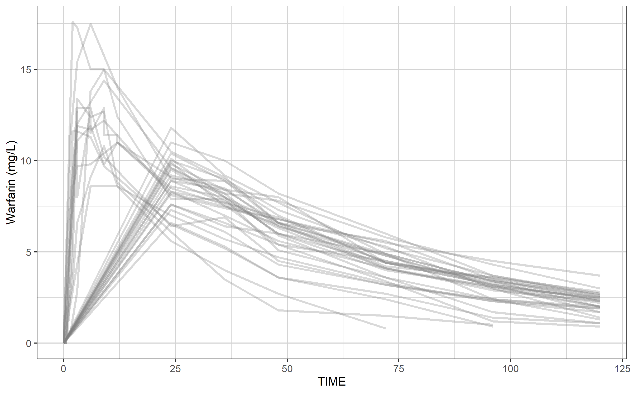
Our warfarin data file: a simple spaghetti plot to provide an overall impression

Slide 23
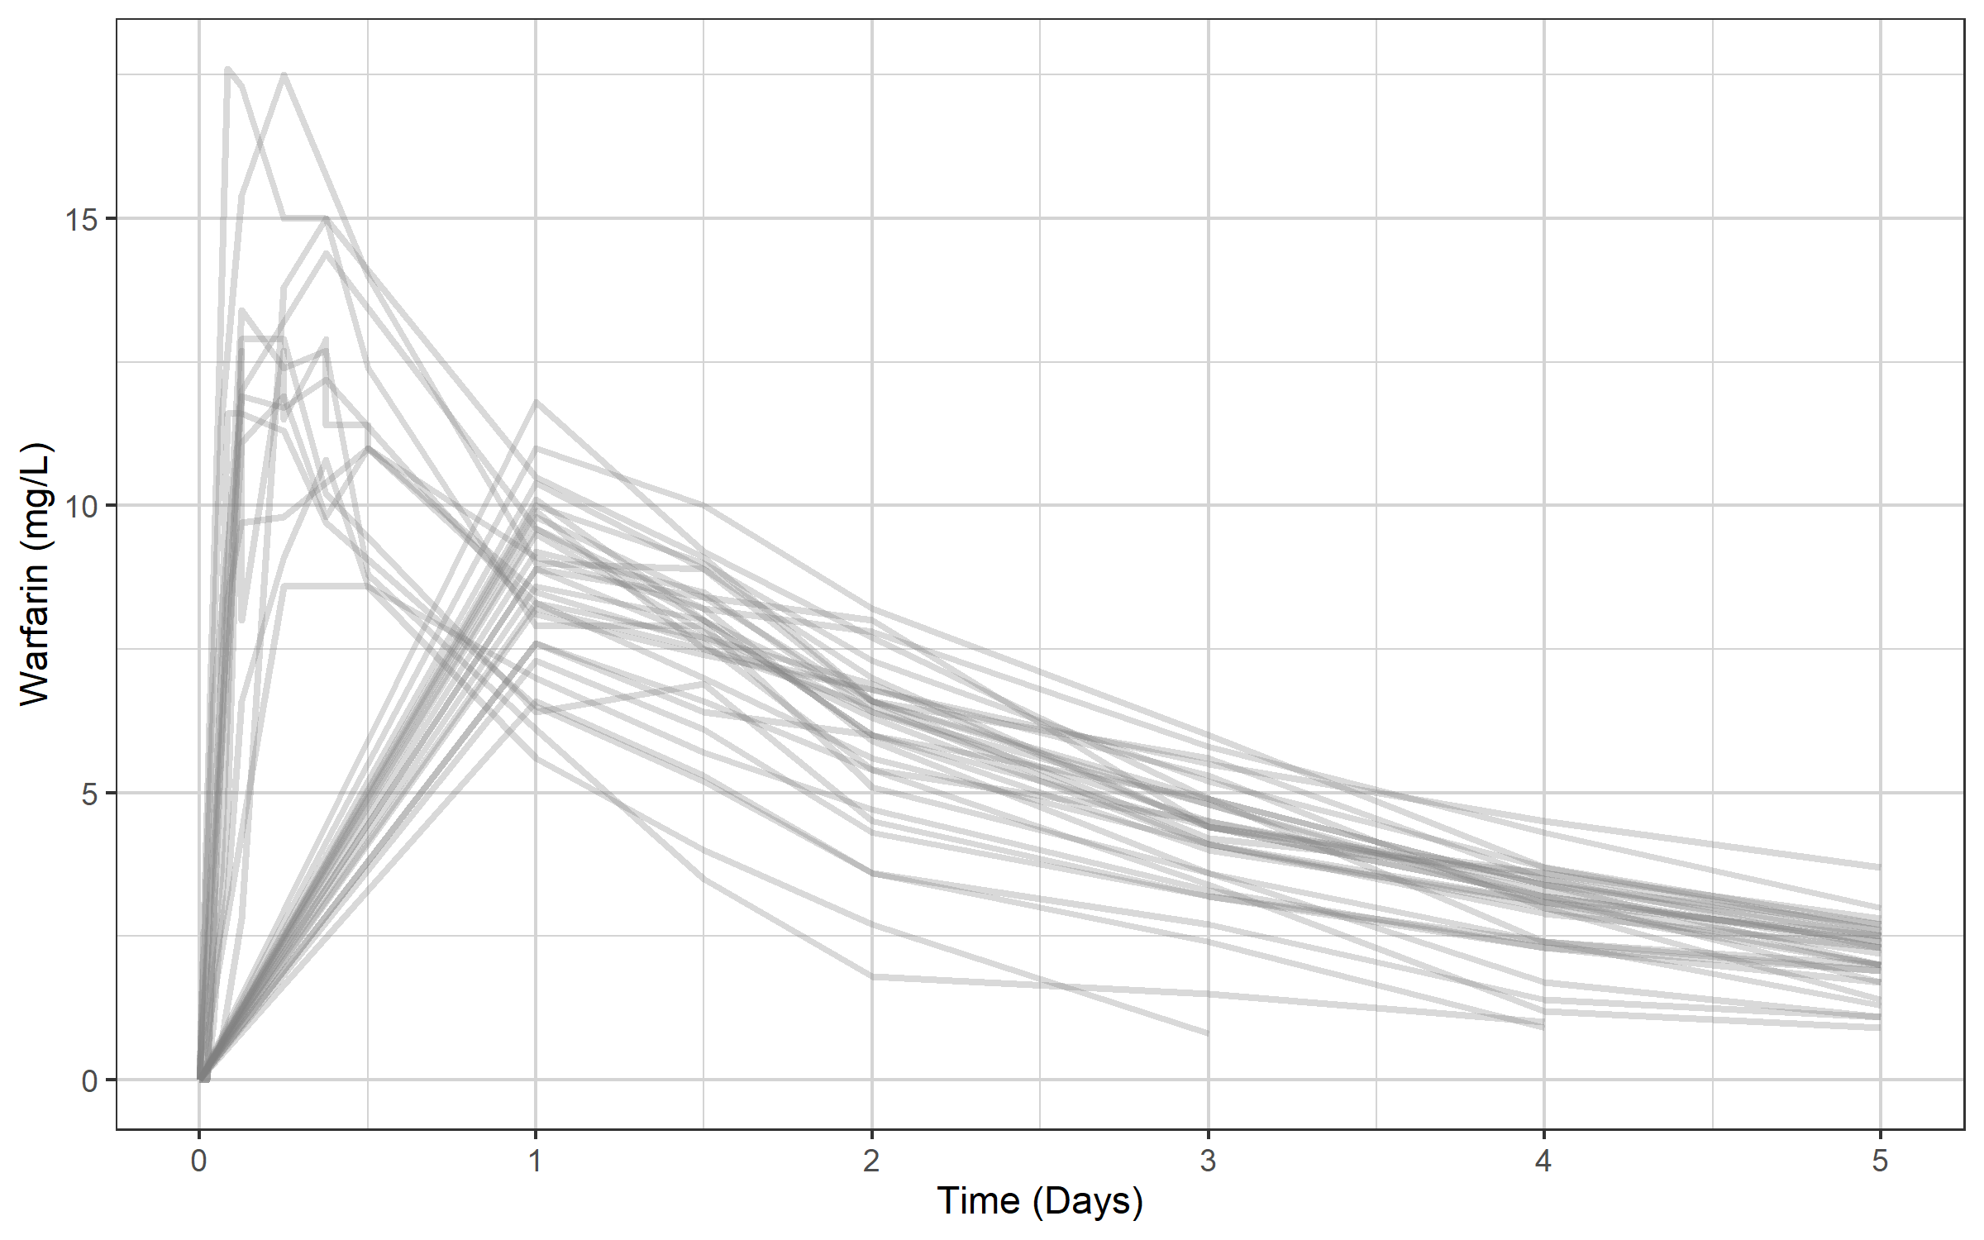
Change the x-axis from hours to days and add a proper label using the xgx helper xgx_scale_x_time_units(units_dataset = "hours", units_plot = "days")

Slide 24
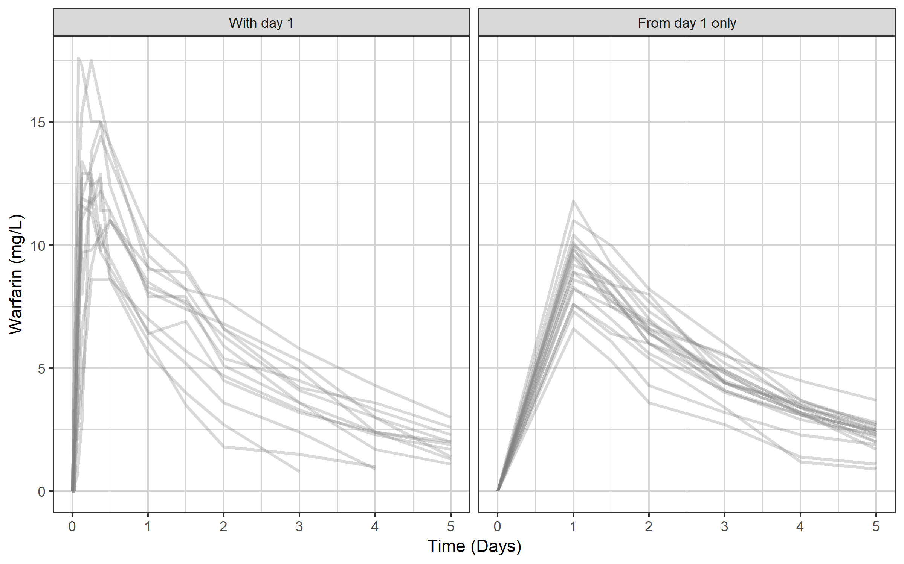
The data set has two types of profiles…

Slide 25
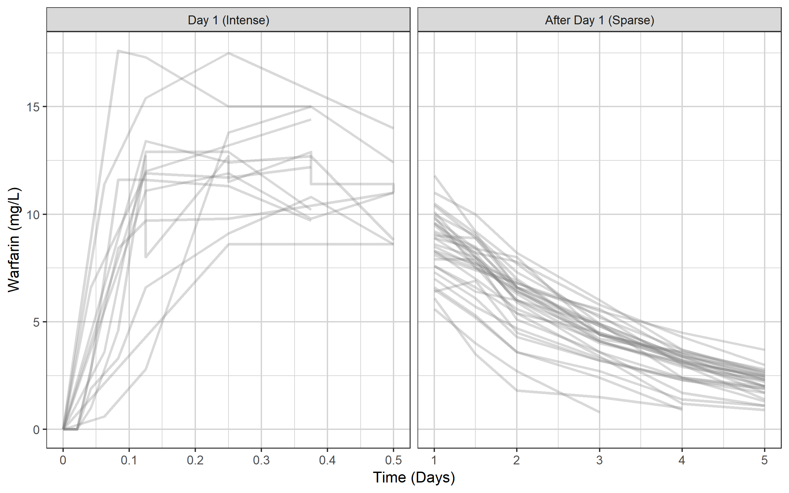
...but you can also group by rich day 1 and sparse later days...

Slide 26
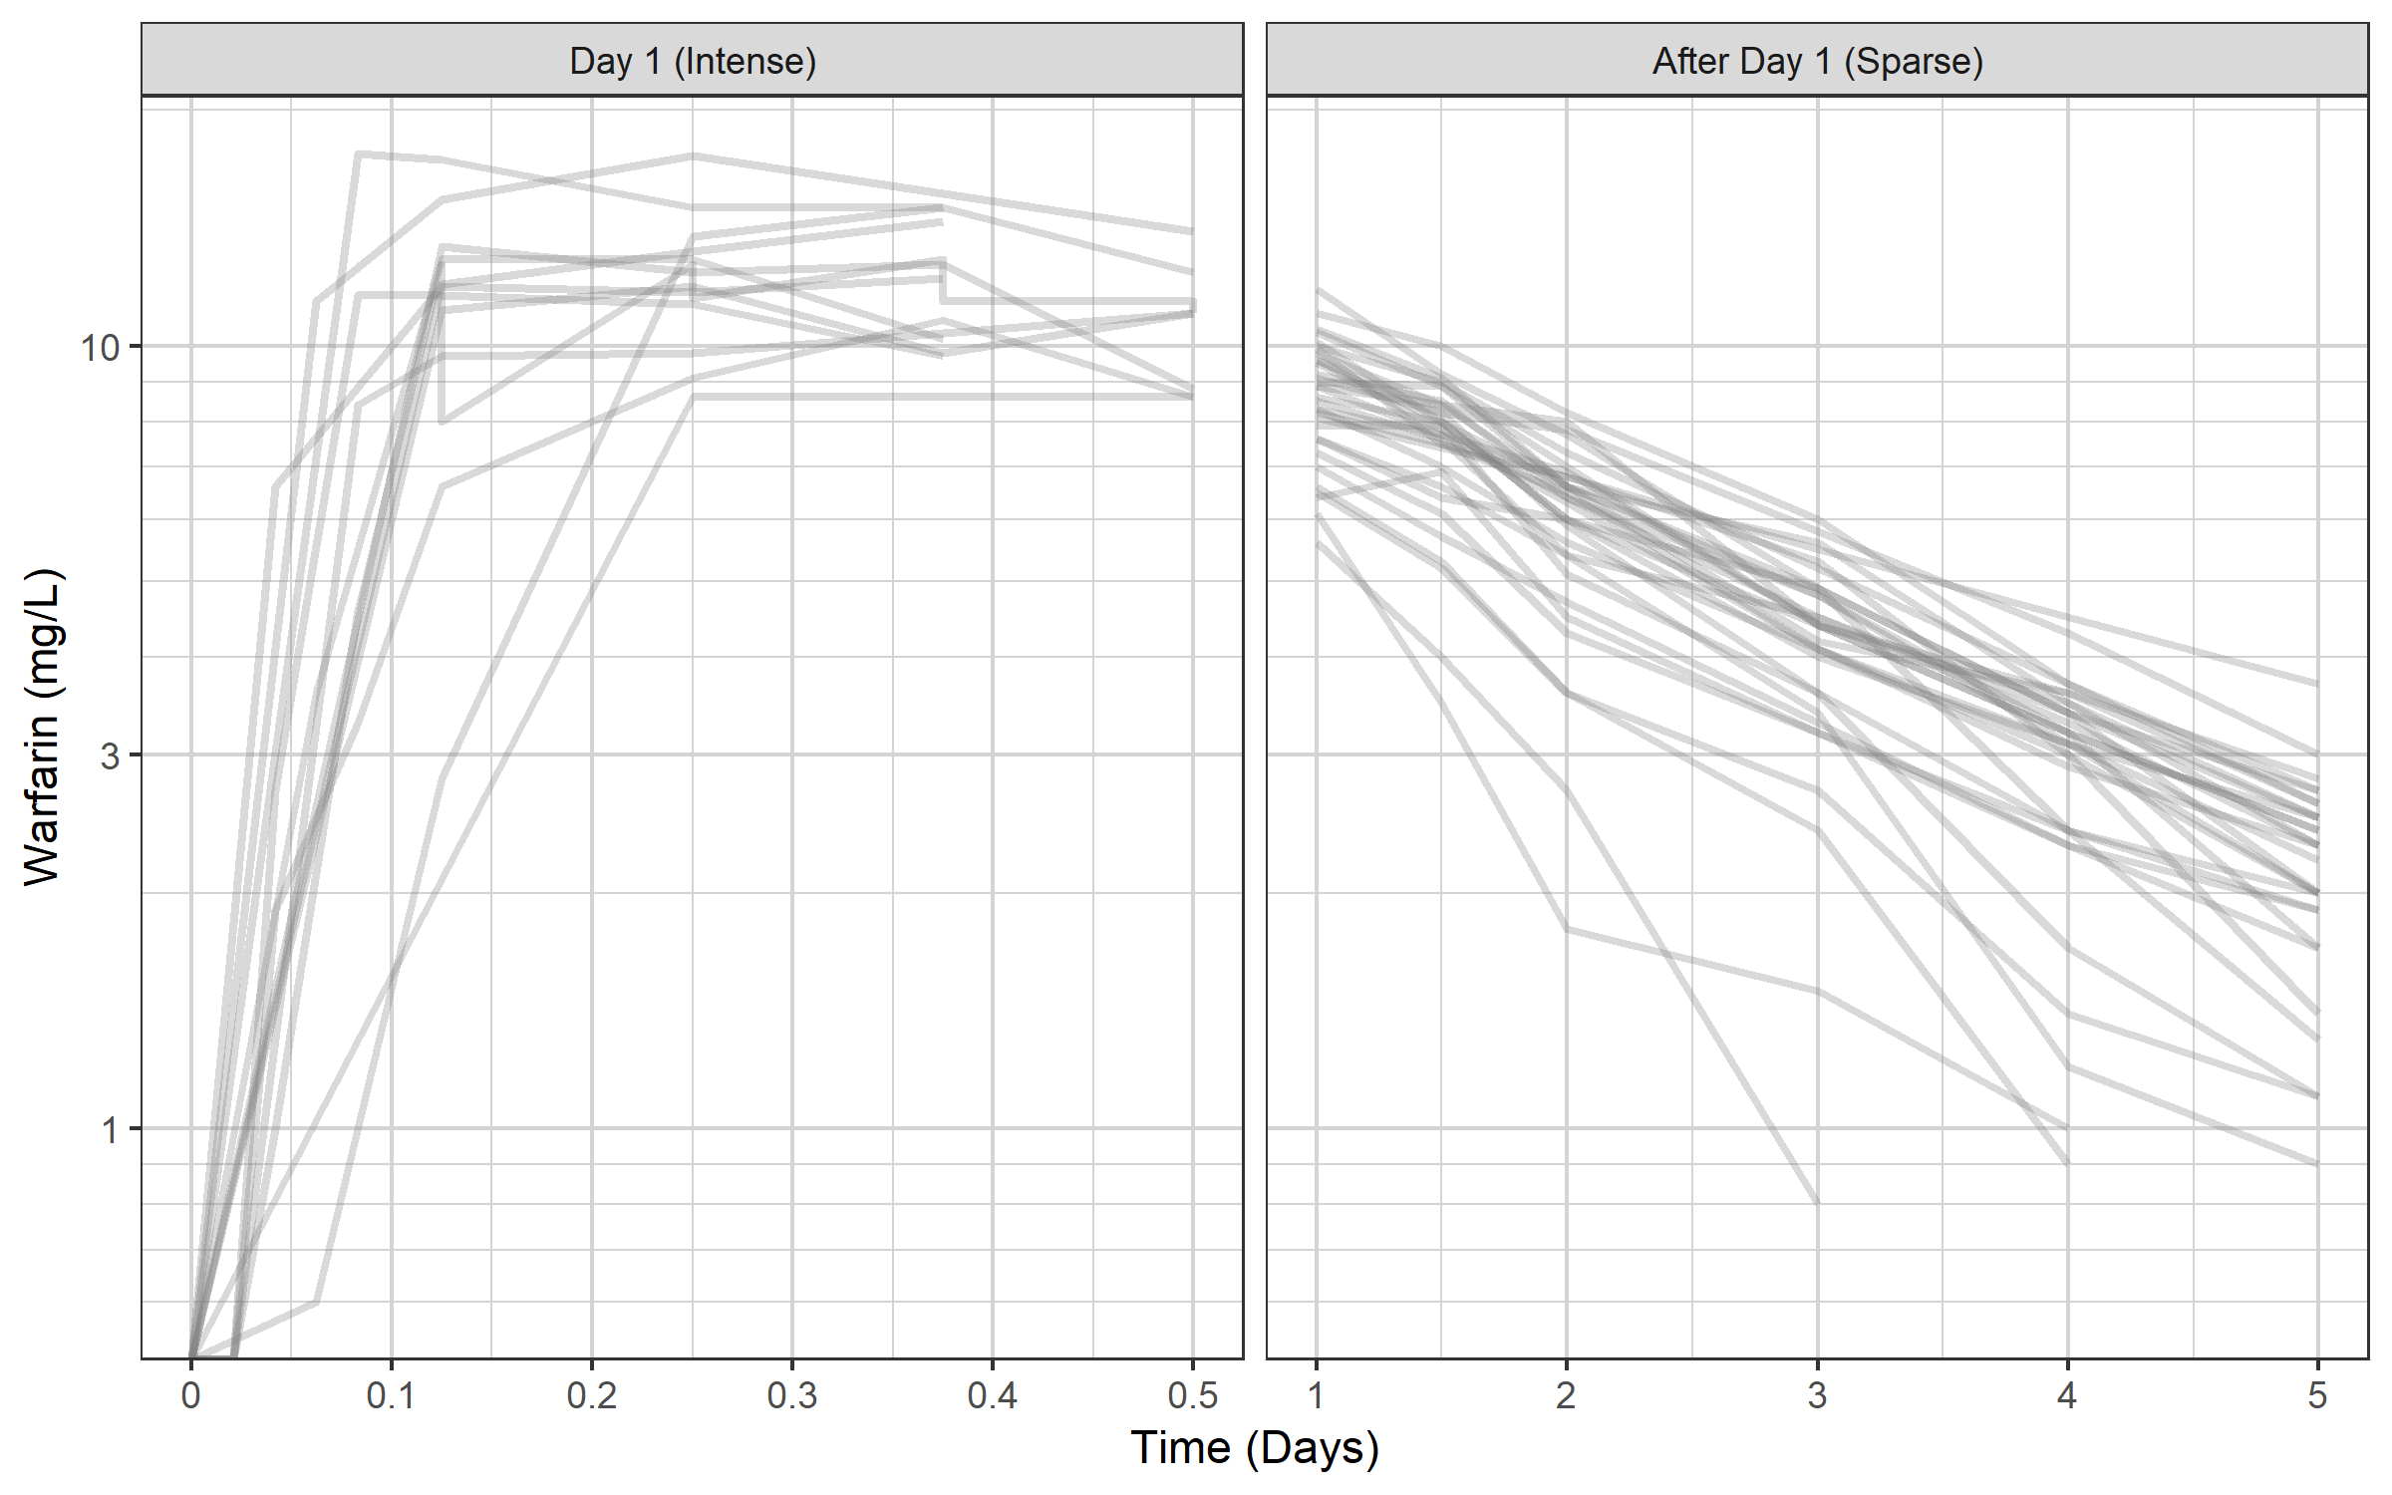
Switch to semi-log scale using xgx helper xgx_scale_y_log10() Any clues to what model we should use?

Slide 27
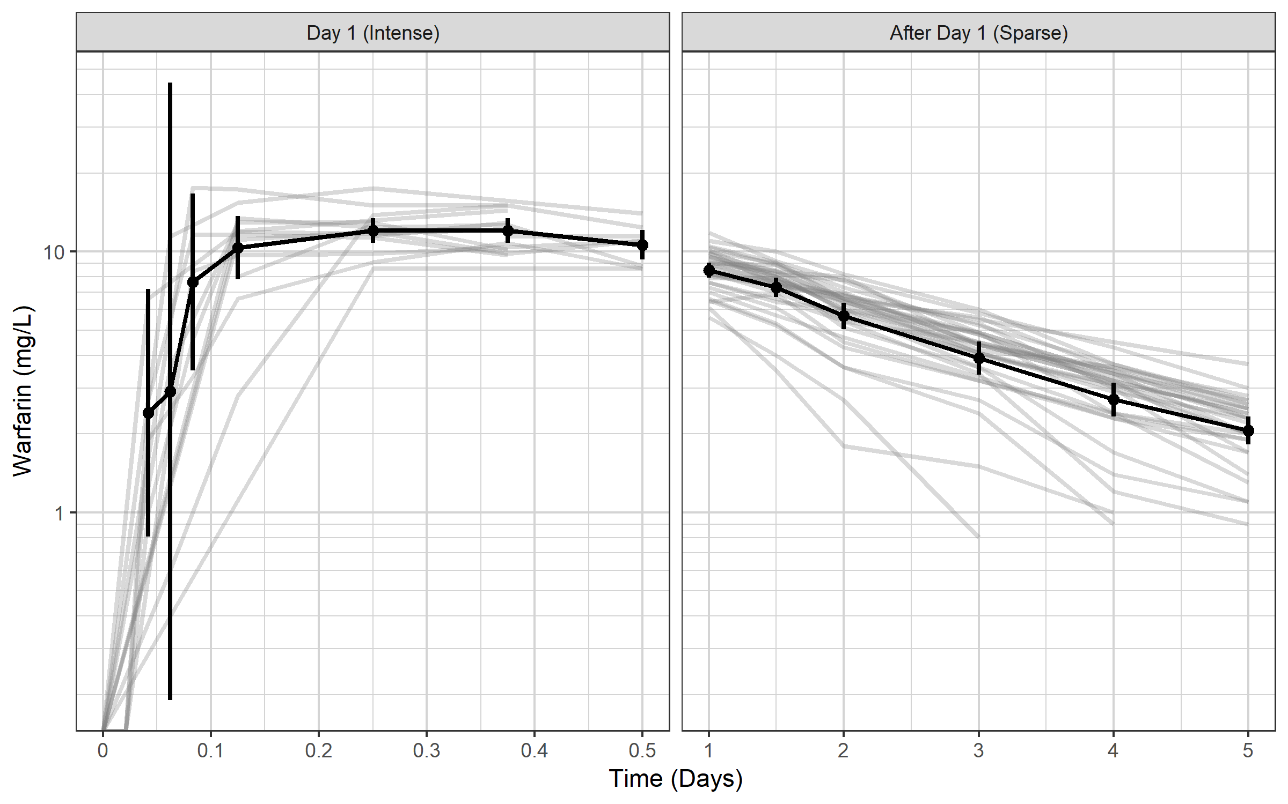
xgx can also add nice summary information if data has nominal times: summaries of mean plus 95% CI xgx_geom_ci(aes(x = TIME, color = NULL, group = NULL, shape = NULL), conf_level = 0.95)

Slide 28
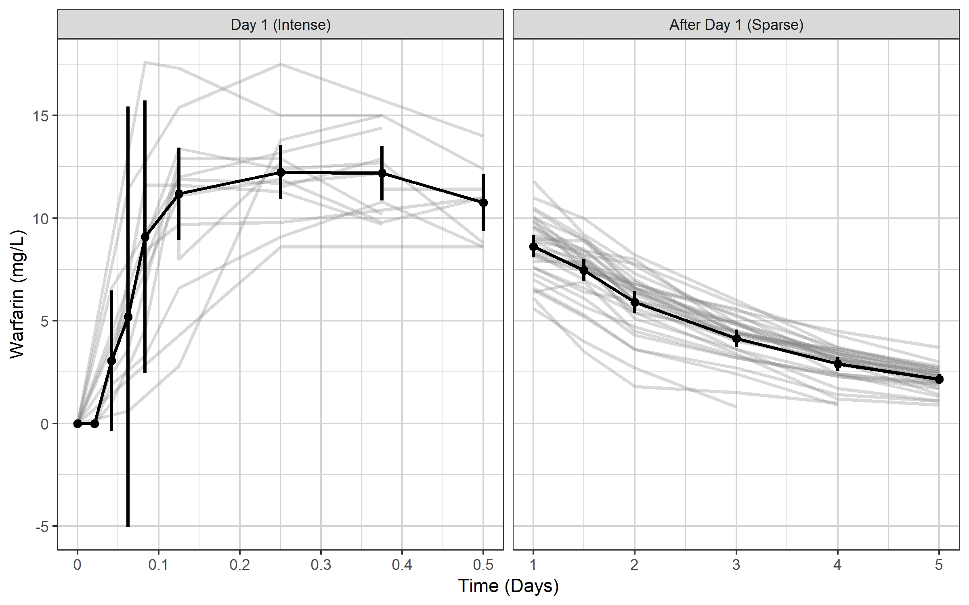
On the linear scale this would result in a CI crossing zero, because CIs are assumedto be symmetrical

Slide 29
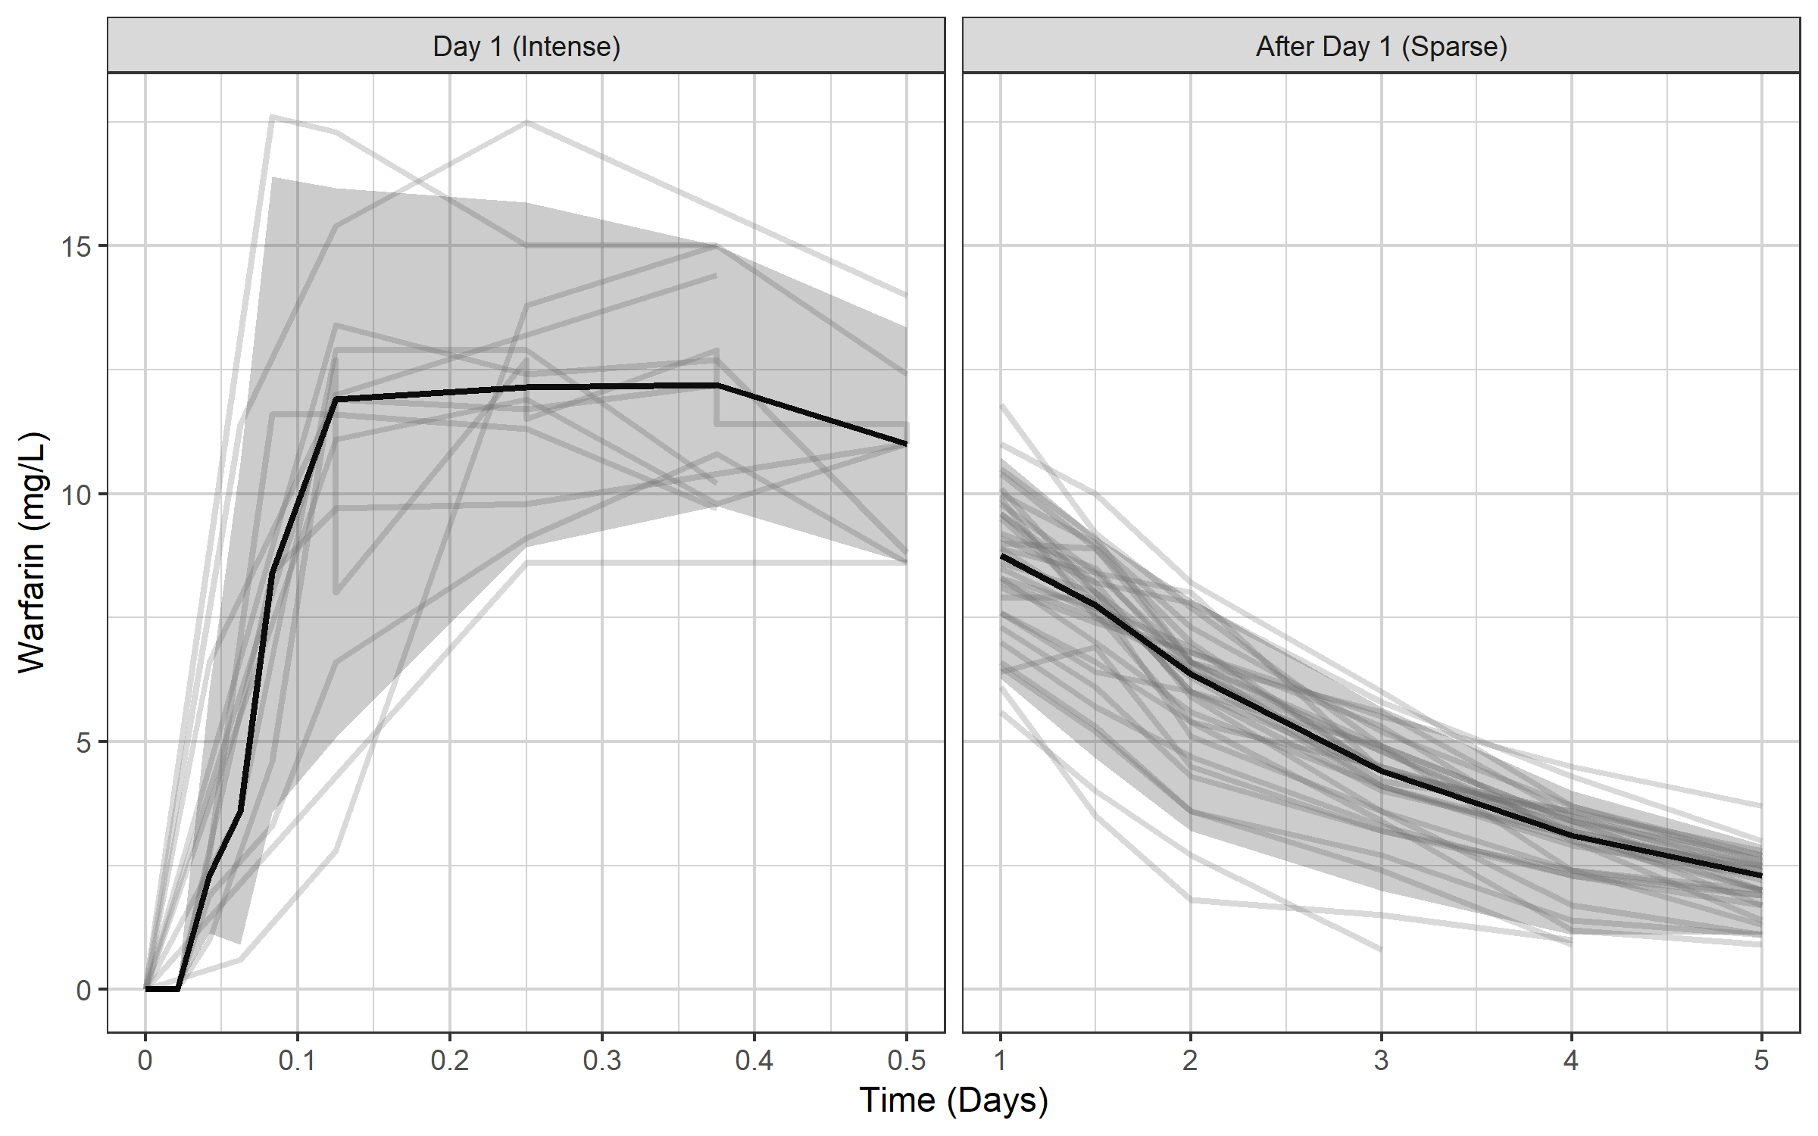
...so perhaps a median and 95% of the data would be more suitable xgx_geom_pi(aes(x = TIME, color = NULL, group = NULL, shape = NULL)

Slide 30
There appears to be a delay in absorption…

Slide 31
You need to know how to simulate before you can estimate
With simulation covered, you can start to think about estimation
Combine the simulation core with estimation routines and you get:
nlmixr²

Slide 32
nlmixr2 is a family of open-source R packages
Written by Wenping Wang and Matt Fidler, and available on CRANª and GitHub^{b}:
builds on rxode2
combined with SAEM, and FOCEI estimation routines, provides an R package for parameter estimation in nonlinear mixed effect models
under very active development!
nlmixr2 is completely free and open source, and does not depend on any other commercial tool such as NONMEM or Monolix
nlmixr2 provides an efficient and versatile way to specify pharmacometric models (both closed-form and ODEs) and dosing scenarios, with rapid execution due to compilation in C
[a] https://cran.r-project.org/web/packages/nlmixr2
[b] https://github.com/nlmixr2/nlmixr2

Slide 33
nlmixr2 is the core of a thriving ecosystem
nlmixr2 is fully supported by ggPMXª
Additionally, xpose.nlmixr2^{b} provides linkage to the xpose package^{c}, feeding the uniform output into a highly flexible diagnostics package
The shinyMixR^{d} project management tool provides an interface to nlmixr2 from both the R command line and a user-friendly browser-based Shiny dashboard application
nlmixr2lib, nlmixr2targets, posologyr, nlmixr2autoinit and many others provide enhanced functionality
nlmixr2 requires access to compilers, easily installed using Rtools on Windows^{e} and built-in compilers on Linux and macOS
Installation is very simple from CRAN:
install.packages("nlmixr2",dependencies=TRUE)
Documentation is available in the form of an online book (nlmixr2.org)^{f} and a dedicated nlmixr blog (blog.nlmixr2.org)
A Docker install is available
[a] https://cran.r-project.org/web/packages/ggPMX/ and https://github.com/ggPMXdevelopment/ggPMX
[b] https://github.com/nlmixr2/xpose.nlmixr2 and https://cran.r-project.org/packages/xpose.nlmixr2
[c] https://cran.r-project.org/packages/xpose and https://uupharmacometrics.github.io/xpose/
[d] https://github.com/RichardHooijmaijers/shinyMixR and https://richardhooijmaijers.github.io/shinyMixR/articles/shinyMixR-vignette.html
[e] https://cran.r-project.org/bin/windows/Rtools/rtools42/rtools.html
[f] https://nlmixr2.github.io/nlmixr2

Slide 34
nlmixr2 has some new features!
nlmixr2lib provides hundreds of models from the literature
nlmixr2 can now use NONMEM for its parameter estimation when using the babelmixr2ª package
The nonmem2rx^{b} and monolix2rx^{c} packages allow reading of output and translation of models from NONMEM and Monolix to rxode2 and nlmixr2 objects
This allows checking of models developed using other tools, additional calculation of covariance matrices where not otherwise available, and nlmixr2 functionality like creation of VPCs and smooth predicted individual profiles (via augPred()) and simulation using rxode2
Additionally, babelmixr2 can use the PKNCA package to provide starting values for PK analysis when rich profiles are available, and can keep track of units…
… and can cross-convert from PopED
nlmixr2autoinit provides an even richer toolset for finding initial estimates (more on this later)
[a] https://cran.r-project.org/web/packages/babelmixr2/index.html
[b] https://cran.r-project.org/web/packages/nonmem2rx/index.html
[c] https://cran.r-project.org/web/packages/monolix2rx/index.html

Slide 35
Advanced functionality in testing!
SCM: nlmixr2scm
Bootstrap: nlmixr2boot
Log-likelihood profiling (LLP): nlmixr2llp
Stochastic simulation and estimation (SSE): nlmixr2sse
Sampling importance resampling (SIR): nlmixr2sir
SCM and bootstrap built on earlier versions in nlmixr2extra
[a] https://github.com/kestrel99/nlmixr2scm
[b] https://github.com/kestrel99/nlmixr2boot
[c] https://github.com/kestrel99/nlmixr2llp
[d] https://github.com/kestrel99/nlmixr2sse
[e] https://github.com/kestrel99/nlmixr2sir

Slide 36
Performance: do I get the same results when I switch from my usual estimation tool to nlmixr2?
Publication in CPT:PSP: Performance of the SAEM and FOCEI algorithms in the open-source non-linear mixed effect modelling tool nlmixrª
nlmixr/FOCEI compared to NONMEM/FOCEI
nlmixr/SAEM compared to Monolix/SAEM
Repeated sparse data sets for a single model
A wide range of models and inputs using single rich data sets
Results for both FOCEI and SAEM compare well to NONMEM and Monolix
[a] https://ascpt.onlinelibrary.wiley.com/doi/10.1002/psp4.12471

Slide 37
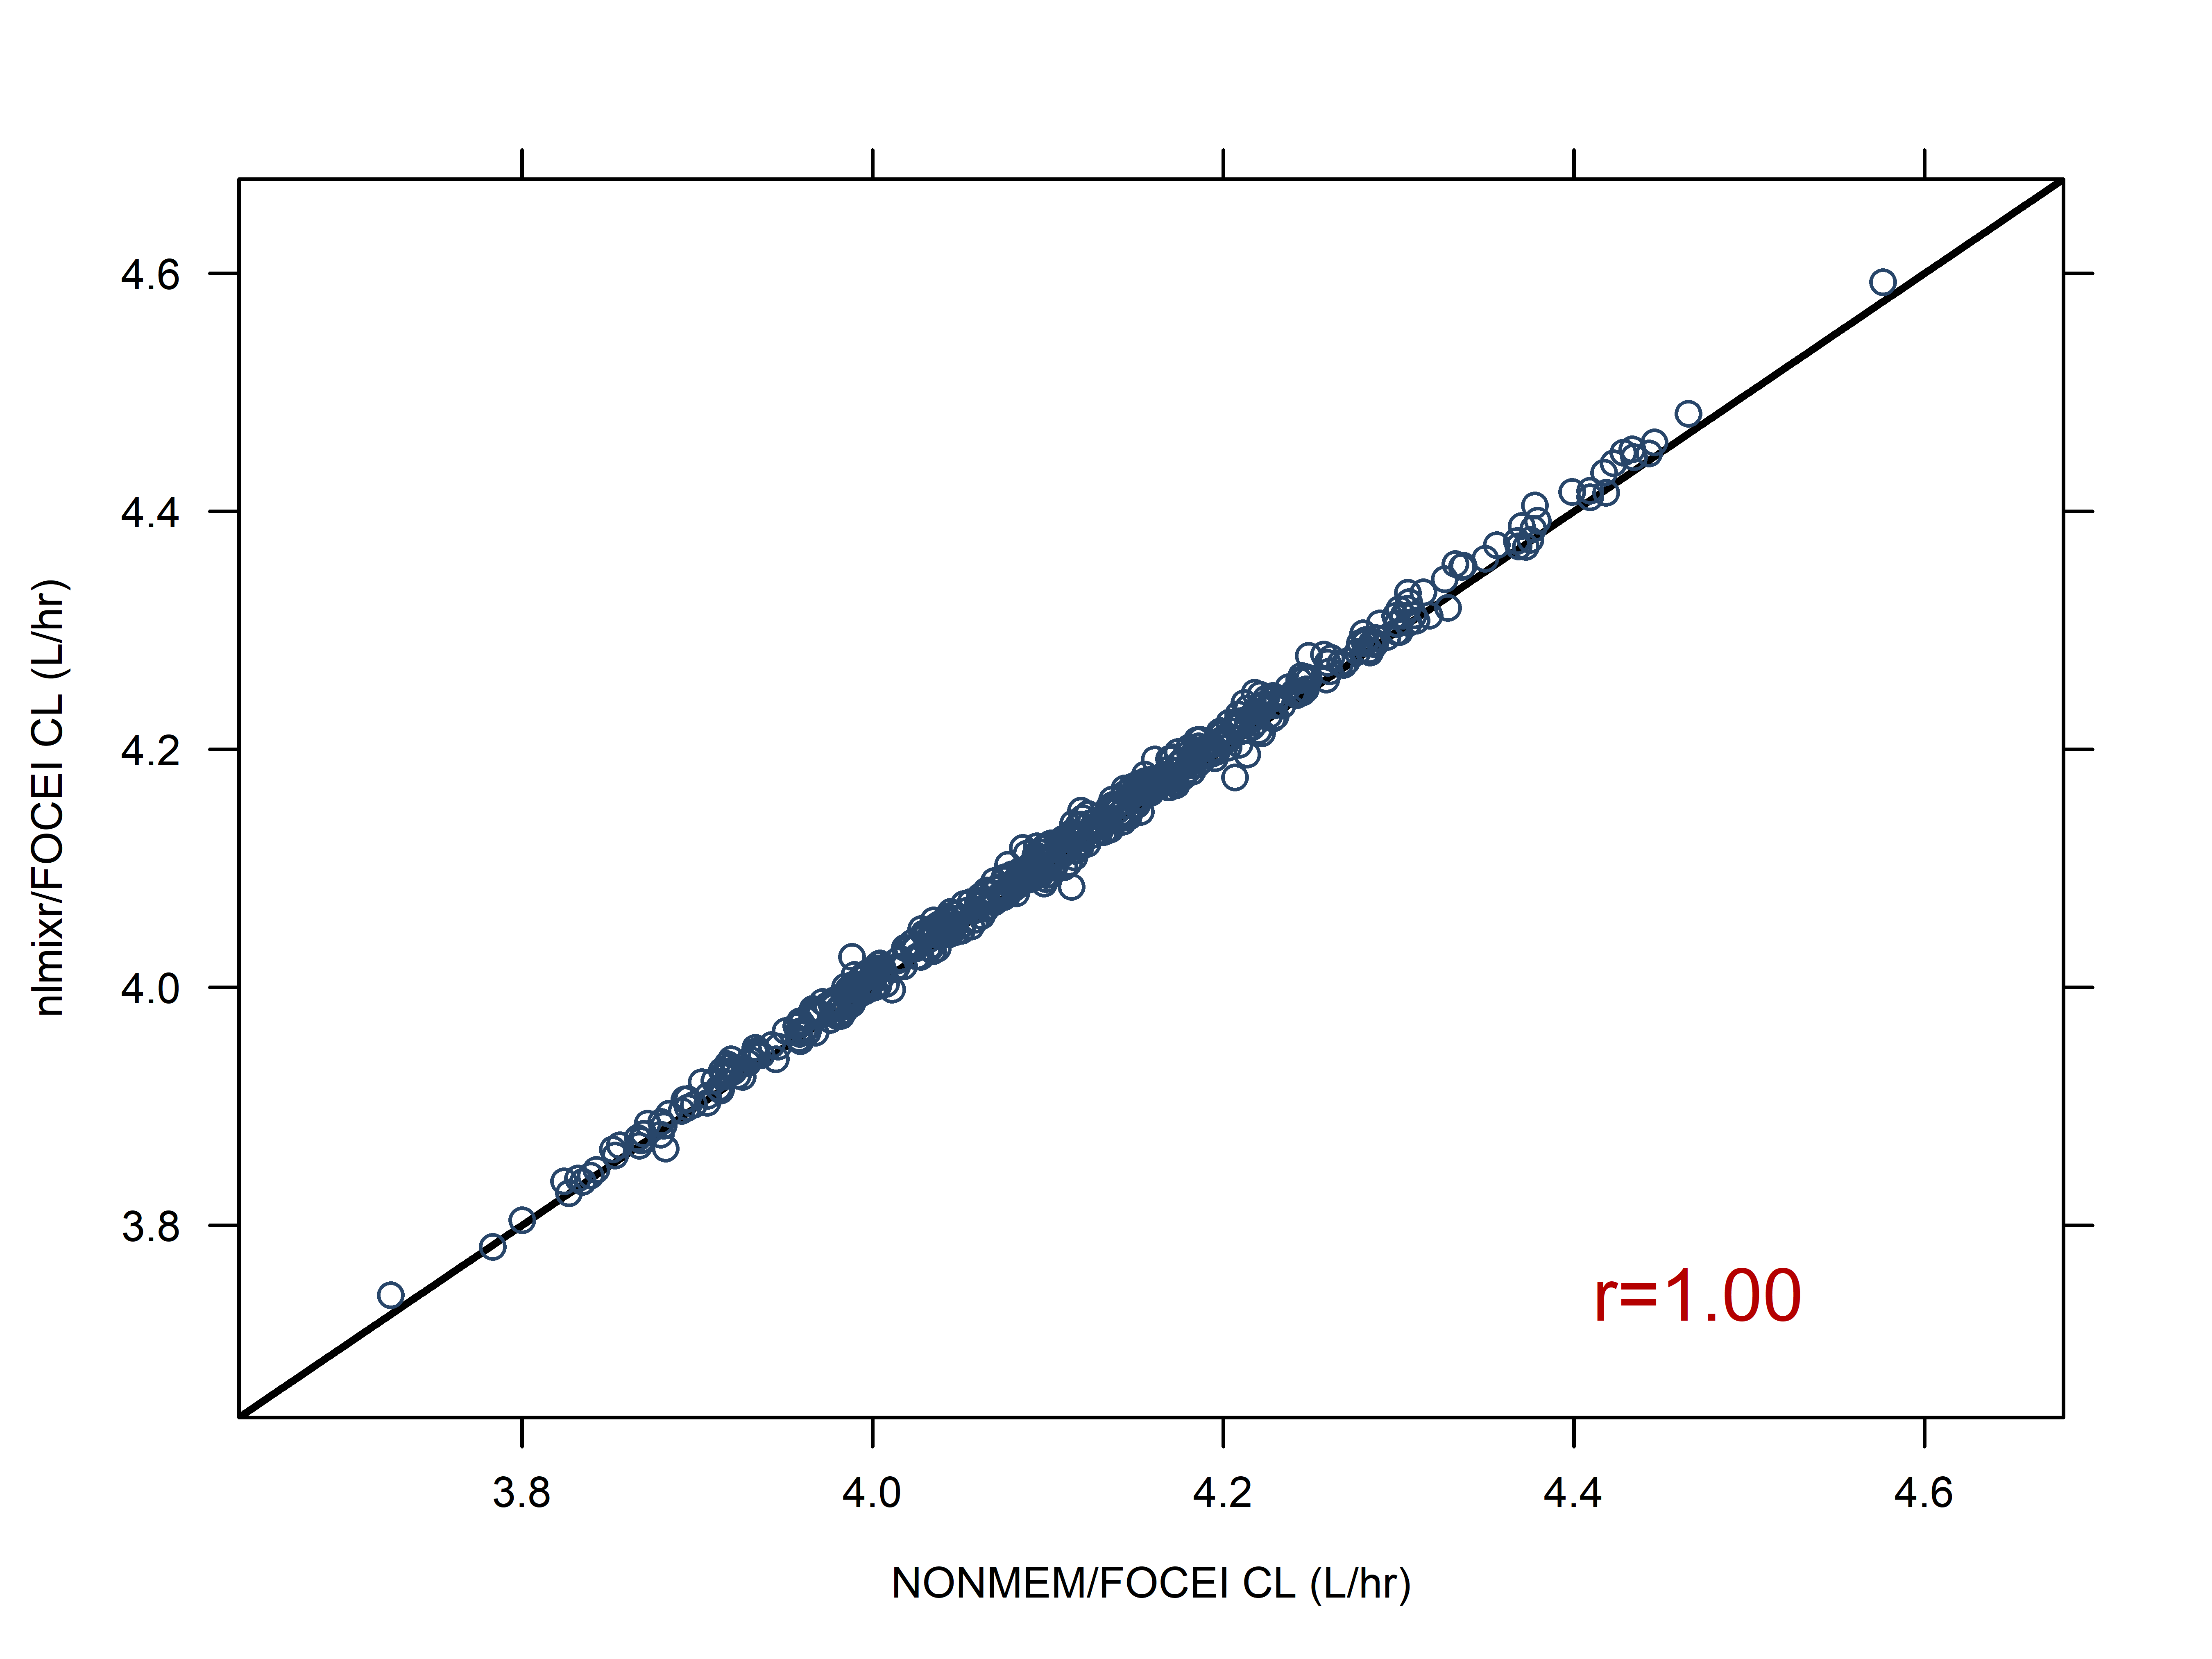
500 sparse data sets are analysed using both NONMEM/FOCEi and nlmixr/FOCEi. Each marker is a single paired data set result for clearance for NONMEM on the x-axis and nlmixr/FOCEi on the y-axis: results are highly correlated (r=1.00), and lie on the line of identity (diagonal black line)

Slide 38
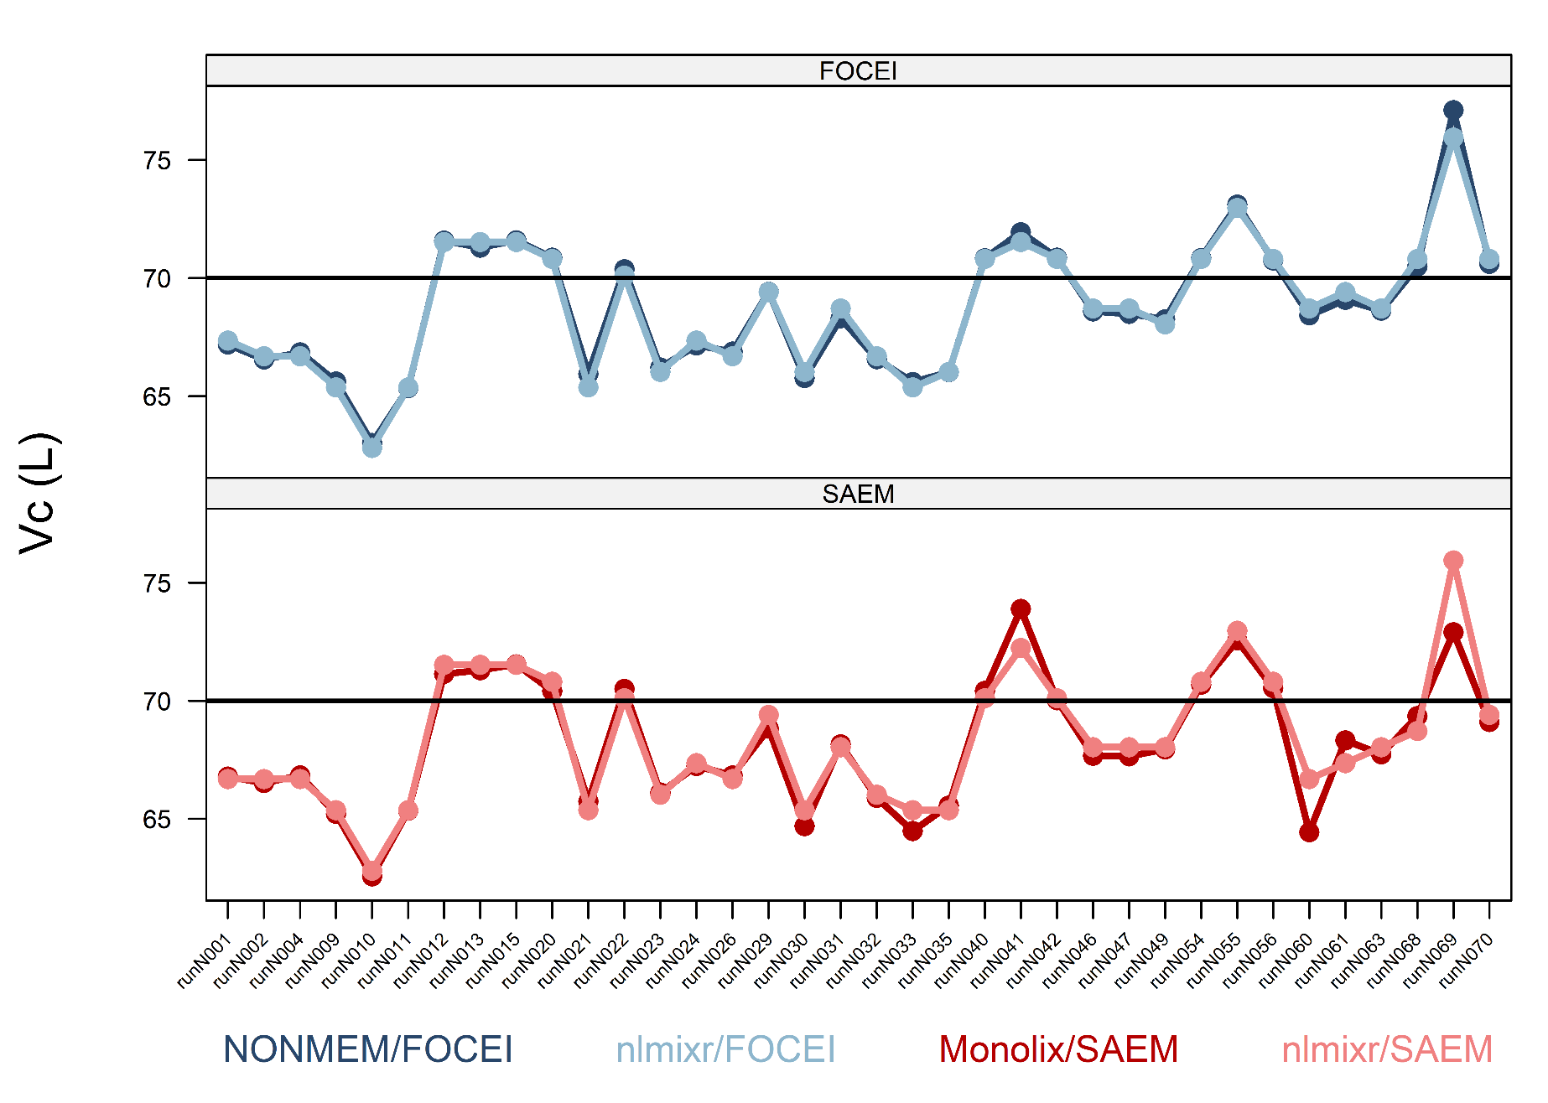
Central volume (Vc): Top panel: FOCEi estimates, bottom panel: SAEM estimates Dark lines: NONMEM/MONOLIX, light lines: nlmixr

Slide 39
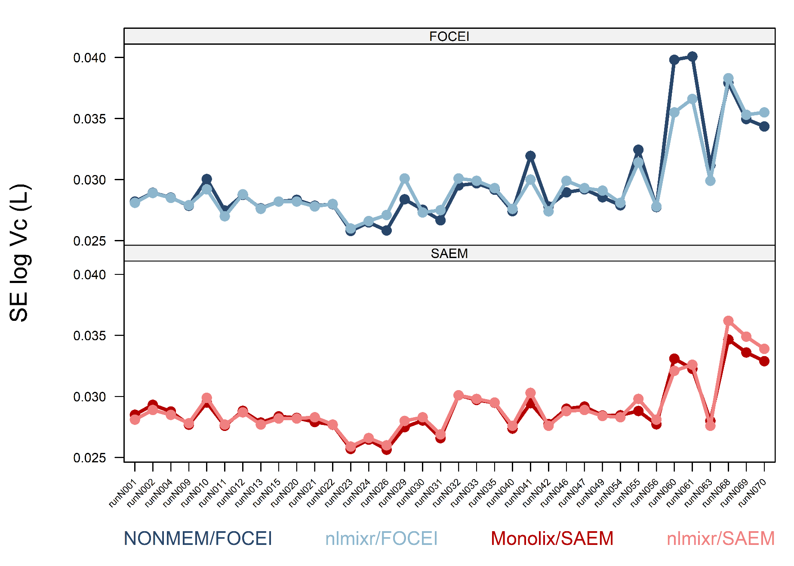
SE of theta estimates for Vc: very good match across software packages Top panel: FOCEi estimates, bottom panel: SAEM estimates Dark lines: NONMEM/MONOLIX, light lines: nlmixr

Slide 40
Models in nlmixr2
rxode2/nlmixr2 Course PAGE 2026, Dubrovnik, Croatia Justin Wilkins, PhD
On behalf of the nlmixr development team:
Matt Fidler, Bill Denney, John Harrold, Richard Hooijmaijers, Mutaz Jaber, Anne Keunecke, Theo Papathanasiou, Rik Schoemaker, Max Taubert, Mirjam Trame, Justin Wilkins, Brendan Bender

Slide 41
Defining nlmixr2 models
Models are defined using a function containing an initialisation block (ini) and a model definition block (model)
One.comp.KA.solved <- function() { ini({ # Where initial conditions/variables are specified
}) model({ # Where the model is specified
}) }

Slide 42
Defining nlmixr2 models
The ini block defines the parameters
Thetas and residual error defined using assignment operators (<- or =)
Etas defined using a model formula (~)
Parameter names, starting values, labels for thetas and errors (using #), bounds for some estimation routines (like FOCEI)
One.comp.KA.solved <- function() { ini({ # Where initial conditions/variables are specified lka <- log(1.15) #log ka (1/h) lcl <- log(0.135) #log Cl (L/h) lv <- log(8) #log V (L) prop.err <- 0.15 #proportional error (SD/mean) add.err <- 0.6 #additive error (mg/L) eta.ka ~ 0.5 eta.cl ~ 0.1 eta.v ~ 0.1 }) model({ … }) }

Slide 43
Defining nlmixr2 models
The model block defines
the relationship between thetas and etas
the model structure using either closed-form solutions or ODEs
the residual error structure, and where it is applied
Closed-form solutions are provided by the linCmt() function, which infers the model based on the parameters provided
One.comp.KA.solved <- function() { ini({
… }) model({ # Where the model is specified cl <- exp(lcl + eta.cl) v <- exp(lv + eta.v) ka <- exp(lka + eta.ka) ## solved system example ## where residual error is assumed to follow proportional and additive error linCmt() ~ prop(prop.err) + add(add.err) }) }

Slide 44
Running nlmixr2 models: the full model
One.comp.KA.solved <- function() { ini({ # Where initial conditions/variables are specified lka <- log(1.15) # log ka (1/h) lcl <- log(0.135) # log Cl (L/h) lv <- log(8) # log V (L) prop.err <- 0.15 # proportional error (SD/mean) add.err <- 0.6 # additive error (mg/L)
eta.ka ~ 0.5 eta.cl ~ 0.1 eta.v ~ 0.1
}) model({ # Where the model is specified cl <- exp(lcl + eta.cl) v <- exp(lv + eta.v) ka <- exp(lka + eta.ka) ## solved system example ## where residual error is assumed to follow proportional and additive error linCmt() ~ prop(prop.err) + add(add.err) }) }

Slide 45
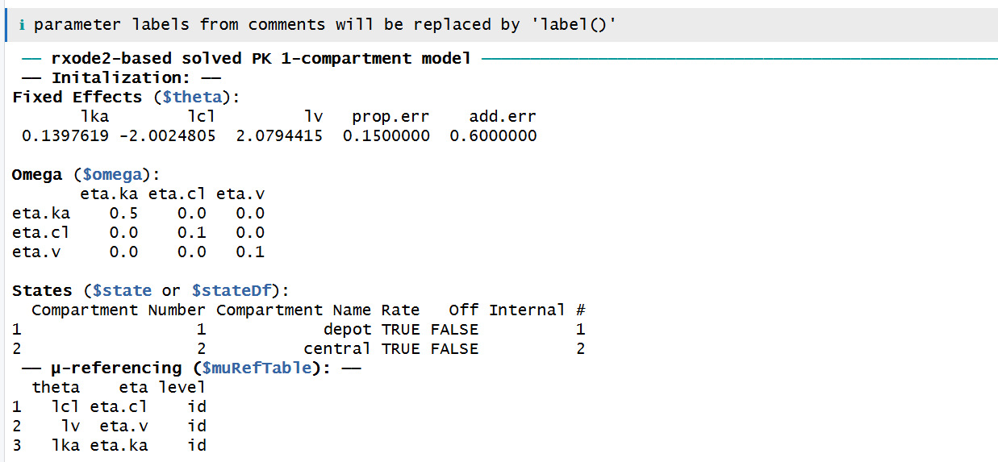
Running nlmixr2 models: check the model code
## Check the model and some of the assumptions made by nlmixr2
nlmixr2(One.comp.KA.solved)

Slide 46
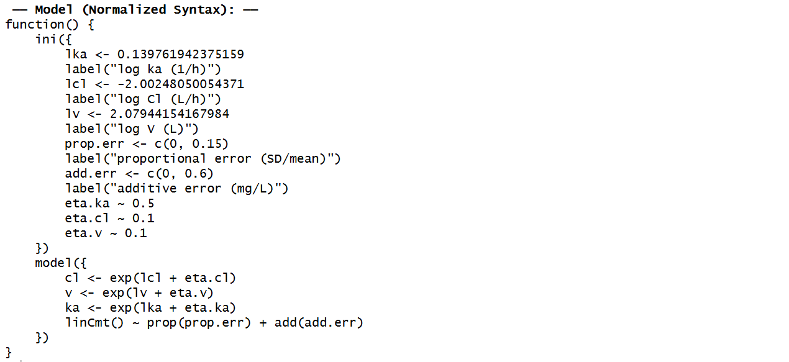
Running nlmixr2 models: check the model code
## Check the model and some of the assumptions made by nlmixr2
nlmixr2(One.comp.KA.solved)

Slide 47
Running nlmixr2 models with the nlmixr2 command
## estimate parameters using nlmixr: run001S <- nlmixr2( One.comp.KA.solved, # the model definition PKdata, # the data set est = "saem", # the estimation algorithm (SAEM) # the SAEM minimisation options: saemControl(nBurn = 200, # 200 SAEM burn-in iterations (the default) nEm = 300, # 300 EM iterations (the default) print = 50), # only print every 50th estimation step tableControl(cwres = TRUE, # calculates NONMEM-style conditional weighted residuals npde = TRUE) # and NPDE values for diagnostics
) ## results are stored in the nlmixr2 object and can be viewed: run001S

Slide 48
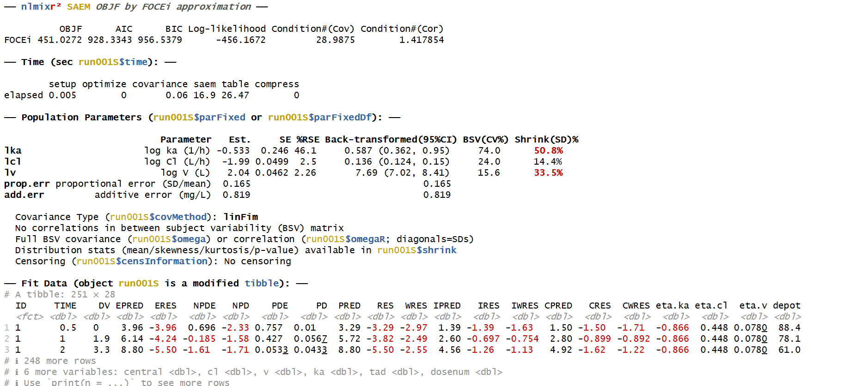
nlmixr2 output for SAEM

Slide 49
The labels in the ini block end up in the output, and the log-transformed parameters are returned with a back-transformation and 95%CIs

Slide 50
Running nlmixr2 models: save the object, and examine parameter trace plots when using SAEM to check convergence
## results are stored in the nlmixr2 object and can be viewed: run001S ## and saved for future use or reference: save(run001S, file = “run001S.Rdata") ## and for SAEM, convergence can be checked using a parameter trace plot: traceplot(run001S)

Slide 51
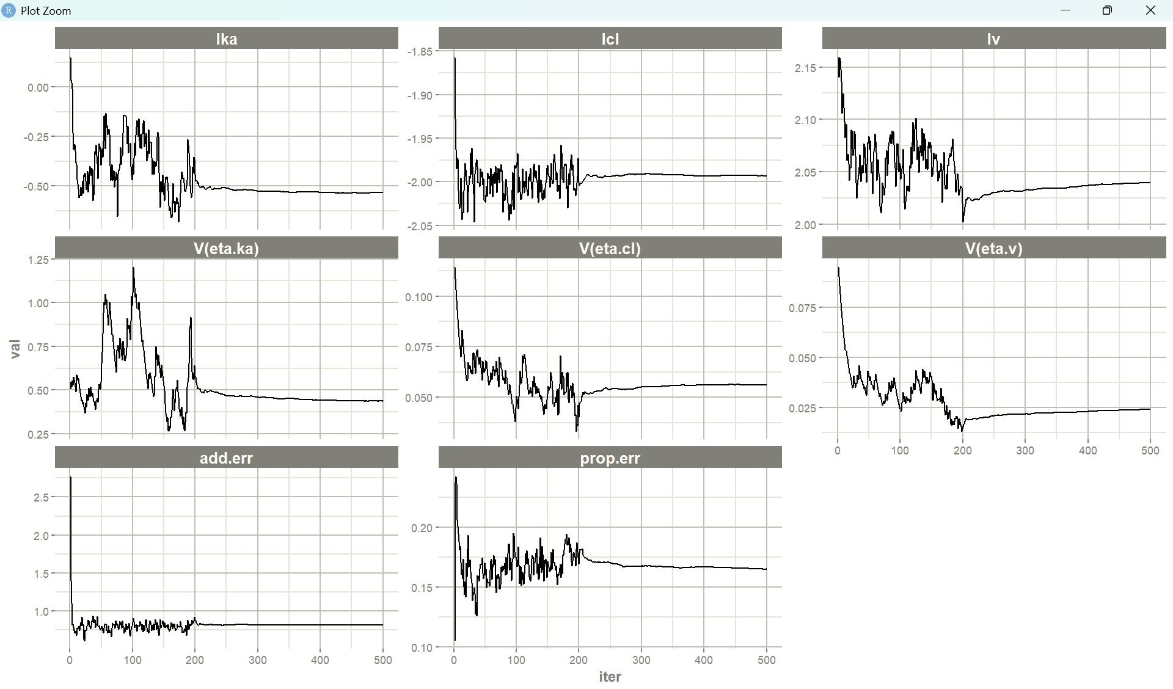
Traceplot for SAEM parameter estimates using traceplot() function

Slide 52
nlmixr2 works well with ggPMX
# Model Diagnostics with ggPMX
# The controller is first constructed
ctr001S <- pmx_nlmixr(run001S,
conts = c("WT","AGE"),
cats=c("SEX","SPARSE"),
vpc=FALSE,
settings=pmx_settings(is.draft=FALSE))
# and can then be piped into a specific plot
# syntax for npde vs pred plot
ctr001S %>% pmx_plot_npde_pred
#alternatively:
pmx_plot_npde_pred(ctr001S)

Slide 53
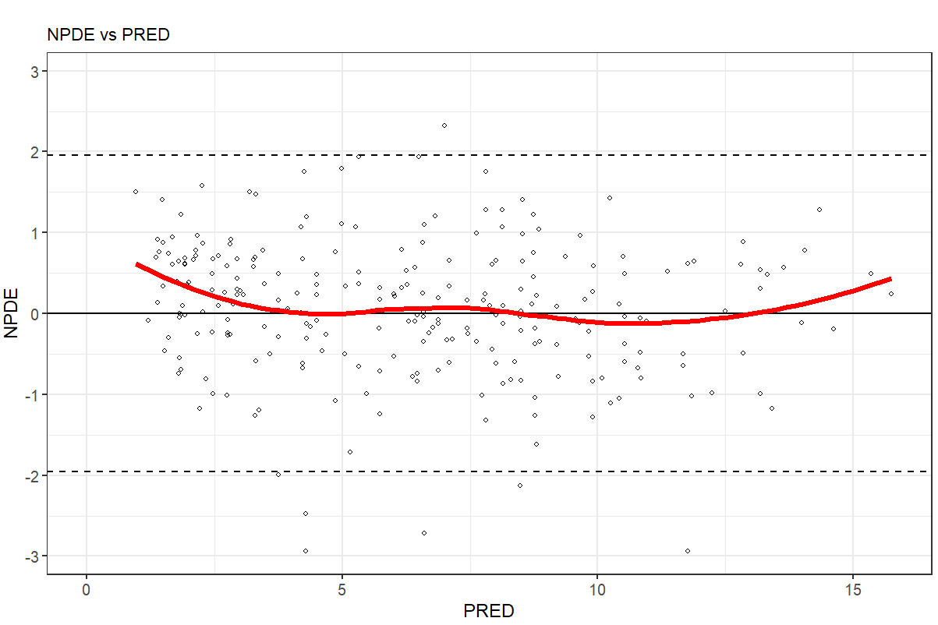
nlmixr2 works well with ggPMX
# Model Diagnostics with ggPMX
# The controller is first constructed
ctr001S <- pmx_nlmixr(run001S,
conts = c("WT","AGE"),
cats=c("SEX","SPARSE"),
vpc=FALSE,
settings=pmx_settings(is.draft=FALSE))
# and can then be piped into a specific plot
# syntax for npde vs pred plot
ctr001S %>% pmx_plot_npde_pred
#alternatively:
pmx_plot_npde_pred(ctr001S)

Slide 54
nlmixr2 works well with ggPMX
## Modify graphical options and add DRAFT label:
ctr001S %>% pmx_plot_npde_time(smooth = list(color="blue"),
point = list(shape=4),
s.draft=TRUE,
labels = list(x = "Time (hours)",
y = "Normalized PDE"))

Slide 55
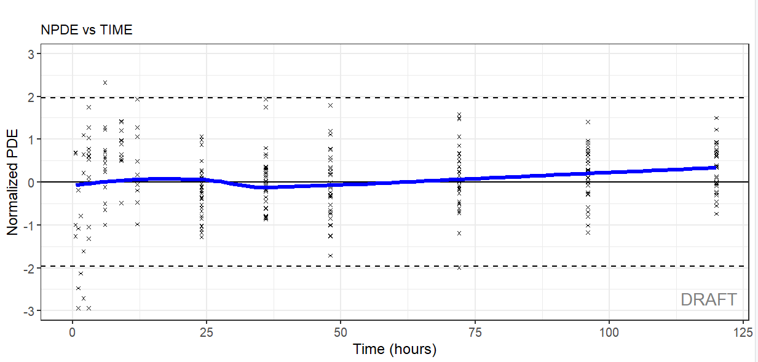
nlmixr2 works well with ggPMX
## Modify graphical options and add DRAFT label:
ctr001S %>% pmx_plot_npde_time(smooth = list(color="blue"),
point = list(shape=4),
s.draft=TRUE,
labels = list(x = "Time (hours)",
y = "Normalized PDE"))

Slide 56
nlmixr2 works well with ggPMX
## DV vs IPRED plot
ctr001S %>% pmx_plot_dv_ipred(scale_x_log10=TRUE, scale_y_log10=TRUE)
#You can filter to restrict the values of IPRED for instance:
ctr001S %>% pmx_plot_dv_ipred(scale_x_log10=TRUE, scale_y_log10=TRUE,filter=(IPRED>1))
## DV vs PRED plot
ctr001S %>% pmx_plot_dv_pred(scale_x_log10=TRUE, scale_y_log10=TRUE)
## Absolute individual weighted residuals to investigate the residual error model
ctr001S %>% pmx_plot_abs_iwres_ipred
#again, alternatively:
#pmx_plot_abs_iwres_ipred(ctr)
ctr001S %>% pmx_plot_iwres_dens
ctr001S %>% pmx_plot_eta_qq
ctr001S %>% pmx_plot_eta_box
ctr001S %>% pmx_plot_eta_hist
ctr001S %>% pmx_plot_eta_matrix

Slide 57
nlmixr2 works well with xpose
*https://uupharmacometrics.github.io/xpose/
## the nlmixr2 object can be transformed into an xpose object to allow diagnostics with the xpose package ## the link between nlmixr2 and xpose is provided by the xpose.nlmixr2 package ## only xpose_data_nlmixr is from xpose.nlmixr2
## all further commands (see cheatsheet) are from the xpose package
xpdb.1s <- xpose_data_nlmixr(run001S) ## this can also be used to generate trace plots (parameters vs iterations:) prm_vs_iteration(xpdb.1s) ## to remove the path to the script from the plot use: prm_vs_iteration(xpdb.1s,caption=NULL)

Slide 58
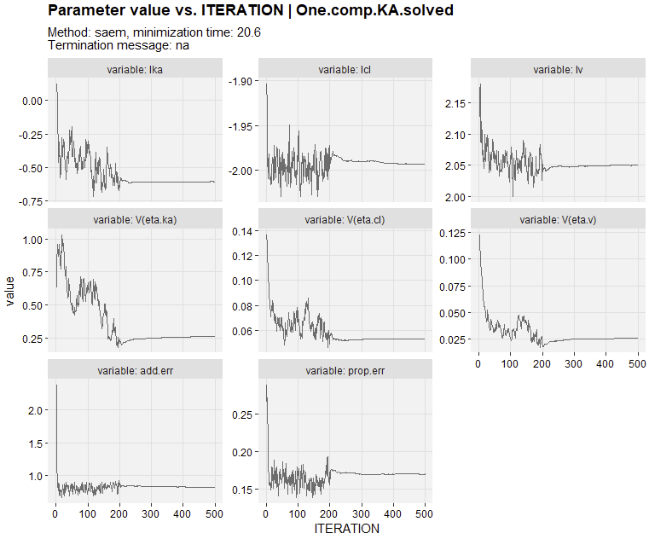
nlmixr2 works well with xpose
*https://uupharmacometrics.github.io/xpose/
## the nlmixr2 object can be transformed into an xpose object to allow diagnostics with the xpose package ## the link between nlmixr2 and xpose is provided by the xpose.nlmixr2 package ## only xpose_data_nlmixr is from xpose.nlmixr2
## all further commands (see cheatsheet) are from the xpose package
xpdb.1s <- xpose_data_nlmixr(run001S) ## this can also be used to generate trace plots (parameters vs iterations:) prm_vs_iteration(xpdb.1s) ## to remove the path to the script from the plot use: prm_vs_iteration(xpdb.1s,caption=NULL)

Slide 59
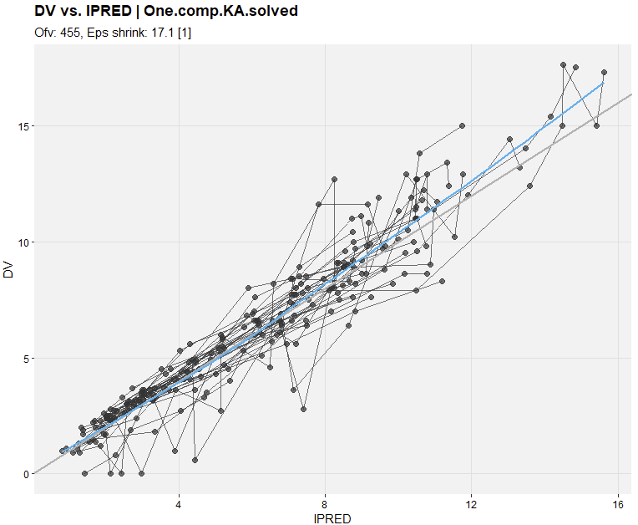
DV vs IPRED using xpose
xpdb.1s <- xpose_data_nlmixr(run001S) ## dv vs ipred plot: dv_vs_ipred(xpdb.1s, caption = NULL)

Slide 60
nlmixr2 is tightly integrated with the vpc package
*http://vpc.ronkeizer.com/
## nlmixr2 comes with its own built-in vpc functionality that uses Ron Keizer's vpc package ## see the cheatsheet for further options
## because the data set uses nominal time points, it is nice to have the bins surround these time points ## so that each time point falls in a bin
bin_mids <- sort(unique(PKdata$TIME))
bin_edges <- bin_mids - c(0, diff(bin_mids) / 2) vpcPlot( run001S, #the nlmixr object n = 500, #number of trials simulated
bins = bin_edges, show = list(obs_dv = TRUE, #additional items to show, like the observations
obs_median = TRUE,
sim_median = TRUE,
sim_median_ci = TRUE,
obs_ci = TRUE,
pi = TRUE
), xlab = "Time (h)", #x-axis label ylab = "Concentration (mg/L)", #y-axis label title = "VPC for first order absorption PopPK model" )

Slide 61
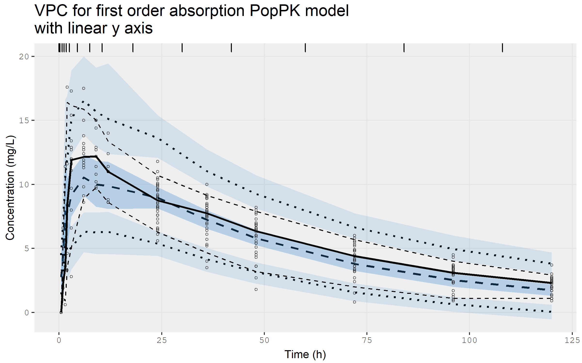
VPC for the base model on linear scale...

Slide 62
...and on log scale
## or with a log y-axis starting at 0.5 vpcPlot( run001S, # the nlmixr2 object n = 500, # number of trials simulated
bins = bin_edges, show = list(obs_dv = TRUE, # additional items to show, like the observations
obs_median = TRUE,
sim_median = TRUE,
sim_median_ci = TRUE,
obs_ci = TRUE,
pi = TRUE
), xlab = "Time (h)", # x-axis label ylab = "Concentration (mg/L)", # y-axis label title = "VPC for first order absorption PopPK model"
log_y = TRUE, # to request a log y-axis log_y_min = 0.5 # starting at 0.5 )

Slide 63
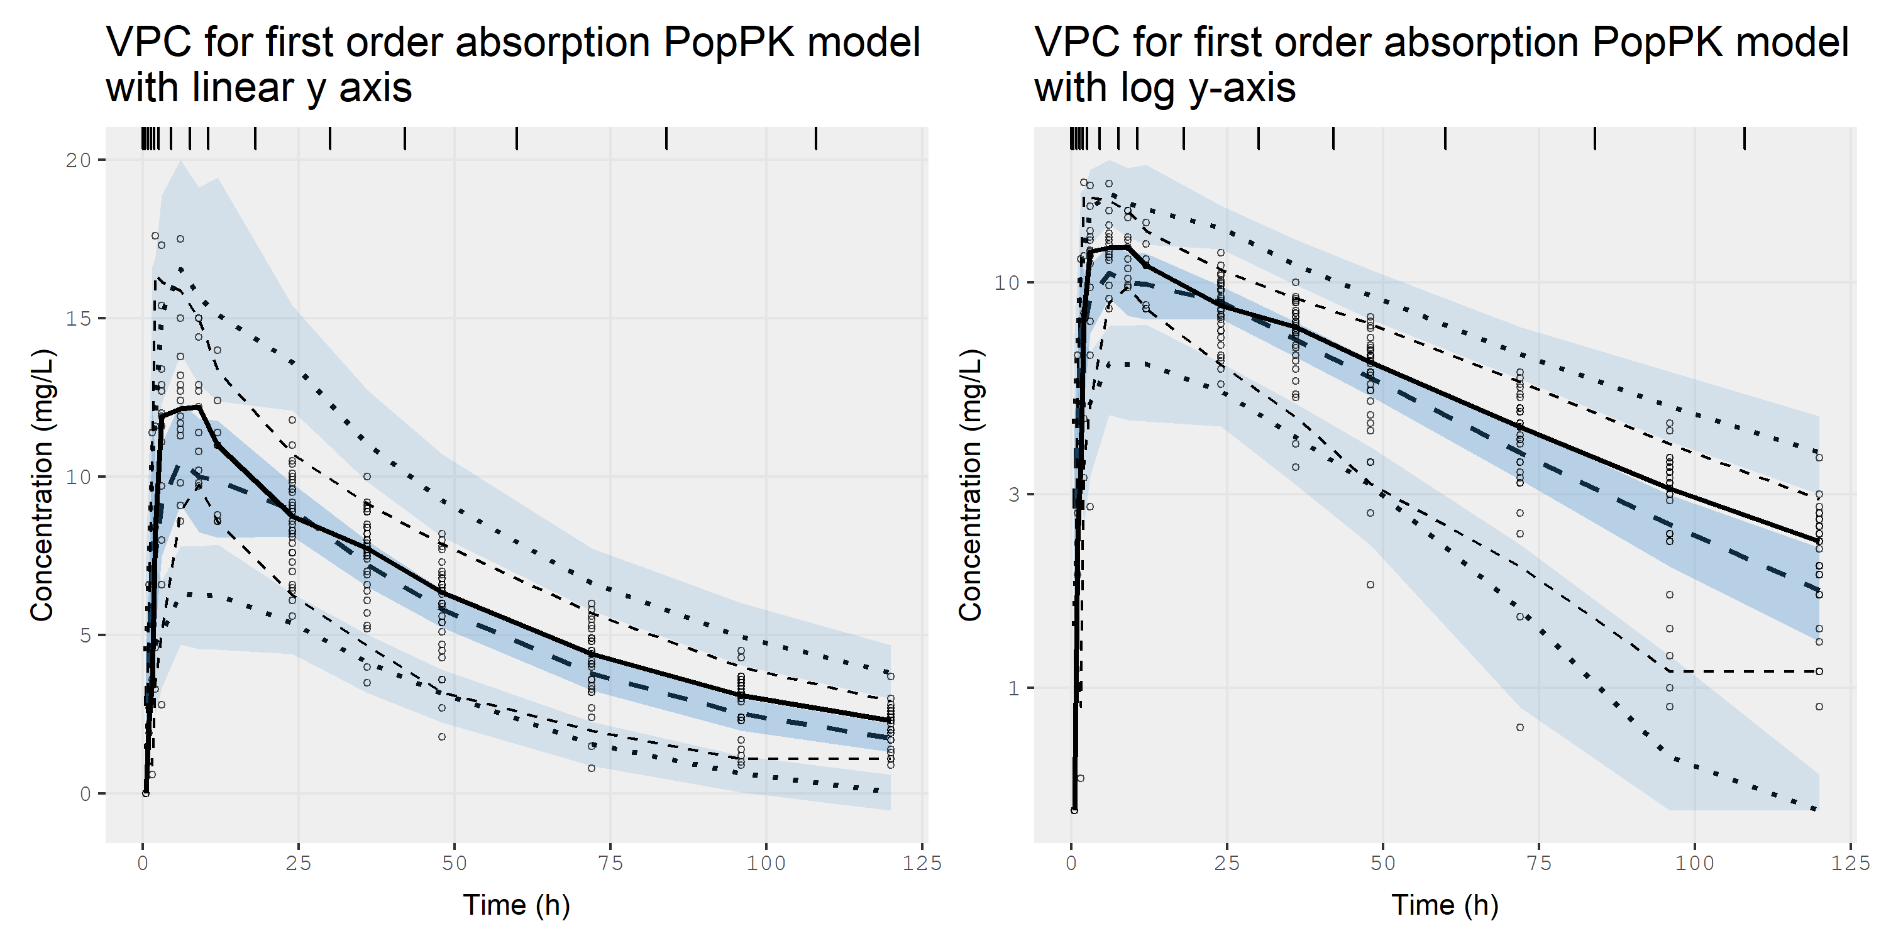
...and on the log scale. It’s wicked fast

Slide 64
Alternatively, using native vpc code so you only need to simulate once
library(vpc)
SimVPC <- vpcSim(run001S, ## the nlmixr2 object
n = 500)
setnames(SimVPC, c("id","time","sim"), c("ID","TIME","DV"))
vpc_vpc( sim = SimVPC,
obs = Pkdata,
bins = bin_edges, show = list(obs_dv = TRUE,
obs_median = TRUE,
sim_median = TRUE,
sim_median_ci = TRUE,
obs_ci = TRUE,
pi = TRUE
), xlab = "Time (h)", # x-axis label ylab = "Concentration (mg/L)", # y-axis label title = "VPC for first order absorption PopPK model\nwith linear y axis" )

Slide 65
nlmixr2 can generate smooth individual plots using augPred
## Individual fits can be generated using augPred (augmented predictions) ## that provides smooth profiles by interpolating the predictions between observations:
plot(augPred(fitOne.comp.KA.solved_S))
## ...use the arrows in the plot window to examine the earlier curves

Slide 66
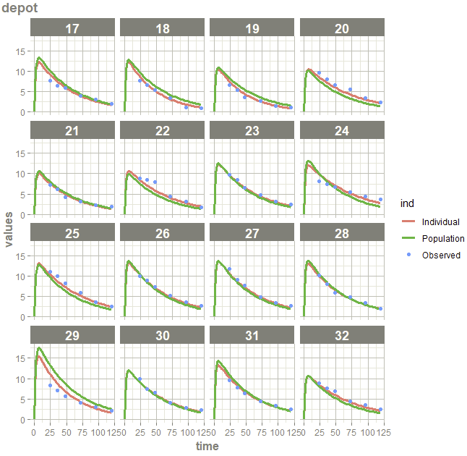
nlmixr2 can generate smooth individual plots using augPred
## Individual fits can be generated using augPred (augmented predictions) ## that provides smooth profiles by interpolating the predictions between observations:
plot(augPred(run001S))
## ...use the arrows in the plot window to examine the earlier curves

Slide 67
use augPred output to plot using your favourite package…
#or the augPred output can be plotted to your liking, for instance using ggplot2 or the lattice function xyplot: indivpk <- augPred(run001S) nlmixCOLS <- c("#28466A","#8DB6CD","#B40000) ## specify array of colours for curves xyplot( values~time|id, ## plot the variable values by time and make a separate panel for each id data=indivpk, ## data source with smooth interpolated predictions and observations groups=ind, ## make separate curves by ind that separates Observed data,
## Individual predictions and Population predictions layout=c(8,4), ## arrange as 8 columns and 4 rows type=c("l","l","p"), ## represent these three by a line, a line and only markers (l=line, p=points) col=nlmixCOLS[c(2,1,3)], ## colours for each curve cex=c(0.1,0.1,1), ## character size for the markers lwd=c(2,2,0.1), ## line width of the lines pch=19, ## use closed circles as marker xlab="Time (hr)\n", ## x-axis label ylab="Warfarin (mg/L)", ## y-axis label as.table=TRUE, ## have the first plot at the top left (otherwise plot 1 starts at the lower left corner) scales=list(alternating=1), ## have axis labels at left and bottom (and not alternating) main="First order-absorption linear elimination", ## title for plot auto.key=list(adj=1,col=nlmixCOLS[c(2,1,3)],columns=3,space="bottom",rectangles=FALSE,points=FALSE) ## key for curves )

Slide 68
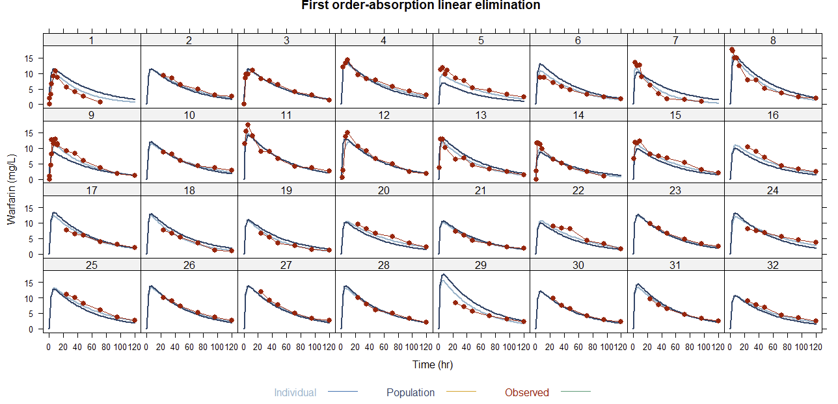
..like lattice, for example

Slide 69
Solved systems and ODEs…
Using solved-system code:
For a solved system, model structure is automatically derived from the parameter names in the ini block
Using ODEs:
ODEs are much more flexible but also more time-consuming
linCmt() ~ prop(prop.err) + add(add.err)
# rxode2-style differential equation definition d/dt(depot) = -ka * depot d/dt(central) = ka * depot - (cl / v) * central ## Concentration is calculated cp = central / v # And is assumed to follow proportional and additive error cp ~ prop(prop.err) + add(add.err)

Slide 70
Running nlmixr2 for a system of ODEs using FOCEI
One.comp.KA.ODE <- function() { ini({ # Where initial conditions/variables are specified lka <- log(1.15) # log ka (/h) lcl <- log(0.135) # log Cl (L/hr) lv <- log(8) # log V (L) prop.err <- 0.15 # proportional error (SD/mean) add.err <- 0.6 # additive error (mg/L) eta.ka ~ 0.5 eta.cl ~ 0.1 eta.v ~ 0.1 }) model({ # Where the model is specified cl <- exp(lcl + eta.cl) v <- exp(lv + eta.v) ka <- exp(lka + eta.ka) # rxode2-style differential equation definition d/dt(gut) = -ka * depot d/dt(center) = ka * depot - (cl / v) * center ## Concentration is calculated cp = center / v ## And is assumed to follow proportional and additive error cp ~ prop(prop.err) + add(add.err) }) } run002F <- nlmixr2(One.comp.KA.ODE, PKdata, est = "focei“, foceiControl(print = 5))

Slide 71
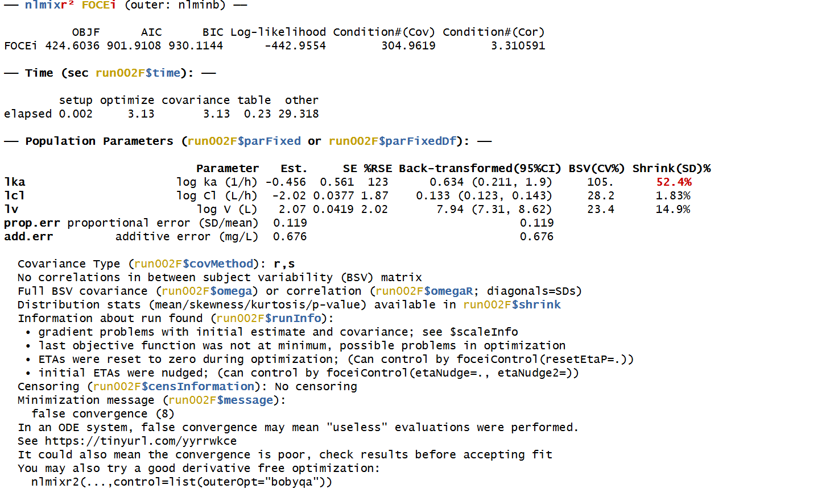
nlmixr2 output for FOCEI with ODEs

Slide 72
Hands-on session II: running nlmixr2 and diagnostics
Examine the code in HandsOn_2.R to run a pre-programmed FOCEI analysis with a solved system and its diagnostics
Examine the code in HandsOn_2.R to run a pre-programmed FOCEI analysis with ODEs
Examine the VPCs and implement alternative models for absorption (like one or more transit compartments…)

Slide 73
Running nlmixr2: 1 transit compartment
## 1 transit compartment One.comp.transit <- function() { ini({ # Where initial conditions/variables are specified lktr <- log(1.15) # log transit rate constant (/h) lcl <- log(0.135) # log Cl (L/h) lv <- log(8) # log V (L) prop.err <- 0.15 # proportional error (SD/mean) add.err <- 0.6 # additive error (mg/L) eta.ktr ~ 0.5 eta.cl ~ 0.1 eta.v ~ 0.1 }) model({ # Where the model is specified ktr <- exp(lktr + eta.ktr) cl <- exp(lcl + eta.cl) v <- exp(lv + eta.v) ## ODE example d/dt(depot) =-ktr*depot d/dt(central) = ktr*trans – (cl/v)*central d/dt(trans) = ktr*(depot - trans) ## where residual error is assumed to follow proportional and additive error central ~ prop(prop.err) + add(add.err) })}

Slide 74
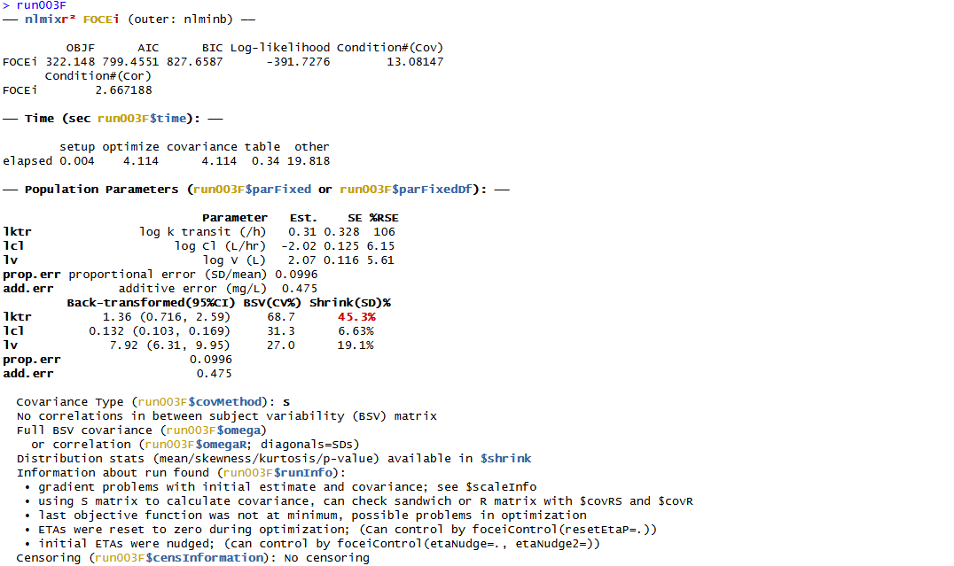
nlmixr2 output: 1 transit compartment with ODEs using FOCEI

Slide 75
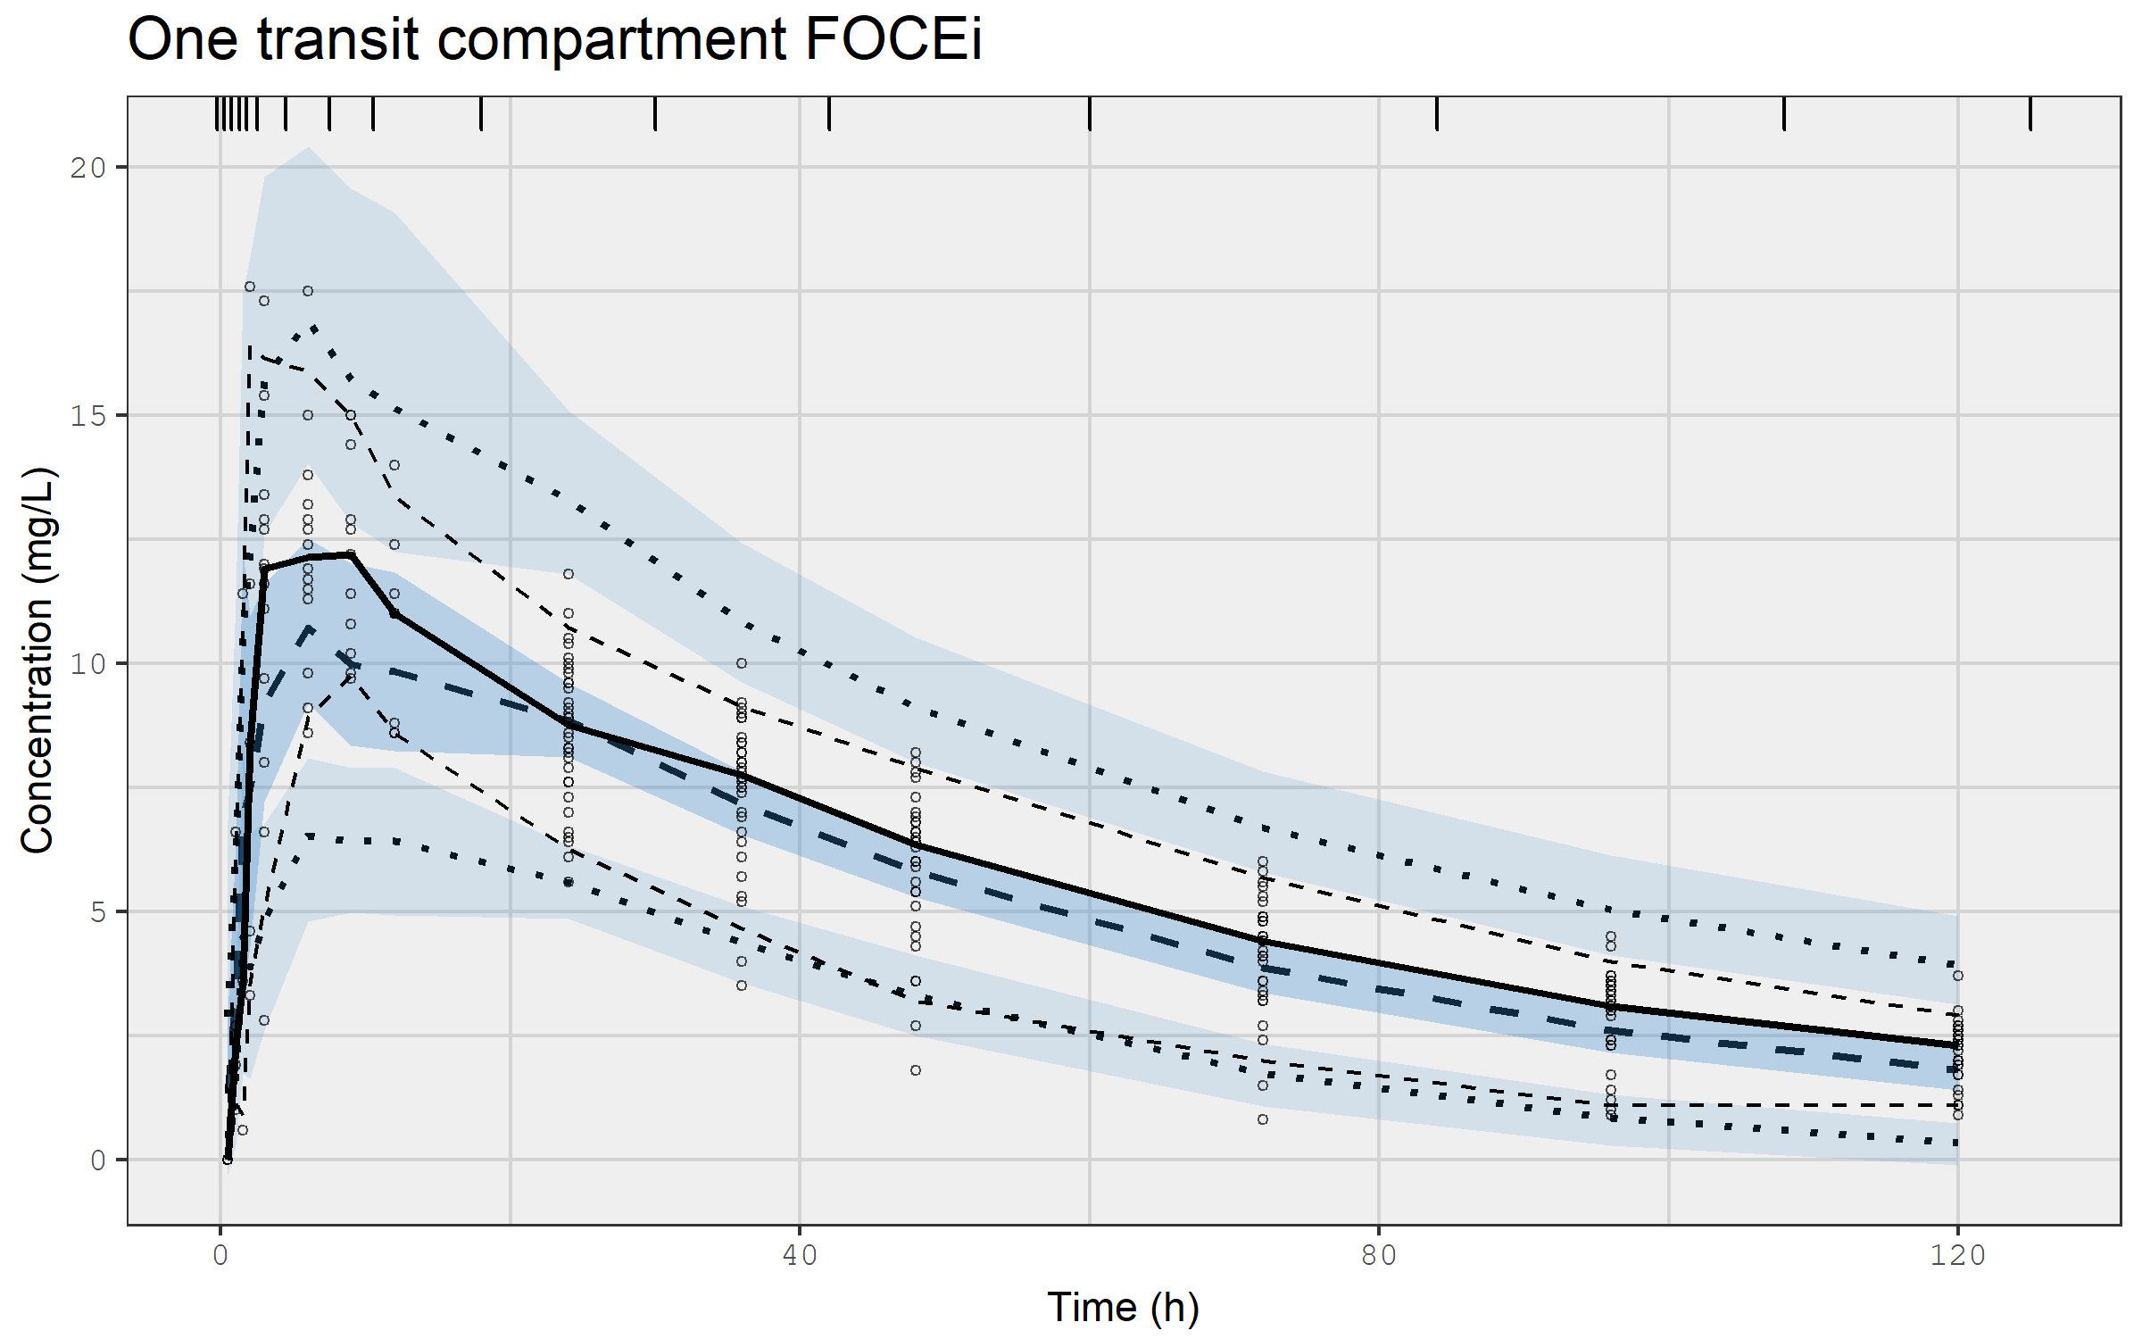
VPC for one compartment model with a transit compartment using FOCEI

Slide 76
Running nlmixr2: 5 transit compartments
## 5 transit compartments KA1tr5ode <- function() { ini({ # Where initial conditions/variables are specified lktr <- log(1.15) # log transit rate constant (/h) lcl <- log(0.135) # log Cl (L/h) lv <- log(8) # log V (L) prop.err <- 0.15 # proportional error (SD/mean) add.err <- 0.6 # additive error (mg/L) eta.ktr ~ 0.5 # IIV ktr eta.cl ~ 0.1 # IIV cl eta.v ~ 0.1 # IIV v }) model({ # Where the model is specified ktr <- exp(lktr + eta.ktr) cl <- exp(lcl + eta.cl) v <- exp(lv + eta.v) ## ODE example d/dt(depot) =-ktr*depot d/dt(central) = ktr*transit5 - cl* central/v d/dt(transit1)= ktr*(depot - transit1) d/dt(transit2)= ktr*(transit1 - transit2) d/dt(transit3)= ktr*(transit2 - transit3) d/dt(transit4)= ktr*(transit3 - transit4) d/dt(transit5)= ktr*(transit4 - transit5) ## where residual error is assumed to follow proportional and additive error central ~ prop(prop.err) + add(add.err) })}

Slide 77
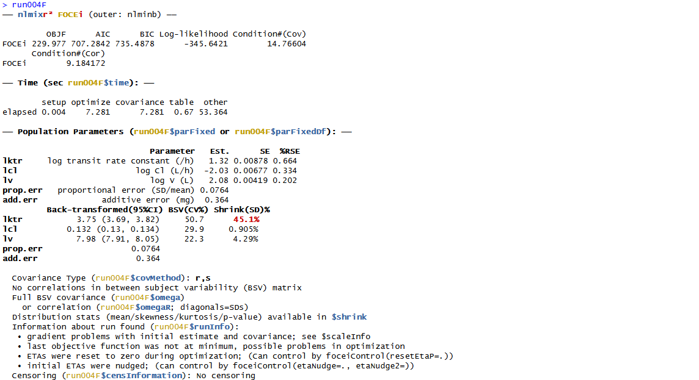
nlmixr2 output: 5 transit compartments with ODEs using FOCEI

Slide 78
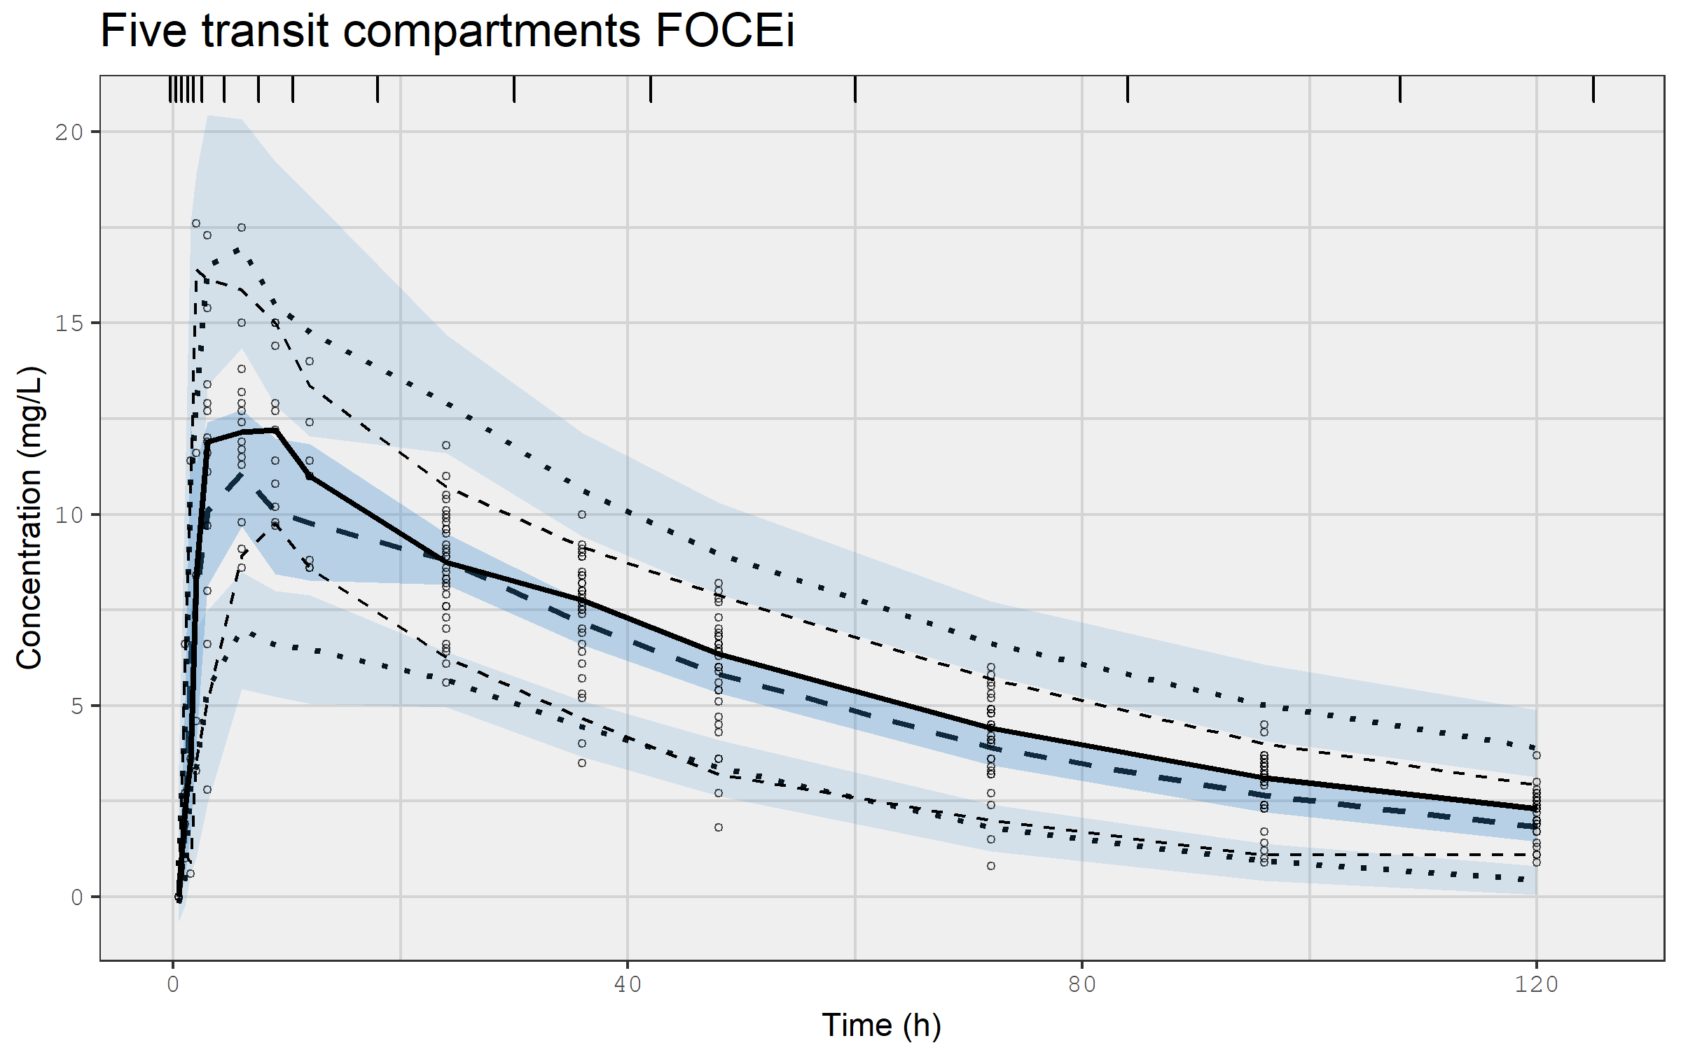
VPC for first order absorption with 5 transit compartments using FOCEI

Slide 79
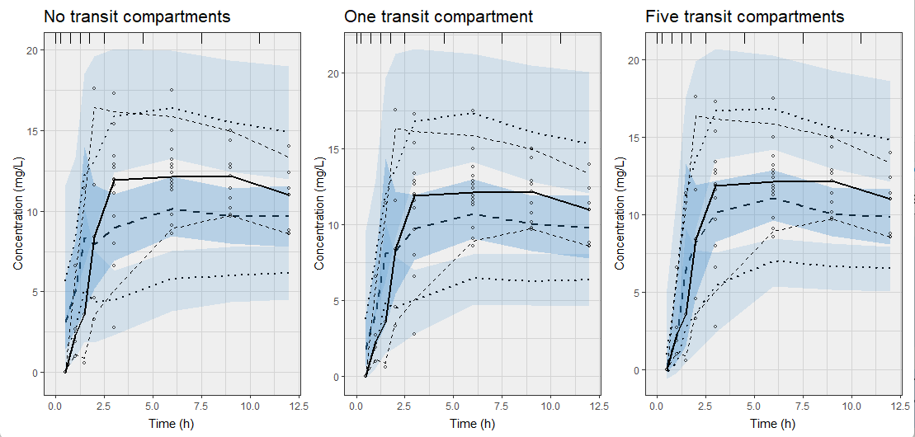
Comparing the VPCs for the first 12 hours to see if absorption is described better using zero, one, or five transit compartments

Slide 80
Code example III: FOCEI in nlmixr2
For future reference, the code is provided in HandsOn_3.R

Slide 81
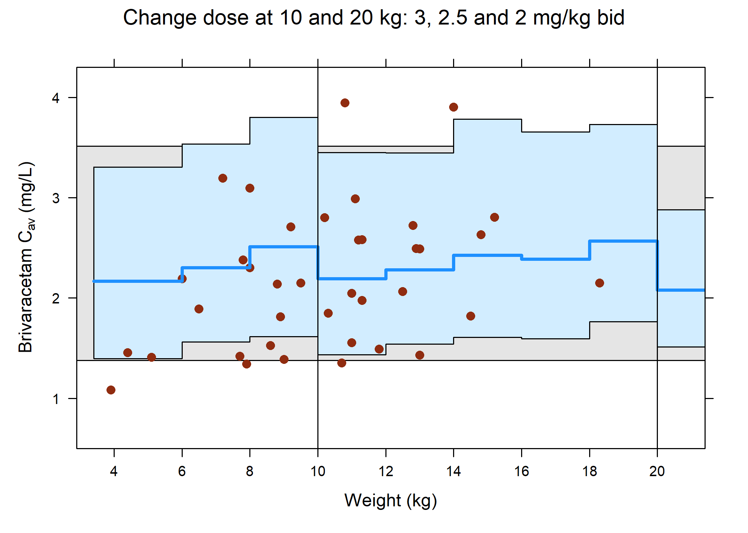
For examination at home: simulations of paediatric posology
The course material has a subdirectory NhanesPosologyGraphs that provides a full worked example of reading in a NONMEM model and using it to simulate paediatric exposures to create the following graph:

Slide 82
nlmixr2 can generate empirical Bayes estimates for Bayesian feedback: individual EBEs for a new data set using existing population parameters
KA1tr5posthoc <- function() { ini({ # Specify previously obtained population estimates (e.g. from NONMEM or nlmixr) lktr <- 1.18994619 # log ktr (/h) lcl <- -2.01737477 # log Cl (L/h) lv <- 2.06631620 # log V (L) prop.err <- 0.07883633 # proportional error (SD/mean) add.err <- 0.37249666 # additive error (mg/L) eta.ktr ~ 0.2532964 eta.cl ~ 0.08073339 eta.v ~ 0.04490733 }) model({ cl <- exp(lcl + eta.cl) v <- exp(lv + eta.v) ktr <- exp(lktr + eta.ktr) d/dt(trns1) = -ktr * trns1 d/dt(trns2) = ktr * trns1 - ktr * trns2 d/dt(trns3) = ktr * trns2 - ktr * trns3 d/dt(trns4) = ktr * trns3 - ktr * trns4 d/dt(trns5) = ktr * trns4 - ktr * trns5 d/dt(central) = ktr * trns5 - (cl/v) * central cp = central/v cp ~ prop(prop.err) + add(add.err) }) } run005ph <- nlmixr2(KA1tr5posthoc, PKdata,
est = "posthoc") # Specify posthoc as estimation method
Useful in a therapeutic drug monitoring setting
Or for generating exposure estimates with a model that you do not want to refit on new data (common in oncology)

Slide 83
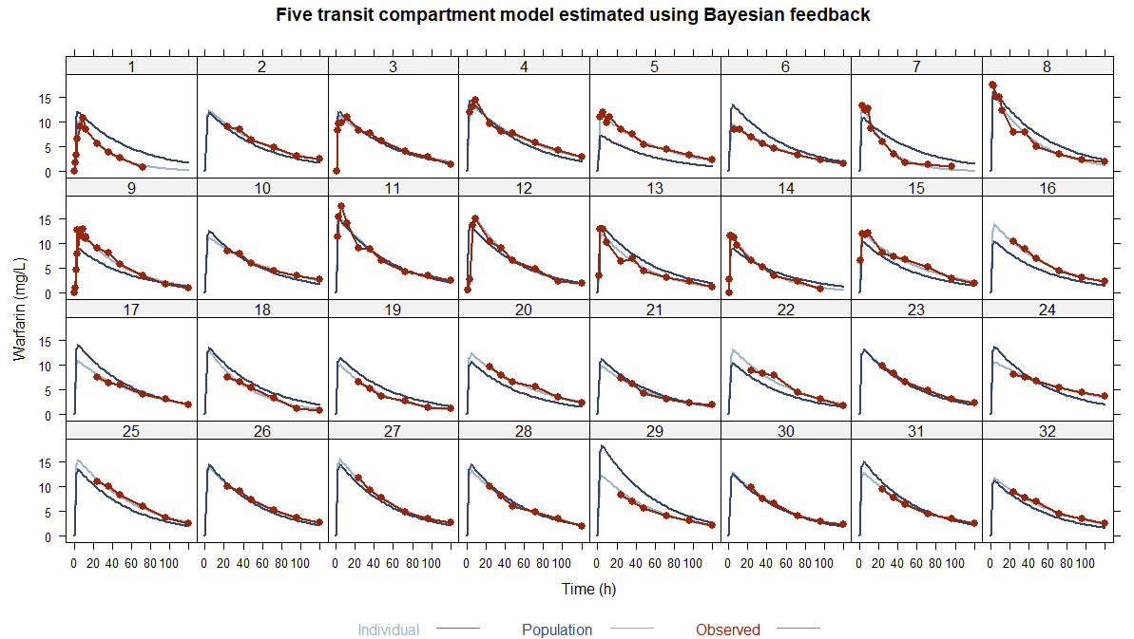
Individual graphs for the five transit compartment model estimated using Bayesian feedback; perfect fit even though there was no population parameter estimation

Slide 84
Parameterisation and mu-referencing
For SAEM, parameters must be defined using ‘mu-referencing’
This means that inter-individual variability (IIV) parameters must be added onto population parameters
This implies estimating log-parameters with the IIV added on the log-scale
For FOCEI, mu-referencing is not strictly required, but is shown to provide superior estimation results
For a binary covariate (e.g. sex 0/1), the back-transformed estimate is a fold-change that can be re-written as a percentage change

Slide 85
Corresponding nlmixr2 code
## One compartment transit model with Sex on V KAtr1_sexV <- function() { ini({ lktr <- log(1.15) # log k transit (/h) lcl <- log(0.135) # log CL (L/h) lv <- log(8) # log V (L) Sex_V <- 0.1 # log Sex on v prop.err <- 0.15 # proportional error (SD/mean) add.err <- 0.6 # additive error (mg/L) eta.ktr ~ 0.5 eta.cl ~ 0.1 eta.v ~ 0.1 }) model({ #Sex on volume cl <- exp(lcl + eta.cl) v <- exp(lv + eta.v + Sex_V * SEX) #the SEX covariate is 0 or 1 in the data set ktr <- exp(lktr + eta.ktr) d/dt(depot) = -ktr * depot d/dt(central) = ktr * trans - (cl/v) * central d/dt(trans) = ktr * depot - ktr * trans cp = central/v cp ~ prop(prop.err) + add(add.err) })

Slide 86
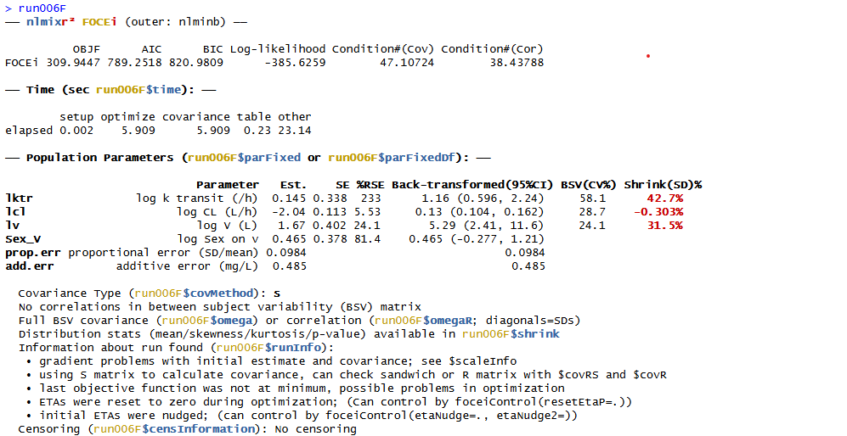
nlmixr2 output: mu-referenced sex on V (log-scale)

Slide 87
Parameterisation and mu-referencing
For a binary covariate (e.g. sex 0/1; female/males), the back-transformed estimate is a fold-change that can be re-written as a percentage change
The estimated 0.465 (95%CI: -0.277/1.21) translates using
exp(c(0.404, -0.0653, 0.874))
to a fold-change estimate of 1.592 (95%CI: 0. 758/3.353)
which corresponds to an increase of 59.2% (95%CI: -24.2%/234.3%)
for males compared to females

Slide 88
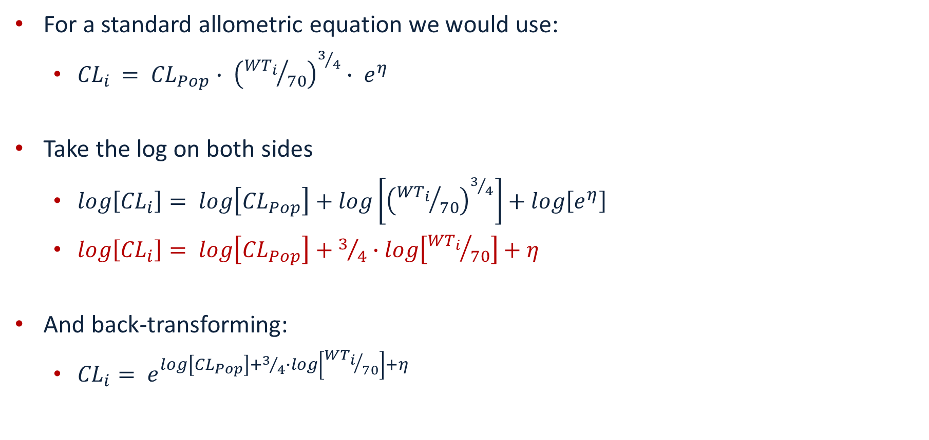
mu-referencing and allometric scaling
For a standard allometric equation we would use:
${CL}_{i }= {CL}_{Pop}∙ {\left({{WT}_{i}}/{70}\right)}^{3/4}∙ e^{η}$
Take the log on both sides
$log\left[{CL}_{i}\right]= log\left[{CL}_{Pop}\right]+log\left[{\left({{WT}_{i}}/{70}\right)}^{3/4}\right]+log\left[e^{η}\right]$
$log\left[{CL}_{i}\right]= log\left[{CL}_{Pop}\right]+3/4∙log\left[{{WT}_{i}}/{70}\right]+η$
And back-transforming:
${CL}_{i}= e^{log\left[{CL}_{Pop}\right]+3/4∙log\left[{{WT}_{i}}/{70}\right]+η}$

Slide 89
Corresponding nlmixr2 code: allometric scaling
One.comp.transit.allo <- function() { ini({ lktr <- log(1.15) # log k transit (/h) lcl <- log(0.15) # log Cl (L/hr) lv <- log(7) # log V (L) ALLC <- fix(0.75) # allometric exponent cl ALLV <- fix(1.00) # allometric exponent v prop.err <- 0.15 # proportional error (SD/mean) add.err <- 0.6 # additive error (mg/L) eta.ktr ~ 0.5 eta.cl ~ 0.1 eta.v ~ 0.1 }) model({ # Allometric scaling on weight cl <- exp(lcl + eta.cl + ALLC * log(WT/70)) v <- exp(lv + eta.v + ALLV * log(WT/70)) ktr <- exp(lktr + eta.ktr) d/dt(depot) = -ktr * depot d/dt(central) = ktr * trans - (cl/v) * central d/dt(trans) = ktr * depot - ktr * trans cp = central/v cp ~ prop(prop.err) + add(add.err) }) }

Slide 90
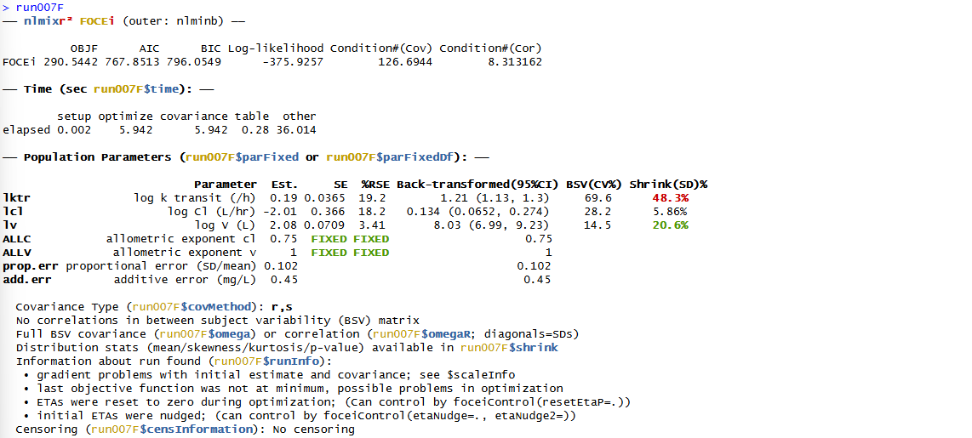
nlmixr2 output: allometric scaling ODEs using FOCEI Change in OFV compared to model without allometric scaling: -31.60

Slide 91
Code example IV: running an nlmixr2 posthoc analysis and implementing covariates using mu-referencing
Examine the code in HandsOn_4.R to run a posthoc analysis
Examine the code in HandsOn_4.R to run a covariate analysis with additive on log-scale covariate implementation
Binary covariate (sex)
Continuous covariate (weight)
Modify the allometrically scaled model with fixed exponents to examine what happens when you set them free

Slide 92
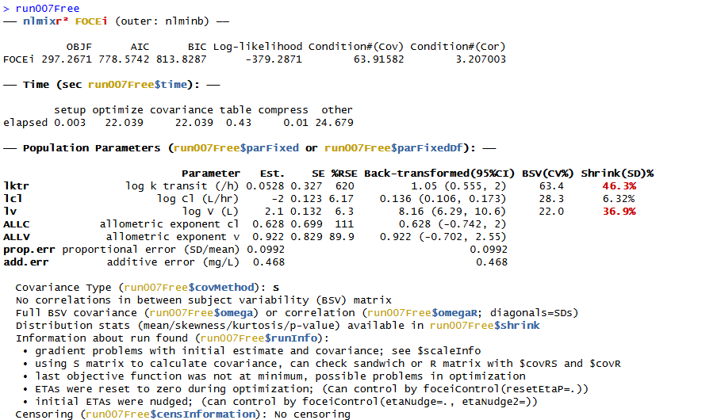
nlmixr2 output: allometric scaling ODEs using FOCEI Freely estimated exponents: drop of 5.30 points

Slide 93
PKPD analysis with nlmixr2: sequential estimation
First approach: use EBEs from a previous PK model to define PK profiles and estimate PKPD relationship
Extract EBEs from nlmixr2 object and merge to PKPD data file
load(file = “run007F.Rdata") # Use the one compartment transit model to start the PD analysis EBEs <- as.data.table(run007F) EBEs <- EBEs[!duplicated(ID), .(ID = as.numeric(as.character(ID)), IKTR = ktr, ICL = cl, IV = v)] PKPDdata <- fread("warfarin_dat.csv")
# Change variable names to upper case (not strictly necessary) setnames(PKPDdata, names(dataF), toupper(names(dataF)))
# Generate MDV data items PKPDdata[, MDV := ifelse(is.na(DV), 1, 0)] PKPDdata[, MDV := ifelse(AMT > 0, 1, MDV)]
# Merge data with PK EBEs PDdata <- merge(PKPDdata, EBEs, by = "ID", all.x = TRUE)
# remove PK measurements from file so as to not confuse the vpcPlot later on PDdata[, DEL := ifelse(DVID == 1 & AMT == 0, 1, 0)] Pddata <- Pddata[DEL == 0]

Slide 94
PKPD analysis with nlmixr2: define turnover model using PK EBEs
KA1tr1IPP_PDtoemax1 <- function() { ini({ tc50 <- log(1) # log ec50 (mg/L) tkout <- log(0.05) # log tkout (/h) te0 <- log(100) # log e0 eta.c50 ~ .5 eta.kout ~ .1 eta.e0 ~ .1 eps.pdadd <- 100 }) model({ c50 = exp(tc50 + eta.c50) kout = exp(tkout + eta.kout) e0 = exp(te0 + eta.e0) # PK parameters from input data set ktr = IKTR cl = ICL v = IV cp = central/v PD = 1 - cp/(c50 + cp) effect(0) = e0 kin = e0 * kout d/dt(depot) = -ktr * depot d/dt(central) = ktr * trans - cl/v * central d/dt(trans) = ktr * depot - ktr * trans d/dt(effect) = kin * PD - kout * effect effect ~ add(eps.pdadd) }) }

Slide 95
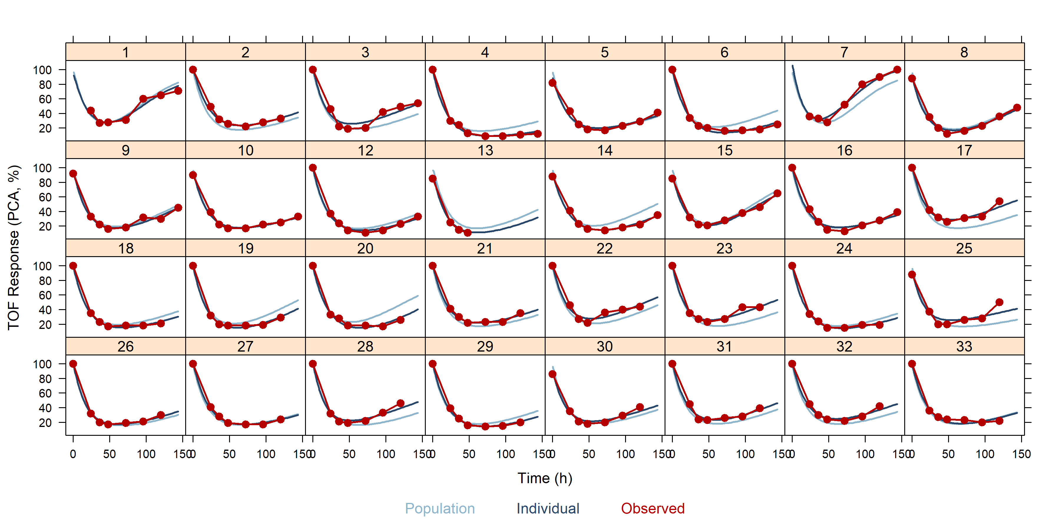
Individual graphs for turnover Emax PD model with PK using EBEs

Slide 96
PKPD analysis with nlmixr2: simultaneous estimation
Second approach: estimate PK and PD simultaneously
The source of observations is identified using a dvid data item
dvid is coded as central and effect in the data object to identify the two types of observation as presented in the model code
dvid can also coded as 1 and 2 in the data object to identify the two types of observation as presented in the model code

Slide 97
Immediate effect simultaneous PKPD analysis with nlmixr2: ini block
# Immediate effect KA1tr1_PDimmemax1 <- function() { ini({ ## PK tktr <- log(1) # log ktr (/h) tcl <- log(0.1) # log CL (L/h) tv <- log(8) # log Vc (L) eta.ktr ~ 1 eta.cl ~ 0.1 eta.v ~ 0.1 eps.pkprop <- 0.1 # proportional error (SD/mean) eps.pkadd <- 0.4 # additive error (mg/L)
## PD tc50 <- log(1) #log ec50 (mg/L) te0 <- log(100) #log e0 eta.c50 ~ .5 eta.e0 ~ .1 eps.pdadd <- 100 }) model({
}) }

Slide 98
Immediate effect simultaneous PKPD analysis with nlmixr2: model block
#Immediate effect model({ ktr <- exp(tktr + eta.ktr) cl <- exp(tcl + eta.cl) v <- exp(tv + eta.v) c50 = exp(tc50 + eta.c50) e0 = exp(te0 + eta.e0) cp = central/v d/dt(depot) = -ktr * depot d/dt(central)= ktr * trans - cl * cp d/dt(trans) = ktr * depot - ktr * trans effect = e0 * (1 - cp/(c50 + cp)) cp ~ prop(eps.pkprop) + add(eps.pkadd) | central effect ~ add(eps.pdadd) | effect }) }

Slide 99
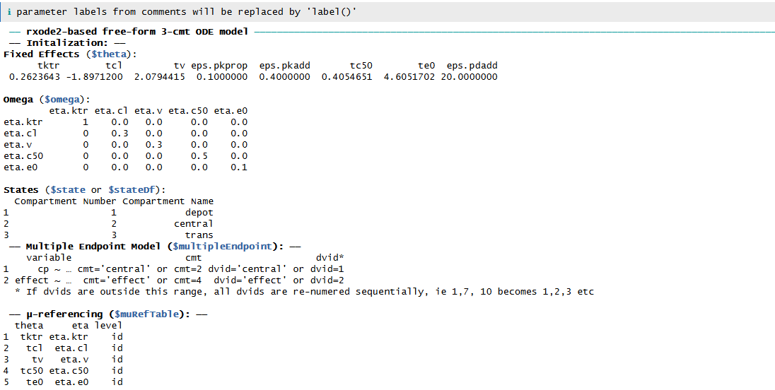
Simultaneous PKPD analysis with nlmixr2: examine defined model
nlmixr2(KA1tr1_PDimmemax1) # Show initial estimates and model information:

Slide 100
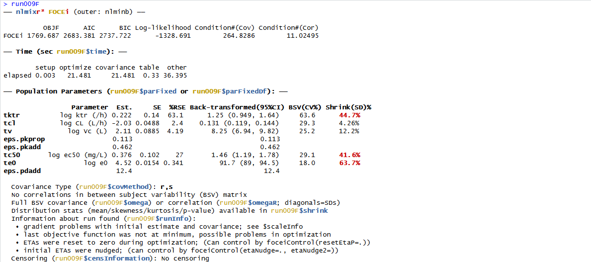
nlmixr2 output: immediate effect simultaneous PKPD model

Slide 101

VPC for immediate effect simultaneous PKPD model

Slide 102
Effect compartment simultaneous PKPD analysis with nlmixr2: ini block
#Effect compartment model KA1tr1_PDceemax <- function() { ini({ ## PK tktr <- log(1) # log ktr (/h) tcl <- log(0.1) # log CL (L/h) tv <- log(8) # log Vc (L) eta.ktr ~ 1 eta.cl ~ 0.1 eta.v ~ 0.1 eps.pkprop <- 0.1 #proportional error (SD/mean) eps.pkadd <- 0.4 #additive error (mg/L) ## PD tc50 <- log(1) #log ec50 (mg/L) tkout <- log(0.05) #log tkout (/h) te0 <- log(100) #log e0 eta.c50 ~ .5 eta.kout ~ .1 eta.e0 ~ .1 eps.pdadd <- 100 }) model({
}) }

Slide 103
Effect compartment simultaneous PKPD analysis with nlmixr2: model block
#Effect compartment model model({ ktr <- exp(tktr + eta.ktr) cl <- exp(tcl + eta.cl) v <- exp(tv + eta.v) c50 = exp(tc50 + eta.c50) kout = exp(tkout + eta.kout) e0 = exp(te0 + eta.e0) emax = 1 cp = central/v d/dt(depot) = -ktr * depot d/dt(central)= ktr * trans - cl * cp d/dt(trans) = ktr * depot - ktr * trans d/dt(ce) = kout * (cp - ce) effect = e0 * (1 - emax * ce/(c50 + ce)) cp ~ prop(eps.pkprop) + add(eps.pkadd) | central effect ~ add(eps.pdadd) | effect }) }

Slide 104

nlmixr2 output: effect compartment simultaneous PKPD model

Slide 105

VPC for effect compartment simultaneous PKPD model

Slide 106
Turnover model simultaneous PKPD analysis with nlmixr2: ini block
# Turnover simultaneous PKPD model KA1tr1IPP_PDtoemax <- function() { ini({ ## PK tktr <- log(1) # log ktr (/h) tcl <- log(0.1) # log CL (L/h) tv <- log(8) # log Vc (L) eta.ktr ~ 1 eta.cl ~ 0.1 eta.v ~ 0.1 eps.pkprop <- 0.1 # proportional error (SD/mean) eps.pkadd <- 0.4 # additive error (mg/L) ## PD tc50 <- log(1) #log ec50 (mg/L) tkout <- log(0.05) #log tkout (/h) te0 <- log(100) #log e0 eta.c50 ~ .5 eta.kout ~ .1 eta.e0 ~ .1 eps.pdadd <- 100 }) model({
}) }

Slide 107
Turnover model simultaneous PKPD analysis with nlmixr2: model block
# Turnover simultaneous PKPD model model({ ktr <- exp(tktr + eta.ktr) cl <- exp(tcl + eta.cl) v <- exp(tv + eta.v) c50 = exp(tc50 + eta.c50) kout = exp(tkout + eta.kout) e0 = exp(te0 + eta.e0) emax = 1 cp = central/v d/dt(depot) = -ktr * depot d/dt(central)= ktr * trans - cl * cp d/dt(trans) = ktr * depot - ktr * trans effect(0) = e0 kin = e0 * kout PD = 1 - emax * cp/(c50 + cp) d/dt(effect) = kin * PD - kout * effect cp ~ prop(eps.pkprop) + add(eps.pkadd) | central effect ~ add(eps.pdadd) | effect }) }

Slide 108

nlmixr2 output: turnover simultaneous PKPD model

Slide 109

VPC for turnover simultaneous PKPD model

Slide 110

VPCs to compare the immediate effect model, the effect compartment model, and the turnover simultaneous PKPD model

Slide 111
Code example V: running nlmixr2 PKPD analysis
Examine the code in HandsOn_5.R to run the sequential or one of the simultaneous PKPD analyses

