Slide 1
nlmixr2 advanced topics
rxode2/nlmixr2 Course PAGE 2026, Dubrovnik, Croatia Justin / Bill?
On behalf of the nlmixr development team:
Matt Fidler, Bill Denney, John Harrold, Richard Hooijmaijers, Mutaz Jaber, Anne Keunecke, Theo Papathanasiou, Rik Schoemaker, Max Taubert, Mirjam Trame, Justin Wilkins, Brendan Bender

Slide 2
Course outline: Part 2
Time-to-event models
Models for categorical data
Custom functions
Model piping
nlmixr2lib
Adaptive dosing
The future

Slide 3
Time to event (TTE) models
Time-to-event (TTE) analysis models the time until a discrete event occurs
Tumor progression, an adverse event, dropout, relapse, device failure, death, etc
The endpoint is not only whether the event occurred, but also how long the subject remained event-free
A subject who is followed for 24 weeks without any event is therefore informative even though an event was not observed

Slide 4
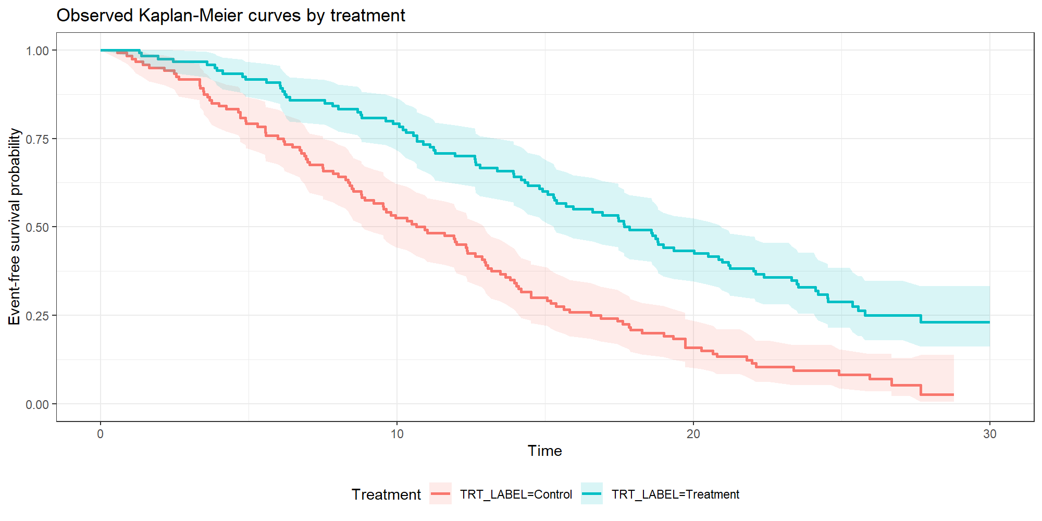
Consider a straightforward example…

Slide 5
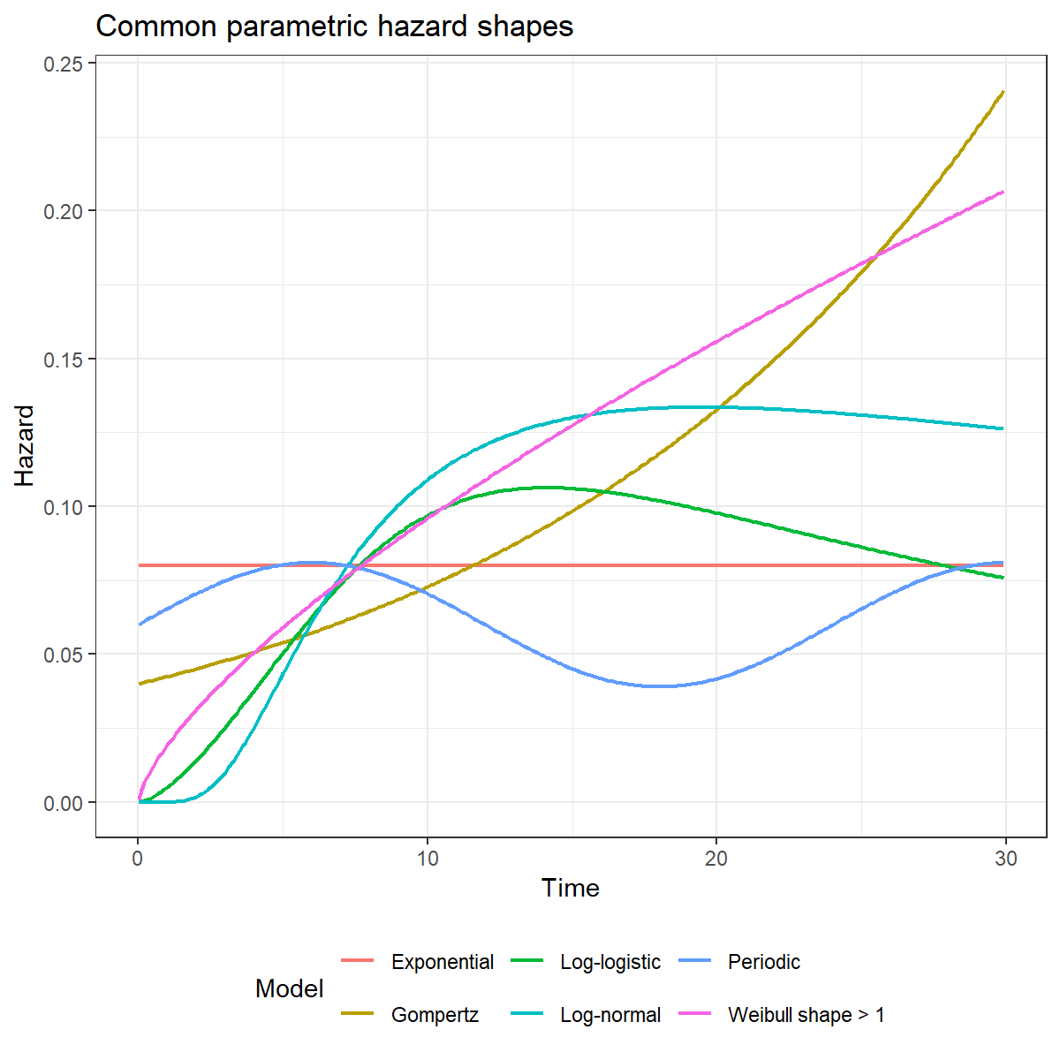
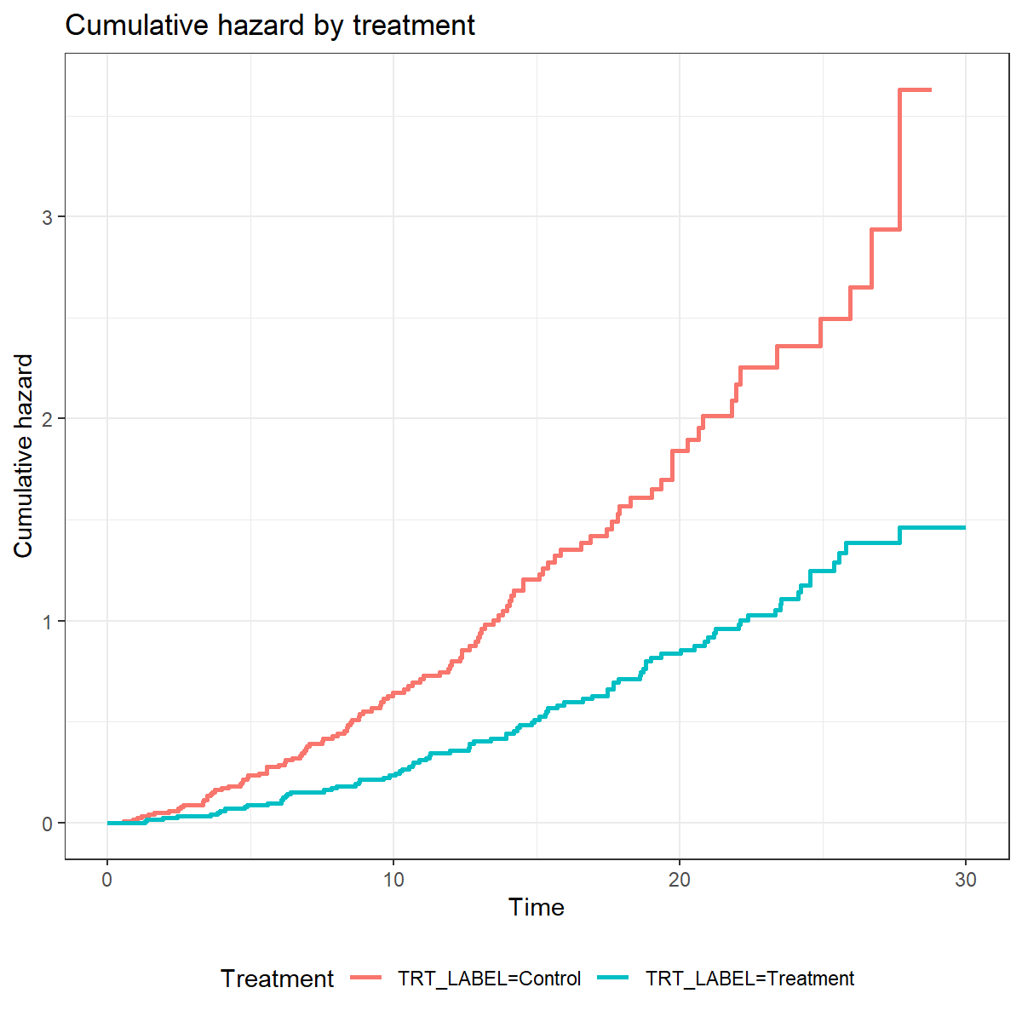
We can do some exploratory analysis to see what kind of hazard distribution we need
Hazard is not constant over time! Looks like Weibull or Gompertz

Slide 6


Let’s try an exponential model first, just to see
TTE models are supported in nlmixr2 using custom likelihoods – ll()
tte_exponential_model <- function() {
ini({
# Baseline log hazard for the control group
log_h0 <- log(0.06)
# Log hazard ratio for treatment versus control
trt_log_hr <- -0.3 })
model({
# Treatment multiplies the baseline hazard on the hazard-ratio scale
log_h <- log_h0 + trt_log_hr * TRT
h <- exp(log_h)
# Exponential cumulative hazard
H <- h * TIME
# Event rows contribute log(h) - H; censored rows contribute -H
tte_ll <- EVENT * log_h - H
ll(tte) ~ tte_ll
})}
# Use bobyqa for this custom likelihood to avoid relying on symbolic gradients
fit_tte_exp <- nlmixr(
tte_exponential_model, tte_data, est = "bobyqa",
control = bobyqaControl(print = 0)
)
$$h\left(t\right)= λ$$
$$H\left(t\right)= λt$$

Slide 7
nlmixr2 fit output
> fit_tte_exp
── nlmixr² log-likelihood bobyqa ──
OBJF AIC BIC Log-likelihood Condition#(Cov) Condition#(Cor)
lPop 1084.069 1529.159 1536.121 -762.5797 6.255733 4.940448
── Time (sec fit_tte_exp$time): ──
setup table other
elapsed 0.003 0.06 10.597
── (fit_tte_exp$parFixed or fit_tte_exp$parFixedDf): ──
Est. SE %RSE Back-transformed(95%CI) BSV(SD) Shrink(SD)%
log_h0 -2.537 0.189 7.448 -2.537 (-2.908, -2.167)
trt_log_hr -0.6261 0.2849 45.5 -0.6261 (-1.185, -0.06772)
Covariance Type (fit_tte_exp$covMethod): r
Censoring (fit_tte_exp$censInformation): No censoring

Slide 8
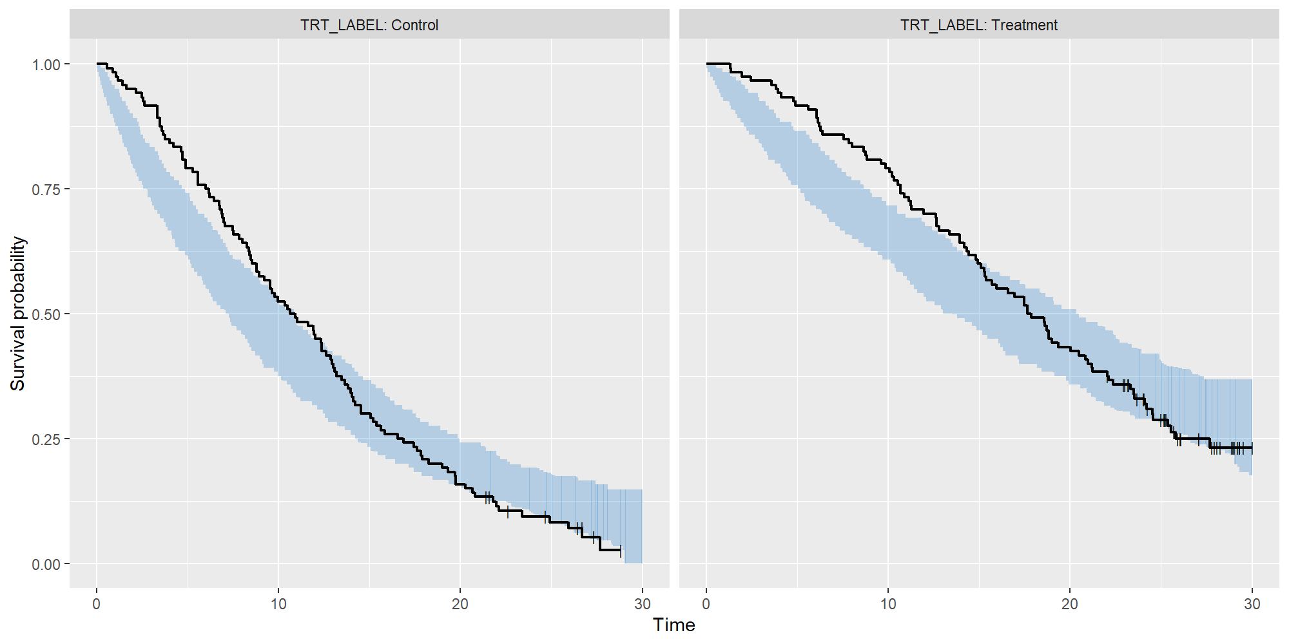
VPC suggests there’s room for improvement
Generated using a custom simulation function together with vpc_tte() from the vpc package

Slide 9


Now for a Weibull model (non-proportional hazard)
tte_weibull_model <- function() {
ini({
# Weibull scale and shape are estimated on log scales
log_scale <- log(12)
log_shape <- log(1.2)
# Log hazard ratio for treatment versus control
trt_log_hr <- -0.3
})
model({
scale <- exp(log_scale)
shape <- exp(log_shape)
# A small offset protects the hazard if TIME is very close to 0
tte_time <- TIME + 1e-6
# Baseline Weibull hazard and cumulative hazard
h0 <- (shape / scale) * (tte_time / scale)^(shape - 1)
H0 <- (tte_time / scale)^shape
# Treatment acts as a proportional hazard multiplier
log_hr <- trt_log_hr * TRT
hr <- exp(log_hr)
h <- h0 * hr
H <- H0 * hr
# Custom TTE log-likelihood contribution
tte_ll <- EVENT * log(h) – H
ll(tte) ~ tte_ll
})}
# Fit the Weibull model to the same TTE data
fit_tte_weibull <- nlmixr(
tte_weibull_model, tte_data, est = "bobyqa",
control = bobyqaControl(print = 0))
$$h\left(t\right)=\frac{γ}{λ}∙{\left(\frac{t}{λ}\right)}^{γ−1}$$
$$H\left(t\right)={\left(\frac{t}{λ}\right)}^{γ}$$

Slide 10
This looks a bit better!
> fit_tte_weibull
── nlmixr² log-likelihood bobyqa ──
OBJF AIC BIC Log-likelihood Condition#(Cov) Condition#(Cor)
lPop 1033.108 1480.198 1490.64 -737.0992 14.47451 5.396522
── Time (sec fit_tte_weibull$time): ──
setup table other
elapsed 0.002 0.05 5.588
── (fit_tte_weibull$parFixed or fit_tte_weibull$parFixedDf): ──
Est. SE %RSE Back-transformed(95%CI) BSV(SD) Shrink(SD)%
log_scale 2.613 0.1207 4.621 13.63 (10.76, 17.27)
log_shape 0.4669 0.1185 25.38 1.595 (1.264, 2.012)
trt_log_hr -0.795 0.2889 36.35 -0.795 (-1.361, -0.2287)
Covariance Type (fit_tte_weibull$covMethod): r
Censoring (fit_tte_weibull$censInformation): No censoring

Slide 11
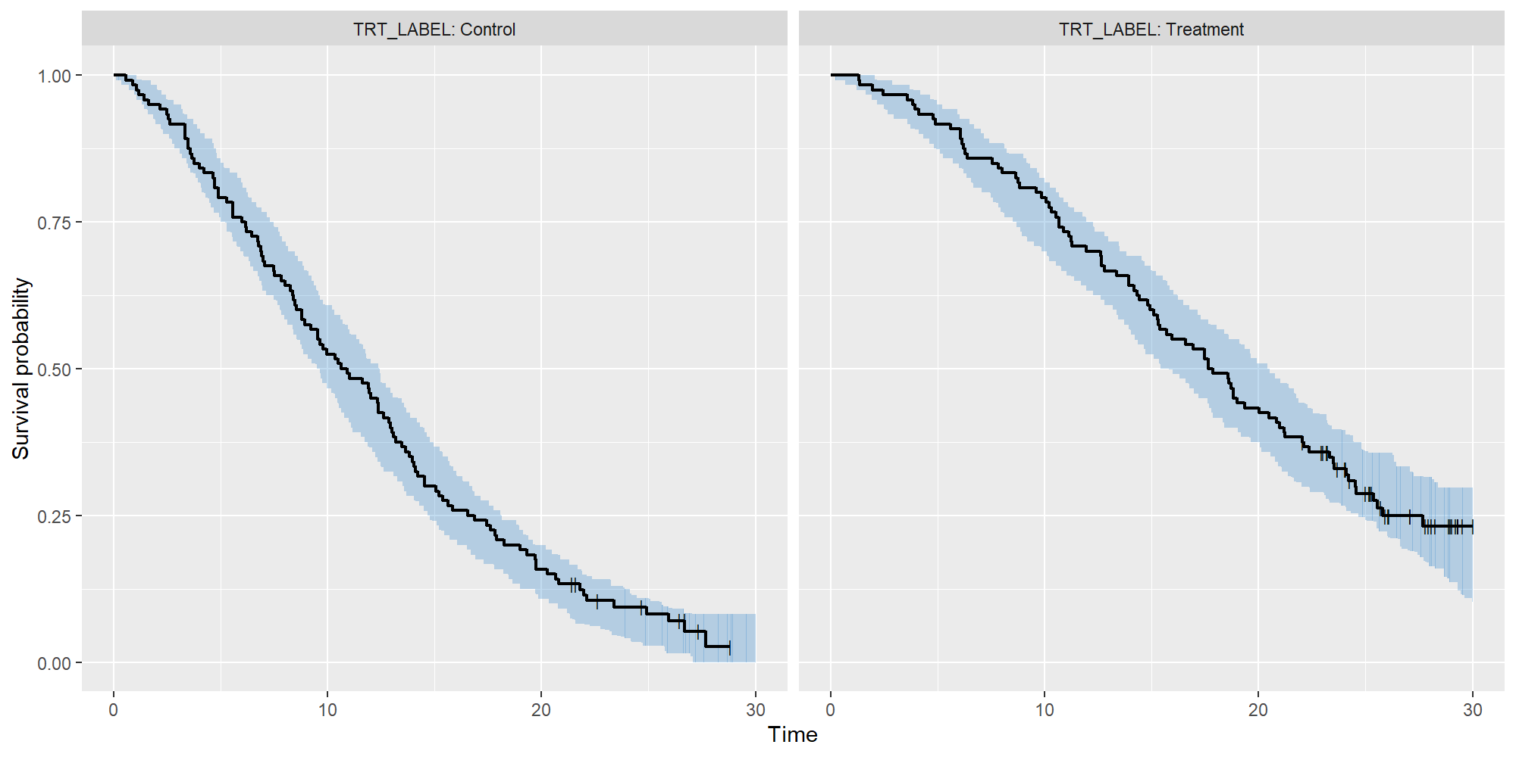
The VPC looks better!

Slide 12
Advanced TTE modeling
The example we show here could just as easily be performed using the survreg package in R – these models are quite simple
Where it starts becoming really useful is with repeated time-to-event (RTTE) models, or with joint models (e.g. TGI-OS)
Code examples are provided in the TTE folder

Slide 13
Models for discrete data
Discrete data can be:
Binary (0 or 1, yes or no)
Categorical (ordered or unordered)
Counts
These kinds of data cannot easily be approximated using continuous-data models

Slide 14
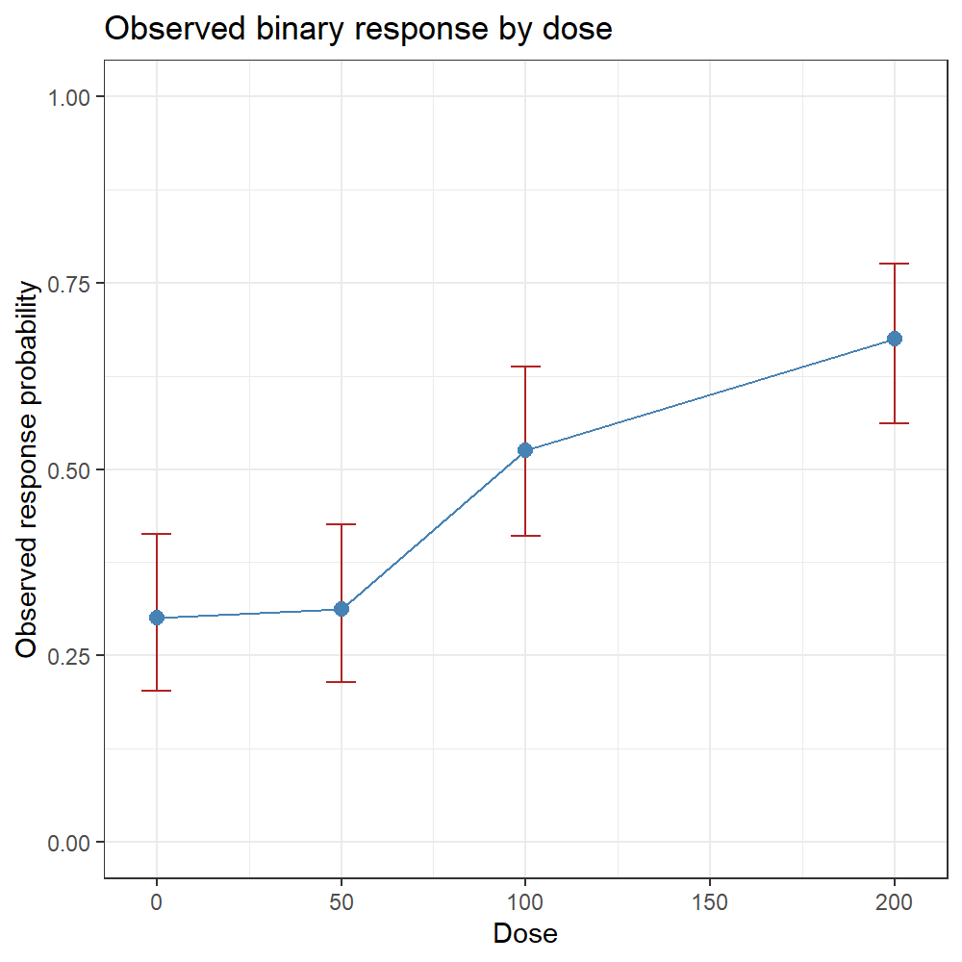
Models for binary data
We typically use logistic regression for binary data
$\text{logit}\left(p_{i}\right)=log\left(\frac{p_{i}}{1−p_{i}}\right)=β_{0}+β_{1}∙x_{1.i}+⋯+$ $β_{n}∙x_{n.i}$
logistic_binary_model <- function() {
ini({
# Log odds of response at dose 0
logit_p0 <- -1
# Change in log odds for each one-unit increase in dose
beta_dose <- 0.008
})
model({
# Linear predictor on the log-odds scale
lp <- logit_p0 + beta_dose * DOSE
# Inverse-logit transformation to obtain a probability
p <- expit(lp)
# A binary response is a binomial endpoint with one trial
one <- 1
RESPONSE ~ dbinom(one, p)
})}
# Fit the logistic regression model
fit_logistic_binary <- nlmixr(
logistic_binary_model, binary_data, est = "nlm",
control = nlmControl(print = 0))

Slide 15

Model fit
> fit_logistic_binary
── nlmixr² log-likelihood nlm ──
OBJF AIC BIC Log-likelihood Condition#(Cov) Condition#(Cor)
lPop -177.2108 414.9099 422.4465 -205.4549 32856.2 7.982354
── Time (sec fit_logistic_binary$time): ──
setup table other
elapsed 0.003 0.08 7.307
── (fit_logistic_binary$parFixed or $parFixedDf): ──
Est. SE %RSE Back-transformed(95%CI) BSV(SD) Shrink(SD)%
logit_p0 -0.9513 0.3745 39.37 -0.9513 (-1.685, -0.2172)
beta_dose 0.008611 0.003285 38.15 0.008611 (0.002173, 0.01505)
This suggests the odds ratio per 100 unit increase in dose is
$$\exp\left(100∙0.008611\right)=2.37$$

Slide 16
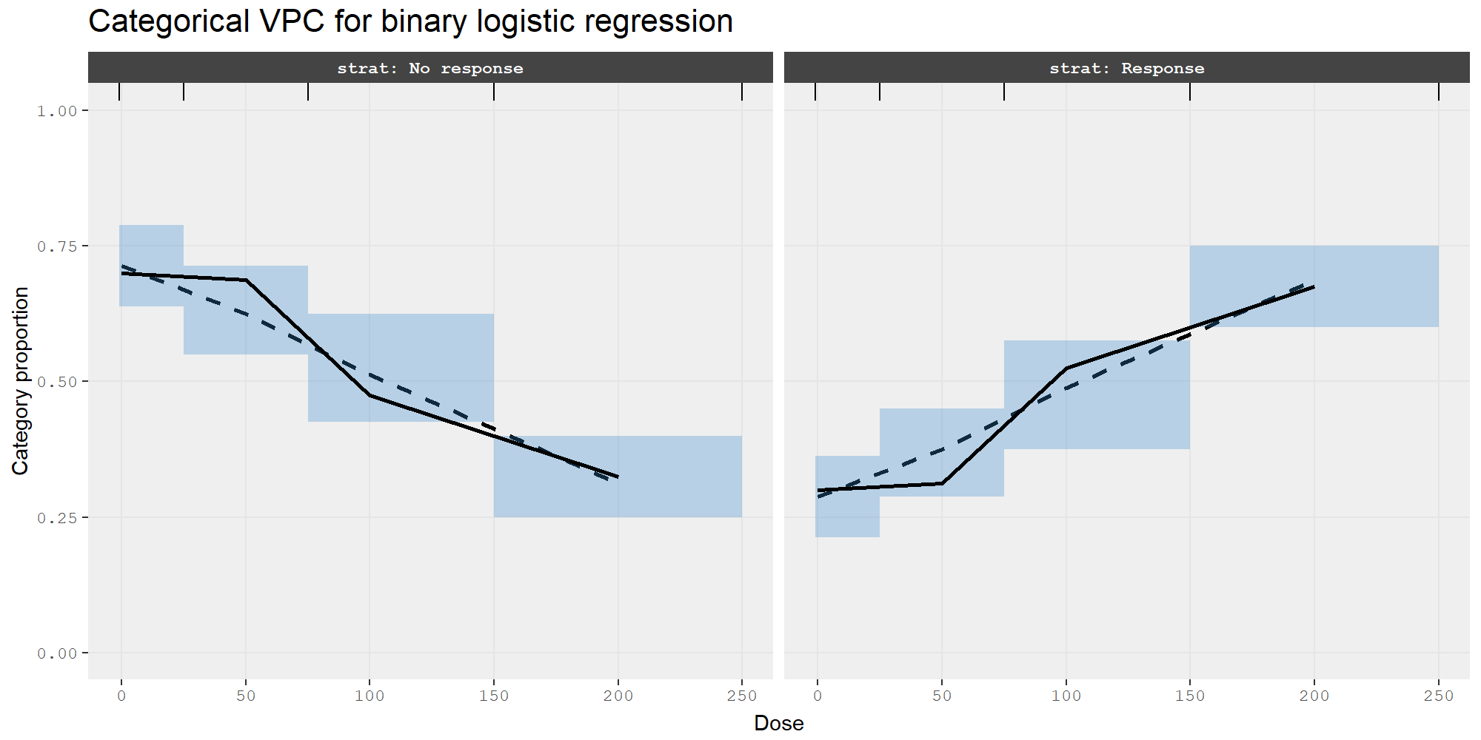
A VPC shows our model does the job
Generated using a custom simulation function together with vpc_cat() from the vpc package

Slide 17
Models for count data
Counts arise when the endpoint is the number of events in an observation window
e.g. seizures per week, infections per treatment cycle, vomiting episodes, device failures
Count data can have different properties:
Equidispersed: for a given individual and covariate pattern, the mean and variance are both the same → Poisson models
Overdispersed: some subjects have many more events than the population mean predicts, while others have few or none → negative binomial models
Zero-inflated: disproportionately high proportion of zero counts → zero-inflated Possion and negative binomial models
nlmixr2 can handle all of these, but as before, we need to write our own likelihood – see the Counts folder for examples
Plan E. Modeling and Simulation of Count Data. CPT: Pharmacometrics & Systems Pharmacology. 2014 Aug 1;3(8):1–12. doi:10.1038/PSP.2014.27

Slide 18
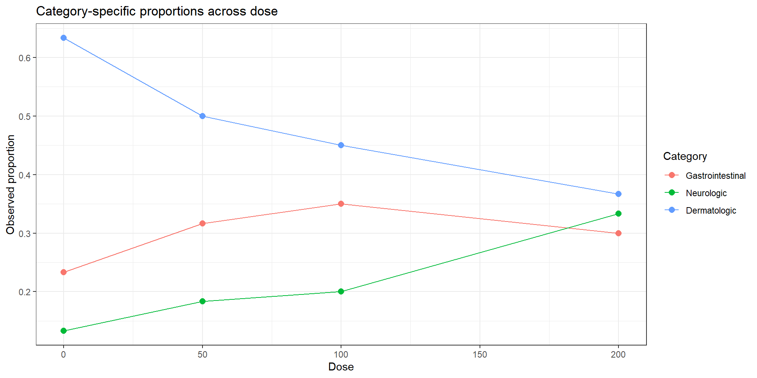
Models for unordered categorical data
Unordered categorical endpoints occur when the outcome is a category, but the categories do not have a natural severity or magnitude ordering
e.g. adverse-event type, reason for discontinuation, responder phenotype, etc.
Categories are not ranked, just different

Slide 19
Models for unordered categorical data
unordered_model <- function() {
ini({
# Category 2 versus category 1 at DOSE = 100
cat2_intercept <- -0.2
cat2_dose <- 0.004
# Category 3 versus category 1 at DOSE = 100
cat3_intercept <- 0.3
cat3_dose <- -0.003
})
model({
# Logits for categories 2 and 3 relative to reference category 1
lp2 <- cat2_intercept + cat2_dose * (DOSE - 100)
lp3 <- cat3_intercept + cat3_dose * (DOSE - 100)
# Category 1 is represented by exp(0) = 1
denom <- 1 + exp(lp2) + exp(lp3)
p1 <- 1 / denom
p2 <- exp(lp2) / denom
# Three categories: 1, 2, and the remainder category 3
CAT ~ c(p1, p2)
})}
# Fit the fixed-effect categorical model
fit_unordered <- nlmixr(unordered_model, unordered_data, est = "nlm")

Slide 20
Models for unordered categorical data
> fit_unordered
── nlmixr² log-likelihood nlm ──
OBJF AIC BIC Log-likelihood Condition#(Cov) Condition#(Cor)
lPop 47.93183 497.0223 510.9449 -244.5112 17878.36 3.521674
── Time (sec fit_unordered$time): ──
setup table other
elapsed 0.003 0.06 9.227
── (fit_unordered$parFixed or fit_unordered$parFixedDf): ──
Est. SE %RSE Back-transformed(95%CI) BSV(SD)
cat2_intercept -0.3537 0.3688 104.3 -0.3537 (-1.077, 0.3691)
cat2_dose 0.003579 0.004876 136.2 0.003579 (-0.005978, 0.01314)
cat3_intercept 0.4228 0.3088 73.02 0.4228 (-0.1823, 1.028)
cat3_dose -0.003625 0.00416 114.8 -0.003625 (-0.01178, 0.004528)
Shrink(SD)%
cat2_intercept
cat2_dose
cat3_intercept
cat3_dose

Slide 21
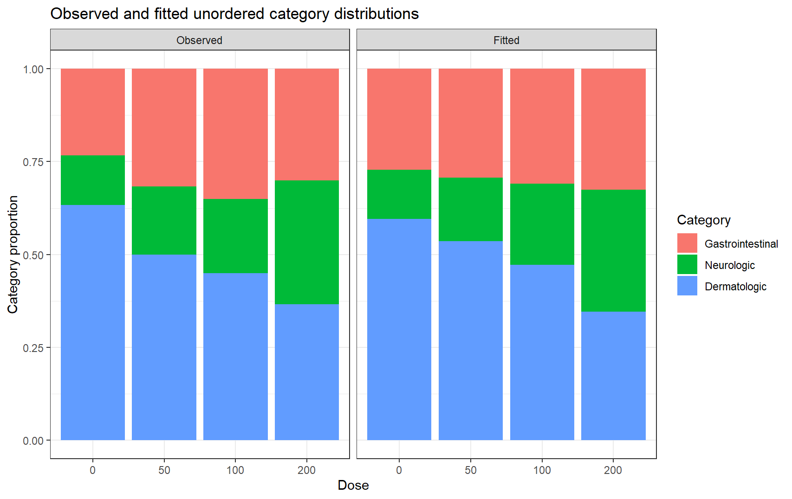
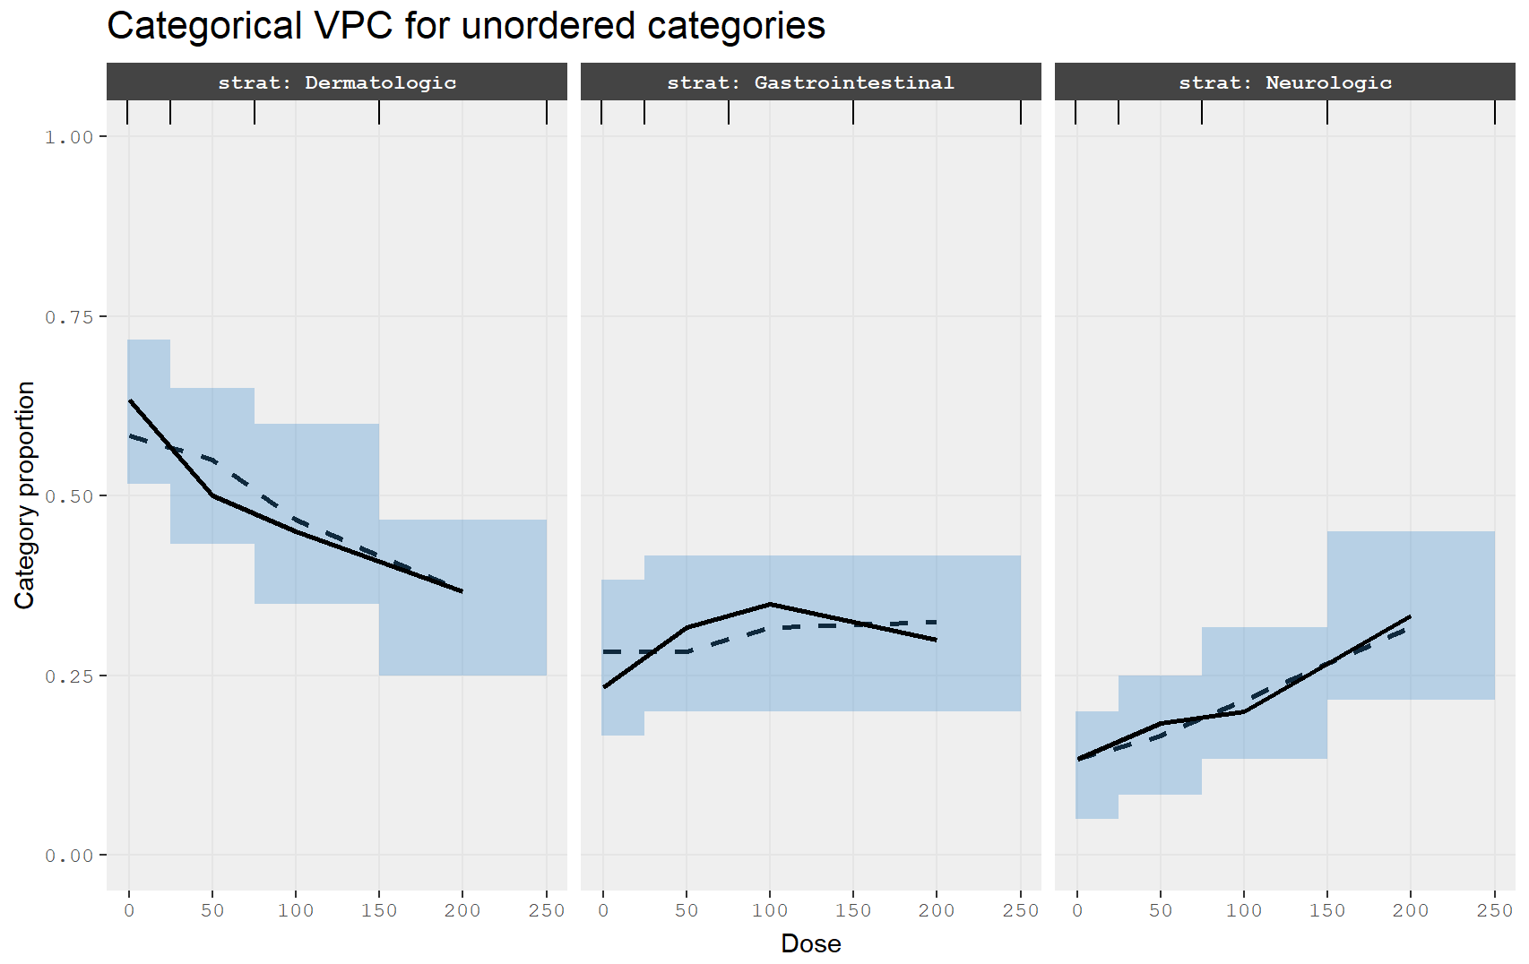
The model fits well!

Slide 22
Models for ordered categorical data
Ordered categorical endpoints are common for safety and symptom scores
none, mild, moderate, severe; grade 0 through grade 4 toxicity; etc.
Similar to unordered categories; probabilities must sum to 1…
Category 1 = p1
Category 2 = p2
Category 3 = p3
Category 4 = 1 – p1 – p2 – p3
The difference is in the cumulative probabilities:
p1 = cp1
p2 = cp2 – cp1
p3 = cp3 – cp2
p4 = 1 – cp3
A convenient way to tackle this is a proportional-odds model with ordered thresholds

Slide 23
Proportional odds model
ordinal_model <- function() {
ini({
# First threshold and positive log-increments to the next thresholds
theta1 <- -1
log_delta2 <- log(1.4)
log_delta3 <- log(1.2)
# Dose effect on the latent severity scale
beta_dose <- 0.005
# Subject-level variability in latent severity
eta_sev ~ 0.05
})
model({
# Linear predictor centered at 100 mg for numerical stability
lp <- beta_dose * (DOSE - 100) + eta_sev
# Ordered thresholds
theta2 <- theta1 + exp(log_delta2)
theta3 <- theta2 + exp(log_delta3)
# Cumulative probabilities P(Y <= k)
cp1 <- expit(theta1 - lp)
cp2 <- expit(theta2 - lp)
cp3 <- expit(theta3 - lp)
# Category probabilities
p1 <- cp1
p2 <- cp2 - cp1
p3 <- cp3 - cp2
# Four ordered categories: 1, 2, 3, and the remainder category 4
SEV ~ c(p1, p2, p3)
})}
# Fit the ordered categorical model
fit_ordinal <- nlmixr(ordinal_model, ordered_data, est = "laplace")

Slide 24
Proportional odds model
> fit_ordinal
── nlmixr² log-likelihood AGQi (outer: nlminb; Laplace) ──
OBJF AIC BIC Log-likelihood Condition#(Cov) Condition#(Cor)
Laplace 163.491 541.0665 557.558 -265.5332 12127.27 5.516579
── Time (sec fit_ordinal$time): ──
setup optimize covariance table other
elapsed 0.002 0.073 0.073 0.13 8.372
── Population Parameters (fit_ordinal$parFixed or fit_ordinal$parFixedDf): ──
Est. SE %RSE Back-transformed(95%CI) BSV(SD) Shrink(SD)%
theta1 -1 0.363 36.3 -1 (-1.71, -0.288)
log_delta2 0.336 0.232 69 0.336 (-0.119, 0.792)
log_delta3 0.182 0.267 147 0.182 (-0.341, 0.706)
beta_dose 0.00685 0.00393 57.3 0.00685 (-0.000847, 0.0146)
eta_sev 0.224 88.1%
Covariance Type (fit_ordinal$covMethod): s
No correlations in between subject variability (BSV) matrix
Full BSV covariance (fit_ordinal$omega)
or correlation (fit_ordinal$omegaR; diagonals=SDs)
Distribution stats (mean/skewness/kurtosis/p-value) available in fit_ordinal$shrink

Slide 25
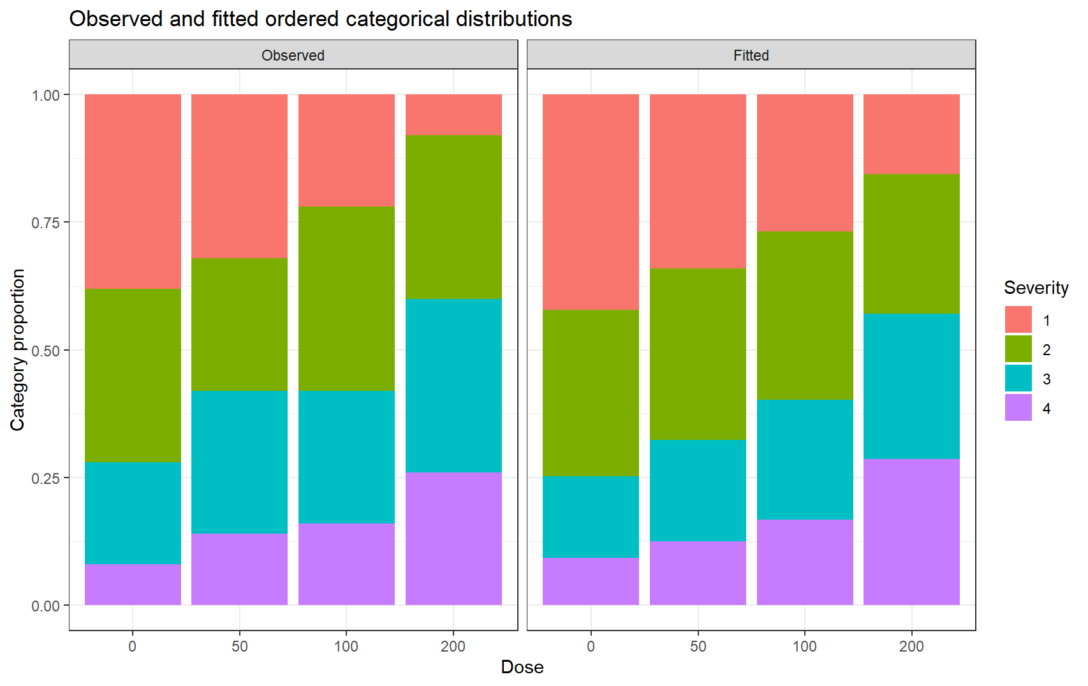
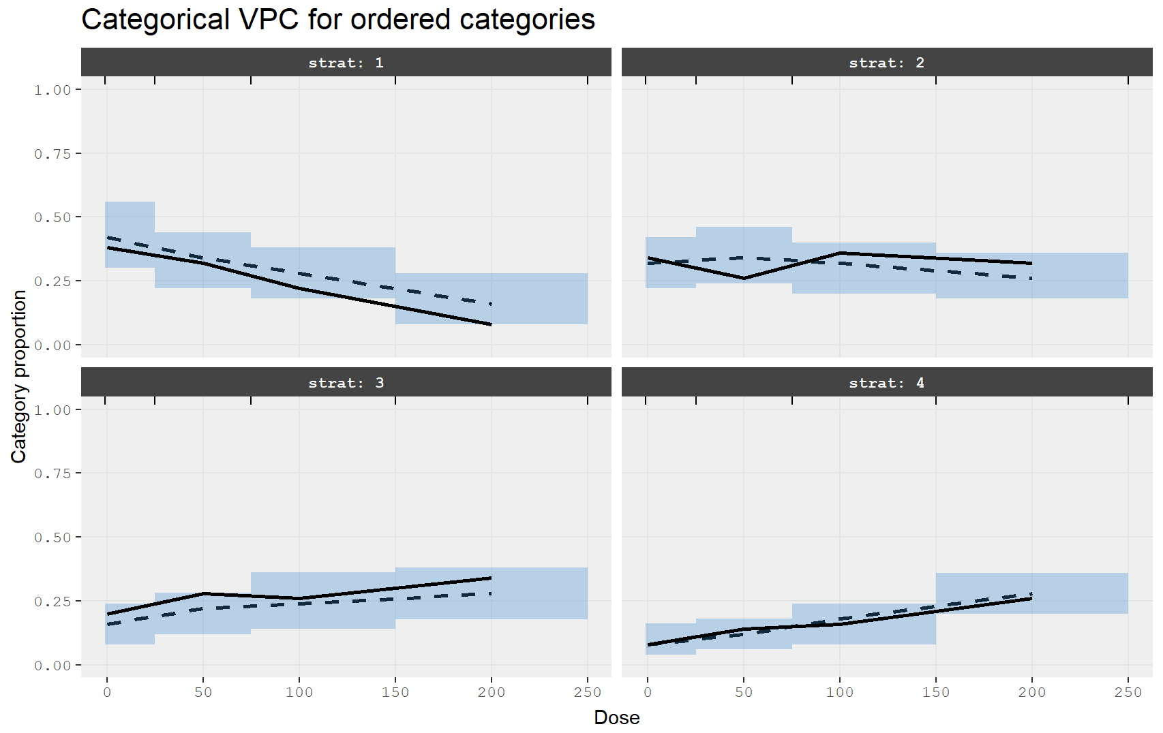
It works!

Slide 26
Custom functions
When defining models, you may wish to write a small R function or make a function integrate into rxode2 somehow. This is possible!
R-based user functions which can be loaded as simple functions or in certain circumstances translated to C to run more efficiently
C functions that you define and integrate into code
Functions that insert rxode2 code into the current model
See https://nlmixr2.github.io/rxode2/articles/Integrating-User-Defined-Functions-into-rxode2.html

Slide 27
Adaptive dosing
rxode2 can modify an individual’s event history while the model is being solved
This allows adaptive dosing strategies such as:
response-guided titration
rescue doses
infusion starts with fixed rate or fixed duration
compartment reset, replacement, or proportional adjustment
phantom/transit doses that update podo() and tad() without adding mass to the compartment
adaptive observation scheduling
https://nlmixr2.github.io/rxode2/articles/adaptive-dosing.html

Slide 28
Model piping
Consider this very simple PK model (it might seem familiar!)
one.compartment <- function() {
ini({
tka <- 0.45; label("Ka")
tcl <- 1; label("Cl")
tv <- 3.45; label("V")
eta.ka ~ 0.6
eta.cl ~ 0.3
eta.v ~ 0.1
add.sd <- 0.7
})
model({
ka <- exp(tka + eta.ka)
cl <- exp(tcl + eta.cl)
v <- exp(tv + eta.v)
d/dt(depot) = -ka * depot
d/dt(center) = ka * depot - cl / v * center
cp = center / v
cp ~ add(add.sd)
})
}

Slide 29
Model piping: the theophylline model
> fit
── nlmixr² FOCEi (outer: nlminb) ──
OBJF AIC BIC Log-likelihood Condition#(Cov) Condition#(Cor)
FOCEi 116.8174 373.4172 393.5968 -179.7086 18.67727 12.50802
── Time (sec fit$time): ──
setup optimize covariance table other
elapsed 0.001 0.475 0.475 2.23 10.329
── Population Parameters (fit$parFixed or fit$parFixedDf): ──
Parameter Est. SE %RSE Back-transformed(95%CI) BSV(CV%) Shrink(SD)%
tka Ka 0.464 0.36 77.5 1.59 (0.786, 3.22) 69.0 0.473%
tcl Cl 1.01 0.313 31 2.75 (1.49, 5.08) 26.8 4.35%
tv V 3.46 0.182 5.26 31.8 (22.3, 45.5) 14.3 11.4%
add.sd 0.695 0.695
Covariance Type (fit$covMethod): s
No correlations in between subject variability (BSV) matrix
Full BSV covariance (fit$omega) or correlation (fit$omegaR; diagonals=SDs)
Distribution stats (mean/skewness/kurtosis/p-value) available in fit$shrink

Slide 30
That estimate of ka was a bit imprecise. What if we fix it to its estimated value? Rewriting the model is too much effort, we’ll just use the pipe
one.ka.0.5 <- fit %>%
ini(tka=fix) %>%
nlmixr(est="focei", control=list(print=0),
table=list(cwres=TRUE, npde=TRUE))
> one.ka.0.5
── nlmixr² FOCEi (outer: nlminb) ──
OBJF AIC BIC Log-likelihood Condition#(Cov) Condition#(Cor)
FOCEi 116.8172 371.417 388.7138 -179.7085 9.780336 6.139784
── Time (sec one.ka.0.5$time): ──
setup optimize covariance table other
elapsed 0.002 0.267 0.267 2.22 7.244
── Population Parameters (one.ka.0.5$parFixed or one.ka.0.5$parFixedDf): ──
Parameter Est. SE %RSE Back-transformed(95%CI) BSV(CV%) Shrink(SD)%
tka Ka 0.464 FIXED FIXED 0.464 69.0 0.466%
tcl Cl 1.01 0.082 8.1 2.75 (2.34, 3.23) 26.8 4.34%
tv V 3.46 0.0443 1.28 31.8 (29.2, 34.7) 14.3 11.4%
add.sd 0.695 0.695
Covariance Type (one.ka.0.5$covMethod): r,s

Slide 31
Model piping
Model piping is quite versatile – can be used for
Changing initial estimates
Changing parameter labels and order
Adding and removing random effects
Adding and removing covariate relationships
All kinds of things!
## Note: currently “cov” is needed as a prefix so nlmixr knows how to deal with it
wt70 <- fit %>%
model({cl <- exp(tcl + eta.cl)*(WT/70)^covWtPow}) %>%
ini(covWtPow=fix(0.75)) %>%
ini(tka=fix(0.5)) %>%
nlmixr(est="focei", control=list(print=0),
table=list(cwres=TRUE, npde=TRUE))

Slide 32
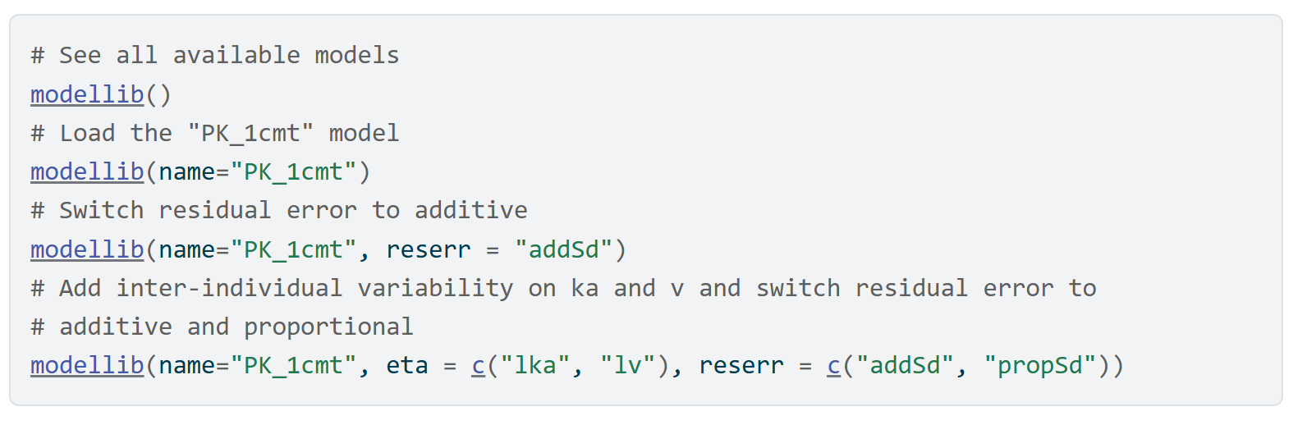
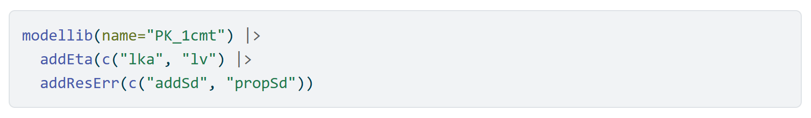
nlmixr2lib
https://nlmixr2.github.io/nlmixr2lib/
nlmixr2lib provides an extensive model library for nlmixr2
Model piping is particularly useful here
At last count, there are a staggering 614 models available! (standard, literature, DDMoRe, …)

Slide 33

nlmixr2rpt
Automates the reporting of analyses performed in nlmixr2
PowerPoint
Word
Uses a YAML file that contains specifications for report elements (figures and tables) as well as the contents of Word and PowerPoint documents
Simple templates for both documents and the report YAML file are included
Format of the document templates can be customized using onbrand
Report contents can be customized by modifying the YAML template
https://nlmixr2.github.io/nlmixr2rpt/
https://cran.r-project.org/web/packages/onbrand/index.html

Slide 34

ruminate: data exploration and analysis
https://ruminate.ubiquity.tools/
Set of Shiny modules to allow users with limited experience to use R for pharmacometrics
Data wrangling: Transform your data (tidyr and dplyr)
Figure generation: Plot your data (ggplot2)
NCA: Run noncompartmental analysis (PKNCA)
Model building: Construct ode-based models (rxode2, in development)
Trial simulation: Adaptive trial simulator (rxode2, in devevelopment)
Each module element will generate the code to reproduce the element (see in real time the relationship between code and output)
Reporting: PowerPoint, Word and Excel
Save your analysis:
Generate a script to reproduce what was done in the app
Return and load the analysis later
Generate workflows to apply an analysis to new datasets

Slide 35
ruminate: adaptive trial simulation
Uses models in rxode2 format (nlmixr2, nonmem2rx, etc)
Pull subject data from datasets or generate it using mk_subjects()
Create a series of conditions and actions
When a condition is met, the action (update dosing, set a compartment to a value, etc) is executed
Conditions and actions can be simple statements (CP < 5) or you can create user defined functions
Evaluations occur at specified times
The function simulate_subjects() wraps around rxode2 to move from one evaluation time to the next.
The starting and stopping can slow things down a bit
You have the flexibility to code the logic above in R

Slide 36

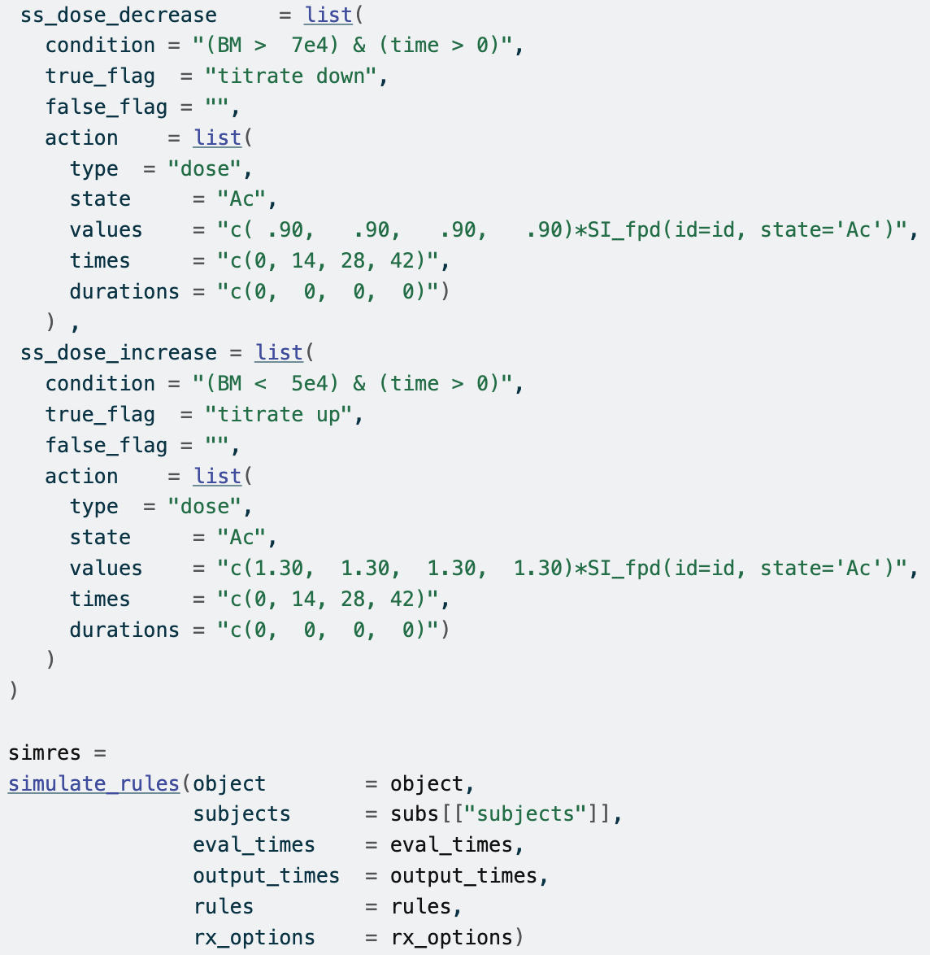
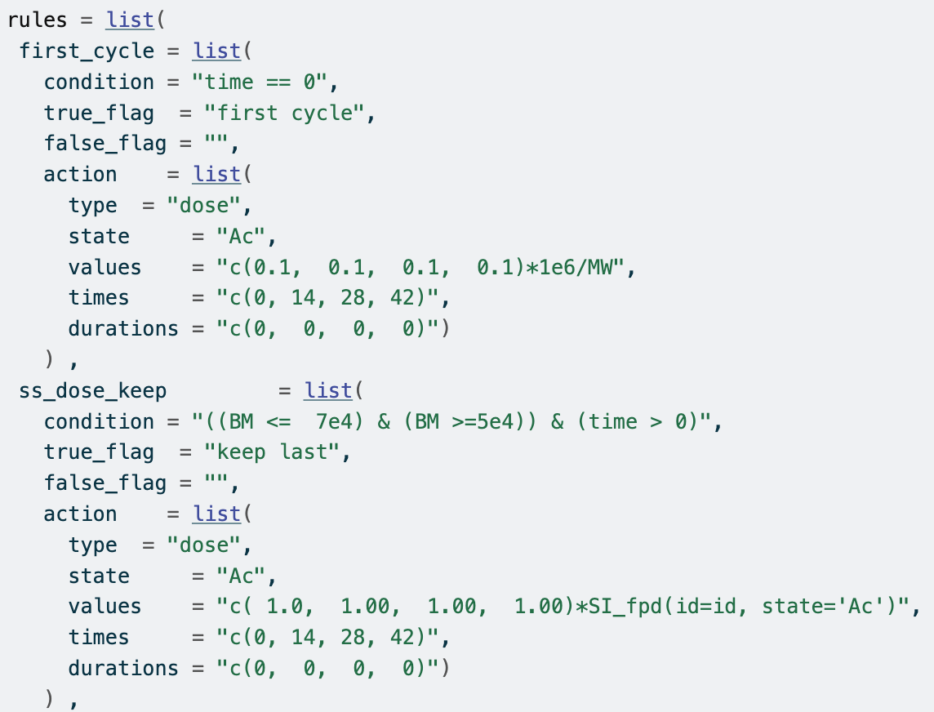
PK/biomarker
Evaluate every 6 weeks
Titrating up or down until the biomarker is within the desired range
BM too high reduce by 10%
First cycle, start at a standard dose
BM too low increase by 30%
Within range keep last dose

Slide 37
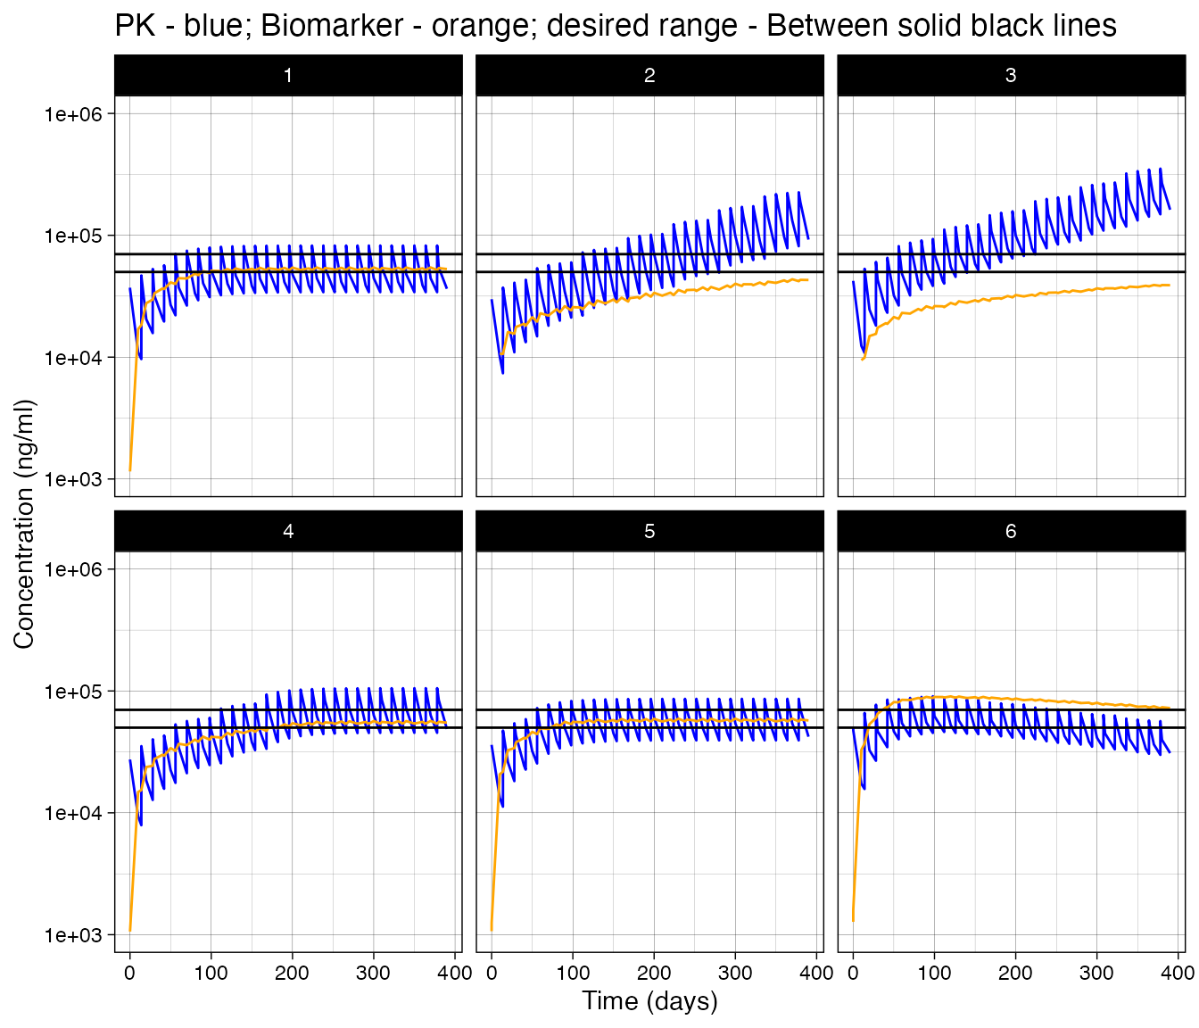
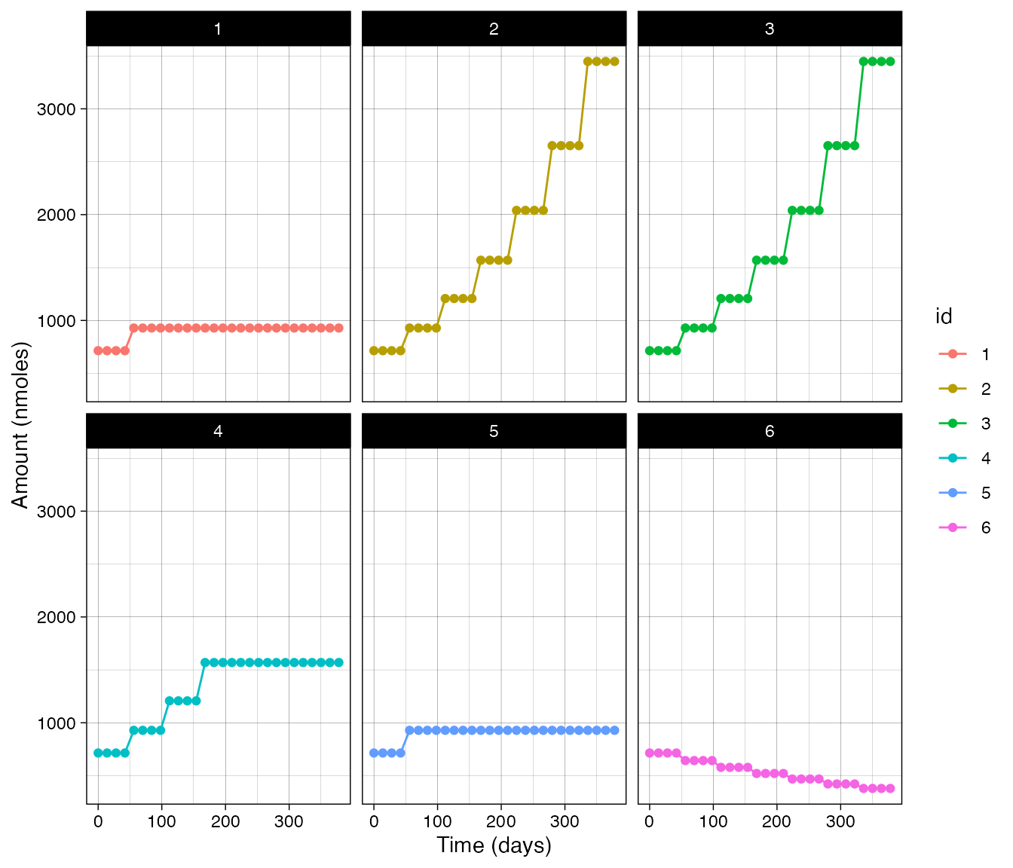
Sample output
https://ruminate.ubiquity.tools/articles/clinical_trial_simulation.html
PLACEHOLDER

