Slide 1
Extending nlmixr2: Tools for Reproducibility, Interactivity, and Collaboration
nlmixr2targets · nlmixr2shiny · nlmixr2save · shinyMixR
rxode2/nlmixr2 Course PAGE 2026, Dubrovnik, Croatia Anne Keunecke, PhD
On behalf of the nlmixr development team:
Matt Fidler, Bill Denney, John Harrold, Richard Hooijmaijers, Mutaz Jaber, Anne Keunecke, Theo Papathanasiou, Rik Schoemaker, Max Taubert, Mirjam Trame, Justin Wilkins, Brendan Bender

Slide 2
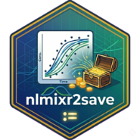

Tools for Reproducibility, Interactivity, and Collaboration
Each package addresses a specific gap in the pharmacometric modeling workflow.
REPRODUCIBILITY
PERSISTENCE
PROJECT MANAGER
MODEL LIBRARY UI
nlmixr2targets
nlmixr2save
shinyMixR
nlmixr2shiny
Pipeline automation
with the targets package
Automatic save & reload
of fit objects
Full project dashboard
for managing runs
Shiny UI for the
nlmixr2lib model library
https://nlmixr2.github.io/nlmixr2save/
https://richardhooijmaijers.github.io/shinyMixR/
https://github.com/nlmixr2/nlmixr2shiny
https://nlmixr2.github.io/nlmixr2targets/

Slide 3
nlmixr2targetsª – Improves reproducibility in your model development workflow Bill Denney
library(targets)
library(nlmixr2targets)
# Define model
pheno <- function() {
ini({
tcl <- log(0.008) # clearance
tv <- log(0.6) # volume
eta.cl + eta.v ~ c(1, 0.01, 1)
add.err <- 0.1
})
model({
cl <- exp(tcl + eta.cl)
v <- exp(tv + eta.v)
ke <- cl / v
d/dt(A1) = -ke * A1
cp = A1 / v
cp ~ add(add.err)
})
}
# Build targets pipeline
list(
tar_nlmixr(
name = pheno_model,
object = pheno,
data = nlmixr2data::pheno_sd,
est = "saem"
)
)
# Fit the model
mod1 <- suppressMessages(nlmixr(pheno, pheno_sd, est="saem",
control=list(print=0, compress=FALSE))
)
# Run — only re-fits if code/data changed
Seamlessly integrates nlmixr2 with Will Landau's {targets^{b}} pipeline toolkit
Avoid re-running completed models
Detects code/data changes — only re-runs what's out of date
Guaranteed reproducibility
tar_nlmixr()wraps model + data + estimation into one target.
Scales to large projects:
tar_nlmixr_multimodel()to run multiple models with one dataset.
tar_nlmixr_multimodel()supports model piping for nlmixr2^{d}
[a] https://nlmixr2.github.io/nlmixr2targets/
[b] https://docs.ropensci.org/targets/
[c] https://wlandau.github.io/targetopia/packages.html
[d] https://nlmixr2.org/articles/modelPiping.html
Notes:
With nlmixr2targets, we solve the classic issue of accidentally rerunning a model that takes four hours to converge. It checks your data and model code Whether you have 5 models or 50, the targets engine manages all dependencies, parallelisation, and incremental updates transparently.

Slide 4
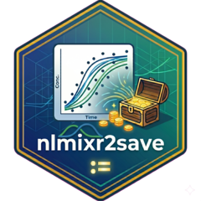
nlmixr2saveª - Persistent save and restore of nlmixr2 fit objects Matt Fidler
library(nlmixr2)
# install the development version of nlmixr2save from GitHub with:
remotes::install_github("nlmixr2/nlmixr2save")
library(nlmixr2save)
# Define model
...
# Build targets pipeline
mod1 <- suppressMessages(nlmixr(pheno, pheno_sd, est="saem",
control=list(print=0,
compress=FALSE)))
# Run — only re-fits if code/data changed
saveFit(mod1) # stores everything in a zip folder with the name as the model.
# automatically load a fit if the arguments for nlmixr2 do not change by using the := cached assignment operator introduced in this package
fitF := nlmixr(pheno, pheno_sd, est="saem",
control=list(print=0,
compress=FALSE)))
Smart Model Storage & Retrieval
Save nlmixr2^{b} fit objects in a compact, portable format that can be read outside R.
Model version saved should be independent of the version of rxode2^{c}and nlmixr2^{b}
Load models instantly without re-fitting
Preserves full fit metadata for downstream use
Automatic Caching: The := operator caches nlmixr2^{b} fits as R-independent zip files.
Use cases:
Share fitted models with collaborators
Archive models for regulatory documentation
Speed up iterative workflows — fit once, reload many times
Save/restore seed based on simulations
[a] https://nlmixr2.github.io/nlmixr2save/index.html
[b] https://nlmixr2.org/
[c} https://nlmixrdevelopment.github.io/RxODE/

Slide 5
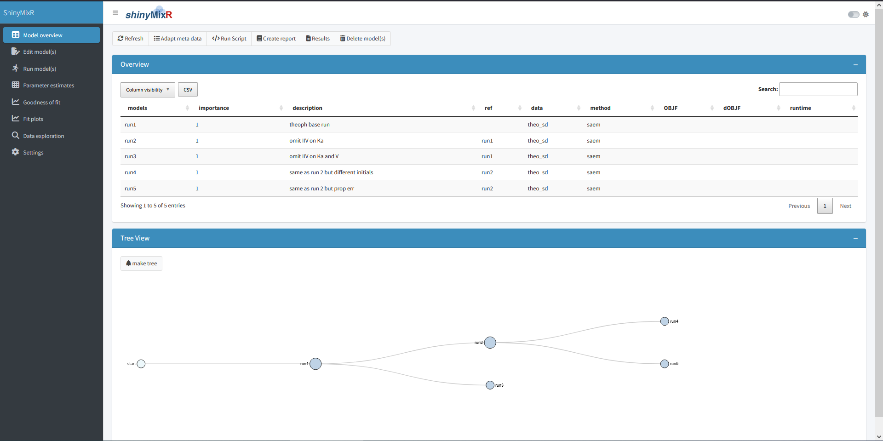
shinyMixRª - Interactive Shiny dashboard for project-centric nlmixr2 workflows Richard Hooijmaijers
Manage, edit, run, compare, analyse and report nlmixr2^{b} models from a GUI
Built-in GOF and fit plots via xpose.nlmixr2^{c} package (or ggplot2^{d})
The interface is created using the shiny ^{e} and shinydasboard^{f} packages
Project-centric structure: models / data / runs.
Model tree view to track model development lineage
Update initial estimates from previous model run
Export reports in PDF and HTML via R3port^{g}
[a] https://nlmixr2.github.io/nlmixr2
[b] https://github.com/nlmixr2/xpose.nlmixr2 and https://cran.r-project.org/packages/xpose.nlmixr2 [c] https://ggplot2.tidyverse.org/
[d] https://github.com/RichardHooijmaijers/shinyMixR and
https://richardhooijmaijers.github.io/shinyMixR/articles/shinyMixR-vignette.html [e] https://shiny.posit.co/
[f] https://rstudio.github.io/shinydashboard/
[g] https://cran.r-project.org/web/packages/R3port/index.htmland https://github.com/RichardHooijmaijers/R3port

Slide 6
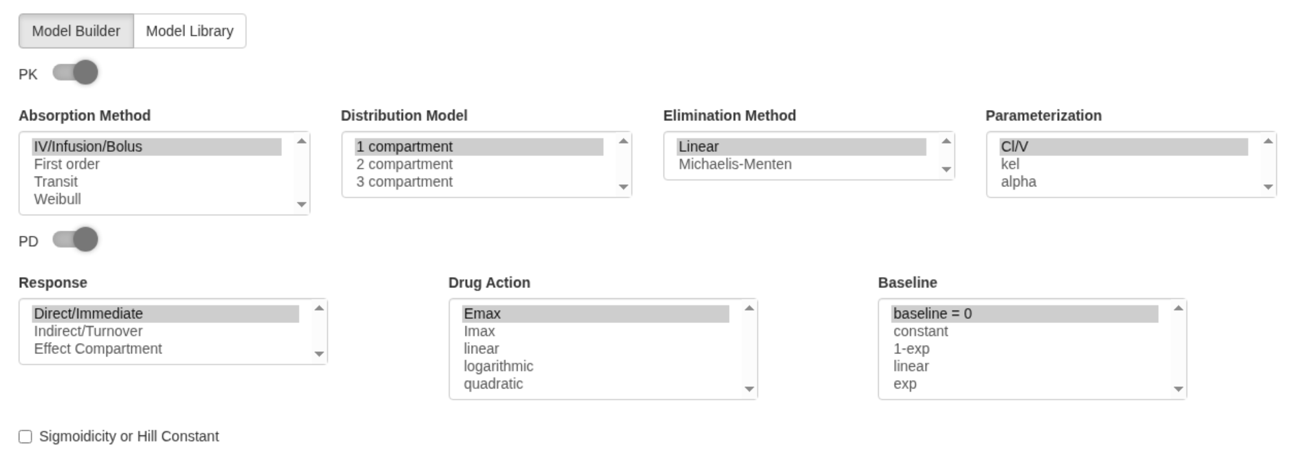
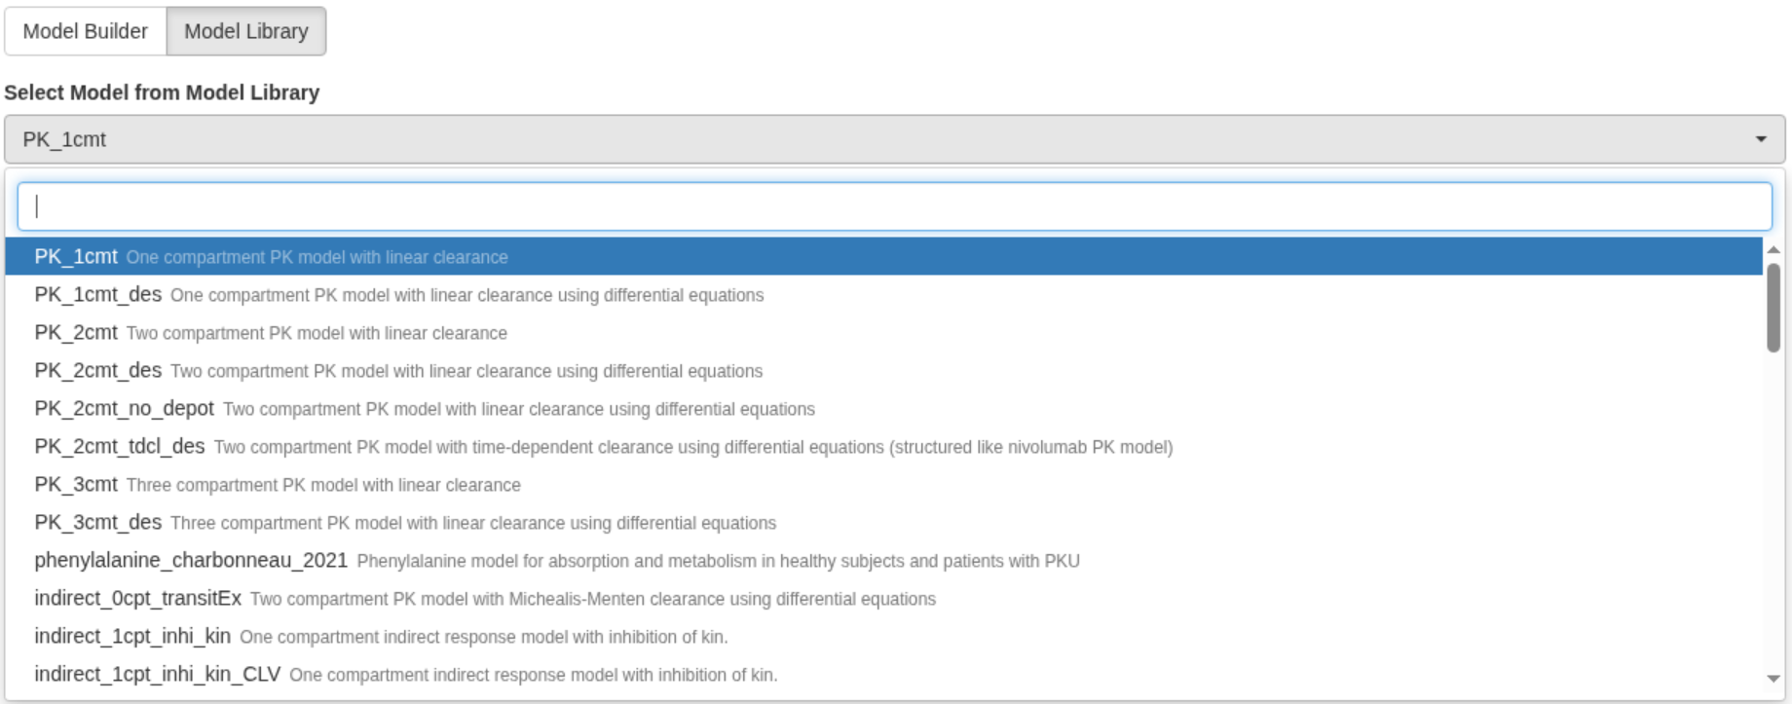
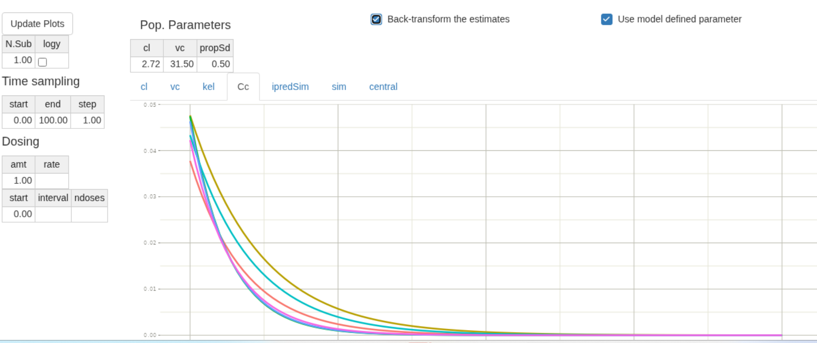
nlmixr2shinyª - Shiny UI for the nlmixr2lib model library Matt Fidler
Point-and-click interface to the nlmixr2lib^{b} library — no model code required.
Modular model builder for simple PK/PD models:
1-3 compartment models
Various absorption models: IV bolus / infusion, first order, Weibull and transit compartment models.
Simple link to PD with direct effect models, indirect effects models and effect compartment model.
Explore the nlmixr2lib^{b} library interactively
nlmixr2shinyª provides Shiny interface to the PK/PD/disease model library in nlmixr2lib^{b} — browse, configure, and launch models without writing model code from scratch.
Easy exploration of the impact of changing model parameters.
[a] https://github.com/nlmixr2/nlmixr2shiny
[b] https://nlmixr2.github.io/nlmixr2lib/ and https://cloud.r-project.org/web/packages/nlmixr2lib/index.html

Slide 7
Tool Comparison
Need
nlmixr2targets
nlmixr2save
shinyMixR
nlmixr2shiny
Avoid re-running unchanged models
✓✓
✓
—
—
Save/reload fit objects to disk
✓✓
✓✓
✓
—
Graphical User Interface
—
—
✓✓
✓✓
Full project/run management
✓
—
✓✓
—
Structured folder organisation
—
—
✓✓
—
Explore PK/PD model library
—
—
—
✓✓
Reproducible workflow
✓✓
✓
✓
—
Interactive model building
—
—
—
✓✓
✓✓ = primary use case ✓ = supported — = not the focus

