Slide 1
Automated Model Parameter Initialisation with nlmixr2autoinit
nlmixr2 Course PAGE 2026, Dubrovnik, Croatia
Zhonghui Huang

Slide 2
Outline
Introduction to nlmixr2autoinit
Hands-on : Integrating nlmixr2autoinit with nlmixr2 (Warfarin PK)
Introduction to nlmixr2auto

Slide 3
nlmixr2autoinit: initial estimate generation for nlmixr2
nlmixr2autoinit is an open-source R package for generating initial estimates for nlmixr models
Released on CRAN in November 2025 (v1.0.0)
Provides starting values for structural and random effect parameters
Applicable to diverse PK scenarios (iv, infusion, extravascular; single/repeated dose; rich/sparse sampling)
Part of the nlmixr2auto ecosystem for automated population pharmacokinetic model development
[a] CRAN: https://cran.r-project.org/package=nlmixr2autoinit
[b] GitHub: https://github.com/ucl-pharmacometrics/nlmixr2autoinit
[c] Huang Z et al. J Pharmacokinet Pharmacodyn (2025). https://doi.org/10.1007/s10928-025-10000-z
Introduction to nlmixr2autoinit
Running nlmixr2autoinit
Introduction to nlmixr2auto

Slide 4
Two main parts in a nlmixr model
Initial Estimates
Model Structure
Where does parameter estimation start?
How does the drug behave in the body?
ini({
model({
tcl <- log(???)
cl <- exp(tcl + eta.cl)
tv <- log(???)
v <- exp(tv + eta.v)
eta.cl ~ ???
ke <- cl / v
eta.v ~ ???
d/dt(A1) = -ke * A1
prop.err <- ???
cp = A1 / v
})
cp ~ prop(prop.err)
})
tcl, tv - typical clearance and volume on log scale
eta.cl, eta.v - inter-individual variability
prop.err - proportional residual error
cl, v - individual clearance and volume
d/dt(A1) – model differential equations
cp ~ prop(prop.err) - links predicted concentration to the error model
})
4
Introduction to nlmixr2autoinit
Running nlmixr2autoinit
Introduction to nlmixr2auto

Slide 5
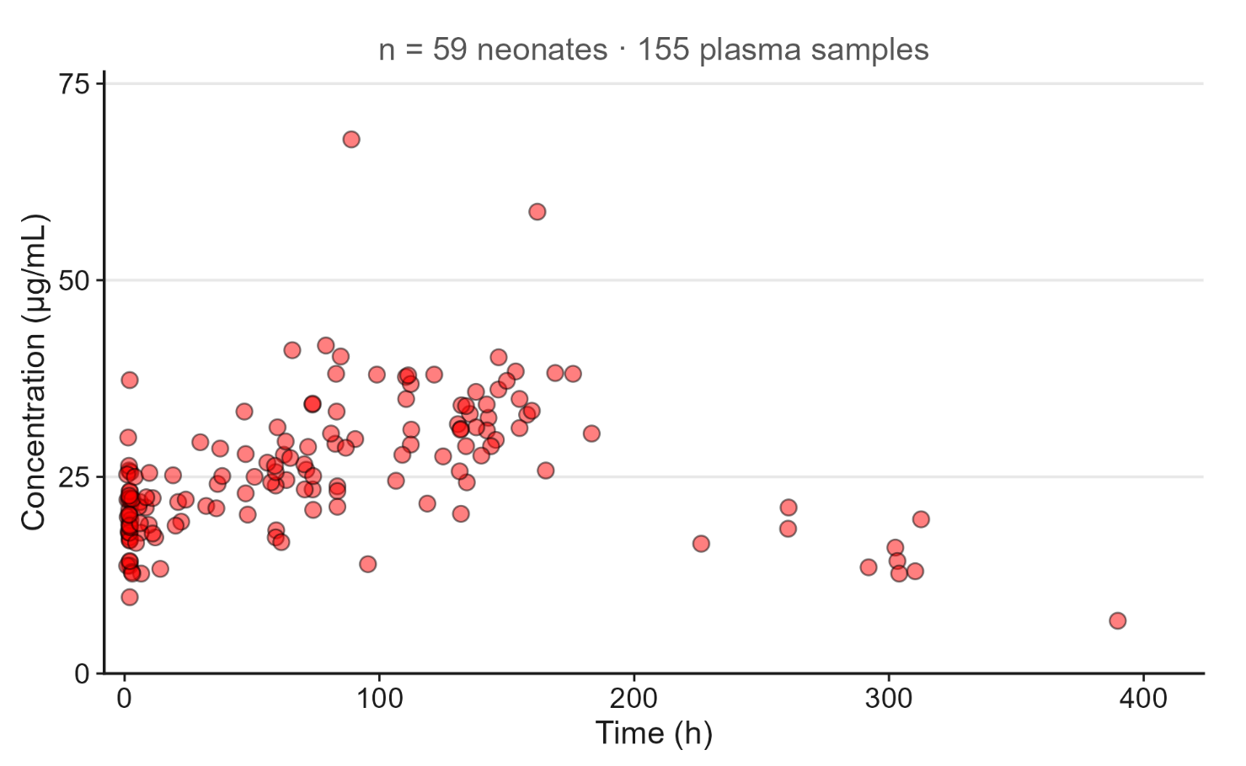
Imagine You Have Data Like This…
Example: Phenobarbitol (pheno_sd)
Repeated dosing
2–3 samples per subject
One sample available for a single dosing interval
Introduction to nlmixr2autoinit
Introduction to nlmixr2autoinit
Running nlmixr2autoinit
Introduction to nlmixr2auto

Slide 6
With Poor Initial Estimates…
one_cmt_iv <- function() {
⚠ Estimation Results
ini({
tcl <- log(1.1) # clearance
Parameter | Estimates | %RSE
tcl | 0.000479 | 6.49e+06
tv | 17 | 5.33e+06
eta.cl (CV%) | 1150% | —
eta.v (CV%) | 1.28e+37 | —
prop.err | 1.87e+06 | —
tv <- log(1.1) # volume
eta.cl ~ 0.1 # IIV on clearance
eta.v ~ 0.1 # IIV on volume
prop.err <- 0.1 # residual error
})
model({
cl <- exp(tcl + eta.cl)
v <- exp(tv + eta.v)
ke <- cl / v
d/dt(A1) = -ke * A1
cp = A1 / v
cp ~ prop(prop.err)
})
Estimation failed
}
fit <- nlmixr(pheno, pheno_sd, "saem", control = saemControl(seed=1234))
Introduction to nlmixr2autoinit
Running nlmixr2autoinit
Introduction to nlmixr2auto

Slide 7
This is where nlmixr2autoinit comes in
From data to initial estimates in one line
outs <- getPPKinits(dat = pheno_sd)
# | Parameter | Method | Value
1 | Ka | IV | NA
2 | CL | Adaptive single-point | 0.0087
3 | Vd | Adaptive single-point | 1.2500
4 | Vmax | Parameter sweeping | 1.0572
5 | Km | Parameter sweeping | 120.0145
6 | Vc (2CMT) | Parameter sweeping | 1.2500
7 | Vp (2CMT) | Parameter sweeping | 0.1250
8 | Q (2CMT) | Parameter sweeping | 0.0174
9 | Vc (3CMT) | Parameter sweeping | 1.2500
10 | Vp (3CMT) | Parameter sweeping | 0.1250
11 | Vp2 (3CMT) | Parameter sweeping | 0.1250
12 | Q (3CMT) | Parameter sweeping | 0.0174
13 | Q2 (3CMT) | Parameter sweeping | 0.0174
14 | Sigma additive | Fallback (fixed fraction) | 5.0434
15 | Sigma proportional | Fallback (fixed fraction) | 0.2000
pheno2 <- function() {
ini({
tcl <- log(0.0087) # CL
tv <- log(1.25) # Vd
eta.cl ~ 0.1
eta.v ~ 0.1
prop.err <- 0.2
})
model({
cl <- exp(tcl + eta.cl)
v <- exp(tv + eta.v)
ke <- cl / v
d/dt(A1) = -ke * A1
cp = A1 / v
cp ~ prop(prop.err)
})
}
Introduction to nlmixr2autoinit
Running nlmixr2autoinit
Introduction to nlmixr2auto

Slide 8
This is where nlmixr2autoinit comes in
⚠ Initial values = 1.1
✓ nlmixr2autoinit values
Parameter | Estimates | %RSE
tcl | 0.000479 | 6.49e+06
tv | 17 | 5.33e+06
eta.cl (CV%) | 1150% | —
eta.v (CV%) | 1.28e+37 | —
prop.err | 1.87e+06 | —
Parameter | Estimates | %RSE
tcl | 0.00559 | 1.52
tv | 1.42 | 17.1
eta.cl (CV%) | 41.1% | —
eta.v (CV%) | 46.6% | —
prop.err | 0.124 | —
Introduction to nlmixr2autoinit
Introduction to nlmixr2autoinit
Running nlmixr2autoinit
Introduction to nlmixr2auto

Slide 9
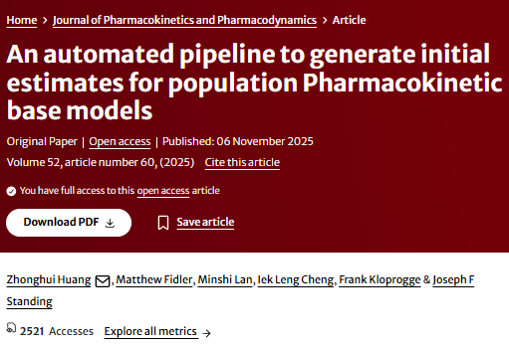
Data-driven methods included in nlmixr2autoinit
Method | Description | Estimated Parameters
Adaptive single-point | Calculates PK parameters from single concentration points per individual under first-dose or steady-state conditions | CL, V_{d}, K_{a}
Naïve pooled NCA | Performs NCA on pooled, dose-normalised concentration-time data from single-dose occasions | CL, V_{d}, K_{a}
Graphic methods | Applies log-linear regression on pooled, dose-normalised first-dose data | CL, V_{d}, K_{a}
Parameter sweeping | Systematically simulates candidate parameter combinations using individual-level data | V_{max}, K_{m}, V_{c}, V_{p}, V_{p2}, Q, Q₂
Data-driven RUV | Estimates residual variability via log-linear regression of terminal-phase data per subject | σ_{add}, σ_{prop}
Fallback (fixed fraction) | Applies empirical default values when data are insufficient for data-driven estimation | σ_{add}, σ_{prop}
Pragmatic fixed value | Assigns a fixed default value across all datasets | ω² = 0.1
CL clearance; V_{d} volume of distribution; K_{a} absorption rate constant; Vmax maximum elimination rate; K_{m} Michaelis constant; V_{c} central compartment volume; V_{p}/V_{p2} peripheral compartment volume(s); Q/Q₂ inter-compartmental clearance(s); σadd additive residual error; σ_{prop} proportional residual error; ω² variance of inter-individual variability.
Introduction to nlmixr2autoinit
Running nlmixr2autoinit
Introduction to nlmixr2auto
Notes:
Data-driven
Compatible with automated modeling tools

Slide 10

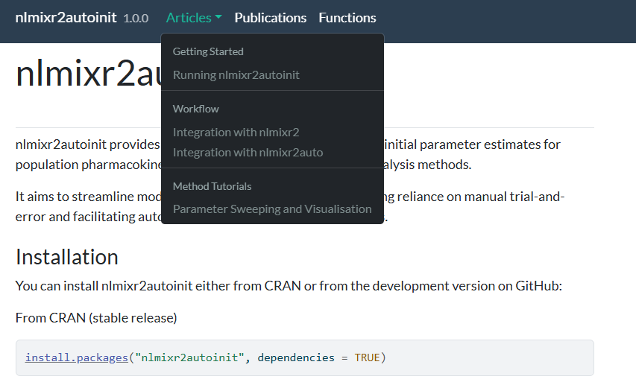
Nlmixr2autoinit tutorial
Introduction to nlmixr2autoinit
Running nlmixr2autoinit
Introduction to nlmixr2auto
Notes:
Data-driven
Compatible with automated modeling tools

Slide 11
Hands-On Time
Hands-on session: Integrating nlmixr2autoinit with nlmixr2
Open HandsOn_running_nlmixr2autoinit.R and examine the code, run the provided examples, and feel free to experiment with your own datasets.

Slide 12
Session Objectives
Explore nlmixr2autoinit using the warfarin dataset
Fit a one-compartment oral model, with initial estimates from nlmixr2autoinit
Apply the workflow to your own PK dataset (optional)
Setup
Install from CRAN (stable release)
install.packages("nlmixr2autoinit", dependencies = TRUE)
install.packages("nlmixr2auto", dependencies = TRUE)
Install the development version from GitHub
devtools::install_github("ucl-pharmacometrics/nlmixr2autoinit")
devtools::install_github("ucl-pharmacometrics/nlmixr2auto")
Introduction to nlmixr2autoinit
Running nlmixr2autoinit
Introduction to nlmixr2auto

Slide 13
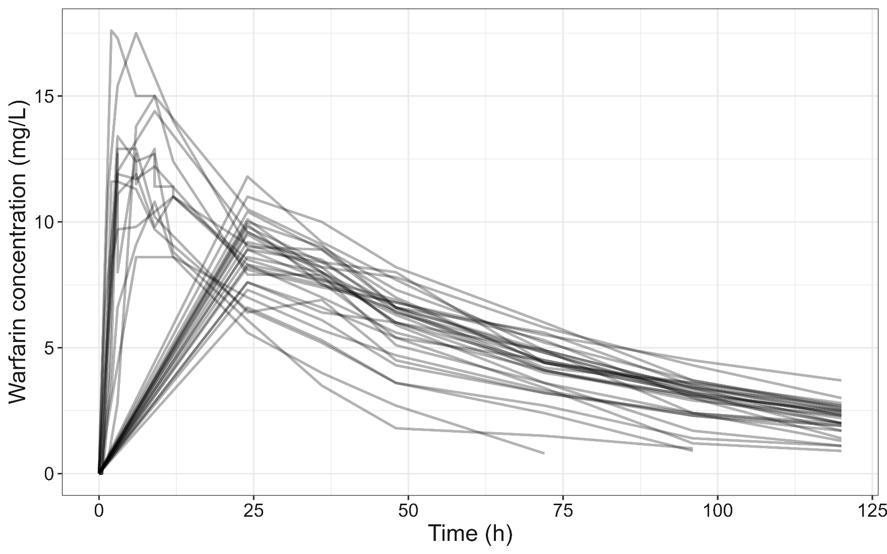
Warfarin Individual Concentration Profiles
32 subjects
Single-dose study
16 subjects: rich PK sampling on Day 1, from 0.5 to 72 hours 16 subjects: sampling from 24 to 120 hours
O’Reilly (1968). Studies on coumarin anticoagulant drugs. Initiation of warfarin therapy without a loading dose. Circulation 1968, 38:169-177.
O’Reilly (1963). Studies on coumarin anticoagulant drugs. The pharmacodynamics of warfarin in man. Journal of Clinical Investigation 1963, 42:10.
Introduction to nlmixr2autoinit
Running nlmixr2autoinit
Introduction to nlmixr2auto
Hands-on session I

Slide 14
Preparing the Warfarin Dataset
library(nlmixr2)
library(nlmixr2autoinit)
## Prepare warfarin PK data
warf_pk <- warfarin[warfarin$dvid == "cp", ]
colnames(warf_pk) <-toupper(colnames(warf_pk))
## cmt column: depot=1 (dose), central=2 (obs)
warf_pk$cmt <- 2
warf_pk[warf_pk$EVID == 1, ]$cmt <- 1
## Run getPPKinits()
inits_warf <- getPPKinits(dat = warf_pk)
## Explore outputs
inits_warf$Datainfo
inits_warf$Recommended_initial_estimates
cmt column required for oral data in nlmixr2autoinit:
depot = 1 for dose rows
central = 2 for obs rows
A single-line call to getPPKinits() is all it takes
Auto-detects dose route · sampling design
Introduction to nlmixr2autoinit
Running nlmixr2autoinit
Introduction to nlmixr2auto
Hands-on session I

Slide 15
Exploring nlmixr2autoinit Outputs
$Run.history records every method combination attempted and evaluated through the pipeline.
To access any component, use <outname>$Run.history$<component>
Component | Description
$base.out | Method combinations and performance metrics for base PK parameters (Kₐ, CL, V_{d})
$sim.2cmpt | Parameter sweep simulation results for 2-compartment parameters
$sim.3cmpt | Parameter sweep simulation results for 3-compartment parameters
$sim.vmax.km | Parameter sweep simulation results for V_{max} and K_{m}
$single.point.out | Results from adaptive single-point estimation methods
$nca.out | Results from NCA
$ka.wanger.nelson | Results from Wagner-Nelson method for Kₐ estimation
$graph.out | Results from graphic methods
$sigma.out | Results from residual variability calculation
Introduction to nlmixr2autoinit
Running nlmixr2autoinit
Introduction to nlmixr2auto

Slide 16
Fitting a 1-compartment oral model with nlmir2autoinit estimates
## B.1 Extract initial estimates
est <- inits_warf$Recommended_initial_estimates
Ka <- as.numeric(est$Values[est$Parameters == "Ka"])
CL <- as.numeric(est$Values[est$Parameters == "CL"])
Vd <- as.numeric(est$Values[est$Parameters == "Vd"])
## B.2 Define 1-cmt oral model
warf_1cmt <- function() {
ini({
lka <- log(Ka); lcl <- log(CL); lv <- log(Vd)
eta.ka ~ 0.1; eta.cl ~ 0.1; eta.v ~ 0.1
prop.err <- prop_err; add.err <- add_err
})
model({
ka <- exp(lka + eta.ka)
d/dt(depot) = -ka * depot
d/dt(central) = ka*depot - (cl/v)*central
})
}
## B.3 Fit with SAEM
run001 <- nlmixr2(warf_1cmt, warf_pk, est = "saem",
control = saemControl(nBurn=200, nEm=300, logLik=TRUE),
table = tableControl(cwres = TRUE))
Initial values pulled directly from nlmixr2autoinit - no manual guessing required
IIV variances fixed at 0.1 as starting values
nlmixr2autoinit supplies lka, lcl, lv, prop_err
Default settings: nBurn = 200 · nEm = 300
logLik = TRUE for AIC/BIC/OFV
Introduction to nlmixr2autoinit
Running nlmixr2autoinit
Introduction to nlmixr2auto

Slide 17
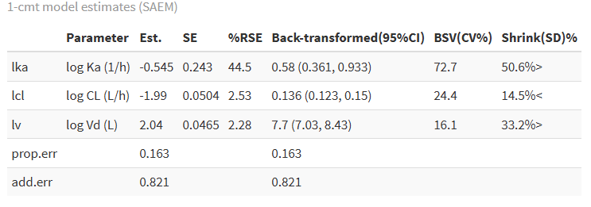
Using nlmixr2autoinit Initial Estimates in nlmixr2
# | Parameter | Method | Value
1 | Ka | Naive pooled NCA (FD) | 0.7280
2 | CL | Naive pooled NCA (FD) | 0.1350
3 | Vd | Naive pooled NCA (FD) | 7.4100
4 | Vmax | Parameter sweeping | 5.5536
5 | Km | Parameter sweeping | 42.5200
6 | Vc (2CMT) | Parameter sweeping | 7.0991
7 | Vp (2CMT) | Parameter sweeping | 1.4198
8 | Q (2CMT) | Parameter sweeping | 0.2700
9 | Vc (3CMT) | Parameter sweeping | 7.0991
10 | Vp (3CMT) | Parameter sweeping | 0.7099
11 | Vp2 (3CMT) | Parameter sweeping | 0.7099
12 | Q (3CMT) | Parameter sweeping | 0.1350
13 | Q2 (3CMT) | Parameter sweeping | 0.1350
14 | Sigma additive | Model-based | 0.1525
15 | Sigma proportional | Model-based | 0.0549
Run nlmixr2 for parameter estimation
Introduction to nlmixr2autoinit
Running nlmixr2autoinit
Introduction to nlmixr2auto

Slide 18
Automated Model building and selection with nlmixr2auto
nlmixr2 Course PAGE 2026, Dubrovnik, Croatia
Zhonghui Huang

Slide 19
nlmixr2auto: automated PopPK modelling for nlmixr2
nlmixr2auto is an open-source R package for automated population pharmacokinetic model (PopPK) development within the nlmixr2 ecosystem
Released on CRAN in February 2026 (v1.0.0)
Enables end-to-end PopPK model development with minimal user intervention
Integrates data-driven initialisation, model fitting, evaluation, and automated model selection
Supports multiple optimisation strategies, including genetic algorithms, ant colony optimisation, tabu search, and stepwise algorithms
[a] CRAN: https://CRAN.R-project.org/package=nlmixr2auto
[b] GitHub: https://github.com/ucl-pharmacometrics/nlmixr2auto
[c] PAGE 32 (2024) Abstr 11272 [www.page-meeting.org/?abstract=11272]
[d] PAGE 34 (2026) Abstr 12080 [www.page-meeting.org/?abstract=12080]
Introduction to nlmixr2autoinit
Hands-on
Introduction to nlmixr2auto
Hands-on session I

Slide 20
Basic example
Choose your search algorithm Change sf.operator() to ga.operator(), aco.operator(), or tabu.operator() to switch between stepwise, GA, ACO, and tabu search strategies.
Customised initial estimates param_table() allows users to supply their own starting values for any parameter. When set to NULL, nlmixr2autoinit generates data-driven estimates.
outs <- sf.operator(
outs <- sf.operator(
dat = pheno_sd,
dat = pheno_sd,
param_table = NULL,
param_table = NULL,
search.space = "ivbase",
search.space = "ivbase",
Define search space
search.space defines the scope of model components to be searched: ivbase (compartments, elimination type, IIV on Km/V_{c}/V_{p}/V_{p2}/Q/Q₂, correlations, error model) or oralbase which further adds IIV on K_{a}.
filename = "pheno_sd",
foldername = "pheno_sd",
Control search algorithms Users can customise which model components are searched and the order in which they are tested via steps, where each digit maps to a component: 1 = compartments, 2 = elimination type, 3 = IIV on K_{m}, 4 = IIV on K_{a}, 5 = structural IIV, 6 = correlations, 7 = error model.
filename = "pheno_sd",
foldername = "pheno_sd",
steps = 1234567,
steps = 1234567,
penalty.control = penaltyControl(),
penalty.control = penaltyControl(),
saem.control = saemControl(nBurn = 200, nEm = 300, rxControl(cores = 4), logLik = TRUE),
saem.control = saemControl(nBurn = 200, nEm = 300, rxControl(cores = 4), logLik = TRUE),
Customisable fitness function Six penalty terms are available, including relative standard error (RSE), shrinkage, inter-individual variability (omega), residual error (sigma), correlation, and covariance penalties.
table.control = tableControl(cwres = TRUE),
table.control = tableControl(cwres = TRUE),
max_wall_time = 2 * 60 * 60 )
Flexible SAEM estimation saemControl() allows users to tune burn-in, EM phases of nlmixr2 and other settings available.
max_wall_time = 2 * 60 * 60 )
)
Safe, scalable automation A per-model time budget prevents any single model from blocking the search.
)
Introduction to nlmixr2autoinit
Hands-on
Introduction to nlmixr2auto
Hands-on session I

Slide 21
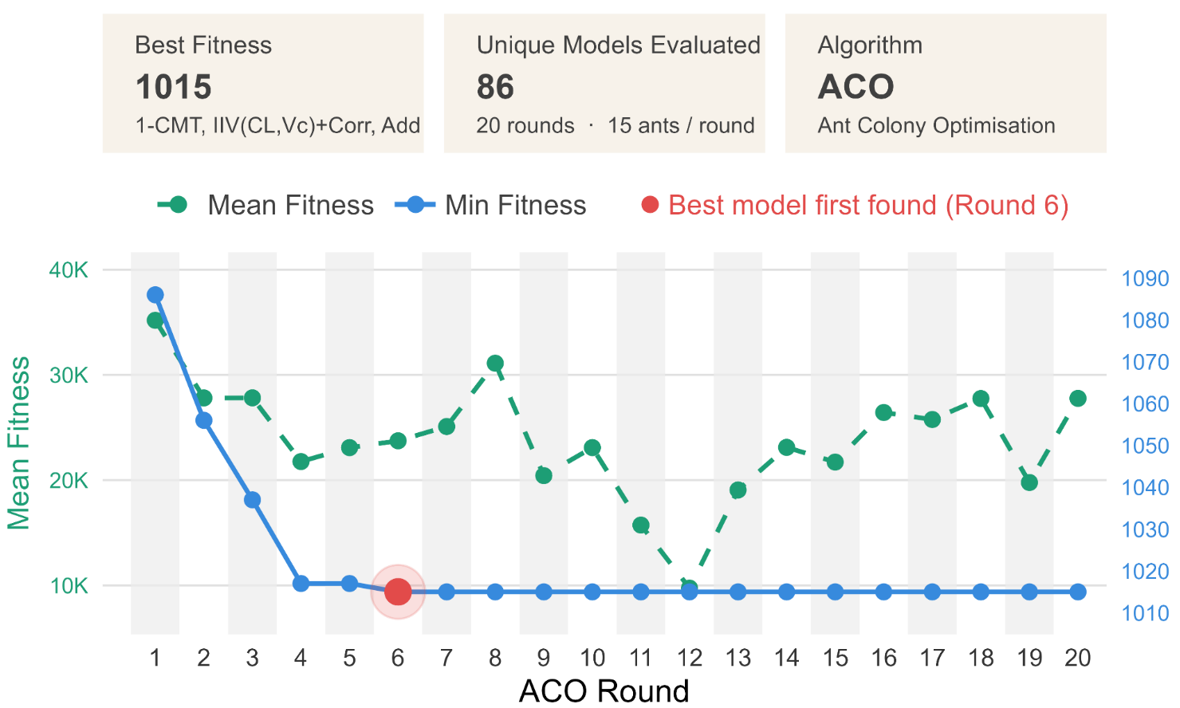
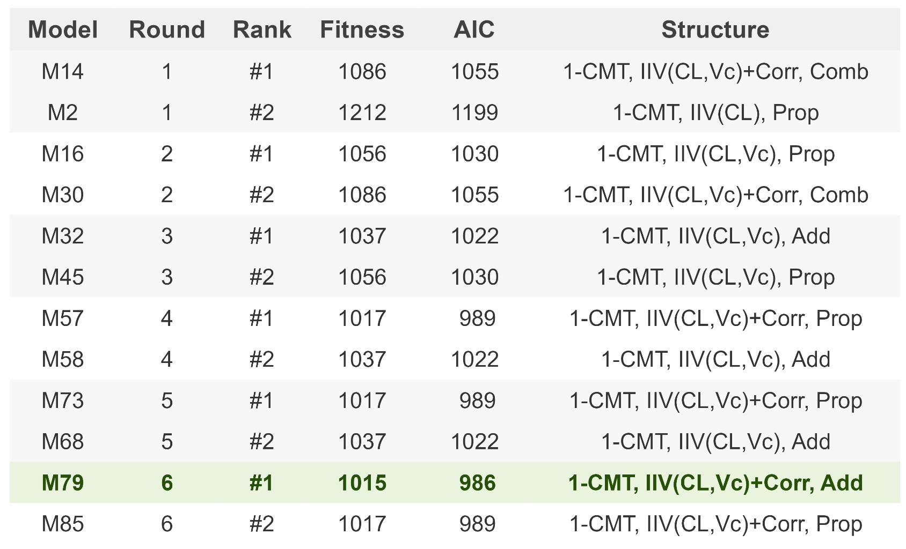
Example outputs
PAGE 34 (2026) Abstr 12080 [www.page-meeting.org/?abstract=12080]
Introduction to nlmixr2autoinit
Hands-on
Introduction to nlmixr2auto
Hands-on session I
nlmixr² development team

Slide 22
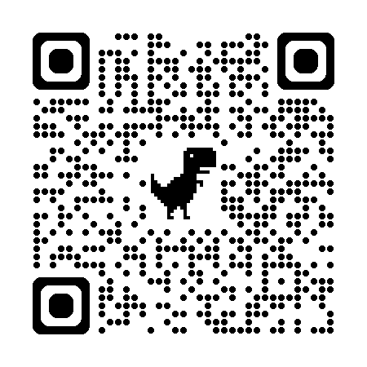
Github
Introduction to nlmixr2autoinit
Hands-on
Introduction to nlmixr2auto
Hands-on session I
nlmixr² development team

