Slide 1

ggPMX speaks NONMEM
Seid Hamzic, Irina Baltcheva & Bruno Bieth
October 2020

Slide 2
ggPMX is now fully compatible with Monolix, NONMEM and nlmixr!
NONMEM-users can now also benefit from ggPMX features!
ggPMX is the first open-source tool to include Monolix, NONMEM and nlmixr!
Monolix
(2016, 2018, 2019)
NONMEM
nlmixr

Slide 3
Features of the NONMEM-reader
Features
Automatic recognition of table files: sdtab, patab, cotab, catab by run-number or .lst file
Automatic recognition of covariates: (if user adheres to the naming convention, sdtab, patab, cotab, catab)
Variable | ggPMX | NONMEM | Other
Dependent variable | DV | DV | e.g. Y, LNDV
Time | TIME | TIME | e.g. TIM2, TIM3
Dependent variable identifier | DVID | DVID | e.g. CMT, YTYPE
Population prediction | PRED | PRED | e.g. EPRED, CPRED, NPRED
Individual population prediction | IPRED | IPRED, CIPRED, CIPREDI | N/A
Individual weighted residuals | IWRES | IWRES, CIWRES, CIWRESI | N/A
Normalized population predictor | NPDE | NPD, NPDE | N/A
Notes:
NONMEM users are potentially already used to xpose, and the reader behaves similary. For you who uses xpose.
The NONMEM-reader handles the automatic recognition of tables with the standard sdtab, patab, cotab,catab convention.
The user can specifiy the run-number or the .lst file and it will detect the tables automatically. The benefit of sticking to naming convention is, that it will autmoatically recognize covariates,
however , individual import is also possible. And include covariates manually.
Very flexible.
*show table*
It is important to mention ggPMX follows a certain naming convetion, for the variables and NONMEM allows flexible naming on some of these variables, here just showing some of the possibilities.
We recommend to stick to the ggPMX convention, however the reader can automatically handle different ways of inputs, or if not, manual specification of these variables is possible.
As for the other fitting softwares,, the ggPMX controller generation is extermly simple.

Slide 4
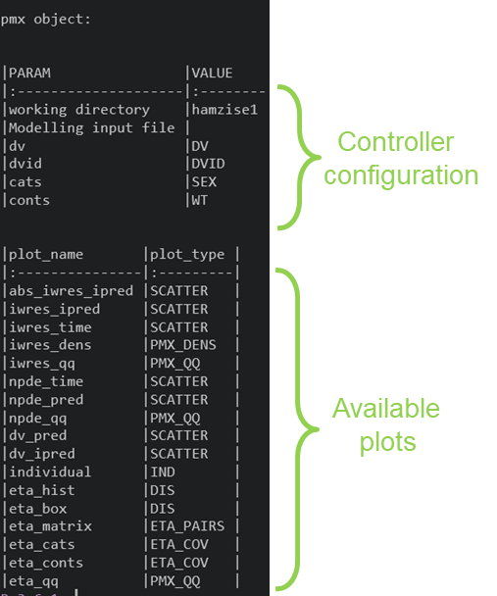
ggPMX speaks NONMEM
# Controller Creation
ctr <- pmx_nm(directory = nonmem_dir_path,
file = “my_nonmem_run.lst")
# Report Generation
ctr %>% pmx_report(name = "ggPMX_Report",
save_dir = "working_directory")
Notes:
Here you see the easiest and best way on how to use the ggPMX NONMEM-reader to generate a ggPMX-report.
The workflow is the same as for monolix and nlmixr data, first the user has to generate the controller .
The pmx_nm() function is used to read NONMEM-tables and to generate the controller (ctr). This is the function we added in.
The user has only to specifiy directory and the .lst file and the reader will look up and read in the tables.
→ on the right hand site you see the controller, contains data, available plots, names of covariates and more.
A report containg the most important plots, can be generated quickly, by using the pmx_report function. Different outputs are possible (pdf, word or html)
Now i’ll show you how exactly this report can look like:

Slide 5
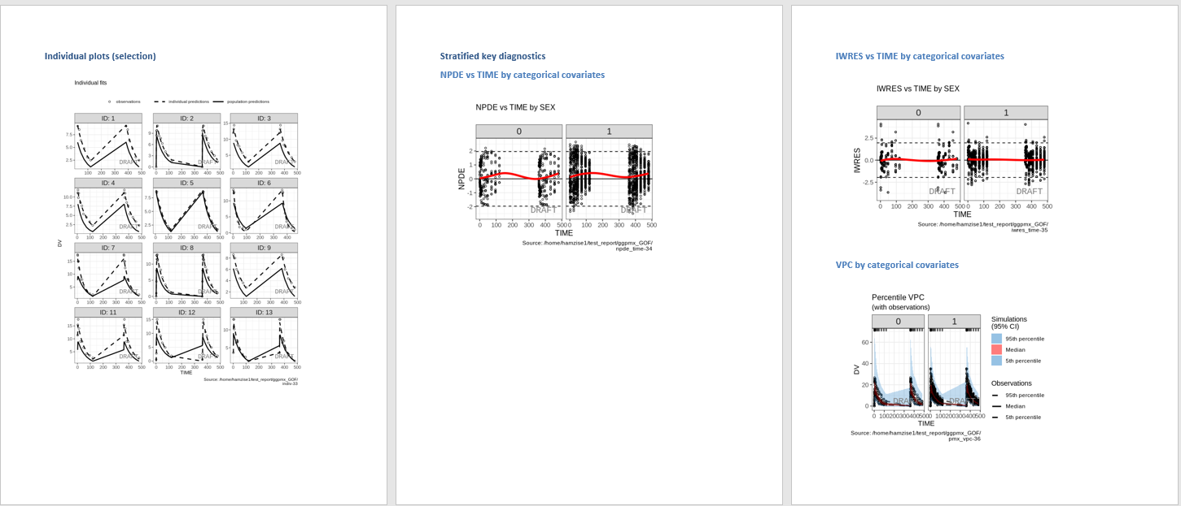
The ggPMX-Report
Notes:
Open a report. HTML report.

Slide 6
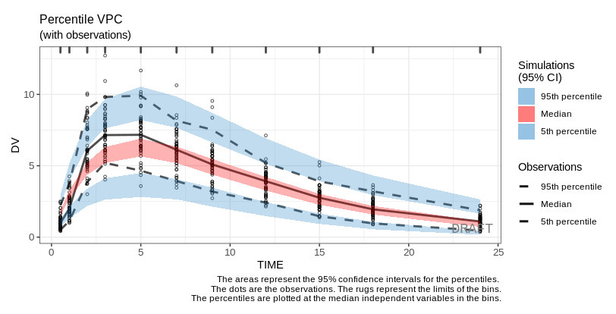
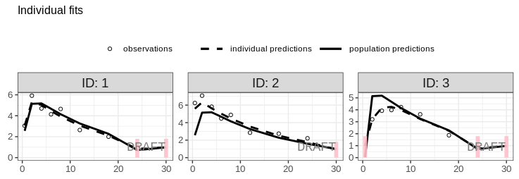
The NONMEM-reader fully implemented with all ggPMX features
BLOQ
VPC
# Controller Creation with BLQ
ctr <- pmx_nm(directory = nonmem_dir,
file = “my_nonmem_run.lst",
bloq = pmx_bloq(cens = “BLQ”,
limit = “LLOQX”))
ctr %>% pmx_plot_individual()
# Controller Creation with VPC
ctr <- pmx_nm(directory = nonmem_dir,
file = "my_nonmem_run.lst",
simfile = “simulation.ctl")
ctr %>% pmx_plot_vpc()
Notes:
Here just some more advanced plots possible with ggPMX, example BLOQ, or VPC

Slide 7
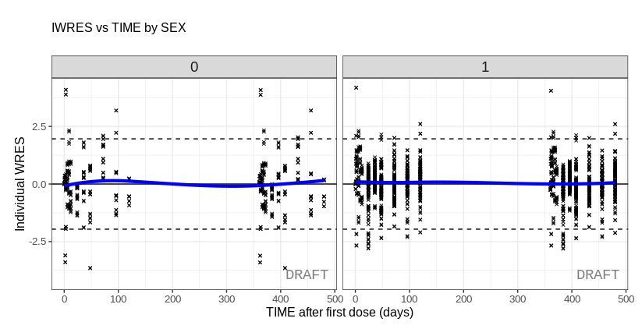
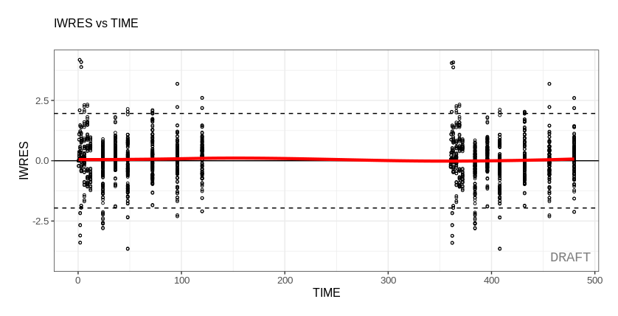
All Diagnostic plots can be customized
Default Setting
Customized Setting
ctr %>% pmx_plot_iwres_time()
ctr %>% pmx_plot_iwres_time(
smooth = list(color = "blue"),
point = list(shape = 4),
is.draft = TRUE,
labels = list(x = "TIME after first dose (days)"),
y = “Individual WRES“,strat.facet = "SEX“)
Notes:
Here an example of customizable plots and stratification, very customizable. These is more you can do, unfortunately I cannot show everything here.

Slide 8
BACK UP SLIDES

Slide 9

Using the run number (runno)
# Controller Creation
ctr <- pmx_nm(directory = nonmem_dir_path,
runno = 1)
# Report Generation
ctr %>% pmx_report(name = "ggPMX_Report",
save_dir = "working_directory")
Side note: sdtab is needed to specifiy covariates automatically (cotab/catab are not enough)

Slide 10


More complex naming of NONMEM table output – back up
# Controller Creation
ctr <- pmx_nm(directory = nonmem_dir_path,
runno = “_exp1” ,
table_suffix = “.nmtab”)
# Controller Creation
ctr <- pmx_nm(directory = nonmem_dir_path,
table_names = “contains_everything.tab” ,
cats = “SEX”,
conts = “WT”)

Slide 11

Controller generation with custom naming of variables - backup
Variable | pmx_nm() | ggPMX
Dependent variable | dv | DV
Time | time | TIME
Dependent variable identifier | dvid | DVID
Population prediction | pred | PRED
Individual population prediction | ipred | IPRED
Individual weighted residuals | iwres | IWRES
Normalized population predictor | npde | NPDE
# Controller Creation with a second time point
ctr <- pmx_nm(directory = nonmem_dir_path,
table_names = “contains_everything.tab”,
cats = “SEX”,
conts = “WT”,
time = “TIM2”,
pred = “EPRED”)

Slide 12
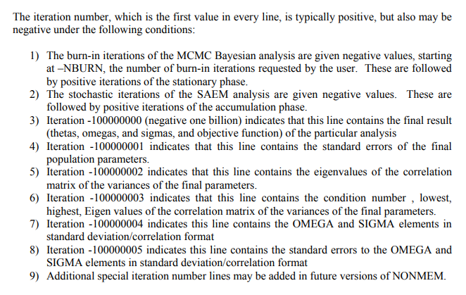
Parameter estimates from .ext file
...
...
...
...
...
...
...
...
...
...
...
...
...
...

Slide 13
Multiple problems resulting in multiple tables within the .ext file

Slide 14


Categorical and Continous variables
With cotab/catab and sdtab tables
With cotab/catab but no sdtab table
With sdtab but no cotab/catab tables

