Slide 1

Tutorial Session 1a: Using Past Models to Bridge to Open Models and Open Science Using nlmixr2
Chairs: Matthew L. Fidler and William S. Denney
Matthew Fidler | Basics of nlmixr2/rxode2 Model Syntax
William Denney | How to import NONMEM and Monolix Models into the nlmixr2/rxode2 Model Function using nonmem2rx and monolix2rx
Mirjam Trame | Simulate New Dosing Scenarios using RxODE2
Theodoros Papathanasiou | Re-estimate New Data Using nlmixr2
Justin Wilkins | Individualize Dosing Using posologyr
Phoenix, AZ November 10 – 13, 2024

Slide 2

Please ensure that you have all packages installed and course materials downloaded
https://github.com/nlmixr2/courses/tree/main/ACoP2024

Slide 3

Basics of nlmixr2/rxode2 Model Syntax
Matthew L. Fidler, M.Stat., Ph.D.
Director, Pharmacometrics
Novartis
Phoenix, AZ November 10 - 13, 2024

Slide 4
How to import NONMEM and Monolix Models into the nlmixr2/rxode2 Model Function using nonmem2rx and monolix2rx
William S. Denney, Ph.D.
Chief Scientist
Human Predictions
Phoenix, AZ November 10 - 13, 2024

Slide 5

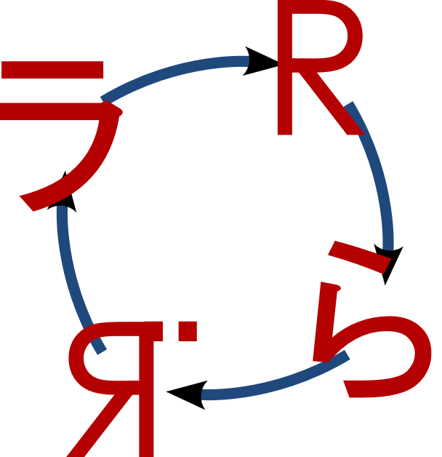
Hands-on for importing NONMEM models into nlmixr2/rxode2 (nonmem2rx)
Please load “nonmem2rx_example.R”
nonmem2rx and monolix2rx
Loads existing models from NONMEM or Monolix
Validates model loading
Rerun the model using the population and individual parameters.
Does rxode2/nlmixr2 get the same answer as the original model?
nonmem2rx and monolix2rx can
Enable easy simulation of that model
Enable easy reporting of that model
Enable easy reproduction of that model in different software

Slide 6
Simulate New Dosing Scenarios using rxode2
Mirjam N. Trame, Pharm.D., Ph.D.
VP, Pharmacometrics
Certara Drug Development Solutions
Phoenix, AZ November 10 - 13, 2024

Slide 7

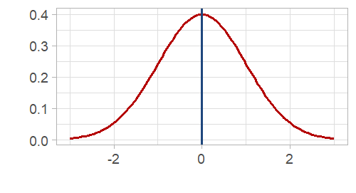
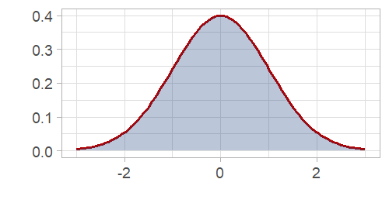
simulating from a nlmixr model
multi-subject
Without uncertainty
With uncertainty

Slide 8
Excursion to RxODE

Slide 9



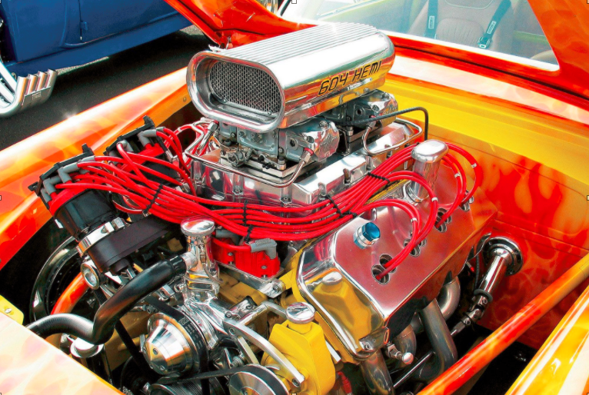
RxODE is the ODE solving engine that powers the estimation methods of nlmixr
Solve ODEs
Estimate Parameters
What do I need to know about RxODE?
What in RxODE is used by nlmixr?
What in RxODE is output by nlmixr?

Slide 10
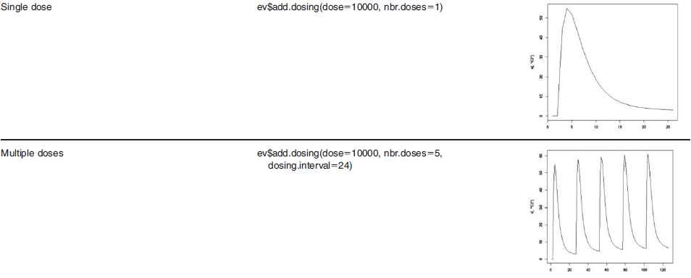
Specify a variety of dosing schedules using the add.dosing() function
Wang W. et al. A Tutorial on RxODE: Simulating Differential Equation Pharmacometric Models in R. CPT:PSP (2016)5,3-10

Slide 11

Creating an eventTable with add.sampling(), add.dosing()
add.sampling = function( | Sampling Times )
add.dosing = function(
dose, | # dose amount
nbr.doses, | # number of doses
dosing.interval=24, | # dosing interval
dosing.to=1, | # where to dose
rate=NULL, | # infusion rate
start.time=0 | # dosing start time
)
add.dosing() can be called incrementally multiple times
ev <- eventTable(amount.units="mg", time.units="hours") %>%
add.dosing(dose=10000, nbr.doses=10, dosing.interval=12) %>%
add.dosing(dose=20000, nbr.doses=5,
start.time=120,dosing.interval=24) %>%
add.sampling(0:240);

Slide 12
Back to Simulating with nlmixr2

Slide 13
Simulating using nlmixr Simulate a new regimen (BID) – No Parameter Uncertainty
Load nlmixr | library(nlmixr)
Specify ODE models | model({ C2 = centr/V2; d/dt(depot) =-KA*depot; d/dt(centr) = KA*depot - CL*C2; })
Specify Dosing & Sampling | ev <- eventTable()# For nlmixr & RxODE simulations ev$add.dosing(dose=4.7,nbr.doses=2,dosing.interval=12) #assume BID ev$add.sampling(seq(0,24,length.out=51))
Simulate Events | n <- 300 bid <- simulate(fit, events=ev, nSub=n*n)
Solved RxODE Object
Simulation Output: sim.id, time, ipred, sim
nlmixr Object

Slide 14
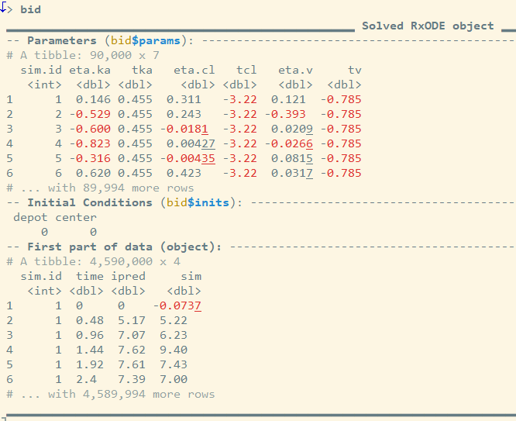
Simulation Output The simulation has information about the parameters that were used in the simulation from the model fit (= Solved RxODE object)
Constant Population Parameters
> summary(bid$params)
sim.id eta.ka tka eta.cl
Min. : 1 Min. :-2.9624044 Min. :0.4546 Min. :-1.2343951
1st Qu.:22501 1st Qu.:-0.4482224 1st Qu.:0.4546 1st Qu.:-0.1794427
Median :45001 Median :-0.0005998 Median :0.4546 Median : 0.0010281
Mean :45001 Mean :-0.0018905 Mean :0.4546 Mean : 0.0005723
3rd Qu.:67500 3rd Qu.: 0.4434868 3rd Qu.:0.4546 3rd Qu.: 0.1824282
Max. :90000 Max. : 2.7591093 Max. :0.4546 Max. : 1.1282721
tcl eta.v tv
Min. :-3.215 Min. :-0.5714017 Min. :-0.7848
1st Qu.:-3.215 1st Qu.:-0.0895164 1st Qu.:-0.7848
Median :-3.215 Median : 0.0009726 Median :-0.7848
Mean :-3.215 Mean : 0.0008345 Mean :-0.7848
3rd Qu.:-3.215 3rd Qu.: 0.0919098 3rd Qu.:-0.7848
Max. :-3.215 Max. : 0.5585632 Max. :-0.7848

Slide 15
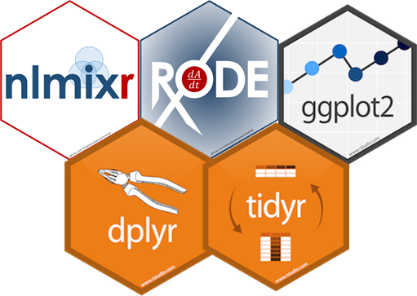
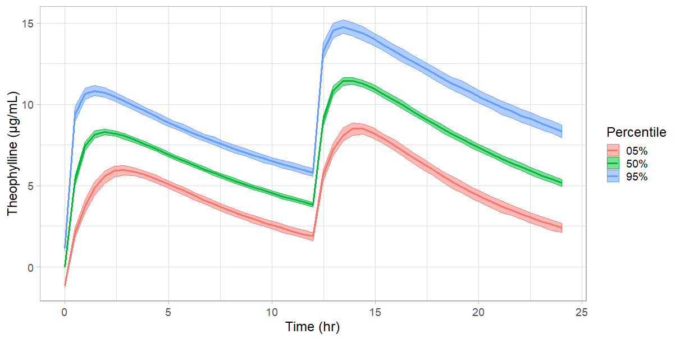
Simulate a new regimen (BID) – No Parameter Uncertainty
→ Simulation Plot
plot(bid) +
ylab("Theophylline (\u03BCg/mL)")+
xlab("Time (hr)")+
theme_light(base_size=18)

Slide 16
Simulating using nlmixr2 Simulate a new regimen (BID) – With Parameter Uncertainty → add one additional parameter “nStud”
Load nlmixr | library(nlmixr2)
Specify ODE models | model({ C2 = centr/V2; d/dt(depot) =-KA*depot; d/dt(centr) = KA*depot - CL*C2; })
Specify Dosing & Sampling | ev <- eventTable()# For nlmixr & RxODE simulations ev$add.dosing(dose=4.7,nbr.doses=2,dosing.interval=12) #assume BID ev$add.sampling(seq(0,24,length.out=51))
Simulate Events | n <- 300 bid <- simulate(fit, events=ev, nSub=n, nStud=n)
Solved RxODE Object
nStud = # of “Studies” sampled
nSub = # subjects per study
nlmixr Object
Simulation Output: sim.id, time, ipred, sim
https://nlmixrdevelopment.github.io/RxODE/articles/RxODE-event-table.html

Slide 17
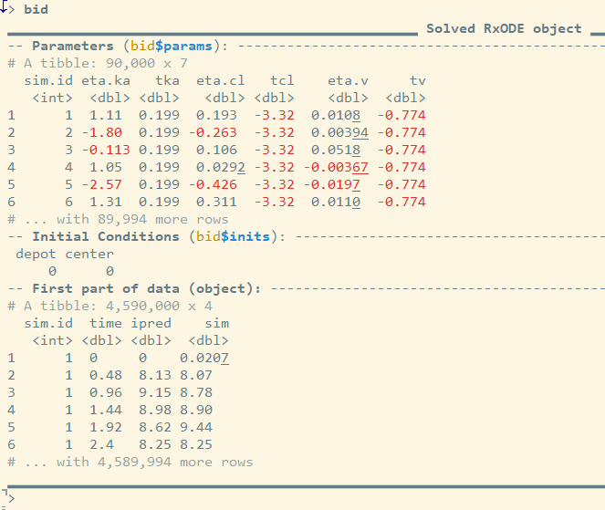
Simulation Output The simulation has information about the parameters that were used in the simulation from the model fit (= Solved RxODE object)
Changing Population Parameters
> summary(bid$params)
sim.id eta.ka tka eta.cl
Min. : 1 Min. :-5.910739 Min. :-0.09778 Min. :-1.3511807
1st Qu.:22501 1st Qu.:-0.363984 1st Qu.: 0.30723 1st Qu.:-0.0734019
Median :45001 Median : 0.001011 Median : 0.45434 Median :-0.0004093
Mean :45001 Mean : 0.001559 Mean : 0.43990 Mean :-0.0007771
3rd Qu.:67500 3rd Qu.: 0.364199 3rd Qu.: 0.56614 3rd Qu.: 0.0724550
Max. :90000 Max. : 6.003083 Max. : 0.94869 Max. : 1.7316982
tcl eta.v tv
Min. :-3.435 Min. :-1.0236210 Min. :-0.9172
1st Qu.:-3.263 1st Qu.:-0.0250715 1st Qu.:-0.8122
Median :-3.213 Median :-0.0000393 Median :-0.7860
Mean :-3.212 Mean : 0.0000356 Mean :-0.7848
3rd Qu.:-3.160 3rd Qu.: 0.0252582 3rd Qu.:-0.7530
Max. :-2.954 Max. : 0.8727193 Max. :-0.6597

Slide 18
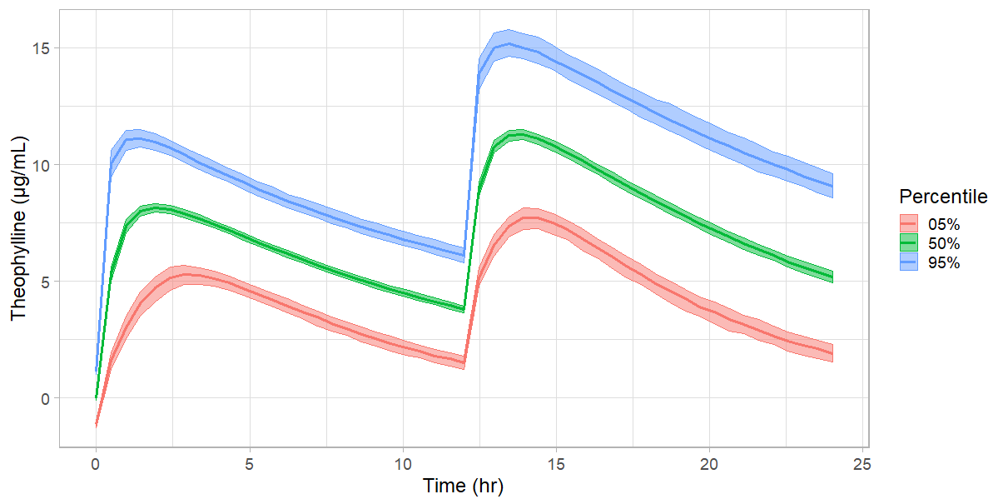
Simulate a new regimen (BID) – With Parameter Uncertainty → Simulation Plot
Higher Absorption Uncertainty
plot(bid) +
ylab("Theophylline (\u03BCg/mL)")+
xlab("Time (hr)")+
theme_light(base_size=18)

Slide 19
Re-estimate New Data Using nlmixr2
Theodoros Papathanasiou, Ph.D.
Associate Director, Pharmacometrics
GSK
Phoenix, AZ November 10 - 13, 2024

Slide 20
Individualize Dosing Using posologyr
Justin Wilkins, Ph.D.
Owner and Senior Consultant
Occams
Phoenix, AZ November 10 - 13, 2024

