Slide 1
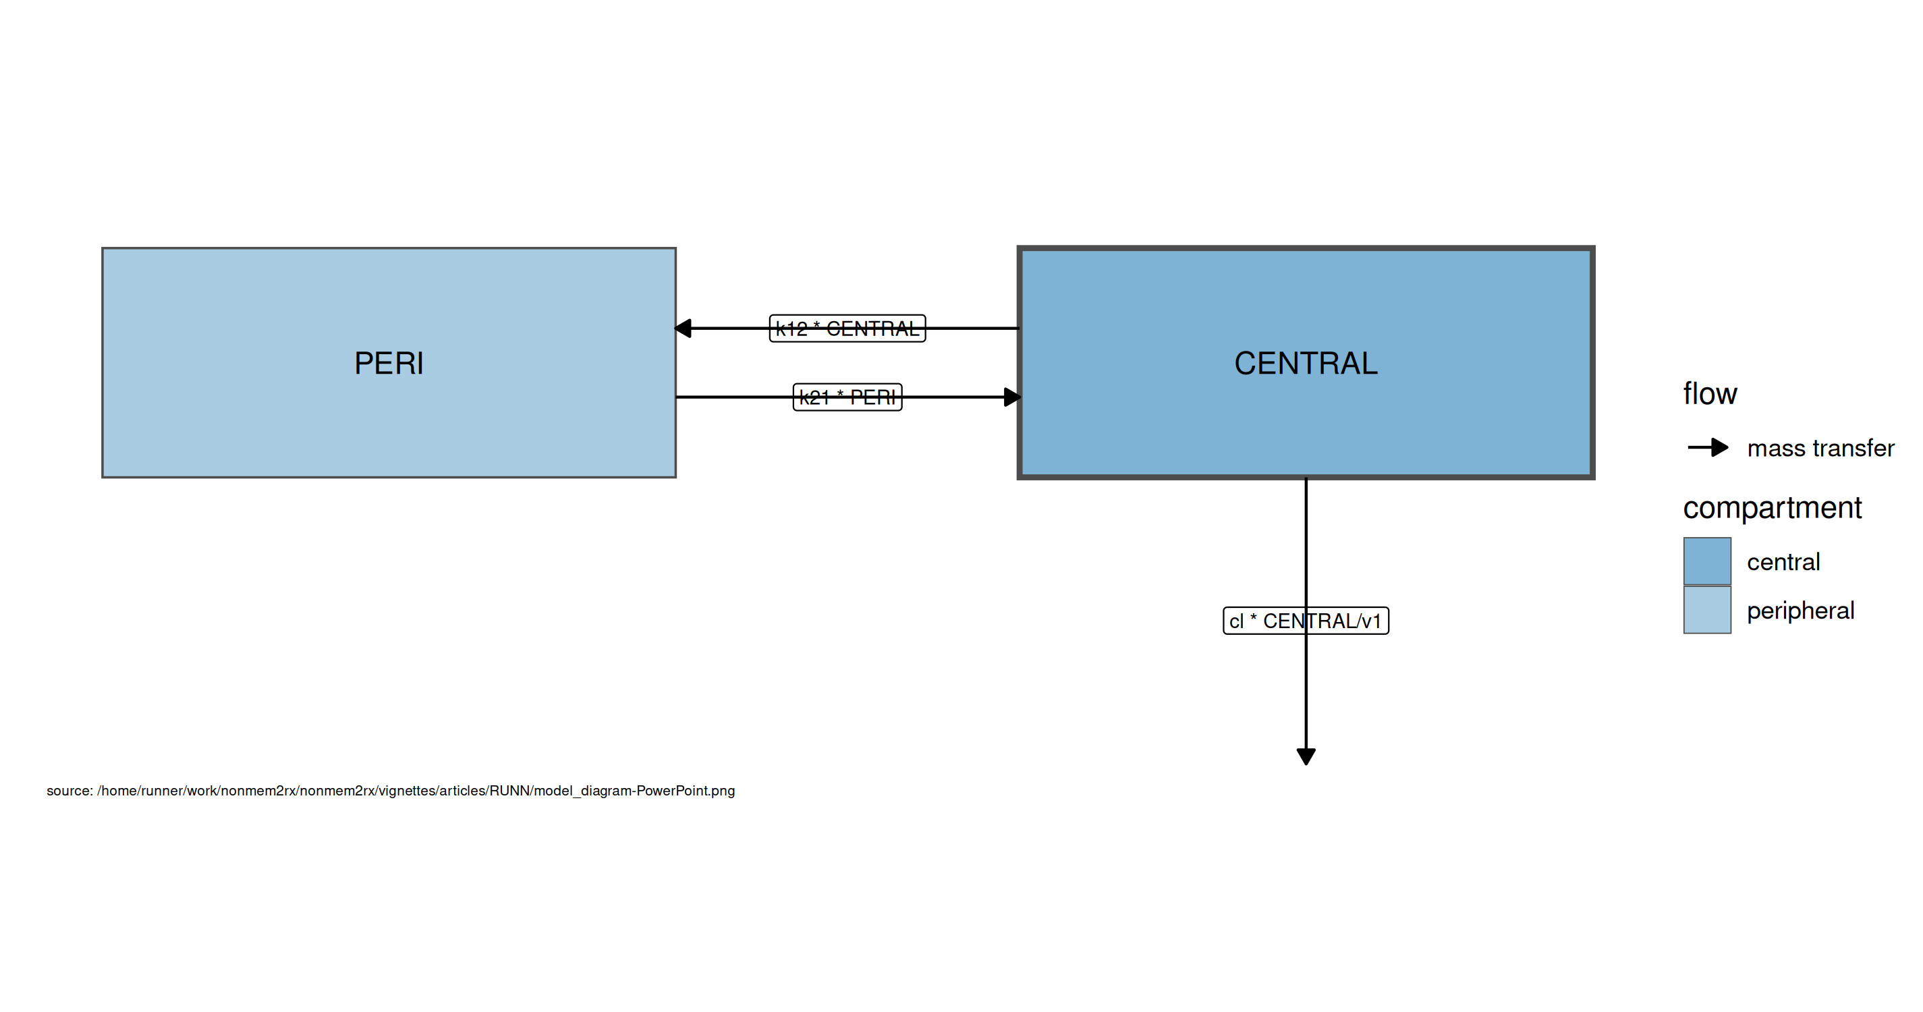
Model structure

Slide 2
Model equations
$$cmt(CENTRAL)$$
$$cmt(PERI)$$
$$cl=exp⁡(theta1+eta1)$$
$$v=exp⁡(theta2+eta2)$$
$$q=exp⁡(theta3+eta3)$$
$$v2=exp⁡(theta4+eta4)$$
$$v1=v$$
$$scale1=v$$
$$k21=\frac{q}{v2}$$
$$k12=\frac{q}{v}$$
$$\frac{d CENTRAL}{dt}=k21×PERI−k12×CENTRAL−\frac{cl×CENTRAL}{v1}$$
$$\frac{d PERI}{dt}=−k21×PERI+k12×CENTRAL$$
$$f=\frac{CENTRAL}{scale1}$$
$$ipred=f$$
$$rescv=RSV$$
$$ipred∼prop(RSV)$$

Slide 3
Parameter Estimates
Parameter | Est. | SE | %RSE | Back-transformed(95%CI) | BSV(CV%) | Shrink(SD)%
log Cl | 1.37 | 0.0298 | 2.17 | 3.94 (3.71, 4.17) | 32.6 | 1.94<
log Vc | 4.20 | 0.0295 | 0.703 | 66.6 (62.8, 70.5) | 32.3 | 2.46<
log Q | 1.38 | 0.0547 | 3.96 | 3.98 (3.57, 4.42) | 32.7 | 40.5>
log Vp | 3.88 | 0.0348 | 0.899 | 48.3 (45.1, 51.7) | 27.5 | 28.4=
RSV | 0.196 | 0.00315 | 1.61 | 0.196 (0.190, 0.203)

Slide 4
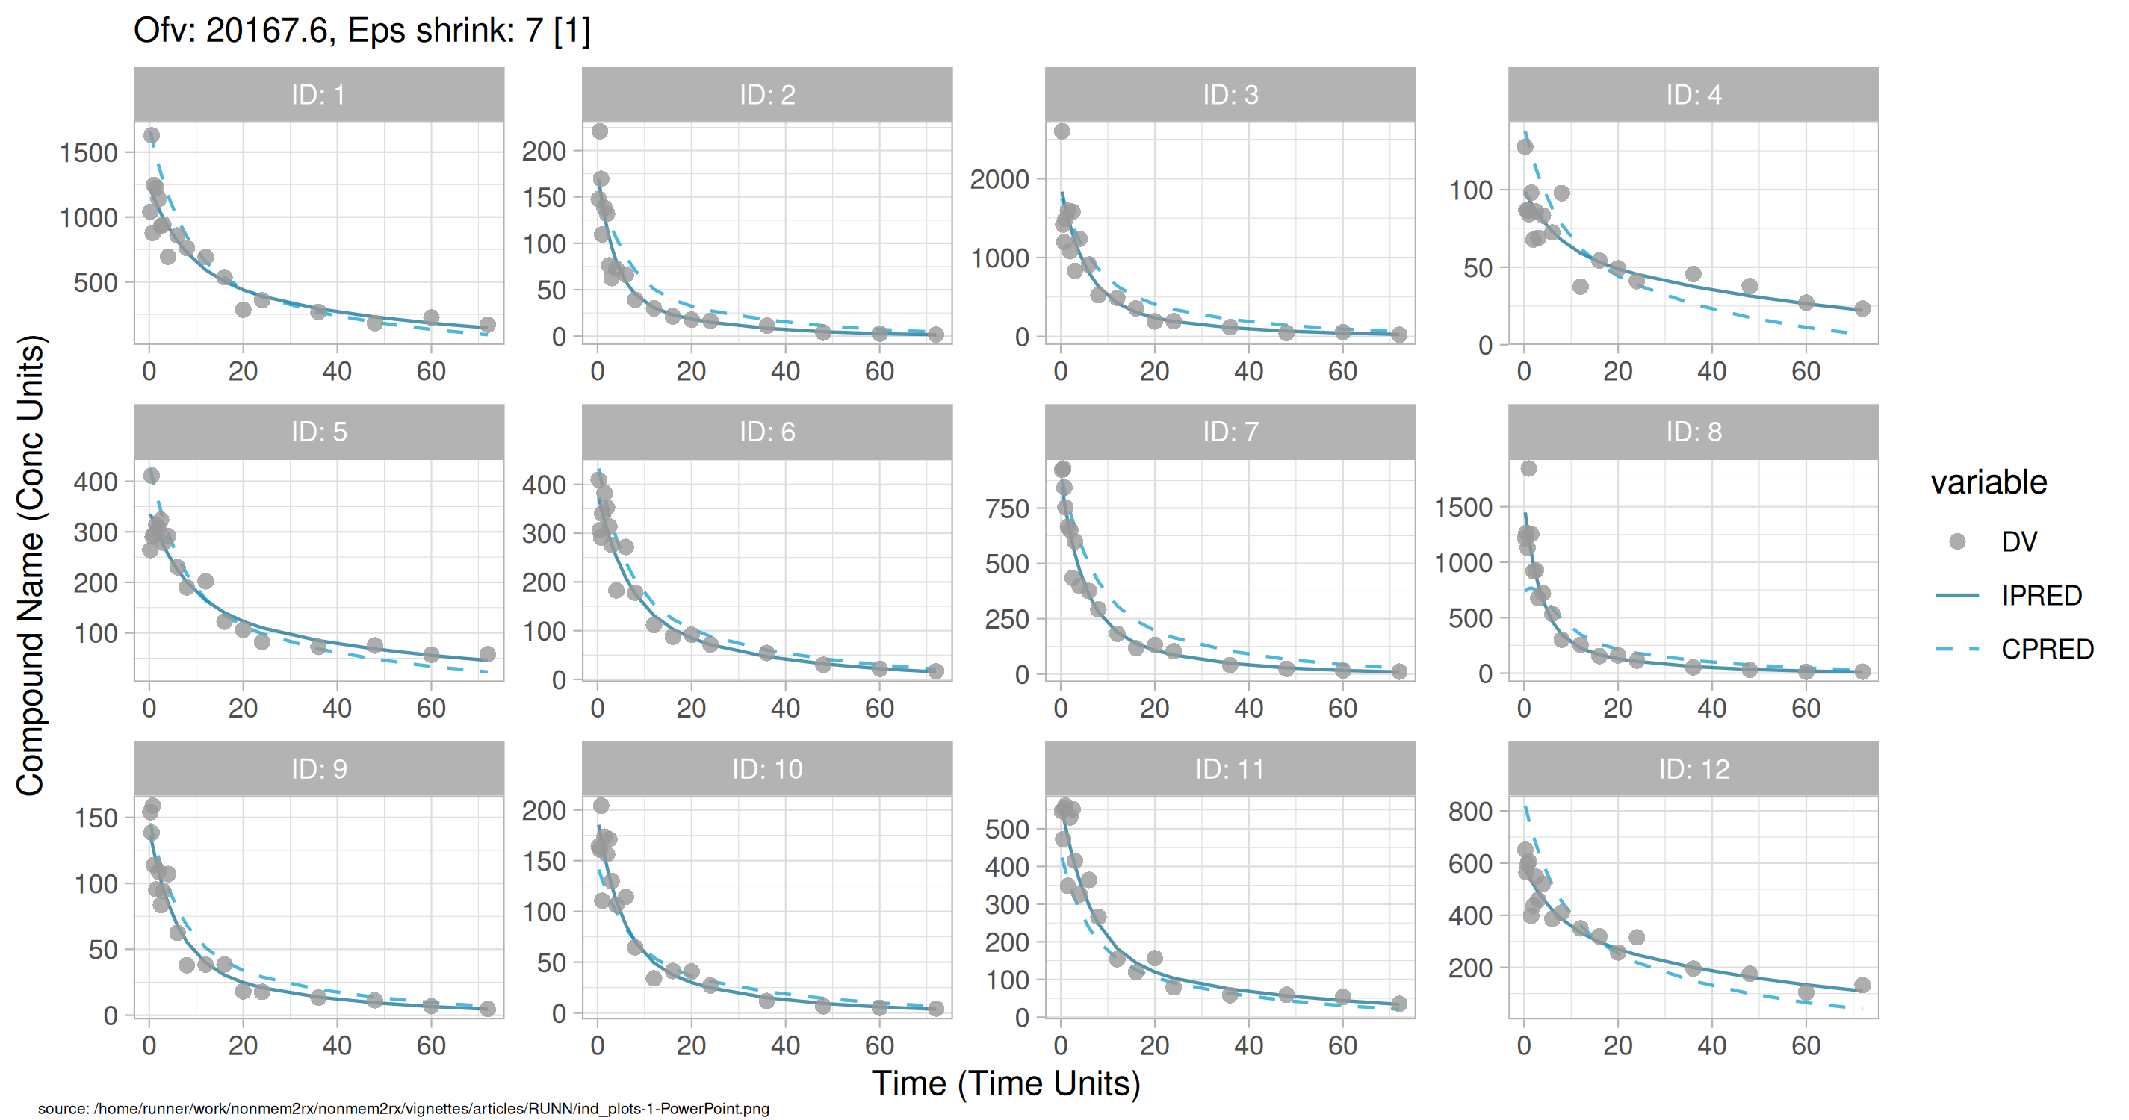
Individual and population prediction overlay

Slide 5
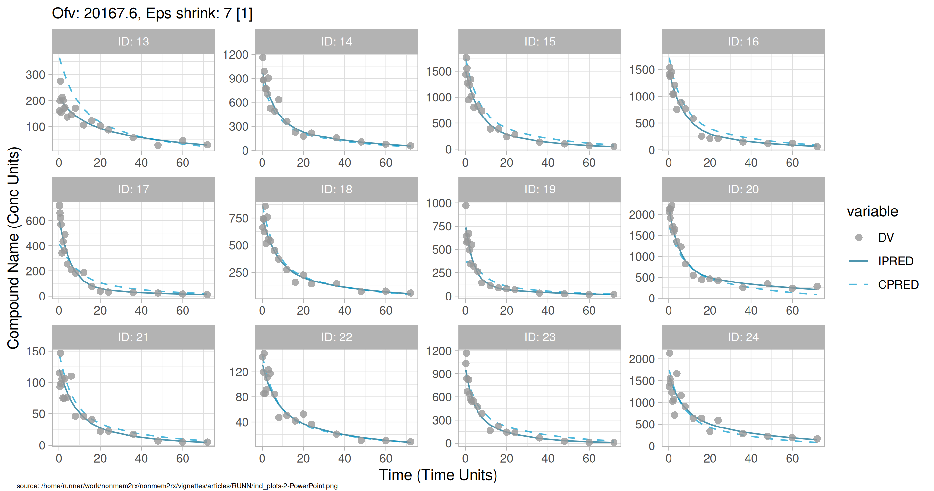
Individual and population prediction overlay

Slide 6
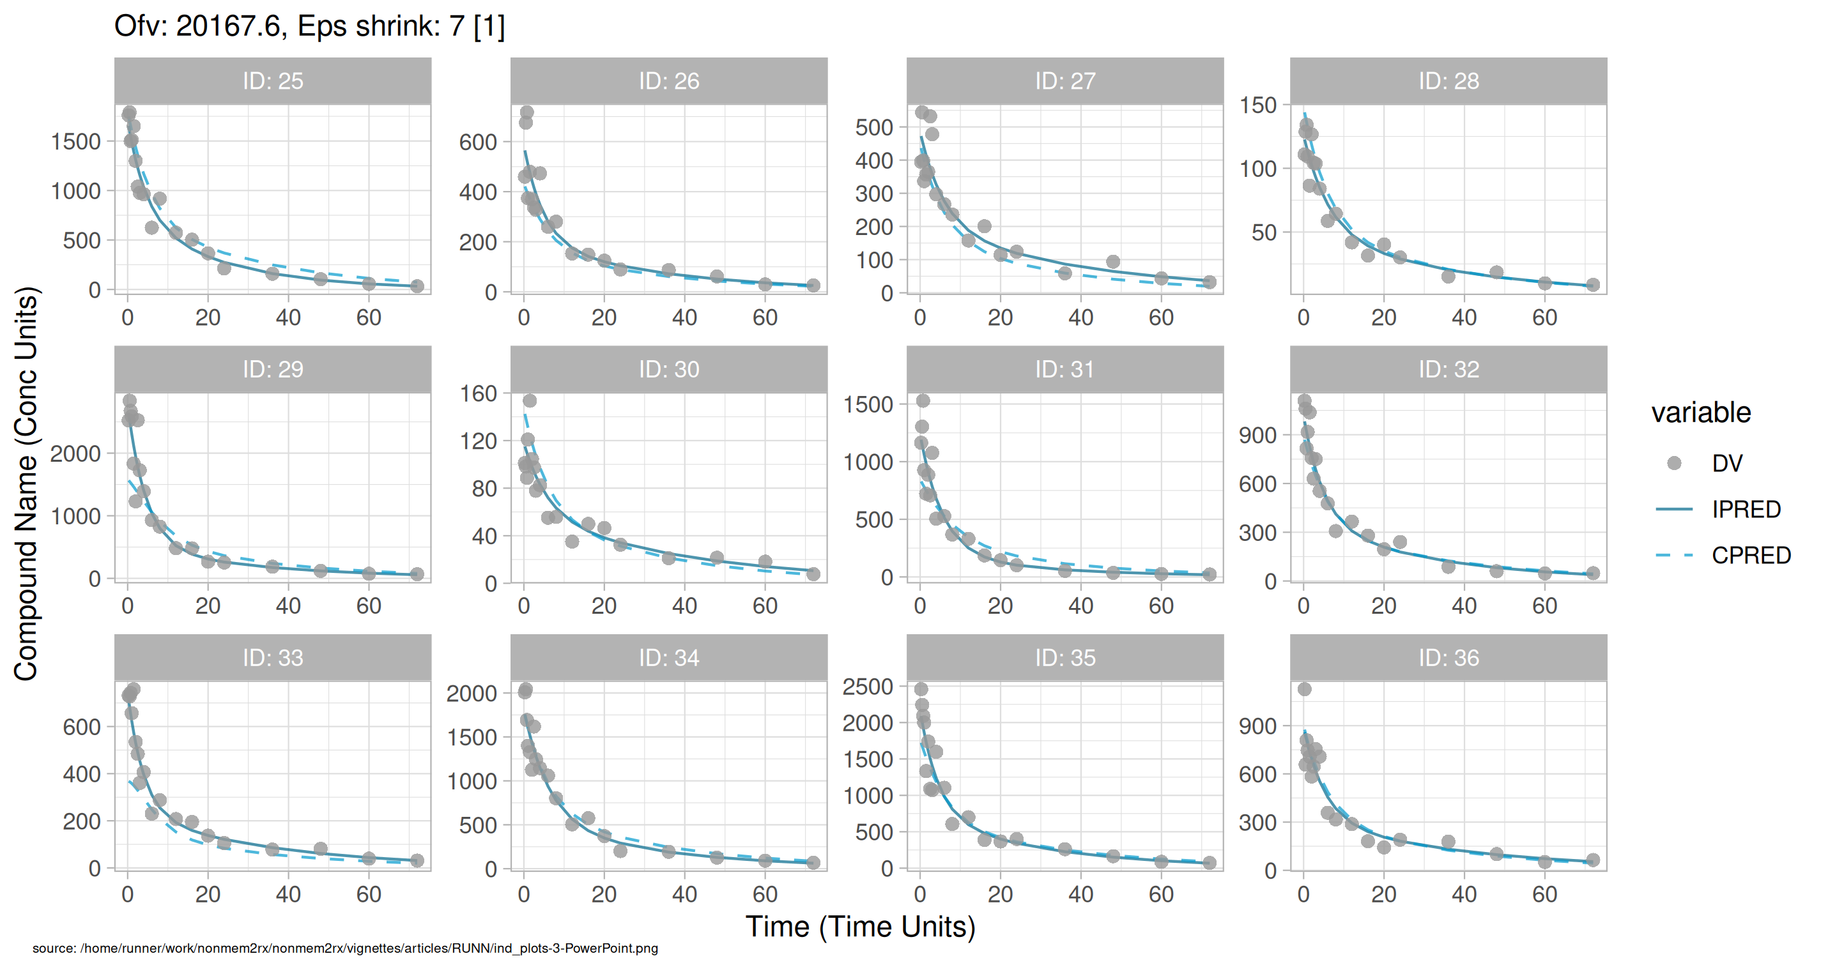
Individual and population prediction overlay

Slide 7
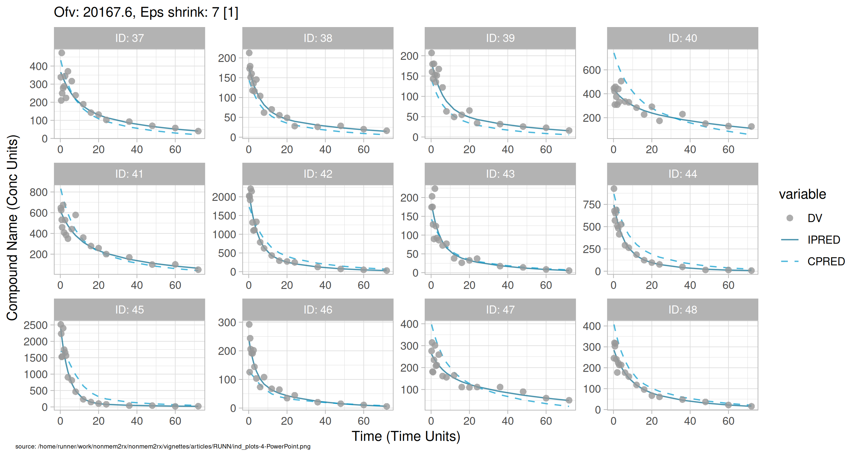
Individual and population prediction overlay

Slide 8
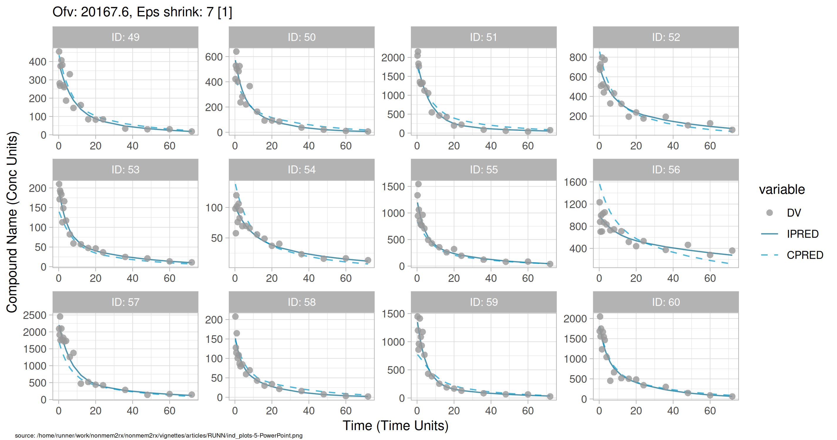
Individual and population prediction overlay

Slide 9
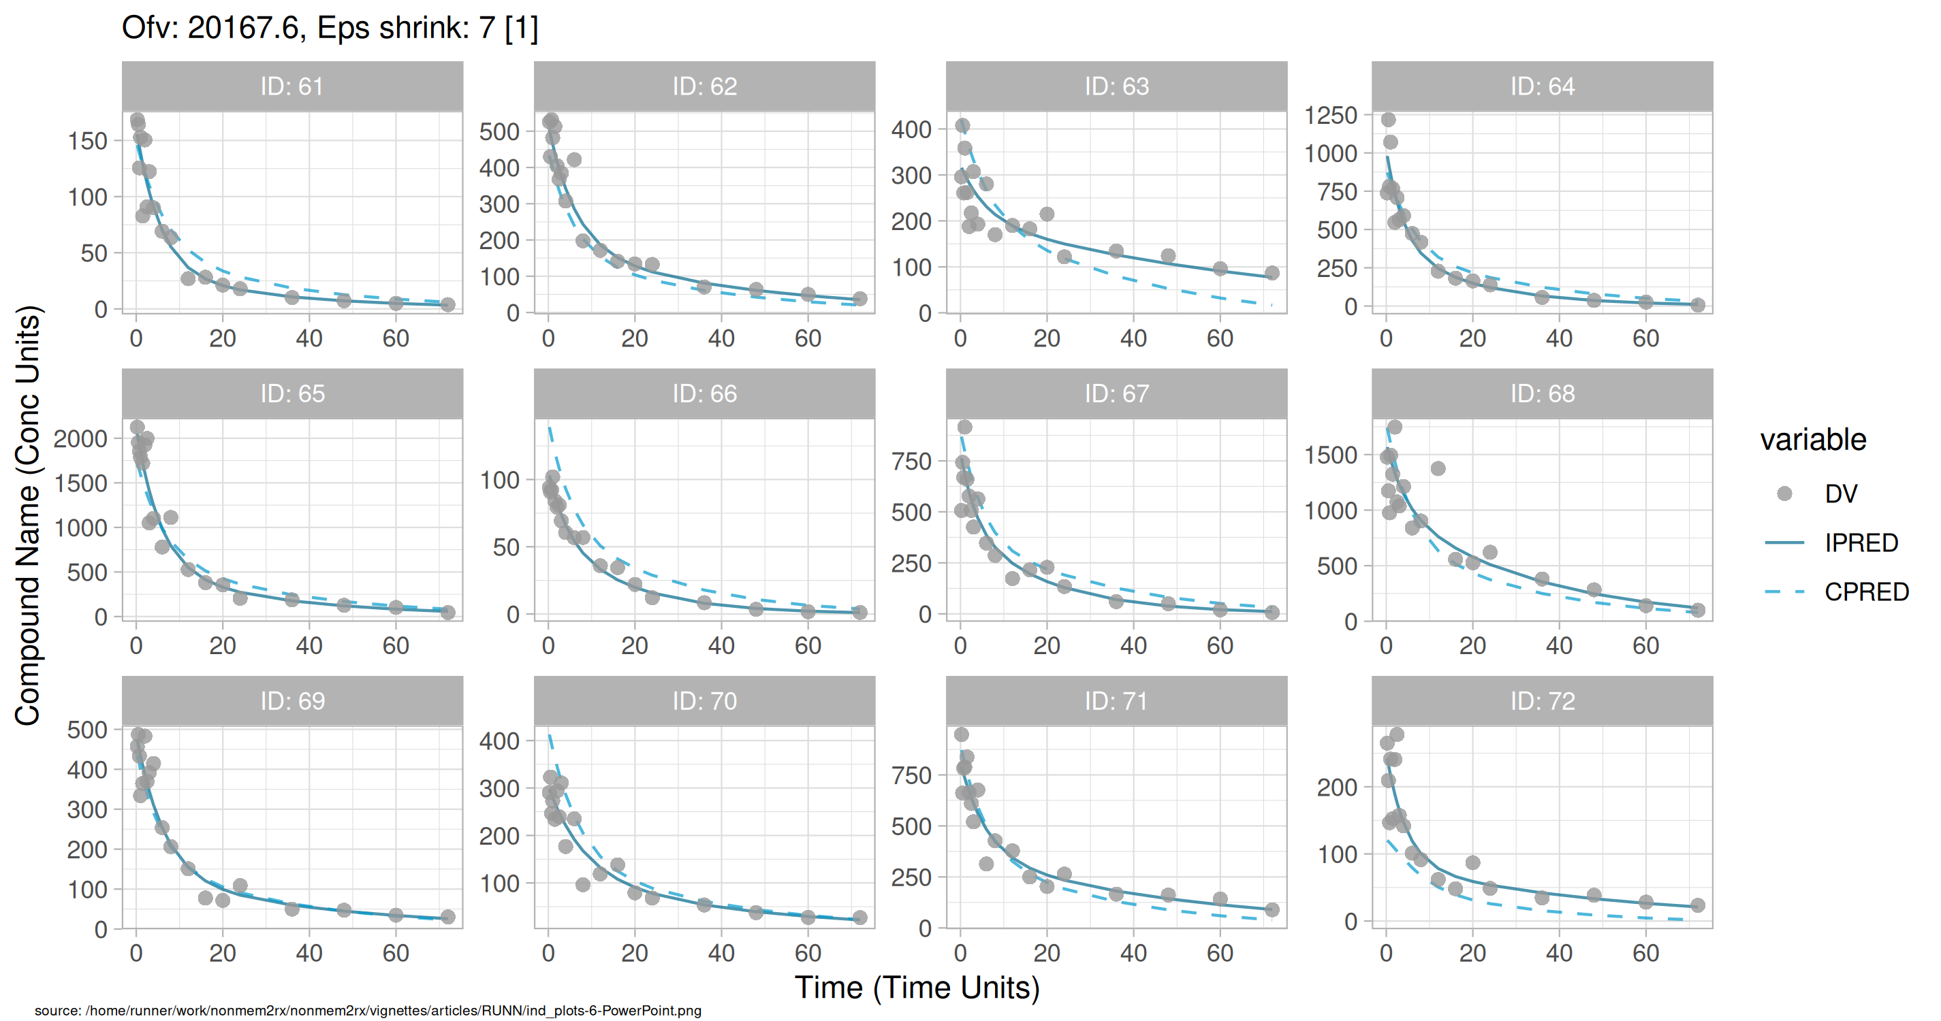
Individual and population prediction overlay

Slide 10
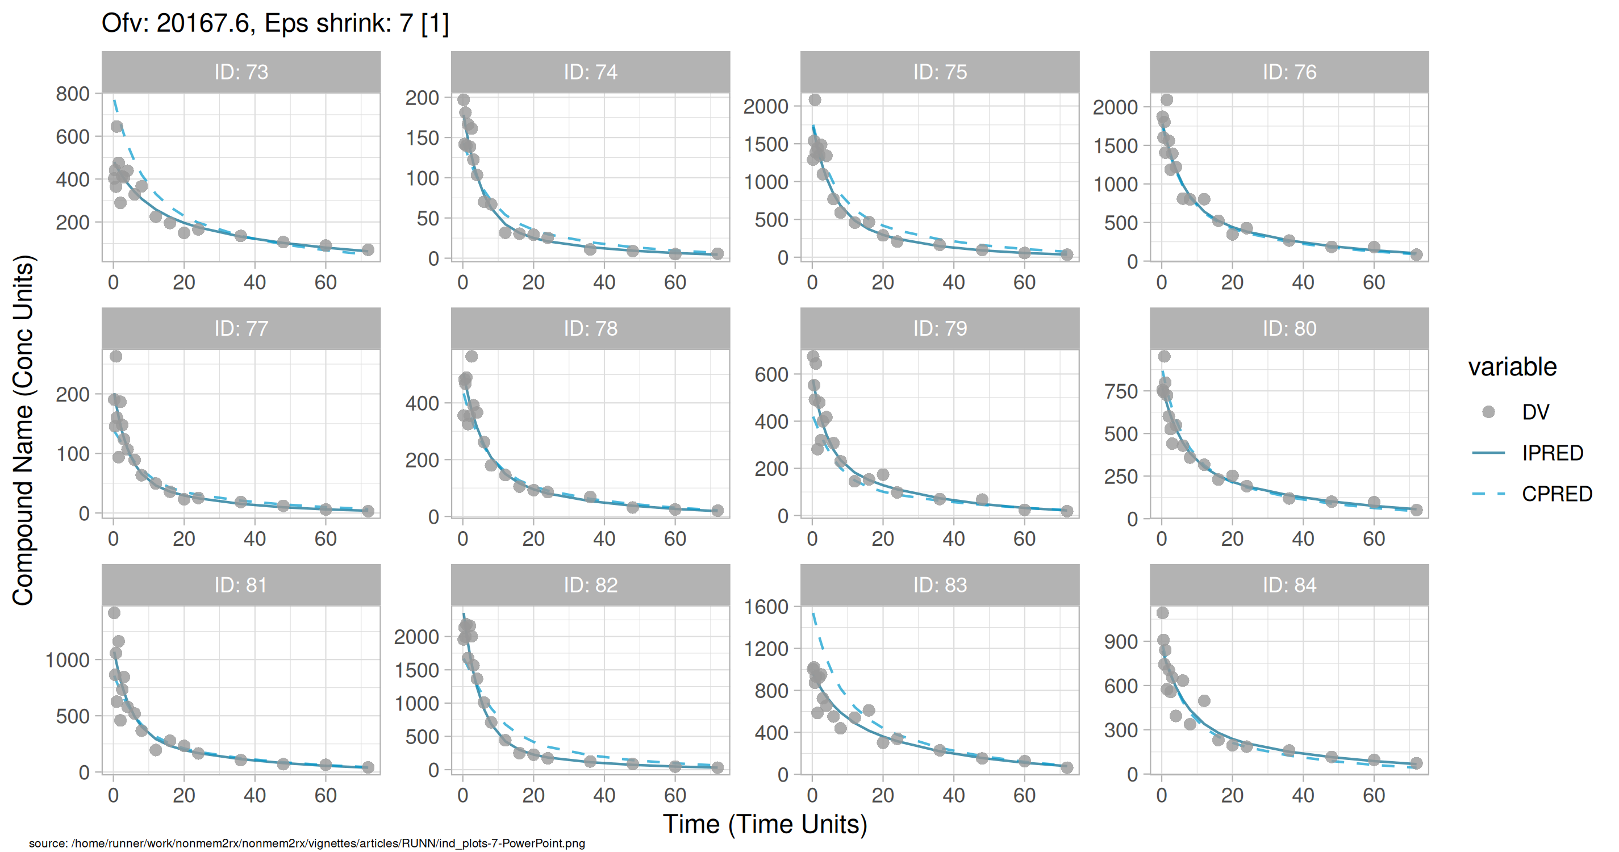
Individual and population prediction overlay

Slide 11
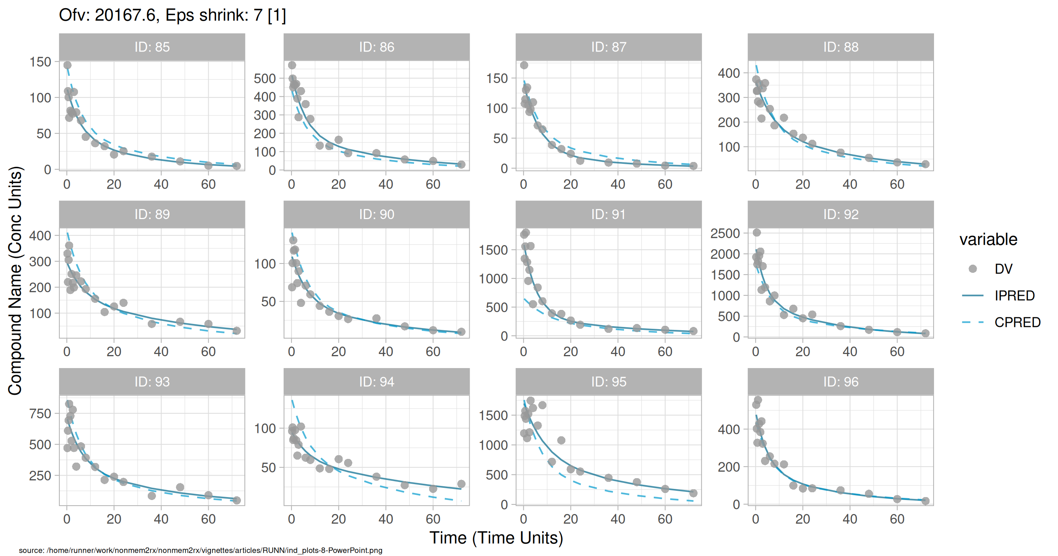
Individual and population prediction overlay

Slide 12
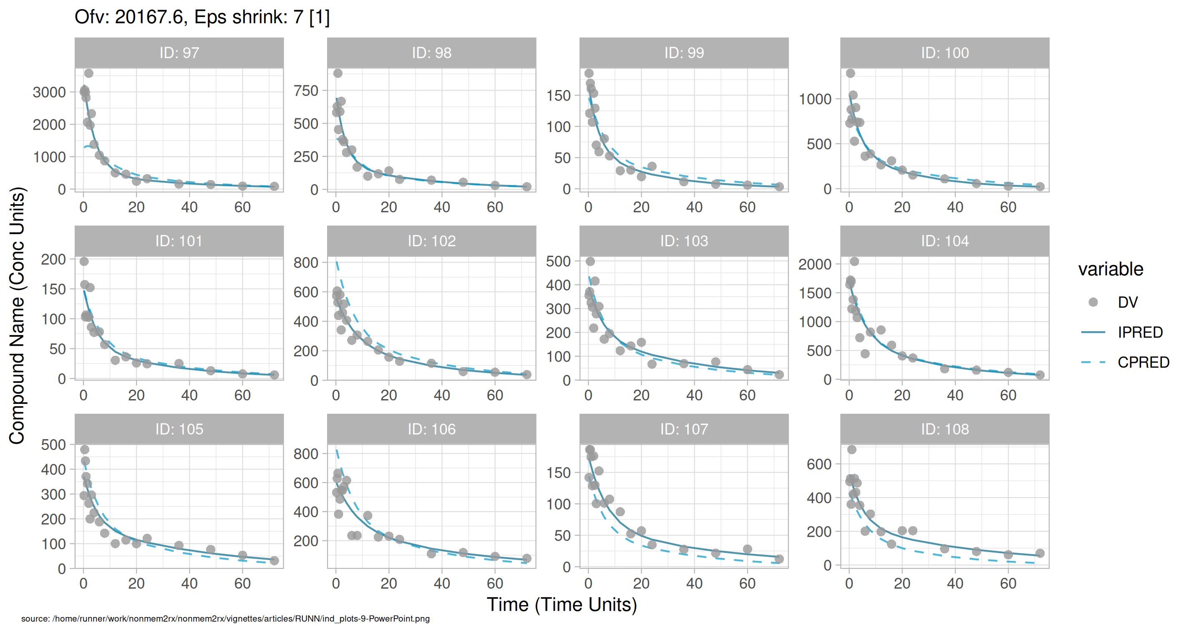
Individual and population prediction overlay

Slide 13
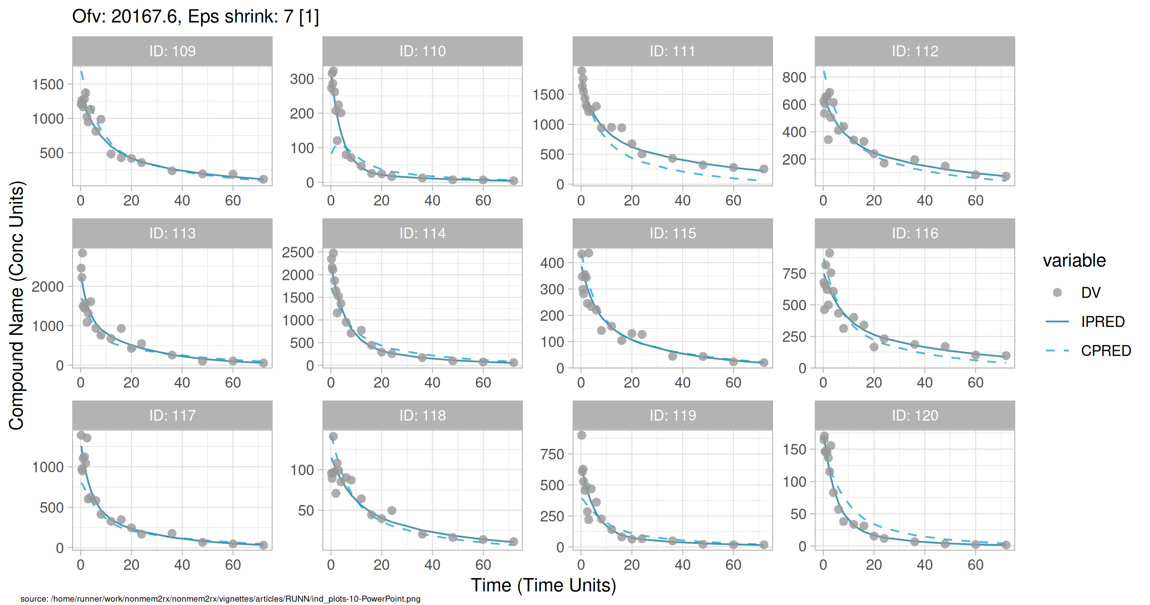
Individual and population prediction overlay

Slide 14
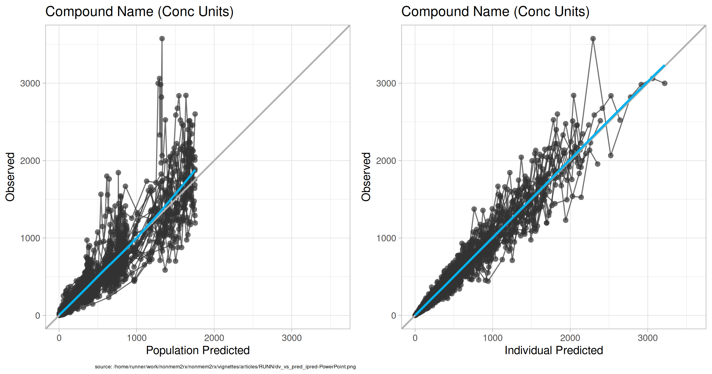
Observed vs Predicted

Slide 15
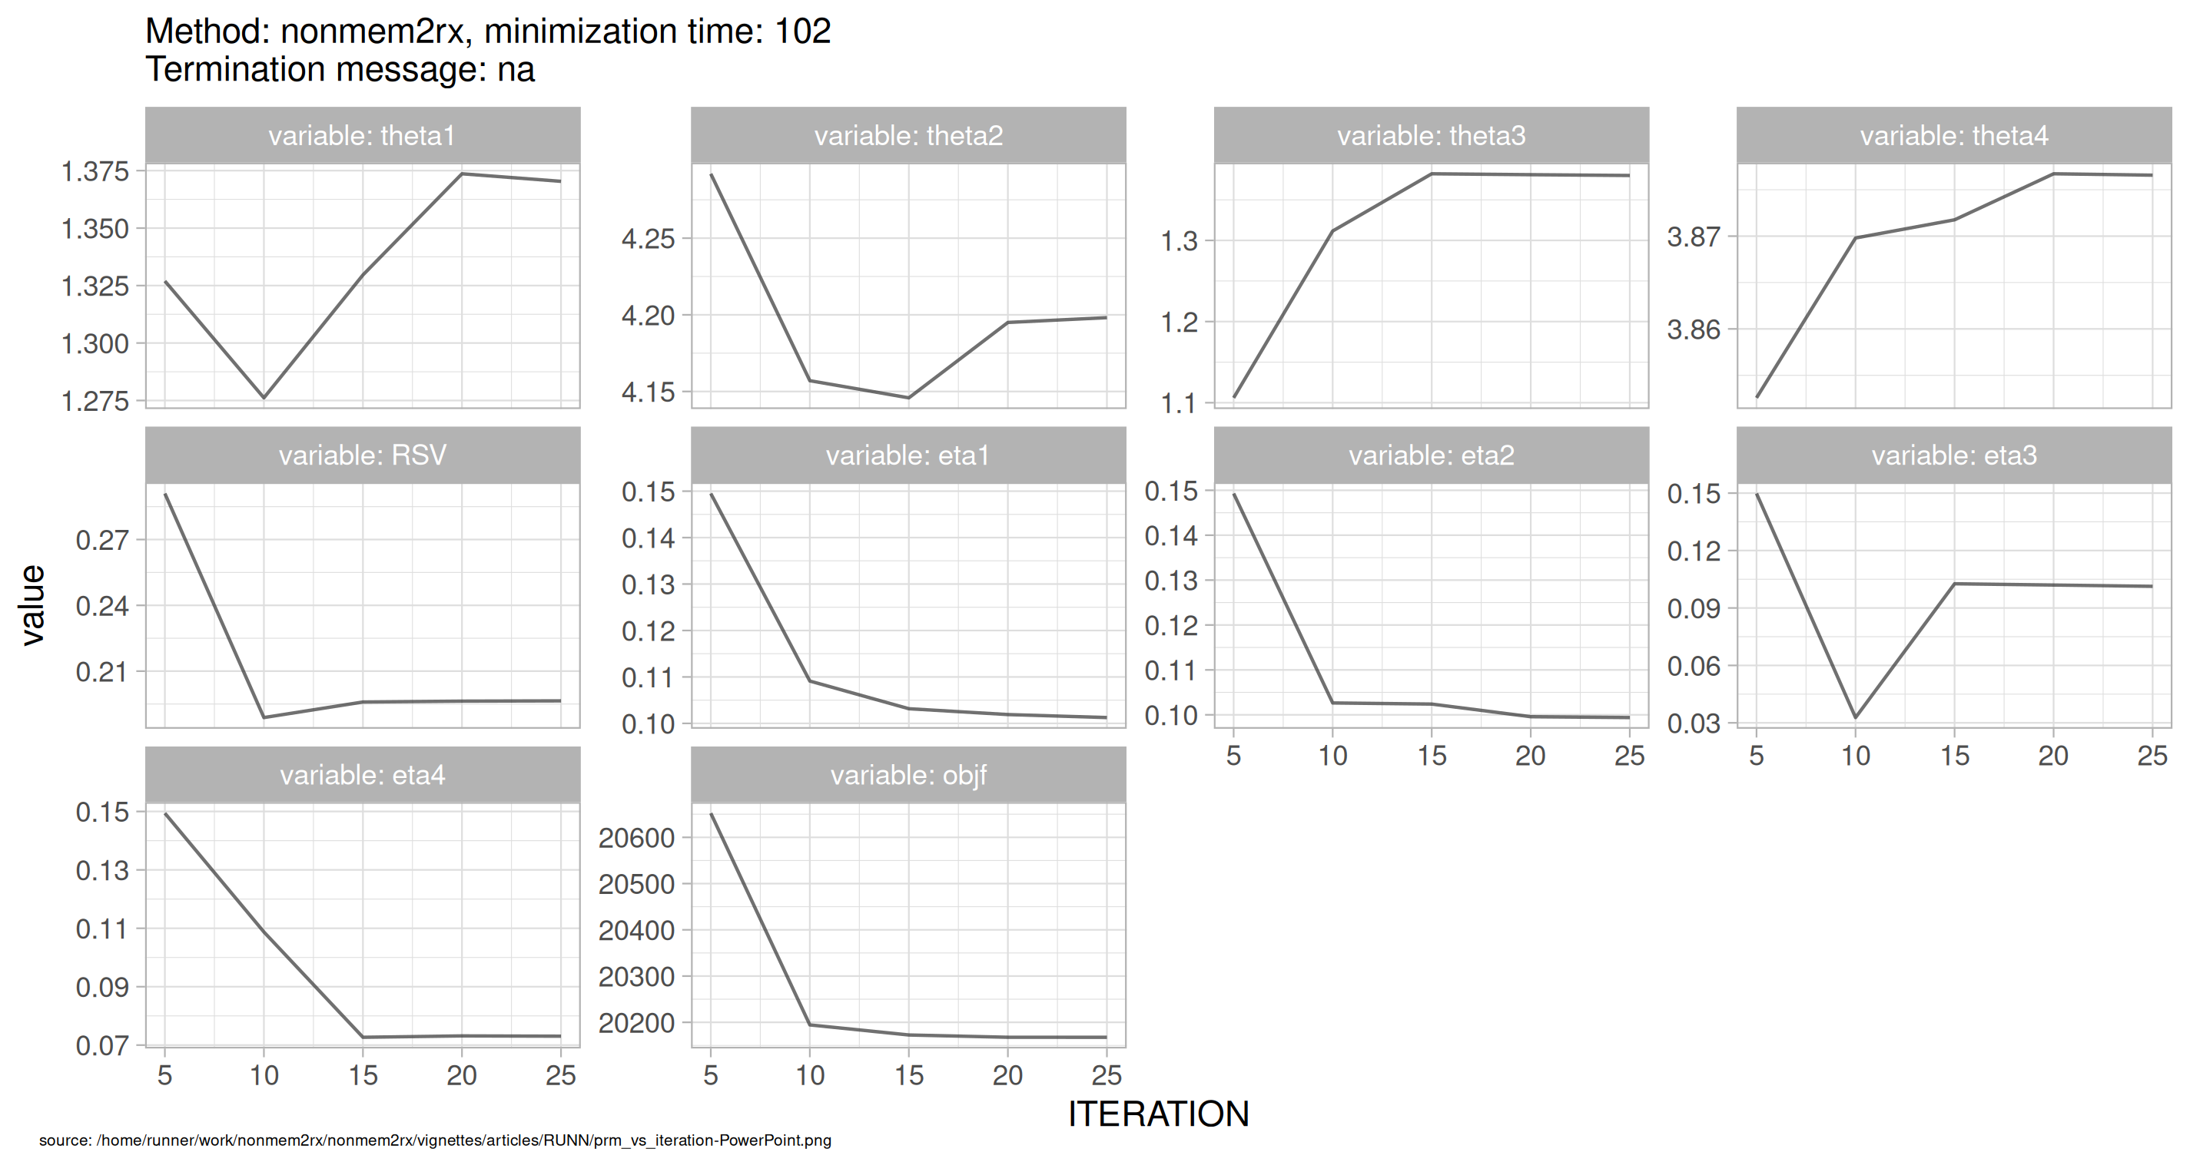
SAEM Stabilization

