Slide 1

Writing models
Running models
Running Models
model <- function(){
ini({
tka <- log(1.5)
tcl <- log(4)
tv <- log(20)
eta.ka ~ 0.5
eta.cl ~ 0.5
eta.v ~ 0.5
add.err <- 0.1
})
model({
ka <- exp(tka + eta.ka)
cl <- exp(tcl + eta.cl)
v <- exp(tv + eta.v)
d/dt(depot) = -ka * depot
d/dt(cent) = ka * depot - cl / v * cent
cp = cent / v
cp ~ add(add.err)
})
}
nlmixr( object, data, est = "nlme", control = list(), calc.resid = TRUE, ...)
Estimation methods
Cheat Sheet
Fixed effects (<- or =)
Model
NONMEM/RxODE data
est = "focei", "foce", "foi", "fo"
These methods are based on our interpretation of the NONMEM routines
control = foceiControl()
outerOpt | Outer Optimization Routine (bobyqa)
sigdig | Controls tolerances of estimation and ODE solving routines. Not the same as NONMEM sigidig parameter but with similar meaning (4)
scaleC | Custom scaling for focei optimization
covMethod | Covariance method “r,s” uses sandwich matrix, “r” uses hessian matrix and “s” uses cross-product matrix. “” does not calculate covariance/standard errors
maxOuterIterations | Maximum number of outer iterations before stopping estimation
maxInnerIterations | Maximum number of inner iterations before stopping individual eta estimation.
...
June 2019 github.com/nlmixrdevelopment
Initial estimates
Estimation method
Control
parameters
Random effects (~)
Calculate conditional weighted residuals
Getting nlmixr
Residual error (<-)
What you need first
R 3.5 or better
RxODE
PreciseSums
SnakeCharmR
nlmixr
Rtools (if you use Windows)
Python with SymPy
See our GitHub homepage for a detailed installation guide and links to nlmixr installers!
Estimation methods
NLME, SAEM, FOCEi, FOCE, FOi, FO & posthoc methods available.
Model parameters
est = "nlme"
Based on the Pinheiro-Bates nlme::nlme method in base R. Fast, but known to produce suboptimal results under some circumstances.
control = nlmeControl()
maxIter | Max number of iterations (50)
pnlsMaxIter | Max iterations for PNLS optimization (7)
msMaxIter | Max iterations for NLM optimization (50)
minScale | Minimal scaling factor for PNLS (0.001)
tolerance | Convergence tolerance (1e⁻⁶)
niterEm | Iterations for EM step (25)
pnlsTol | Tolerance for PNLS step (1e⁻³)
msTol | Tolerance for MS step (1e⁻⁷)
returnObject | Return object after unsuccessful convergence (F)
msVerbose | Show trace details for NLM (F)
apVar | Calculate approximate covariance matrix (T)
.relStep | Relative step size for numerical derivatives
minAbsParApVar | Minimum absolute parameter value in the approximate variance calculation (0.05)
opt | Optimizer ("nlminb" [default] or "nlm")
natural | Use natural parametrization for general positive-definite matrices (pdSymm) in reStruct (T)
sigma | Fixed residual error. Calculate if NULL (default) or 0
... | Additional arguments to nlminb
ODEs
Concentration
Residual error
Optional extras
Model
xpose.nlmixr: Graphical diagnostics using xpose
shinyMixR: A GUI for building nlmixr models in shiny
Models are defined as functions, with ini (initial estimates) and model (model) blocks. Parameters are best defined on the log scale. Assignments can use <- or =. Random effects are expressed as variances using the tilde (~). Bounds are supported for FOCEi (but not NLME or SAEM currently), e.g.
est = "posthoc"
Uses posthoc step of FOCEi algorithm, it similar to using foceiControl(maxOuterIterations=0)
Table Options
ini
tcl <- c(-3, 0.1, 5) # log scale (FOCEi only)
table = tableControl()
This controls what additional table output are included in the final nlmixr model
table = tableControl()
cwres | Boolean indicating if you need to calculate conditional weighted residuals (CWRES). On by default for FOCE(i) routines. This will also generate WRES, CPRED and CRES. Additionally this will add the FOCEi objective function value
npde | Calculate npde residuals (NPDE). This will also generate EPRED and ERES
nsim | Number of simulations used for NPDE (default 300)
ties | Boolean indicating if noise will be added to avoid ties in NPDE calculation (TRUE)
seed | Random seed to use for npde calculation (1009)
...
Solved systems
Linear compartmental PK models with oral and IV dosing all have closed-form solutions similar to NONMEM ADVANs.
The linCmt() term replaces the ODEs. nlmixr will guess the model form from the parameters specified.
Error blocks
Parameter correlations are expressed as triangular blocks (zeroes should not be used):
model
linCmt() ~ add(add.err)
ini
eta.cl + eta.v ~ c(0.1, 0.005, 0.1)
est = "saem"
An implementation of the stochastic approximation expectation-maximization algorithm. No termination criteria, can be slow when using ODEs.
control = saemControl()
seed | Random seed (99)
n.burn | Number of iterations in the SA (burn-in) step (200)
n.em | Number of iterations in the EM step (300)
nmc | Number of Markov chains (3)
nu | Numbers of transitions of kernels used in the Hasting-Metropolis algorithm. Default is c(2,2,2) representing 40 for each transition initially (each multiplied by 20)
atol | Absolute convergence tolerance (1e⁻⁶)
rtol | Relative convergence tolerance (1e⁻⁴)
stiff | Flag for stiff ODE systems (T, uses LSODA)
transit_abs | Flag for transit absorption model (F)
print | Iterations to complete before printing to console (1)
... | Additional arguments
SAEM Covariates
Fit object properties
SAEM Covariates must pre-transformed in the dataset to be linear. Initial estimates are necessary. Often this requires covariates to be on the log-scale. This is only required with SAEM.
Residual error
Additive, proportional and combined additive and proportional error models are available.
ini
coveff1 <- c(-5, 0.1, 5) coveff2 <- c(-0.5, -0.1, 0) Data: logWtCov = log(wt/70)
Adding Table items after fit
You can add conditional weighted residuals, weighted residuals and NPDE to any fit by the following functions
model
cp ~ add(add.err)
cp ~ prop(prop.err)
cp ~ add(add.err) + prop(prop.err)
model
cl <- exp(tcl + coveff1*logWt + eta.cl) v2 <- exp(tv2 + coveff2*CatCov + eta.v2)
Adding Tables
fit <- fit %>% addCwres() fit <- fit %>% addNpde()

Slide 2

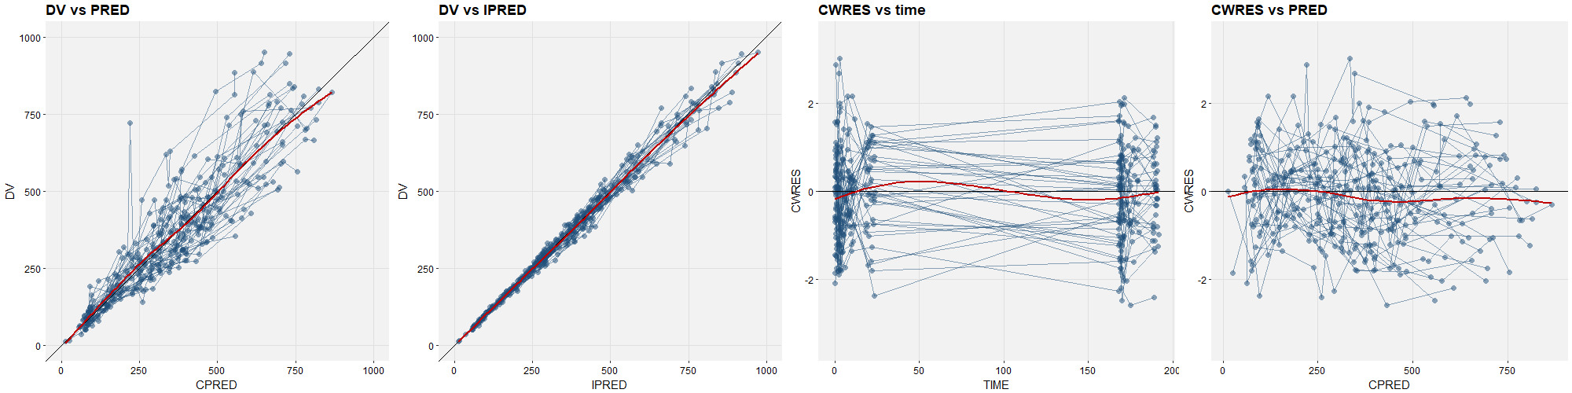
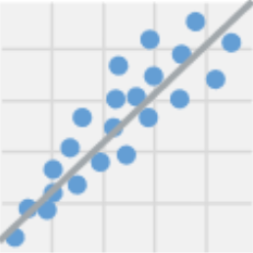
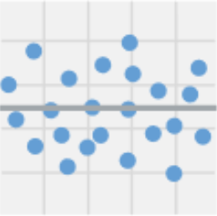
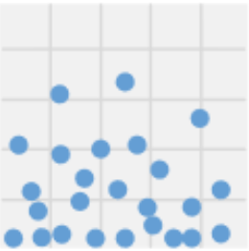
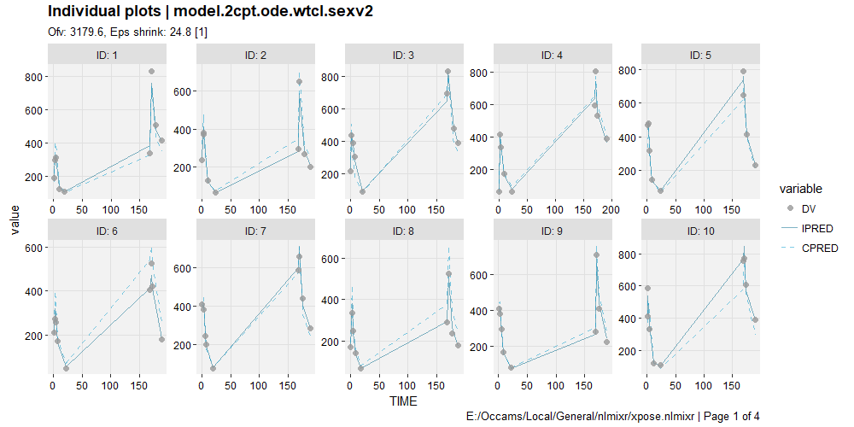
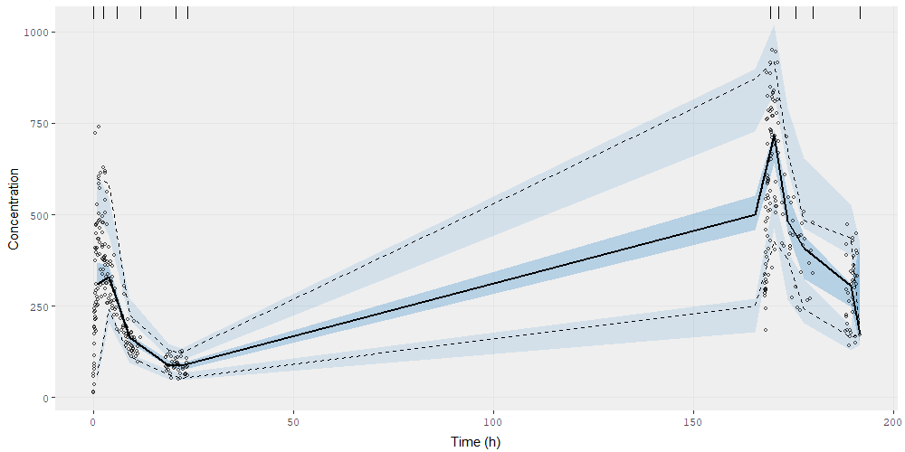
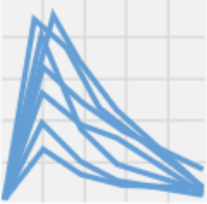
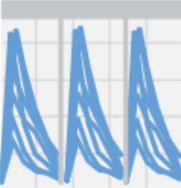
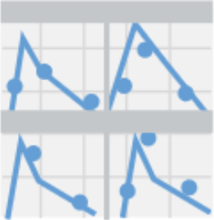
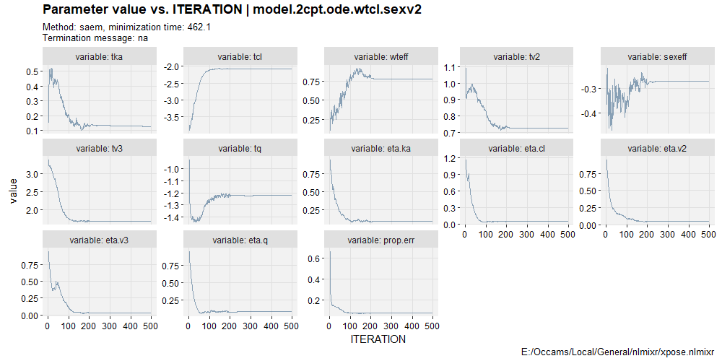
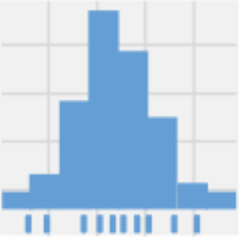
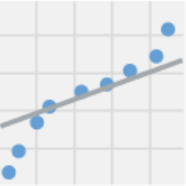
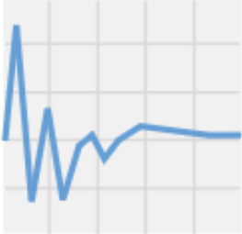
VPCs: vpc
Graphical diagnostics: xpose
nlmixr uses the simulation capabilities of RxODE and the vpc package to generate VPCs directly from the fitted model object:
Loading a model into xpose
Basic goodness-of-fit
In order to use the functionality of xpose, we first need to convert our nlmixr model object into an xpose database using the xpose.nlmixr package.
The xp_theme option allows a theme object (defining how plots will be drawn) to be specified.
 | dv_vs_pred(xpdb)
 | dv_vs_ipred(xpdb)
 | res_vs_idv(xpdb, res="CWRES")
 | res_vs_pred(xpdb, res="CWRES")
 | absval_res_vs_idv(xpdb, res="CWRES")
 | absval_res_vs_pred(xpdb, res="CWRES")
 | dv_vs_idv(xpdb, group="ID")
 | ipred_vs_idv(xpdb, group="ID")
 | pred_vs_idv(xpdb, group="ID")
 | dv_preds_vs_idv(xpdb)
nlmixr
vpc_ui(myfit, n=600,show=list(obs_dv=T), log_y=T, xlab="Time (h)", ylab="Concentration (mg/L)")
xpose.nlmixr
xpdb <- xpose_data_nlmixr(myfit, xp_theme = theme_xp_nlmixr())
Plot layers and aesthetics
Besides being able to manipulate xpose graphs in the same ways as ggplot2 graphs using layers, plot aesthetics can be directly specified using layer_argument, where layer is the layer, and argument is the argument applying to it.
Individual plots
 | ind_plots(xpdb)
Most useful VPC options
xpose
dv_vs_pred(xpdb, point_color="blue")
fit | nlmixr fit object
n | Number of simulation iterations
bins | Either "density", "time", or "data", "none", or one of the approaches available in classInterval() such as "jenks" (default) or "pretty", or a numeric vector specifying the bin separators
n_bins | When using the "auto" binning method, what number of bins to use
bin_mid | Either "mean" for the mean of all timepoints (default) or "middle" to use the average of the bin boundaries
show | What to show in VPC (obs_dv, obs_ci, pi, pi_as_area, pi_ci, obs_median, sim_median, sim_median_ci). See example
stratify | Character vector of stratification variables (max 2)
smooth | “Smooth" the VPC (connect bin midpoints) or show as rectangular boxes (default T)
pred_corr | Perform prediction-correction (default F)
pi | Simulated prediction interval to plot. Default is c(0.05, 0.95)
ci | Confidence interval to plot. Default is (0.05, 0.95)
facet | "wrap", "columns", or "rows"
log_y | Logarithmic y-axis? (default F)
xlab | Label for x-axis
ylab | Label for y-axis
title | Title
uloq | Upper limit of quantification (default NULL)
lloq | Lower limit of quantification (default NULL)
vpc_theme | Theme. Expects list of class vpc_theme created with function vpc_theme()
Distributions
Layers for scatterplots
point | Options for geom_point
line | Options for geom_line
guide | Options for geom_abline
smooth | Options for geom_smooth
text | Options for geom_text
xscale | Options for scale_x_continuous or scale_x_log10
yscale | Options for scale_y_continuous or scale_y_log10
 | prm_distrib(xpdb)
 | eta_distrib(xpdb)
 | cov_distrib(xpdb)
 | res_distrib(xpdb, res="CWRES")
 | prm_qq(xpdb)
 | eta_qq(xpdb)
 | cov_qq(xpdb)
 | res_qq(xpdb, res="CWRES")
Editing and subsetting data
Editing/filtering data in xpose is performed by dplyr.
filter | Subset data based on logical condition(s)
mutate | Add, modify or remove variables
Layers for distributions
histogram | Options for geom_histogram
density | Options for geom_density
rug | Options for geom_rug
xscale | Options for scale_x_continuous or scale_x_log10
yscale | Options for scale_y_continuous or scale_y_log10
Iteration trace plots
xpose
xpdb %>% filter(WT>70) %>% dv_vs_pred()
 | prm_vs_iteration(xpdb)
Plot types
Editing data types
The xpose package supports different plot types, according to the type of data being plotted.
xpose.nlmixr tries to assign variables to types automatically, and often this works well. Sometimes manual adjustments are needed, though.
xpose
dv_vs_pred(xpdb, type="pls") eta_distrib(xpdb, type="hdr")
Access functions
list_vars(xpdb) | Display variable assignments
set_var_types(xpdb, ...) | Modify variable assignments
get_code(xpdb) | Display model
get_data(xpdb) | Extract data
print(xpdb) | Display summary of xpose data object
Scatterplots
p | Point
l | Line
s | Smooth
t | Text
Distributions
h | Histogram
d | Density line
r | Rug
xpose
list_vars(xpdb1) xpdb2 <- set_var_types(xpdb1, .problem = 1, catcov='sex')
Icons and content for xpose courtesy of Ben Guiastrennec and the xpose team! Xpose can do much more than this – get the official cheat sheet at uupharmacometrics.github.io/xpose/articles/cheatsheet.pdf

