Slide 1
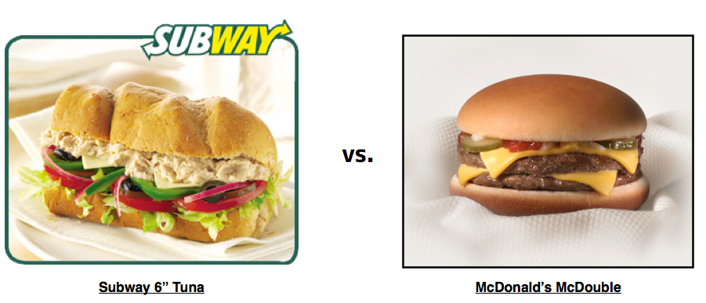
Which is healthier?
Kathy Manthey
Manuela Muñoz
Nicole Muscanell
Notes:
Notes:
Open with question about which item is healthier to set up the point of our dashboard and what purpose it fills
It might be good here to point out that most of us have probably wondered at some point what items are healthier or not
And to what extent a certain chain has healthier items versus another
Question: which is healthier, the classic tuna sandwich at Subway, or the McDouble?
Answer: McDouble: 380 calories, Classic Tuna: 450 calories.
The tuna also has slightly more carbs and fat, but is a little bit healthier when it comes to micronutrients such as vitamin A & C

Slide 2



purpose
Fast food nutrition dashboard
Restaurant
Food Category
Menu items
Visualizations
Stacked bar chart
Radial charts
Scatterplot
Other features
Homepage
Data page
Notes:
Major Points:
Our dashboard helps answer these questions about the nutritional content of food at three major chains.
Allow users to pick any two menu items by filtering down via cascading dropdown menus.
Filters include: restaurant, food categories, and menu items
Goal was to tie the dropdowns to the stacked bar (macronutrients) and two gauge charts (micronutrients)
The scatterplot was meant to be a way to be able to look a a bigger slice of data at once (we picked three major macronutrients)

Slide 3

About the data
Data structure & issues
Four csv files from Kaggle
Special characters
Pairing down categories
Final data
750 menu items
10 food categories
SQLite DB with four tables
Inconsistencies in nutrient values
Notes:
Major Points:
We started cleaning this data during the ETL project (which involved a lot of combining, replacing strings, adding ID’s, re-naming and re-organizing columns, etc.
For this project we still needed to do some cleaning: mainly removing special characters and narrowing down our food categories from 30+ to 10
The final data do have some inconsistencies, i.e., not all menu items had micronutrient info, or data for the percent of daily value variables
Note: add full list of final nutrient variables here for reference

Slide 4
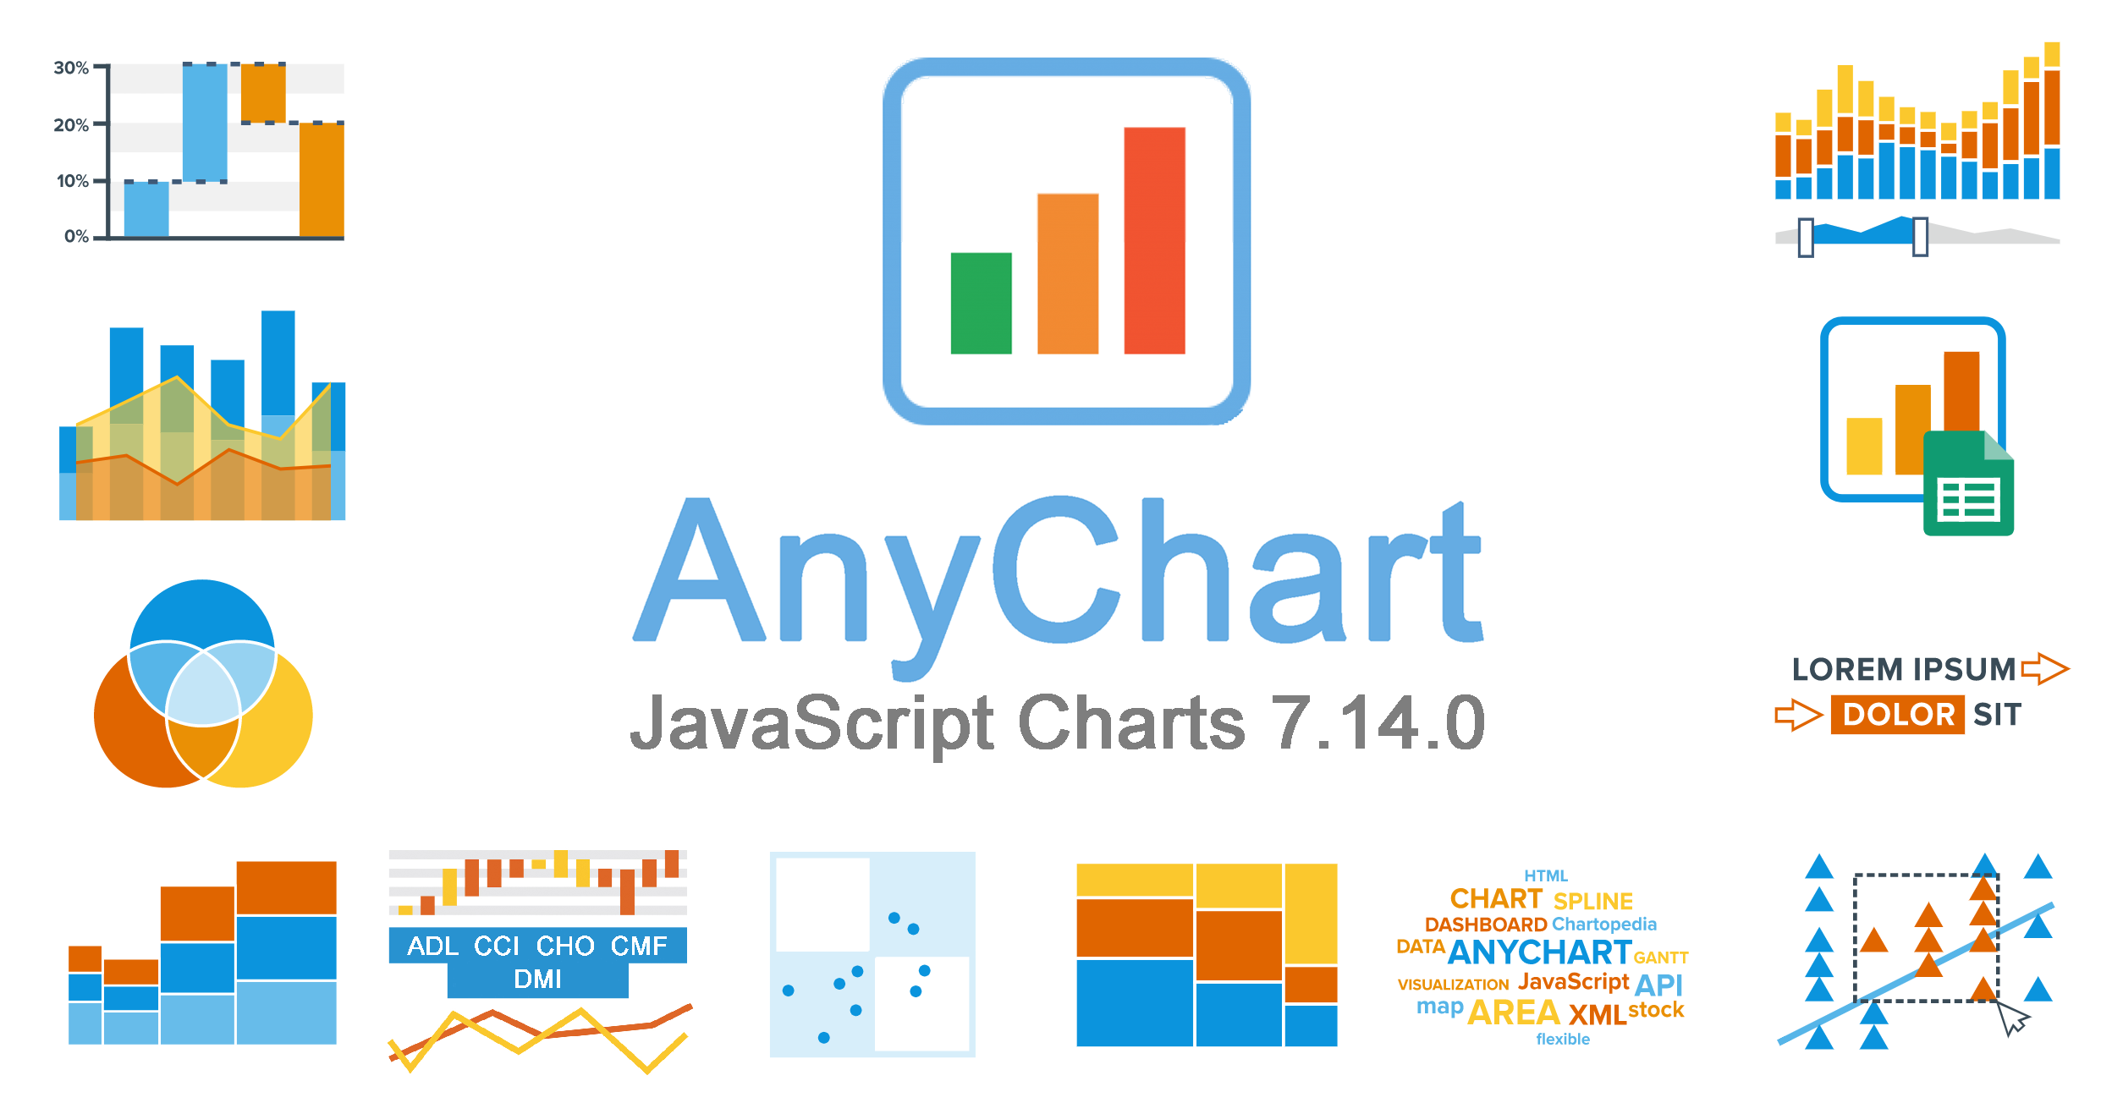


specifications
Backend
Python Flask
SQLite
Front-end
HTML
CSS
JavaScript
JS libraries
AnyChart
D3
Notes:
Major Points:
We set up a flask app as our web framework
Our database was housed by SQLite
We pulled data from SQLite and stored it in JSON format via routes to be pulled for the plots
AnyChart JS Charts is a flexible, cross-platform and cross-browser JavaScript charting library that allows you to add interactive HTML5 charts and dashboards to any web projects.
Note: If we get Heroku to work by class, add it into this slide.

Slide 5
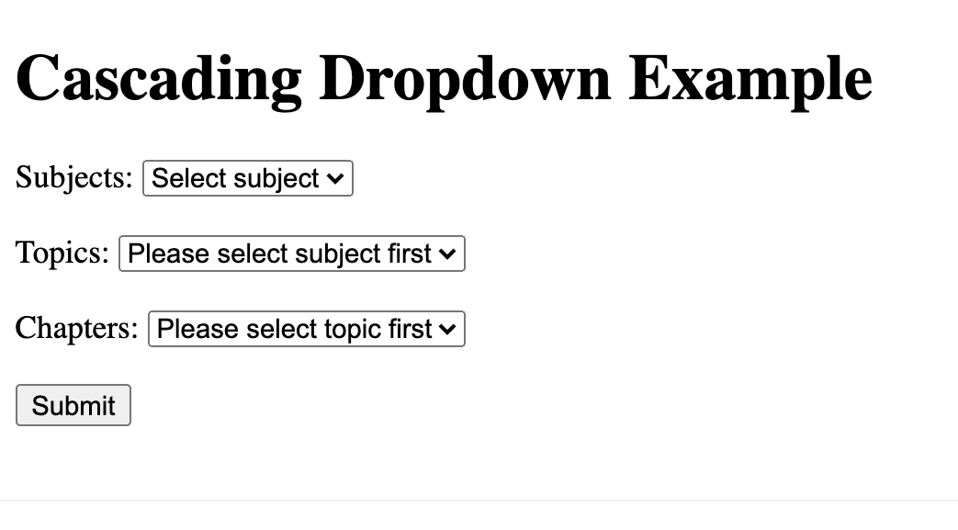
Dropdown menus
w3schools.com
Notes:
Major Points:
We took the base code from w3schools; relatively short code that filters data for each respective dropdown after a selection has been made
Also clears out data upon any new selection or page reload
Trickiest part was trying this function to both gauge charts and the stacked bar: this required some data restructuring and addition of a loop to avoid breaking the stacked bar
Importantly: this code was only written up to the point of filtering correctly the final selection items in the third dropdown menu. We had to add the rest.

Slide 6
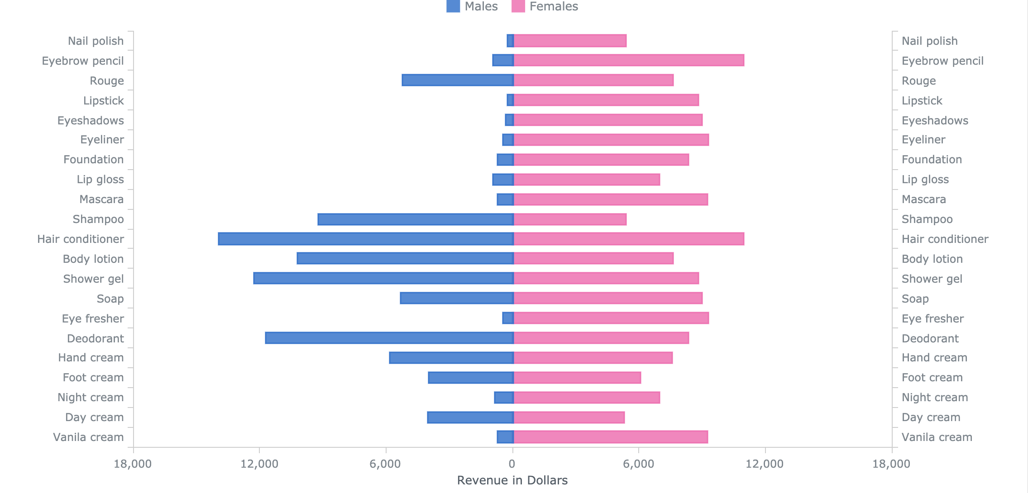
Stacked bar chart
AnyChart
Notes:
Major Points:
The stacked bar chart consists mainly of svg paths (lines)
This chart is created by utilizing negative values to create the bars from the center and outwards (left and right)
Out of the box, but still was tricky getting data into correct format for the plot.
Some styling harder to change since it’s made up of many svg paths, and comes already linked to several css sources via AnyChart
Also, linking these to the dropdown menus was tricky because bars were inversed and the chart is built together (had to figure out a loop to get one side to retain info and not break during menu selection)
Stacked bar link:
https://www.anychart.com/products/anychart/gallery/Bar_Charts/Stacked_Bar_Chart_with_Negative_Values.php

Slide 7
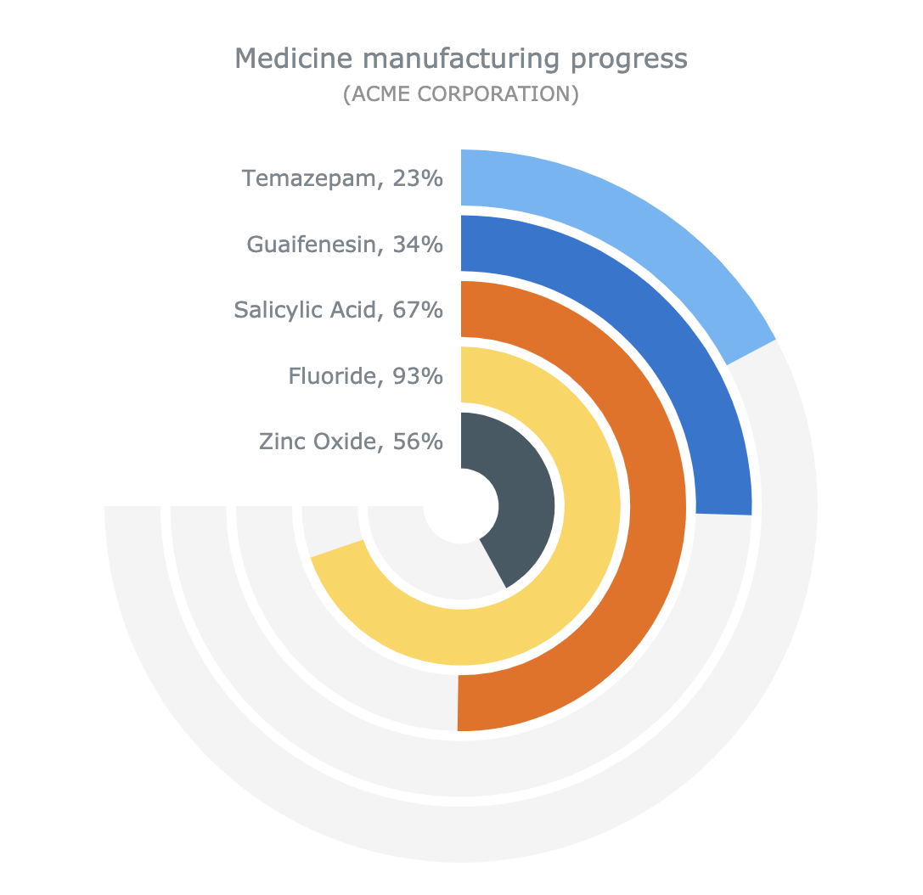
gauge charts
AnyChart
Notes:
Major Points:
Circular gauge chart link: https://www.anychart.com/products/anychart/gallery/Circular_Gauges/Solid_Gauge.php

Slide 8
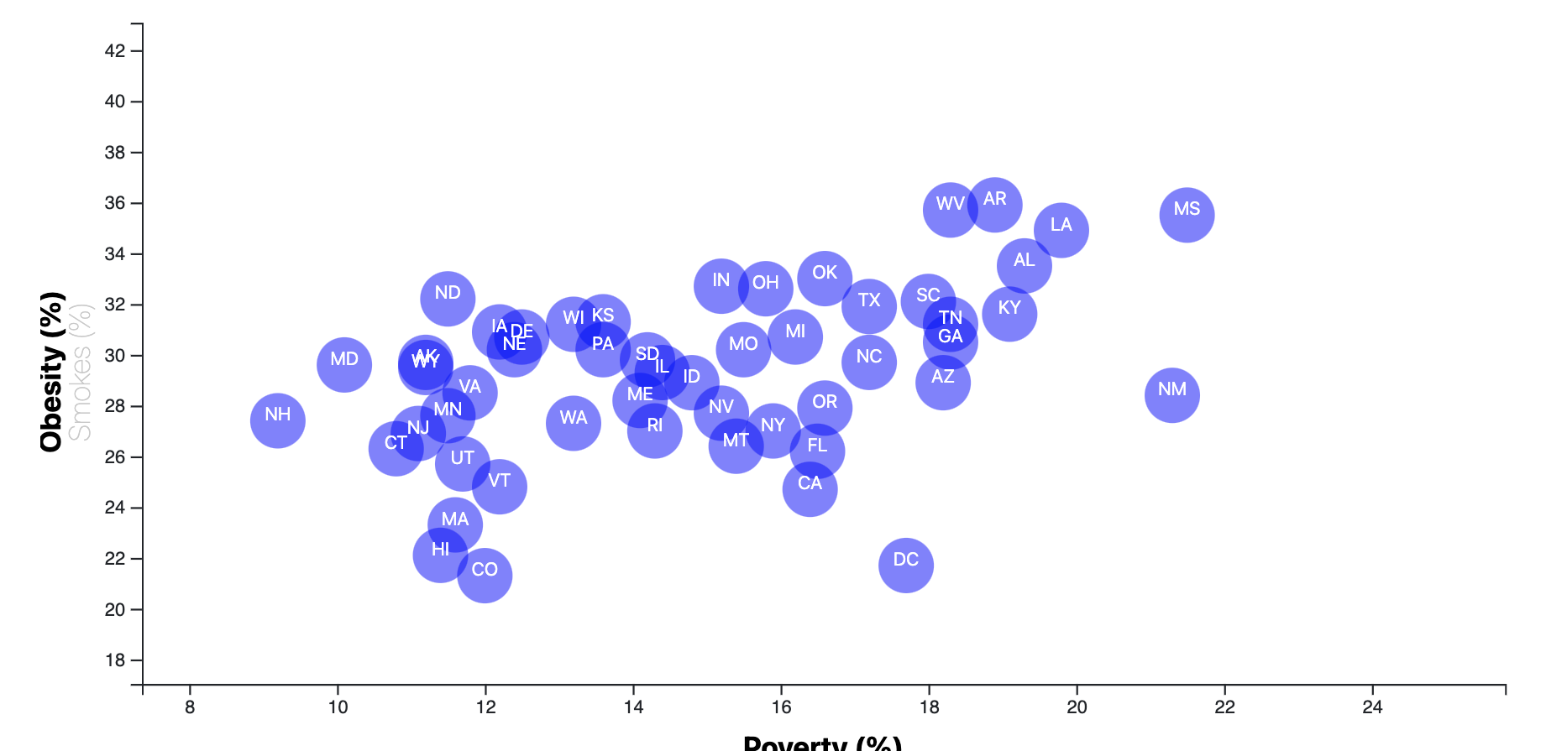
scatterplot
D3.js
Notes:
Major Points:

Slide 9

The reveal…
Notes:
Demo Points:
Start with homepage, show one of the restaurant links (from the image/logo)
Then, how the json data
Then the dashboard:
Dropdown selections:
Start with Subway, classic tuna and McDonald’s McDouble
Pick other items for a second example
Scatter plot:
Mention the x-axis are menu –items; nothing to do with size
Go through each restaurant and macronutrient

