Slide 1
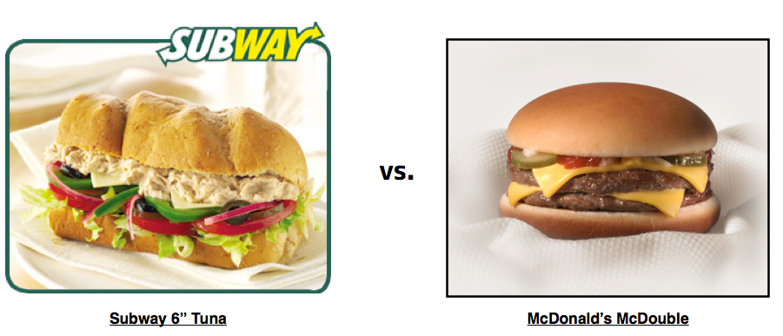
Which is healthier?
Kathy Manthey
Manuela Muñoz
Nicole Muscanell

Slide 2



purpose
Fast food nutrition dashboard
Restaurant
Food Category
Menu items
Visualizations
Stacked bar chart
Gauge charts
Scatterplot
Other features
Homepage

Slide 3

About the data
Data structure & issues
Four csv files from Kaggle
Special characters
Pairing down categories
Final data
750 menu items
10 food categories
DB with four tables
Some missing values

Slide 4
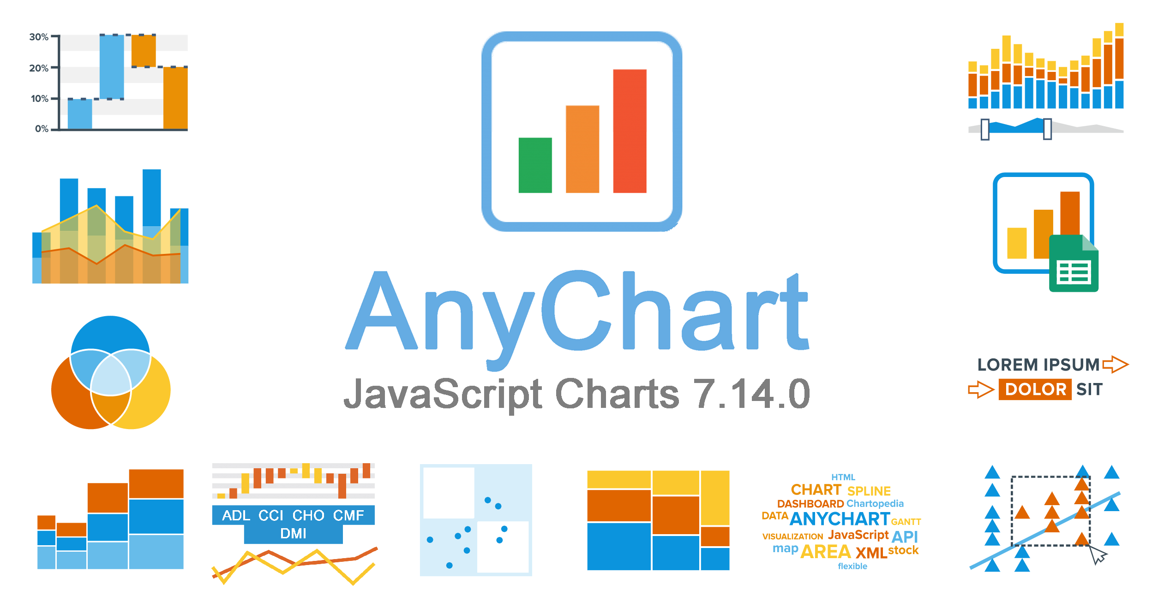




specifications
Backend
Python Flask
SQLite/Postgres
Front-end
HTML
CSS
JavaScript
JS libraries
AnyChart
D3

Slide 5
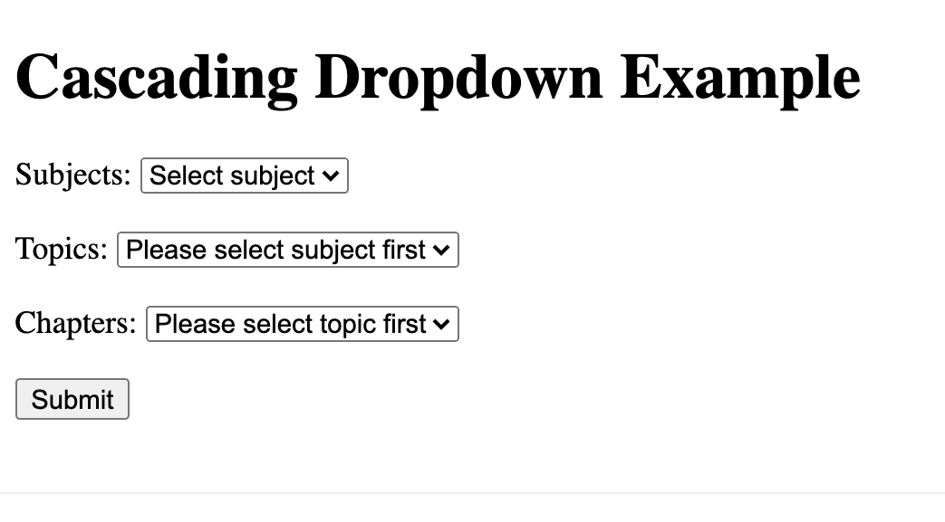
Dropdown menus
w3schools.com

Slide 6
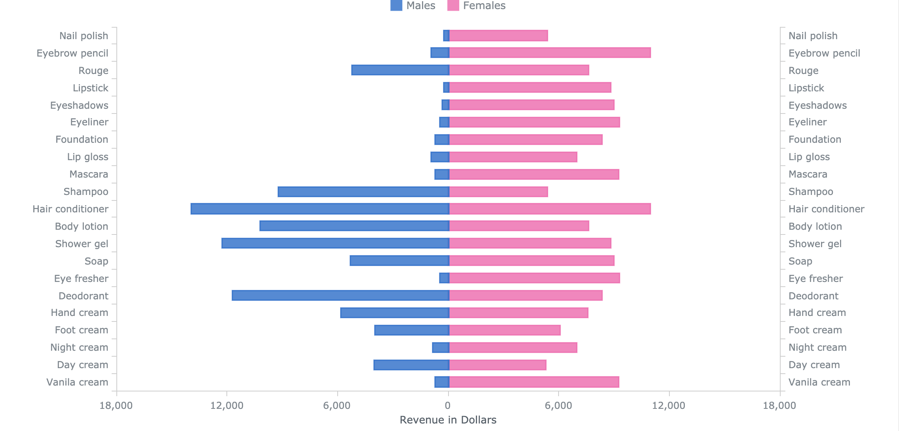
Stacked bar chart
AnyChart

Slide 7
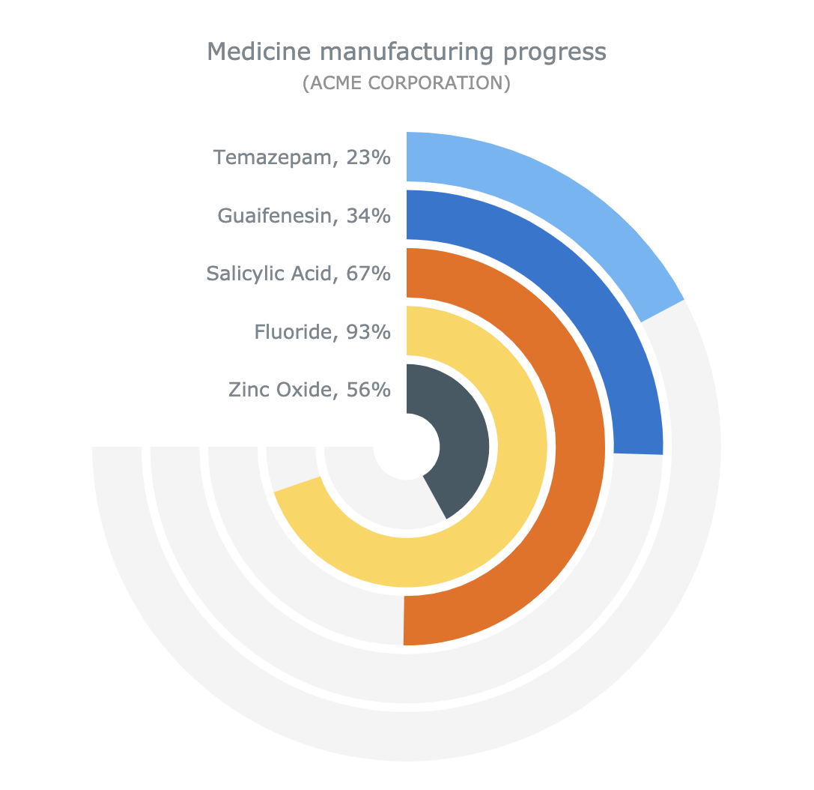
gauge charts
AnyChart

Slide 8
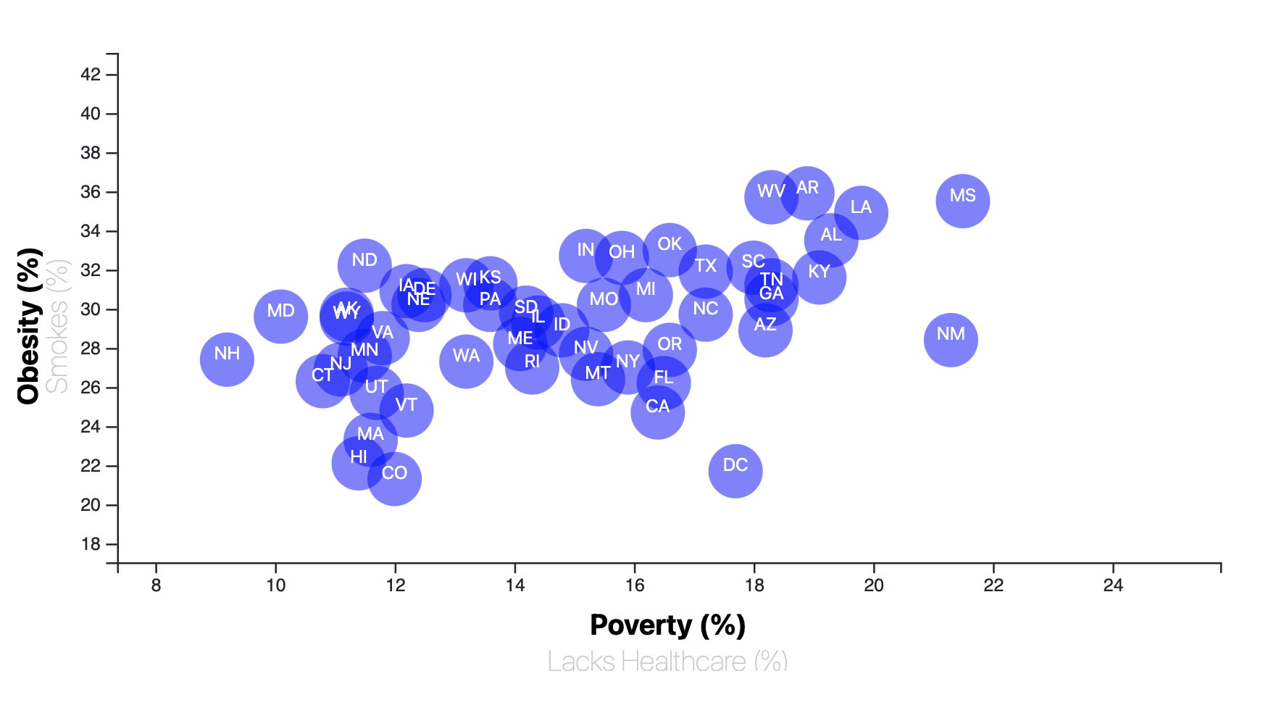
scatterplot
D3.js

Slide 9

The reveal…

