Slide 1
TD2013007: Method and System for Protecting Content from Screen-shooting
Fang Hui
Infocomm Security Department
Institute for Infocomm Research, Singapore
12 June 2013

Slide 2
Content
Introduction
Related Work
Access Control Scheme
Integrated Authentication and Access Control
Performance Analysis
Notes:
2

Slide 3
Related Work
To render content to human, content must be plaintext. But Smartphone (BYOD) is usually installed with a camera.
Ciphertext
Plaintext
HD/USB/Network
Main RAM
Visual Buffer
Screen
RAM capturing
Screen dumping
Photograph
Attack:
Buffer Interference
?
Defense:
Random Address

Slide 4
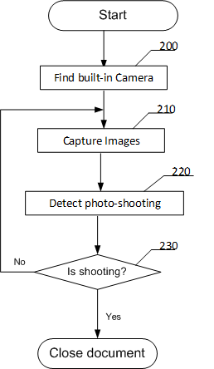
Anti-Screen-Photo Scheme

Slide 5
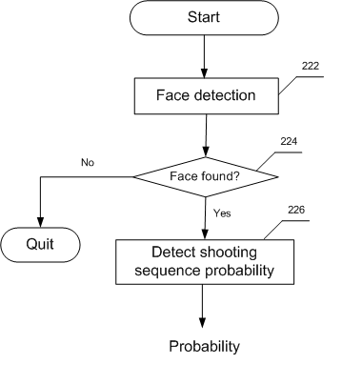
Detecting Screen-shooting
e.g., at least one hand entering camera view

Slide 6
Market
MNC Companies
Government
Military organization
Finanical

Slide 7

Implementation
PC, Monitor with built-in Camera (Asus: 27-Inch Full-HD, LEDWebcam US$300, ViewSonic: VX2703MH-LED US$284 in Amazon)
OpenCV 2.4
MS Office 2007

Slide 8
Demo

Slide 9
Thanks

