Slide 2

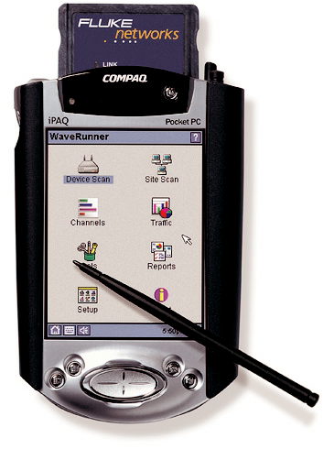


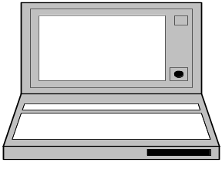
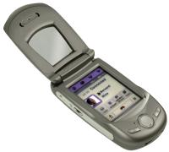

Virtual Badminton Archecture
Projector
CricketD
Server
Galaxy voice
Mobile
PDA
WWW

Slide 3
Components
Server: collect location info from 3+1 crickets,and coordinate the game process.
Mobile: I/O device,recognize voice command and show the changing (score,position) info.
PDA: I/O device,provide GUI to show the changing (score,position) info and recognize voice in speechbuilder.
WWW: access the web page for live score.
Projector: output device connected to server
Cricket : provide the 3 distances to player and calculate the position

