Slide 1
Accelerating FPC
Lokesh N
(14355)

Slide 2
Problem Definition
FPC - Foreign Plan Costing
Consider a Query Q
Assume it has two predicates p1, p2
Selectivity s1, s2
A Plan P(s1, s2) is optimal for the query Q if cost of execution of query through the plan p(s1, s2) is lesser than that of executing the same query through any other plan
FPC is estimation of the cost of executing a query through non optimal plans
  We don't want the result set but only the execution cost
Accelerating FPC is about optimizing the execution time of FPC

Slide 3
FPC Code Flow
We submit query to postgres in the form
  explain (format xml) query fpc plan.xml
Because it is an explain query, only planner gets invoked and execution of the query does not happen
We parse the query and check for fpc keyword
If fpc is present we invoke fpc library and initialize hint state
Hint state is the data structures we use to store the plan we want to force
Hint State records the following information
  Scan method for a base relation
  Join method for join relation
  Order of joins

Slide 4
Creating Hint state
The plan.xml file is parsed into a string of the form
Scan information
  IndexScan(customer)
  IndexScan(catalog_sales)
  IndexScan(date_dim)
  BitmapHeapScan(customer_address)
Order information
  Order((((date_dim catalog_sales )customer )customer_address ))
Join Information
  HashJoin(date_dim catalog_sales customer customer_address )
  NestLoop(date_dim catalog_sales customer )
  NestLoop(date_dim catalog_sales )
We parse this string again and create FpcHintState Data Structure
We also create joinmask and scanmask which stores the information about the desired join and scan method

Slide 5
GUC Configurations
GUC is Grand Unified Configuration
These are global variables that can be set by usersWe set the GUC config by the command
  SET ENABLE_SEQSCAN TO OFF;
  Now when postgres costs the sequential scan, the start-up cost gets bumped to Infinity and thereby seq scan method gets pruned away
  Postgres allows users to configure these variables per user per database
But we want fine grained control over GUC variables
Eg. consider the following hint
  IndexScan(customer)
  IndexScan(catalog_sales)
  We need to force different scans within a single query’s execution context
  Hence we need FPC to set and unset the GUC config as the query is running at appropriate places

Slide 6
Postgres Hooks
Hooks are global Function pointers exposed by postgres for third party libraries to provide custom implementation
When PostgreSQL wants to use a hook
  It checks if the global function pointer is defined
  It executes our hook if it is defined
We Currently implement 3 hooks
planner_hook
  To initialize hint state
get_relation_info_hook
  To set scan mask and delete inappropriate indexes
join_search_hook
  To force join mask

Slide 7
Avoid Index Fetching
When planner gets the information about base relation, it also gets the information about index_paths available in it.
We then call get_relation_info_hook to check if index scan is allowed, if not, we delete the index list
Hence a new hook is defined
get_index_required_hook which will check the hint sate before fetching the index_paths and fetch only if required
Since the number of base relations are mostly less than 20 this change didn't show much improvements

Slide 8


Add Parsed String to Plan.xml
On every invocation of fpc, we parse the xml file into string and load it into a hint state.
Plans are not going to be changed manually
Hence this repeated parsing is unnecessary
A new tag <parseString> which will contain the string that we obtain after parsing the plan file
For the first usage of the plan, we write the tag into the plan file
On successive invocations of the query through the same plan, only the <parseString> tag is parsed to get the plan information

Slide 9
Candidate for Optimization
Inspecting the profile for a query with 21 base relations revealed that more than 90% of the time is consumed by join_search
This should not be the case because we need not construct the DP lattice anymore
We know the plan that needs to be forced
Current implementation creates joinrelation for every relation in the DP lattice
Now we don’t make a join relation unless it is required
This way for a query with “N” relations we create only “N” joinrelations
After changes 126711 join relations reduced to 21 joinrelations

Slide 10
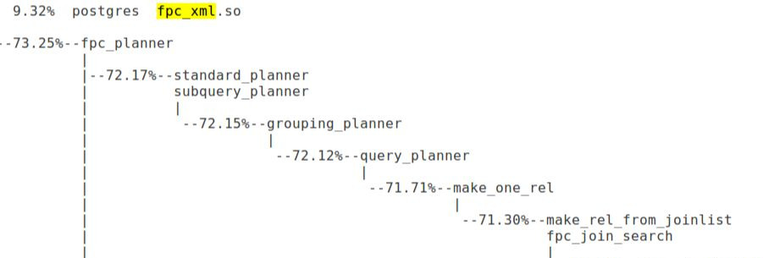
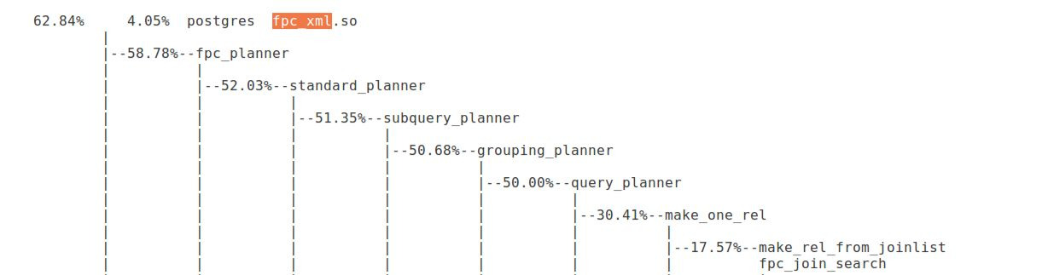
Figure 1 : Profile before changes
Figure 2: Profile after changes

Slide 11
Validation
Fetched the plans from fpc before and after changes
Validated for TPCDS queries (7, 15, 18, 19, 26, 27, 91)
Number of error prone predicates range from 3 to 6
Injected selectivities in (5 * 5) dimension with selectivities (0.00005, 0.0005, 0.005, 0.05, 0.1)
Compared the total cost of both the plans and recorded the differences
Compared the plan structure of both the plans and recorded the differences

Slide 12
Results
TPCDS Query No | 7 | 15 | 18 | 19 | 26 | 27 | 91
No Plans | 127 | 14 | 20 | 20 | 120 | 120 | 178
No Error Prone Selectivity (total no. Plans) | 4(79375) | 3(1750) | 6(312500) | 5(62500) | 4(75000) | 4(75000) | 4(111250)
Cost difference > 0.1% | 0 | 0 | 1000 | 0 | 0 | 0 | 0
Cost difference > 0.001% | 0 | 0 | 14600 | 0 | 0 | 0 | 0
Original Execution time(ms) | 23005675 | 45922 | 27923054 | 4065217 | 23510300 | 21887948 | 80314988
Optimal Execution time(ms) | 21274111 | 39811 | 22467583 | 3673301 | 21250111 | 19316161 | 56532230
% decrease in Execution time | 7.52 | 13.3 | 18.89 | 9.64 | 9.61 | 11.71 | 29.61
Plan Differences | 0 | 0 | 8500 | 0 | 0 | 0 | 0

Slide 13
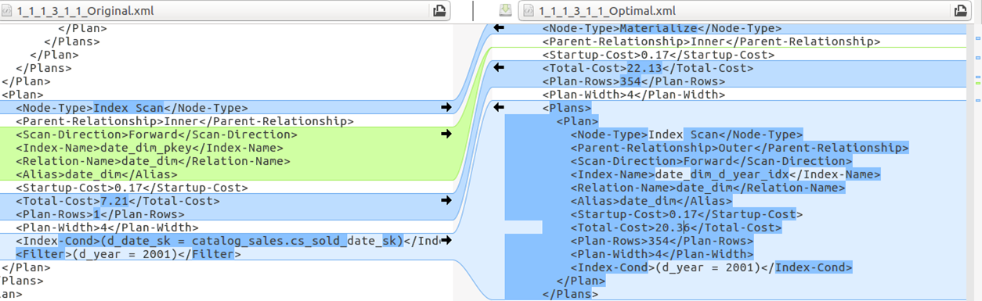
Figure 3 : Plan Difference

Slide 14
Minute Cost Differences
There are minute cost differences comparing the before and after plans
All these costs are very minute and difference is < 0.001% (it is noteworthy that plancost is in the orders of many digits)
However these differences occur because of the difference in plan-row estimation of a joinrelation
Plan Rows = outer_rows * inner_rows * jselec;
As per the analysis, Code flow is the same but there is a small change in the jselec for certain joinrelations and hence the difference
This plan rows change causes changes in the estimated cost of the plan

Slide 15
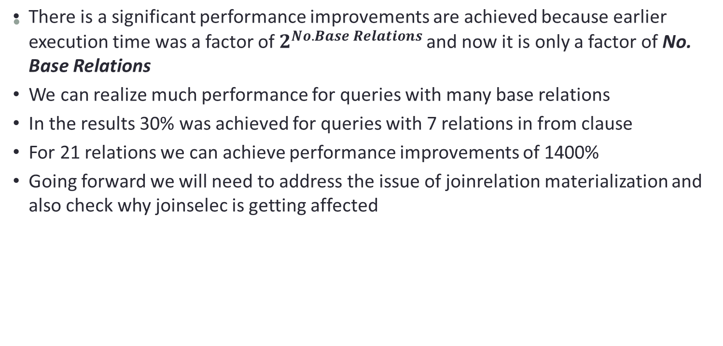
Conclusion

Slide 16
Thank You

