Slide 1


Gradient Coreset for Federated Learning
Durga Sivasubramanian*, Lokesh Nagalapatti*, Rishabh Iyer*, Ganesh Ramakrishnan*
*
*

Slide 2
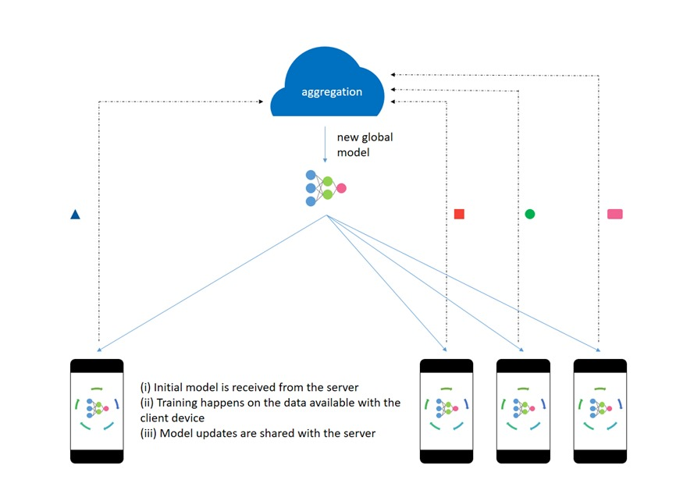
Federated Learning

Slide 3
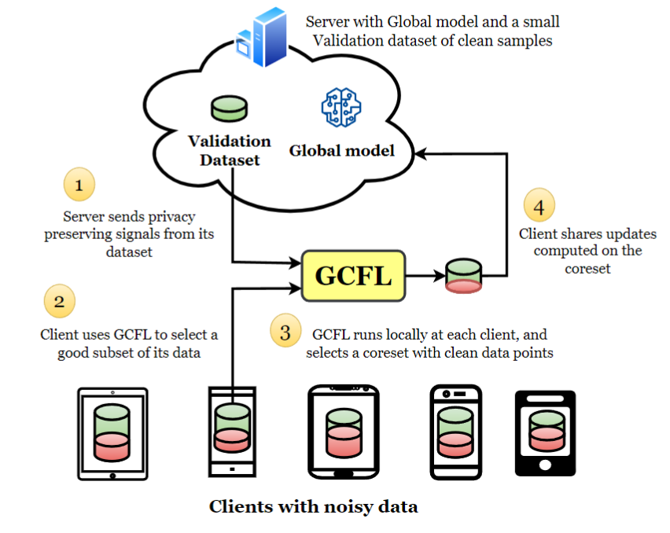
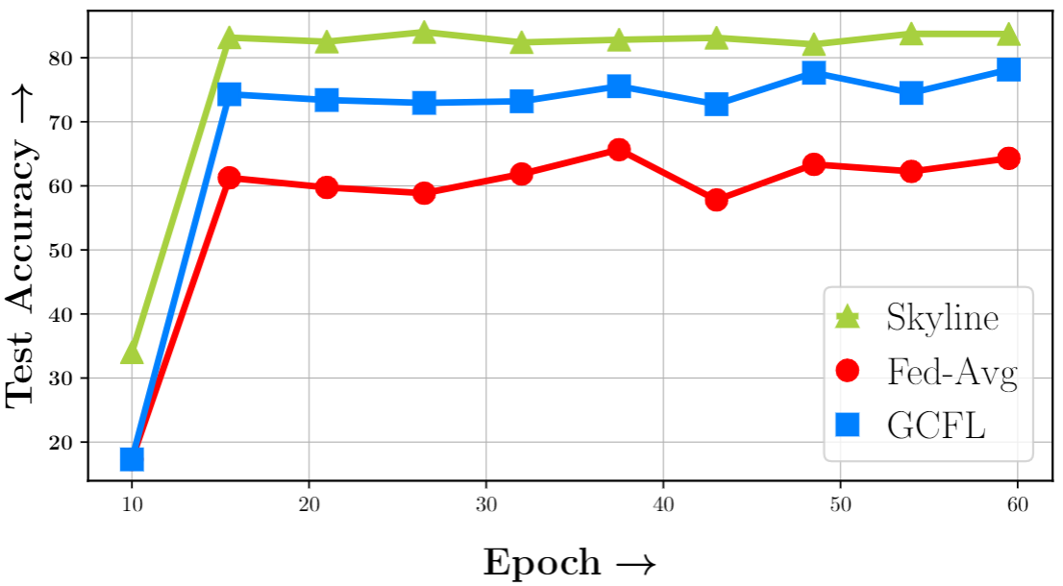
Effect of noise in federated learning

Slide 4






Problem setup
We want to train machine learning model, ground truth target distribution .
However, server has , however is too little to train any modern machine learning models.
Therefore, the server seeks help from N clients who have enough training data,
However,

Slide 5

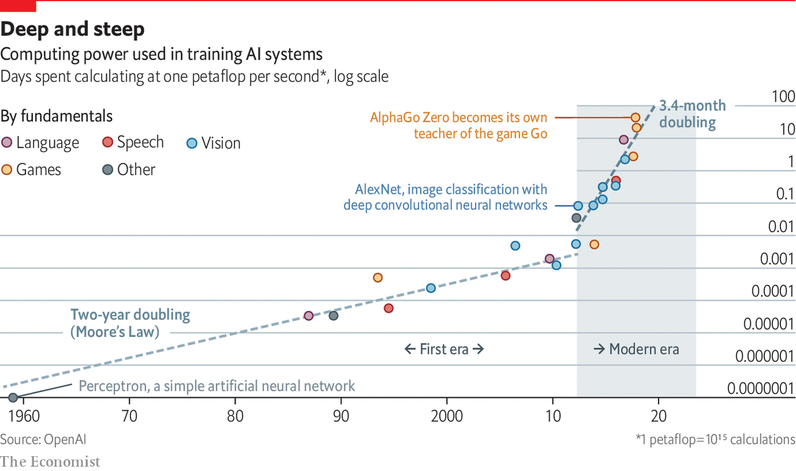


Training Costs
Energy Consumption
Environmental Impact
https://www.economist.com/technology-quarterly/2020/06/11/the-cost-of-training-machines-is-becoming-a-problem

Slide 6

Data explosion
In addition to noise introduced by client diversity, federated learning also inherits the problem of labeled data having redundancy. Can we intelligently subset client data to train a robust model efficiently?

Slide 7

Data Subset Selection
Training on an “informative” data subset enables efficient and robust learning
To select a subset of points one need to rank points based on their suitability. Ranking could be done using a static or dynamic metric.
Static metric could be diversity or representation among input features
Most dynamic metrics uses loss gradient. CRUST [1] selects subsets with most representative loss gradients. GLISTER [2] selects susbet that improves validation performance the most. GRADMATCH [3] selects subset that is best able to approximate mean gradient.
Baharan Mirzasoleiman, Jeff Bilmes, and Jure Leskovec. 2020. Coresets for data-efficient training of machine learning models.
Krishnateja Killamsetty, Durga Sivasubramanian, Ganesh Ramakrishnan, and Rishabh Iyer. 2021b. Glister: Generalization based data subset selection for efficient and robust learning. In AAAI.
Krishnateja Killamsetty, Durga S, Ganesh Ramakrishnan, Abir De, and Rishabh Iyer. 2021a. Grad-match: Gradient matching based data subset selection for efficient deep model training. In Proceedings of the 38th International Conference on Machine Learning, volume 139 of Proceedings of Machine Learning Research, pages 5464–5474. PMLR.

Slide 8
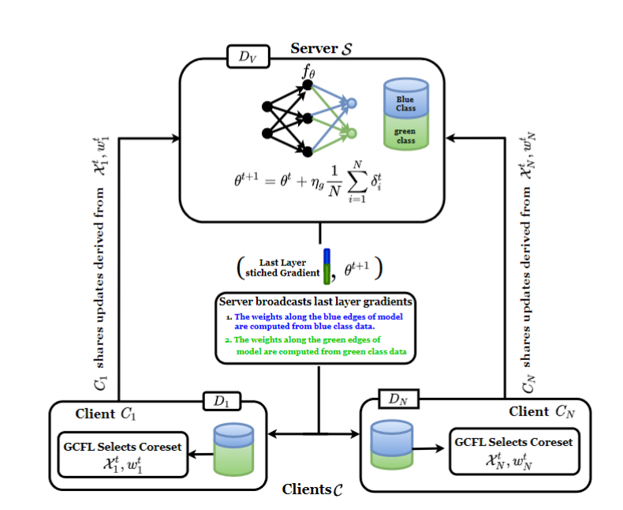
Privacy preserving subset selection - GCFL

Slide 9
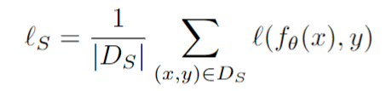
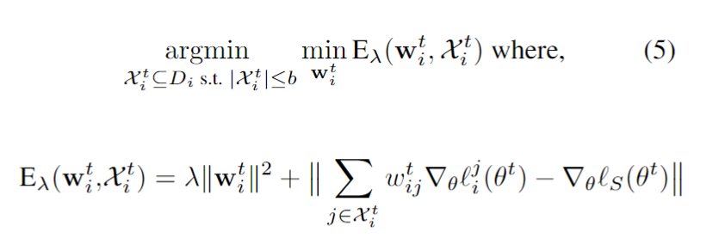
Coreset selection for Federated learning
Let loss at server's end be,
Then we wish to solve following optimization problem,
where, is loss associated with j^{th} instance of i^{th} client.

Slide 10








Subset Selection
The optimization problem is weakly submodular
Hence could be solved using greedy algorithm with approximation guarantees – we use orthogonal matching pursuit (OMP) algorithm
Find projection for each and chose the with whose projection is maximum and add it to .
Solve linear regression problem to find for .
Set .
Repeat the steps with new until the or (budget).
Return .

Slide 11
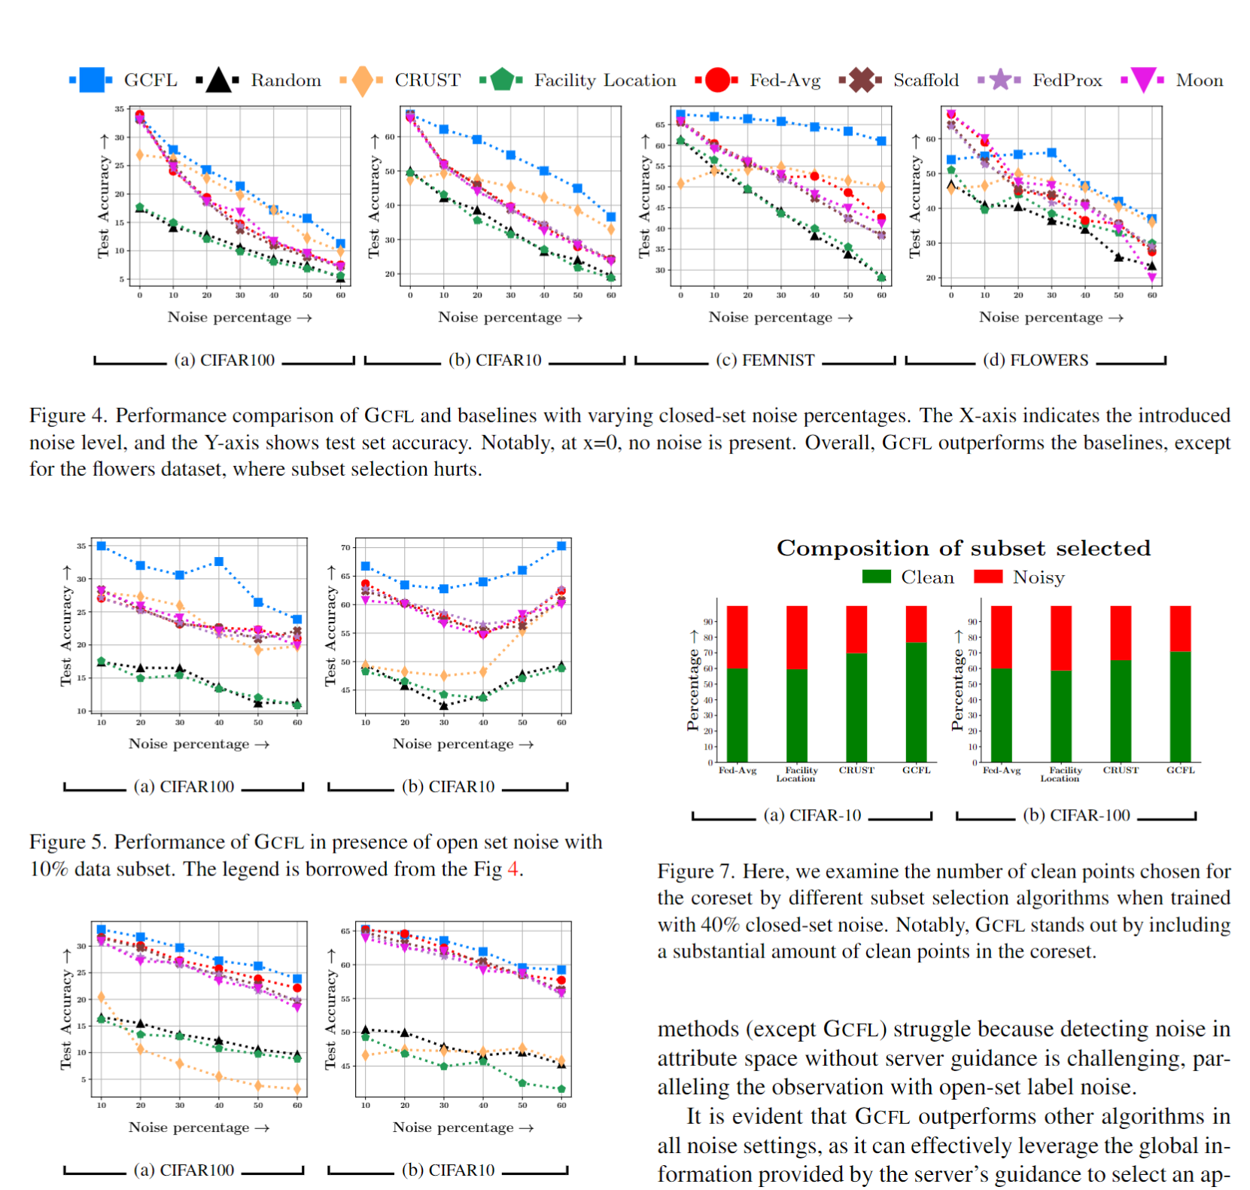
Results when clients' data is noisy

Slide 12
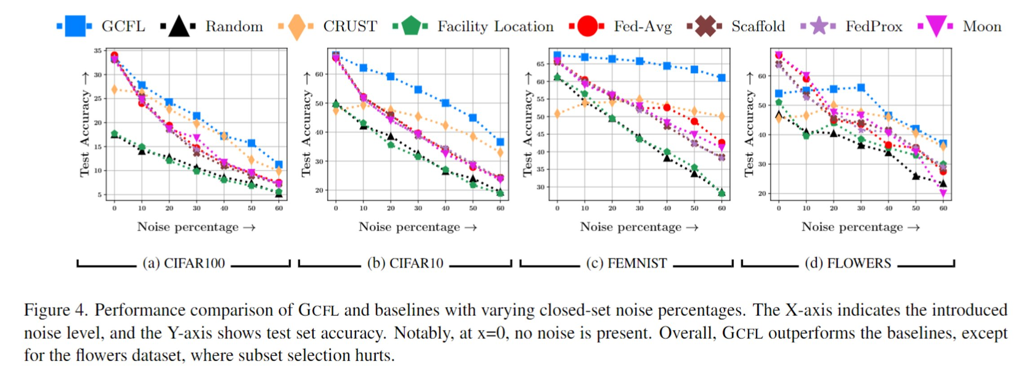
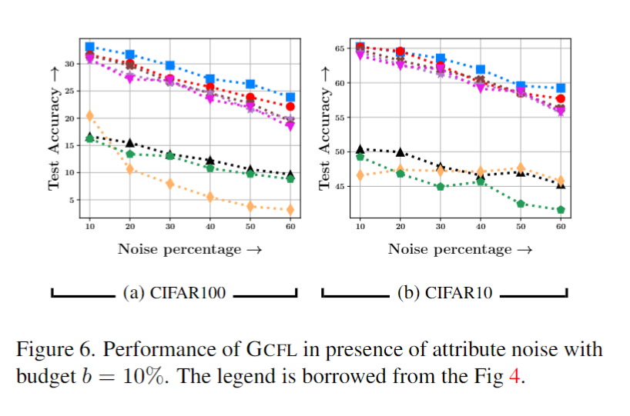
Results when clients' data is noisy
Performance of GCFL in the presence of open set noise with 10% data subset
Performance of GCFL in the presence of attibute noise with 10% data subset

Slide 13
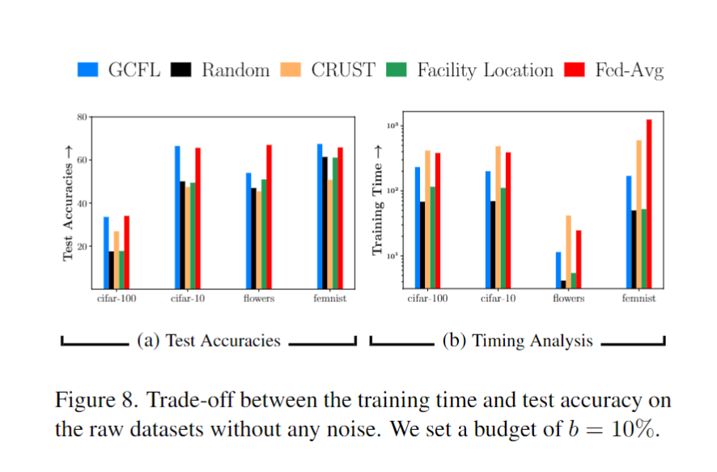
GCFL for improving training efficiency

Slide 14
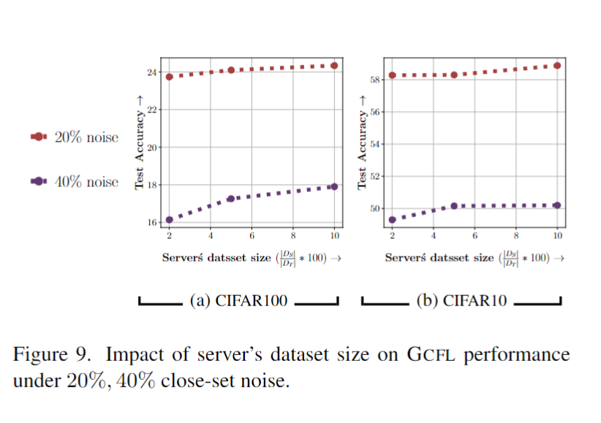
Ablation on the size of

Slide 15
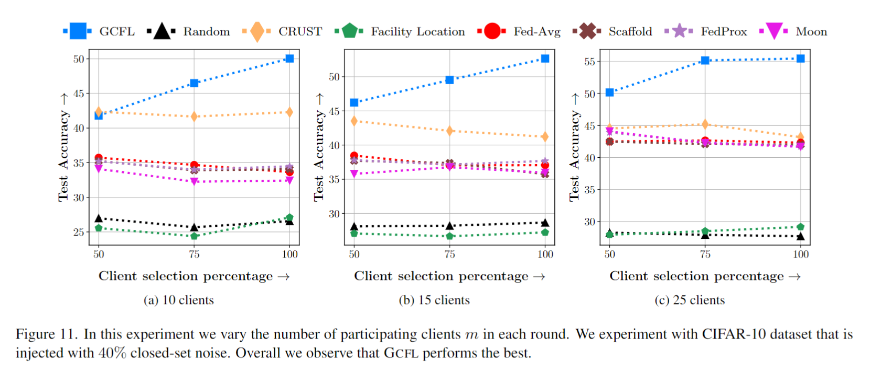
Ablation on client participation

Slide 16

Conclusion
We developed a gradient matching optimization algorithm for data efficient and robust training for federated learning settings.
We achieve best trade-offs between accuracy and efficiency while effectively mitigating the adverse impact of noise.
For more details, do visit our poster.

