Slide 1


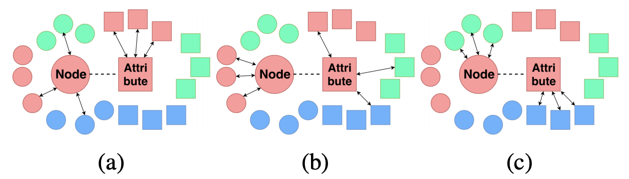
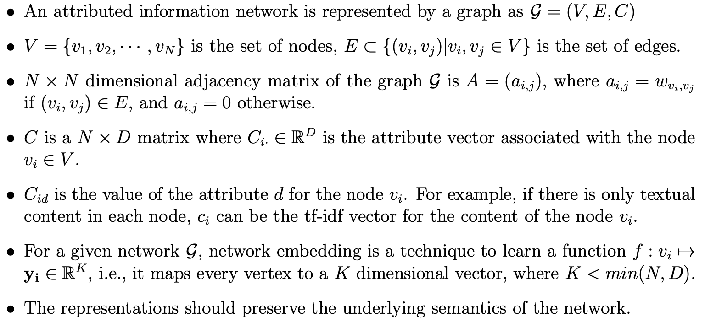
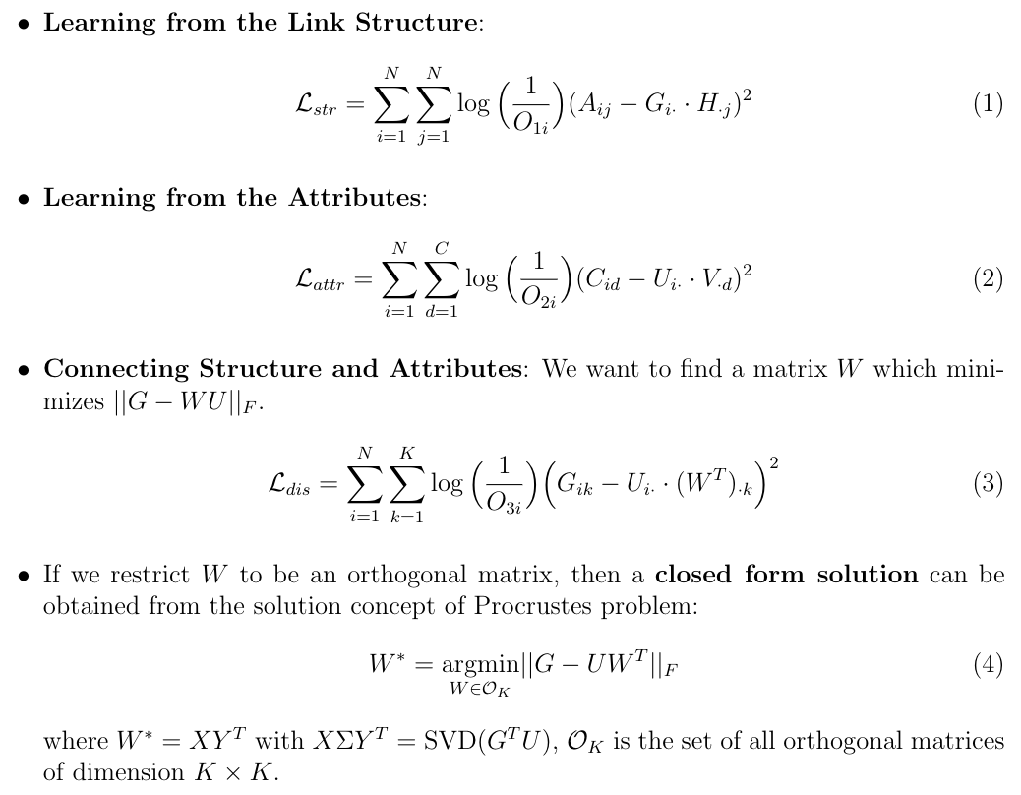
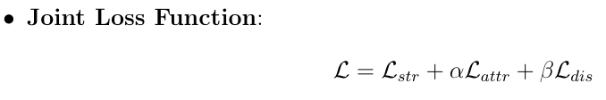
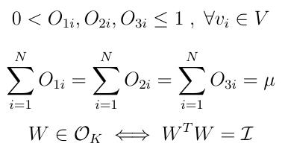
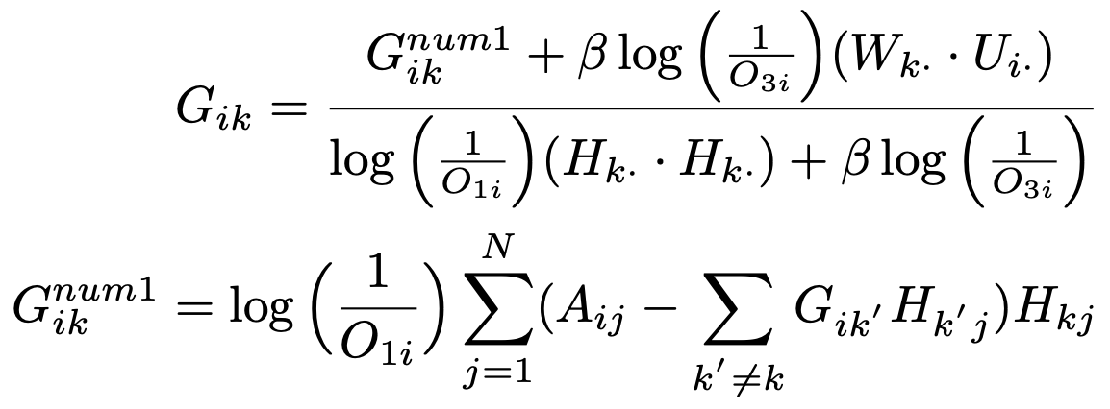
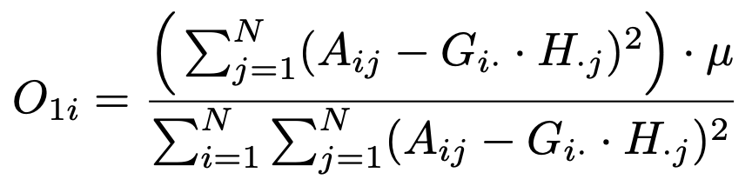
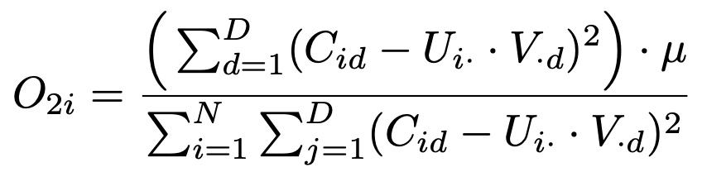
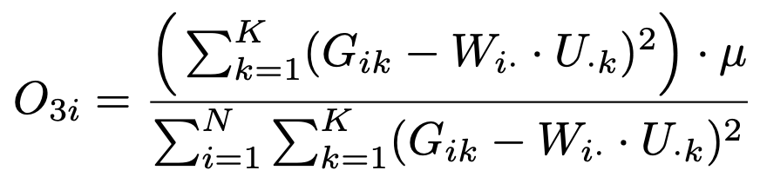
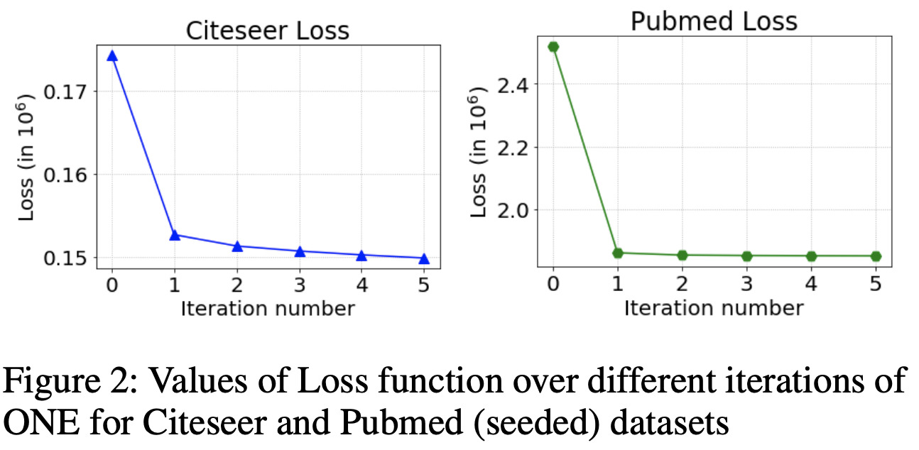
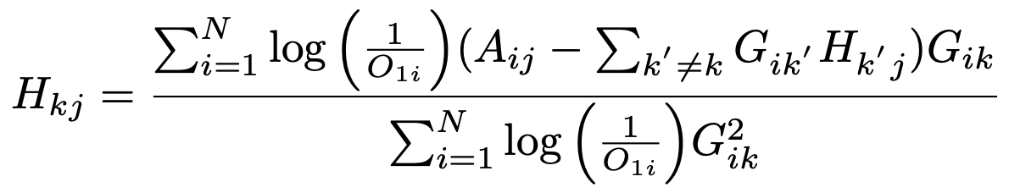

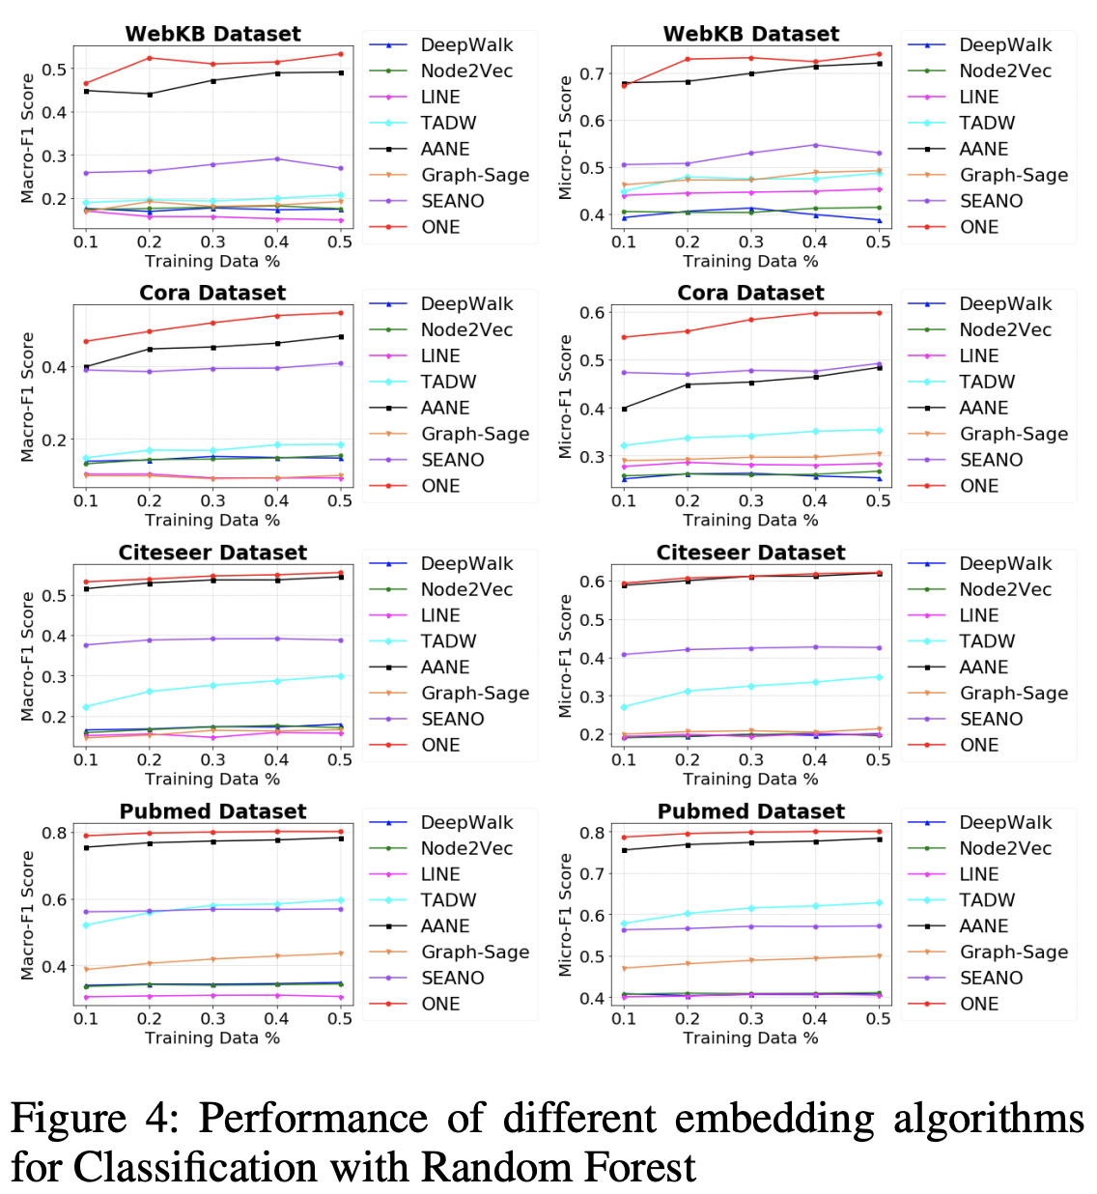
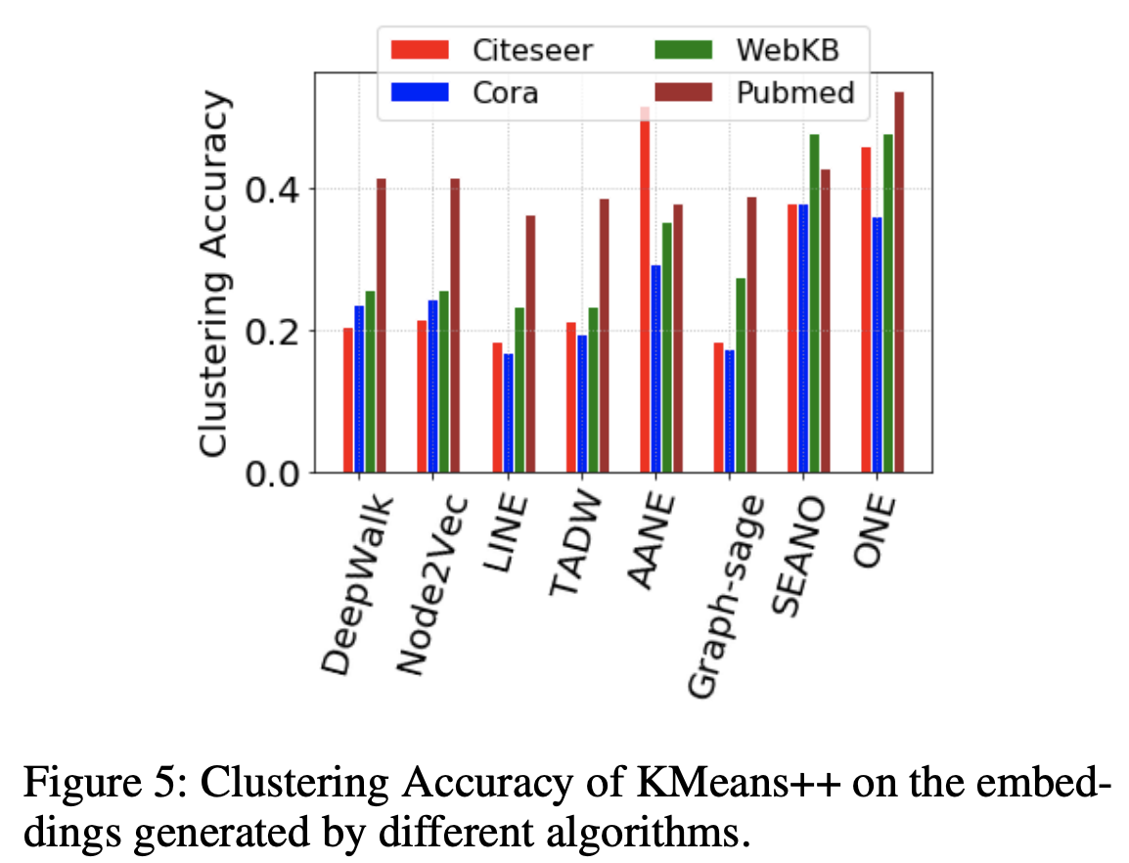
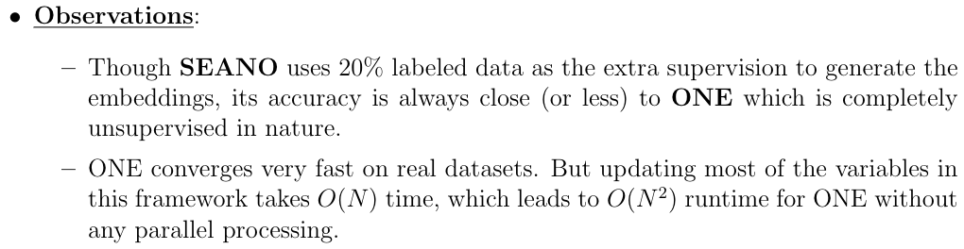
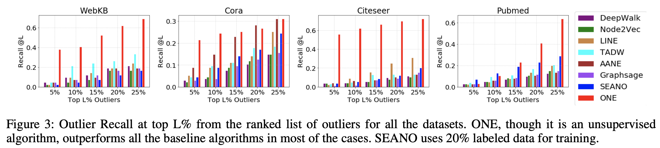
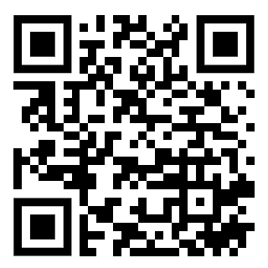
Outlier Aware Network Embedding for Attributed Networks
Sambaran Bandyopadhyay, Lokesh N, M Narasimha Murty
sambaran.ban89@gmail.com, sambband@in.ibm.com
IBM Research, India Indian Institute of Science, Bangalore
AAAI 2019 - Paper ID: 1715
Introduction and Motivation
In an attributed network, each node comes with some content within (also known as node attributes).
Existing attributed network approaches work well when the network is consistent between structure and attributes.
Real world networks often have anomalous (outlier) nodes, which affect the embeddings of other nodes in the network. Thus all the downstream network mining tasks may fail miserably in the presence of such outliers.
We proposed an unsupervised Outlier aware Network Embedding algorithm (ONE) for attributed networks, which minimizes the effect of the outlier nodes, and hence generates robust network embeddings.
To the best of our knowledge, this is the first work to propose a completely unsupervised algorithm for attributed network embedding integrated with outlier detection.
(a) Structural Outlier: The node has edges to nodes from different communities.
(b) Attribute Outlier: The attributes of the node are similar to attributes of the nodes from different communities.
(c) Combined Outlier: Node belongs to a community structurally but it has a different community in terms of attribute similarity.
Problem Formulation and Solution Approach
Update Rules and Experimental Setup
Experimental Results

