Slide 1
Assignment 3
Prince Nlombi

Slide 2
Bar/Club Hiring
Introduction (or Background):
Owning a venue and organizing times and dates for Artists who would like to book out the venue, preferable for art events. Prices and services are in a written contract
Purpose of system:
To detail and bookkeep details of events and prices in a logbook
Description: Recordings of events are detailed, with every entity presented
Entities present: Artists, Equipment, Organizers, Employees, Event

Slide 3
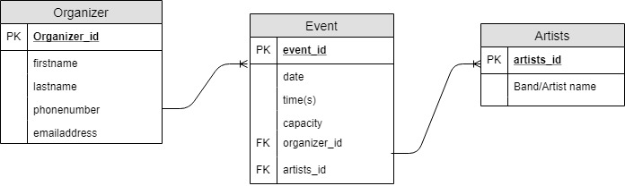
Entity Relationship Diagram

Slide 4
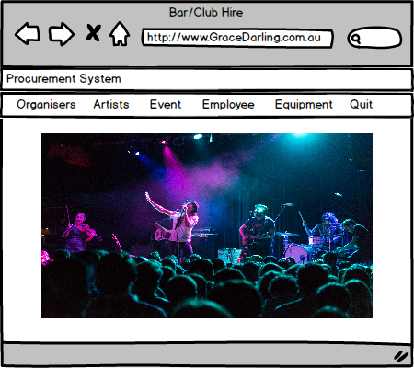
Gui Mockups

Slide 5
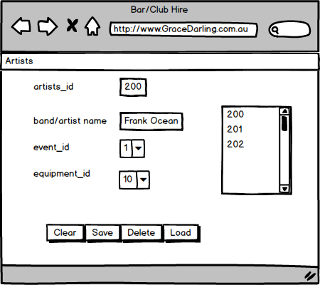
Gui Mockups

Slide 6
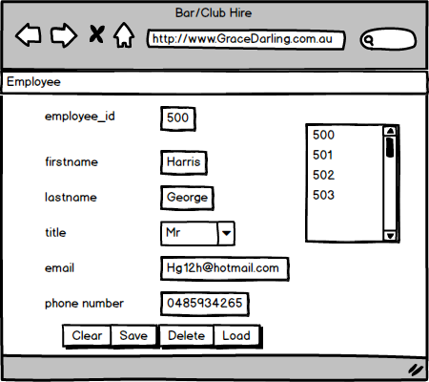
Gui Mockups

Slide 7
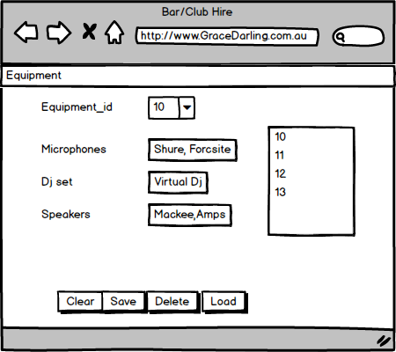
Gui Mockups

Slide 8
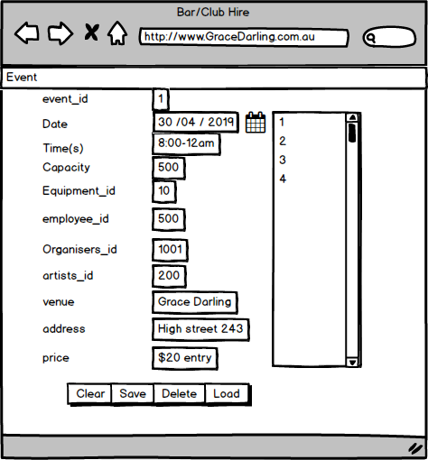
Gui Mockups

