Slide 1
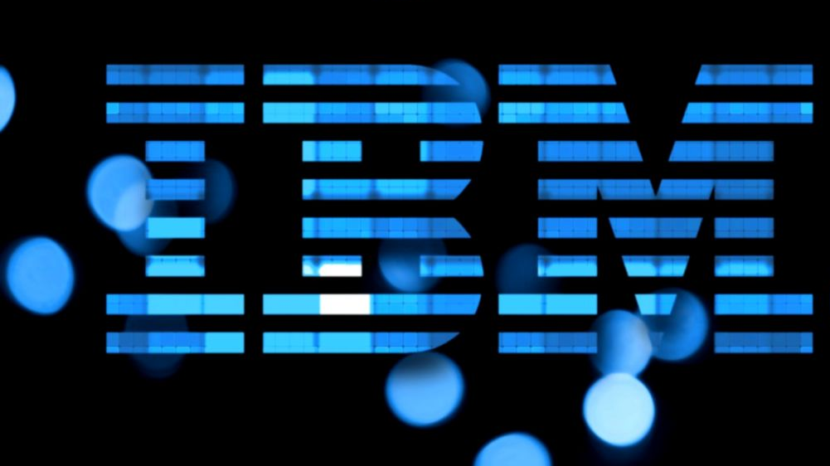
Modern Build Workflows with DBB/Git
A model for managing source during your transition to DBB/Git

Slide 2
Overview
The purpose of this deck is to provide guidance on managing source code in mixed Git and Legacy SCM (like Endevor or Changeman) during a transition to DBB/Git Pipelines.
A key goal for a successful migration is maintaining a seamless development workflow between the old and new processes.
Specifically, how to share source code that is common in a mixed SCM environment

Slide 3
Defining the scope of code sharing
Mainframe source code is typically shared within:
Programs of one product line/business unit
Privately used by one owing team
Shared across related product lines
publicly shared across a small set of teams and with clear ownership
Enterprise-wide
Publicly shared across teams with clear ownership. For example, common date routines, logging, customer master API’s …

Slide 4
Moving to Git
Changes how application source is structured, accessed and shared
Going from legacy SCM PDS(s) to many smaller application repos
More isolation = more collaboration
Today - one PDS resolves all copybook includes
Future - one or more repos will resolve copybook includes
Cross system Impact analysis and team collaboration will be an even more important best practice

Slide 5
Moving to Git – The transition phase
Sharing code between migrated and non-migrated apps is a challenge
It’s a bi-directional issue
How will migrated apps access non-migrated shared source
How will non-migrated apps access migrated shared source
Solutions
Concatenate centralized Source PDS(s) in the DBB build (SYSLIB DD)
Publish shared Repo’s in Central Source PDS used by Legacy SCM

Slide 6
Common code sharing techniques
Common mainframe component sharing techniques (aka - interfaces):
Shared source code like CICS comm-areas, or record layouts for flat files (copybooks)
Resolved - during the build process
Shared static modules
Resolved - during the binder process
Share dynamic modules
Resolved - at runtime
Shared data - like a common DB2 view or MQ feed
Resolved - at build with a private or public data structure (copybook) and as an API (dynamic or static module)

Slide 7
Managing shared code (Repo Design Ideas)
Repos
Customer Tracking - Team
Account Receivable - Team
Inventory - Team
Corp. - Common Services - Team
App(s)
Common
App(s)
Common
App(s)
Common
Common
Common code can be shared across applications in git as separate repos.
This improves visibility (where is the code) and provides more granular security access.
Folders within a repo can also be shared across teams but
managing access and configuring subfolders check-outs can be complicated.

Slide 8
Sharing code in a mixed SCM environment (legacy & Git)
Migrated App Repos
Migrated app
Private
Common
DBB Build
Concate syslib
Release process
includes a “Publish” step
Legacy PDS(s)
Non-Migrated App
Members
Publish common repo source to legacy SCM PDS(s) and
concatenate PDS’s in the groovy build process
Notes:
This illustrates how to share common source in a mixed SCM (Git and legacy tools like Endevor),
Once an application is migrated to Git (top Box), a build for that app can include Shared code residing in the Legacy SCM PDS (bottom box) via SYSLIB concatenation in groovy.
Conversely, a migrated app may publish their shared code to the Legacy SCM for use by non-migrated applications (bottom box). Publishing is only needed during the transition phase. Once all applications are migrated, they can share common code in Git as previously discussed (slide 6)

Slide 9
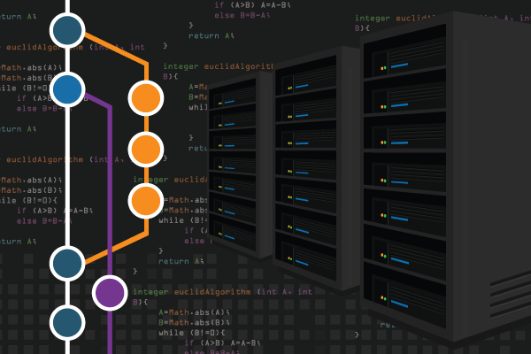
Modern DevOps Workflows - Git & Release Management
Notes:
Overall Branching - https://www.youtube.com/watch?v=FyAAIHHClqI&t=172s
Basics PR - https://www.atlassian.com/git/tutorials/making-a-pull-request
Benefits of Git - https://www.atlassian.com/git/tutorials/what-is-version-control#benefits-of-version-control

Slide 10


Git Branch Model for Mainframe Applications
Release
Point
Lead
Branch-per-Feature: allows developers to branch off a main repo to work in isolation.
Develop Branch
Feature-#52
PR
Feature-#12
Feature-#2
This example illustrates a common mainframe Branching Model. During a sprint, a developer clones from a main branch (e.g. Develop) to create a feature and work in isolation. When ready they open a Pull Request (PR) that performs a pipeline DBB build. Quality gates are also performed like peer review and automated testing. If the code passes, the PR is approved and merged into the Develop branch. The developer deletes the new feature and repeat this process for their new tasks.
GitFlow with IDz: - IDZ: clone “Develop” branch from GitHub, create a “LOCAL” feature, make some chg, test, commit/push to GitHub
- GitHub: Create PR to merge the new feature to “Develop”, peer review, pipeline Build, Approve, Delete new-feature
- IDZ: Delete new-Feature (work on next feature)
Notes:
Overall Branching - https://www.youtube.com/watch?v=FyAAIHHClqI&t=172s
Basics PR - https://www.atlassian.com/git/tutorials/making-a-pull-request
Benefits of Git - https://www.atlassian.com/git/tutorials/what-is-version-control#benefits-of-version-control
TIP: - In Git Hub change the default Branch setting to “Develop” to avoid cloning “Master”.
- Develop is refreshed by Team Leads at the end of sprints as needed or when Hot Fixes need to be merged.
- cloning https in USS use “git -c http.sslVerify=false clone repo-url…”

Slide 11
Big Picture
TagV1.0.0
TAG V2.0.0
Master
Git
Release
Dev (integration Branch)
Feature
Tools
IDz
Orchestrator
DBB/Groovy (build)
Release/Deploy Tool (UCD)
User Build
Unit Test
Team Build (CI)
Integration Test
Regression test
Functional test
Pen Test …
Runtime
User
Team
QA
Prod
Dev
QA
PROD

Slide 12
DBB Build Flow
Compile Phase- A migrated app include source from its own repo(s), a any externally shared Repo(s). It can also concatenate Dev and Prod source PDSs during the Compile phase. Common Git source changes are available to other migrated apps and can be published to a PDS to support non-migrated application builds.
Binder- includes static calls stored in:
- a user (developer) PDS for unit testing
- a Team PDS for Continuous Integration testing
- from production level PDS(s)
Go – Dynamically called modules can come from User, Team or production libraries.
Compile
Binder (link)
Go
App repo
App
Git
source
object
load
Comm
Corp
repo
Static
Dynam
Publish
Deploy
Cross
team
corp
user
team
Dev – in progress
Dev – in progress
Legacy SCM (PDS)
Cross
team
corp
Prod
prod
SYSLIB Concatenation (copybooks …)
Runtime Load PDSs

Slide 13
Summary
Moving to Git takes planning, careful design and collaboration
Good designs include clear, sound code sharing practice
Managing Git and Legacy source is achieved through
Publishing from Git to Legacy PDS’s
Concatenation of PDS’s to Groovy Build

Slide 14
The End

Slide 15
DBB Build – a basic flow
DBB Build Flow
DBB Build- uses the application’s repo and, when applicable, a Corp. Repo that's shared across team(s).
A standard DBB Build uses Git Repo(s) to compile, then link to create an executable load module.
Any shared repo(s) can be included in the application’s configuration using DBB Sample zAppBuild framework.
Compile
Binder (link)
GO
App Source
App
Git
source
object
load
Comm
Corp
repo
Notes:
This illustrates how a Git-based application can access shared Repos during a DBB build

Slide 16
DBB Build – Publishing Shared Code
DBB Build Flow
This illustrates the 2 key concepts on how to share code in a mixed SCM environment.
A) Git based apps can concatenate production PDS(s) source libraries during a DBB build. A migrated app can include source from its own Comm repo, a Corp Repo and/or Central PDS(s) managed on a legacy SCM environment.
B) Common Git source can be published to a central PDS to support non-migrated application builds.
App Source
App
source
Concat
Git
Comm
Corp
repo
Publish
Central PDS
Legacy SCM (PDS)
PROD SYSLIB Concatenation (copybooks …)
Notes:
In more complex sharing environments, a mix of migrated and non-migrated applications may need to shard common code.
This diagram illustrates one approach to support this requirement during the transition phase.
The key concept is that through normal source concatenation’s you can access both Git and PDS based source code during the compile phase. - Git source can be local to the App as well as shared corporate-wide repos.
- PDS’s can be added to the build scripts that reflect Development (In progress changes) and/or production versions.
As applications migrate to GIT, they will be locked down from further updates in the legacy SCM. During this transition, some applications will be in GIT while others remain in the legacy SCM. A migrated application can still access legacy source using standard SYSLIB PDS concatenation. This can include shared source in development and/or production libraries. Alternatively, a legacy application may need to access a migrated application’s common code. This can be supported by publishing the application’s common repo to Dev and/or Prod libraries until all applications have migrated to GIT.

Slide 17
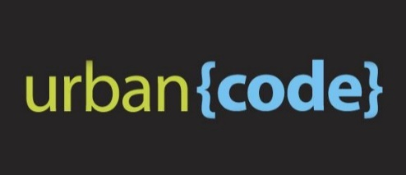
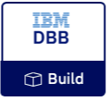
DBB/UCD – Build, Package, Release, Deploy
GIT
Urban Code Deploy
DBB
Build.groovy
Build
UCD Code Station
Component Versions
BuildReport.json
TARFILE
TARFILE
DBB
deploy.groovy
Package
TARFILE
TARFILE
Deploy
artifacts
TARFILE
TARFILE
artifacts
myapp.tar
artifacts
Load1, dbrm…
Shiplist.xml
BuzTool
Release
$LPAR=xyz
CICS – COPY LOAD
BATCH/CICS – COPY LOAD
DB2 BIND DBRM
NEWCOPY …
Continuous Integration
Continuous Deployment

Slide 18
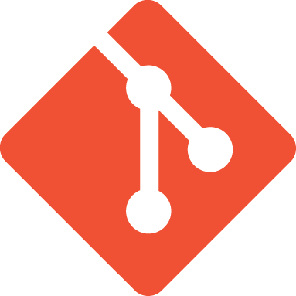



From CI to CD
GIT – Branching Model
Pipeline
CI
CD
M
M+1
Merge/rebase - Master
Prod M+1
Sprint
R+1
Release – Final Build
QA/UAT
R+1
D
PR – Integration Build
Team
F
F
User Feature build
User
F
BUILD
DEPLOY
RUN
M=Master, D=Develop, F=Feature, R=Release, +1 is a new tag version, Long Lived Branch

