Slide 1
Sample CICS - Build, Package and Deploy – UCD Flow
GIT
Build
DBB
Build.groovy
Urban Code Deploy
UCD Code Station
Component Version
BuildReport.json
Package.groovy
TARFILE
artifacts
TARFILE
TARFILE
Deploy
artifacts
artifacts
TARFILE
TARFILE
TARFILE
myapp.tar
myapp.tar
Release
Load1, dbrm…
manifest
BuzTool
$LPAR=xyz
CICS – COPY LOAD
BATCH/CICS – COPY LOAD
DB2 BIND DBRM
NEWCOPY …
Continuous Integration
Continuous Deployment

Slide 2
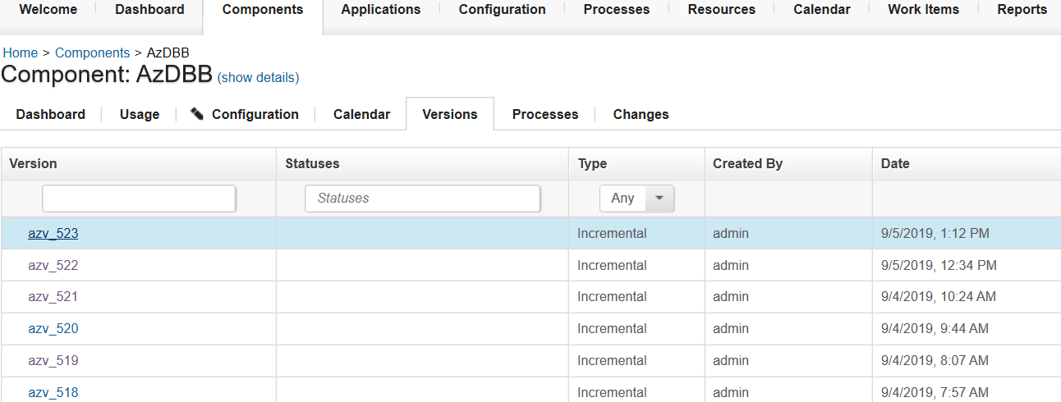
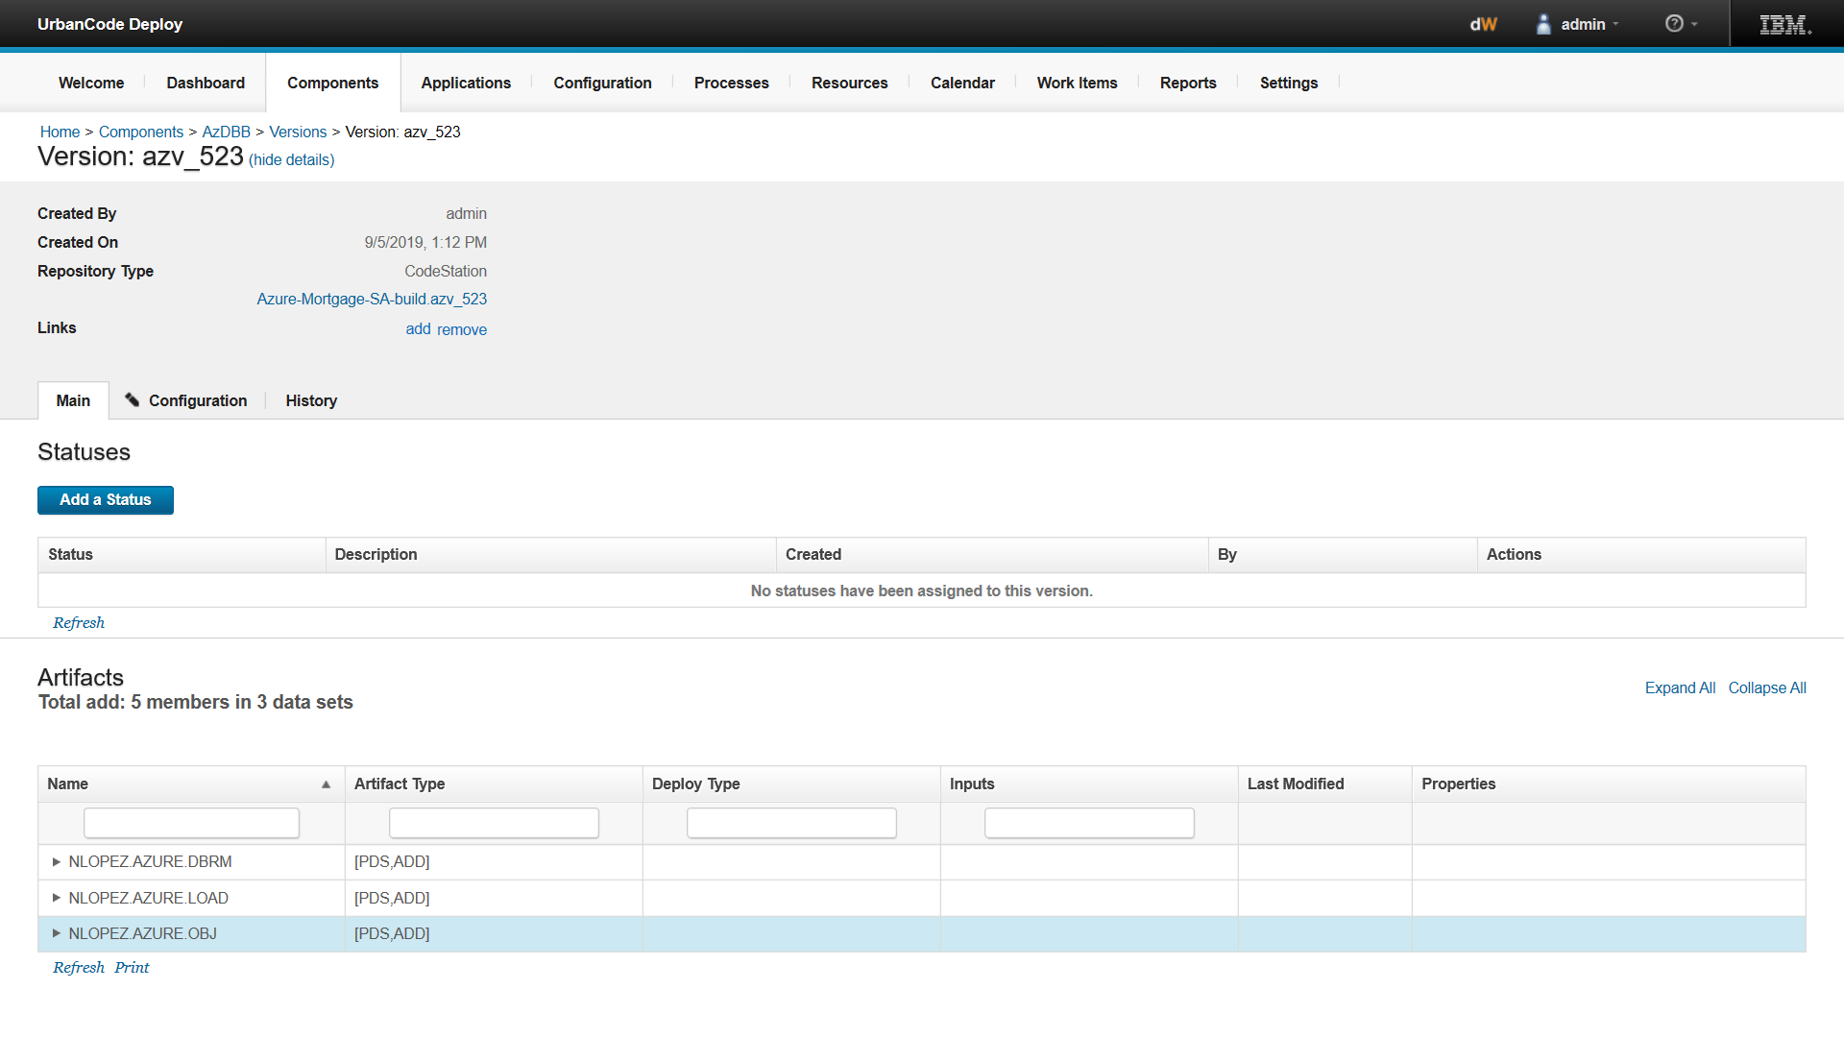
Urban Code Deploy
Artifact Store – Code Station
Artifact Store
Link to trace back to DBB Build Report for this release

Slide 3
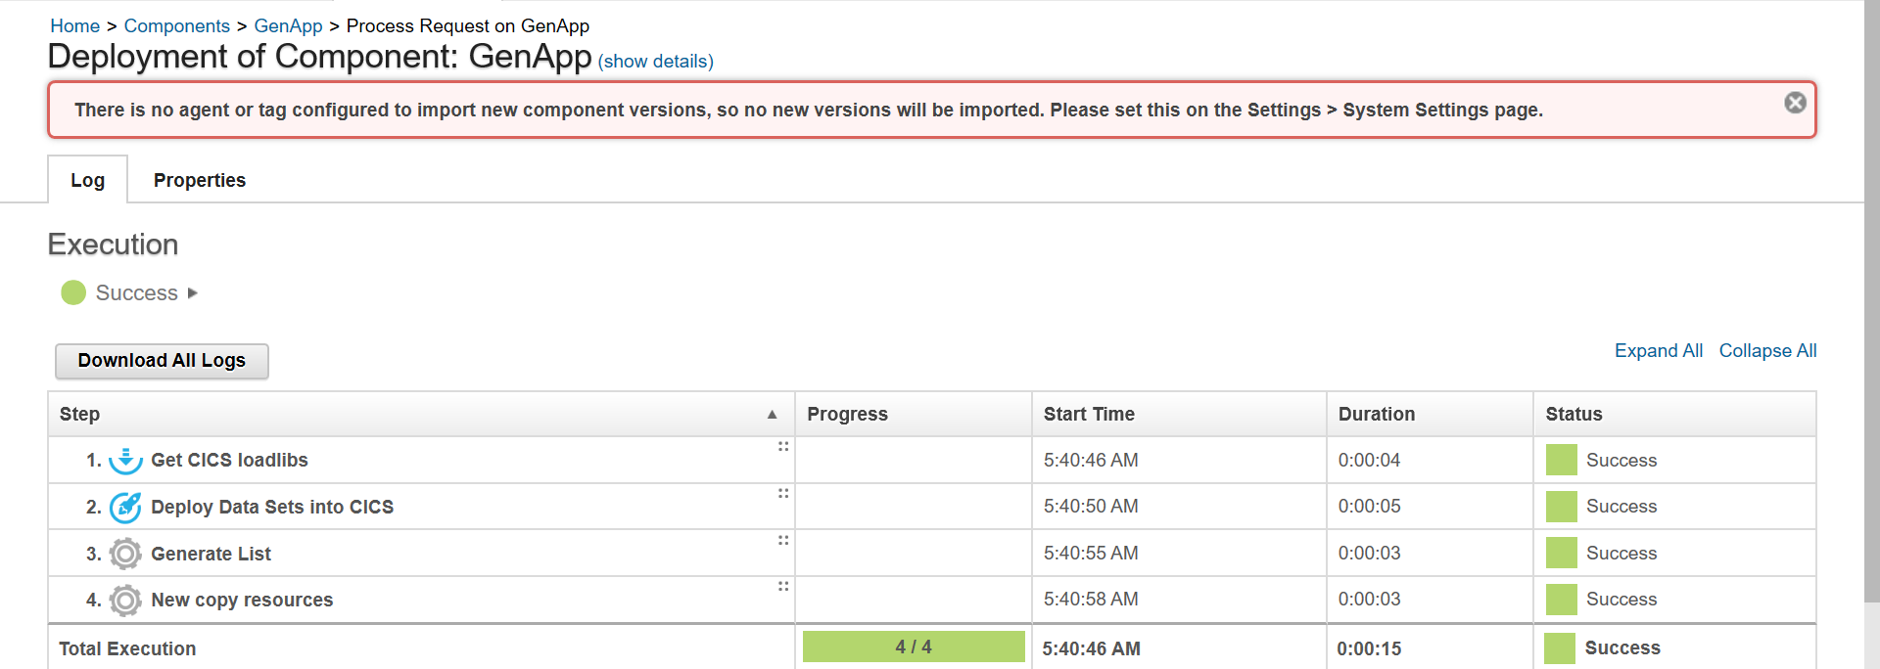
Deployment details
Deployment

Slide 4
Build, Package and Scripted Deploy - Artifactory Flow
GIT
DBB
Build.groovy
artifactory
$LPAR=xyz
CICS – COPY LOAD
BATCH/NCAL – COPY LOAD
DB2 BIND DBRM
NEWCOPY
TARFILE
TARFILE
BuildReport.json
TARFILE
Package.groovy
TARFILE
TARFILE
artifacts
TARFILE
TARFILE
Artifacts
Publish.groovy
Pull.groovy
App.yaml
TARFILE
CicsDeployUtilities.groovy
Application-conf/
deploy.$lpar.yaml

