Slide 1
Maximizing the Utility of Small Training Sets in Machine Learning
Raymond J. Mooney
Department of Computer Sciences
University of Texas at Austin

Slide 2
Computational Linguistics and
Machine Learning
Manually encoding the large amount of knowledge needed for natural-language processing (NLP), e.g. grammars, lexicons, syntactic, semantic, and pragmatic preferences, etc., is difficult and time consuming.
Machine learning techniques can automatically acquire such knowledge by discovering patterns in appropriately annotated corpora.
Machine learning techniques (a.k.a. empirical methods, statistical NLP, corpus-based methods) have been more effective at building accurate and robust NLP systems than previous “rationalist” methods based on human knowledge engineering.
Therefore, machine learning approaches have come to dominate computational linguistics, causing a “scientific revolution” in the field.

Slide 3
Demand for Annotated Corpora
Learning methods typically require large amounts of supervised training data in order to produce accurate results.
Large annotated corpora have been constructed for popular languages such as English.
  Syntax: Treebanks
  Word Sense: SENSEVAL data
  Semantic Roles: FrameNet and PropBank
Building large, clean, well-balanced, annotated corpora requires significant infrastructure and many hours of dedicated effort by expert linguists.
Constructing similar large corpora for less-studied languages is frequently not practical.

Slide 4
Treebanks
English Penn Treebank: Standard corpus for testing syntactic parsing consists of 1.2 M words of text from the Wall Street Journal (WSJ).
Typical to train on about 40,000 parsed sentences and test on an additional standard disjoint test set of 2,416 sentences.
Chinese Penn Treebank: 100K words from the Xinhua news service.
Annotated corpora exist for several other languages, see the Wikipedia article “Treebank”

Slide 5
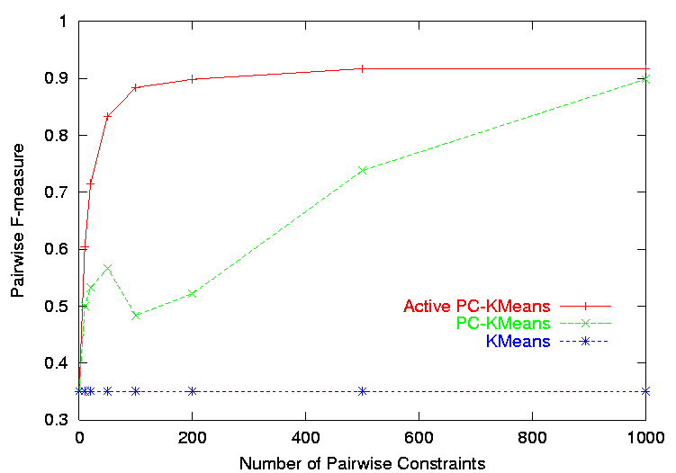
Learning from Small Training Sets
Various machine learning methods have been developed for improving generalization performance when training data is limited.
The value of such methods is evaluated using learning curves that plot accuracy vs. training-set size.

Slide 6
Methods for Improving Results on
Small Training Sets
Ensembles: Diverse committees of alternative hypotheses.
Active Learning: Selecting the most informative examples for annotation and training.
Transfer Learning: Exploiting and adapting knowledge for related problems.
Unsupervised Learning: Learning from unannotated data.
Semi-Supervised Learning: Learning from a combination of annotated and unannotated data.

Slide 7
Learning Ensembles
Learn multiple alternative definitions of a concept using different training data or different learning algorithms.
Combine decisions of multiple definitions, e.g. using weighted voting.
Training Data
⋅ ⋅ ⋅ ⋅ ⋅ ⋅ ⋅ ⋅
Data1
Data2
Data m
Learner1
Learner2
⋅ ⋅ ⋅ ⋅ ⋅ ⋅ ⋅ ⋅
Learner m
⋅ ⋅ ⋅ ⋅ ⋅ ⋅ ⋅ ⋅
Model1
Model2
Model m
Model Combiner
Final Model

Slide 8
Value of Ensembles
When combing multiple independent and diverse decisions each of which is at least more accurate than random guessing, random errors cancel each other out, correct decisions are reinforced.
Human ensembles are demonstrably better
  How many jelly beans in the jar?: Individual estimates vs. group average.
  Who Wants to be a Millionaire: Expert friend vs. audience vote.
Ensembles are particularly useful when training data is limited and therefore the variance across training samples and learning methods is more pronounced.

Slide 9
Homogenous Ensembles
Use a single, arbitrary learning algorithm but manipulate training data to make it learn multiple models.
  Data1 ≠ Data2 ≠ … ≠ Data m
  Learner1 = Learner2 = … = Learner m
Different methods for changing training data:
  Bagging: Learns a committee of classifiers each trained on a different sample of the training data [Breiman ′96]
  Boosting: Learns a series of classifiers each one focusing on the errors made by the previous one [Freund & Schapire ′96]
  DECORATE: Learns a series of classifiers by adding artificial training data to encourage diversity [Melville and Mooney ’03]

Slide 10
DECORATE
(Melville & Mooney, 2003)
Change training data by adding new artificial training examples that encourage diversity in the resulting ensemble.
Improves accuracy when the training set is small, and therefore resampling and reweighting the training set has limited ability to generate diverse alternative hypotheses.

Slide 11
Overview of DECORATE
Current Ensemble
Training Examples
+
-
C1
-
+
+
Base Learner
+
+
-
+
-
Artificial Examples

Slide 12
Overview of DECORATE
Current Ensemble
Training Examples
+
-
C1
-
+
+
Base Learner
C2
-
+
-
-
+
-
-
-
+
+
Artificial Examples

Slide 13
Overview of DECORATE
Current Ensemble
Training Examples
+
-
C1
-
+
+
Base Learner
C2
-
+
+
C3
+
-
Artificial Examples

Slide 14
Experimental Methodology
Compared DECORATE with Bagging, AdaBoost and J48
  J48 is a Java implementation of the C4.5 decision tree learner.
  We use J48 as the base learner for the ensemble methods.
  An ensemble size of 15 was used.
10x10-fold cross-validation were run on 15 UCI datasets
Learning curves were generated
  To test performance on varying amounts of training data.
  Selected different percentages of total available data as points on the learning curve.
  We chose 10 points ranging from 1-100%.

Slide 15
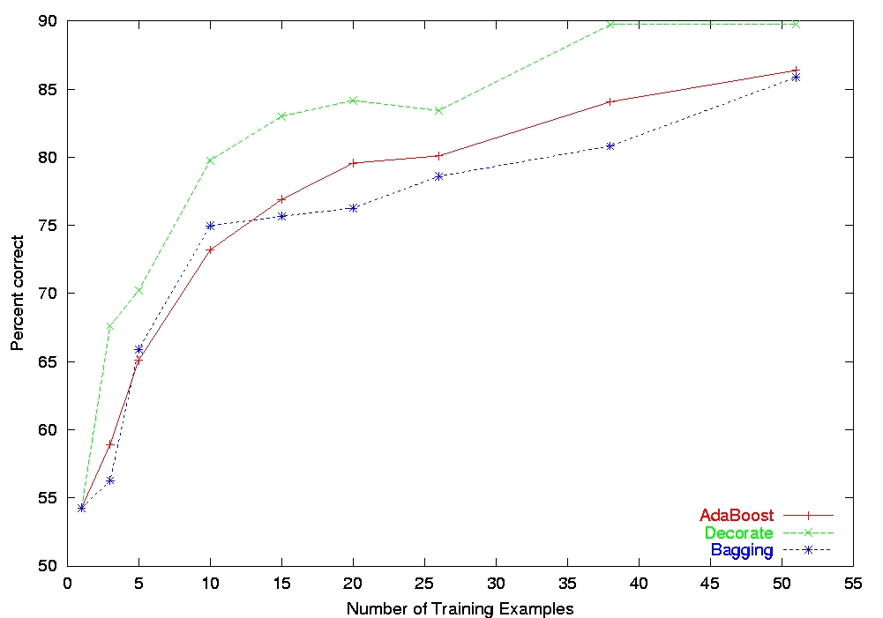
Learning Curve for Labor Contract Prediction
  Decorate achieves higher accuracies throughout the learning curve
  Small dataset (57 examples) – hence Decorate has an advantage
Notes:
So far we have looked at learning curve statistics summarized over many datasets. But we can also look at learning curves for individual datasets. I’ll present a couple of datasets that clearly demonstrate the improvements that Decorate can bring. We have plotted here the accuracies of the Decorate, bagging and boosting given varying amounts of training data from the Labor dataset. We note that Decorate achieves higher accuracies throughout the learning curve. This is primarily because Labor is quite a small dataset, with approximately 60 examples. So bagging and boosting are limited in the amount of diversity they can produce – as discussed earlier.

Slide 16
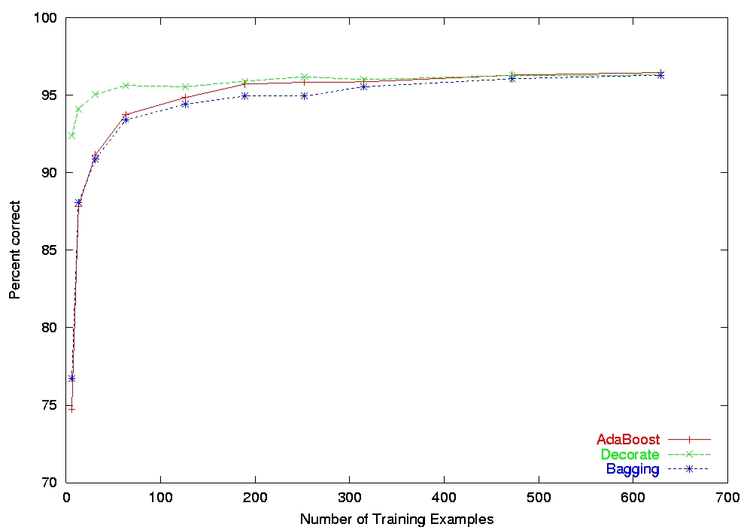
Learning Curve for Cancer Diagnosis
  Typically, performance of methods will converge given enough data.
  Mostly, Decorate achieves higher accuracy with fewer examples.
  Here it produces an accuracy > 92% with just 6 examples.
Notes:
More typically the performance of the 3 ensemble methods will converge given enough data. But in most cases Decorate achieves higher accuracy given fewer examples. In the breast cancer dataset, shown here, Decorate produces an accuracy greater than 92% with just 6 examples. (Boosting & Bagging produce almost no improvement over the base learner’s accuracy of 75%)

Slide 17
Active Learning
Most randomly-chosen examples are not particularly informative since they illustrate common phenomena that have probably already been learned.
In active learning, the system is responsible for selecting good training examples and asking a teacher (oracle) to provide a label.
In sample selection, the system picks good examples to query by picking them from a provided pool of unlabeled examples.
In query generation, the system must generate the description of an example for which to request a label.
Goal is to minimize the number of queries required to learn an accurate concept description.

Slide 18
Ensembles and Active Learning
Ensembles can be used to actively select good new training examples.
Select the unlabeled example that causes the most disagreement amongst the members of the ensemble.
Applicable to any ensemble method:
  QueryByBagging
  QueryByBoosting
  ActiveDECORATE

Slide 19
Active-DECORATE
Unlabeled Examples
Utility = 0.1
Current Ensemble
Training Examples
C1
+
+
-
C2
+
-
DECORATE
+
C3
+
-
C4
+

Slide 20

Active-DECORATE
Unlabeled Examples
Utility = 0.1
0.9
0.3
0.2
0.5
Current Ensemble
Training Examples
C1
+
+
-
C2
+
-
DECORATE
+
C3
-
-
+
C4
-
Acquire Label

Slide 21
Experimental Methodology
Compared Active-Decorate with QBag, QBoost and Decorate (using random sampling)
  Used ensembles of size 15
  Used J48 as the base learner
2x10-fold cross-validations were run on 15 UCI datasets
In each fold, learning curves were generated
  The set of available examples treated as unlabeled pool
  At each iteration, the active learner selected sample of examples to be labeled and added to training set
  For passive learner, Decorate, examples were selected randomly
At the end of the learning curve, all systems see the same training examples.
  The curves evaluate the how well an active learner orders the set of examples in terms of utility

Slide 22
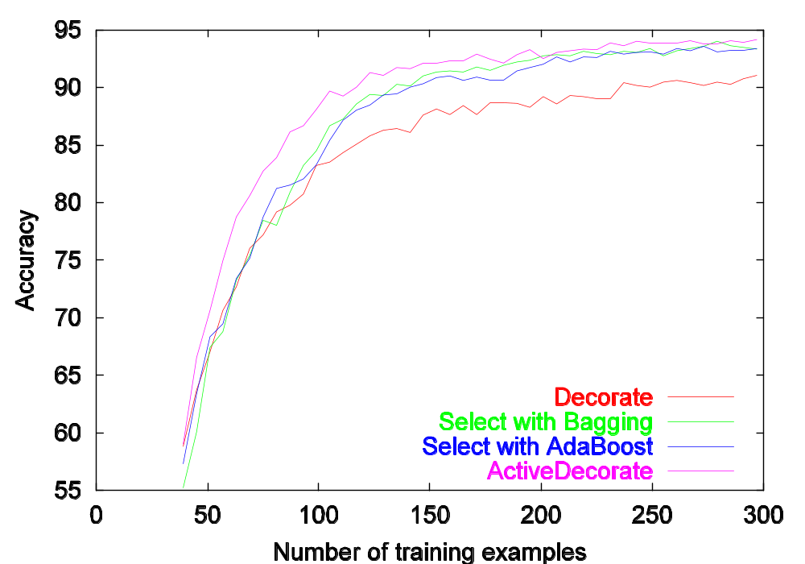
Learning Curve for Soybean Disease Diagnosis
≈ 60% savings
in supervision

Slide 23
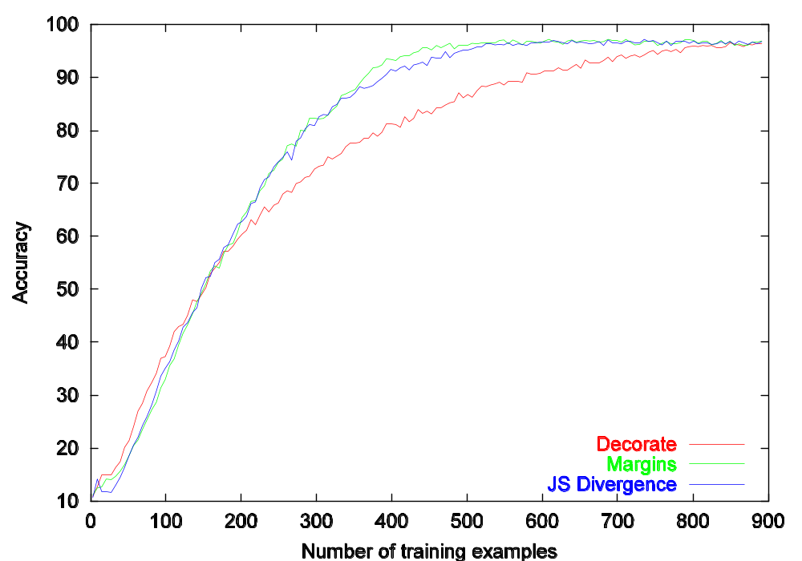
Learning Curve for Spoken Vowel Recognition
≈ 50% savings
in supervision

Slide 24
Transfer Learning a.k.a. Adaptation, Learning to Learn, Lifelong Learning
Use learning on a previous related problem (the source) to improve learning on the current problem (the target) .
Various approaches:
  Use model learned from source as a statistical prior for the target.
  Hierarchical Bayesian Models and Shrinkage
  Theory revision: Adapt learned source model to the target.
  Multitask Learning: Learn one model for multiple related tasks.

Slide 25
Using Source as a Prior
Use a statistical model trained on the source to provide priors for estimating the parameters for the target.
Requires the target and the source to have the same set of features.
Equivalent to “corpus mixing” in which data from the source is mixed with data from the target prior to training.
  Usually weight the target data more heavily.

Slide 26
Corpus Mixing
Target Training Examples
+
-
-
+
-
-
+
-
-
Classifier
-
Learner
+
-
+
+
+
-
-
+
+
Source Training Examples

Slide 27
Corpus Mixing Results
(Roark and Bacchiani, 2003)
Test transfer learning for statistical syntactic treebank parsing from one English corpus to another.
Source training data is 21,818 sentences from the Brown corpus.
Target data is from Wall Street Journal.
  Training set size varied.
  Test set of 2,245 sentences
Target data weighted 5 times as much as source data.
Target Domain Training Size | Baseline F-Measure | Transfer F-Measure
2,000 sentences | 80.50% | 83.05%
4,000 sentences | 82.60% | 84.35%
10,000 sentences | 84.90% | 85.40%

Slide 28
Transferring from One Language to Another
Many transfer methods require the same features in the target and source.
Since in computational linguistics, the features are typically words, this prevents transfer across languages.
However, if a word-aligned parallel bilingual corpus is available, annotation can be “projected” from a source to a target language.
Statistical word alignment tools like GIZA++ can be used to align words in a parallel bilingual corpus.
Once annotation has been projected across a parallel corpus from a source to target language, the resulting data can be used to train an analyzer in the target domain.

Slide 29
Projecting a POS Tagger
(Yarowsky & Ngai, 2001)
English POS Tagger
DT JJ NN IN JJ NN
English: a significant producer for crude oil
Word alignment
French: un producteur important de petrole brut
DT NN JJ IN NN JJ Projected POS Tags
POS Tag Learner
French POS Tagger

Slide 30
POS Tagging Transfer Results
(Yarowsky & Ngai, 2001)
Evaluate on English-French Canadian Hansards parallel corpus (2 million words).
Model | Aligned French | Novel French
Project from English | Core: 76% Full: 69% | N/A
Trained on Projected Data | Core: 96% Full: 93% | Core: 94% Full: 91%
Directly Trained on 100K French Words | Core: 97% Full: 96% | Core: 98% Full: 97%

Slide 31
Unsupervised Learning
Unannotated text is typically much easier to obtain than annotated text.
However, purely unsupervised learning typically does not result in the desired analyses.
  Early results on unsupervised induction of probabilistic context grammars was very disappointing (Lari & Young, 1990).
  They tend to find structure in data that reflects a complex combination of semantic and syntactic regularities.
  This lead to the focus on developing supervised treebanks.
Recent unsupervised learning methods using appropriately constrained probabilistic dependency models have successfully induced grammatical structure from unannotated text (Klein and Manning, 2002; 2004)

Slide 32
Semi-Supervised Learning
Use a combination of unlabeled and labeled data to improve accuracy.
Typically labeled set is small and unlabeled set is much larger since it is easier to obtain.
Methods for semi-supervised learning:
  Self-labeling and semi-supervised EM
    Ghaharami & Jordan, 1994; Nigam et al., 2000
  Co-training
    Blum & Mitchell, 1998
  Transductive Support Vector Machines (SVM’s)
    Vapnik, 1998; Joachims, 1999
  Hidden Markov Random Field (HMRF)
    Basu, Bilenko, & Mooney, 2004

Slide 33
Self-Labeling
Training Examples
Unlabeled Examples
+
+
-
Learner
Classifier
-
-
+
+
-
+
+

Slide 34
Self-Labeling
Training Examples
+
+
-
Learner
Classifier
-
-
+
+
-
+
+
Classifier retrained on automatically labeled
data is frequently more accurate

Slide 35
Semi-Supervised EM
Training Examples
Unlabeled Examples
+
+
−
-
Prob. Learner
Prob.
Classifier
+
−
-
+
−
+
+
−
+
+
−

Slide 36
Semi-Supervised EM
Training Examples
+
+
−
-
Prob. Learner
Prob.
Classifier
+
−
-
+
−
+
+
−
+
+
−

Slide 37
Semi-Supervised EM
Training Examples
+
-
Prob. Learner
Prob.
Classifier
-
+
+
+
−
+
−
+
−
+
−
+
−

Slide 38
Semi-Supervised EM
Training Examples
Unlabeled Examples
+
+
−
-
Prob. Learner
Prob.
Classifier
+
−
-
+
−
+
+
−
+
+
−

Slide 39
Semi-Supervised EM
Training Examples
+
+
−
-
Prob. Learner
Prob.
Classifier
+
−
-
+
−
+
+
−
+
+
−
Continue retraining iterations until probabilistic labels on unlabeled data converge.

Slide 40
Semi-Supervised EM Results
Experiments on assigning messages from 20 Usenet newsgroups their proper newsgroup label.
With very few labeled examples (2 examples per class), semi-supervised EM significantly improved predictive accuracy:
  27% with 40 labeled messages only.
  43% with 40 labeled + 10,000 unlabeled messages.
With more labeled examples, semi-supervision can actually decrease accuracy, but refinements to standard EM can help prevent this.
  Must weight labeled data appropriately more than unlabeled data.
For semi-supervised EM to work, the “natural clustering of data” must be consistent with the desired categories
  Failed when applied to English POS tagging (Merialdo, 1994)

Slide 41
Semi-Supervised EM Example
Assume “Catholic” is present in both of the labeled documents for soc.religion.christian, but “Baptist” occurs in none of the labeled data for this class.
From labeled data, we learn that “Catholic” is highly indicative of the “Christian” category.
When labeling unsupervised data, we label several documents with “Catholic” and “Baptist” correctly with the “Christian” category.
When retraining, we learn that “Baptist” is also indicative of a “Christian” document.
Final learned model is able to correctly assign documents containing only “Baptist” to “Christian”.

Slide 42
Semi-Supervised Clustering
Uses limited supervision to aid unsupervised clustering of data.
Does not assume the user has a predetermined set of known classes in mind.
Supervision is typically given in the form of pairwise constraints:
  Must-link: These two instances should be in the same class.
  Cannot-link: These two instances should be in different classes.

Slide 43
Semi-Supervised Clustering with Pairwise Constraints
# Publications
Prof
2-way clustering
Student
Linguist
Computer Scientist
Programming Ability

Slide 44
Semi-supervised Clustering with Pairwise Constraints
# Publications
Prof
2-way clustering
Student
Cannot-link
Must-link
Linguist
Computer Scientist
Programming Ability

Slide 45
Semi-Supervised Clustering with
Hidden Markov Random Fields (HMRFs)
HMRFs provide a well-founded probabilistic model for clustering data (Basu, Bilenko, & Mooney, 2004) that considers both:
  Similarity between instances in a cluster.
  Consistency with supervisory pairwise constraints.
Variant of the k-means clustering algorithm was developed for inferring the most likely class assignments in an HMRF model.
Active-learning algorithm was also developed for selecting informative pairwise supervision queries (Basu, Banerjee, & Mooney, 2004).
  Should these two examples be put in the same class?

Slide 46
Active Semi-Supervised Clustering on
Classifying Messages from 3 Newsgroups
talk.politics.misc vs. talk.politics.guns, vs. talk.politics.mideast
≈ 80% savings
in supervision!

Slide 47
Conclusions
Typically, machine learning and data mining methods are seen as requiring large amounts of (annotated) training data.
However, a variety of techniques have been developed for improving the accuracy of models learned from small training sets.
  Ensembles
  Active Learning
  Transfer Learning
  Unsupervised Learning
  Semi-Supervised Learning
These techniques (and others) may help develop robust computational-linguistics tools from the limited data available for less studied languages.

