Slide 1


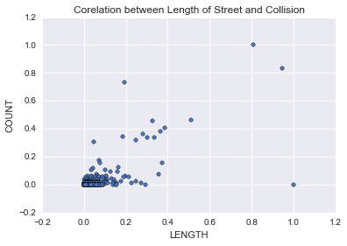
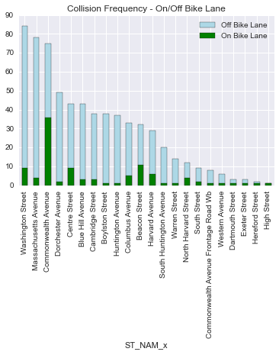
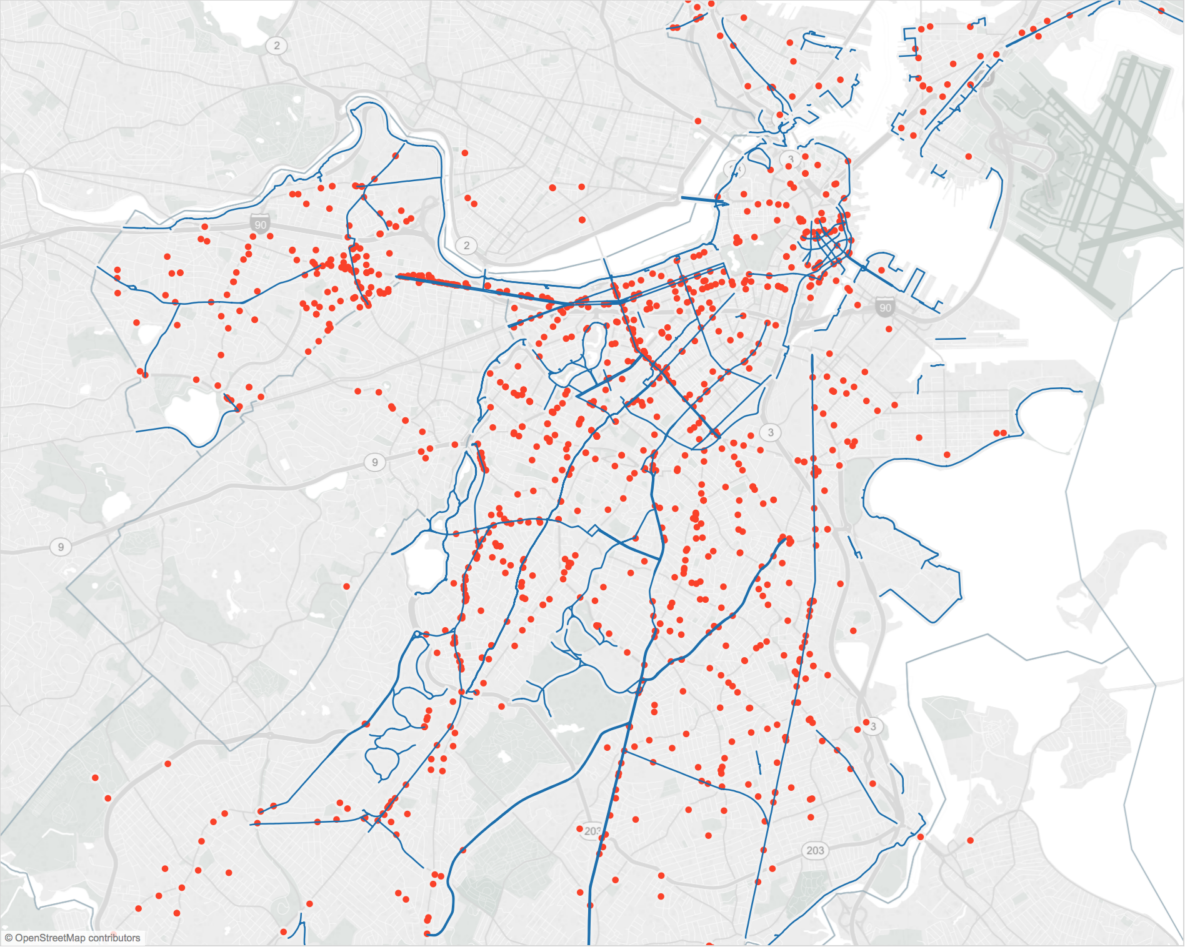

Expanding Select Bicycle Lanes to Improve Bike Safety in Boston
Enze Yan
enze@bu.edu
CS 512 & CS 591 L1
Start State
S₂
INTRODUCTION
2007 – Boston Bicycle Program launched: doubled ridership.
2012 – 5 fatal bicycle incidents.
2013 – Boston Bike Network Plan : decreasing bicycle crashes by 50 percent by 2020.
This project: identifying a comprehensive network of bicycle routes through the city of Boston based on the Bikes Crash Data.
Add 1 Lane
Add 1 Lane
Start State
S₃
Add 2 Lanes
S₁
Figure 3. States Transformation≈
Optimization:
Maximize S₁ where most bike lanes are connected.
non-linear model:
$argmax i,j∈N\sum{\left(−1\right)}$
constraint set: $xi,j∈\left\{0,1\right\}$ where 0 represents no bike lane, 1 means there is a bike lane.
Solver: dReal
Minimize S₂ where single bike lanes are left alone.
linear model:
$argmin i,j∈N\sum{|xi−xj|}$
constraint set: $xi,j∈\left\{0,1\right\}$ where 0 represents no bike lane, 1 means there is a bike lane.
Solver: Z3Opt
Both models need constraint on how many bike lanes K would like to be added:
$x1+x2+…+xN≤K$
Figure 2a.
x_{i}+x_{j}
DATA
Bikes Crash Data Sets (2009 – 2012):
Boston Bikes Crash Data (by BPD)
EMS Crash Data (by City of Boston)
Bike Collision Database (by Harvard Dataverse)
Existing Bike Network (by BostonGIS)
Boston OpenStreetMap (by Metro Extracts)
to get groups of connected streets
to acquire the length of each street
DATA VISUALIZATION
Figure 2b.
Figure 2a: no strong evidence suggests the covariance between the length of the street versus the amount of bike collisions.
Figure 2b: there are significantly less collisions occurred in the bike lane, compared to the streets without bike lane.
DATA ANALYSIS
Goal:
To build a better connected bike lane network
What are the main streets that need a bike lane (if it hasn’t) in order to achieve connective routes?
Modeling:
3 states for each pair of streets (x_{i},x_{j}) that connect/intersect:
S₁ = both streets have bike lanes.
S₂ = only 1 of the 2 streets has a bike lane.
S₃ = neither of the streets have bike lanes.
Binary representation:
S₁ = (1, 1)
S₂ = (1, 0) or (0, 1)
S₃ = (0, 0)
State Transformation (Figure 3.)
FUTURE WORK
Linear Programming vs. Integer Programming
Statistical analysis on the impact of adding bike lanes.
Updated Bike Collision Data.
More information on when (date) each bike lane was installed in order to match with the bike collision on bike lane.
REFERENCES
Boston Bikes, http://www.cityofboston.gov/bikes
Figure 1., https://public.tableau.com/profile/asross#!/
http://www.cs.bu.edu/faculty/kfoury/UNI-Teaching/CS512-Spring16
http://cs-people.bu.edu/lapets/591/
Figure 1. Existing Bike Lane & Bikes Collisions in Boston

