Slide 1
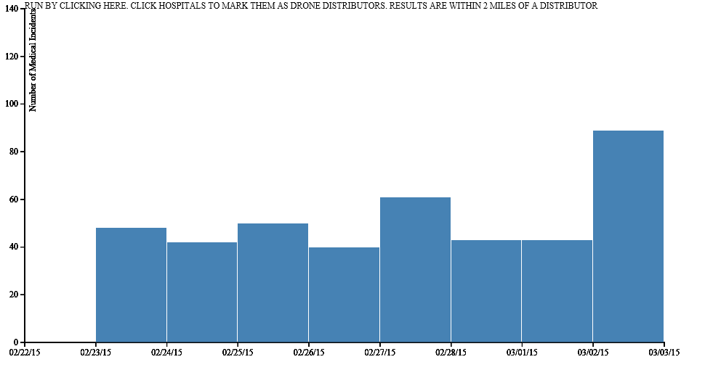
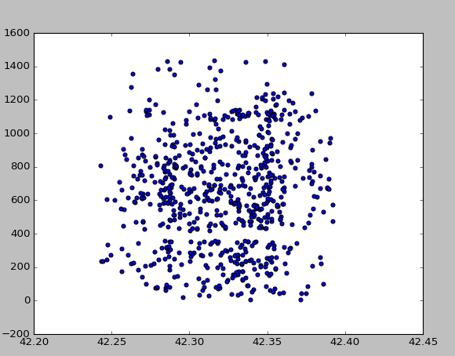
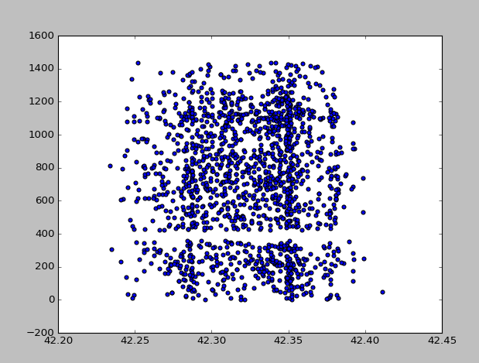
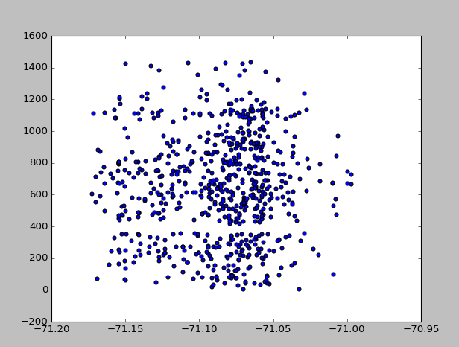
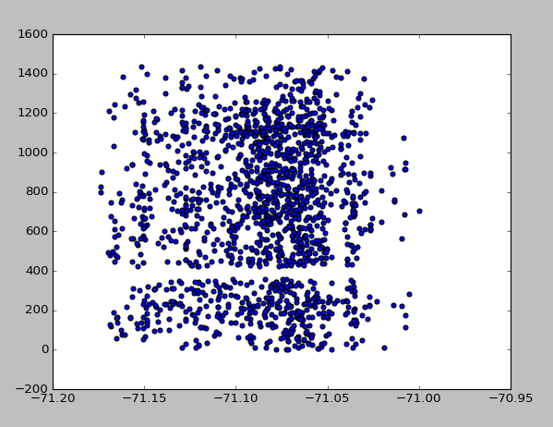
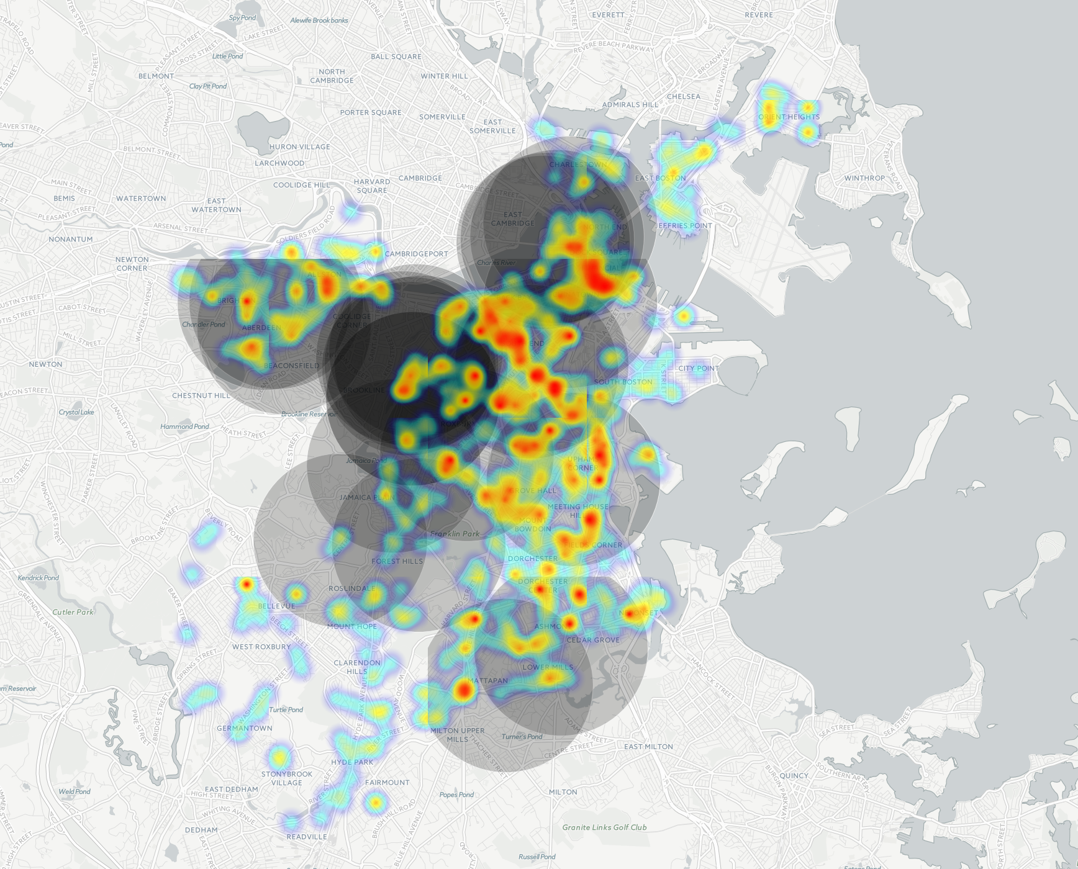
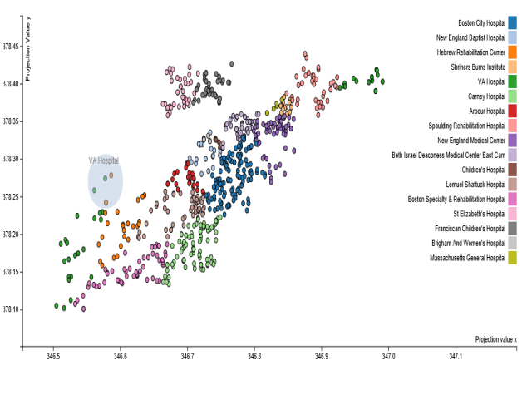
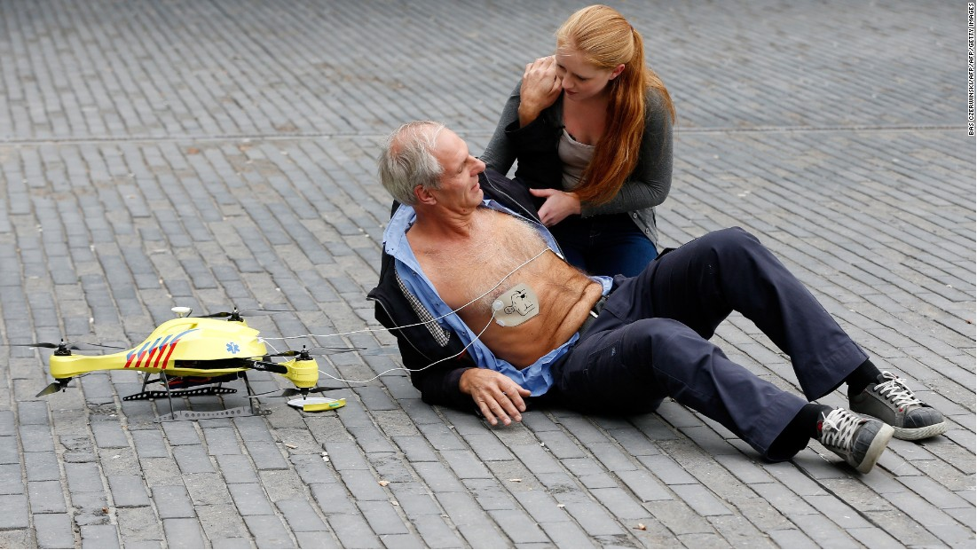
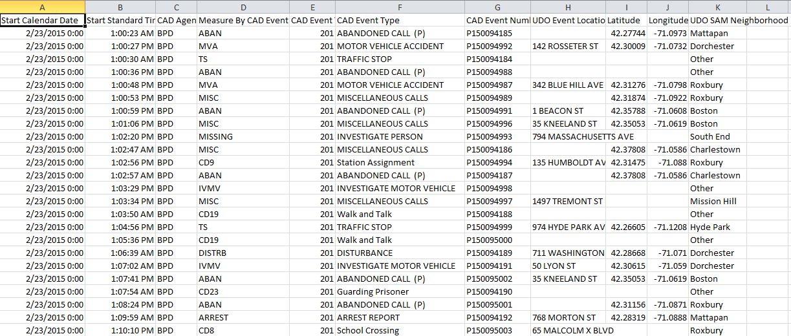
FEASIBILITY OF DRONE USE FOR BOSTON MEDICAL
AND PROTECTIVE SERVICES
THE PROBLEM
THE DATA
THE RESULTS
Emergency Medical Services are a vital part of any urban ecosystem. As the field rapidly changes, as new technologies make their way into the hands of first responders around the world, it is important to examine how these technologies can be used to best affect modern cityscapes. This Project aims to begin investigating the use of drones for Medical and Protective Services in Boston.
Time is one of the most important factors in many medical emergencies. For example, patients suffering cardiac arrest deal with brain damage and death in approximately 4-6 minutes. According to the 2011 Boston EMS Annual Report, the average Priority 1 Median response time is 5.7 Minutes. If defibrillators can reach a patient within 1 minute “This response speed increases the chance of survival following a cardiac arrest from eight percent to 80 percent.“ Its easy to imagine drones carrying epi-pens, medications, or other time sensitive emergency medical supplies, directly to patients. Further its easy, in this age of government surveillance, to imagine police departments using a technology that allows them to have eyes on a crime scene minutes before officers arrive. Or to follow fleeing perps as they leave a crime scene. Drone technology is poised to start filtering into the urban landscape in a major way in the following decades.
Examination focuses on:
Statistical analysis of medical and police events versus time of day
Optimization of Drone Placement using Hospitals and Police Stations as
launching points for the drones
Visualizations of Range and Event Locations
THEORETICAL SPECS:
60mph Top Speed
1 Hour Flight time
Remote Piloted Flight
2 mi Patrol Radius
$15,000 price tag
Data was gathered from the City of Boston Data Portal and includes: Boston Police Department 911, Hospital Locations, and Police Department Locations
The 911 dataset is the major component behind the research. It includes a date, a time of call, various event data such as location and type, and sometimes malformed location information (that needed repair).
Latitude vs Minutes past 6 AM Latitude vs Minutes past 6 AM
Medical Events Police Events
EVENTS WITHIN 2 MILES OF MASS GEN, CHILDREN’S, BOSTON CITY HOSPITAL.
(USERS CAN SELECT WHICH HOSPITALS)
Longitude vs Minutes past 6 AM Longitude vs Minutes past 6 AM
Medical Events Police Events
PS_911
HOS_LOC
PS_LOC
PS_EVENTS
MED EVENTS
2MI MASS GENERAL
PS_EVENTS_STATS
MED_EVENTS_STATS
HS/PS_EVENTS are datasets containing a set of events possibly served by drones, and the distance to all hospitals and police stations respectively. STATS contains data derived from statistical analysis
MED_OPT
Statistical Analysis shows no correlation between time of day and either longitude nor latitude for 911 call directed towards both police and medical staff. 911 calls are fairly evenly distributed except for a strange blackout of calls around 1:30 PM. Also noticeable more 911 calls being directed in the middle of the city center at all hours of the day. Optimization proved to be a tricky issue, after all its hard to quantify where saving human lives should be prioritized in terms of latitude and longitude. I used bounds representing a possible maximum number of drones per hospital, the maximum amount of flights a drone could take a day, and limiting the number of drones that should be put in hospitals that are very near to each other. Other potential bounds that could be included could be funds that an individual hospital can spend on drones, some hospitals potentially not being able to host drones, etc. The maximization function put as many drones near as many potential events as possible, but could be modified to include riskfactor of locations (i.e. flying drones in crime ridden neighborhoods). As it is my script needs more situational data to perform at a really informative level.
SOURCES OF DATA AND BACKROUND INFORMATION:
https://data.cityofboston.gov/ , https://www.cityofboston.gov/images_documents/2011_Boston_EMS_Annual_Report_tcm3-32900.pdf , http://www.mayoclinic.org/medical-professionals/clinical-updates/trauma/medical-drones-poised-to-take-off , http://www.alecmomont.com/projects/dronesforgood , http://www.cnet.com/news/ambulance-drone-delivers-help-to-heart-attack-victims/

