Slide 1

Student Group Formation Using Linear Programming
-Nidhi Lovanshi nlovansh@kent.edu

Slide 2
Problem Overview
Objective:
Assign 12 students into 4 groups of 3 students to maximize group success in a class project
Key requirements:
Each group contains exactly 3 students.

Slide 3
Factors for Group Success
Chosen Factors:
GPA: Measures academic performance.
Skill Relevance: Demonstrates expertise in technical or specialized areas.
Leadership: Ability to lead and work in a team.
Weights
GPA: 40%
Skill Relevance: 30%
Leadership: 30%

Slide 4
Data Generation
Approach:
Randomly generated data for 12 students.
Ranges:
GPA: 2.0–4.0
Skill Relevance: 0–10
Leadership: 0–10
Composite Success Score:
SuccessScore = 0.4 * GPA + 0.3 * SkillRelevance + 0.3 * Leadership

Slide 5
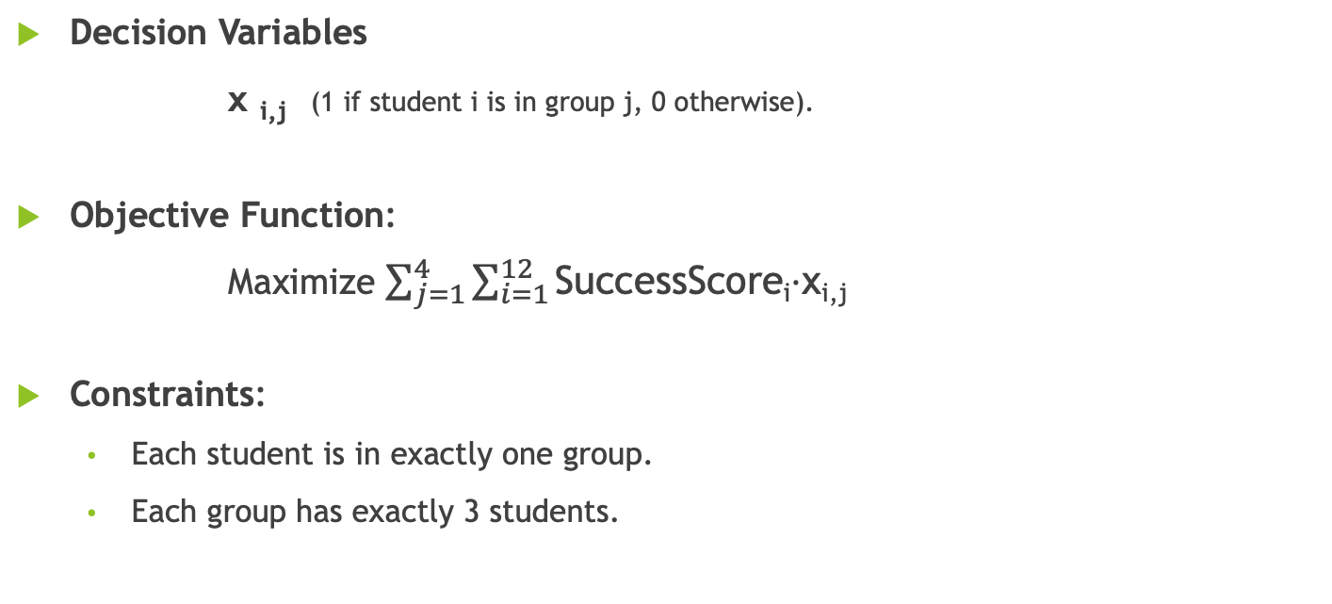
Mathematical Model
Decision Variables
x _{i,j} (1 if student i is in group j, 0 otherwise).
Objective Function:
Maximize $\sum_{j=1}^{4}{\sum_{i=1}^{12}{\text{SuccessScore}\text{i}\text{​⋅}\text{xi}\text{,}\text{j}\text{​}}}$
Constraints:
Each student is in exactly one group.
Each group has exactly 3 students.

Slide 6
Implementation
Tool Used: R (lpSolveAPI package).
Steps:
Generate data and calculate success scores.
Define decision variables and constraints.
Address the linear programming problem to find a solution.
Github link: https://github.com/nlovansh/QMM/blob/main/nlovansh_F.Rmd

Slide 7
Results
Optimal Group Assignments:
Group 1: Students 4, 8, 9
Group 2: Students 6, 10, 12
Group 3: Students 1, 2, 7
Group 4: Students 3, 5, 11
Optimal Success Score:
Max Z = 56.85392

Slide 8
Validation
Group Sizes:
Group Sizes: 3,3,3,3
Student Assignments:
Each student is in exactly one group.

Slide 9
Conclusion
Summary:
Successfully assigned students into balanced groups using LP.
Maximized the success score while adhering to constraints.
Future Applications:
Use real-world data for better insights.

