Slide 1

Final Report
"Bait Buster"
Presented by Lihi Nofar, Tomer Portal, Aviv Elbaz

Slide 2
Problem Description - Clickbait in Digital Media​
Deceptive headlines using psychological manipulation to drive engagement​
Why essential:​
72% of users feel tricked by misleading headlines (Pew Research)​
Erodes trust: 68% say clickbait reduces overall media credibility​
Financial impact: Wastes $7B/year in misplaced ad revenue​
Why challenging:​
Stylistic ambiguity: Legitimate teasers vs. manipulative hooks​
Cultural context: Humor/sarcasm varies across regions​
Adaptive tactics: Continuous evolution of manipulation methods

Slide 3
Project Objectives​
Develop dual-capability system:​
1.1. Detection (binary classification)​
1.2. Method attribution (multi-label classification)​
2. Compare architectural approaches:​
2.1. Single-step (joint detection + attribution) using LLMs​
2.2. Two-step (cascaded models) using fine-tuned BERT​
3.Establish evaluation framework:​
3.1. Quantitative metrics (F1, accuracy, recall, precision)​
3.2. Human evaluation protocol

Slide 4


Formal Task Specification
Input
Output
Metrics
News headline text (original or clickbait-modified).​
between 15-20 words avg.
Binary classification: Clickbait (1) or Not (0).​ If clickbait, multi-label classification: Which tactics/styles were used?​
Accuracy, Precision, Recall, F1-score for detection.​ Multi-label metrics for tactics attribution (macro/micro F1).​

Slide 5

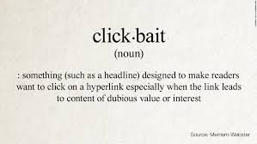
Implementation Plan
Generate dataset with real headlines and clickbait variants using LLMs and style methods.​
Preprocess and label the dataset.​
Train and evaluate:​
Single-step pipeline: simultaneous detection and tactics attribution.​ For example, using GPT-4o zero/few-shot.
Two-step pipeline: separate detection and attribution models.​
Analyze and compare model performances.​

Slide 6
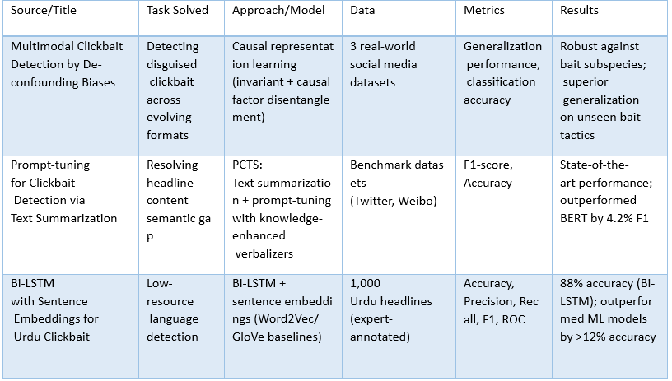
Prior Art

Slide 7
Data Preparation
Source dataset description
link to News headlines 2024 in kaggle:
https://www.kaggle.com/datasets/dylanjcastillo/news-headlines-2024
scraped between April 25th and April 26th, 2024
Data generation:
Clickbait headline versions were created based on original headlines. The tactics were select randomly: for each headline, relevant tactics were selected from the predefined list of 10 clickbait tactics.
Additional data augmentation was applied during training (using the augment_text() function), creating variations of clickbait headlines.
Description of relevant fields:
clickbait_dataset.csv — 3 columns:
original: Original (non-clickbait) headline.
clickbait: Clickbait version of the headline (used as model input).
methods: List of clickbait tactics (binary vector of 10 values).

Slide 8
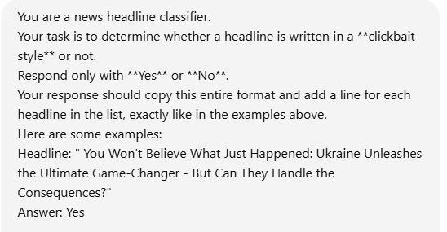
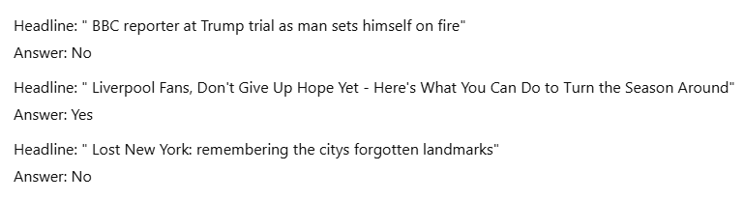
Prompts and examples
For GPT-based one-step pipeline, few-shot prompting was used to generate clickbait/tactics predictions.
The same clickbait headlines and tactics were used as inputs to the BERT/RoBERTa-based models.

Slide 9
Model Used
Clickbait Detection (Step 1):
Model: TFBertForSequenceClassification (binary classification). Pretrained model: bert-base-uncased.
Tactic Attribution (Step 2):
Model: TFRobertaForSequenceClassification (multilabel classification, 10 labels). Pretrained model: roberta-base. With custom threshold tuning for better multilabel performance.
GPT-based one-step pipeline:
Models used: GPT-4o (OpenAI), Gemini 2.5 Flash (Google DeepMind). Using prompting only (no fine-tuning).

Slide 10
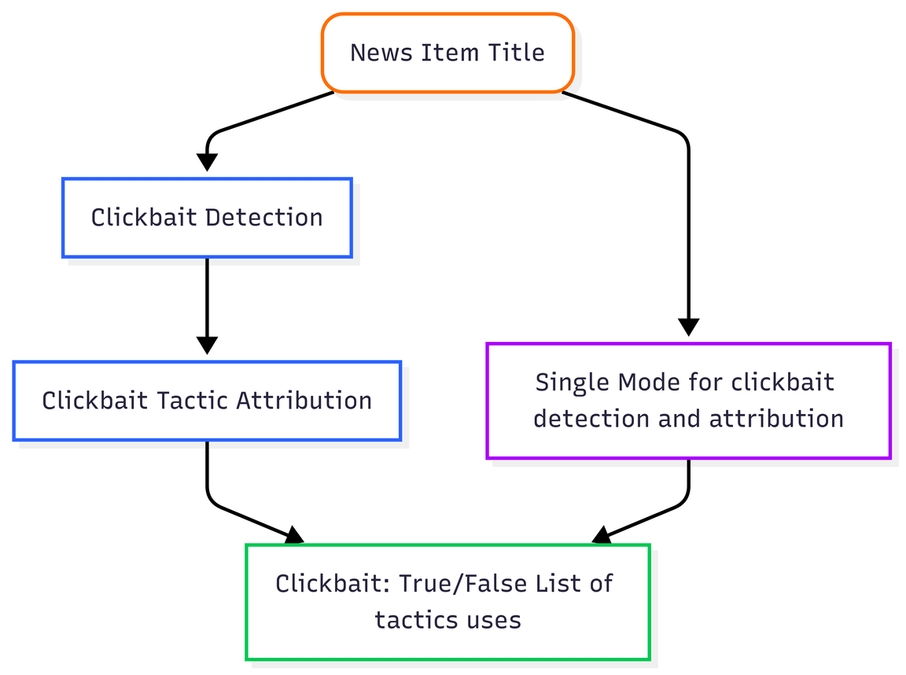
model/pipelines are used
Two pipelines were evaluated:
One-step pipeline - a single large language model (LLM) prompt performs both clickbait detection (binary: clickbait vs. non-clickbait) and tactic attribution (identifying which of the 10 clickbait tactics are used, or "non-clickbait" if none).
Two-step pipeline -the process is split into two independent parts: Clickbait detection and tactic attribution.

Slide 11
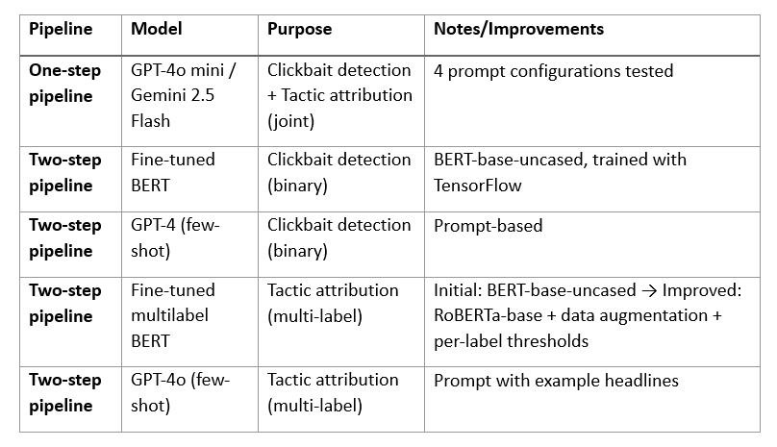

Table of models/configurations

Slide 12
How the models were trained
The Clickbait detection model
used a TFBertForSequenceClassification (binary classification) trained on merged source and clickbait headlines, tokenized with BertTokenizer. It was optimized with Adam (learning rate 0.00002), trained for 3 epochs with batch size 32. Evaluation metrics: accuracy, precision, recall, and F1 on the test set.
The Tactic attribution model
used TFBertForSequenceClassification (multi-label, 10 labels) trained on clickbait_dataset.csv, with headlines and tactic vectors. Tokenization was done with BertTokenizer. The model used Adam (learning rate 0.00002), 3 epochs, batch size 16. Performance was evaluated with precision, recall, and F1 per tactic. Improvements included switching to RoBERTa-base, adding data augmentation, and applying per-label thresholds.

Slide 13



Data split
Clickbait detection:
Tactic attribution:
Dataset: 1,740 headlines (870 clickbait + 870 regular).
Split: 80% training (1,392 examples), 20% testing (348 examples).
pre-improvement model: 870 clickbait titles. 20% test and 80% training.
Improved model (used with augmented): 1740 clickbait titles. (also 80% and 20%)
Platform: Google Colab (CPU runtime).

Slide 14
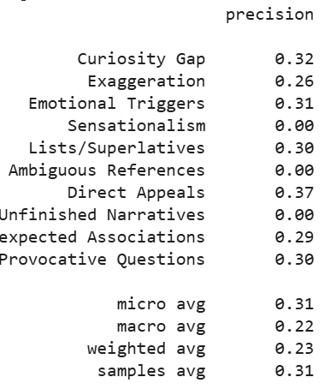
Metrics
Metric was used at each step:
Clickbait detection: Accuracy, Precision, Recall, F1-score
Tactic attribution: Precision, Recall, F1-score per tactic plus micro, macro, and weighted averages.
Classification:
Both steps are classification tasks:
Clickbait detection - binary classification
Tactic attribution- multilabel classification (10 independent binary labels).
validations set and test set:
During training: validation set = the test set (20% of the data). No additional validation is used (like validation_split inside the train).
During evaluation: the same test set, used for the final performance evaluation (classification_report, precision/recall/F1).

Slide 15

Code Organization
Results files:
Data files:
The evaluation results were generated in the notebook using sklearn.metrics. The evaluation report includes Precision, Recall, and F1-score, as well as support and overall micro, macro, and weighted averages.
contains original headline, clickbait headline (used as model input), and a binary vector of 10 clickbait tactics.
Major tasks and code files/functions
There are 4 code files in the project. One for generating clickbait headlines, the second and third for a two step pipeline, and the last for a one step pipeline.
Link to GitHub:
https://github.com/nlp-hit-2025/clickbait

Slide 16
Single-Step Detection Pipeline
Single-Step Pipeline
Unified Assessment
Efficiency, At a Cost
Simultaneous clickbait detection and method inference through one LLM prompt.
Each model assesses a headline (some models receive examples of clickbait and non-clickbait), having been given a dictionary of clickbait creation tactics.
Streamlined, Single-prompt-fits-all approach, with no training or fine-tuning.
Tendency towards False-Positives and over attribution of methods.

Slide 17




LLM Configurations for Clickbait
Evaluating Performance in Detection
1
2
3
4
Evaluated 4 LLM Configurations
Prompted with Headlines
Performance Metrics
Capabilities and Limitations
We assessed GPT-4o mini and Gemini-2.0 Flash, each on both Zero-Shot and Two-Shot prompts.
Each model was prompted with various headlines to analyze their classification capabilities.
Calculated Micro and Macro F1-Scores for multi-label method inference, Accuracy and F1-Score for binary clickbait detection.
Results led to a clearer understanding of the models' detection capabilities and inherent limitations.

Slide 18
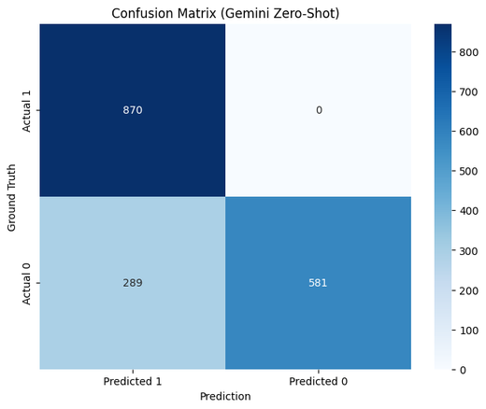
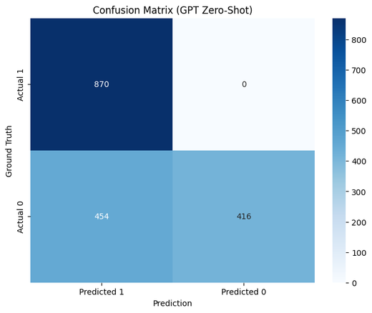
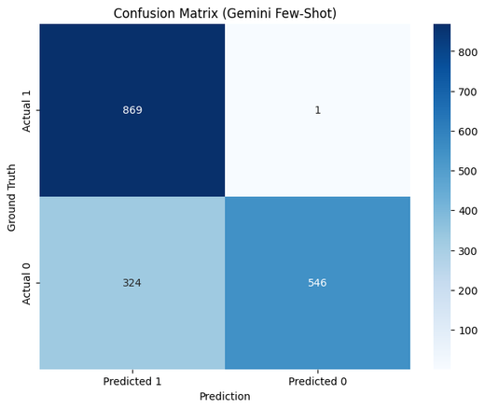
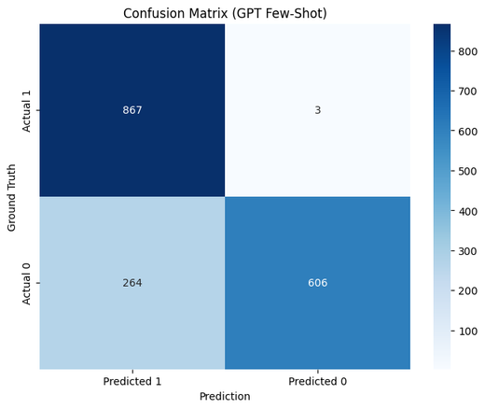
Evaluation Metrics for Clickbait Detection
Measuring model performance with F1-scores and precision
Worsened
Improved
Gemini Zero-Shot
Gemini Few-Shot
GPT Few-Shot
Task
GPT Zero-Shot
Method Inference
Highest Micro-F1
0.474
Micro-F1
0.400
Lower Micro-F1
0.466
Improved Micro-F1
0.434
Accuracy
0.834
Lowest Accuracy
0.739
Lower Accuracy
0.813
Improved Accuracy
0.847
Classification

Slide 19
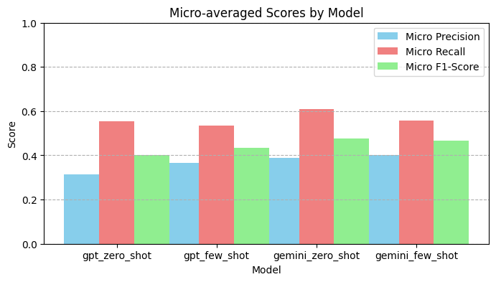
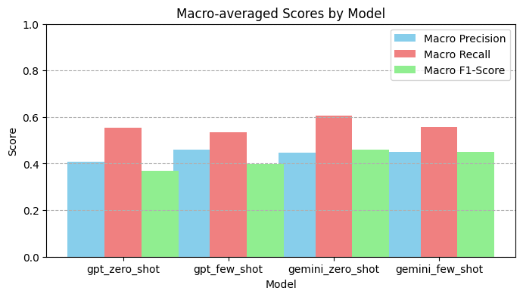
Evaluation Metrics for Clickbait Detection
Measuring model performance with F1-scores and precision
Worsened
Improved
Gemini Zero-Shot
Gemini Few-Shot
GPT Few-Shot
Task
GPT Zero-Shot
Method Inference
Highest Micro-F1
0.474
Micro-F1
0.400
Lower Micro-F1
0.466
Improved Micro-F1
0.434
Accuracy
0.834
Lowest Accuracy
0.739
Lower Accuracy
0.813
Improved Accuracy
0.847
Classification

Slide 20
Two-Step Clickbait Pipeline
Clickbait Detection and Method Inference on Different Models
Task Separation
Clickbait detection and tactic attribution are performed sequentially and independently.
Allows each model to specialize, with no mutual interference.
Dedicated Models
Clickbait Detection: Fine-tuned BERT or GPT-4 with few-shot prompting is used for binary classification.
Tactics Attribution: Multi-label BERT or GPT-4 with few-shot prompting identifies clickbait tactics.
Accuracy and Robustness
Fine-tuned BERT exhibits near-perfect performance in clickbait detection. Tactics attribution benefits from enhanced architectures (e.g., RoBERTa), data augmentation, and custom thresholds.
Efficiency Trade-Offs
Offers fine-grained insights and higher adaptability compared to the single-step pipeline, but demands more computational resources and time.

Slide 21
BERT and GPT-4 Overview
Understanding Their Roles in Detection Pipelines
BERT
Used primarily for classification tasks, providing enhanced context understanding which is crucial for accurate results.
GPT-4
Employed with few-shot prompting, significantly improving tactic attribution by leveraging its advanced language generation capabilities for diverse scenarios.
Detection Pipeline
The integration of BERT and GPT-4 forms a robust detection pipeline that enhances the identification and classification of clickbait content through sophisticated model interactions.

Slide 22


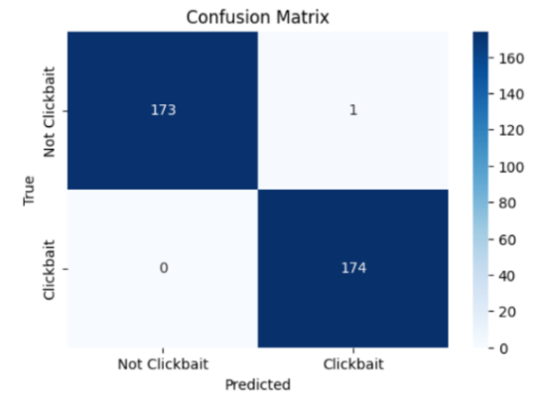
BERT for Clickbait Detection
Leveraging BERT to identify clickbait headlines
Fine-tuning BERT model
We adapted the BERT model for clickbait detection, optimizing its parameters to improve performance and accuracy in distinguishing between types of headlines.
Achieved 100% accuracy
The fine-tuned model reached an impressive accuracy rate of 100%, indicating its effectiveness in clickbait detection scenarios.

Slide 23


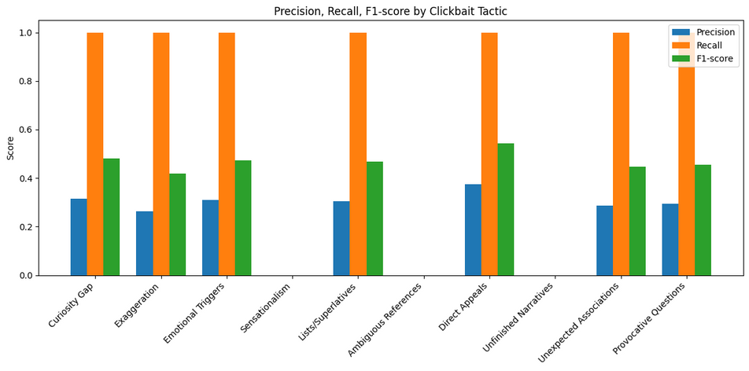
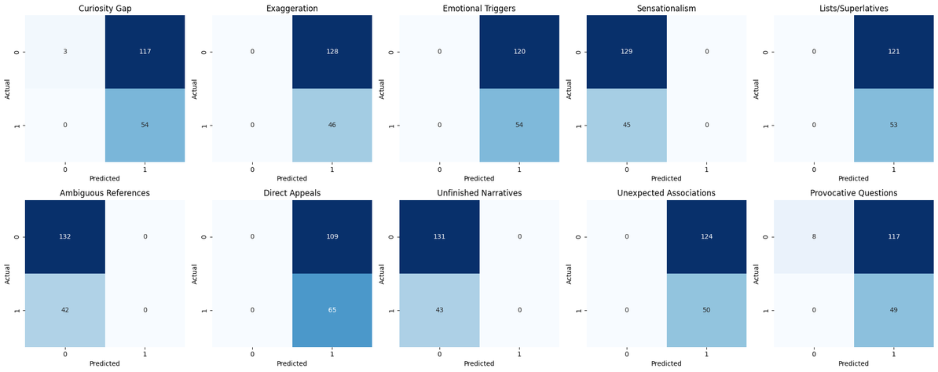
Multi-Label BERT Insights
Enhancements in Clickbait Detection Accuracy
Multi-Label BERT Model
We trained a multi-label BERT model to classify various tactics in clickbait headlines.
High Recall, Low Precision
Recall of 1.00 for most tactics means the model recognizes almost all cases where a tactic is present; Precision around 0.30 means it also “guesses” many labels that are not actually present.
Conclusion: The model tends to "over-recognize" labels – too sensitive but not accurate.
Missed Tactics
Sensationalism Ambiguous References Unfinished Narratives – The model did not recognize these tactics at all, perhaps they are too rare or obfuscated in the data.

Slide 24
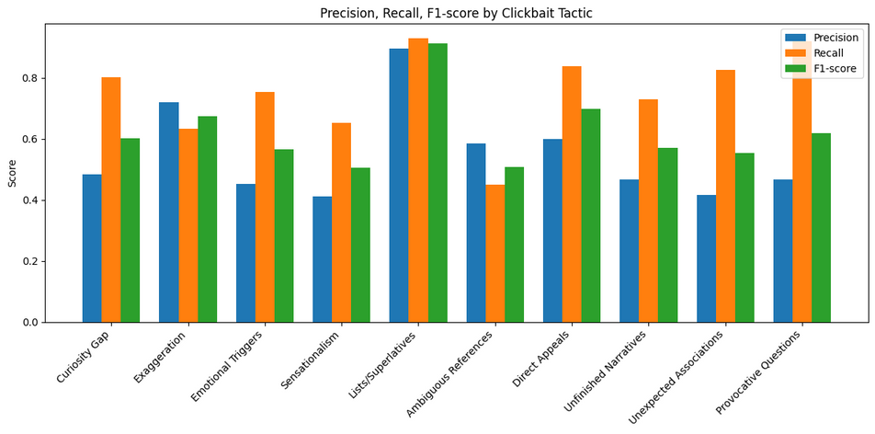
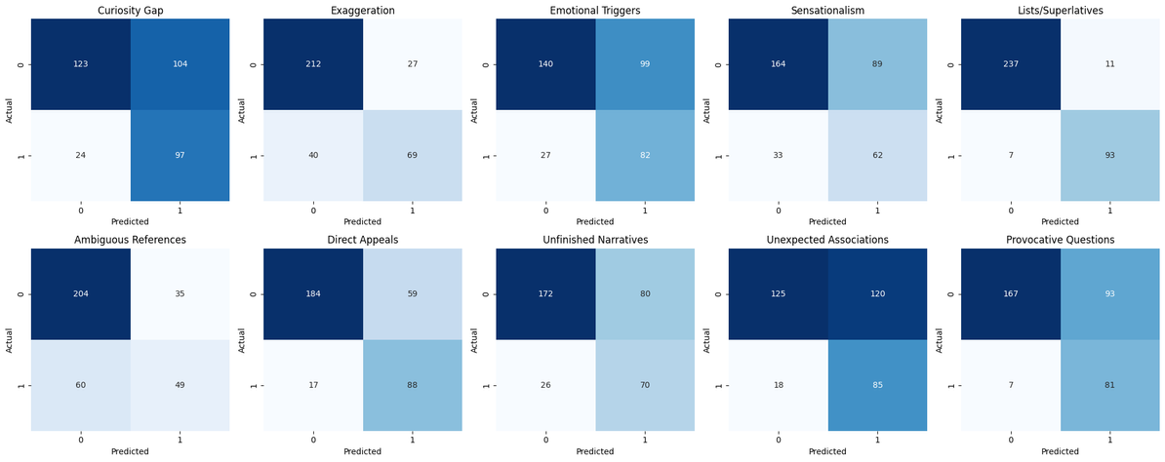
Multi-Label BERT Improvements
Enhancements in Clickbait Detection Accuracy
Utilizing RoBERTa
Switching to RoBERTa enhanced the model’s accuracy, providing better context understanding for clickbait classification.
Data Augmentation
Duplicate versions of titles with different wordings (e.g. bolded words, exclamation marks, marketing wording) were added, to diversify the data and improve the overall ability of the model.
Adjusted Prediction Thresholds
instead setting p > 0.5 as indicating a positive label, a threshold was calculated separately for each tactic using ROC analysis on the validation set

Slide 25
Evaluating GPT-4's Few-Shot Prompting
Analyzing the effectiveness of few-shot prompting in classifying clickbait tactics with GPT-4
High accuracy in classification
GPT-4 demonstrated high accuracy when classifying clickbait tactics through few-shot prompting.
False positives observed
Despite its strengths, the model produced false positives, indicating a cautious approach that may lead to misclassification.
Challenges for Clickbait Attribution
Further False-Positives: Model over-attributes tactics, including correct ones but inferring extras, leading to high Recall but lower Precision.
Ambiguous Tactic Interpretation: Model tends to interpret tactics too broadly. For example, emotional expressions like “You’ll Be Furious” will also be labeled as Direct Appeals, even though their main meaning is to activate emotion.

Slide 26
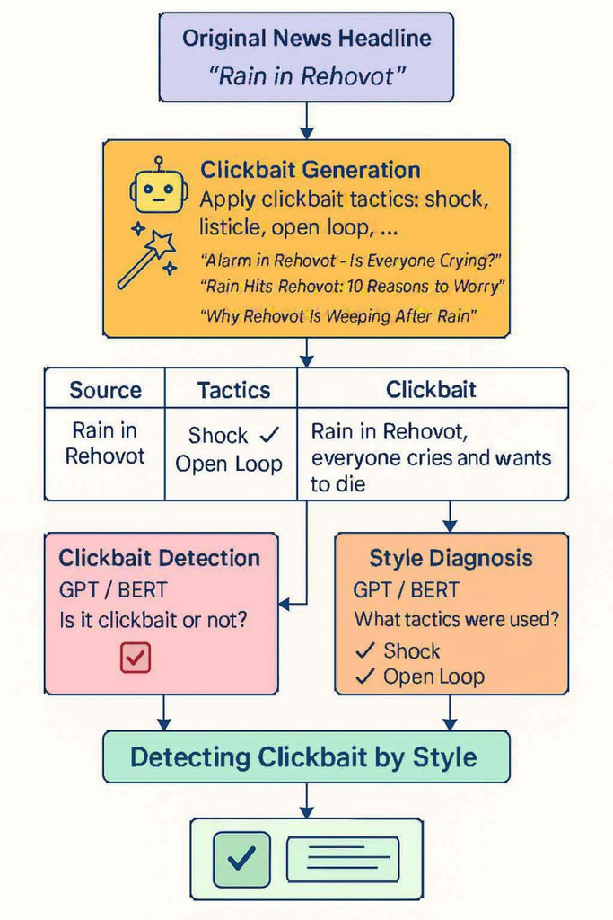
Graphical Abstract

