Slide 1
A Neural Conversational Model (O Vinyals, Q Le 2015) A Persona-Based Neural Conversation Model (J Li, M Galley, C Brockett, GP Spithourakis, J Gao, B Dolan 2016)
NLP masters 최상혁 03 Apr 2021

Slide 2
A Neural Conversational Model (O Vinyals, Q Le 2015)
NLP masters 최상혁 03 Apr 2021

Slide 3
Contents
A Neural Conversational Model (O Vinyals, Q Le 2015)
0. Abstract
1. Introduction
2. Related Work
3. Model
4. Datasets 4.1. IT Helpdesk Troubleshooting dataset 4.2. OpenSubtitles dataset
5. Experiments 5.1. IT Helpdesk Troubleshooting experiments 5.2. OpenSubtitles experiments
6. Discussion

Slide 4
0. Abstract
A Neural Conversational Model (O Vinyals, Q Le 2015)

Slide 5
0. Abstract
A Neural Conversational Model (O Vinyals, Q Le 2015)
Seq2seq 으로 Conversational model을 만들었다.
Predicting the next sentence given the previous sentence or sentences in a conversation.
Seq2seq… NMT는 English -> French, 대화 모델은 previous -> next
Can be trained end-to-end
Can generate simple conversation
Lack of consistency

Slide 6
1. Introduction
A Neural Conversational Model (O Vinyals, Q Le 2015)

Slide 7
1. Introduction
A Neural Conversational Model (O Vinyals, Q Le 2015)
Sequence to sequence (Sutskever et al., 2014)
Encoder-Decoder structure
Requires little feature engineering and domain specificity whilst mapping or surpassing state-of-the-art results.
Conversational modeling
Pre-neural: very narrow in domain & major undertaking on feature engineering
Seq2seq (this work): predicting the next sequence given the previous sequence or sequences using recurrent networks (end-to-end approach)

Slide 8
3. Model
A Neural Conversational Model (O Vinyals, Q Le 2015)

Slide 9
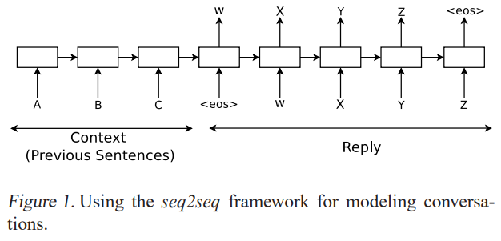
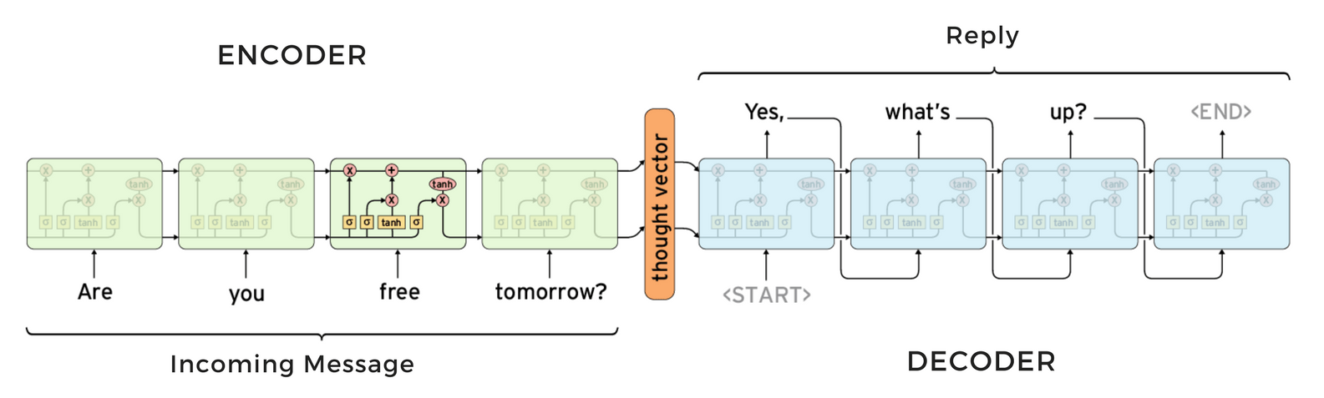
3. Model
A Neural Conversational Model (O Vinyals, Q Le 2015)
Figure 1.
이미지 출처 : https://medium.com/google-developer-experts/taking-neural-conversation-model-to-production-b0d2e7c190e4

Slide 10
5. Experiments
A Neural Conversational Model (O Vinyals, Q Le 2015)

Slide 11
5.2. OpenSubtitles experiments
A Neural Conversational Model (O Vinyals, Q Le 2015)
Movie conversations
Turn taking is not clearly indicated, we treated consecutive sentences assuming they were uttered by different characters. 누가 말했는지를 몰라서 그냥 문장 단위로 쪼갰다.
Training set - 62M sentences (923 tokens) Validation set - 26M sentences (395 tokens)
하나의 pair of sentences (input / output sentence)가 training set과 test set 둘 다에 존재하지 않도록 했다고 함.

Slide 12
5.2. OpenSubtitles experiments
A Neural Conversational Model (O Vinyals, Q Le 2015)
A two-layered LSTM
AdaGrad with gradient clipping
Each layer of the LSTM has 4096 memory cells
100K vocab size
Interestingly, adding the soft attention mechanism of (Bahdanau et al., 2014) did not significantly improve the perplexity on neither training or validation sets.

Slide 13
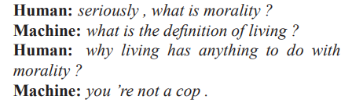
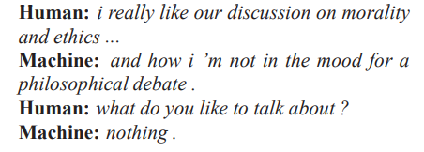
5.2. OpenSubtitles experiments
A Neural Conversational Model (O Vinyals, Q Le 2015)
재미있었던 Samples
Notes:
도덕성이 뭐니?
사는 것의 정의가 뭐니?
사는 거랑 도덕성이랑 관련이 있어?
넌 경찰도 아니잖아. (왜 꼬치꼬치 캐물어)
도덕성과 윤리 이런 거에 대해 논의하는 게 좋은데…
난 그런 철학적인 토론 할 기분이 아닌데
그럼 무슨 얘기 하고싶은데?
nothing

Slide 14
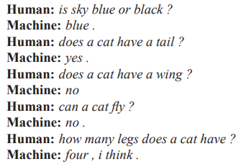
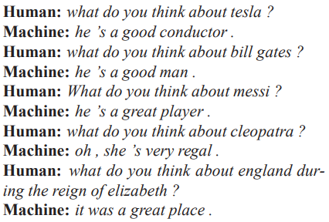
5.2. OpenSubtitles experiments
A Neural Conversational Model (O Vinyals, Q Le 2015)
좋았던 점
Can remember facts
Understand contexts
Perform common sense reasoning (sky의 색깔이 뭐니? -> Blue)
Can generalize to new questions.
이 모든 게 사람의 지식의 개입 없이 end-to-end로 되었다는 것.

Slide 15
5.2. OpenSubtitles experiments
A Neural Conversational Model (O Vinyals, Q Le 2015)
아쉬운 점
Simple, short, sometimes unsatisfying answers (yes, sir. / I don’t know. / no / yes / he’s a good man …)
Does not capture a consistent personality. The answers can sometimes be inconsistent.

Slide 16
6. Discussion
A Neural Conversational Model (O Vinyals, Q Le 2015)

Slide 17
6. Discussion
A Neural Conversational Model (O Vinyals, Q Le 2015)
의의: A simple language model based on the seq2seq framework can be used to train a conversational engine. Purely data driven approach without any rules can produce rather proper answers to many types of questions.
한계: - 짧고 간단한 대답 - lack of coherent personality (consistency)

Slide 18
A Persona-Based Neural Conversation Model (J Li, M Galley, C Brockett, GP Spithourakis, J Gao, B Dolan 2016)
NLP masters 최상혁 03 Apr 2021

Slide 19
Contents
A Persona-Based Neural Conversational Model (J Li et al., 2016)
0. Abstract
1. Introduction
2. Related Work
3. Sequence-to-Sequence Models
4. Personalized Response Generation 4.1. Notation 4.2. Speaker Model 4.3. Speaker-Addressee Model 4.4. Decoding and Reranking
5. Datasets 5.1. Twitter Persona Dataset 5.2. Twitter Sordoni Dataset 5.3. Television Series Transcripts
6. Experiments 6.1. Evaluation 6.2. Baseline 6.3. Results 6.4. Qualitative Analysis
7. Conclusions

Slide 20
0. Abstract
A Persona-Based Neural Conversational Model (J Li et al., 2016)

Slide 21
0. Abstract
A Persona-Based Neural Conversational Model (J Li et al., 2016)
Neural response generation에서 Speaker consistency를 높였다.
Speaker Model – a single-speaker
Speaker-Addressee Model – a dyadic (두 부분으로 된, 청자까지 고려하는)

Slide 22
1. Introduction
A Persona-Based Neural Conversational Model (J Li et al., 2016)

Slide 23
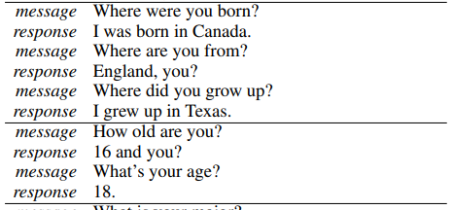
1. Introduction
A Persona-Based Neural Conversational Model (J Li et al., 2016)
같은 의미를 가진, 서로 다른 표현의 질문들에 대해 답변이 계속 달라지더라.
어떤 actor의 PERSONA = 대화 속에서 정의된다. => 대화 data를 학습하는 과정에서 PERSONA를 포착할 수 있다. => seq2seq models에 persona-embedding을 추가로 넣는 방식으로 PERSONA를 학습하고, inference에 활용한다.
Speaker Model: a single-speaker
Speaker-Addressee Model: a dyadic (두 부분으로 된 / 청자까지 고려하는)

Slide 24
3. Sequence-to-Sequence Models
A Persona-Based Neural Conversational Model (J Li et al., 2016)
Notes:
앞에서 Seq2seq에 대해 얘기는 했지만 본 논문에서는 이 seq2seq을 변형해서 썼기 때문에, seq2seq의 구조부터 해서 설명을 다시 해보도록 하겠습니다.

Slide 25
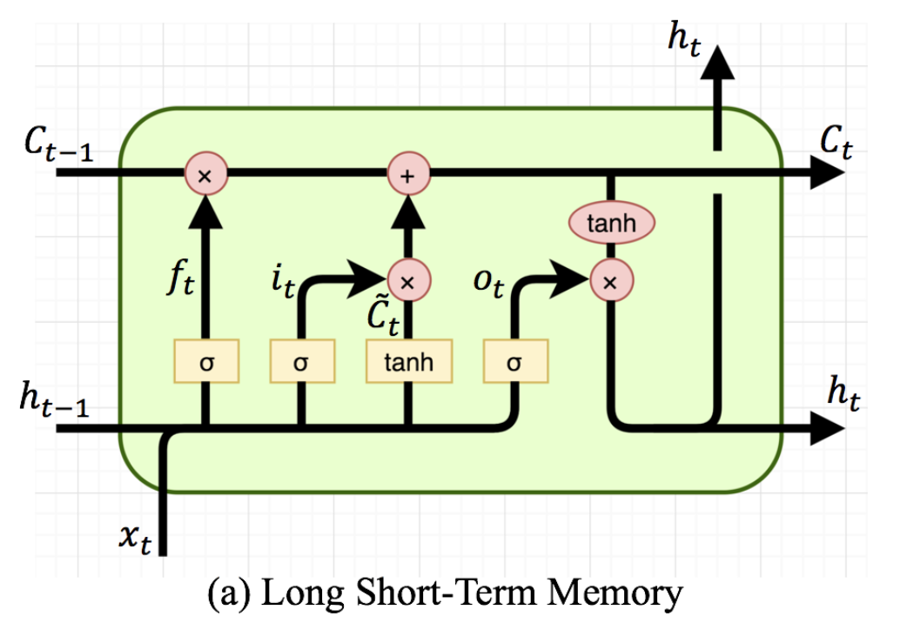
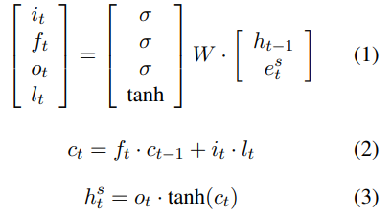
3. Sequence-to-Sequence Models
A Persona-Based Neural Conversational Model (J Li et al., 2016)
이미치 출처: http://docs.likejazz.com/lstm/
Notes:
우리 머리 속에서 잊혀졌던 LSTM을 다시 가져와봅시다.
아 여기 이미지의 x가 여기 식에서는 e가 됩니다.
그래서 이번 input e_t와 이전 hidden unit h_(t-1)를 concat 해서 f도 만들고 i도 만들고 o도 만들고, C tilde … 여기서는 l이네요
어쨌든 이런 것들을 다 만들어서 cell state C_t와 hidden state h_t를 내놓습니다.

Slide 26
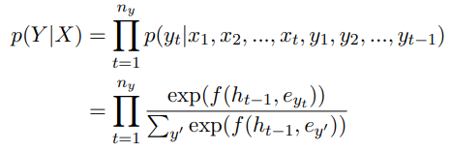
3. Sequence-to-Sequence Models
A Persona-Based Neural Conversational Model (J Li et al., 2016)
이미지 출처 : https://medium.com/google-developer-experts/taking-neural-conversation-model-to-production-b0d2e7c190e4
Notes:
그래서 우리는 이걸 maximize 해야 하죠.
음 그러니까 t시점의 정답 단어 y_t가 나올 확률은, 모든 시점의 encoder와, t시점 이전의 decoder의 input에 conditional하게 걸려있게 됩니다. 다시 말해, 앞의 단어들이 그 다음 단어를 만들어내는 left-to-right 방식이죠.
그리고 이 조건부 확률은 LSTM으로 나온 값에 softmax를 취해서 얻게 됩니다.
혹시 여기까지 잘 이해 되셨을까요??

Slide 27
4. Personalized Response Generation
A Persona-Based Neural Conversational Model (J Li et al., 2016)
Notes:
앞에서 Seq2seq에 대해 얘기는 했지만 본 논문에서는 이 seq2seq을 변형해서 썼기 때문에, seq2seq의 구조부터 해서 설명을 다시 해보도록 하겠습니다.

Slide 28
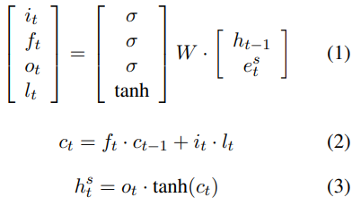
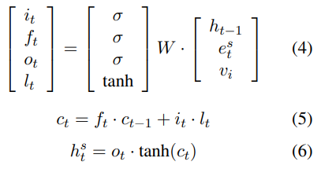

4.2. Speaker Model
A Persona-Based Neural Conversational Model (J Li et al., 2016)
Speaker’s persona as a vector representation
Each speaker $i$ is associated with a user-level representation $v_{i} ∈R^{K×1}$
Speaker의 특징을 명시적으로 annotate 하지 않고, 대화 데이터에서 모델이 자동으로 학습하게끔 함.
$v_{i}$ is shared across all conversations that involve speaker $i$

Slide 29
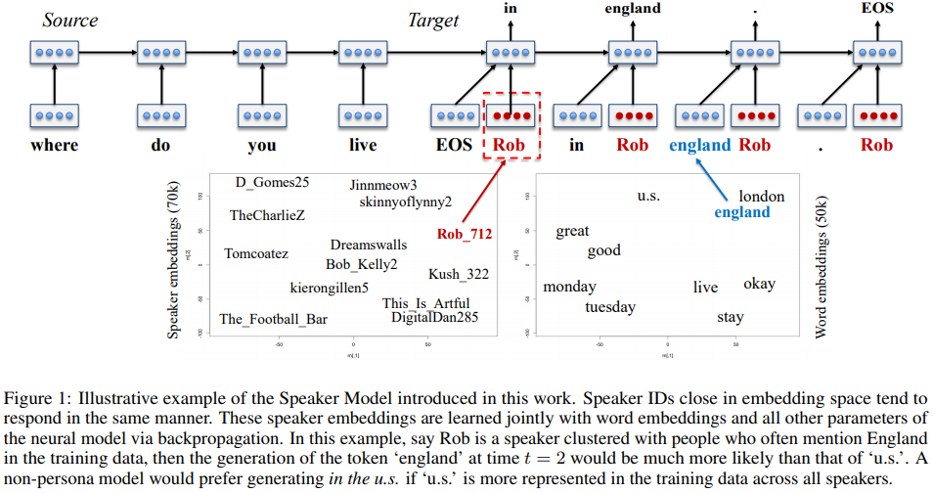
4.2. Speaker Model
A Persona-Based Neural Conversational Model (J Li et al., 2016)
Speakers producing similar responses tend to have similar embeddings.

Slide 30

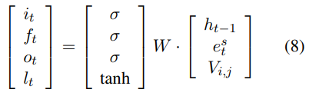


4.3. Speaker-Addressee Model
A Persona-Based Neural Conversational Model (J Li et al., 2016)
Speaker $i$ => $v_{i}$
Addressee $j$ => $v_{j}$
$V_{i, j}=tanh⁡(W_{1}∙v_{i}+W_{2}∙v_{j})$
모두가 모두와 충분히 많은 대화를 나눴을 리가 없기 때문에 학습이 불완전함.
Speaker model과 마찬가지로 비슷한 대답을 하는 사람이면 비슷한 embedding을 갖게 됨.

Slide 31
4.4. Decoding and Reranking
A Persona-Based Neural Conversational Model (J Li et al., 2016)
Decoding -> Skip. (paper를 참고해주세요)
너무 일반적이고 짧은 문장 생성을 방지하기 위해, We follow Li et al. (2016) by reranking the generated N-best list using a scoring function that linearly combines a length penalty and the log likelihood of the source given the target.
R : output (response)
M : input
v : persona
Maximize ->
Output에서 역으로 Input을 얻을 수 있도록 (generic response 방지)
길이가 너무 짧으면 패널티

Slide 32
6. Experiments
A Persona-Based Neural Conversational Model (J Li et al., 2016)
Notes:
앞에서 Seq2seq에 대해 얘기는 했지만 본 논문에서는 이 seq2seq을 변형해서 썼기 때문에, seq2seq의 구조부터 해서 설명을 다시 해보도록 하겠습니다.

Slide 33
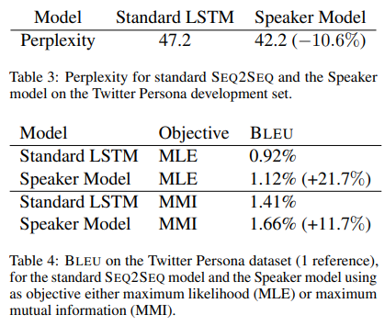
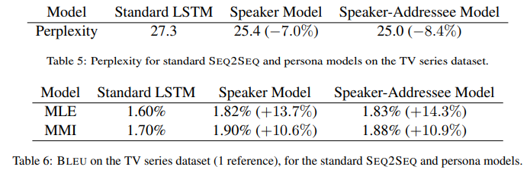
6.3. Results
A Persona-Based Neural Conversational Model (J Li et al., 2016)
>
>
<
<
<
Notes:
숫자가 이상하네요…

Slide 34
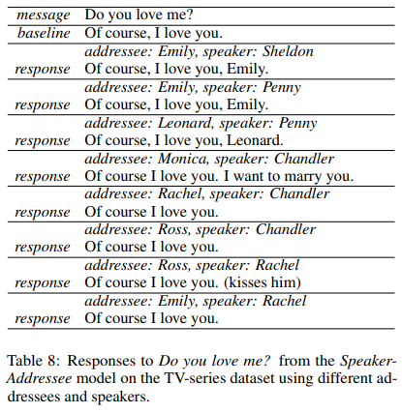
6.4. Qualitative Analysis
A Persona-Based Neural Conversational Model (J Li et al., 2016)
Speaker-Addressee model is sensitive to the identity of the addressee, generating words specifically targeted at that addressee (e.g. Emily)
Human Evaluation “more consistent” baseline: 1.6% Speaker model: 6.1%
Notes:
숫자가 이상하네요…

Slide 35
7. Conclusions
A Persona-Based Neural Conversational Model (J Li et al., 2016)

Slide 36
7. Conclusions
A Persona-Based Neural Conversational Model (J Li et al., 2016)
Two persona-based response generation models, Speaker Model, Speaker-Addressee Model
By encoding personas in distributed representations, we are able to capture personal characteristics such as speaking style and background information.
우리의 최종 목표는 대화 상대의 말을 분석해서, 그 사람처럼 말하는 거다. (emulate that individual’s persona in terms of linguistic response behavior and other salient characteristics)
Notes:
숫자가 이상하네요…

Slide 37
Thanks!
References A Neural Conversational Model (O Vinyals, Q Le 2015) A Persona-Based Neural Conversational Model (J Li et al., 2015)
https://medium.com/google-developer-experts/taking-neural-conversation-model-to-production-b0d2e7c190e4
http://docs.likejazz.com/lstm/

