Slide 1

Deciphering Undersegmented Ancient Scripts Using Phonetic Prior
Jeongyong Kim, Ph.D.

Slide 2
“Этоодинмаленькийшагдля человекаодингигантскийскачок длячеловечества.”
- НилАрмстронг

Slide 3
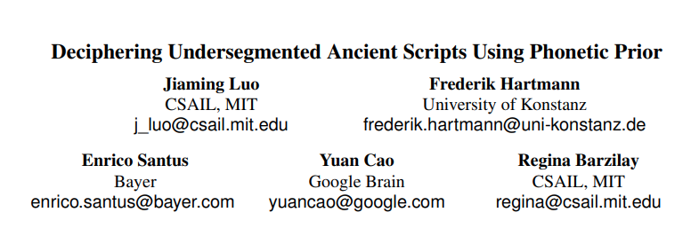
Transactions of the Association for Computational Linguistics, Volume 9 (2021)

Slide 4
Deciphering Undersegmented Ancient Scripts Using Phonetic Prior
Deciphering Scripts:
Этоодинмаленькийшагдлячеловекаодингигантскийскачокдлячеловечества
Undersegmented:
Unsegmented: Этоодинмаленькийшагдлячеловекаодингигантскийскачокдлячеловечества
Undersegmented: Это один маленькийшагдля человека один гигантскийскачокдлячеловечества
Segmented: Это один маленький шаг для человека, один гигантский скачок для человечества
Phonetic Prior
This is an [?]_____.

Slide 5
Previous works: Deciphering unknown languages
Assumptions
Knowledge of language family of the lost language
Word boundaries are provided
Counterexamples
Iberian
Candidates: Greek? Latin? Basque?
Goal
Match spans in the lost texts with known tokens

Slide 6

Authors’ Approaches:
Using linguistic constraints
Phonological regularities of sound change: [k] –X--> [m]
Size of phonological inventory preserved during evolution
Approach
Joint modelling of ‘word segmentation’ and ‘cognate alignment’
Phoneme2vec (?)
Monotonic alignment using edit-distance
[de] Telefon ←→ [en] telephone

Slide 7
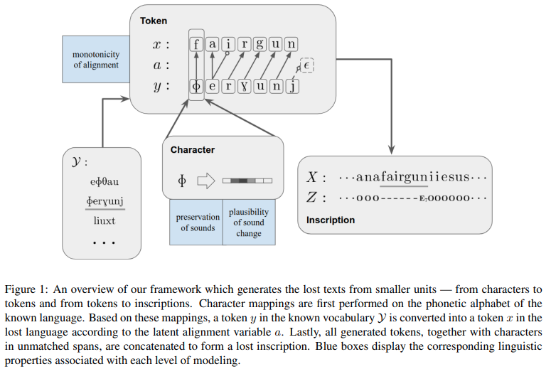
Framework
Y: Known language
↓ a: ‘latent’ variable (function)
X: Phonetic alphabet of the lost language
Z: Lost language

Slide 8
Concepts
Plausibility of sound change
Example: 감자 → 캄차, 빈대 → 핀태
Changed: 예사소리 → 거센소리
Preserved: 연구개파열음 (ㄱ,ㅋ), 경구개파찰음 (ㅈ, ㅊ), 양순파열음 (ㅂ,ㅍ), 치경파열음 (ㄷ,ㅌ)
Non-example: 감자 → 차캄, 빈대 → 틴패
Preserved: 연구개파열음 (ㄱ,ㅋ), 경구개파찰음 (ㅈ, ㅊ), 양순파열음 (ㅂ,ㅍ), 치경파열음 (ㄷ,ㅌ)
Preservation of sounds:
Example: 반갑습니다 --> 판캅습니타
Non-example: 반갑습니다 → fㅏㄴ갑thㅡㅂ니다.
Monotonicity of alignment:
Example: Biden → Байден
Non-example: Biden → Байенд

Slide 9


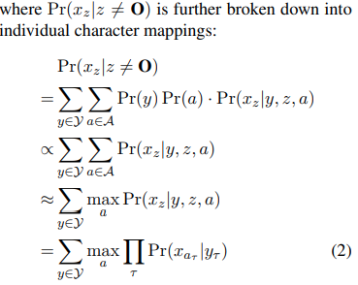
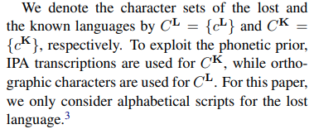
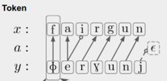



Mathematical Modelling
Y: Known language
↓ a: ‘latent’ variable (function)
X: Phonetic alphabet of the lost language
Z: Lost language
Goal: Maximize $\operatorname{Pr}\left(X\right)=$
Unmatched span
Matched span
$$1=0.7+0.2+0.1≅0.7$$

Slide 10


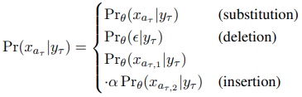
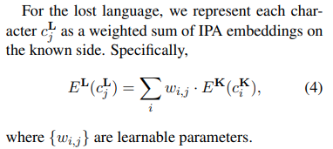
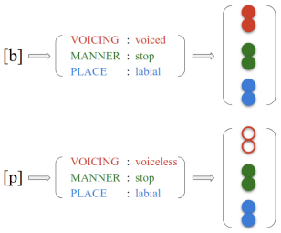
Phoneme2Vec (?)
IPA transcription of lost language
Э
e

Slide 11
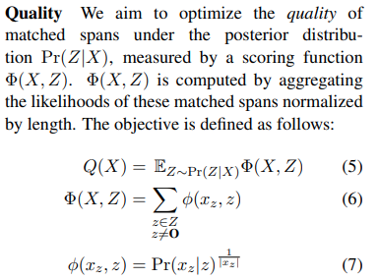
Objective Function

Slide 12
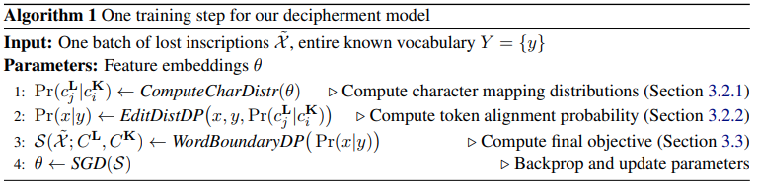
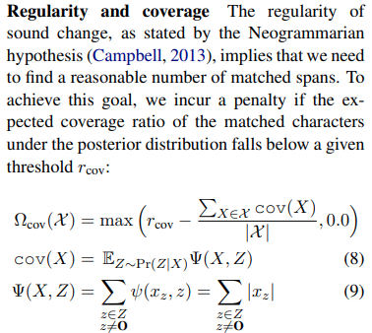
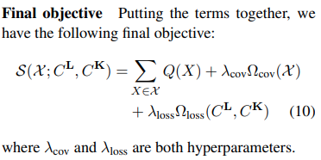
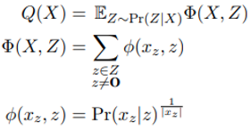

Algorithm
Entire corpus

Slide 13
“It’s one small step for man, one giant leap for mankind.”
- Neil Armstrong

