Slide 1
BERT : Pre-training of Deep Bidirectional Transformers for Language Understanding (J. Devlin, M. Chang, K. Lee, K. Toutanova, 2018)
NLP masters 최상혁 16 Jan 2021

Slide 2
Contents
0. Abstract
1. Introduction
2. Related Work
3. BERT 3.1. Pre-training BERT 3.2. Fine-tuning BERT
4. Experiments 4.1. GLUE 4.2. SQuAD v1.1 4.3. SQuAD v2.0 4.4. SWAG
5. Ablation Studies 5.1. Effect of Pre-training Tasks 5.2. Effect of Model Size 5.3. Feature-based Approach with BERT
6. Conclusion

Slide 3
앞부분 요약
기존 pre-train 모델인 ELMo, OpenAI GPT의 문제
shallow bidirectional or unidirectional 해서 language representation 능력이 부족.
이는 pre-train의 목적인 general language model에 부적합.
BERT : Deeper bidirectional => better representation
BERT
Masked Language Model * ELMo : left to right and right to left * OpenAI GPT : left to right
Next Sentence Prediction

Slide 4
3. BERT
Bidirectional Encoder Representations from Transformers

Slide 5
3. BERT
Pre-training and Fine-tuning
Pre-training : trained on unlabeled data over different pre-training tasks.
Fine-tuning : downstream tasks, using labeled data
A distinctive feature of BERT is its unified architecture across different tasks. => Fine-tuning이 쉽다!

Slide 6
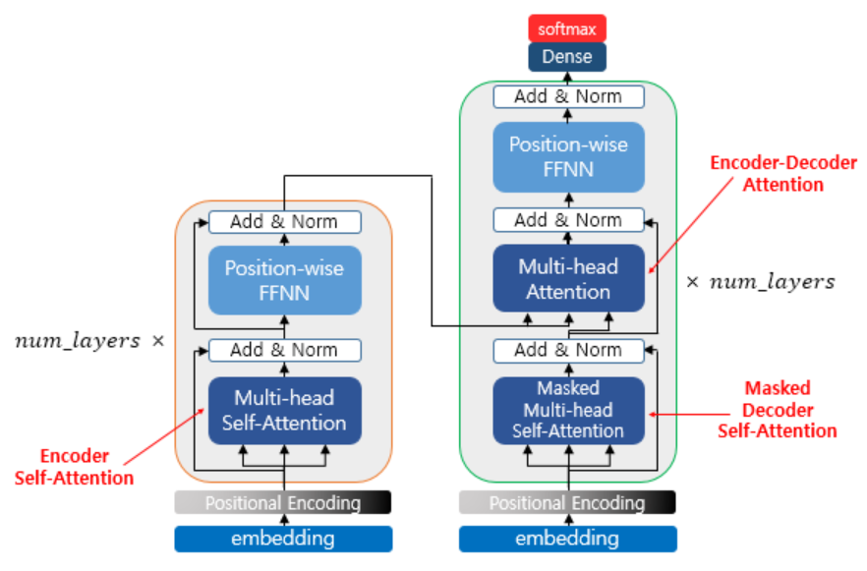
3. BERT – Model Architecture
BERT architecture : multi-layer bidirectional Transformer encoder 지난 시간 본 Transformer, 그 중 Encoder 부분만.
Notes:
Transformer에 대해 따로 설명하지는 않겠습니다.

Slide 7
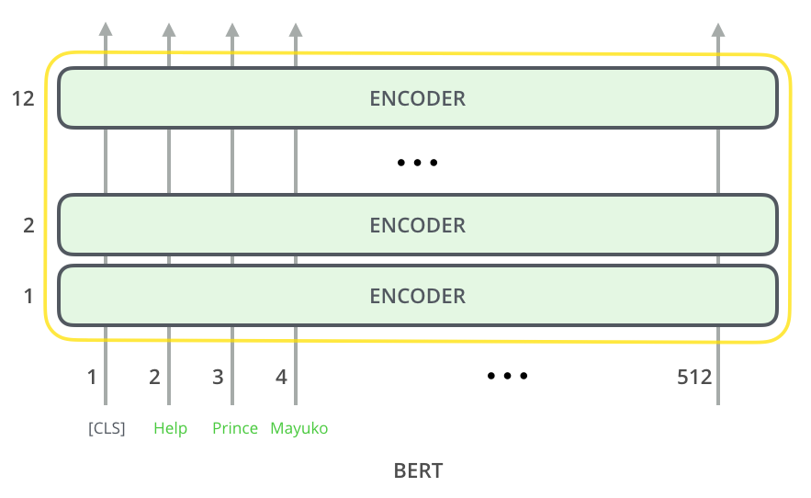
3. BERT – Model Architecture
BERT architecture : multi-layer bidirectional Transformer encoder 지난 시간 본 Transformer, 그 중 Encoder 부분만.
Notes:
Transformer에 대해 따로 설명하지는 않겠습니다.

Slide 8
3. BERT – Model Architecture
BERT architecture : multi-layer bidirectional Transformer encoder 지난 시간 본 Transformer, 그 중 Encoder 부분만.
Hyperparameters: L : number of layers (Transformer blocks) H : hidden size (FFNN size => 4H) A : number of self-attention heads
BERT_base : L=12, H=768, A=12, Total parameters=110M # params of BERT_base == # params of OpenAI GPT
BERT_large : L=24, H=1024, A=16, Total Parameters=340M
Notes:
Transformer에 대해 따로 설명하지는 않겠습니다.

Slide 9
3. BERT – Input/Output Representation
Unambiguously represent both a single sentence and a pair of sentences in one token sequence.
“sentence” can be an arbitrary span of contiguous text, rather than an actual linguistic sentence. 구두점(punctuation) 단위로 끊기는 게 아님. 하나의 “sentence”가 여러 문장을 담고 있을 수도. 그냥 a list of words 이라고 생각하는 게 편하다.
“sequence” refers to the input token sequence to BERT, which may be a single sentence or two sentences packed together. 하나 혹은 두 개의 sentences로 이루어진 것. sentence(s) => sequence of tokens => input of BERT
Notes:
Transformer에 대해 따로 설명하지는 않겠습니다.

Slide 10
3. BERT – Input/Output Representation
We use WordPiece embeddings with a 30,000 token vocabulary. Word Piece : distinct token의 개수를 효과적으로 제한함. 빈도가 높은 단어들은 그 자체를 하나의 unit으로, 빈도가 낮은 것들은 subword units로 쪼개어서 저장. 총 unit의 개수를 제한시킴. e.g.) 단어 : 자연어처리를 공부하는 사람들입니다 WordPiece : _자 연 어 처리 를 _공부 하는 _사람 들 입니다
Special tokens in Sequence
[CLS]로 시작 The final hidden state corresponding to [CLS] is used as the aggregate sequence representation for classification tasks.
[SEP]로 구분 we separate sentences (in a sequence) with a special token [SEP]. + segment embeddings
Notes:
Transformer에 대해 따로 설명하지는 않겠습니다.

Slide 11
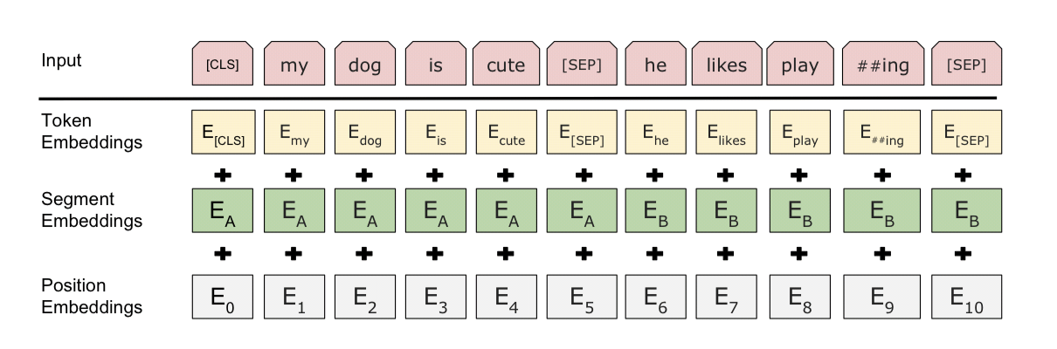
3. BERT – Input/Output Representation
For a given token (can be a single sentence or sentence pair), its input representation is constructed by summing the corresponding token, segment, and position embeddings. - Segment embedding … {0: first sentence, 1: second sentence} - Position embedding은 기존 Transformer와 동일 (라이브러리에서 알아서 처리해줍니다.)
Notes:
Transformer에 대해 따로 설명하지는 않겠습니다.

Slide 12
3.1. Pre-training BERT - MLM
Masked Language Model (MLM)
In order to train a deep bidirectional representation, we simply mask some percentage of the input tokens at random, and then predict those masked tokens. … we only predict the masked words rather than reconstructing the entire input. 기존 language model들(e.g. GPT)의 경우 앞 단어를 보고 뒷 단어를 예측. BERT는 MLM을 이용해서 전체 token들 중 몇 개를 masking 해서 없애고, 주변 단어들로 그 없어진 걸 예측하도록 하는 것.
… a downside is that we are creating a mismatch between pre-training and fine-tuning, since the [MASK] token does not appear during fine-tuning. 문제점 : masking이 fine-tuning 할 때는 나타나지 않는다. Mismatch.
Notes:
Transformer에 대해 따로 설명하지는 않겠습니다.

Slide 13
3.1. Pre-training BERT - MLM
the [MASK] token does not appear during fine-tuning.
To mitigate this … If the i-th token is chosen, we replace the i-th token with (1) the [MASK] token 80% of time (2) a random token 10% of the time (3) the unchanged i-th token 10% of the time
Then T_i will be used to predict the original token with cross entropy loss. T_i : final hidden vector for the i-th input token
Transformer encoder 입장에서 보면 predict 해야 하는 자리가 있고, 해당 자리의 input이 [mask]인지 random word인지 원래 단어인지가 불확실해지기 때문에 더 robust 해진다.

Slide 14
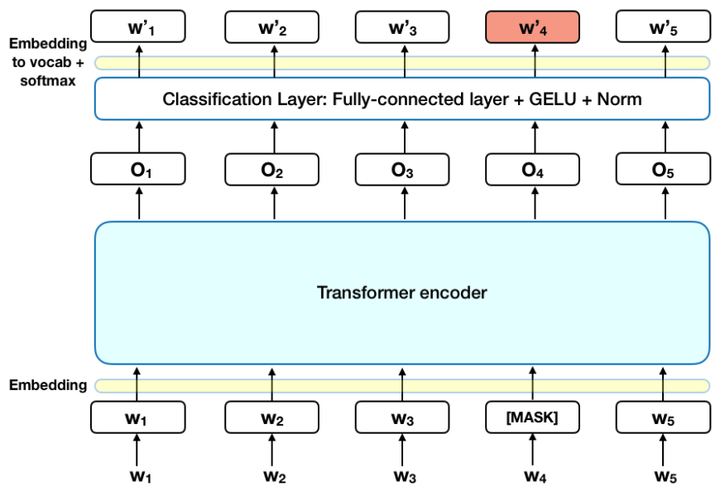
3.1. Pre-training BERT - MLM
Notes:
Transformer에 대해 따로 설명하지는 않겠습니다.

Slide 15
3.1. Pre-training BERT - NSP
Next Sentence Prediction (NSP)
In order to train a model that understands sentence relationships, we pre-train for a binarized next sentence prediction task that can be trivially generated from any monolingual corpus.
50% : sentence A, B가 실제 연속되는 sentences 50% : sentence A, B가 random하게 뽑힌 두 문장
아주 easy한 task이지만, QA, NLI 등의 task에 대한 성능을 크게 높여주었다!

Slide 16
3.2. Fine-tuning BERT
For applications involving text pairs, a common pattern is to independently encode text pairs before applying bidirectional cross attention, such as Parikh et al. (2016); Seo et al. (2017). BERT instead uses the self-attention mechanism to unify these two stages, as encoding a concatenated text pair with self-attention effectively includes bidirectional cross attention between two sentences. 거의 모든 tasks에 거의 end-to-end 하게 학습 및 inference 가능. 두 문장을 한 번에 self-attention 하는 방식 덕분에, 두 문장의 관계까지 학습하게 됨.

Slide 17
3.2. Fine-tuning BERT
… sentence A and sentence B from pre-training are analogous to (1) sentence pairs in paraphrasing, (2) hypothesis-premise pairs in entailment, (3) question-passage pairs in question answering, (4) a degenerate text-∅ pair in text classification or sequence tagging.
At the output, the token representations are fed into an output layer for token level tasks, such as sequence tagging or question answering, and the [CLS] representation is fed into an output layer for classification, such as entailment or sentiment analysis. Task에 따라 CLS를 쓸 수도 있고, sentence tokens를 쓸 수도 있다.

Slide 18
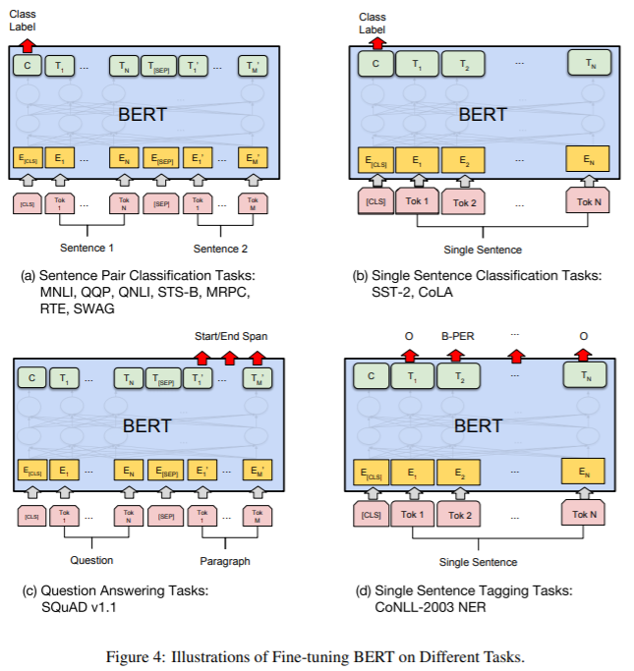
3.2. Fine-tuning BERT

Slide 19
4. Experiments

Slide 20
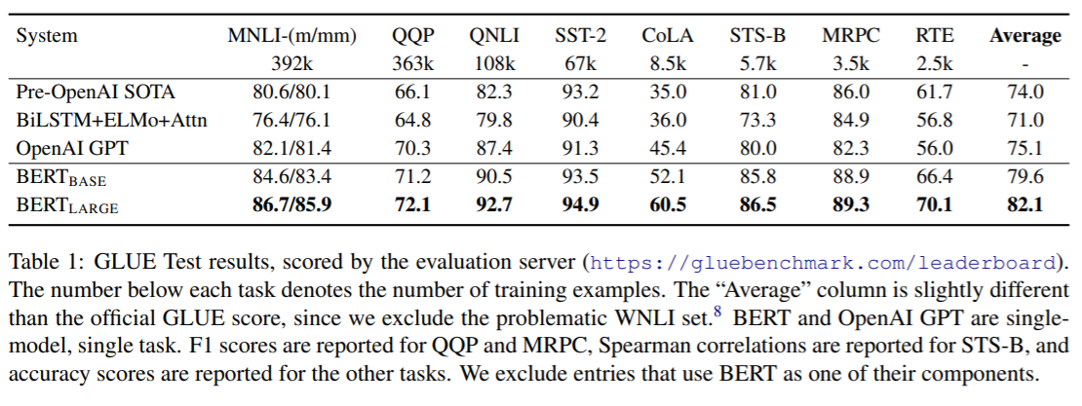
4.1. GLUE
The General Language Understanding Evaluation (GLUE) benchmark is a collection of diverse natural language understanding tasks. Pre-training 모델의 general한 성능을 평가하기 위한 지표. 여러 subtasks(2019년 9월 기준 11)에 대한 성능의 합.

Slide 21

4.2. SQuAD v1.1
The Stanford Question Answering Dataset
100k of Question/answer pairs

Slide 22
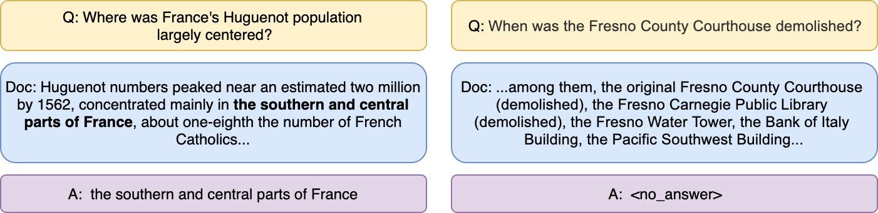
4.3. SQuAD v2.0
SQuAD v1.1 + 50k unanswerable questions
unanswerable question은 온라인의 crowd worker들이 직접 생성(즉, 기계적으로 생성된 것이 아니라 진짜 인간이 생성했으므로 질이 높음)
SQuAD v1.1에서 F1 86%를 기록했던 신경망 기반의 시스템이 SQuAD v2.0 데이터셋에서는 F1 66%를 기록

Slide 23
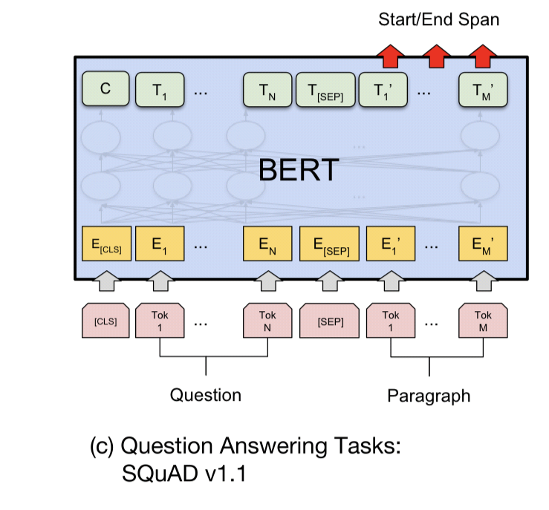
4.2~3. SQuAD v1.1 and SQuAD v2.0

Slide 24
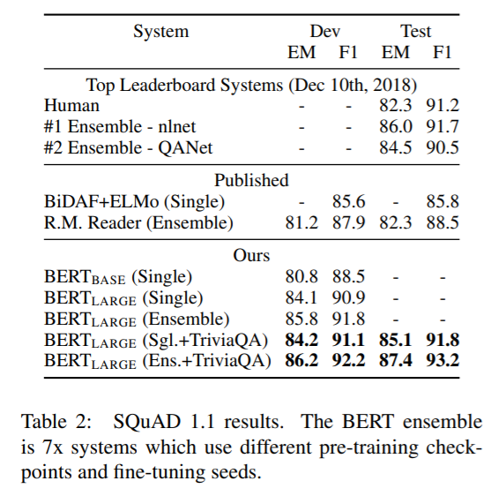
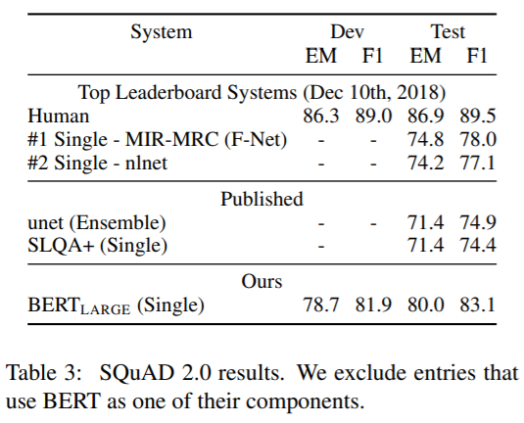
4.2~3. SQuAD v1.1 and SQuAD v2.0

Slide 25
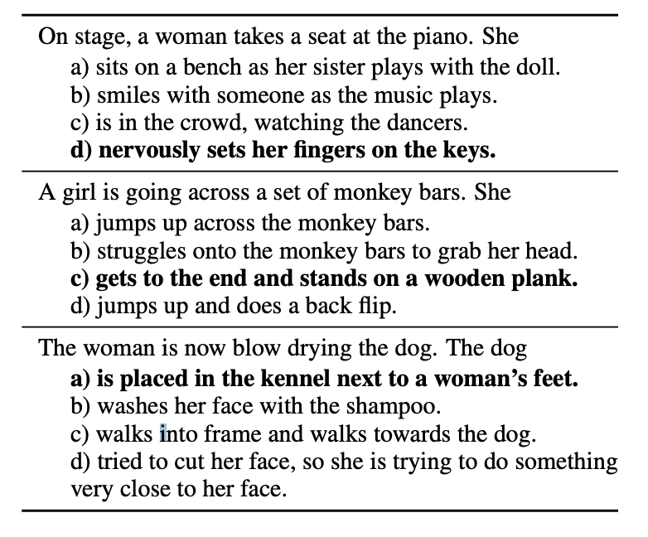
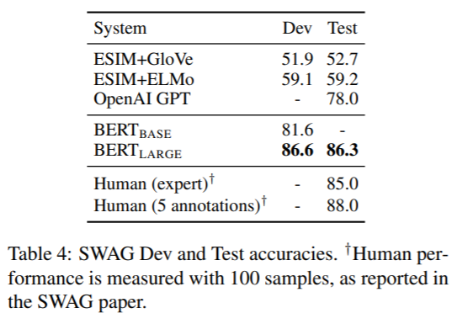
4.4. SWAG
The Situations With Adversarial Generations (SWAG)
contains 113k sentence-pair completion examples that evaluate grounded commonsense inference.

Slide 26
5. Ablation Studies
요소들을 하나씩 제거해가면서 각 요소의 중요도를 파악.

Slide 27
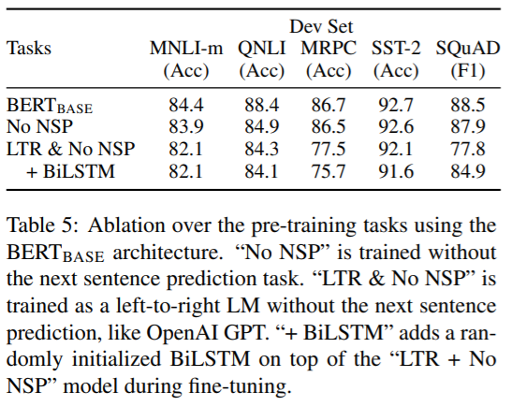
5.1. Effect of Pre-training Tasks
No NSP : without the “next sentence prediction” NSP의 effect를 알 수 있음.
LTR & No NSP : Left-to-Right LM, rather than MLM OpenAI GPT와 비교하면, - larger training dataset - input representation - fine-tuning scheme
+BiLSTM : “LTR & No NSP” fine-tuning 할 때 randomly initialized BiLSTM 추가.
결과 NSP -> NLI, QA MLM -> MRPC, SQuAD

Slide 28
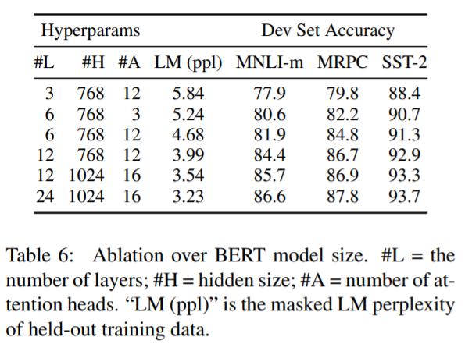
5.2. Effect of Model Size
Differing number of layers(#L), hidden units(#H), and attention heads(#A)
Larger models lead to a strict accuracy improvement
Significant improvements on top of models which are already quite large.
Scaling to extreme model sizes leads to large improve- ments on very small scale tasks, provided that the model has been sufficiently pre-trained. pre-train하는 모델의 size가 크면 downstream task 성능이 상승.

Slide 29
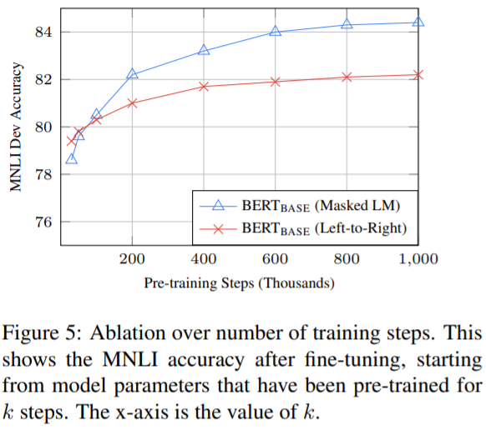
5.2. Effect of Model Size
BERT training은 오래 걸린다. (500,000 ~ 1,000,000 step에서 accuracy gain 1.0%p)
MLM이 LTR보다 오래 걸린다. (but almost immediately outperform!)

Slide 30
5.3. Feature-based Approach with BERT
Feature-based approach : 특정 task를 수행하는 network에 pre-trained language representation을 추가적인 feature로 제공. 즉, 두 개의 network를 이어 붙여서 사용하는 것. E.g. ELMo
Advantage (vs fine-tuning) 1) not all tasks can be easily represented by a Transformer encoder architecture, and therefore require a task-specific model architecture to be added. Transformer로 represent 할 수 없는 task라도, feature-based에 task-specific model을 (뭐든지) 갖다 붙일 수 있음. 2) there are major computational benefits to pre-compute an expensive representation of the training data once and then run many experiments with cheaper models on top of this representation. 사이즈가 큰 pre-training model을 tuning 하지 않아 계산 효율적.

Slide 31
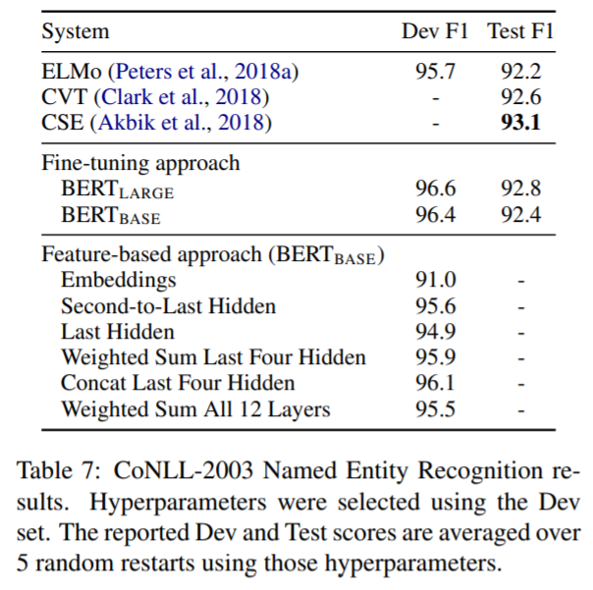
5.3. Feature-based Approach with BERT
The best performing method concatenates the token representations from the top four hidden layers of the pre-trained Transformer, which is only 0.3 F1 behind fine-tuning the entire model. This demonstrates that BERT is effective for both finetuning and feature-based approaches.

Slide 32
6. Conclusion

Slide 33
6. Conclusion
Our major contribution is further generalizing these findings to deep bidirectional architectures, allowing the same pre-trained model to successfully tackle a broad set of NLP tasks.
Deep bidirectional pre-training model => 하나의 모델로 여러 태스크에서 좋은 성능을 얻음.

Slide 34
Thanks!

